Slide 1
Unidata’s Common Data Model and
NetCDF Java Library API
Overview
John Caron
Unidata/UCAR
Nov 2006

Slide 2
Why Java?
Portability
Object Oriented
Libraries everywhere
Thriving open source development
Strong typing (aka type safety)
  needed for large development projects
Good tools: IDEs, debuggers, profilers
Very productive
Performance is not a problem (in our domain)

Slide 3
Java Negatives
Cant link Java libraries into C/Fortran apps
  Can with MatLab, though
Arguably not suitable for large scale numerical computation
Specialized languages can be more productive

Slide 4
What’s a Data Model?
An Abstract Data Model describes data objects and what methods you can use on them.
An API is the interface to the Data Model for a specific programming language
A file format is a way to persist the objects in the Data Model.
A data access protocol like OPeNDAP plays the role of a file format (sort of).
An Abstract Data Model removes the details of any particular API and the persistence format.

Slide 5
Common Data Model Layers
Scientific Datatypes
Point
Trajectory
Station
Radial
Grid
Swath
Coordinate Systems
Data Access

Slide 6
Application
Scientific Datatypes
Datatype Adapter
NetCDF-Java version 2.2 architecture
NetcdfDataset
ADDE
CoordSystem Builder
NetcdfFile
THREDDS
I/O service provider
Catalog.xml
OPeNDAP
NetCDF-3
NIDS
NcML
NetCDF-4
GRIB
HDF5
GINI
Nexrad
DMSP
…

Slide 7
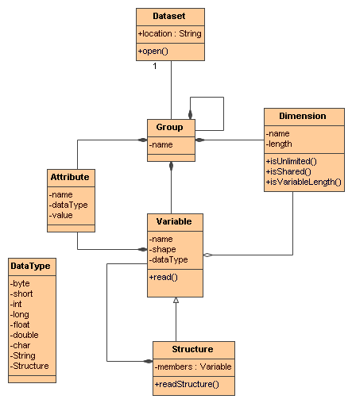
NetCDF-4 and
Common Data Model
(Access)

Slide 8
I/O Service Provider Implementations
General: NetCDF, HDF5, OPeNDAP
Gridded: GRIB-1, GRIB-2
Radar: NEXRAD level II, NEXRAD level III, DORADE
Point: BUFR
Satellite: DMSP, GINI

Slide 9
I/O Service Provider
Implement this interface:
public interface IOServiceProvider {
boolean isValidFile( RandomAccessFile raf);
void open( RandomAccessFile raf, NetcdfFile ncfile);
Array readData( Variable v2, List section);
// only if you use Structures
Array readNestedData( Variable v2, List section);
}

Slide 10
NcML Datasets
Application
Application
THREDDS dataset
NcML dataset
dataset
NcML dataset
dataset

Slide 11
NcML example
<?xml version="1.0" encoding="UTF-8"?>
<netcdf xmlns="http://www.unidata.ucar.edu/schemas/netcdf/ncml-2.2"
location=“/data/nids/N0R_20041119_2147">
<attribute name=“DataType" value=“Radar" />
<remove type=“attribute” name=“password" />
<variable name="Reflectivity" orgName=“R34768”>
<attribute name="units" value=“dBZ" />
</variable>
</netcdf>

Slide 12
TDS/NcML Aggregation
<dataset name="WEST-CONUS_4km Aggregation" urlPath="satellite/3.9/WEST-CONUS_4km">
<netcdf xmlns=“http://www.unidata.ucar.edu/schemas/netcdf/ncml-2.2”>
<aggregation dimName="time" type="joinExisting">
<scan location=“C:/data/goes/" suffix=".gini"/>
</aggregation>
</netcdf>
</dataset>

Slide 13
Coordinate Systems

Slide 14
Coordinate Systems needed
NetCDF, OPeNDAP, HDF data models do not have integrated coordinate systems
  so georeferencing not part of API
  Need conventions to specify (eg CF-1, COARDS, etc)
Contrast GRIB, HDF-EOS, other specialized formats

Slide 15
Coordinate Variables
dimensions:
lat = 64;
lon = 128;
variables:
  float lat(lat);
  float lon(lon);
  double temperature(lat,lon);

Slide 16
Coordinate Variables
  One-dimension variable with same name as its dimension
  Strictly monotonic values
  No missing values
The coordinates of a point (i,j,k) is the tuple {cvar1(i),cvar2(j),cvar3(k)}
Used exclusively by many early Conventions, such as COARDS.

Slide 17
Limitations of 1D Coordinate Variables
Non lat/lon horizontal grids:
  float temperature(y,x)
  float lat(y, x);
  float lon(y, x);
Trajectory data:
  float NKoreaRadioactivity(pt);
  float lat(pt);
  float lon(pt);
  float altitude(pt);
  float time(pt)

Slide 18
General Coordinates in CF
  float P(y,x);
  P:coordinates = “lat lon”;
  float lat(y, x);
  float lon(y, x);
  float Sr90(pt);
  Sr90:coordinates
  = “lat lon altitude time”;

Slide 19
Coordinate Systems (abstract)
A Coordinate System for a data variable is a set of Coordinate Variables₂ such that the coordinates of the (i,j,k) data point is the tuple {cvar1(i,j,k),cvar2(i,j,k),cvar3(i,j,k),…}
The dimensions of each Coordinate Variable must be a subset of the dimensions of the data variable.

Slide 20
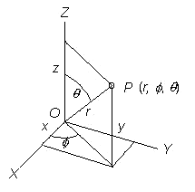
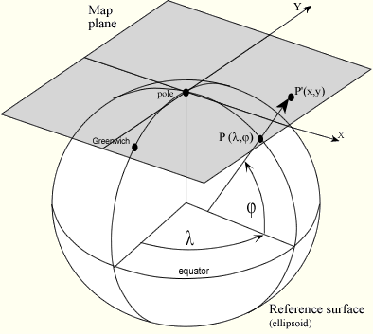
Need Coordinate Axis Types
float gridData(t,z,y,x);
float time(t);
float y(y);
float x(x);
float lat(y,x);
float lon(y,x);
float height(t,z,y,x);
float radialData(radial, gate)
float distance(gate)
float azimuth(radial)
float elevation(radial)
float time(radial)

Slide 21
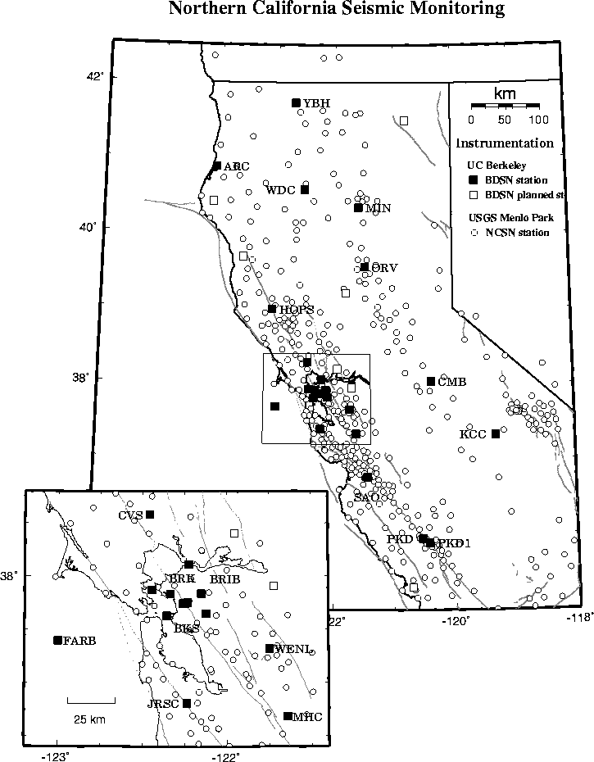
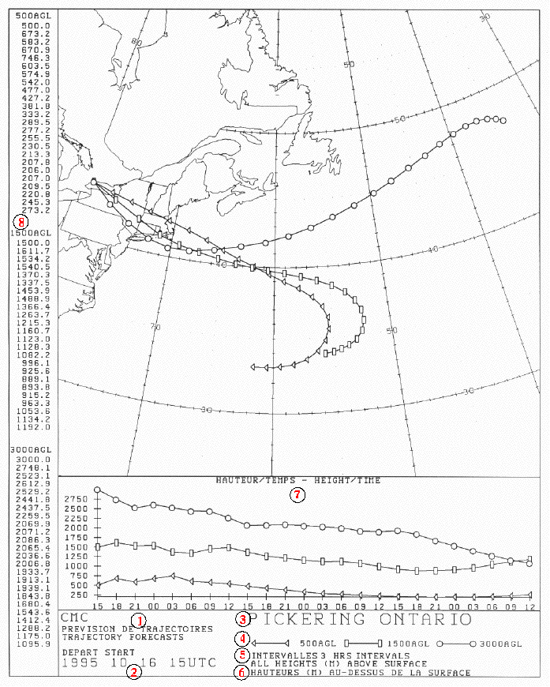
The same??
float stationObs(pt);
float lat(pt);
float lon(pt);
float z(pt);
float time(pt);
float trajectory(pt);
float lat(pt);
float lon(pt);
float z(pt);
float time(pt);

Slide 22
Revised Coordinate Systems
Specify Coordinate Variables
Specify Coordinate Types
  (e.g. lat, lon, time, cartesian x, y, polar coordinates etc.)
Specify connectivity (implicit or explicit) between data points
Implicit: Neighbors in index space are (connected) neighbors in coordinate space. Allows efficient searching.

Slide 23
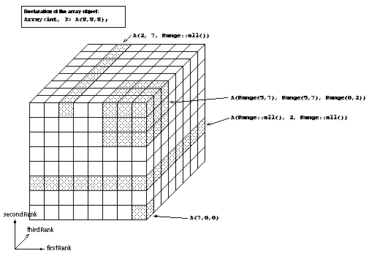
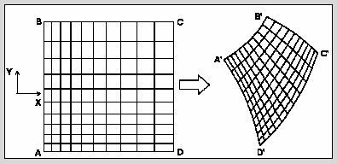
Gridded Data
Cartesian coordinates
All dimensions are connected
float gridData(t,z,y,x);
float time(t);
float y(y);
float x(x);
float lat(y,x);
float lon(y,x);
float height(t,z,y,x);
Connected means
Neighbors in index space are neighbors in coordinate space

Slide 24
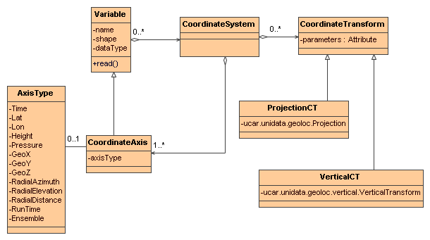
Coordinate Systems UML

Slide 25
Scientific Data Types

Slide 26
Scientific DataTypes
Based on datasets Unidata is familiar with
  APIs are evolving
How are data points connected?
Intended to scale to large, multifile collections
Intended to support “specialized queries”
  Space, Time
Corresponding “standard” NetCDF file conventions

Slide 27
Gridded Data
Cartesian coordinates
All dimensions are connected
x, y, z, time
recently added runtime and ensemble
refactored into GridDatatype interface
float gridData(t,z,y,x);
float time(t);
float y(y);
float x(x);
float lat(y,x);
float lon(y,x);
float height(t,z,y,x);

Slide 28
Grid methods
CoordinateAxis getTaxis();
CoordinateAxis getXaxis();
CoordinateAxis getYaxis();
CoordinateAxis getZaxis();
Projection getProjection();
int[] findXYindexFromCoord( double x_coord, double y_coord);
Array getDataSlice (Range[] …)
GridDatatype makeSubset (Range[] …)

Slide 29
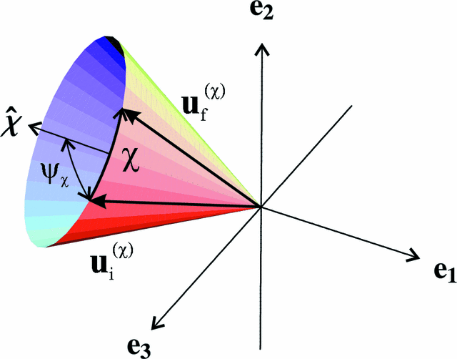
Radial Data
Polar coordinates
All dimensions are connected
Not separate time dimension
radialData(radial, gate) :
distance(gate)
azimuth(radial)
elevation(radial)
time(radial)

Slide 30
Radial methods
interface Sweep {
public float[] readData(int radial);
public float getGateSize();
public float getElevation(int radial);
public float getMeanElevation();
public float getAzimuth(int radial);
public float getMeanAzimuth();
public EarthLocation getOrigin(int radial);
}

Slide 31
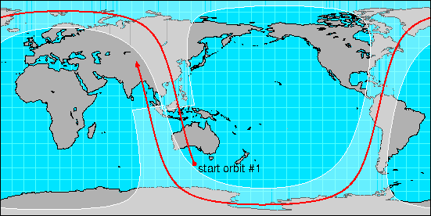
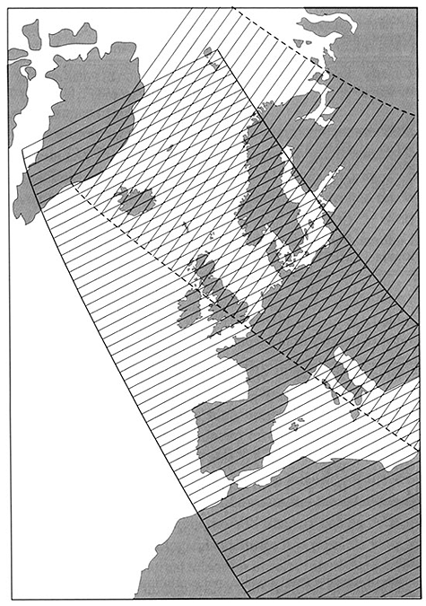
Swath
lat/lon coordinates
not separate time dimension
all dimensions are connected
swathData(line,cell)
lat(line,cell)
lon(line,cell)
time(line)
z(line,cell) ??

Slide 32
Point Observation Data
Set of measurements at the same point in space and time
Point dimension not connected
float obs1(pt);
float obs2(pt);
float lat(pt);
float lon(pt);
float z(pt);
float time(pt);
Structure {
lat, lon, z, time;
v1, v2, ...
} obs( pt);

Slide 33
PointObsDataset Methods
// Collection of StructureData
Collection getData(
LatLonRect boundingBox,
Date start, Date end);

Slide 34
Trajectory Data
pt dimension is connected
Collection dimension not connected
Structure {
lat, lon, z, time;
v1, v2, ...
} obs(pt); // connected
Structure {
name;
Structure {
lat, lon, z, time;
v1, v2, ...
} obs(*); // connected
} traj(traj) // not connected

Slide 35
TrajectoryObs Methods
int getNumPoints();
StructureData getData(int point);
DataIterator getDataIterator();

Slide 36
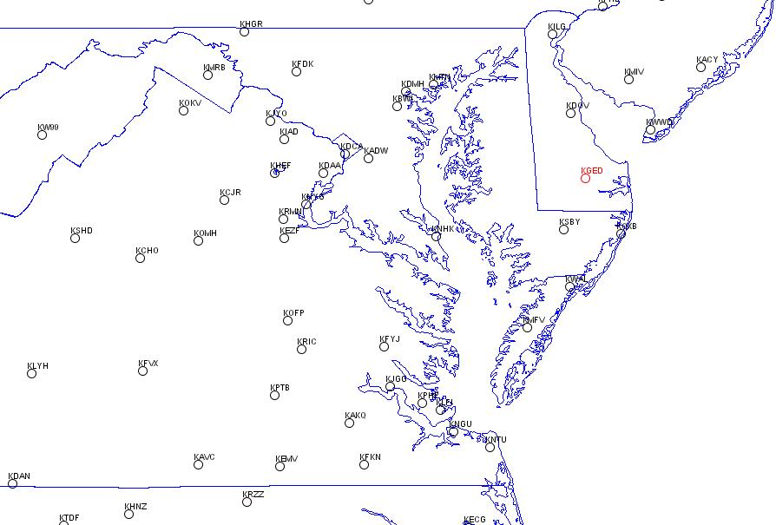
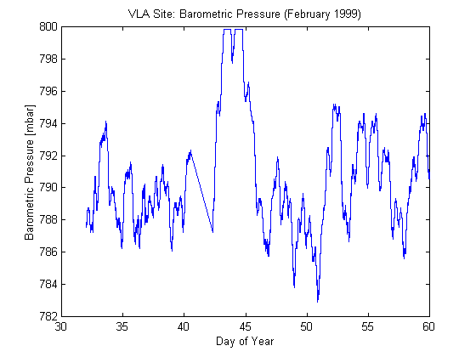
Time series Station Data
Structure {
name;
lat, lon, z;
Structure{
time;
v1, v2, ...
} obs(*); // connected
} stn(stn); // not connected

Slide 37
StationObs Methods
// return List of Station
List getStations();
// return List of StructureData
List getData(
Station s,
Date start, Date end);

Slide 38
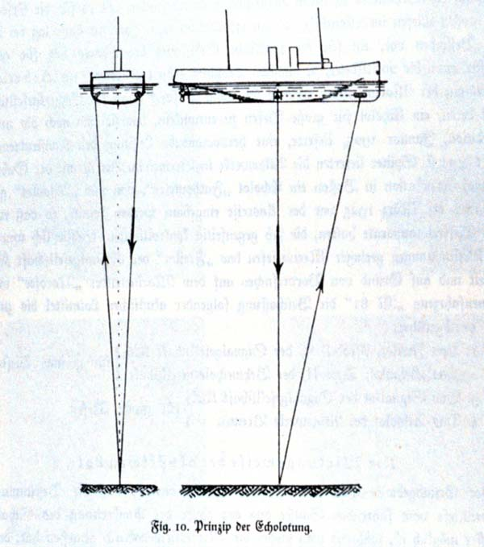
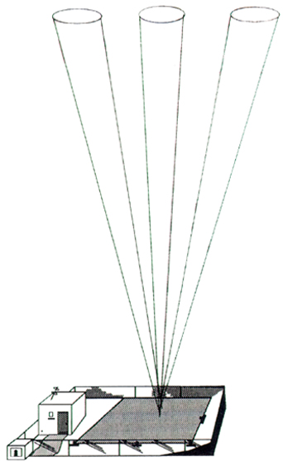
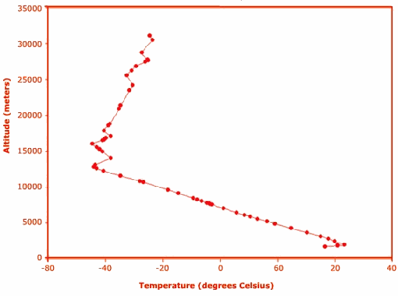
Profiler/Sounding Station Data
Structure {
name;
lat, lon, time;
Structure {
z;
v1, v2, ...
} obs(*); // connected
} stn(stn); // not connected
Structure {
name;
lat, lon;
Structure {
time,
Structure {
z;
v1, v2, ...
} obs(*); // connected
} time(*); // connected
} stn(stn); // not connected

Slide 39
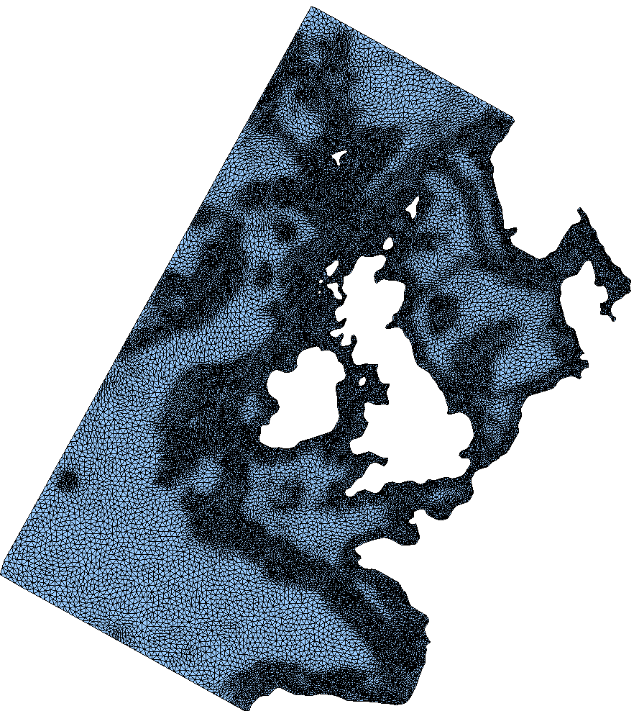
Unstructured Grid
Pt dimension not connected
Looks the same as point data
Need to specify the connectivity explicitly
float unstructGrid(t,z,pt);
float lat(pt);
float lon(pt);
float time(t);
float height(z);

Slide 40
Standardizing NetCDF Formats
Grid: CF-1 Convention
  Need improvements for regional models (WRF), GIS
Radar: “Radar Exchange Format”
  With radar community (led by NCAR ATD)
Point Observations
  Unidata Observation Dataset Conventions
Unstructured Grids
  Recent group formed to extend CF Conventions

