Slide 1
Unidata’s TDS Workshop
TDS Overview – Part I
21-22 July 2011

Slide 2
THREDDS Data Server (TDS)
Web server for scientific data (written in 100% Java)
Can serve any dataset the netCDF-Java library can read
  E.g., netCDF-3, netCDF-4, HDF-4, HDF-5, HDF-EOS, GRIB-1, GRIB-2
Catalogs advertise available datasets and services
Data access services:
  OPeNDAP
  OGC WMS and WCS
  NCSS
Data collection services
  Aggregation
  Point/station collection
Metadata services
  THREDDS
  ncISO: ISO, UDDC, NcML

Slide 3
THREDDS Data Server (TDS)
Data User: Why?
  aksdfj
Data Provider: Why
  kadjf

Slide 4
THREDDS Data Server
Servlet Container
catalog.xml
Remote Access
Client
THREDDS Server
WCS
OPeNDAP
HTTPServer
WMS
NetCDF-Java
library
configCatalog.xml
Datasets
IDD Data
motherlode.ucar.edu

Slide 5
Common Data Model (CDM)
Implemented in the netCDF-Java library (3 layers)
NetCDF Data Access:
  Access to array-based scientific data (netCDF data model)
  Read various file formats, map into data model (IOSP)
NetcdfDataset:
  Geospatial coordinate systems (conventions)
  NcML: Modify existing dataset
  Aggregation of datasets
Scientific Feature Types, e.g.:
  Gridded Data; Radial Data; Swath Data
  Discrete Sampling Features:
    Point Data; Station Data; Profile Data
    Trajectory (e.g., aircraft track) Data

Slide 6
Application
Scientific Feature Types
Datatype Adapter
NetCDF-Java/
CDM architecture
NetcdfDataset
CoordSystem Builder
NetcdfFile
THREDDS
I/O service provider
Catalog.xml
OPeNDAP
NetCDF-3
NIDS
NetCDF-4
GRIB
NcML
HDF5
GINI
Nexrad
DMSP
…

Slide 7
THREDDS Data Server
Servlet Container
catalog.xml
Remote Access
Client
THREDDS Server
WCS
OPeNDAP
HTTPServer
WMS
NetCDF-Java
library
configCatalog.xml
Datasets
IDD Data
motherlode.ucar.edu

Slide 8
THREDDS Catalogs
Catalogs collect, organize, and describe datasets
  Hierarchical collections of datasets (virtual directories)
  Each dataset may have multiple access methods
  Documentation (metadata) may be added
    To the catalog itself
    To individual datasets (inheritance optional)
Servers can use catalogs to advertise the datasets they serve

Slide 9
THREDDS Catalogs
<?xml version='1.0' encoding='UTF-8'?>
<catalog xmlns=“http://www.unidata.ucar.edu/namespaces/thredds/InvCatalog/v.0”
xmlns:xlink="http://www.w3.org/1999/xlink" version="1.0.2">
<service name="odap" serviceType="OPENDAP" base="/thredds/dodsC/" />
<dataset name="TDS Tutorial: example 2">
<metadata inherited="true">
<serviceName>odap</serviceName>
</metadata>
<dataset name="TDS Tutorial: example data 1" urlPath="test/example1.nc" />
<dataset name="TDS Tutorial: example data 2" urlPath="test/example2.nc" />
<dataset name="TDS Tutorial: example data 3" urlPath="test/example3.nc" />
<catalogRef xlink:title="My Other Catalog“
xlink:href="myOtherCatalog.xml" />
<catalogRef xlink:title="Far Away Univ catalog“
xlink:href="http://www.farAwayU.edu/thredds/catalog.xml" />
</dataset>
</catalog>

Slide 10
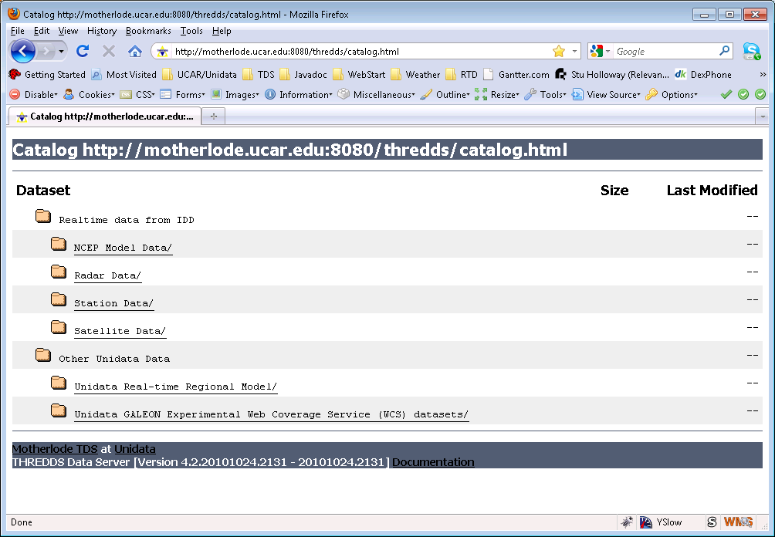
THREDDS Catalogs

Slide 11
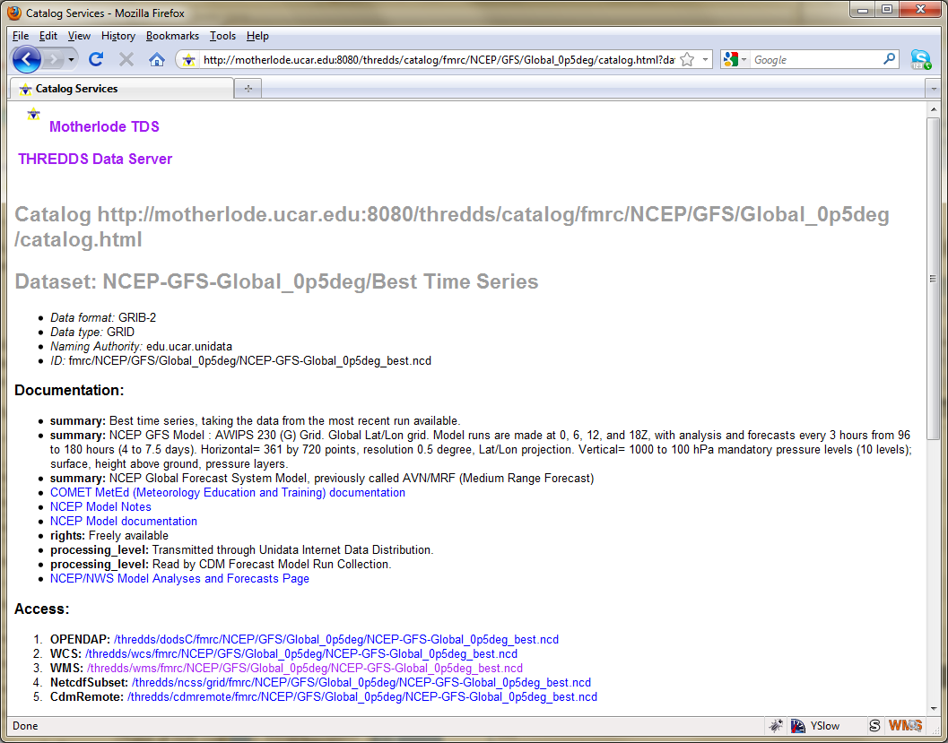
THREDDS Catalogs

Slide 12
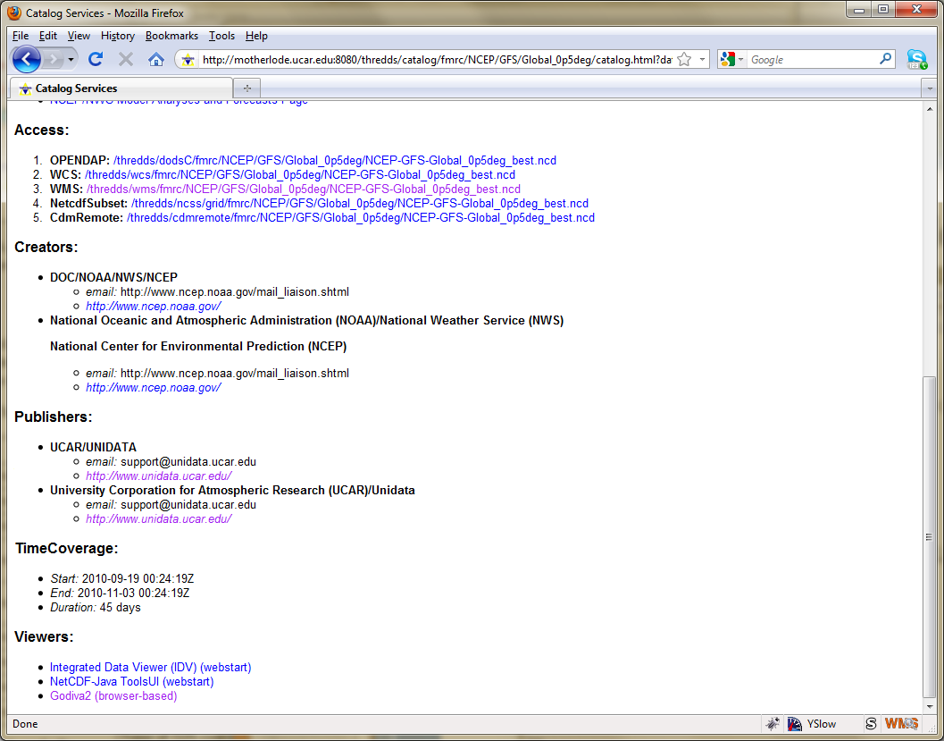
THREDDS Catalogs

Slide 13
THREDDS Data Server
Servlet Container
catalog.xml
Remote Access
Client
THREDDS Server
WCS
OPeNDAP
HTTPServer
WMS
NetCDF-Java
library
configCatalog.xml
Datasets
IDD Data
motherlode.ucar.edu

Slide 14
Data Access Services
Bulk File Transfer
  HTTP Server (any file)
Remote access, subsetting CDM files
  OPeNDAP (any* CDM file)
  Web Coverage Service (grids)
  Web Map Service (grids)
  Others
    NetCDF Subset Service (grids)
    Radar Collection Subset Service

Slide 15
Data Access Services
Clients
OPeNDAP (lots, including IDL, MatLAB)
WCS (still minimal, but expect to grow)
  GDAL, CADCorp, George Mason, OWSLib
WMS (speak WMS; consume GIF, JPEG, and PNG)
  Browsers, Portals, ARC GIS, Google Earth, etc
NetCDF Subsetter
  HTML forms interface
  Web service (CUAHSI)
  ESRI ArcGIS (manual download of netcdf-CF)

Slide 16
THREDDS Data Server
Servlet Container
catalog.xml
Remote Access
Client
THREDDS Server
WCS
OPeNDAP
HTTPServer
WMS
NetCDF-Java
library
configCatalog.xml
Datasets
IDD Data
motherlode.ucar.edu

Slide 17
Configuration Catalogs
Administrator tells the TDS which / how datasets are to be served
Identify the files on disk
Name, organize, sort, filter into virtual collections
Add discovery metadata
Integrated with NcML
  Create virtual datasets

Slide 18
TDS Configuration Catalogs
…
<datasetScan name="Ocean Satellite Data“
path="/data/ocean/sat/"
location= "/data/tds/netcdf/">
<metadata inherited="true">
<serviceName>odap</serviceName>
<dataType>Grid</dataType>
<dataFormat>NetCDF</dataFormat>
<documentation xlink:href="http://ncep.noaa.gov/modelinfo/index.html"
xlink:title="NCEP Model documentation" />
<documentation type="processing_level">
Transmitted through Unidata Internet Data Distribution.
</documentation>
</metadata>
</datasetScan>
…

Slide 19
TDS and NcML
Embed NcML into the TDS configuration catalog
Server serves a virtual dataset defined by NcML
  NcML hidden from the client
Can “fix” metadata problems
Can augment metadata
General Aggregations
  joinNew, joinExisting, Union
Specialized Aggregations
  Forecast Model Run Collection (FMRC)
  Point Feature Collections
Notes:
The TDS can use NcML to wrap datasets that are being served, adding or fixing metadata. The client doesn’t see the NcML, it sees only the dataset the NcML describes. The NcML aggregation capability is what the TDS uses as the replacement to the old OPeNDAP aggregation server.

Slide 20
TDS / NcML
Modify and serve through TDS
<dataset name=“Polar Orbiter Data" urlPath =“idd/sat/PolarData“ >
<netcdf location="/data/sat/P02393.hdf”>
<attribute name="Conventions" value="CF-1.4"/>
<variable name="Reflectivity" orgName=“R34768”>
<attribute name="units" value=“dBZ" />
<attribute name=“coordinates" value=“time lat lon" />
</variable>
</netcdf>
</dataset>

Slide 21
THREDDS Data Server
Servlet Container
catalog.xml
Remote Access
Client
THREDDS Server
WCS
OPeNDAP
HTTPServer
WMS
NetCDF-Java
library
configCatalog.xml
Datasets
IDD Data
motherlode.ucar.edu

Slide 22
THREDDS Data Server
Getting Started
TDS is written in 100% Java
  Installing Java 1.6
TDS uses the Java Servlet framework
  Installing Tomcat 6
Deploying the TDS
…

