Slide 1

Metadata and ncISO services
Why metadata is important
THREDDS and metadata
NcISO services
Data discovery systems
The brokering approach

Slide 2

1.1 What's metadata
Metadata & ncISO services
1.Why metadata is important
Yeah, is that boring thing about data...

Slide 3






1.2 What's metadata
Metadata & ncISO services
1.Why metadata is important
Contact information
Access
information
Spatial
coverage
Time
coverage
Access
protocols
More...

Slide 4
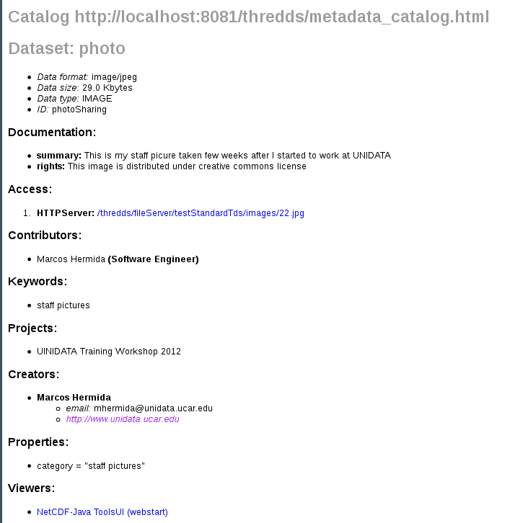
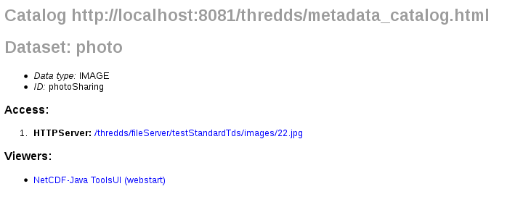
1.3 We are data providers...
Metadata & ncISO services
1.Why metadata is important

Slide 5

1.3 Enables data discovery
Metadata & ncISO services
1.Why metadata is important
- BETTER INTEROPERABILITY
- IMPROVES DATA EXCHANGE

Slide 6
2.1 Default THREDDS metadata
Metadata & ncISO services
2.THREDDS and metadata
Access, spatial and time coverage....
Unidata Data Discovery Conventions (UDDC)
Get metadata from files (CF-conventions...)

Slide 7
2.2 Adding metadata to catalogs
Metadata & ncISO services
2.THREDDS and metadata
Metadata tags:
- Documentation
- metadata
- property
- ...
Inheritance: inherited=”true”

Slide 8
2.3 Minimal set of metadata?
Metadata & ncISO services
2.THREDDS and metadata
- Depends on your needs
-UDDC recommendations:
http://www.unidata.ucar.edu/software/netcdf-java/formats/DataDiscoveryAttConvention.html

Slide 9
3.1 Why NcISO?
Metadata & ncISO services
3.NcISO services
Translate TDS metadata into standard formats:
-ISO-19115: Geographic information
-ISO-19115-2: imagery and gridded data
-ISO-19119: Geographic information services
Notes:
If thredds already provides metadata, why ncISO?

Slide 10
3.2 What is NcISO?
Metadata & ncISO services
3.NcISO services
Developed by NGDC (National Geophysical Data Center)
Not just translate into ISO:
  - NcML information of our datasets: ncml service
  - Assesses our metadata: UDDC service
  - ISO documents: ISO service

Slide 11
3.3 Enabling ncISO
Metadata & ncISO services
3.NcISO services
ThreddsConfig.xml:
<NCISO>
<ncmlAllow>true</ncmlAllow>
<uddcAllow>true</uddcAllow>
<isoAllow>true</isoAllow>
</NCISO>
ncISO for datasets in your catalogs:
<service name="ncml" serviceType="NCML" base="/thredds/ncml/"/>
<service name="uddc" serviceType="UDDC" base="/thredds/uddc/"/>
<service name="iso" serviceType="ISO" base="/thredds/iso/"/>

Slide 12
3.4 ncISO demo (metadata tour)
Metadata & ncISO services
3.NcISO services
-NOAA NCDC NOMADS:
* http://nomads.ncdc.noaa.gov/thredds/catalog.html
-NOAA Pacific Fisheries Environmental LabL:
* http://oceanwatch.pfeg.noaa.gov/thredds/catalog.html
-USGS Woods Hole Science Center:
* http://coast-enviro.er.usgs.gov/thredds/catalog.html
-UNIDATA IDD Real-time Archive:
* http://motherlode.ucar.edu:8080/thredds/catalog.html

Slide 13
3.5 ncISO exercise
Metadata & ncISO services
3.NcISO services
1. Enable ncISO
2. Check your UDDC score
3. Add metadata and improve the UDDC score

Slide 14
4.1 GI-Cat, Geoportal
Metadata & ncISO services
4.Data discovery systems
Harvest metadata from thredds catalogs
Enabling searches on TDS (brokers)
Running instances:
- EuroGeoss Broker:
http://www.eurogeoss-broker.eu/
- ESIP Discovery Cluster :
http://23.23.211.222:8080/geoportal/

Slide 15
4.2 Issues harvesting metadata
Metadata & ncISO services
4.Data discovery systems
Tds instances don't provide too much metadata
Crawl at dataset level. Don't harvest metadata at collection level.
Provide access to datasets rather than to actual data

Slide 16
4.3 GI-Cat & Geoportal demo
Metadata & ncISO services
4.Data discovery systems
Running instances:
* EURO GEOSS (GI-Cat):
http://www.eurogeoss-broker.eu/
* NGDC geoportal:
http://www.ngdc.noaa.gov/geoportal/catalog/main/home.page
* ESIP Discovery Cluster:
http://23.23.211.222:8080/geoportal/catalog/main/home.page

Slide 17
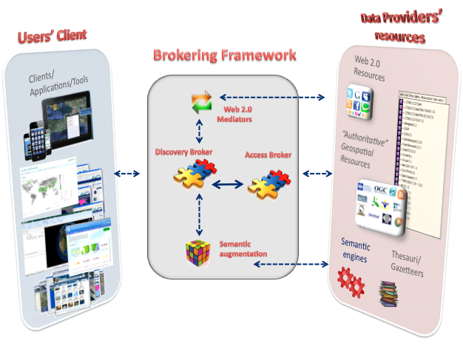
5.1 Broker architecture
Metadata & ncISO services
5.The brokering approach
Sample Brokering Framework (from Earthcube Brokering Manifesto)

Slide 18
5.2 Examples
Metadata & ncISO services
5.The brokering approach
* CSW catalog
* OpenSearch

