Slide 1
TDS Archictecture
Dec 2008

Slide 2
TDS is a data server
HTTP Tomcat Server
THREDDS Server
catalog.xml
Remote Access
HTTPServer
OPeNDAP
NetCDF-Java
library
WCS/WMS
NetcdfSubset
RadarServer
configCatalog.xml
Datasets
IDD Data
motherlode.ucar.edu

Slide 3
TDS is not a …
Portal
Discovery service
Content Management Service (CMS)
Visualization service
Other servers using TDS:
  Ferret-TDS, CDP, ??
  IOOS CI (future?)
  Hyrax (catalog creation)

Slide 4
Tomcat Architecture
Catalina
Coyote
HTTP Connector
aka context
war file
separate class loader
webapp
servlet
servlet
Apache
httpd
Coyote
AJP Connector
webapp
servlet
servlet

Slide 5
TDS Data Services
Tomcat
Bulk File Transfer
  HTTP Server (any file)
Remote access, subsetting CDM files
  OPeNDAP (any CDM file)
  Web Coverage Server (grids)
  NetCDF Subset Service (grids)
  Web Map Server (grids) (soon)
thredds
fileServer
dodsC
wcs
ncss
http://{server:port}/{contextPath}/{service}/...
http://motherlode.ucar.edu:8080/thredds/wcs/...

Slide 6
Case 1: dataset = file
Assume a dataset maps to 1 file on disk
Keep all such files in a small number of directory trees
Keep track of data roots
  Map(dataRoot, dirLocation)

Slide 7
Case 1: Mapping URLs to datasets
http://{server:port}/{contextPath}/{service}/{datasetPath}
http://myserver:8080/thredds/wcs/{dataRoot}/{filePath}
Map(dataRoot, dirLocation)
NetcdfDataset.open(dirLocation/filePath)

Slide 8
Case 2 : Virtual datasets
Store additional metadata about the file
  Discovery metadata in Catalog
  Integrate directly into dataset (NcML)
Aggregate multiple files into a single dataset
  Syntactic level (NcML)
  Semantic level (FMRC, netCDF Subset Service)

Slide 9
Case 2: virtual datasets
Map(datasetPath, ncmlElement)
NcML.open(ncmlElement)

Slide 10
TDS configuration
Read Configuration Catalogs
  Map(dataRoot, dirLocation)
  Map(datasetPath, ncmlElement)
  Map(datasetPath, restrictedAccess)

Slide 11
Current Issues
File Server not really integrated – need to be able to translate virtual dataset -> file
NcML / Catalog XML are different
  Catalog metadata may not match dataset metadata
  Scanning mechanism for NcML different than for catalogScan
Make Configuration easier

Slide 12
Big Issues
Manage large / very large collections
  Must be integrated with LDM
  Must be integrated with scour
  Database may be right thing to use
  But lots of performance questions
Semantic subsetting
  Subsetting in coordinate space
  Subsetting on data values

Slide 13
Dataset Granularity
(motherlode 30 day archive)
NCEP models (motherlode 30 day archive)
  31 datasets
  ~10K files
  ~100M GRIB records
BUFR
  ~50 datasets
  177 K messages / day
  6.7 M observations / day
NEXRAD 2 : 738K files (volumes) (x10 sweeps)
NEXRAD 3 : 16M files

Slide 14
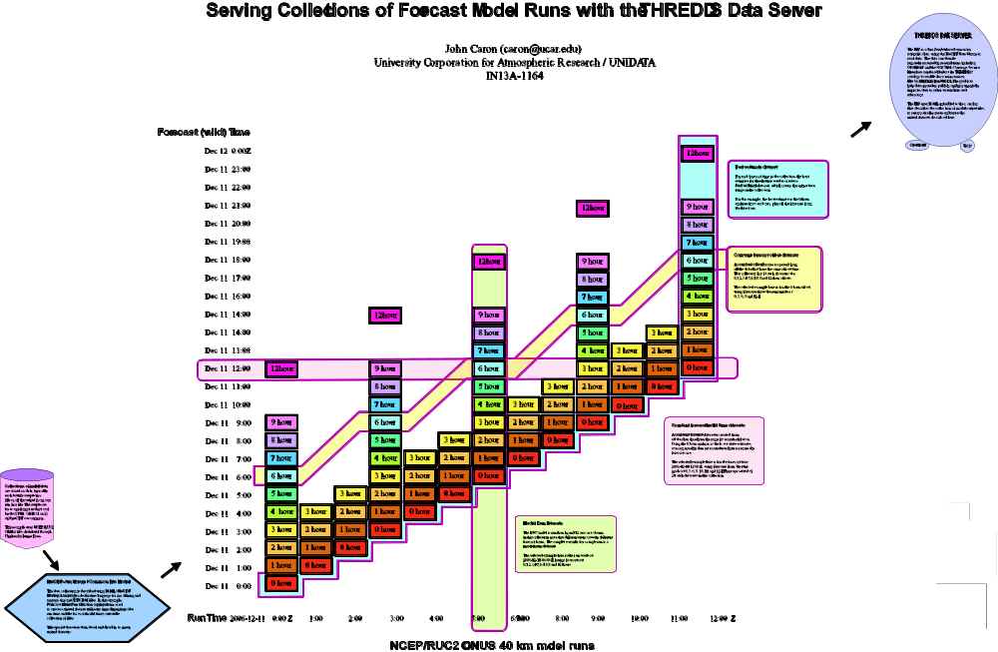
Forecast Model Run Collection
(FMRC)

Slide 15
NetCDF Subset Service
Experiment with REST style web service
Allow to subset the dataset by:
  Lat/lon bounding box
  time and vertical coordinate range
  list of Variables
NetCDF, XML, CSV (spreadsheet)
Gridded Data
  Output is a CF-1.0 netCDF file
  Variation of WCS (simplified request protocol)
Grid as Point Datasets (experimental)
  Extract vertical profile, time series from one point in model data
Station Data: metars (7 day rolling archive)

Slide 16
NEXRAD Radar level 2/3
Subset Service
Allow to subset the dataset by:
  Lat/lon bounding box
  time range
  list of Variables
Returns THREDDS catalog
  With OPeNDAP URLs

Slide 17
Apache Tomcat
“Sweet spot” for server functionality
  Lighter, simpler
Java web application server
  Not a full J2EE server
Servlet container / JSP server
  Standard API
Reference implementation (pre 2.5)
Part of Apache

Slide 18
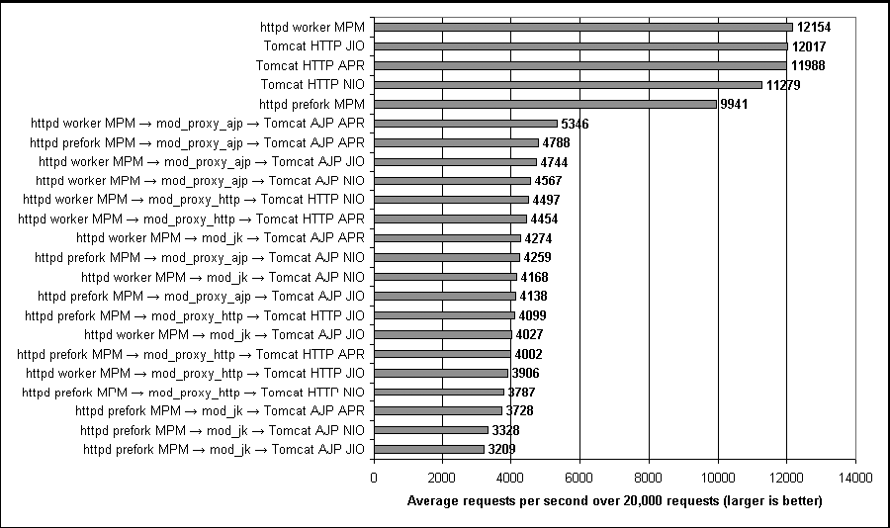
Tomcat: The Definitive Guide, Jason Brittain (O’Reilley 2007)

Slide 19
Tomcat Features
Thread Pools – manage multiple simultaneous connections
Virtual Hosts
Clustering and session replication
Request processing pipeline
  Filters and valves
Compression

Slide 20
Tomcat Security Management
Manage user authorization
  Role based (assign users to roles)
  Users in xml files, JNDI, rdbms, etc
Authentication
  Basic, digest, SSL
  Auto redirect to secure port

Slide 21
Jetty
100% Java HTTP Server and Servlet Container
“Jetty's claim to fame is that it is designed be embedded in other Java code”
  Many collaborations, active community
  production quality
  Large deployed base
Commercially developed by Mort Bay Consulting
Apache license

Slide 22
Glassfish
Sun’s J2EE server
GPL and commercial (Sun Java System Application Server 9)
Branch of Tomcat 5
Grizzly HTTP Connector
  Based on Java NIO for high performance
Configuration GUI

Slide 23
J2EE Services
JPA Java Persistence API – connect to database
JTA transaction manager
JMS Java Message Service
EJB 3.0 Enterprise Java Beans
JNDI naming and directory interface

Slide 24
Spring Framework
Hibernate/Spring = better EJBs
  Dominates new web development
  JPA/EJB 3.0 are “JCP standards-based” imitations

Slide 25
Spring Framework
Lightweight framework for gluing components together
  Uses Dependency Injection (IoC = inversion of control)
  Encourages separation of concerns and other Software best practices.
  Application code does not depend on Spring
  Spring managed beans / POJOs
Used both for J2SE and J2EE development

Slide 26
Spring Components
Data Access Object
  Supports JDBC and ORM (Hibernate, JDO)
  Consistent abstractions for exceptions and connection
Aspect Oriented Programming
  Dynamic proxies using interfaces
Data Binding and Validation
Testing
Web MVC
Spring Security
JMX glue
Modules

Slide 27
Spring Web MVC
MVC (Model-View-Controller) - separates:
  Domain specific code [model]
  Web/servlet framework [controller]
  Web display technology [view]

Slide 28
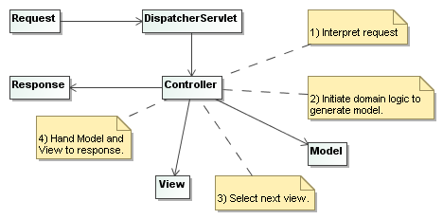
Spring Web MVC
MVC (Model-View-Controller)

Slide 29
Spring Web MVC
Controller
  Implements: handleRequest(req,res):ModelAndView
  CommandController: map general requests to beans
  FormController: map form requests to beans
Model – domain specific code
  TDS: catalogs, data roots, file
  NetCDF: dataset, gridded
View
  Implements: render(Map,req,res):void
  JSP, Velocity, Tiles, iText, POI
  Struts, JSF, Tapestry, WebWork
  Our own views: byte range file access

Slide 30
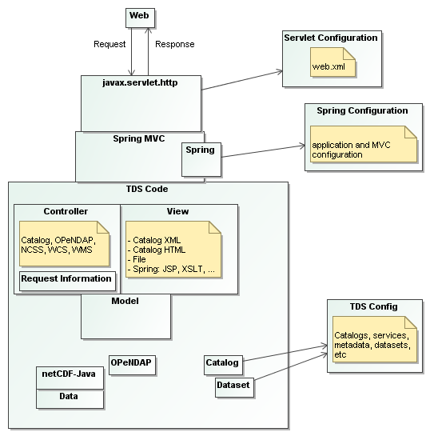
TDS on Spring

Slide 31
TDS use of Spring
Standard ways to manage complexity
  Can simplify collaborations
  Ease “Pie Truck” recovery
Existing Spring Components
  Spring Security
  MVC (servlet dispatch)
Active community creating components
Used by collaborators
  CDP, ncWMS

