Slide 1
THREDDS Data Server (TDS)
Installation and Administration
Ethan Davis
Unidata
8 November 2010

Slide 2
THREDDS Data Server
Serves scientific data
  Any dataset read by the netCDF-Java library
    E.g., netCDF 3&4, HDF 4&5 (and HDF–EOS), GRIB 1&2
  Using various data access services
    E.g., OPeNDAP, OGC WMS & WCS, NCSS, HTTP
Serves THREDDS catalogs

Slide 3
THREDDS Data Server (cont.)
100% Java
Java 1.6
  JDK 1.7 is coming “early 2011” : new File API
Tomcat 6.0
  Reports that Jetty works
Spring 2.5
  Internal configuration
  Spring MVC
Packaged as a single file: thredds.war
Open-source license

Slide 4
THREDDS Data Server
Servlet Container
catalog.xml
Remote Access
Client
THREDDS Server
WCS
OPeNDAP
HTTPServer
WMS
NetCDF-Java
library
configCatalog.xml
Datasets
IDD Data
motherlode.ucar.edu

Slide 5
Application
Scientific Feature Types
Datatype Adapter
NetCDF-Java/
CDM architecture
NetcdfDataset
CoordSystem Builder
NetcdfFile
THREDDS
I/O service provider
Catalog.xml
OPeNDAP
NetCDF-3
NIDS
NetCDF-4
GRIB
NcML
HDF5
GINI
Nexrad
DMSP
…

Slide 6
CDM/netCDF-Java
NetCDF Data Access
  Data Model: Variables (arrays), Dimensions, Attributes
  I/O Service Provider (IOSP)
NetcdfDataset:
  Geospatial coordinate systems
  Scale/offset and missing
  NcML: Modify existing datasets; Aggregate datasets
Scientific Feature Types:
  Gridded Data; Radial Data; Swath Data
  Discrete Sampling Features:
    Point Data; Station Data; Profile Data
    Trajectory (e.g., aircraft track) Data

Slide 7
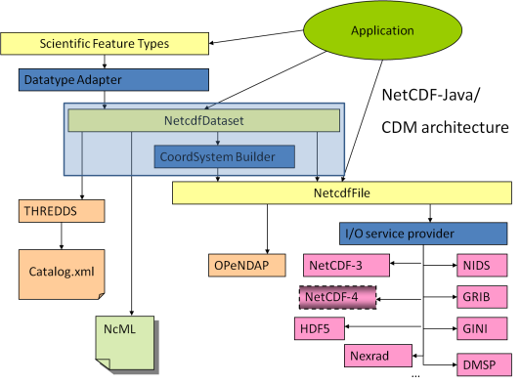
Coordinate Systems
Used to geolocate data
Dataset must describe the coordinate systems used
Use conventions to describe coordinate systems
  CF Convention (recommended)
  Other conventions are recognized by netCDF-Java library
What you get if your data follows conventions
  Standard visualization, debugging, and data manipulation tools
  Standard servers to make your data remotely accessible

Slide 8
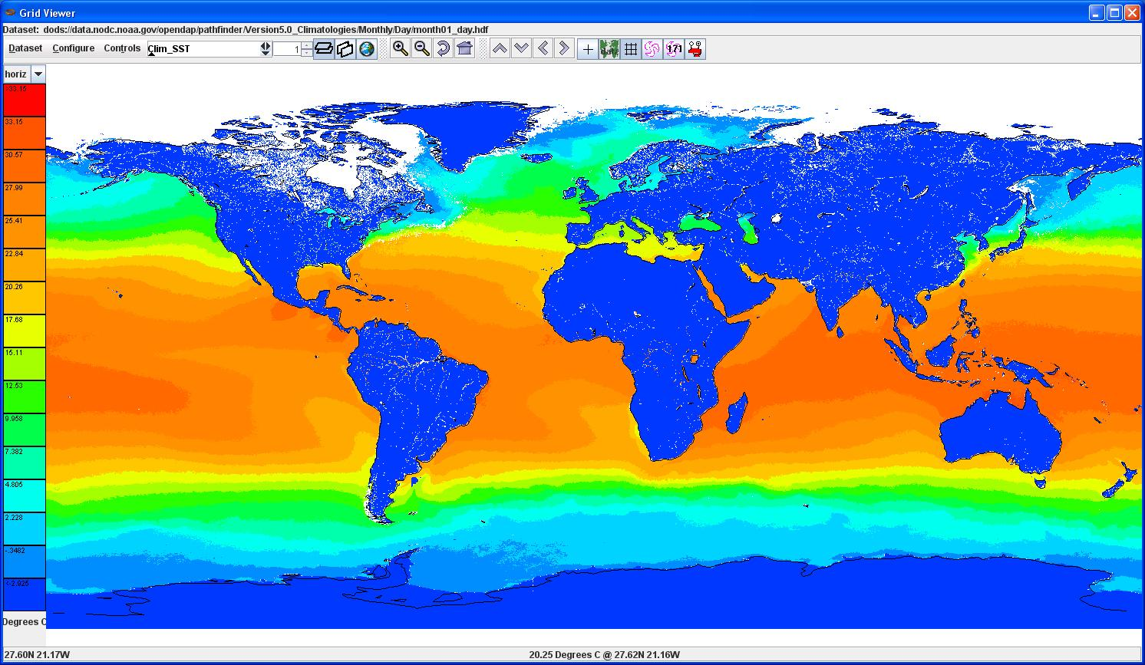
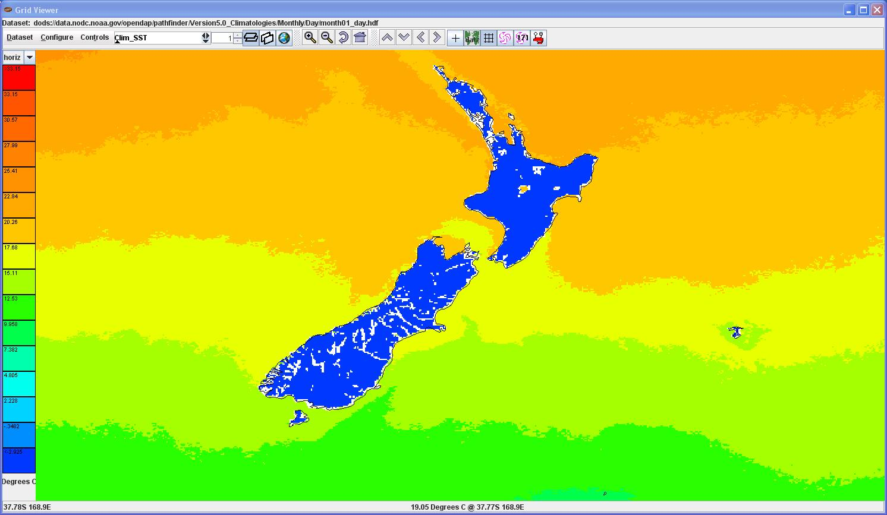
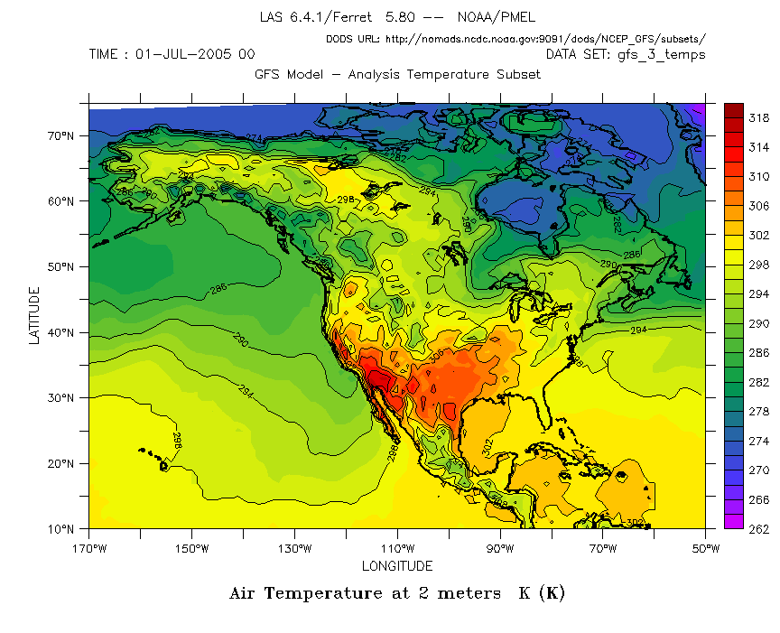
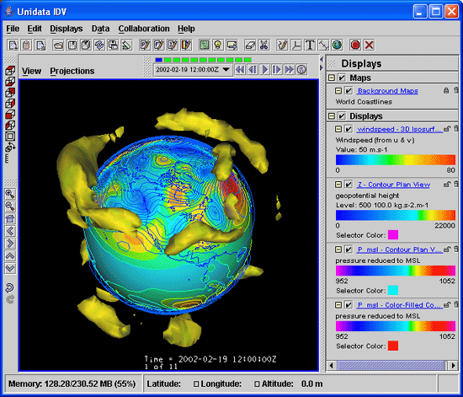
Coordinate Systems

Slide 9
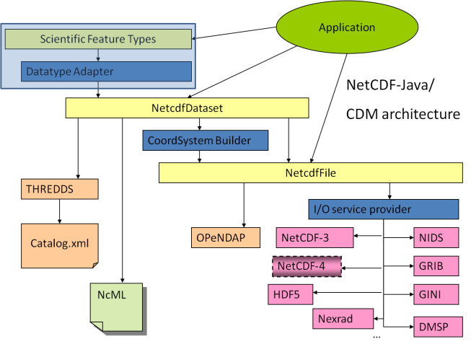
Scientific Feature Types
Gridded Data
Radial Data
Swath Data
Discrete Sampling Features
  Point data
  Station data
  Profile data
  Trajectory (i.e., aircraft track) data

Slide 10
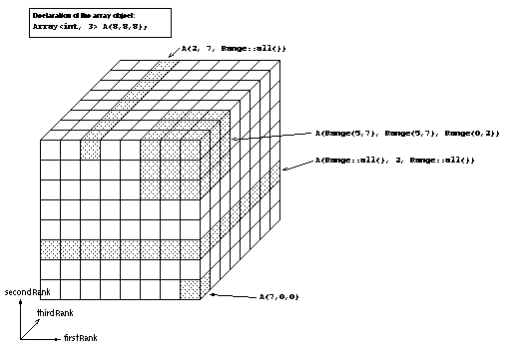
Gridded Data
Cartesian coordinates
Data is 2,3,4D
All dimensions have 1D coordinate variables (separable)
float gridData(t,z,y,x);
float t(t);
float y(y);
float x(x);
float z(z);
netCDF: coordinate variables
OPeNDAP: grid map variables
HDF: dimension scales

Slide 11
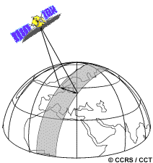
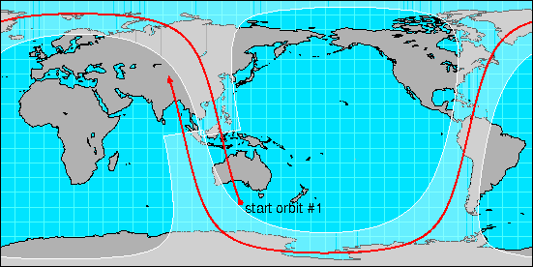
Swath
two dimensional
track and cross-track
not separate time dimension
aka curvilinear coordinates
float swathData( track, xtrack)
float lat(track, xtrack)
float lon(track, xtrack)
float alt(track, xtrack)
float time(track)

Slide 12
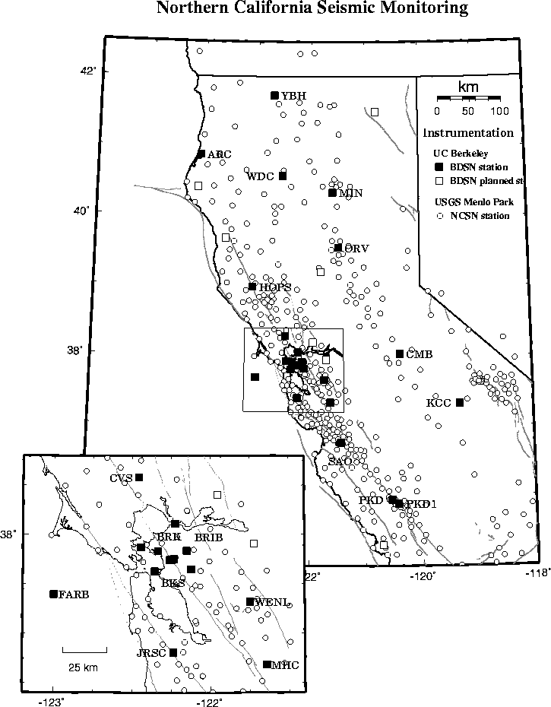
Point Observation Data
Set of measurements at the same point in space and time = obs
Collection of obs = dataset
Sample dimension not connected
float obs1(sample);
float obs2(sample);
float lat(sample);
float lon(sample);
float z(sample);
float time(sample);

Slide 13
THREDDS Data Server
Servlet Container
catalog.xml
Remote Access
Client
THREDDS Server
WCS
OPeNDAP
HTTPServer
WMS
NetCDF-Java
library
configCatalog.xml
Datasets
IDD Data
motherlode.ucar.edu

Slide 14
THREDDS Catalogs
Catalogs collect, organize, and describe datasets
  Hierarchical collections of datasets (virtual directories)
  Each dataset may have multiple access methods
  Documentation (metadata) may be added
    To the catalog itself
    To individual datasets (inheritance optional)
Servers can use catalogs to advertise the datasets they serve

Slide 15
THREDDS Catalogs
<?xml version='1.0' encoding='UTF-8'?>
<catalog xmlns=“http://www.unidata.ucar.edu/namespaces/thredds/InvCatalog/v.0”
xmlns:xlink="http://www.w3.org/1999/xlink" version="1.0.2">
<service name="odap" serviceType="OPENDAP" base="/thredds/dodsC/" />
<dataset name="TDS Tutorial: example 2">
<metadata inherited="true">
<serviceName>odap</serviceName>
</metadata>
<dataset name="TDS Tutorial: example data 1" urlPath="test/example1.nc" />
<dataset name="TDS Tutorial: example data 2" urlPath="test/example2.nc" />
<dataset name="TDS Tutorial: example data 3" urlPath="test/example3.nc" />
<catalogRef xlink:title="My Other Catalog“
xlink:href="myOtherCatalog.xml" />
<catalogRef xlink:title="Far Away Univ catalog“
xlink:href="http://www.farAwayU.edu/thredds/catalog.xml" />
</dataset>
</catalog>

Slide 16
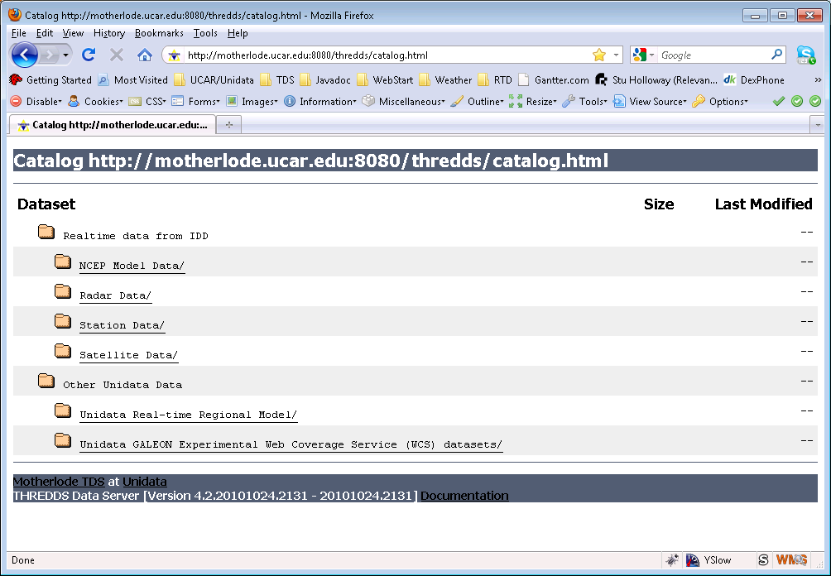
THREDDS Catalogs

Slide 17
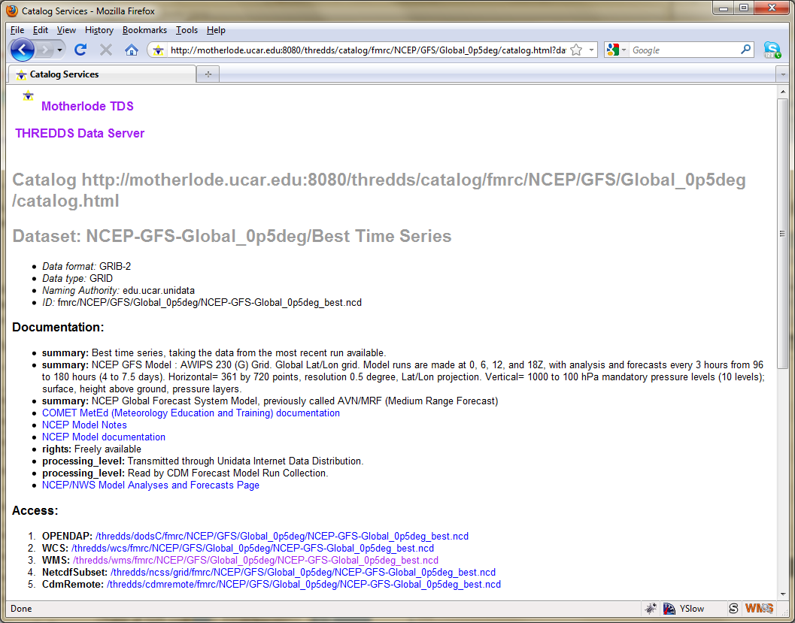
THREDDS Catalogs

Slide 18
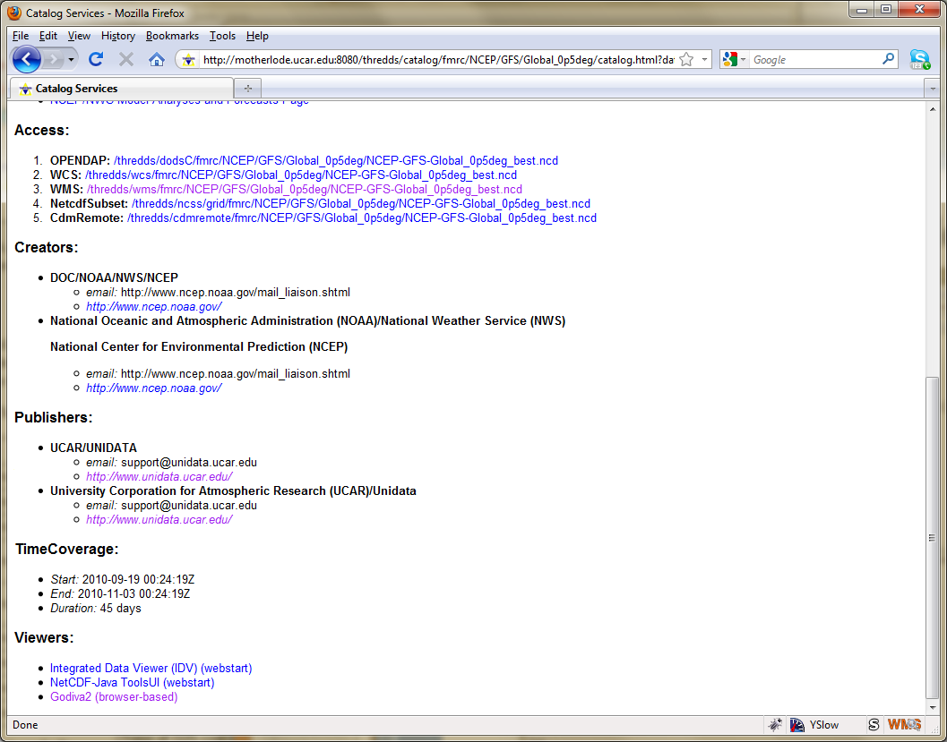
THREDDS Catalogs

Slide 19
THREDDS Data Server
Servlet Container
catalog.xml
Remote Access
Client
THREDDS Server
WCS
OPeNDAP
HTTPServer
WMS
NetCDF-Java
library
configCatalog.xml
Datasets
IDD Data
motherlode.ucar.edu

Slide 20
Data Access Services
Bulk File Transfer
  HTTP Server (any file)
Remote access, subsetting CDM files
  OPeNDAP (any* CDM file)
  Web Coverage Service (grids)
  Web Map Service (grids)
  Others
    NetCDF Subset Service (grids)
    Radar Collection Subset Service

Slide 21
Data Access Services
Clients
OPeNDAP (lots, including IDL, MatLAB)
WCS (still minimal, but expect to grow)
  GDAL, CADCorp, George Mason, OWSLib
WMS (speak WMS; consume GIF, JPEG, and PNG)
  Browsers, Portals, ARC GIS, Google Earth, etc
NetCDF Subsetter
  HTML forms interface
  Web service (CUAHSI)
  ESRI ArcGIS (manual download of netcdf-CF)

Slide 22
OPeNDAP Service
Low-level protocol for remote access to CDM files
Current version 2.0; NASA ESE standard
  Working on new 4.0 protocol spec
TDS can serve any* CDM file
  Subsetting by variable, index range
Uses the OPeNDAP-Java (DAP 2.0) library
Non-streaming = response in memory
Automatic compression (deflate)
  You must enable in TDS

Slide 23
OGC Web Services
OGC (Open Geospatial Consortium)
Web Services:
  Web Feature Service (vector, GIS, GML)
  Web Map Service (raster, GIS, 2D, jpeg)
  Web Coverage Service (4D, data formats)
  Web Processing Service Remote GIS operations
  Web Catalog Service (CSW) (SQL-like query service)
Based on ISO/TC 211 Family of Standards
  ISO/TC 211 = Geographic Information/Geomatics
Google donated KML spec to OGC
Motivated by a huge drive towards standardization
Standards still evolving

Slide 24
TDS WCS 1.0 Service
Allow to subset the dataset by:
  Lat/lon or projection bounding box
  time and vertical coordinate range
  list of Variables
Return formats
  GeoTIFF floating point, grayscale
  NetCDF/CF-1.0
No reprojections, resamplings
Restricted to Gridded Datasets the CDM recognizes
  Additional WCS restriction:
    Grid must be evenly spaced in x,y

Slide 25

Web Map Service (WMS)
GetCapabilities -> metadata
GetMap -> map image, based on client-selected parameters, inc:
  Image width/height
  Image coordinate reference system
  Geographic bounding box
  Depth/height and time
  Style
GetFeatureInfo -> information about a particular map pixel
  Format not standardized
Specification supports 4D data (although tools often do not)

Slide 26
TDS WMS
Based on ncWMS (Jon Blower, U of Reading)
ncWMS notable features
  Fast generation of images
  Ability to read CDM datasets on variety of projections
  Can reproject images into large number of coordinate systems
    Uses geotoolkit’s extensive projection library

Slide 27
TDS WMS (cont)
ncWMS non-standard features
  Piecemeal metadata-serving in JSON format
    avoids large XML Capabilities document
  Extra metadata for science data
    e.g. units of measurement
  New parameters in GetMap for styling:
    Choose color palette
    Set contrast range
    Linear or logarithmic scaling
    Far simpler than Styled Layer Descriptor
  Generation of timeseries plots via GetFeatureInfo
  … but fully backward-compatible with WMS1.1.1 and 1.3.0

Slide 28
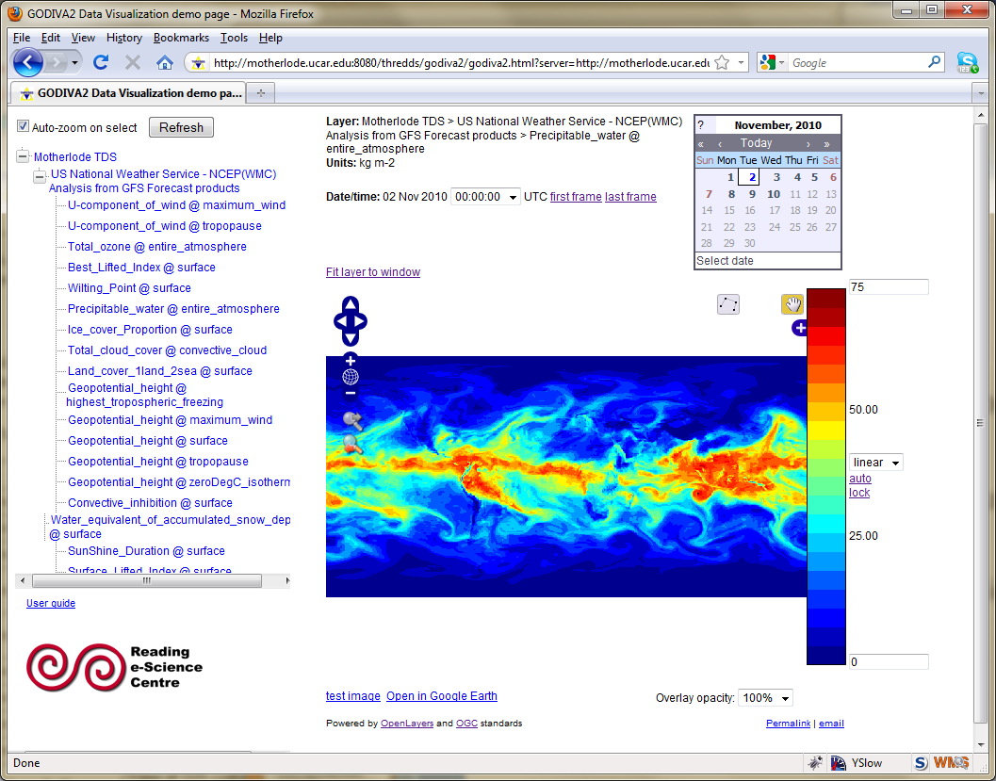
TDS WMS (cont)
Godiva2 web client (ncWMS)
  Uses OpenLayers (JavaScript) library

Slide 29
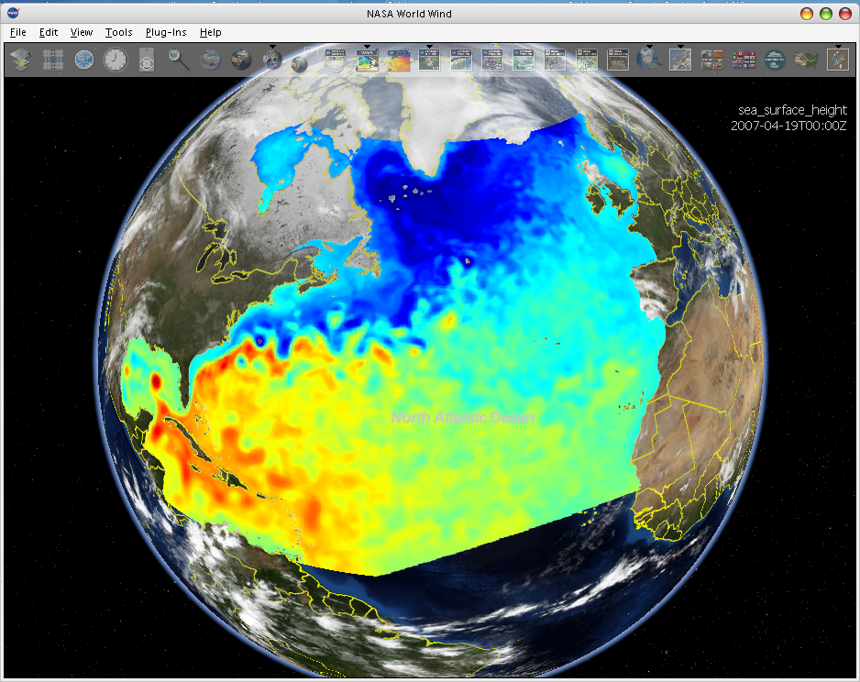
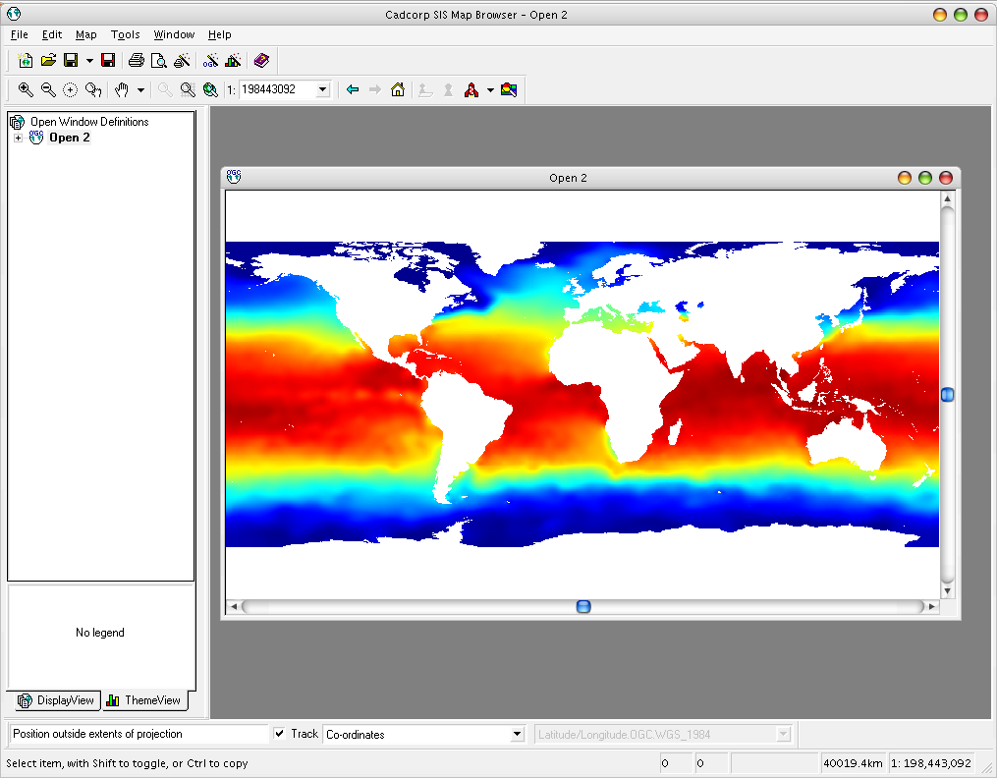
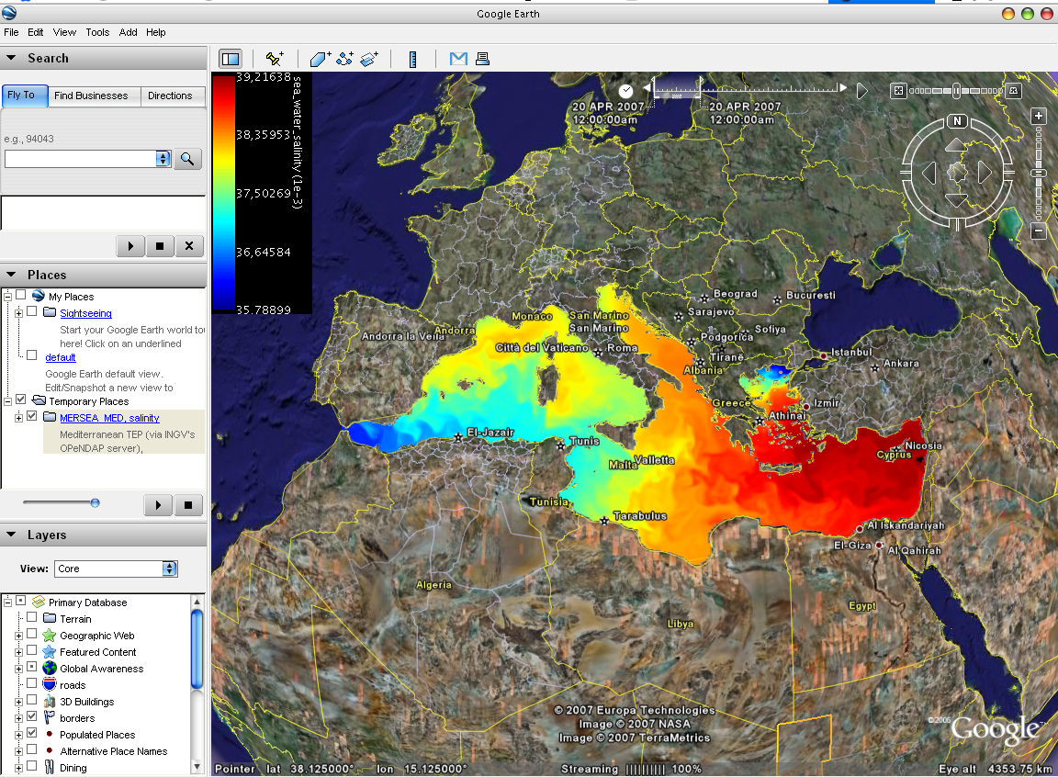
WMS Interoperability
NASA World Wind
3rd-party clients can’t use the custom WMS extensions
Cadcorp SIS
Google Earth
Godiva 2

Slide 30
Experimental Services
Mostly used just on motherlode
  not ready for general use
Radar Collection Service
NetCDF Subset Service (ncss)
CDM Remote Service (cdmremote)
  Probably replace ncss

Slide 31
NetCDF Subset Service
Experiment with REST style web service
Allow to subset the dataset by:
  Lat/lon bounding box
  time and vertical coordinate range
  list of Variables
Output: NetCDF, XML, CSV (spreadsheet)
Gridded Data
  Output is a CF / netCDF file
  Variation of WCS (simplified request protocol)
Grid as Point Datasets
  Extract vertical profile, time series from one point in model data
  Station Data: metars (7 day rolling archive)

Slide 32
THREDDS Data Server
Servlet Container
catalog.xml
Remote Access
Client
THREDDS Server
WCS
OPeNDAP
HTTPServer
WMS
NetCDF-Java
library
configCatalog.xml
Datasets
IDD Data
motherlode.ucar.edu

Slide 33
Configuration Catalogs
Administrator tells the TDS which / how datasets are to be served
Identify the files on disk
Name, organize, sort, filter into virtual collections
Add discovery metadata
Integrated with NcML
  Create virtual datasets

Slide 34
TDS Configuration Catalogs
…
<datasetScan name="Ocean Satellite Data“
path="/data/ocean/sat/"
location= "/data/tds/netcdf/">
<metadata inherited="true">
<serviceName>odap</serviceName>
<dataType>Grid</dataType>
<dataFormat>NetCDF</dataFormat>
<documentation xlink:href="http://ncep.noaa.gov/modelinfo/index.html"
xlink:title="NCEP Model documentation" />
<documentation type="processing_level">
Transmitted through Unidata Internet Data Distribution.
</documentation>
</metadata>
</datasetScan>
…

Slide 35
TDS and NcML
Embed NcML into the TDS configuration catalog
Server serves a virtual dataset defined by NcML
  NcML hidden from the client
Can “fix” metadata problems
Can augment metadata
General Aggregations
  joinNew, joinExisting, Union
Specialized Aggregations
  Forecast Model Run Collection (FMRC)
  Point Feature Collections
Notes:
The TDS can use NcML to wrap datasets that are being served, adding or fixing metadata. The client doesn’t see the NcML, it sees only the dataset the NcML describes. The NcML aggregation capability is what the TDS uses as the replacement to the old OPeNDAP aggregation server.

Slide 36
TDS / NcML
Modify and serve through TDS
<dataset name=“Polar Orbiter Data" urlPath =“idd/sat/PolarData“ >
<netcdf location="/data/sat/P02393.hdf”>
<attribute name="Conventions" value="CF-1.4"/>
<variable name="Reflectivity" orgName=“R34768”>
<attribute name="units" value=“dBZ" />
<attribute name=“coordinates" value=“time lat lon" />
</variable>
</netcdf>
</dataset>

Slide 37
TDS / NcML
Modify all files in datasetScan
<datasetScan name=“Polar Orbiter" path="/data/sat/"
location= "/data/hdf/polar/">
<netcdf>
<attribute name="Conventions" value="CF-1.4"/>
<variable name="Reflectivity" orgName=“R34768”>
<attribute name="units" value=“dBZ" />
<attribute name=“coordinates" value=“time lat lon" />
</variable>
</netcdf>
</datasetScan>

Slide 38
TDS / NcML
Aggregation
<dataset name="WEST-CONUS_4km Aggregation“
urlPath="satellite/3.9/WEST-CONUS_4km">
<netcdf>
<aggregation dimName="time" type="joinExisting">
<scan location="/data/satellite/WEST-CONUS_4km/" suffix=".gini" />
</aggregation>
</netcdf>
</dataset>

Slide 39
TDS FMRC Aggregation
…
<featureCollection name="NCEP-NAM-Polar_90km" featureType="FMRC“
path="fmrc/NCEP/NAM/Polar_90km">
<collection spec=“/data/NAM_Polar_90km_#yyyyMMdd_HHmm#.grib2$“
recheckAfter="15 min" olderThan="5 min"/>
<update startup="true" rescan="0 5 3 * * ? *" />
<protoDataset choice="Penultimate" change="0 2 3 * * ? *" />
<fmrcConfig regularize="true“ datasetTypes="TwoD Best Files Runs" />
</featureCollection>
…

Slide 40
Status: CDM/netCDF-Java & TDS
TDS 4.2
  Stable version … real soon now!
  Changes from TDS 4.1
    Refactor FMRC aggregation to simplify configuration and improve performance.
    Improved integration with ncWMS code including adding the Godiva2 browser based WMS client.
    Uses CDM/netCDF-Java 4.2
netCDF-Java 4.2
  Stable version as of October 2010
  Changes from netCDF-Java 4.1
    GRIB processing improved (correctly identify time interval variables).
    FMRC aggregations code refactored.
    Extended caching system and code to manage large dataset collections.
    OPeNDAP parsing grammar shared with the OPeNDAP/netCDF C library.

