Slide 1

Data Discovery
Data discovery systems
TDS and metadata
NcISO services

Slide 2
Data Discovery
1.Data discovery systems
1.1 GI-Cat, Geoportal, GeoNetwork
TDS does not support searching features.
We look for data browsing through catalogs.
Data discovery systems harvest metadata from TDS catalogs and expose it through interfaces that TDS itself does not support (Brokers).
Data discovery systems enable searches on TDS servers!
Harvest data from other sources (OGC services, ISO metadata standards), federated systems...

Slide 3
1.2 Issues harvesting metadata
Data Discovery
1.Data discovery systems
TDS instances don't provide too much metadata.
Crawl at dataset level. Don't harvest metadata at collection level.
Manage large numbers of datasets.
Provide access to datasets rather than to actual data.
Data display that is useful, meaningful and satisfactory for multi-disciplinary users.

Slide 4
1.3 GI-Cat & Geoportal demo
Data Discovery
1.Data discovery systems
Running instances:
* EURO GEOSS (GI-Cat):
http://www.eurogeoss-broker.eu/
* NGDC geoportal:
http://www.ngdc.noaa.gov/geoportal/catalog/main/home.page
* NODC geoportal:
http://data.nodc.noaa.gov/geoportal/catalog/search/search.page

Slide 5

2.1 Metadata matters
Data Discovery
2.THREDDS and metadata
- METADATA ENABLES DATA DISCOVERY
- BETTER INTEROPERABILITY
- IMPROVES DATA EXCHANGE

Slide 6
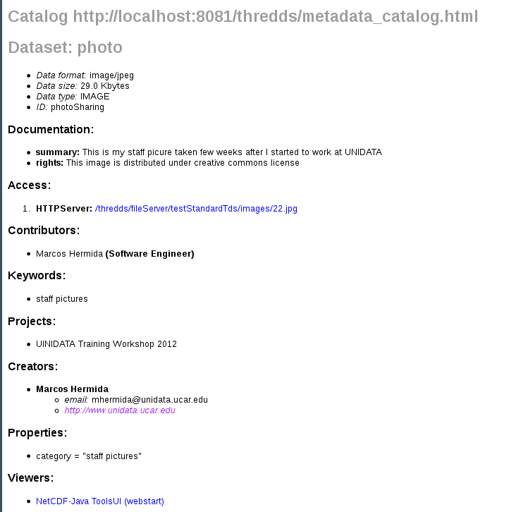
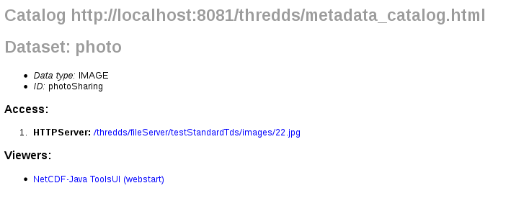
2.2 We are data providers...
Data Discovery
2.THREDDS and metadata

Slide 7
2.3 TDS metadata
Data Discovery
2.THREDDS and metadata
TDS provides several kinds of metadata: access, spatial and time coverage, contact, title, summary, keywords, variables....
Feature Collections get metadata from files (CF-conventions, GRIB...)
Attribute Conventions Dataset Discovery (ACDD)
http://wiki.esipfed.org/index.php/Attribute_Convention_for_Data_Discovery_(ACDD)

Slide 8
2.4 Adding metadata to catalogs
Data Discovery
2.THREDDS and metadata
Metadata tags:
- Documentation, metadata, property...
- Reference:
http://www.unidata.ucar.edu/projects/THREDDS/tech/catalog/v1.0.2/InvCatalogSpec.html#metadataElement
Inheritance: inherited=”true”
ACDD recommendations:
http://wiki.esipfed.org//index.php/Attribute_Convention_for_Data_Discovery_(ACDD)

Slide 9
3.1 What is NcISO?
Metadata & ncISO services
3.NcISO services
Developed by NGDC (National Geophysical Data Center)
NcISO provides a set of services for managing our metadata:
  - NCML: information of our datasets in ncml
- UDDC(*): assesses our metadata service
  - ISO: translate catalogs into ISO documents
(*) UDDC former acronym for ACDD

Slide 10
3.2 Enabling ncISO
Data Discovery
3.NcISO services
ThreddsConfig.xml:
<NCISO>
<ncmlAllow>true</ncmlAllow>
<uddcAllow>true</uddcAllow>
<isoAllow>true</isoAllow>
</NCISO>
ncISO for datasets in your catalogs:
<service name="ncml" serviceType="NCML" base="/thredds/ncml/"/>
<service name="uddc" serviceType="UDDC" base="/thredds/uddc/"/>
<service name="iso" serviceType="ISO" base="/thredds/iso/"/>

Slide 11
3.3 ncISO exercise
Data Discovery
3.NcISO services
1. Enable ncISO
2. Check your UDDC(*) score
3. Add metadata and improve the UDDC score
(*) UDDC former acronym for ACDD

