Slide 1
Unidata TDS Workshop
TDS Overview – Part I
XX-XX October 2014

Slide 2

Unidata – Who are we?
Funded primarily by the U.S. National Science Foundation
Mission:
  To provide data, tools, and community leadership for improving Earth-system education and research
At the Unidata Program Center, we
  Provide access to data (via push and pull systems)
  Develop open source tools and infrastructure for data access, analysis, visualization, and data management
  Advance metadata standards for the Earth system science community
  Support users of our technologies: faculty, students, and researchers
  Help to build, represent, and advocate on behalf of our community
Notes:
Although the main focus of our work is on providing real-time data, Unidata develops tools, middleware, and services that contribute to broader cyberinfrastructure needs of the community.

Slide 3
Access to Data: Push
IDD Real-time Data Flow
  34 data feeds provide radar, satellite, text bulletins, lightning, model forecasts, surface and upper air observations, …
  LDM routinely handles 13 GB/hour input, with as many as 280,000 products/hour
  Unidata pushes out 13 TB/day, users pull over 630 GB / day via remote access
  Worldwide collaboration of over 260 institutions running LDM software
Unidata’s LDM
  Protocol and client/server software
  Event-driven data distribution
  Supports subscription to subsets of data feeds

Slide 4
Access to Data: Pull
IDD data from Unidata available via
  Servers:
    McIDAS ADDE
    TDS
    RAMADDA
  Protocols:
    http, FTP
    ADDE, OPeNDAP
    OGC WCS and WMS
The Unidata TDS server thredds.ucar.edu* (formerly known as motherlode) “archives” latest 14 days or so of IDD data

Slide 5
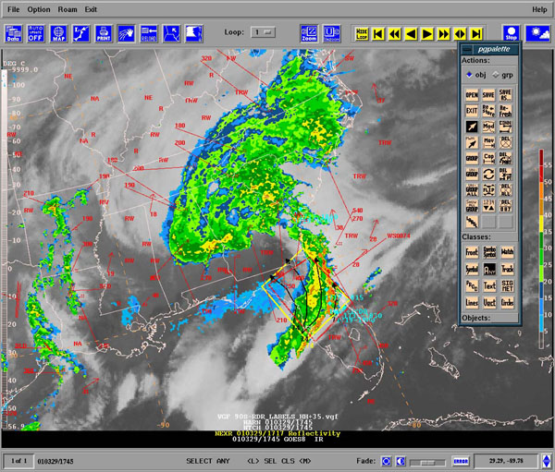
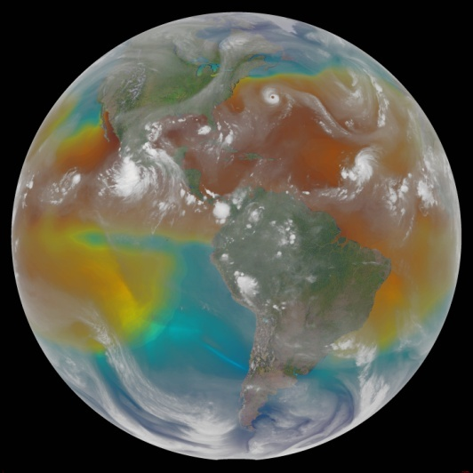
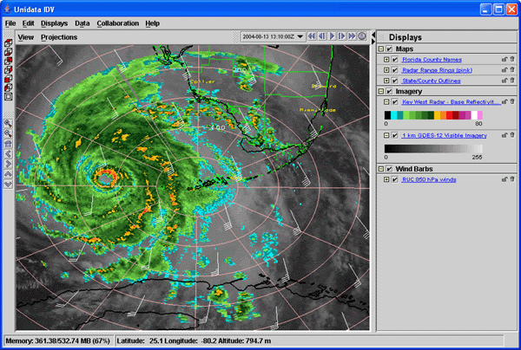
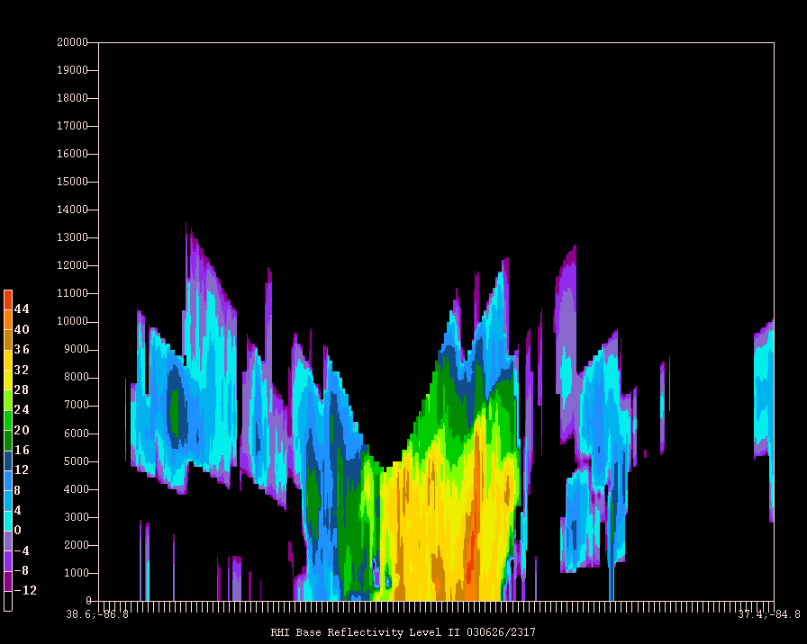
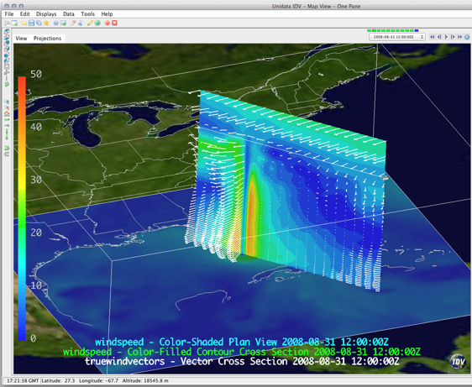
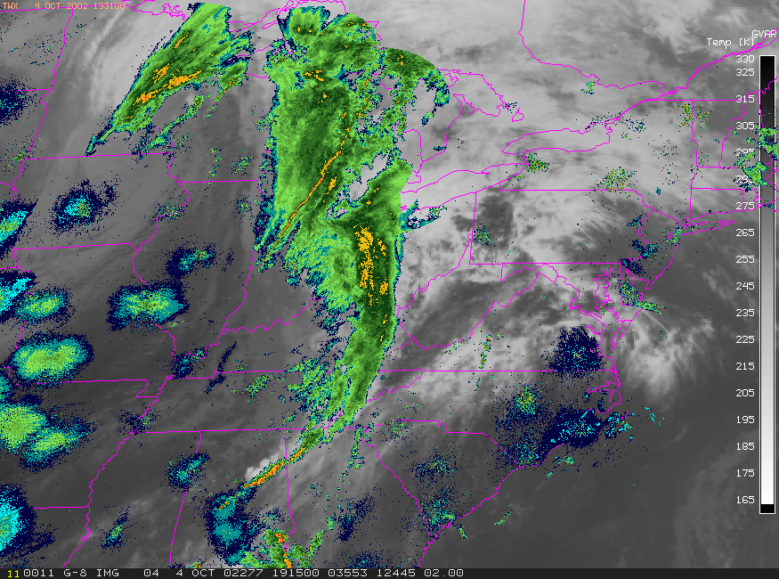
Visualizing and Analyzing Data
GEMPAK
McIDAS-X
IDV

Slide 6
Unidata User Community
Support the community
  User Workshops
  Training Workshops
  Mailing lists
    For specific software packages
    “community” email list – for Unidata community announcements
Represent and advocate for the community
More: http://www.unidata.ucar.edu/

Slide 7
Why TDS – Users
As a user, some things I want to be able to do:
  Easily ‘see’ information regarding the dataset, without the need to download any files
    Temporal / spatial ranges, available variables, contact info, dataset details
  Get only the data I need/want
    Temporal, spatial, and variable subsetting
  Get data remotely in a variety of ways
  Download one file, even if data span multiple files

Slide 8
Why THREDDS Data Server (TDS)
– Data Providers
As a data provider, I want to be able to:
  Catalog my data holdings
  Aggregate data files
  Provide a ‘quick view’ of my data
  Easily add information (metadata) to my datasets
  Fix ‘incorrect’ datasets*
  Allow flexibility in the way users access my data
  Give users what they need to do science!

Slide 9
THREDDS Data Server (TDS)
Web server for scientific data (written in 100% Java)
Can serve any dataset the netCDF-Java library can read
  E.g., netCDF-3, netCDF-4, HDF-4, HDF-5, HDF-EOS, GRIB-1, GRIB-2
Advertise available datasets and services via catalogs
Data access (subset) services:
  OPeNDAP
  OGC WMS and WCS
  NCSS, cdmRemote
Data collection services
  Aggregation
  Point/station collection
Metadata services
  THREDDS
  ncISO: ISO, UDDC, NcML

Slide 10
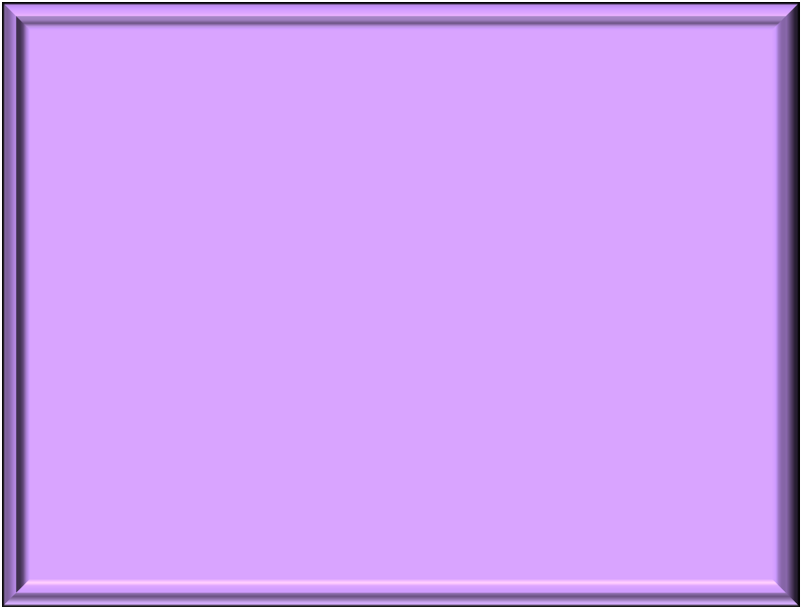
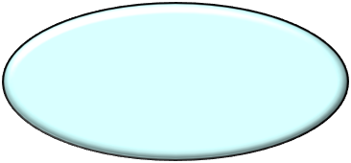
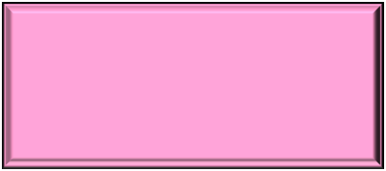


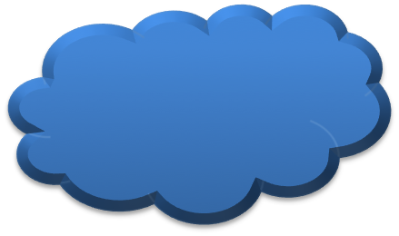
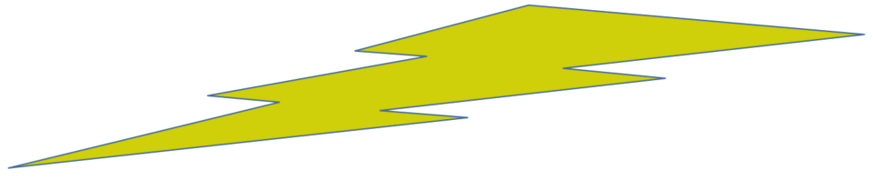
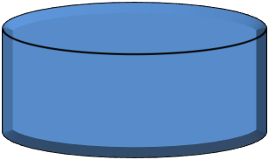
THREDDS Data Server
Servlet Container
catalog.xml
Remote Access
Client
THREDDS Server
WCS
OPeNDAP
HTTPServer
WMS
NetCDF-Java
Library
configCatalog.xml
IDD Data
Datasets
thredds.ucar.edu

Slide 11
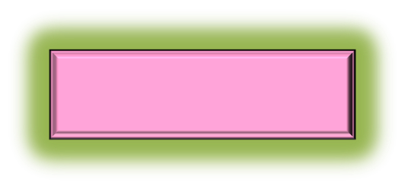
THREDDS Data Server
Servlet Container
catalog.xml
Remote Access
Client
THREDDS Server
WCS
OPeNDAP
HTTPServer
WMS
NetCDF-Java
Library
configCatalog.xml
IDD Data
Datasets
thredds.ucar.edu

Slide 12
Common Data Model (CDM)
Implemented in the netCDF-Java library (3 layers)
NetCDF Data Access:
  Access to array-based scientific data (netCDF data model)
  Read various file formats, map into data model (IOSP)
NetcdfDataset:
  Geospatial coordinate systems (conventions)
  NcML: Modify existing dataset
  Aggregation of datasets
Scientific Feature Types, e.g.:
  Gridded Data; Radial Data; Swath Data
  Discrete Sampling Features:
    Point Data; Station Data; Profile Data
    Trajectory (e.g., aircraft track) Data

Slide 13
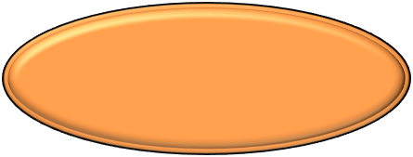





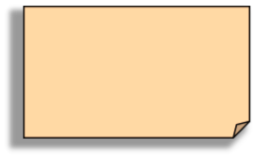







Application
Scientific Feature Types
Datatype Adapter
NetCDF-Java/
CDM architecture
NetcdfDataset
CoordSystem Builder
NetcdfFile
THREDDS
I/O service provider
Catalog.xml
OPeNDAP
NetCDF-3
NIDS
NetCDF-4
GRIB
NcML
HDF5
GINI
Nexrad
DMSP

Slide 14
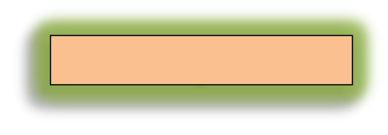
THREDDS Data Server
Servlet Container
catalog.xml
Remote Access
Client
THREDDS Server
WCS
OPeNDAP
HTTPServer
WMS
NetCDF-Java
Library
configCatalog.xml
IDD Data
Datasets
thredds.ucar.edu

Slide 15
THREDDS Catalogs
Catalogs collect, organize, and describe datasets
  Hierarchical collections of datasets (virtual directories)
  Each dataset may have multiple access methods
  Documentation (metadata) may be added
    To collections of datasets
    To individual datasets (inheritance optional)
Servers can use catalogs to advertise the datasets they serve

Slide 16
THREDDS Catalogs
<?xml version="1.0" encoding="UTF-8"?>
<catalog name="THREDDS Server Default Catalog : You must change this to fit your server!"
xmlns="http://www.unidata.ucar.edu/namespaces/thredds/InvCatalog/v1.0"
xmlns:xlink="http://www.w3.org/1999/xlink">
<service name="all" base="" serviceType="compound">
<service name="odap" serviceType="OpenDAP" base="/thredds/dodsC/" />
<service name="http" serviceType="HTTPServer" base="/thredds/fileServer/" />
</service>
<datasetRoot path="test" location="content/testdata/" />
<dataset name="Test Single Dataset" ID="testDataset" serviceName="odap"
urlPath="test/testData.nc" dataType="Grid"/>
<dataset name="Test Single Dataset 2" ID="testDataset2" serviceName="odap"
urlPath="test/testData2.grib2" dataType="Grid"/>
<datasetScan name="Test all files in a directory" ID="testDatasetScan" path="testAll”
location="content/testdata”>
<metadata inherited="true">
<serviceName>all</serviceName>
<dataType>Grid</dataType>
</metadata>
<filter>
<include wildcard="*eta_211.nc"/>
</filter>
</datasetScan>
<catalogRef xlink:title="Test Enhanced Catalog" xlink:href="enhancedCatalog.xml" name=""/>
</catalog>

Slide 17
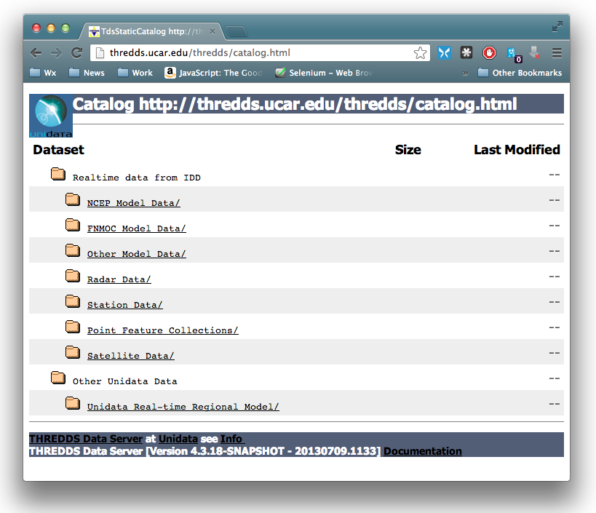
THREDDS Catalogs

Slide 18
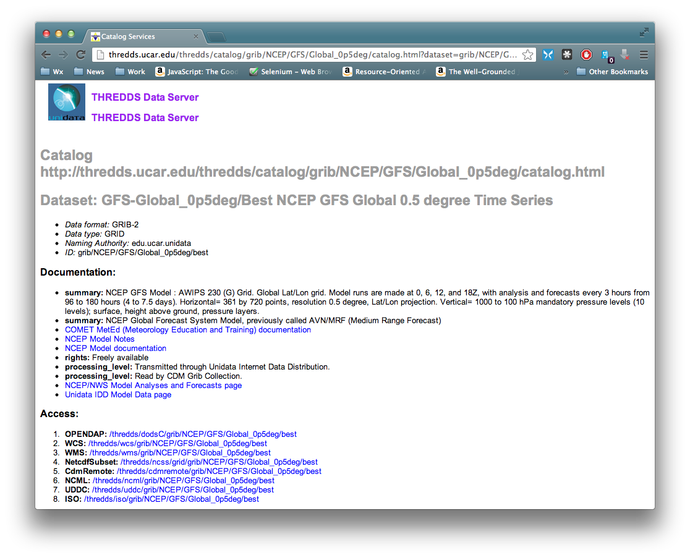
THREDDS Catalogs

Slide 19
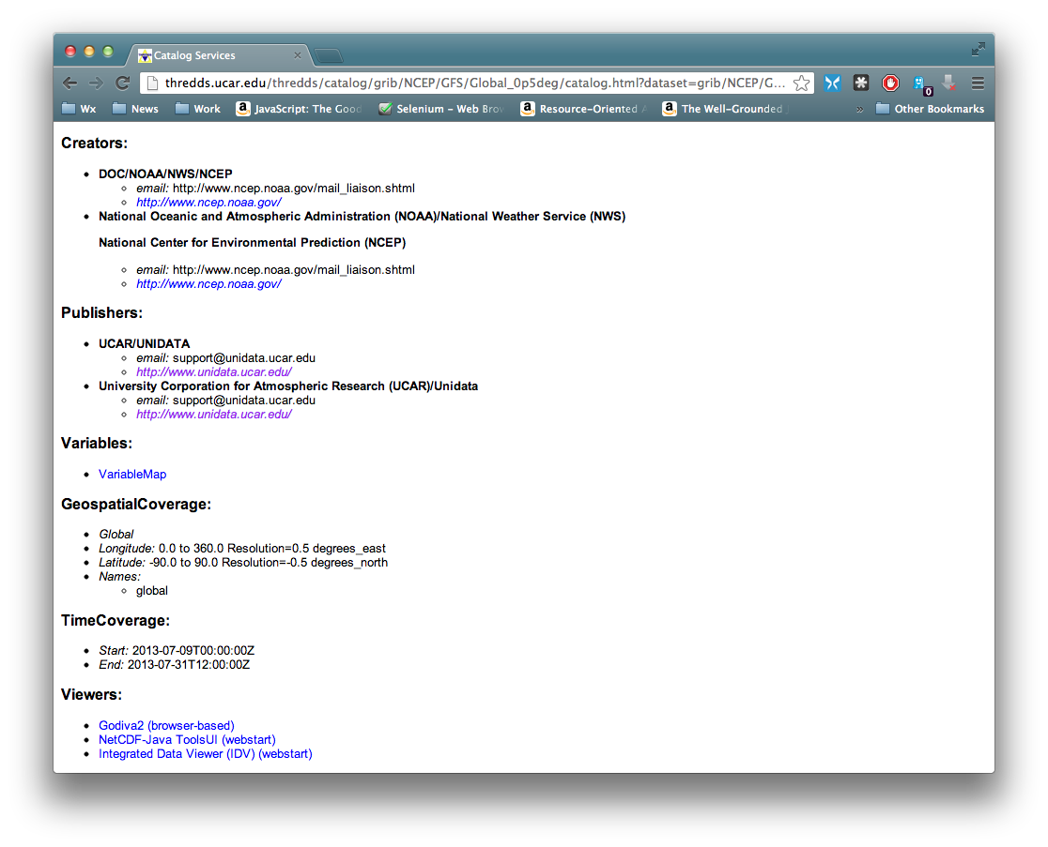
THREDDS Catalogs

Slide 20
THREDDS Data Server
Getting Started
TDS is written in 100% Java
TDS uses the Java Servlet framework
  Need to Install Tomcat or other servlet container
    Tomcat used in many places (The Weather Channel, Netflix, LinkedIn, to name a few)
    Note: many cloud services can use servlets (e.g. Amazon Web Services, CloudBees, Google App Engine, Windows Azure Compute, etc.)
First up: Install and configure Tomcat

