Slide 1

Metadata and ncISO services
Why metadata is important
THREDDS and metadata
NcISO services
Data discovery systems
The brokering approach

Slide 2

1.1 What's metadata
Metadata & ncISO services
1.Why metadata is important
Yeah, is that boring thing about data...

Slide 3






Metadata & ncISO services
1.Why metadata is important
1.2 What's metadata
Contact information
Access
information
Spatial
coverage
Time
coverage
Access
protocols
More...

Slide 4
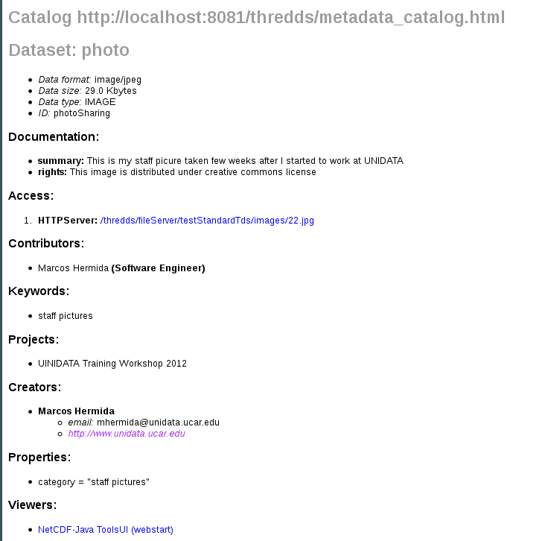
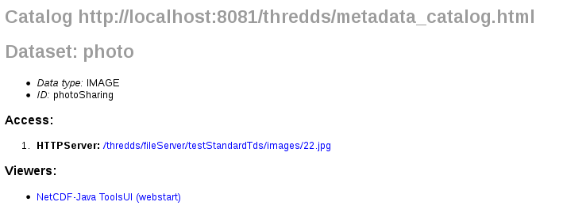
Metadata & ncISO services
1.Why metadata is important
1.3 We are data providers...

Slide 5

Metadata & ncISO services
1.Why metadata is important
1.3 Enables data discovery
- BETTER INTEROPERABILITY
- IMPROVES DATA EXCHANGE

Slide 6
Metadata & ncISO services
2.THREDDS and metadata
2.1 Default THREDDS metadata
Access, spatial and time coverage....
Unidata Data Discovery Conventions (UDDC)
Get metadata from files (CF-conventions...)

Slide 7
Metadata & ncISO services
2.THREDDS and metadata
2.2 Adding metadata to catalogs
Metadata tags:
- Documentation
- metadata
- property
- ...
Inheritance: inherited=”true”

Slide 8
Metadata & ncISO services
2.THREDDS and metadata
2.3 Minimal set of metadata?
- Depends on your needs
-UDDC recommendations:
http://www.unidata.ucar.edu/software/netcdf-java/formats/DataDiscoveryAttConvention.html

Slide 9
Metadata & ncISO services
3.NcISO services
3.1 Why NcISO?
Translate TDS metadata into standard formats:
-ISO-19115: Geographic information
-ISO-19115-2: imagery and gridded data
-ISO-19119: Geographic information services
Notes:
If thredds already provides metadata, why ncISO?

Slide 10
Metadata & ncISO services
3.NcISO services
3.2 What is NcISO?
Developed by NGDC (National Geophysical Data Center)
Not just translate into ISO:
  - NcML information of our datasets: ncml service
  - Assesses our metadta: UDDC service
  - ISO documents: ISO service

Slide 11
Metadata & ncISO services
3.NcISO services
3.3 Enabling ncISO
ThreddsConfig.xml:
<NCISO>
<ncmlAllow>true</ncmlAllow>
<uddcAllow>true</uddcAllow>
<isoAllow>true</isoAllow>
</NCISO>
ncISO for datasets:
<service name="ncml" serviceType="NCML" base="/thredds/ncml/"/>
<service name="uddc" serviceType="UDDC" base="/thredds/uddc/"/>
<service name="iso" serviceType="ISO" base="/thredds/iso/"/>

Slide 12
Metadata & ncISO services
3.NcISO services
3.4 ncISO demo (metadata tour)
-NOAA NCDC NOMADS:
* http://nomads.ncdc.noaa.gov/thredds/catalog.html
-NOAA Pacific Fisheries Environmental LabL:
* http://oceanwatch.pfeg.noaa.gov/thredds/catalog.html
-USGS Woods Hole Science Center:
* http://coast-enviro.er.usgs.gov/thredds/catalog.html
-UNIDATA IDD Real-time Archive:
* http://motherlode.ucar.edu:8080/thredds/catalog.html

Slide 13
Metadata & ncISO services
3.NcISO services
3.5 ncISO exercise
1. Enable ncISO
2. Check your UDDC score
3. Add metadata and improve the UDDC score

Slide 14
Metadata & ncISO services
4.Data discovery systems
4.1 GI-Cat, Geoportal
Harvest metadata from thredds catalogs
Enabling searches on TDS (brokers)
Running instances:
- EuroGeoss Broker:
http://www.eurogeoss-broker.eu/
- ESIP Discovery Cluster :
http://23.23.211.222:8080/geoportal/

Slide 15
Metadata & ncISO services
4.Data discovery systems
4.2 Issues harvesting metadata
Tds instances don't provide too much metadata
Crawl at dataset level. Don't harvest metadata at collection level.
Provide access to datasets rather than to actual data

Slide 16
Metadata & ncISO services
4.Data discovery systems
4.3 GI-Cat & Geoportal demo
Running instances:
* EURO GEOSS (GI-Cat):
http://www.eurogeoss-broker.eu/
* NGDC geoportal:
http://www.ngdc.noaa.gov/geoportal/catalog/main/home.page
* ESIP Discovery Cluster:
http://23.23.211.222:8080/geoportal/catalog/main/home.page

Slide 17
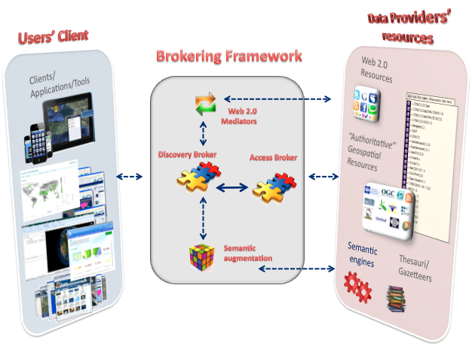
Metadata & ncISO services
5.The brokering approach
5.1 Broker architecture
Sample Brokering Framework (from Earthcube Brokering Manifesto)

Slide 18
Metadata & ncISO services
5.The brokering approach
5.2 Examples
* CSW catalog
* OpenSearch

