Slide 1
Samsung Innovation Campus

Slide 2
Indian Food Data Analysis Report
Team – Nikhil Upadhyay, Piyush Daiya, Muskan Toppo, Neeraj Kumar, Mridul Soni

Slide 3
Indian Food Data Analysis Report
UNIT 1. Introduction
1.1. Objective
1.2. Tools and Techniques
UNIT 2. Data Source
UNIT 3. Data Preparation and Cleaning
3.1. Importing Libraries
3.2. Creating Data frames
3.3. Dropping missing values & replacing invalid data
UNIT 4. Analysis and Visualization
UNIT 5. Question & Answers
UNIT 6. Conclusion & Reference
Notes:
Note:

Slide 4
India is renowned for its rich cultural diversity, which is also reflected in its vast array of culinary delights. This project delves into an analysis of Indian food dishes, aiming to uncover insights into the regional, state-wise, and flavor profiles of various dishes.
Introduction
UNIT
01
Objectives
Regional Distribution: Analyzing how different regions of India contribute to its culinary diversity.
State-wise Analysis: Understanding the variety of dishes associated with different states.
Flavor Profiles: Categorizing dishes based on their flavor—whether sweet, sour, or spicy.
Diet Type: A breakdown of vegetarian and non-vegetarian dishes across the country.
Tools & Techniques
Dataset: A comprehensive dataset with detailed information about Indian dishes.
Pandas Library: Used for data manipulation and analysis, transforming raw data into workable DataFrames.
Matplotlib & Seaborn: Libraries used for creating visual representations of the data, aiding in better understanding and communication of insights.

Slide 5
Problem Statement
The goal of this project is to analyze the nutritional composition, regional variations, and ingredient usage patterns in popular Indian dishes using Python. The analysis aims to understand the health impact, cultural significance, and dietary trends of Indian cuisine across different regions of the country. The project will also explore the relationship between ingredients and their nutritional value to provide insights for health-conscious individuals and food enthusiasts.
Project Description
Indian cuisine is renowned for its diverse flavors, rich ingredients, and unique cooking methods. However, there is limited data-driven analysis on its nutritional content, ingredient patterns, and regional variations. This project aims to bridge that gap by utilizing Python to analyze a dataset of popular Indian dishes.
The project will involve: 1.Data Collection and Cleaning: Compile a comprehensive dataset of Indian dishes, including details such as dish names, ingredients, cooking methods, regional origins, and nutritional information (calories, protein, fat, carbohydrates, vitamins, minerals, etc.).
2.Data Exploration and Visualization: Analyze the dataset to identify trends, such as the most common ingredients, popular dishes in different regions, and the nutritional composition of various foods. Use data visualization techniques to display these patterns.

Slide 6
3.Nutritional Analysis: Evaluate the nutritional profile of various dishes and categorize them based on their health benefits (e.g., high protein, low carb, high fiber). Compare the nutritional content across different regions and dish categories.
4.Ingredient Usage Patterns: Analyze the frequency and combination of ingredients used in Indian cuisine. Identify the most commonly used spices, herbs, and core ingredients. Explore ingredient substitution possibilities for healthier alternatives.
5.Regional Variations: Examine how Indian cuisine varies across different regions by analyzing the ingredients, cooking methods, and nutritional content. This can highlight how local culture, climate, and geography influence dietary habits.

Slide 7
DATA SOURCE
DATA SOURCE
UNIT
02
The data used in this analysis is sourced from Kaggle and contains information about 255 Indian dishes, including their region, state, ingredients, cooking time, flavor profile, and diet type. Indian Food Dataset on Kaggle
Jupyter Notebook: An open-source tool that combines live code, equations, visualizations, and narrative text, which was used for step-by-step development and presentation of the data.
Kaggle: The platform from where the dataset was obtained, providing reliable and well-structured data on crime against women in India.

Slide 8

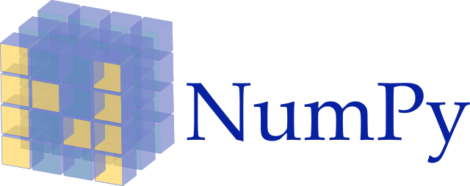


DATA PREPARATION AND CLEANING
DATA PREPARATION & CLEANING
UNIT
03
Importing pandas library
Creating pandas data frames
Analysing the No. of rows & columns
Dropping the rows with Null values and invalid entries.

Slide 9
Requirement already satisfied: numpy in c:\users\nikhi\appdata\local\programs\python\python312\lib\site-packages (2.1.1) Requirement already satisfied: pandas in c:\users\nikhi\appdata\local\programs\python\python312\lib\site-packages (2.2.2) Requirement already satisfied: matplotlib in c:\users\nikhi\appdata\local\programs\python\python312\lib\site-packages (3.9.2) Requirement already satisfied: seaborn in c:\users\nikhi\appdata\local\programs\python\python312\lib\site-packages (0.13.2) Requirement already satisfied: python-dateutil>=2.8.2 in c:\users\nikhi\appdata\roaming\python\python312\site-packages (from pandas) (2.9.0.post0)
Requirement already satisfied: pytz>=2020.1 in c:\users\nikhi\appdata\local\programs\python\python312\lib\site-packages (from pandas) (2024.1)
Requirement already satisfied: tzdata>=2022.7 in c:\users\nikhi\appdata\local\programs\python\python312\lib\site-packages (from pandas) (2024.1)
Requirement already satisfied: contourpy>=1.0.1 in c:\users\nikhi\appdata\local\programs\python\python312\lib\site-packages (from matplotlib) (1.3.0)
Requirement already satisfied: cycler>=0.10 in c:\users\nikhi\appdata\local\programs\python\python312\lib\site-packages (from matplotlib) (0.12.1)
Requirement already satisfied: fonttools>=4.22.0 in c:\users\nikhi\appdata\local\programs\python\python312\lib\site-packages (from matplotlib) (4.53.1)
Requirement already satisfied: kiwisolver>=1.3.1 in c:\users\nikhi\appdata\local\programs\python\python312\lib\site-packages (from matplotlib) (1.4.7)
Requirement already satisfied: packaging>=20.0 in c:\users\nikhi\appdata\roaming\python\python312\site-packages (from matplotlib) (24.1)
Requirement already satisfied: pillow>=8 in c:\users\nikhi\appdata\local\programs\python\python312\lib\site-packages (from matplotlib) (10.4.0)
Requirement already satisfied: pyparsing>=2.3.1 in c:\users\nikhi\appdata\local\programs\python\python312\lib\site-packages (from matplotlib) (3.1.4)
Requirement already satisfied: six>=1.5 in c:\users\nikhi\appdata\roaming\python\python312\site-packages (from python-dateutil>=2.8.2->pandas) (1.16.0)

Slide 10
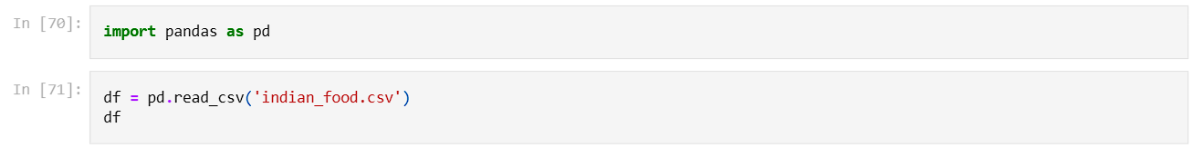
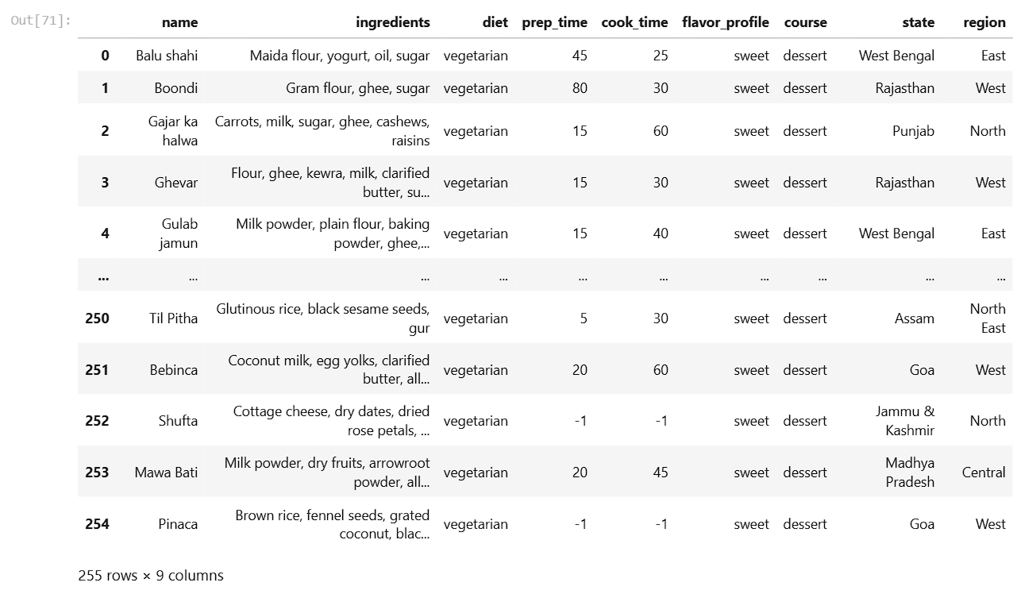

Slide 11
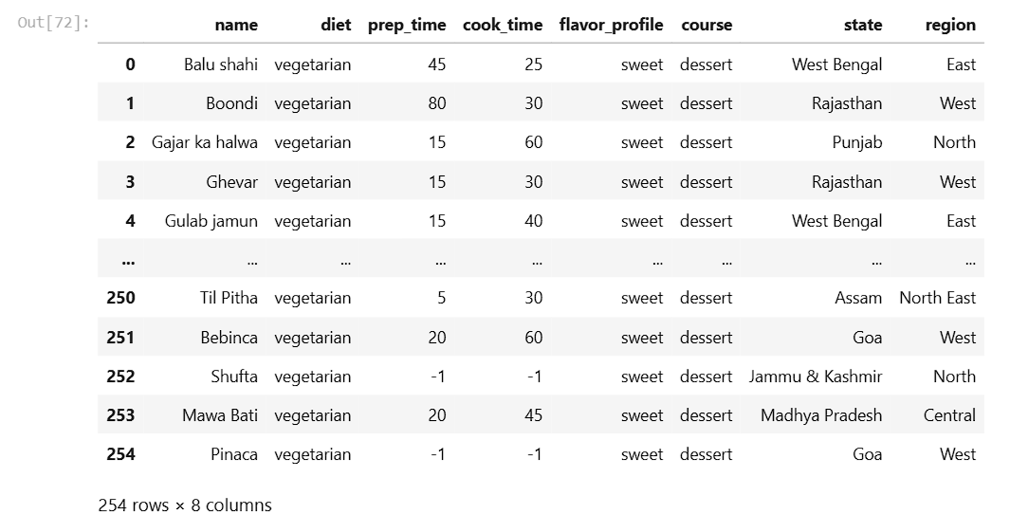

Slide 12
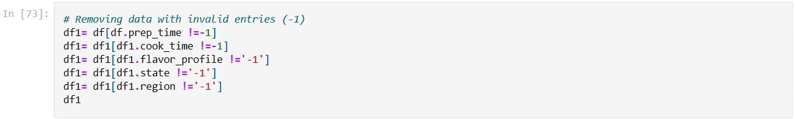
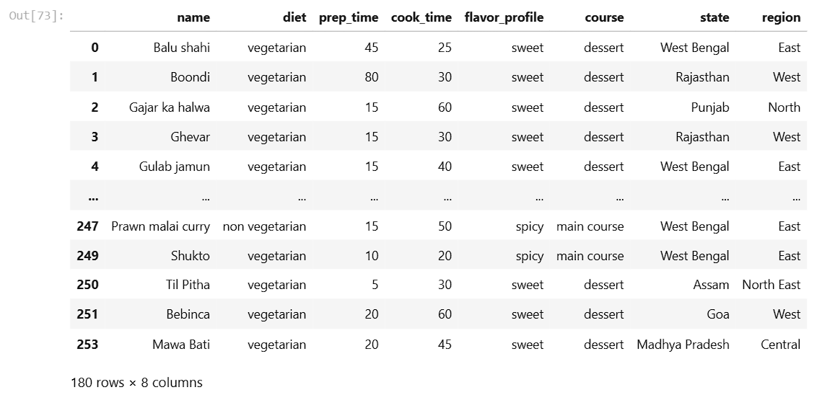

Slide 13

ANALYSIS AND VISUALIZATION
ANALYSIS AND VISUALIZATION
UNIT
04
Importing libraries for visualization i.e. matplotlib, seaborn, etc.
Exploring all Data Columns using .info() method.
Computing interesting statistics for numeric columns using .describe() method.
Exploring Dietwise i.e. Veg/non-veg No. of dishes.
Exploring Coursewise i.e. dessert, snack, main course, starter No. of dishes.
Exploring Statewise No. of dishes.
Exploring Regionwise i.e. North, South, Central, etc. No. of dishes.
Exploring Flavorwise i.e. Sweet, Sour, Spicy, etc. No. of dishes.

Slide 14
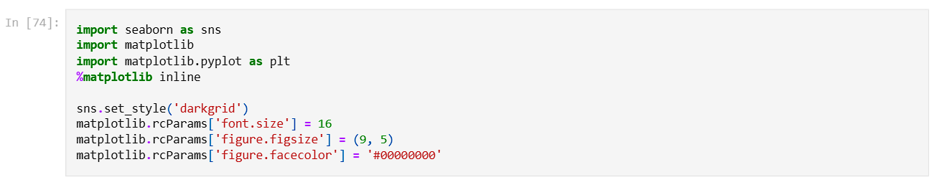
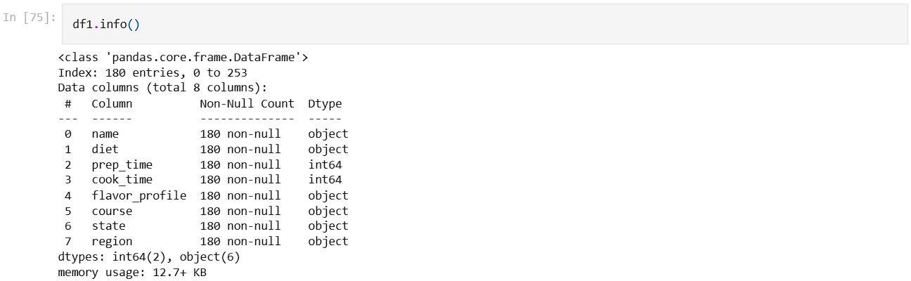

Slide 15
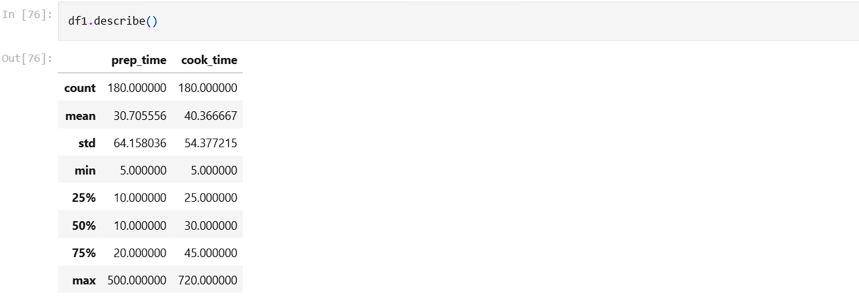
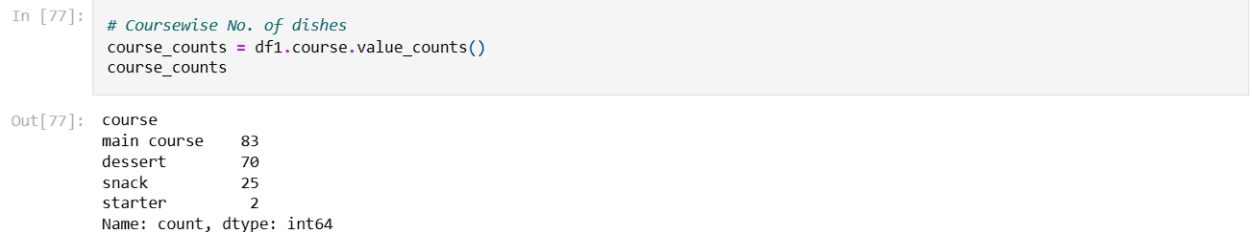

Slide 16
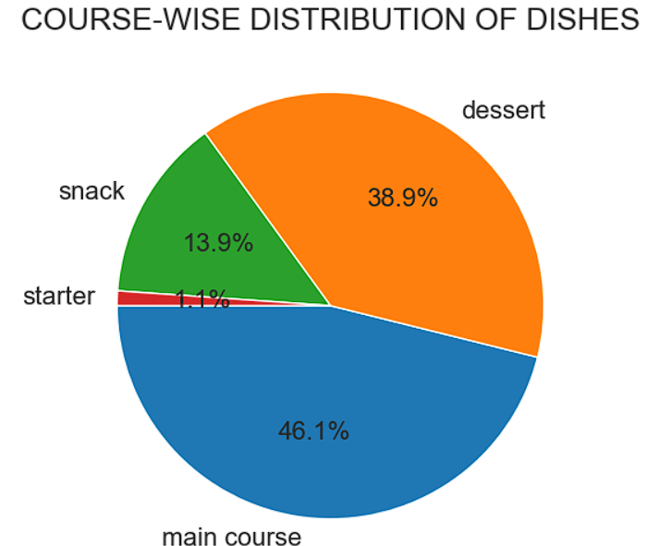
The pie chart clearly shows the coursewise distribution of Indian dishes.
About 46% of Indian dishes comes under main course which is the highest among all courses.
And only 1% of Indian dishes comes under starter which is the least among all courses.

Slide 17
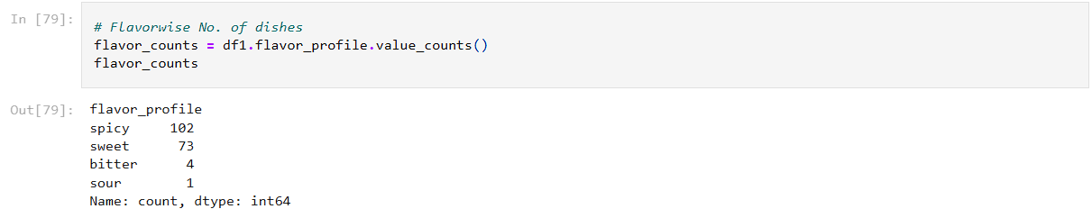
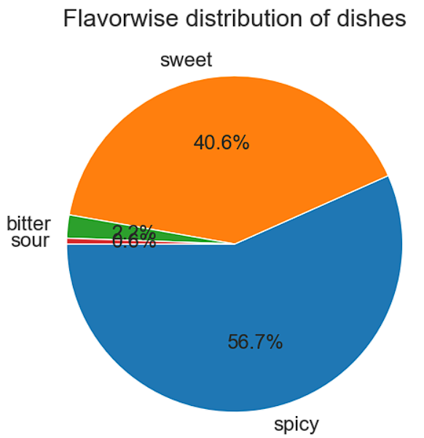
The pie chart clearly shows the flavorwise distribution of Indian dishes.
About 56.7% of Indian dishes are spicy which is the highest among all flavors.
And only 0.6% of Indian dishes are sour which is the least among all flavors.

Slide 18
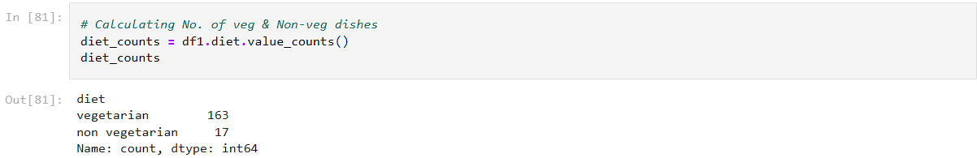
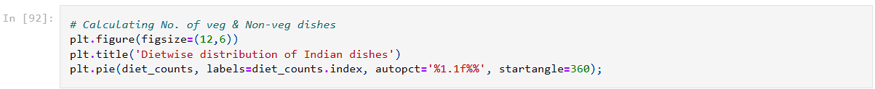
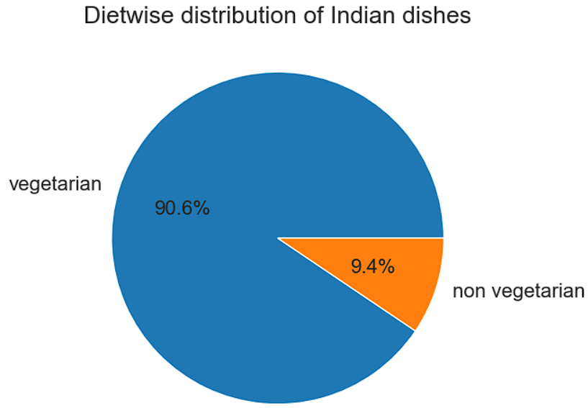
The pie chart clearly shows the dietwise distribution of Indian dishes.
About 91% of Indian dishes are veg.
And only 9% of Indian dishes are Non-veg.

Slide 19
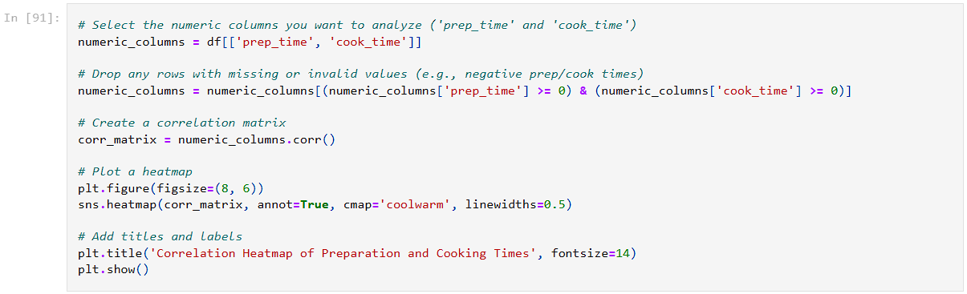
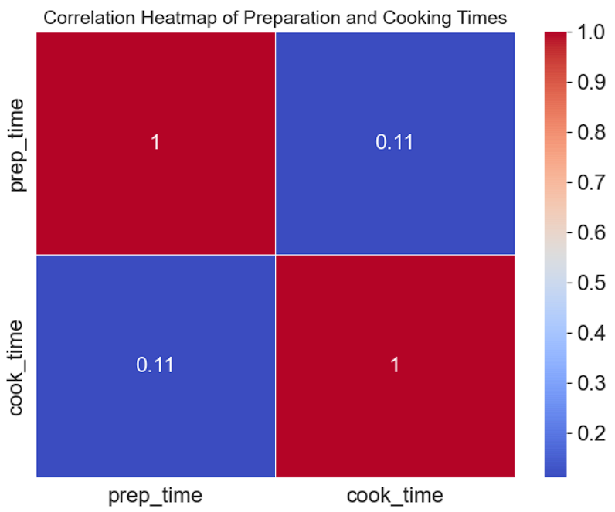

Slide 20
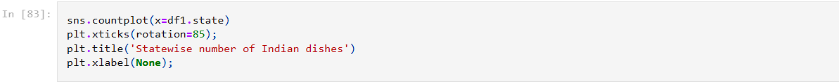
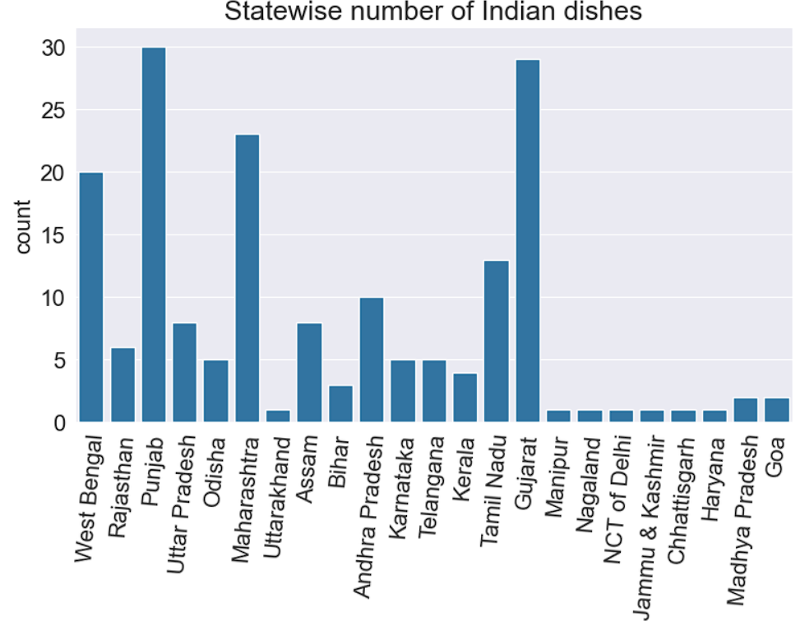
From this graph we can clearly see the which state of India has more number of dishes.
Punjab has the highest number of dishes about 30 dishes.
Closely followed by Gujarat having the second highest number of dishes about 29 dishes.
And states like Nagaland, Jammu & Kashmir, Uttarakhand, Manipur, Chhattisgarh have very few dishes.

Slide 21
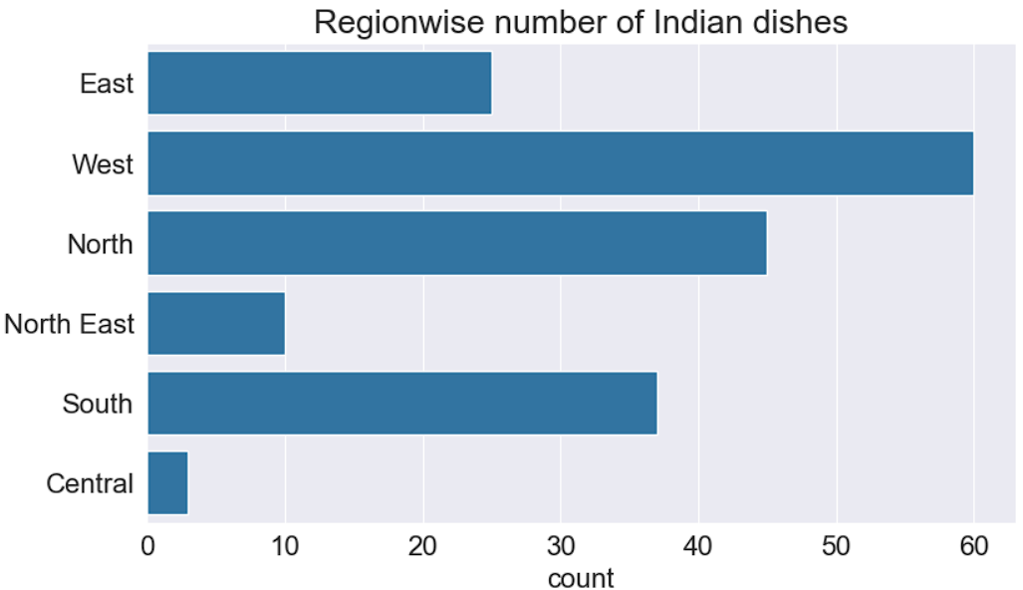
From this graph we can clearly see the which region of India has more number of dishes.
West India has the highest number of dishes about 60 dishes.
Followed by North India having the second highest number of dishes about 45 dishes.
And Central India has the least number of dishes about 3 dishes.

Slide 22

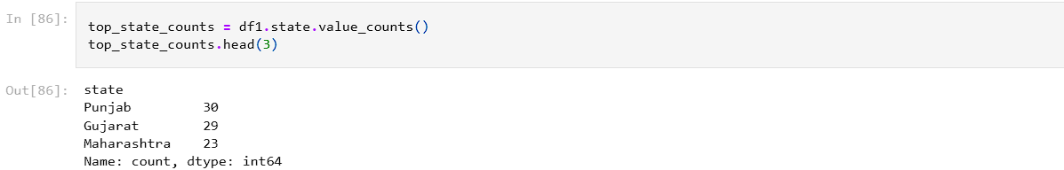
QUESTION AND ANSWERS
Question & Answers
UNIT
05
Let's answer some of the interesting questions about the dataset.
Q1: Most of the Indian dishes comes under, Which type of diet i.e. veg/non-veg?
Answer: 90.6% of Indian dishes comes under veg category.
Q2: Which are the top three states in India having highest number of dishes?
Answer: Top three Indian states having highest number of dishes are Punjab, Gujarat, and Maharashtra.

Slide 23
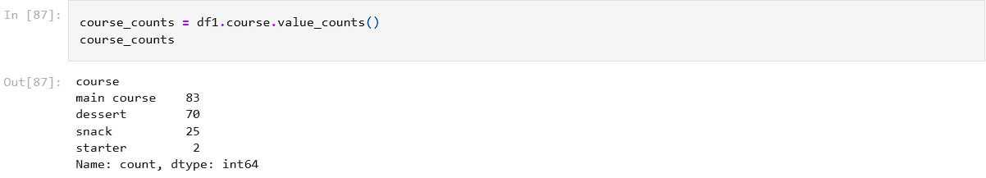
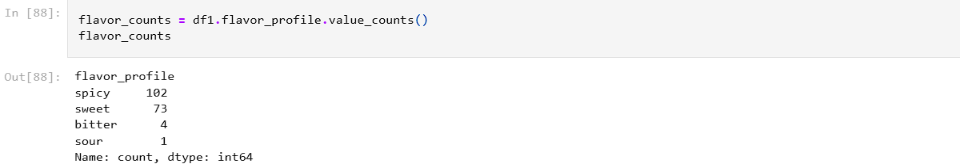
Q3: Most of the Indian dishes comes under, Which type of course?
Answer: Most of the Indian dishes comes under Main-course category.
Q4: What type of flavor Most of the Indians prefer in the various dishes?
Answer: Most of the Indian likes spicy flavor in their dishes followed by sweet flavor.

Slide 24
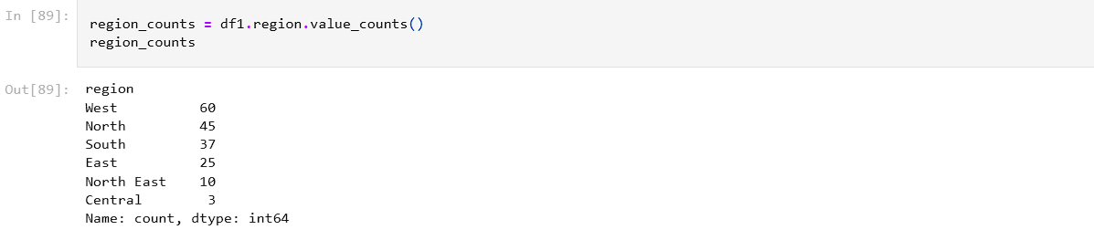
Q5: Which region of India has the highest and the least number of dishes?
Answer: West India has the highest number of dishes and Central India has the least number of dishes.

Slide 25
Inferences and Conclusion:
Inferences and Conclusion
UNIT
06
Most of the Indian dishes are Vegetarian.
Large number of Indian dishes have spicy flavor.
A large number of Indian dishes are served as main course.
Punjab has the highest number of dishes followed by Gujarat.
Here are some ideas for further exploration:
Statewise analysis for Veg/Non-veg dishes.
Ingredient wise analysis for Indian dishes.
Preparation-time analysis for Indian dishes.
Cooking-time analysis for Indian dishes.
References:
Source of dataset: https://www.kaggle.com/nehaprabhavalkar/indian-food-101
pandas library: https://pandas.pydata.org/docs/user_guide/index.html
matplotlib library: https://matplotlib.org/3.3.1/users/index.html
seaborn library: https://seaborn.pydata.org/tutorial.html
opendatasets Python library: https://github.com/JovianML/opendatasets

