Slide 1
ELECTRONIC VOTING SYSTEM OF CLASS REPRESENTATIVE
SUBMITTED BY
Ipseeka Malla(730315)
Kabita Duwal(730316)
Sandhya Basnet(730336)
Unika Shakya(730348)

Slide 2
INTRODUCTION
Computerized system,
Process in which voter can vote their desirable candidate,
Manual voting system is a tiring,
Reduces manpower,
Saves time to a very large extent.

Slide 3
OBJECTIVE
Reviewing the existing or current voting system.
To increase the speed of processing and counting votes.
Security

Slide 4
SCOPE
Consumer survey
Highly secure
Error free result

Slide 5
LITERATURE REVIEW
Caltech/MIT voting technology project,”modular voting architecture”.
Neumann ,”generic voting criteria”.
Rebecca Mercuri,” Mercury method”.

Slide 6
Algorithm
Step 1: Start
Step 2: Login into the system by entering username and password.
Step 3: If the username and password doesn’t match show error message and go to step 2.
Step 4: If the username and password is “admin” then show the admin menu to register, view, edit and delete access then go to step 8.
Step 5: If voter then show the voters menu which has candidate’s information.
Step 6: Take the choice of the voter.
Step 7: Count the vote, log out the voter and delete voter’s information.
Step 8: Stop.

Slide 7
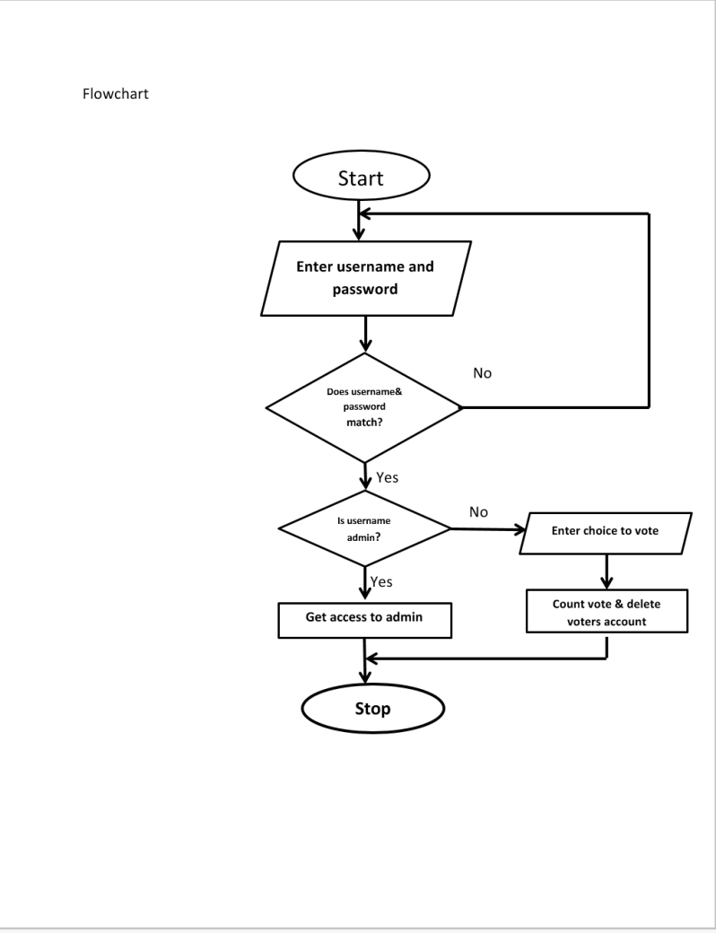

Slide 8
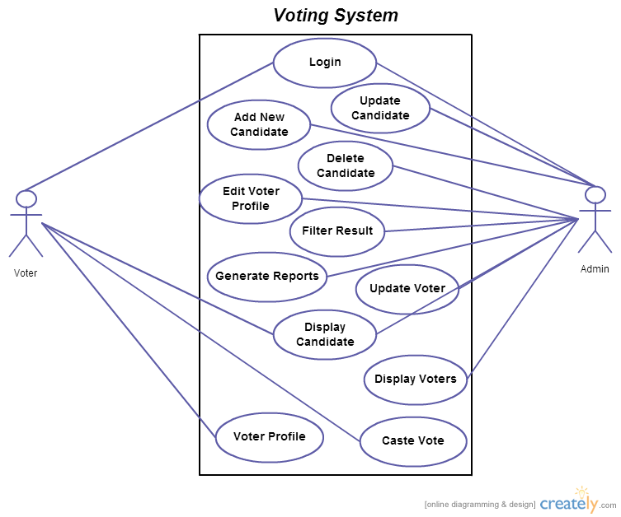

Slide 9
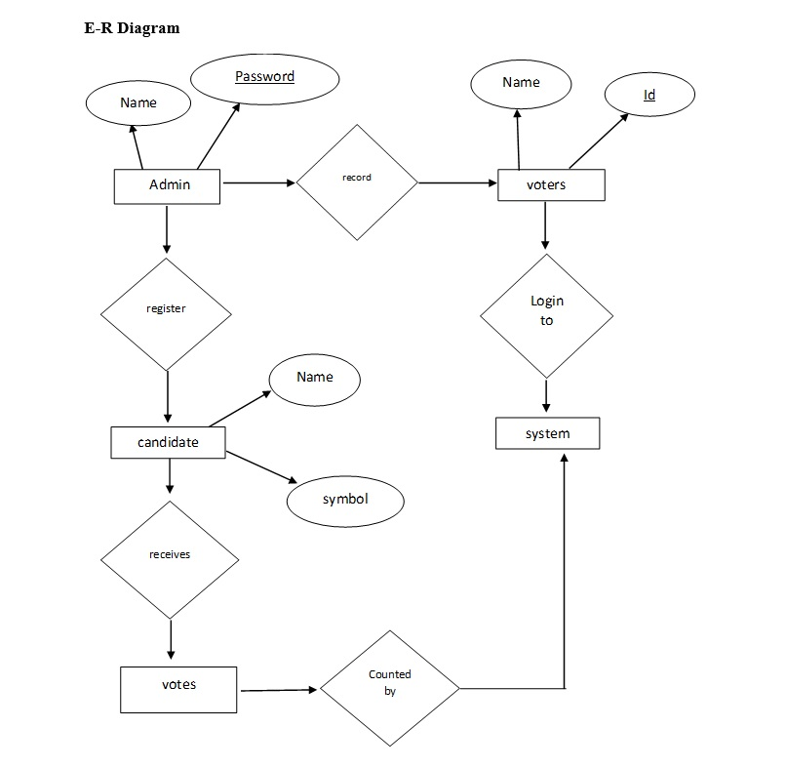

Slide 10
Conclusion
Enable the students to cast vote via computerized form.
Automatically count votes and display result.

Slide 11
Reference
https://pdfs.semanticscholar.org D.Friedman & his team “Electronic voting Literature Review” [visited on 21 December 2017]
https://academica.com M.Nagash ”Mini Project on Electronic Voting System” [visited on 18 December 2017]
https://scribd.com Michelle Ann M.L. Batausa ”Report on Electronic Voting System”[visited on 19 December 2017]
https://www.slideshare.net/folagtech/electronic-voting-system Afolabi B. OluwaGbenga “Slide on Electronic Voting System”[visited on 19 December 2017]
https://www.joblagao.com [visited on 16 December 2017]

Slide 12
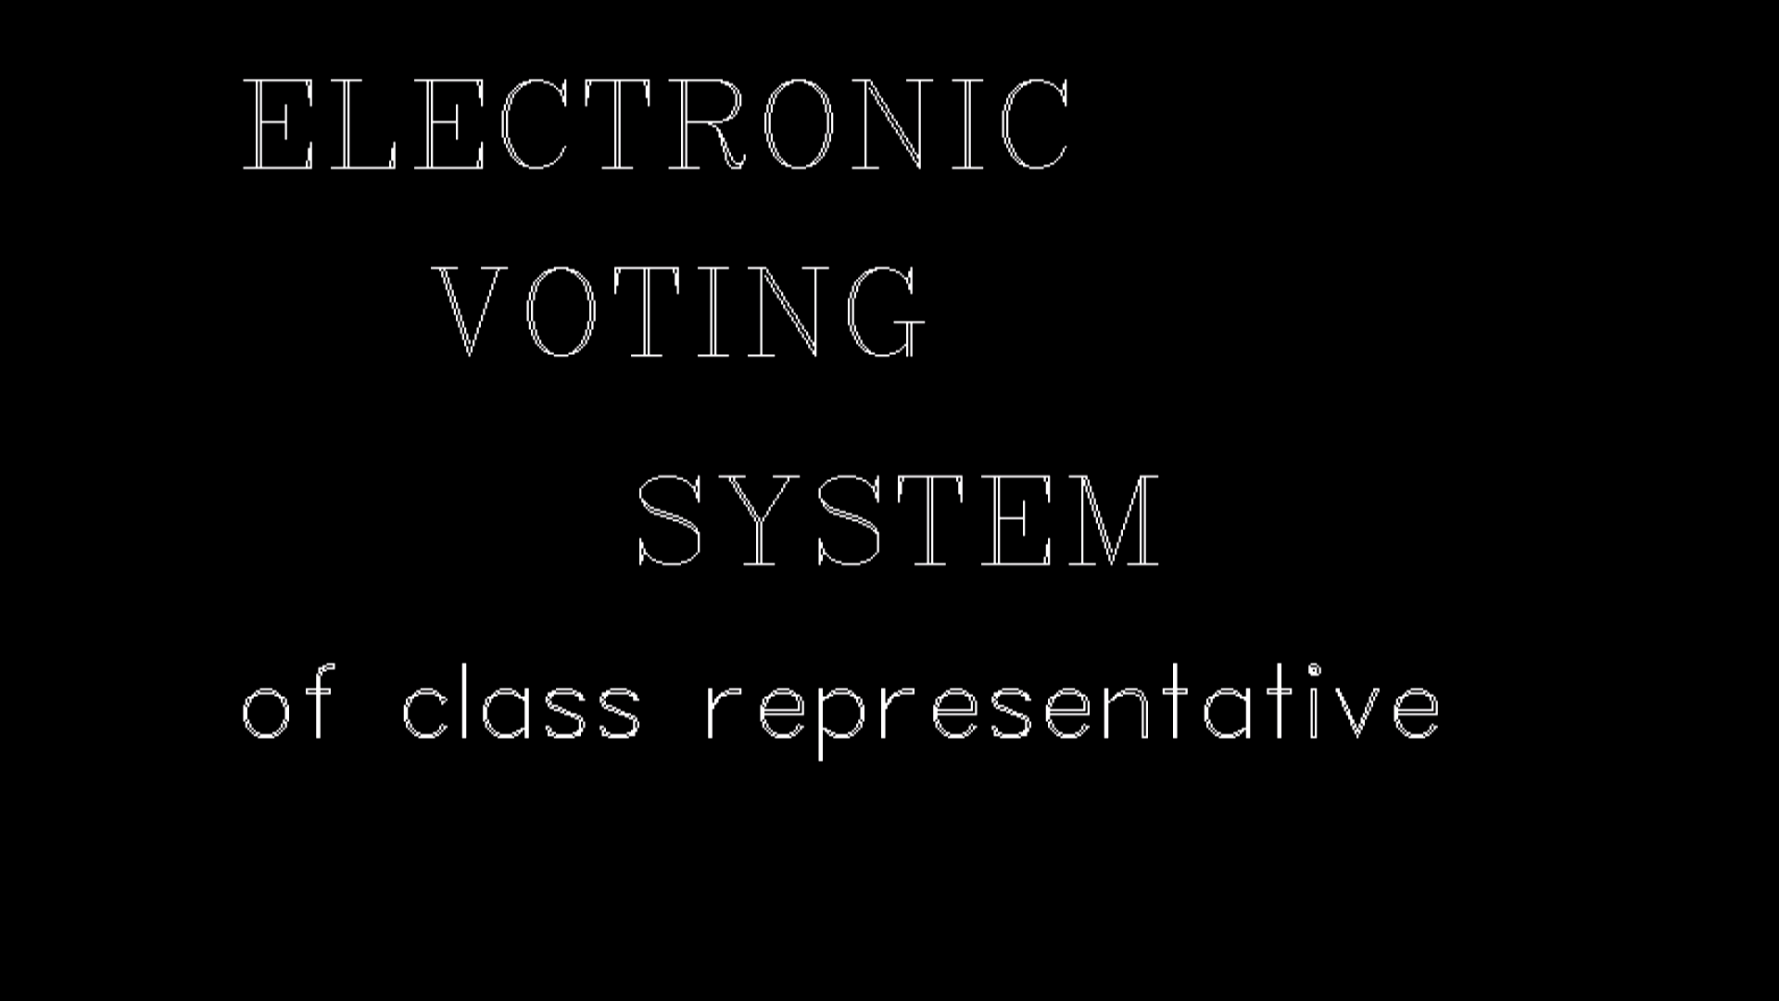

Slide 13
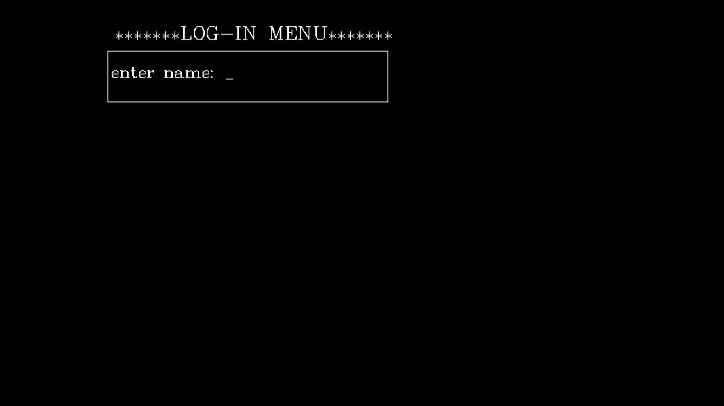

Slide 14
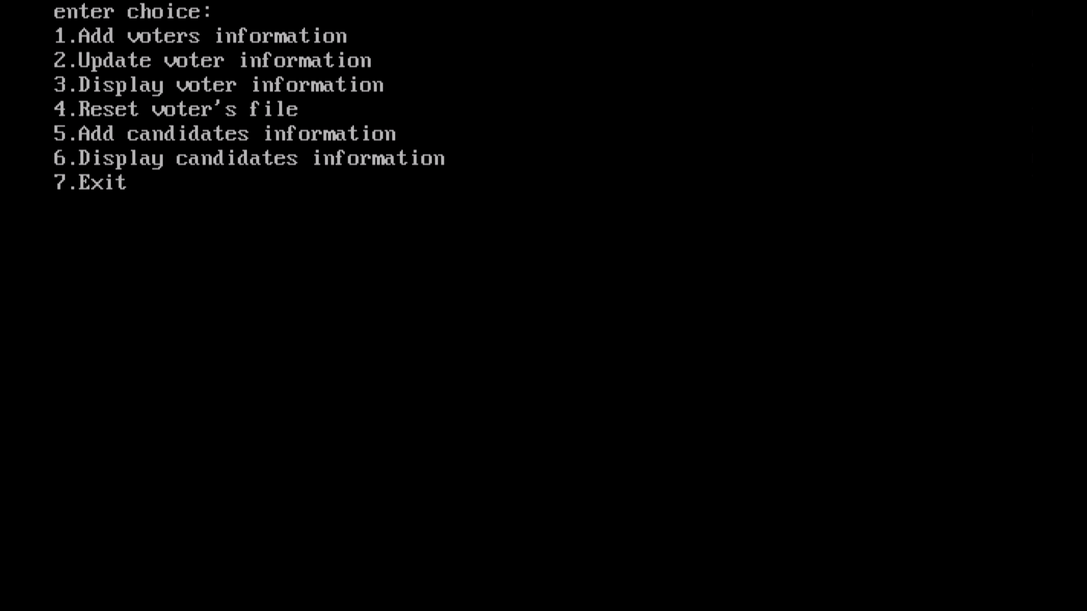

Slide 15
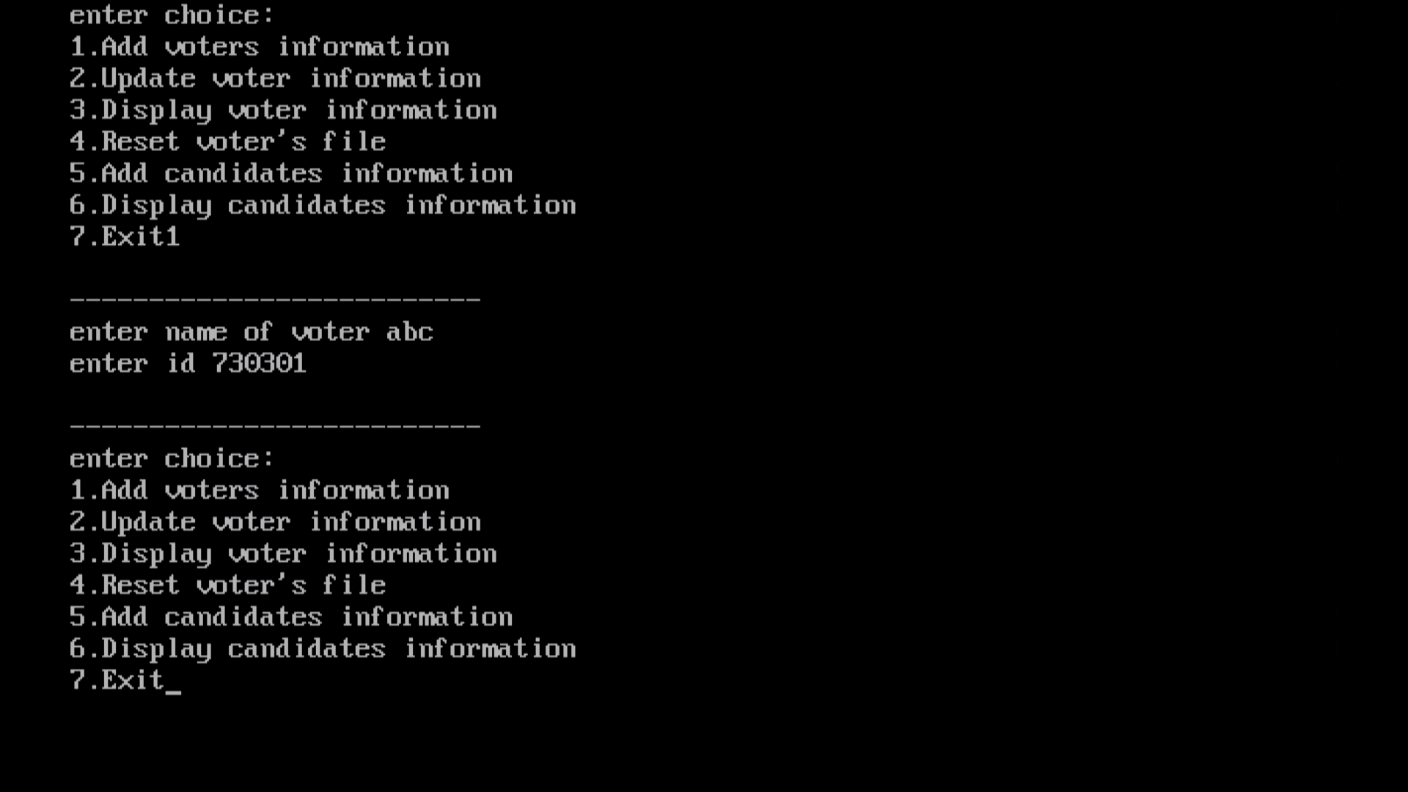

Slide 16
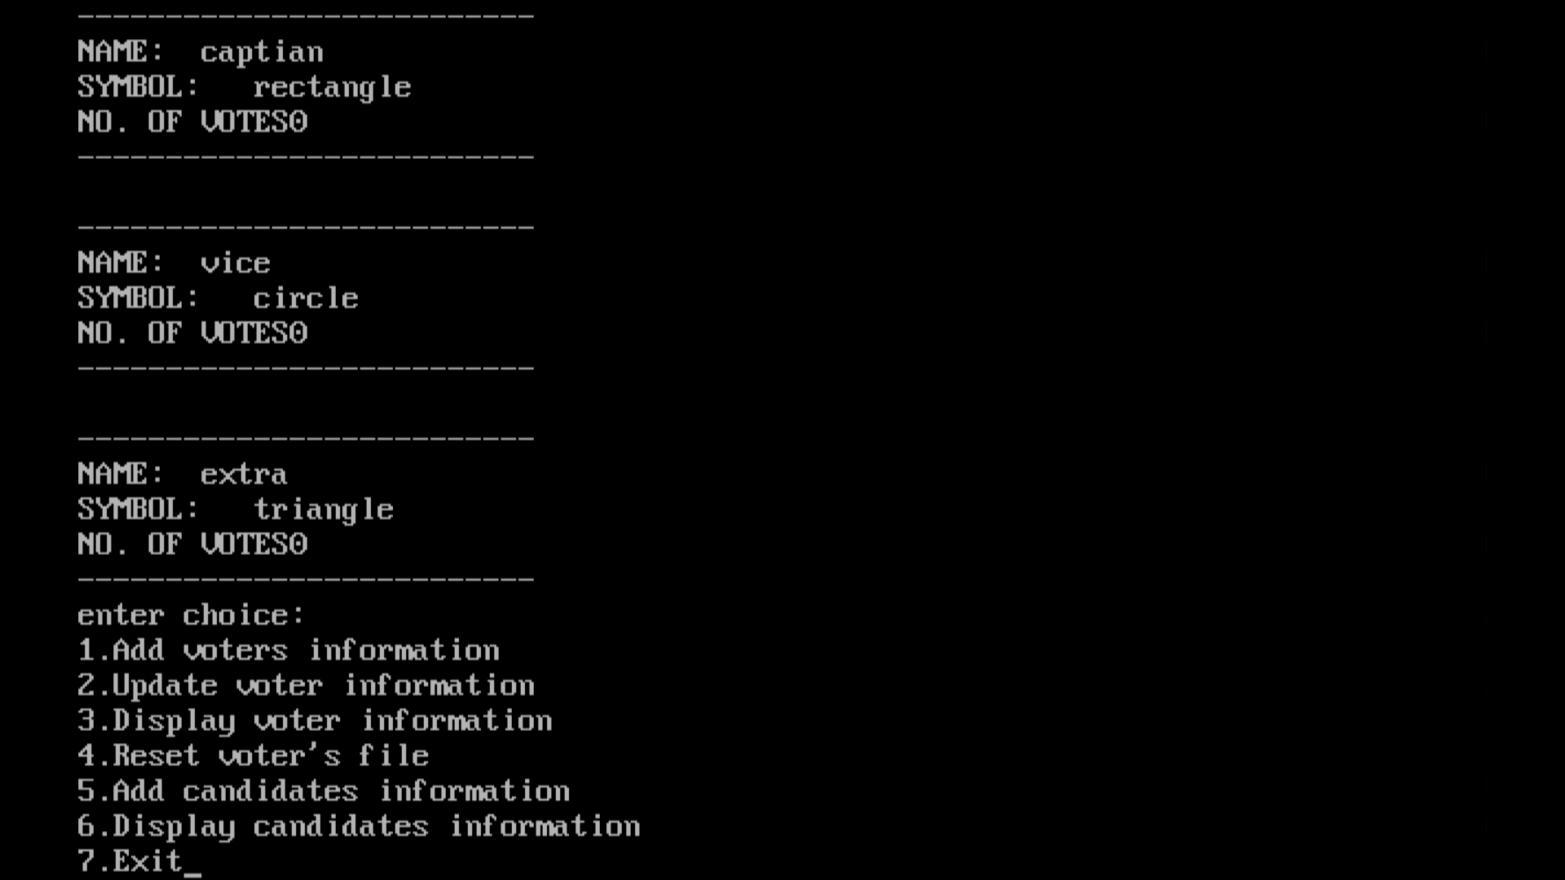

Slide 17
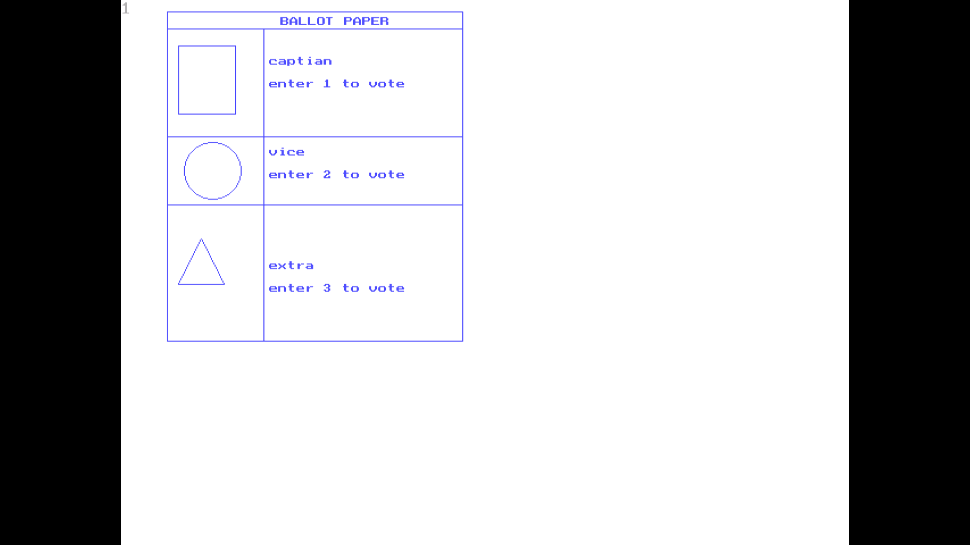

Slide 18
Thank you!!!

