Slide 1

A PRESENTATION ON PROJECT OF E-MART
PRESENTED BY:
Sandesh Lawaju(371563)
Sujan Koju(371570)
Unika Shakya(371576)

Slide 2
INTRODUCTION
In general buying and selling of products or services via internet is termed as E-commerce.
AI-driven E-commerce sites help businesses increase sales, retain customers, boost customer satisfaction and many more.
We proposed this domestic E-commerce website named “E-Mart” to meet the needs of Nepali community.
Platform for different people to create an account, advertise products, so that other users can view and buy them directly from the seller.
It implements personalization and provide comment filer.

Slide 3
MOTIVATION
Sites like Ebay, OLX has motivated us to build this website.
Desired to satisfy consumer of Nepali community.

Slide 4
STATEMENT OF PROBLEM
We normally go from shop to shop until we find the product of interest.
The problem in this method is
  Time consuming.
  Tiresome.
  Finding exact product.

Slide 5
OBJECTIVE
To build a platform where people or business organizations can buy and sell any kind of goods with each other.

Slide 6
LITERATURE REVIEW
In 1994, Pizza Hut offered online ordering of Pizza on their website.
In 1995 EBay was built as an auction site which later became one of the most popular online person-to-person trading community.
In the context of Nepal, Munchahouse.com was started in 2000.
In 2005, Hamrobazar , a free online classified portal was opened.
In 2011, Sastodeal, an e-commerce platform specializing in “deals” was launched.

Slide 7
LITERATURE REVIEW ( contd..)
At present, digital marketing or e-commerce has taken the business prospect to the next level with the help of AI technology.
eBay uses artificial intelligence in personalization, search, natural language processing and so on.
The Daraz Mobile Application implements artificial intelligence by providing three super smart options for the customers to shop online with more

Slide 8
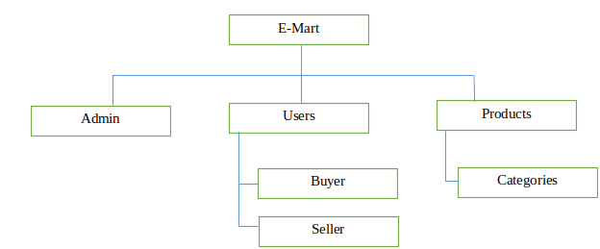
SYSTEM BLOCK DIAGRAM

Slide 9
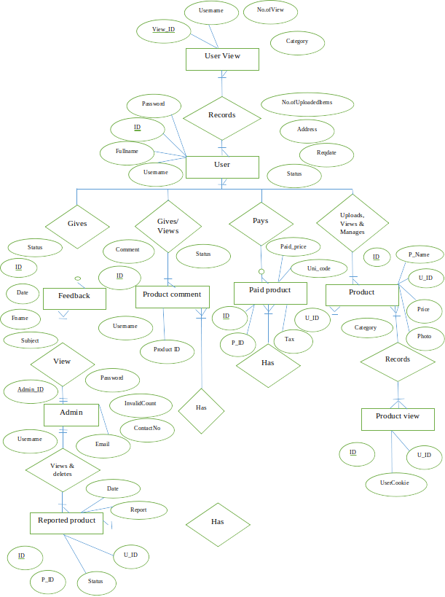
ER DIAGRAM

Slide 10
TOOLS AND PLATFORM
Front End : HTML, CSS, Javascript
Back End : Java Hibernate, Spring-MVC, Mysql
Server : Tomcat, Xampp
IDE : Eclipse

Slide 11
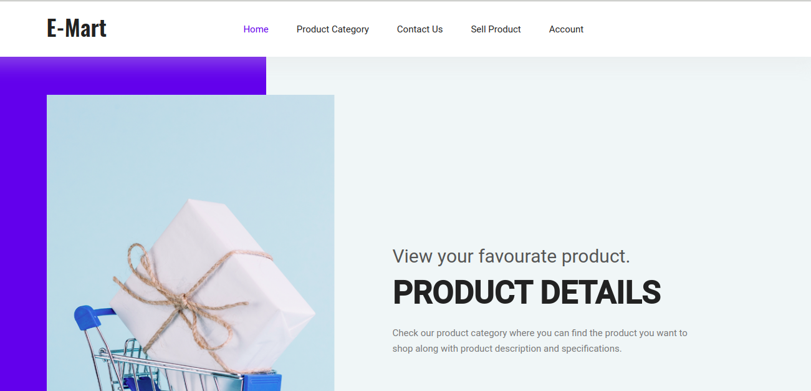
RESULTS AND DISCUSSION
Home page

Slide 12
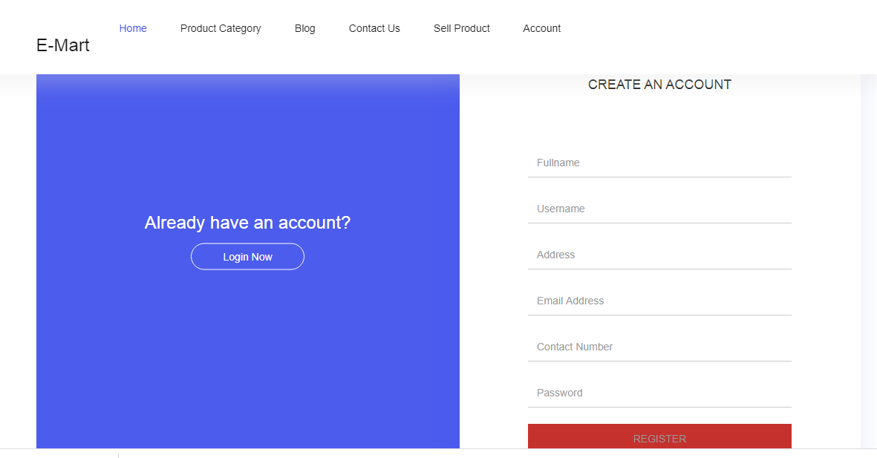
User Account Register Page

Slide 13
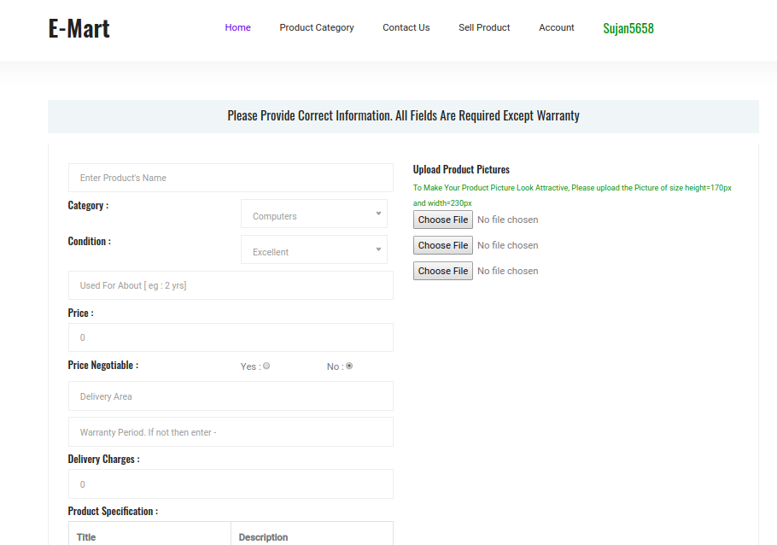
Product Upload page

Slide 14
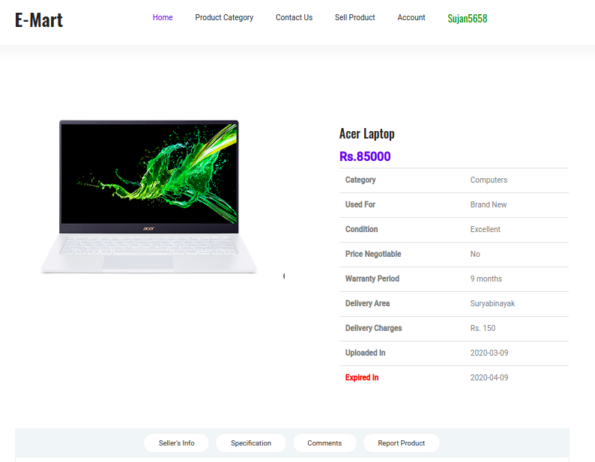
Single Product Display Page

Slide 15
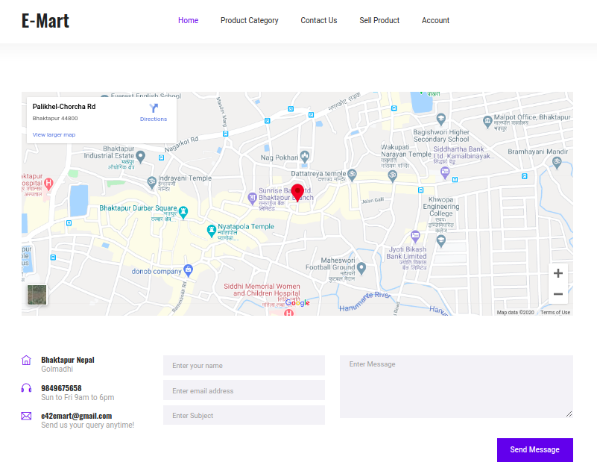
Contact us

Slide 16
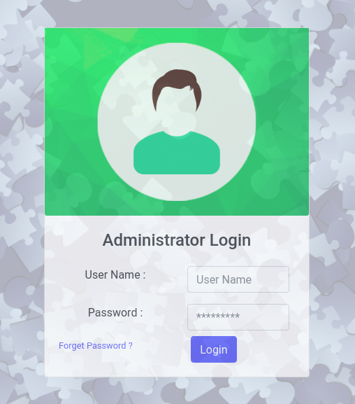
Admin Login

Slide 17
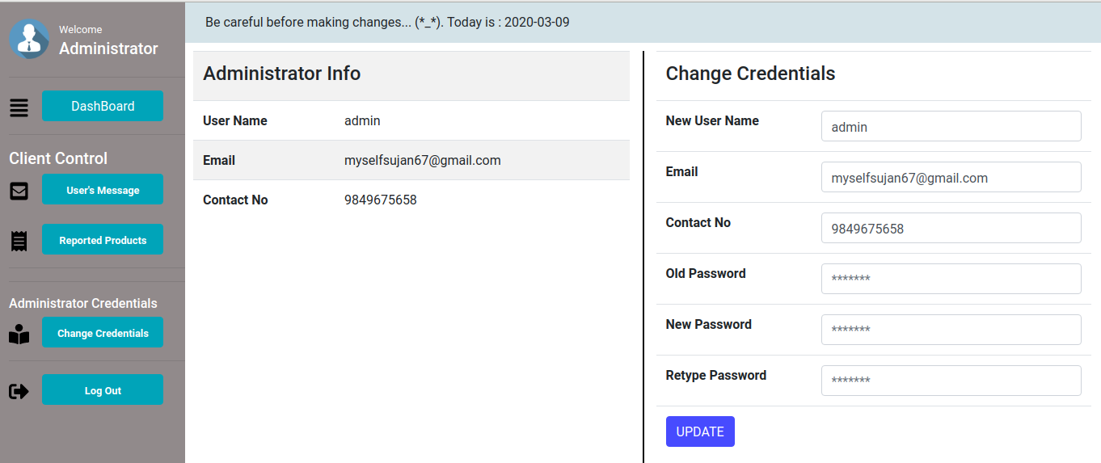
Admin Home page

Slide 18
CONCLUSIONS
This project “E-Mart” is a user-friendly e-commerce platform where the seller can advertise their products and the buyer can purchase their product of interest directly from the seller.
In this project, Model View Controller (MVC) concept is implemented using Spring Hibernate to make it more efficient and secure.

Slide 19
FUTURE RECOMMENDATIONS
This project can be further developed into an android application.
In future, we can also add search buttons and recommendations using artificial intelligence to make this project more user-friendly.

Slide 20
REFERENCES
Binshan Lin, "E-commerce in Nepal: a case study of an underdeveloped country" in International Journal of Management and Enterprise Development , January 2005 (17 November 2019)
Deepika Kathirvel,"ARTIFICIAL INTELLIGENCE OF E-COMMERCE PLATFORM" in Asian Journal of Marketing , January 2018 (20 November 2019)
J. Srinivasan and Deepika Kathirvel, "ARTIFICIAL INTELLIGENCE OF E-COMMERCE PLATFORM", January 2018 (18 November 2019)
Richard Boateng and Richard Heeks, "E-Commerce in Developing Economies: A Review of Theoretical Frameworks and Approaches", January 2008 (18 November 2019)

Slide 21
REFERENCES(contd..)
https://becominghuman.ai/how-ecommerce-companies-are-using-ai-to-drive-higher-sales-user-experience-20d9d9bbb2b0 (20 November 2019)
https://www.forbes.com/sites/bernardmarr/2019/04/26/the-amazing-ways-ebay-is-using-artificial-intelligence-to-boost-business-success/#41b4ef02c2ee (20 November 2019)
http://icetoday.net/2018/09/the-new-daraz-app-comes-with-artificial-intelligence/(20 November 2019)
http://leafcloud.blogspot.com/2016/09/an-article-on-e-commerce-in-nepal.html (17 November 2019)
https://neoteric.eu/blog/6-ways-to-use-artificial-intelligence-in-e-commerce/ (20 November 2019)

Slide 22
Thank you!!

