Slide 1

Presentation on
“Yatra Tours and Travel(Kathmandu Valley)”
Ipseeka Malla(730315)
Manisha Kasalawat(730321)
Sandhya Basnet(730336)
Unika Shakya(730348)

Slide 2
Introduction
A travel agency is a private retailer or public service that provides travel and tourism related services .
A customer’s first experience with the business is a visit to the website.
This project help customer to view the packages and itinerary of various tourism sites home through internet connection on mobile or other electronic devices.
The customer can view the picture of their desire destination.
In this website ,they can also preview the reviews and able to provide feedback.
Admin is solely responsible to control all the activities of the websites.

Slide 3
Statement of problems
itinerary issues
feedback failures
additional charges
extra packages needed

Slide 4
Objectives
To build a travel agency website for brief summary of the area, with highlights of important places, the schedule and its price.

Slide 5
System block diagram
5

Slide 6
Algorithm
1. Start
2. If admin login then
View message details, update information and keep record of tickets.
Go to step 5.
3. If want to give feedback then
Enter your email address and feedback message
Click on submit button
4. If want to order ticket then
Enter your name, contact number, email address and other details
Click on submit button.
5. Stop

Slide 7
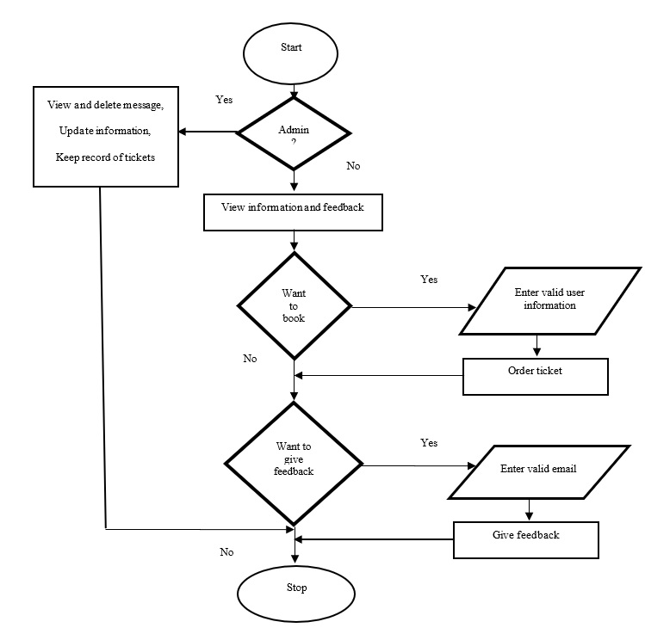
Flowchart
7

Slide 8
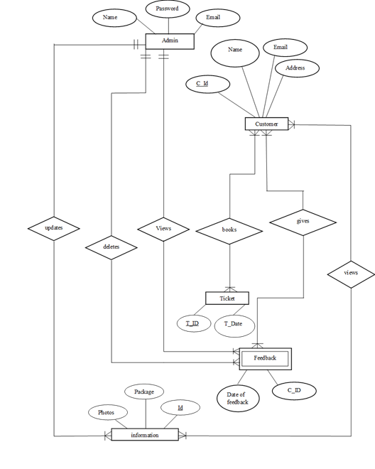
Er Diagram
8

Slide 9
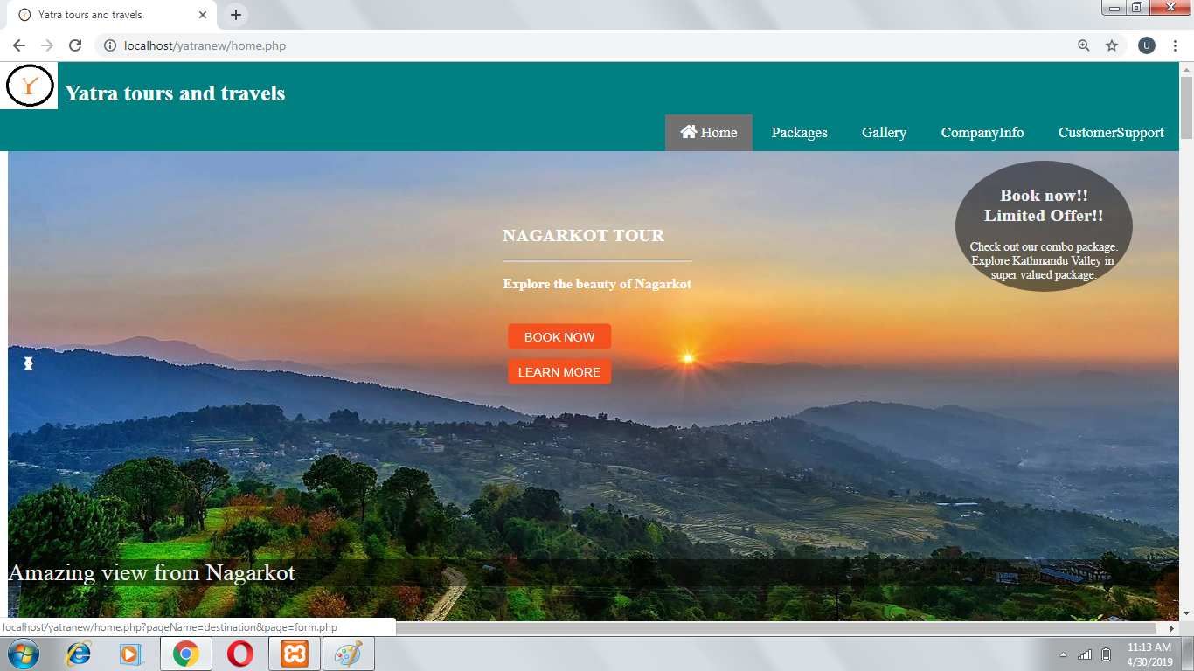
Screenshots

Slide 10
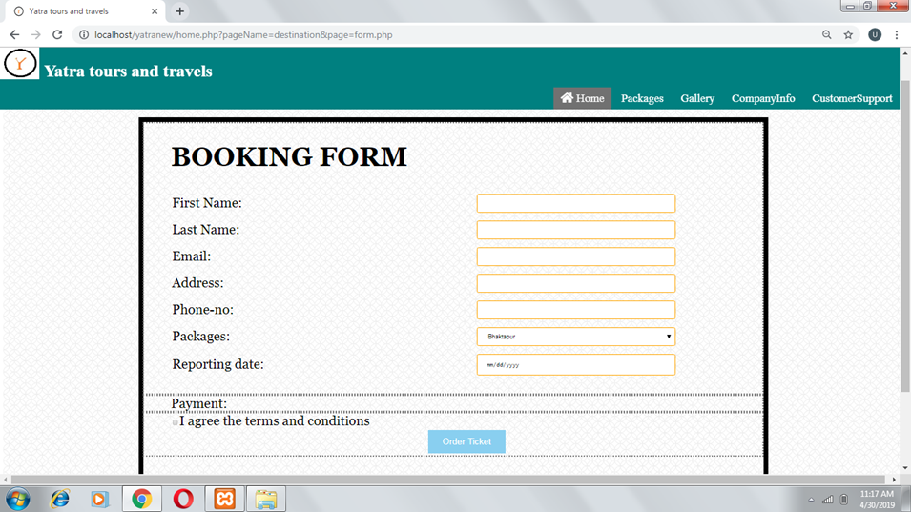

Slide 11
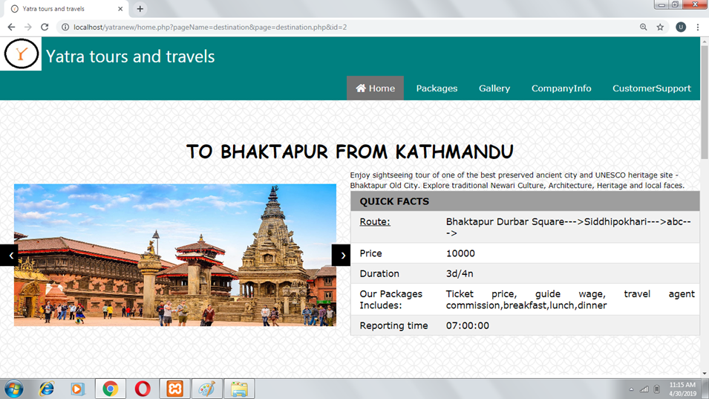

Slide 12
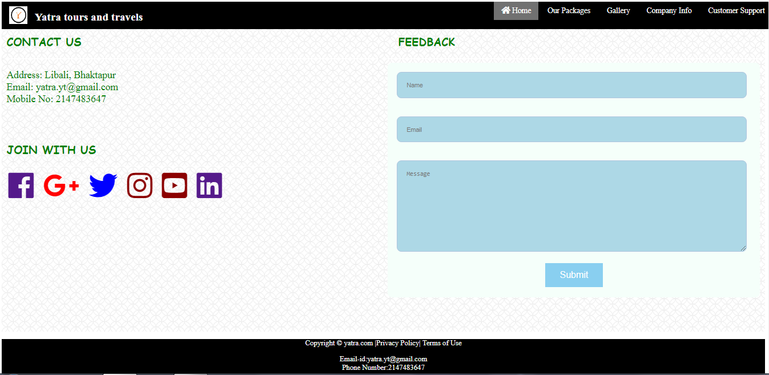

Slide 13
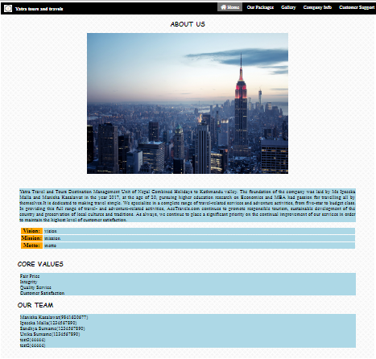

Slide 14
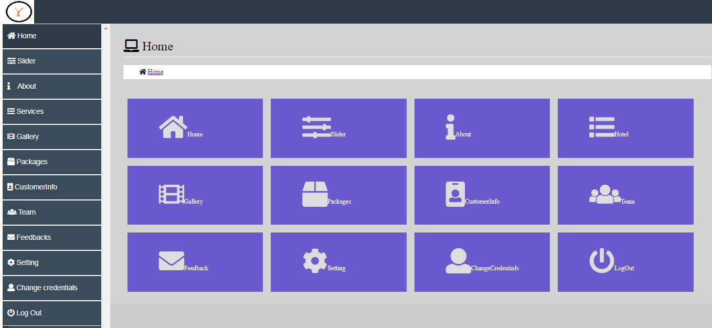

Slide 15
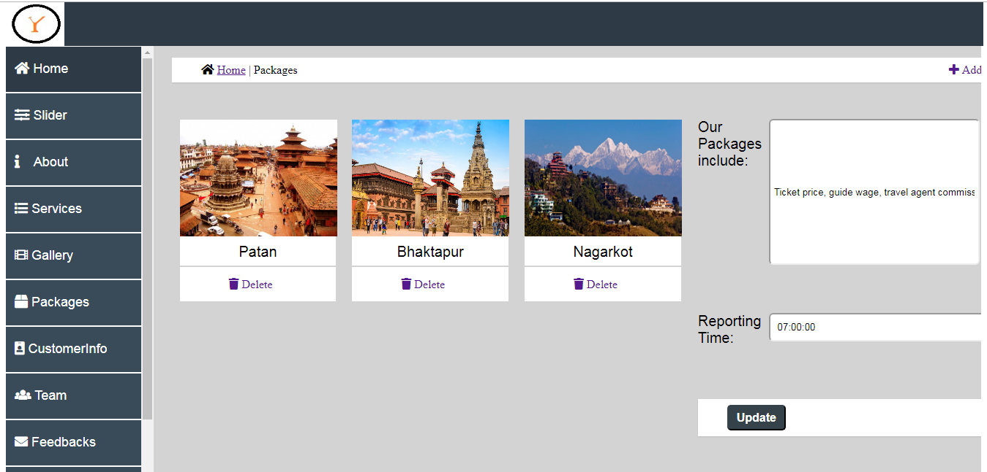

Slide 16
Conclusion
Enables the customers to order packages by form,
Customers will be able pay through their credit card or debit card,
Allows customer to give any feedback needed for further improvement,
Admin controls addition of packages, update of existing information and view the records of customers,
Furthermore, this webpage make easy for the user to view and order the packages online from anywhere in the world.

Slide 17
Reference
http://www.jdpower.com/business/press-releases/2014-online-travel-agency-satisfaction-report (7 January 2019)
https://www.scribd.com/doc/21634275/Project-Report-on-Travel-and-Tourism-in-Travel-Agency(13 January 2019)
https://www.ibisworld.com/industry-trends/market-research-reports/administration-business-support-waste-management-services/administrative/travel-agencies.html(6 28 January 2019)
https://www.acetravels.com (3 February 2019)
https://www.theguardian.com/travel/2014/mar/12/how-25-years-of-the-web-inspired-travel-revolution(15 February 2019)
http://www.dcsplus.net/blog/three-types-of-reports-every-travel-company-needs(22
February 2019)
https://www.slideshare.net/AmitPatil81/online-tours-and-travel(25 February 2019)

Slide 18
THANK YOU!!!!

