Slide 1


Slide 2
Understanding Journals

Slide 3

DEFINITION OF AN ACADEMIC JOURNAL
Definition
To inform, report and make available original research and new findings
Often devoted to a single discipline or subdiscipline where articles are peer reviewed

Slide 4

TYPES OF JOURNALS
Traditional subscription based
Customers need to pay to access content (subscription especially for print)
Authors not charged for publishing
Owned by a Society/Institution or a Publisher
Professional Society
Case Study Journals

Slide 5

TYPES OF JOURNALS
Open Access (Definition)
Customers get free access to content
Authors pay to publish
Types
Green: published like a traditional journal for a fixed period (between 6-24 months) before it is made free to access
Gold: author pays to publish, and article is free to access as soon as it is published
Diamond/Platinum: author doesn’t pay to publish, institution or society pays publisher

Slide 6
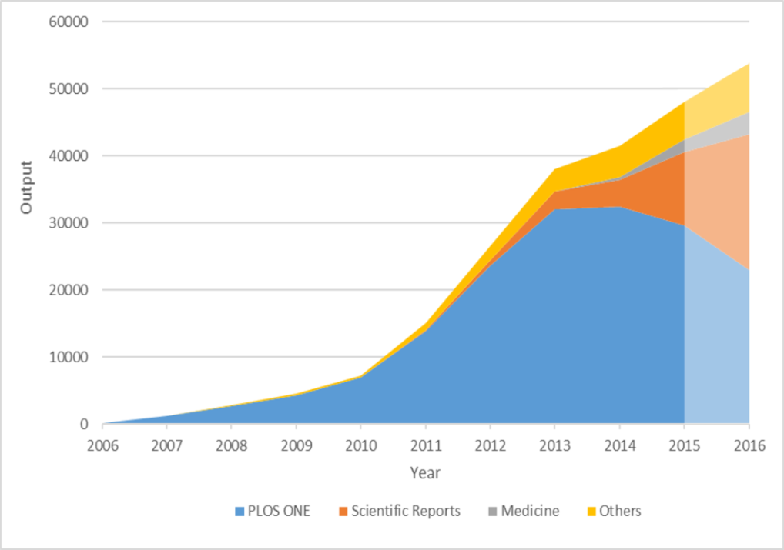
TYPES OF JOURNALS
MEGA JOURNALS
A mega journal (also mega-journal and megajournal) is a peer reviewed academic Open Access journal designed to be much larger than a traditional journal by exercising low selectivity among accepted articles.
Must read: https://en.wikipedia.org/wiki/Mega_journal#Definition

Slide 7
Haven’t Registered Yet?

Slide 8




THANK YOU
www.vikramshilaedu.in
Have Questions?

