Slide 1


Slide 2
Research & Publishing Ethics

Slide 3
Some definitions
What is the meaning of Philosophy in the degree of PhD?
Philosophy here comes from a Latin word and denotes “Love Of Wisdom”
Why is the term PhD used generically across disciplines?
The “Love of Wisdom” refers to original research done by the scholar that is presented to a review board and successfully defended before them.
What is ethics in publishing?
Refers collectively to the correct practices to follow when writing and seeking publishing of any sort of intellectual property

Slide 4
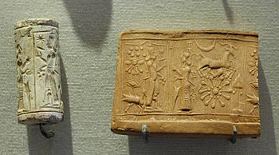
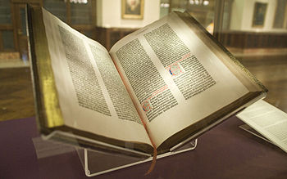
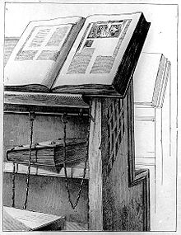
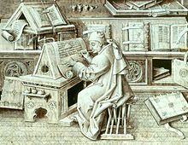
Understanding Publishing
The first “publisher” the creator of seals: Mesopotamia 4500 years old
The Guttenberg Bible: Acknowledged as the first book published with movable type.
Year of publication 1426
Images courtesy: Wikipedia

Slide 5
Why Publish?
What is the meaning of ‘To Publish’?
To make public the idea, thought, or concept that so far resides in a human brain.
What is the need to publish?
To establish copyright
What happens when you publish?
The idea, thought or concept is made known to the public
Copyright is established
Other collateral intellectual property rights are established
Right to translate
Right to assign copyright
Right to transform from one form of intellectual property to another

Slide 6
Understanding Plagiarism
What is the definition of plagiarism?
The passing-off of someone else’s intellectual property right as your own
What is the legal side of plagiarism?
There is no legal consequence of plagiarizing anyone’s work.
Why then is plagiarism so important?
Academic credibility is reduced and the threat of falsified research looms over the entire research project

Slide 7
Understanding Copyright
What is Copyright?
The right to copy any intellectual property AND to profit from such copying
The law is man-made and doesn’t exist in nature
There is no copyright in any art created by anyone except humans
When is Copyright created?
When a creation of the mind is recorded on any media in the living world
What is the legal implication of Copyright violation?
Financial damages, imprisonment where financial damages can’t be paid
What are the losses due to Copyright violation?
Damage of reputation
Revocation of awards and degrees

Slide 8
Understanding Copyright
What is a Copyright infringement?
The use of another’s intellectual property WITHOUT consent, for financial or prestige gain
How does one avoid a Copyright infringement?
By demonstrating that permission from the original copyright owner has been obtained. It has to be in writing.
Where permission isn’t obtainable (e.g. where a publishing house is no longer in existence) then demonstrate that reasonable efforts have been taken to obtain permission

Slide 9
Haven’t Registered Yet?

Slide 10
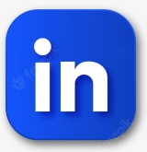



THANK YOU
www.vikramshilaedu.in
Have Questions?

