Slide 1


Slide 2
Structure of an Academic Book

Slide 3

TYPES of academic BOOKS
CONVENTIONAL FORMS
Monographs
Edited Collections
Critical editions
Exhibition or museum /gallery catalogues
DIGITAL FORMS
Ebooks
Digital critical editions and archives
New forms of publication

Slide 4
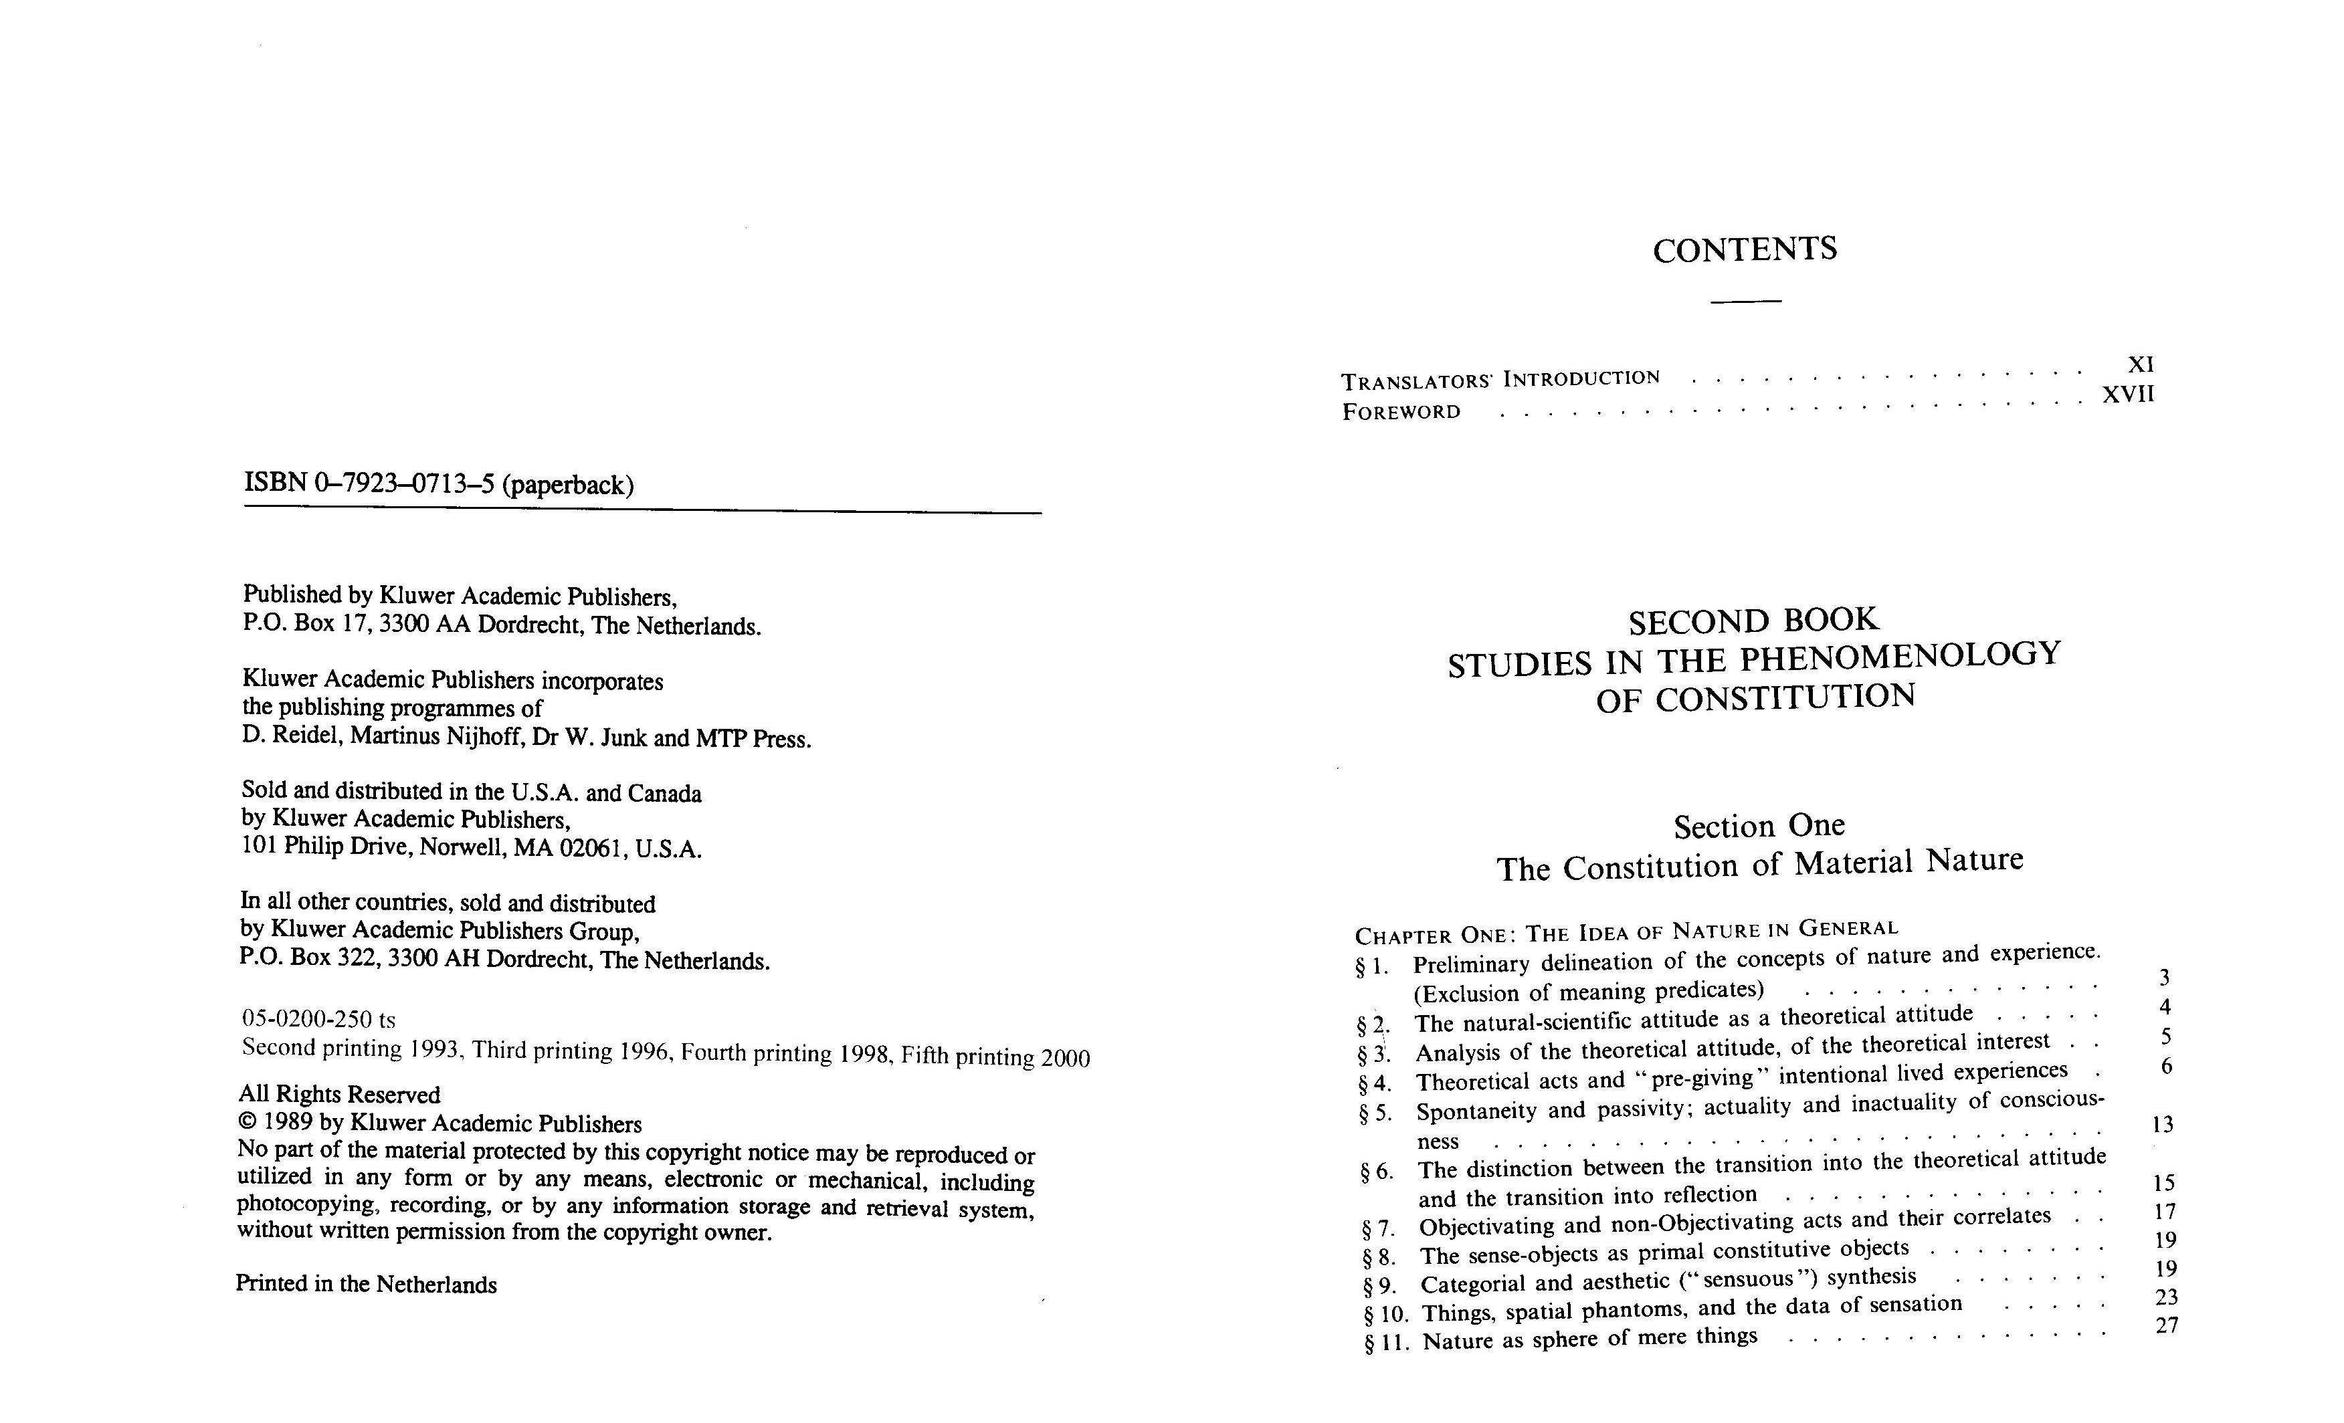
The Basics
Front Cover
Preliminary pages
Title
Copyright
Introduction etc.
Table of Contents
Chapters
Index
Bibliography
Back Cover

Slide 5

Specific to Academic Books
Author credentials
Strong introduction – answer the question ‘Why write this book?’
Scope of the work
Methodology
Each chapter contains ONE CENTRAL THEME with sufficient academic evidence

Slide 6
Specific to Academic Books
Tables numbered in the format XX.YY
(where XX = Chapter number and YY = Table number)
Graphics numbered in the format AA.BB
(where AA = Chapter number and BB = Table number)
Referencing
Citations to be properly referenced
Every table and graphic if sourced from a third party, then source to be provided
Bibliography – every entry must be sufficiently detailed

Slide 7
Haven’t Registered Yet?

Slide 8




THANK YOU
www.vikramshilaedu.in
Have Questions?

