Slide 1
Recitation 10
Final Exam 2015,2016,2017
Linan Huang

Slide 2
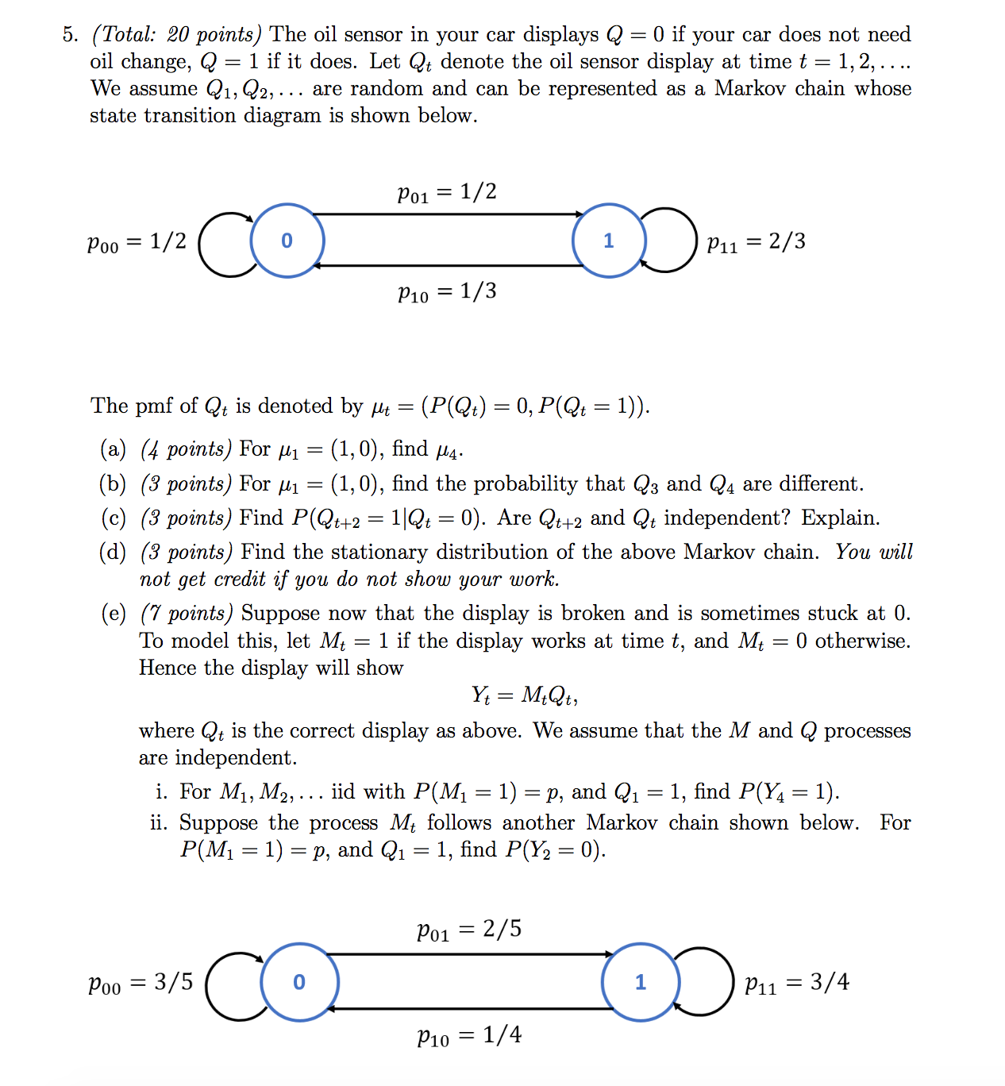
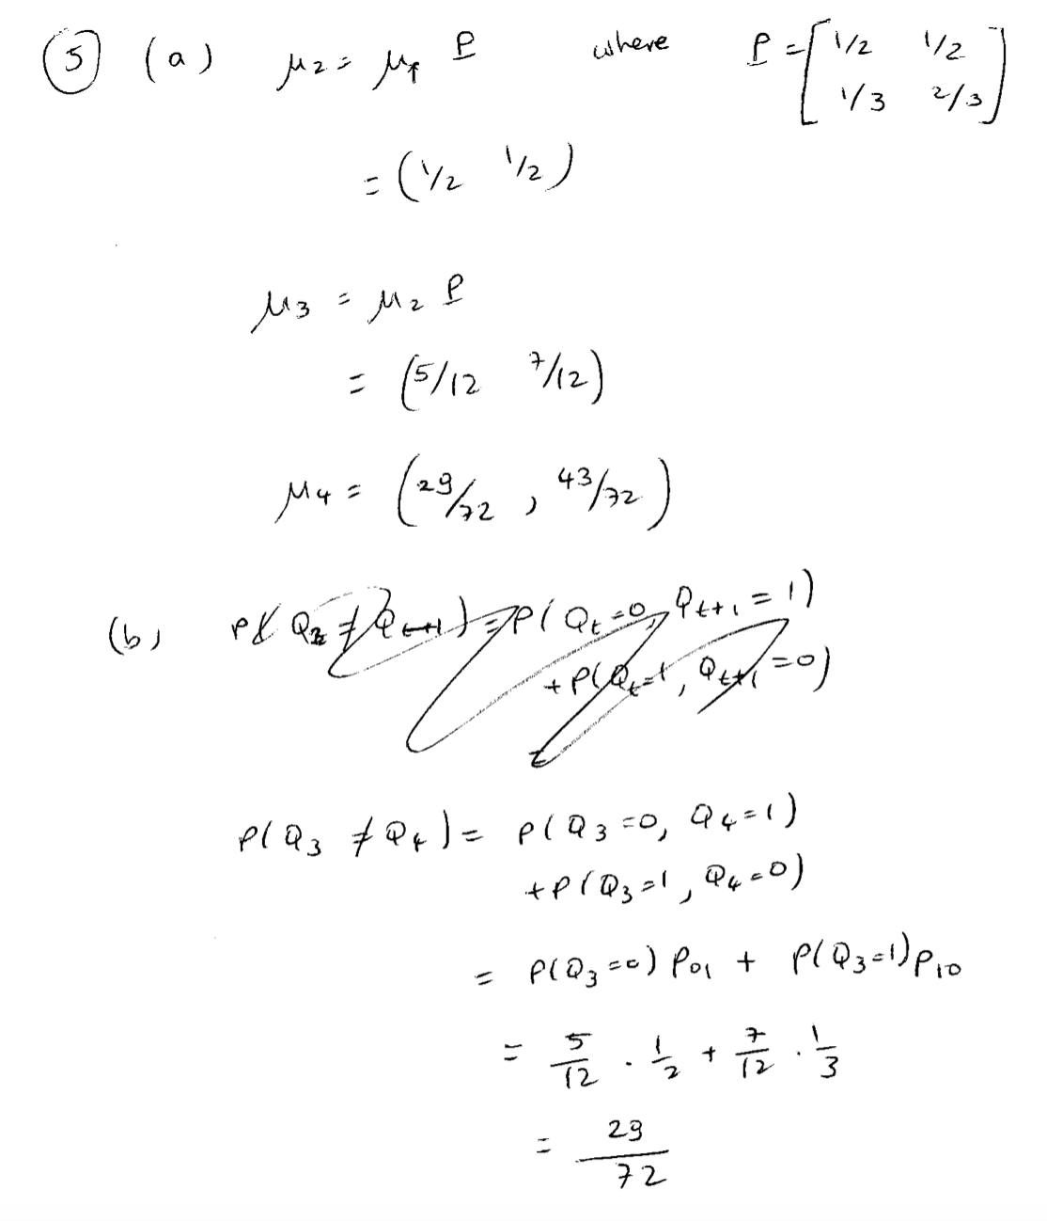
Q1

Slide 3
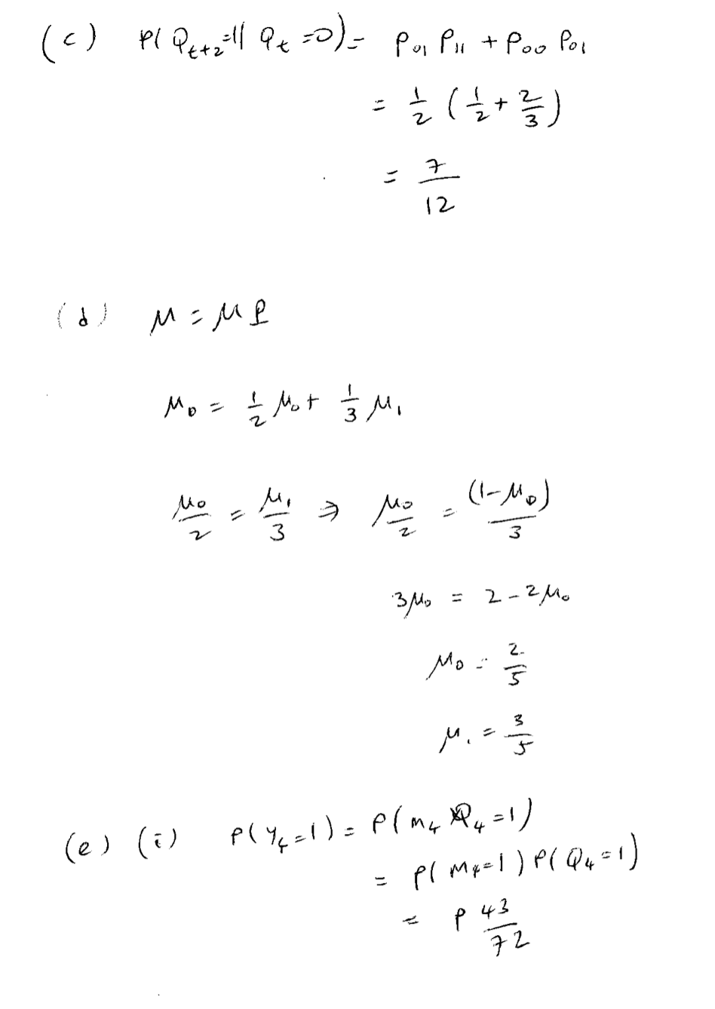
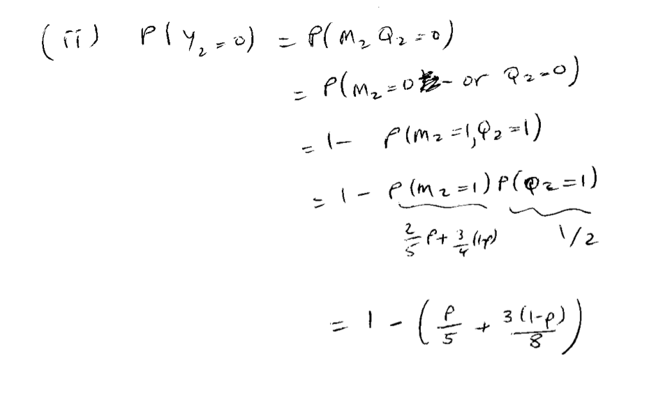

Slide 4
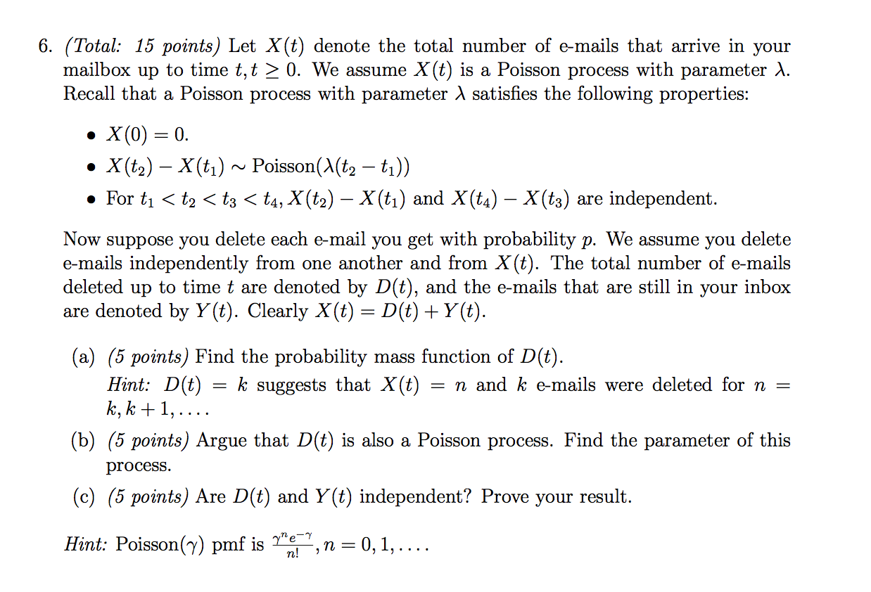
Q2

Slide 5
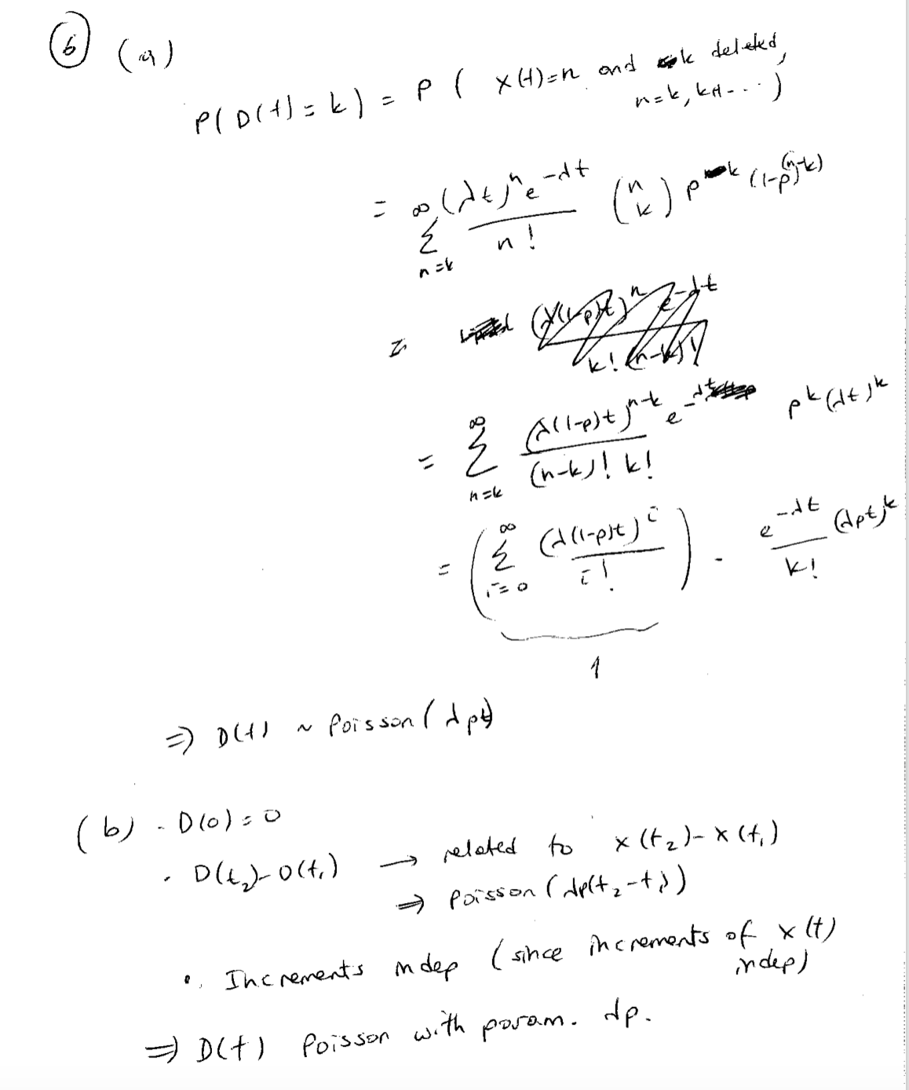
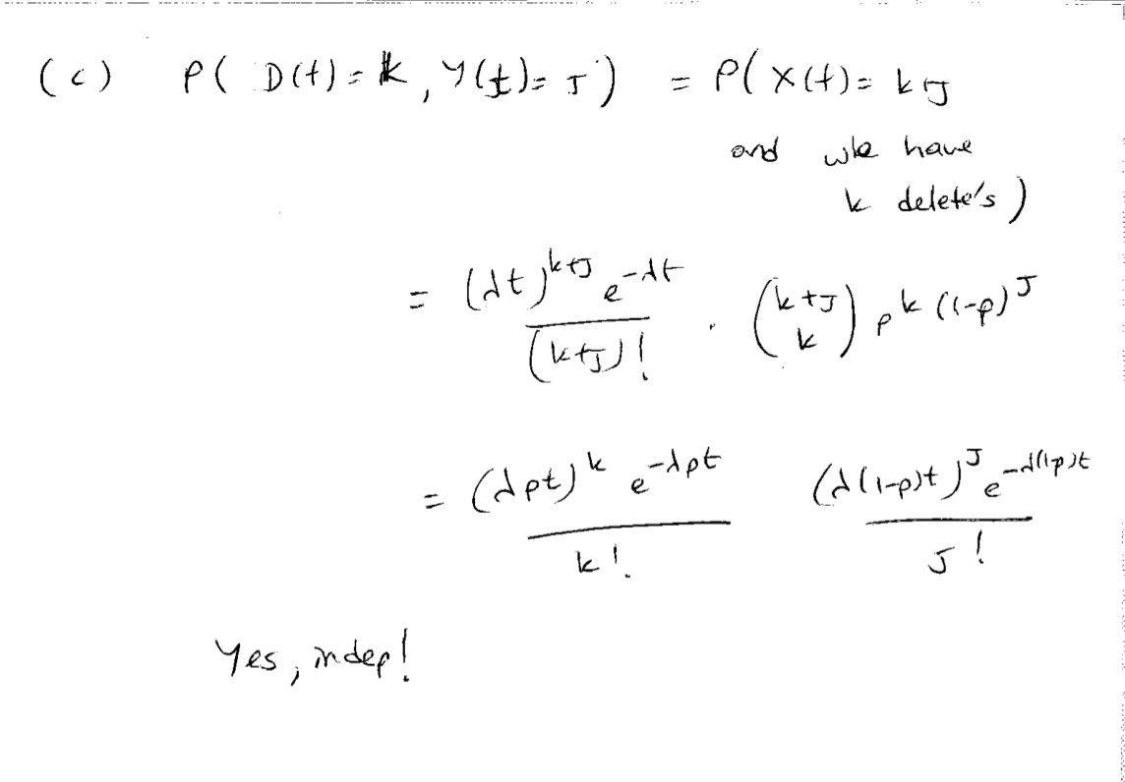

Slide 6
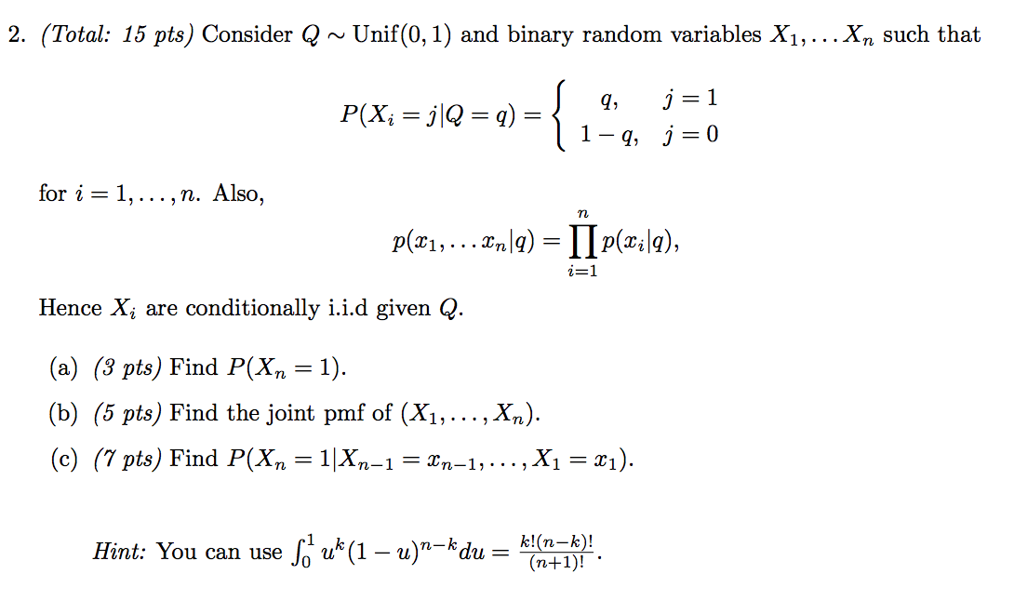
Q3

Slide 7
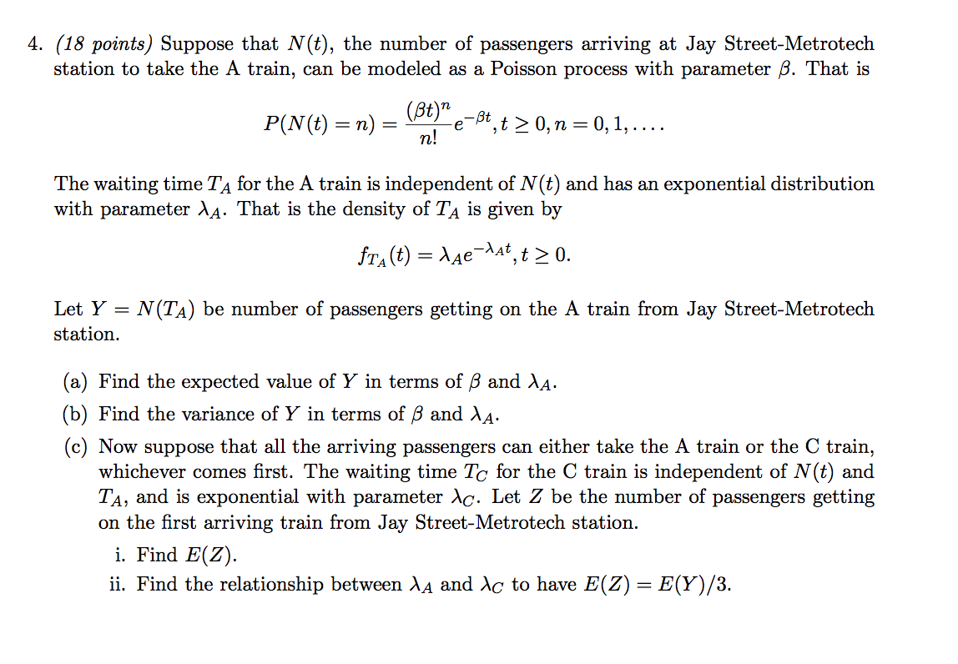
Q4

Slide 8
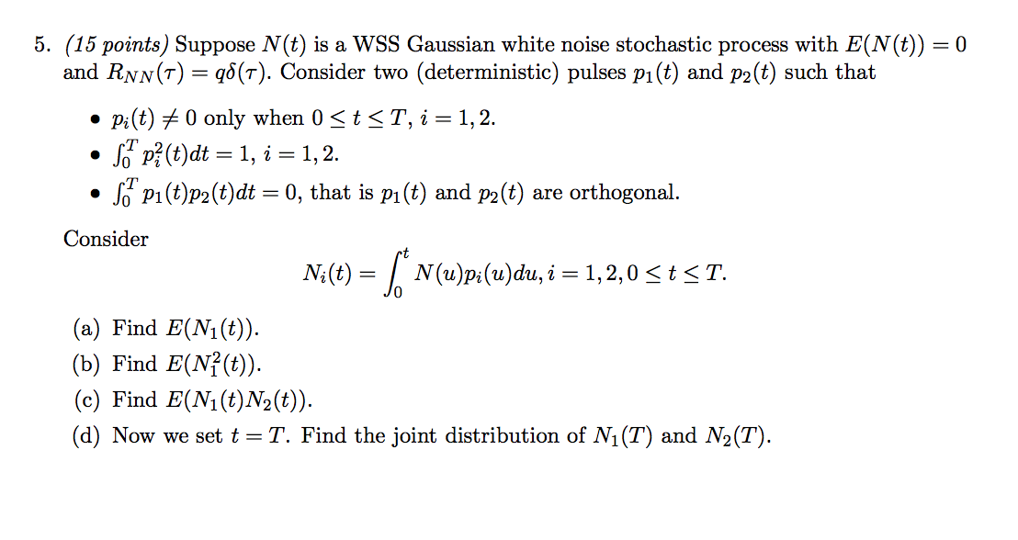
Q5

Slide 9
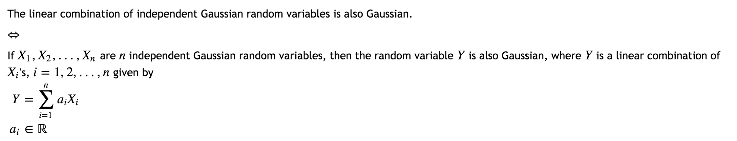
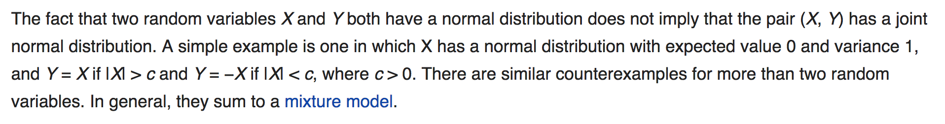

P176: Two r.v. x and y are jointly normal if the sum ax+by is normal for every a and b.
In general, random variables may be uncorrelated but statistically dependent. But if a random vector has a multivariate normal distribution then any two or more of its components that are uncorrelated are independent.
If X and Y are normally distributed and independent, this implies they are "jointly normally distributed”.
However, a pair of jointly normally distributed variables need not be independent (would only be so if uncorrelated, $ρ=0$)
Notes:
https://math.stackexchange.com/questions/570858/integral-of-a-gaussian-process-has-gaussian-distribution/1129990
I think the object you really want to be integrating is a Gaussian process with some specified mean and covariance function. And you'll probably want the covariance function to have some regularity to it (e.g. continuous) in order to guarantee that the integral exists.

Slide 10
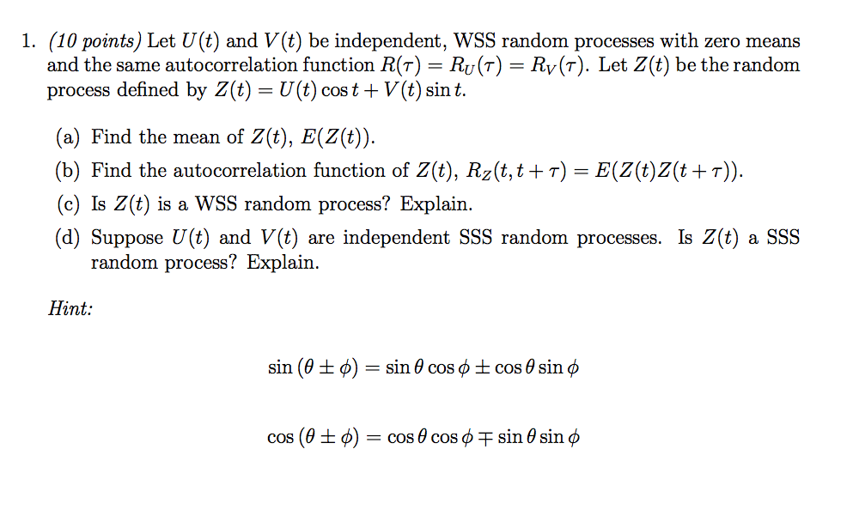
Quiz4

Slide 11
