Slide 1
Recitation 2
Random variables, probability distribution and density functions, continuous and discrete random variables.
Linan Huang

Slide 2
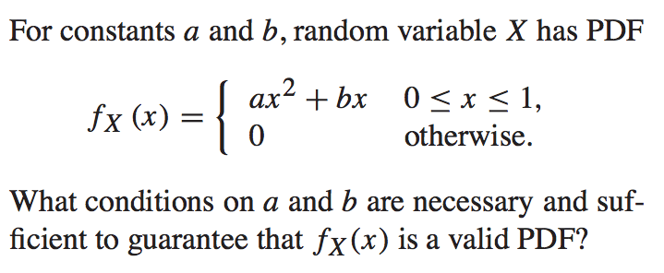
Q1. Warm Up

Slide 3
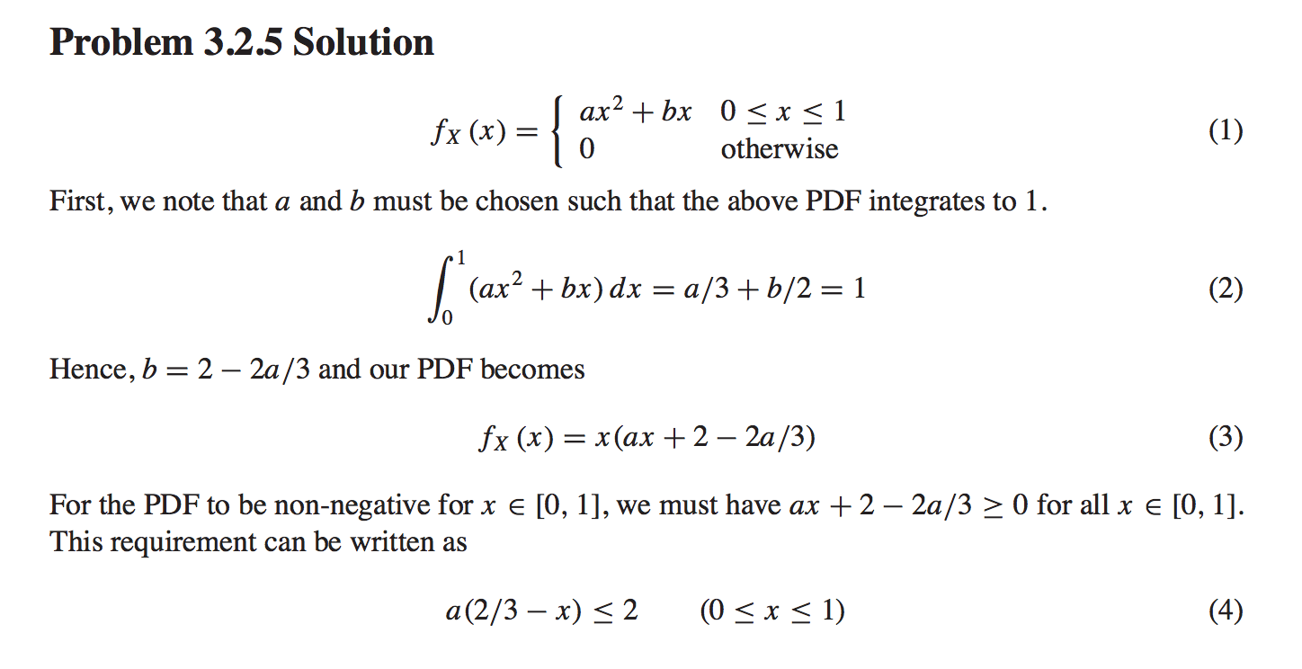

Slide 4
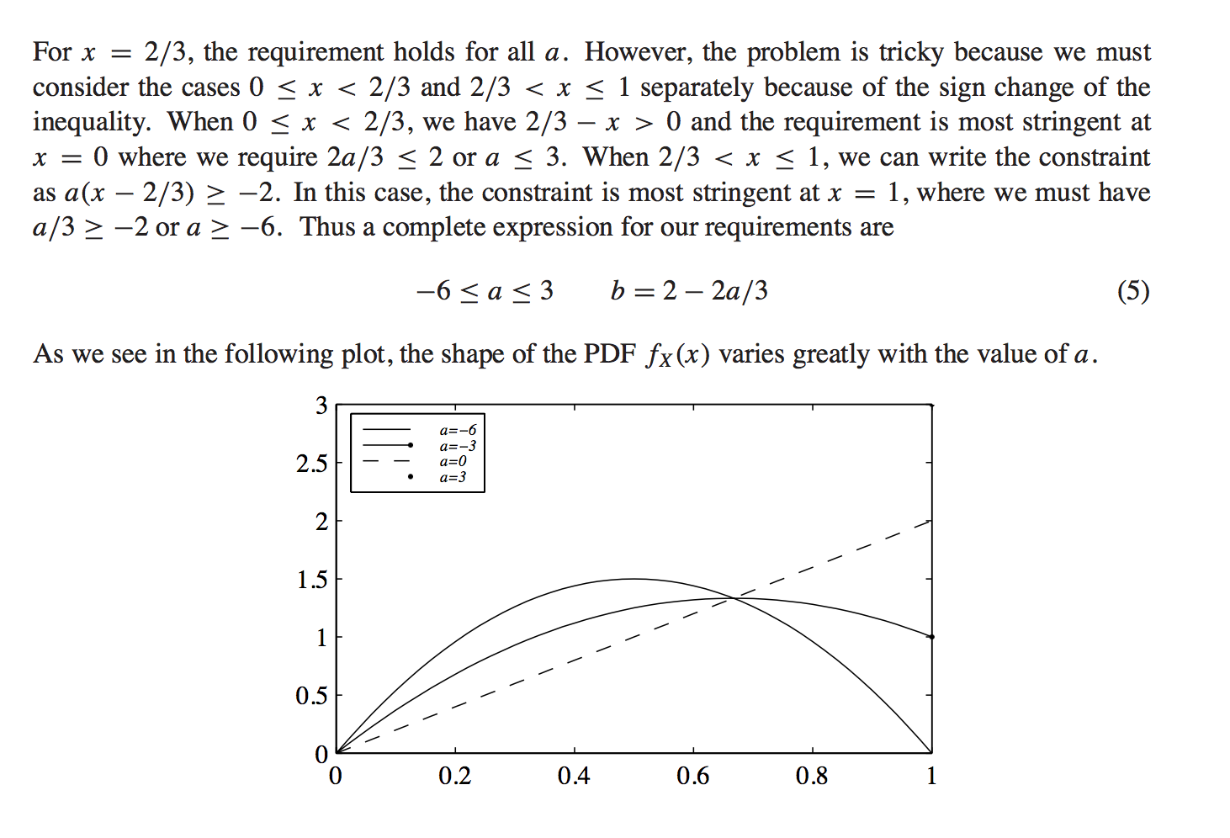

Slide 5
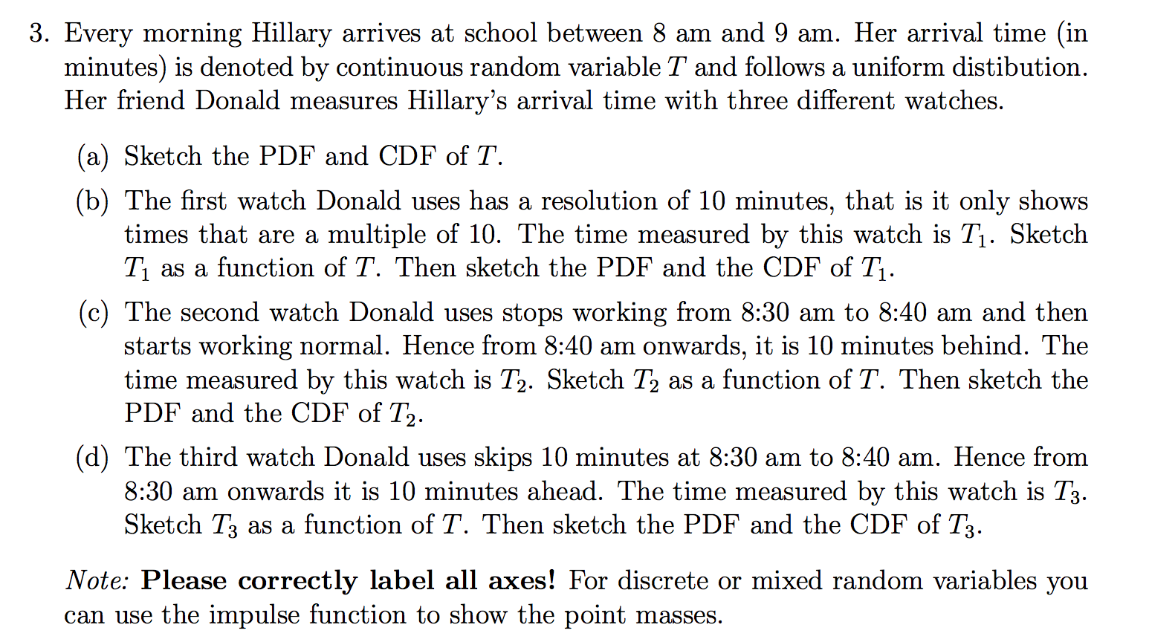
Q2. Exercise

Slide 6
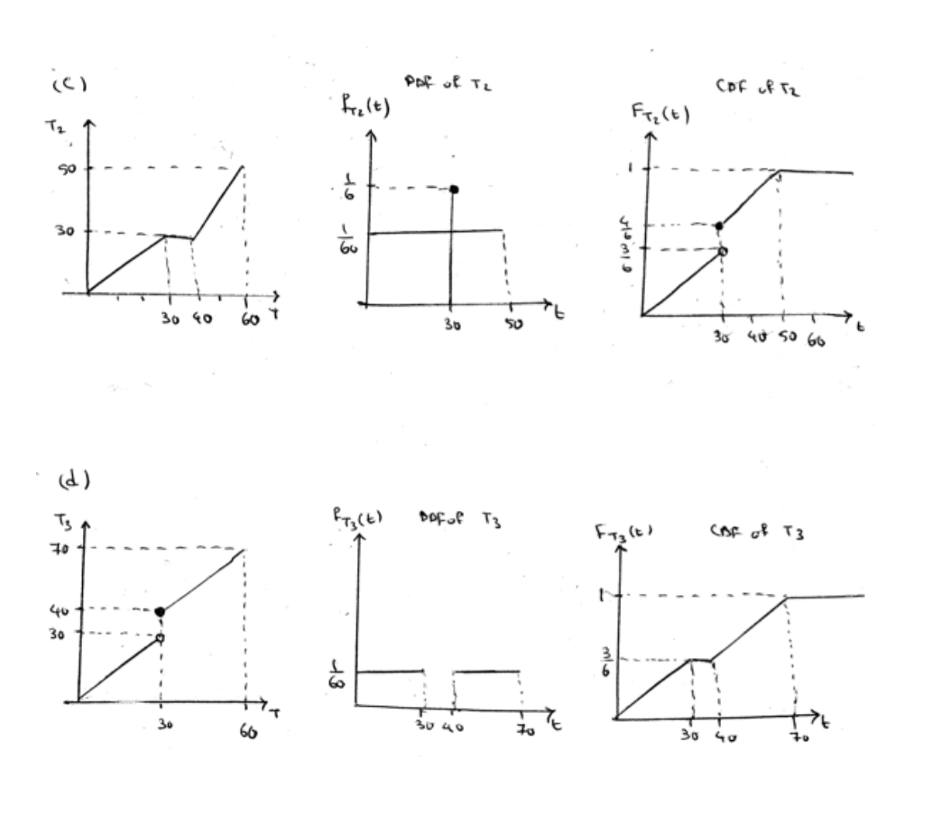
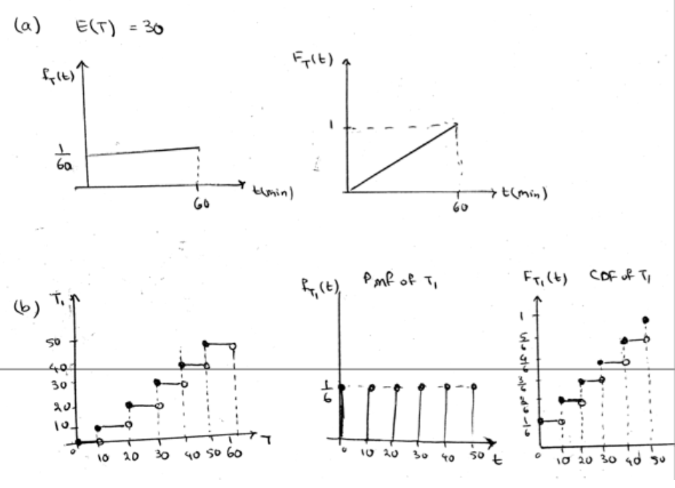

Slide 7
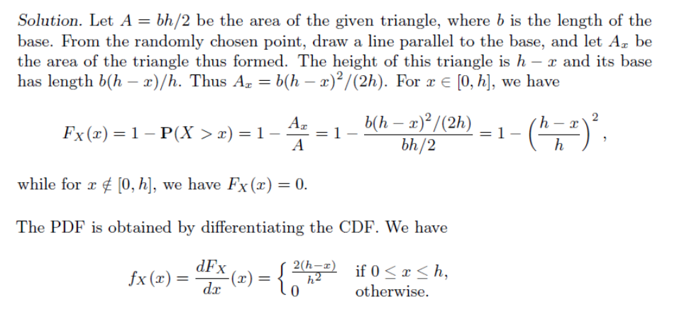
Q3. Geometric models of probability

Slide 8
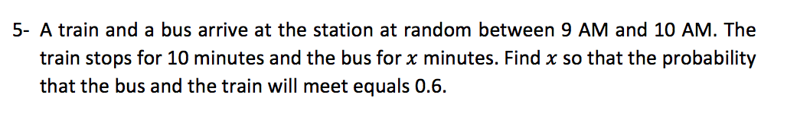
Q4. Geometric models of probability
Missing conditions:
The arrival is uniformly distributed.
Independence: The train’s arrival time does not affect the bus, and vice verse.

Slide 9
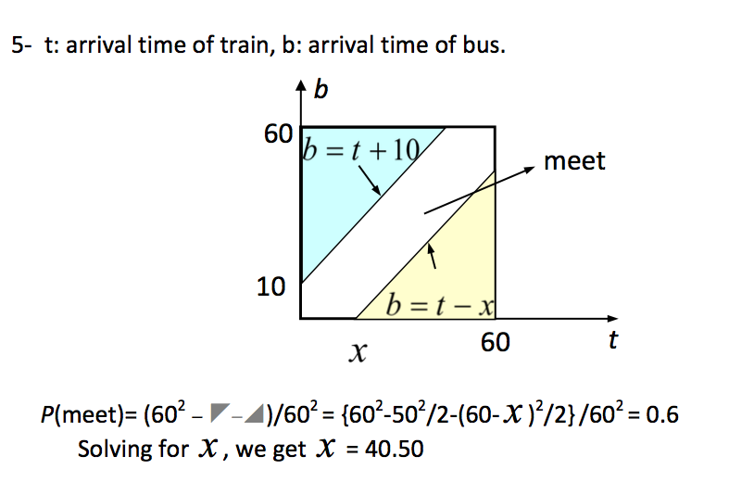

x is the arriving time of train
y is the arriving time of bus
Event A: they can meet

Slide 10
Q5. Geometric models of probability
Light A, B distance: 120m
Add two with the order: ACDB
The probability that A and C dis>40, and D and B dis>40?

Slide 11
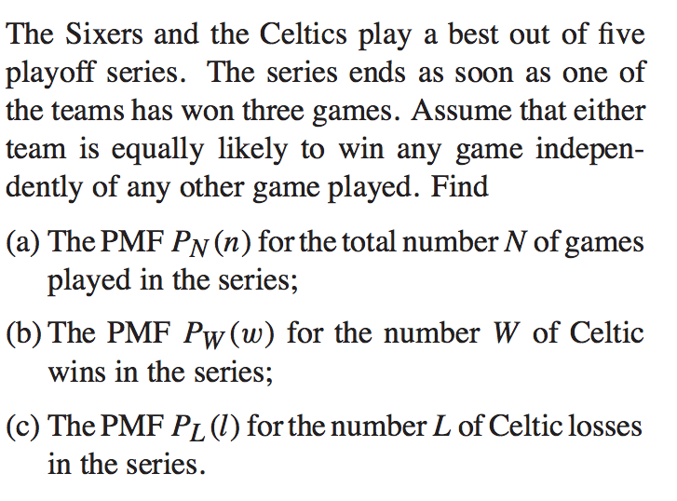
Q6.

Slide 12
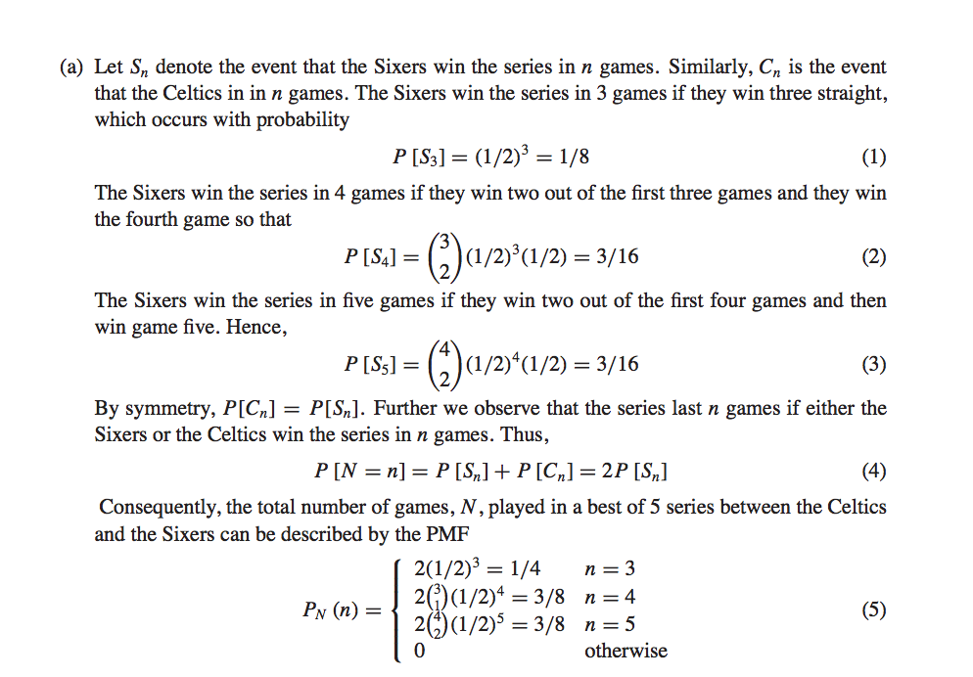

Slide 13
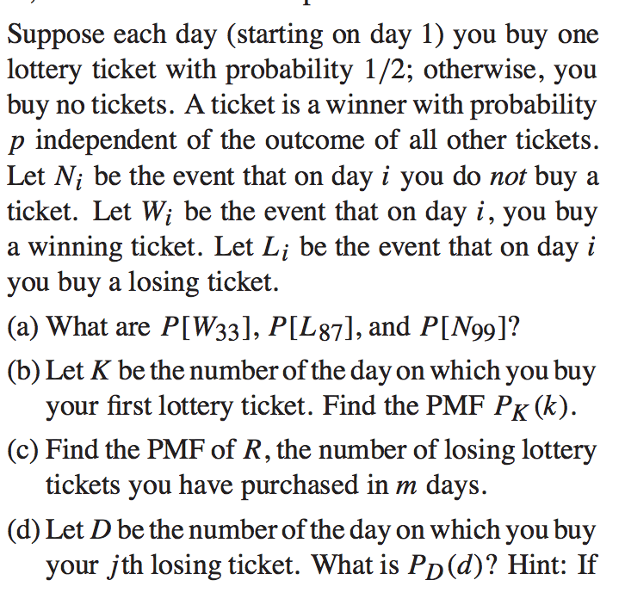

Q7.

Slide 14
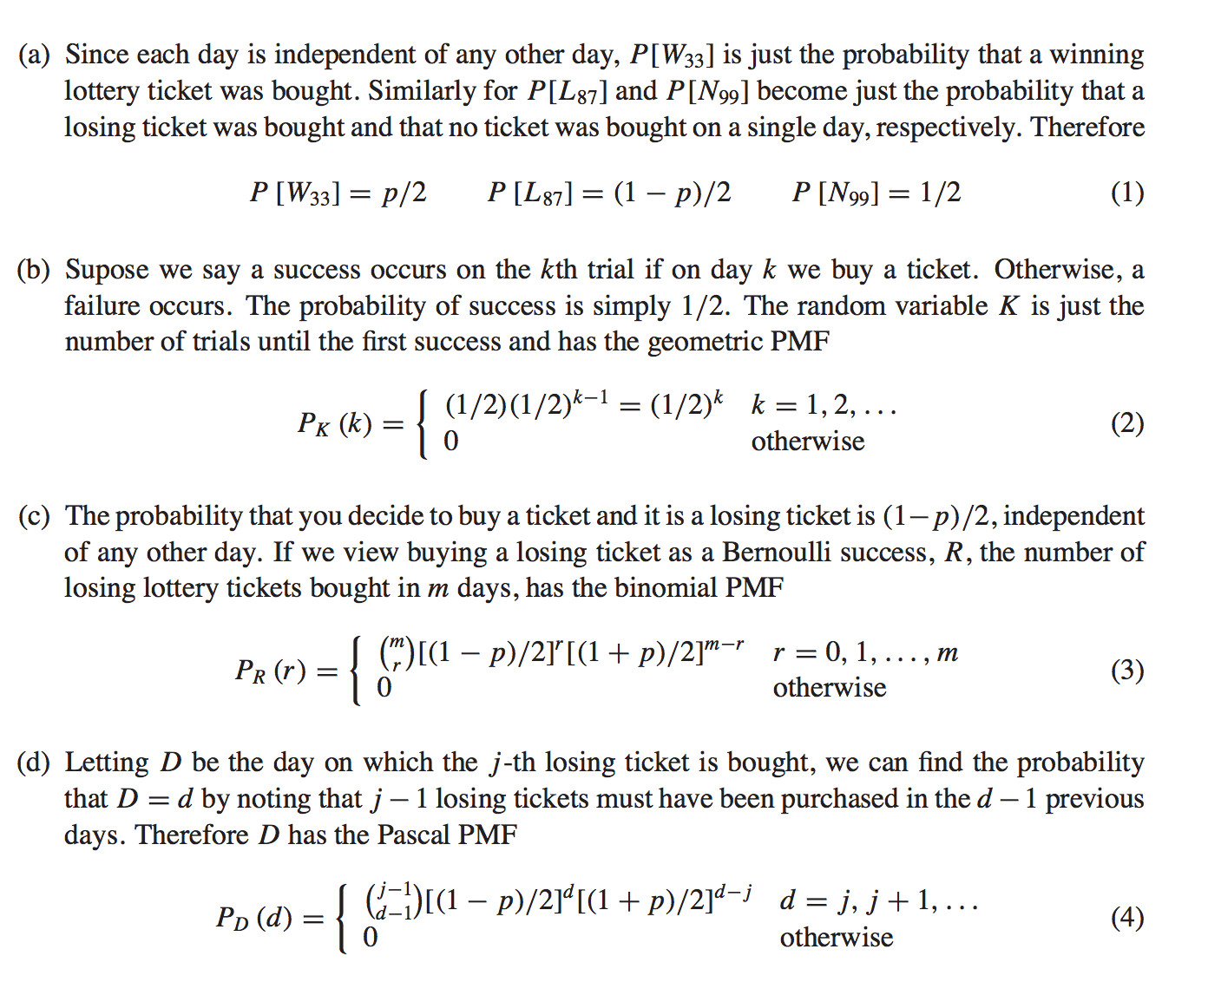

Slide 15
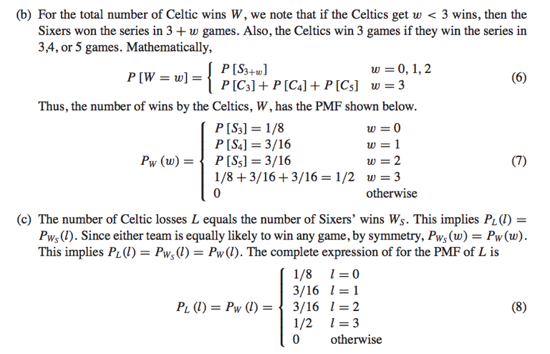

Slide 16
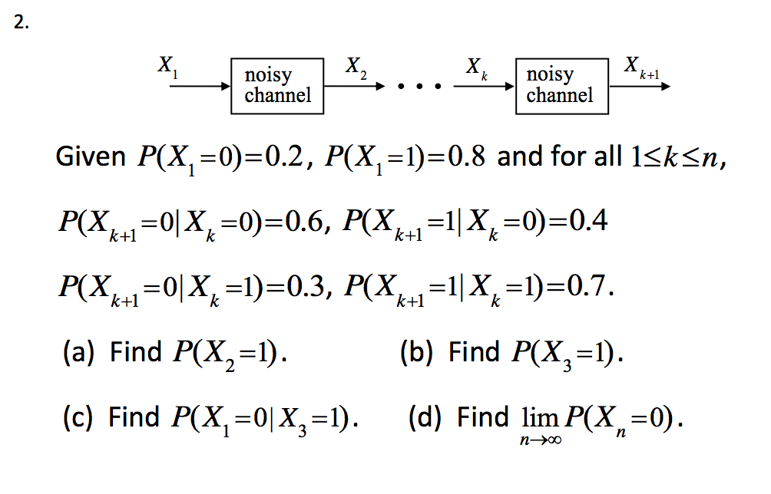
Q8. MC

Slide 17
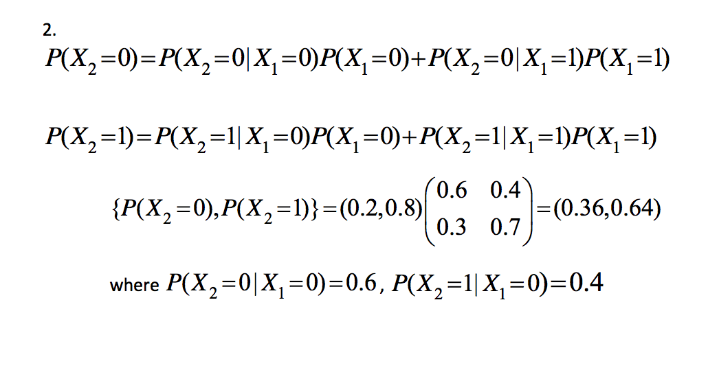
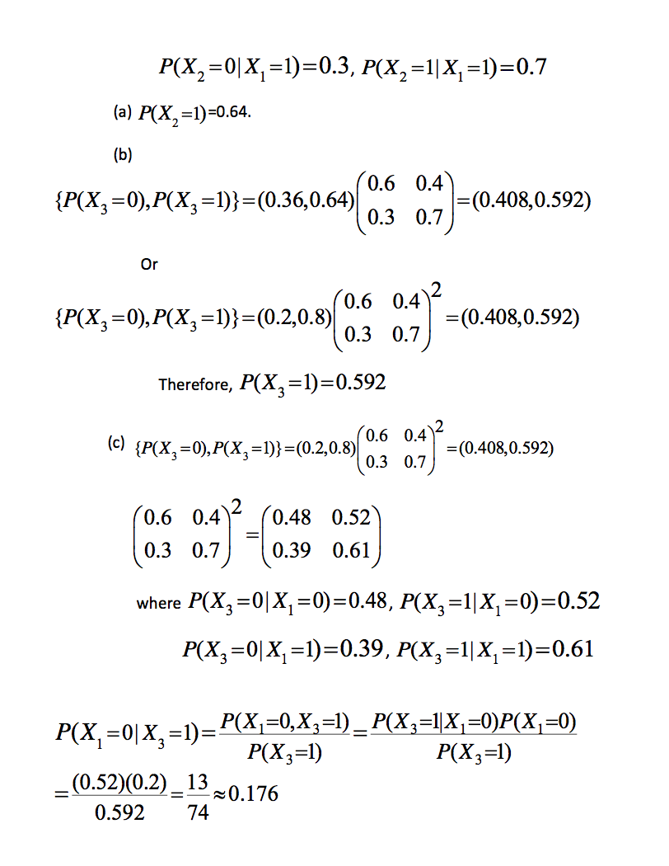
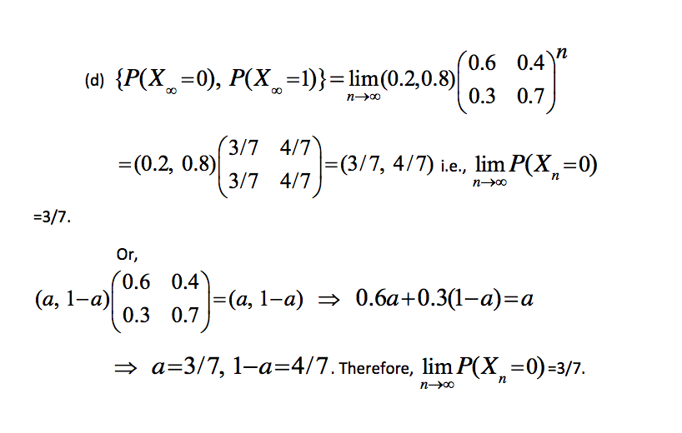
stationary distribution
a limiting distribution doesn’t have to exist
a limiting distribution is a stationary distribution
the chain itself does not converge to anything, because it is continually jumping around, but the probability distribution might.

Slide 18
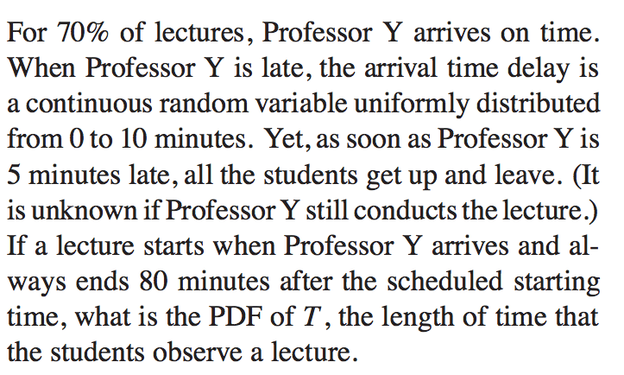
Q9.

Slide 19
