Slide 1
Recitation 4
Characteristic functions [Fourier transform of the density function],
Moment generating functions [Laplace transform of the density function].
Chebyshev's inequality and Markov inequality.
Two random variables, Joint distribution and density function, independence, and marginal distribution.
A investigation of expectation and mean.
Linan Huang

Slide 2
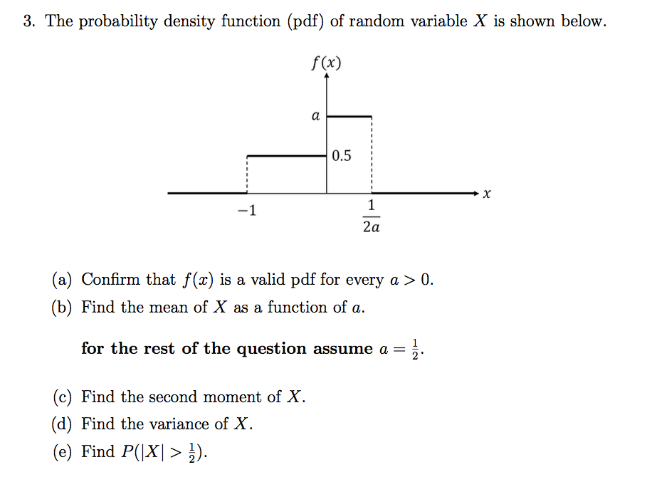
Exercise 4

Slide 3
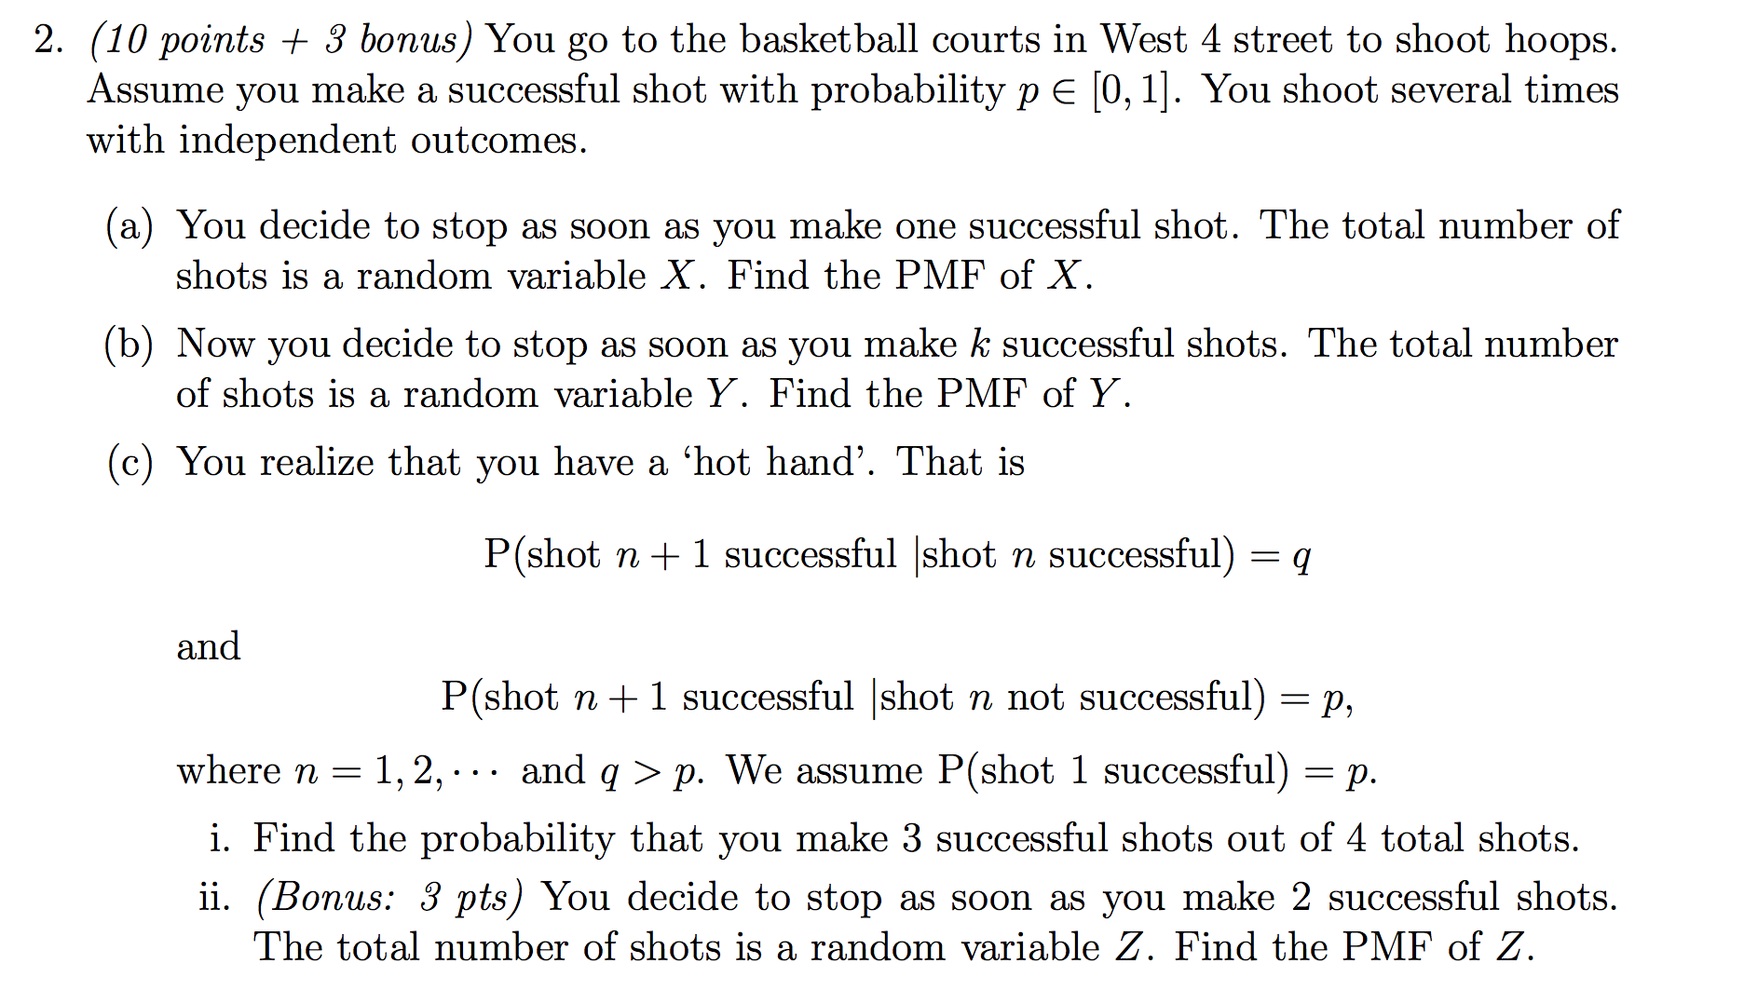
Quiz1

Slide 4
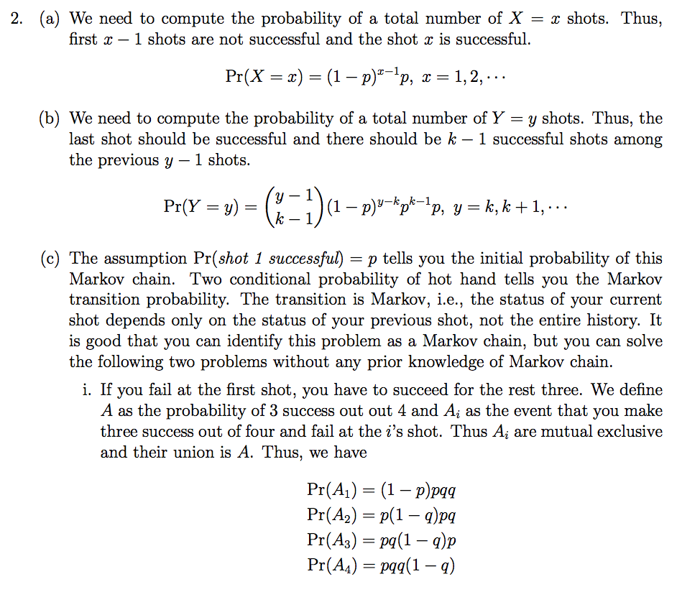

Slide 5
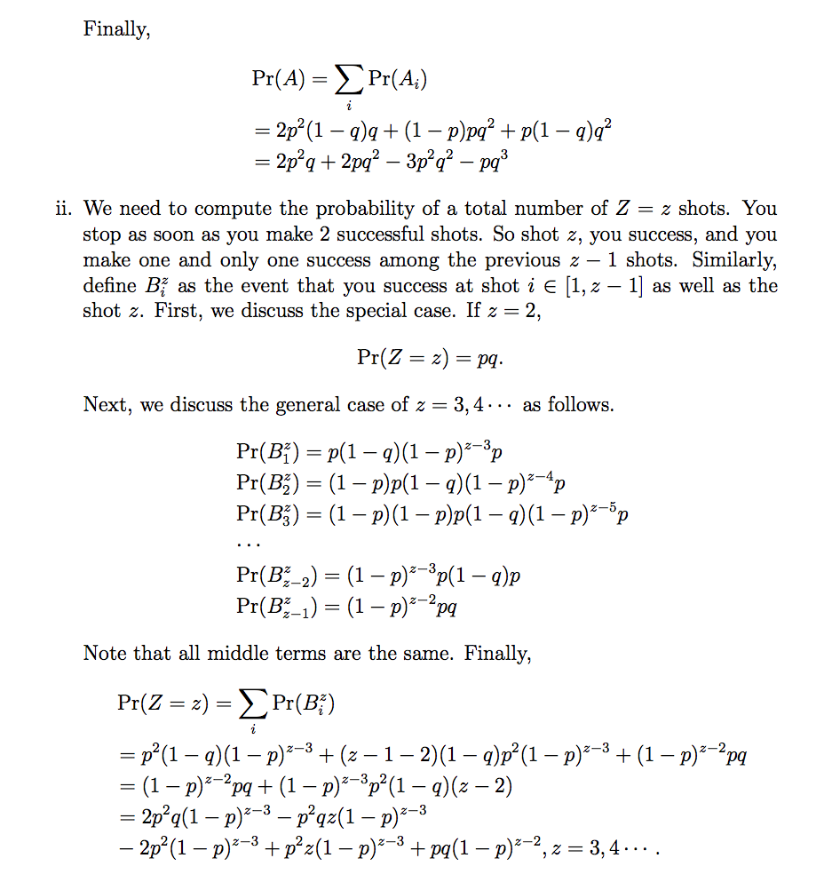

Slide 6
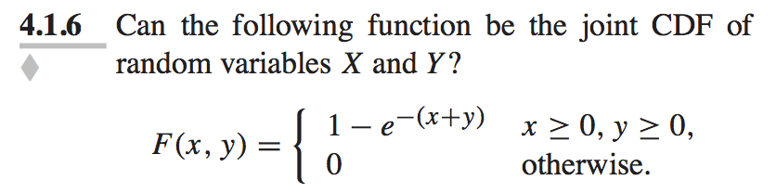
Q3

Slide 7
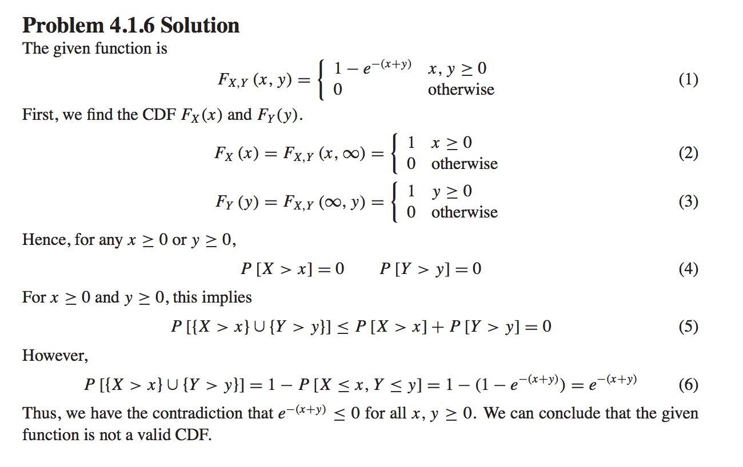

Slide 8
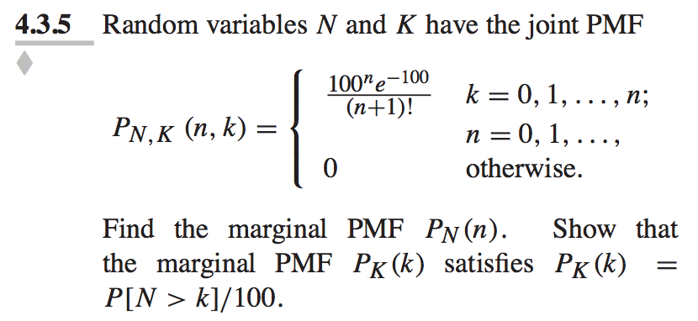
Q4

Slide 9
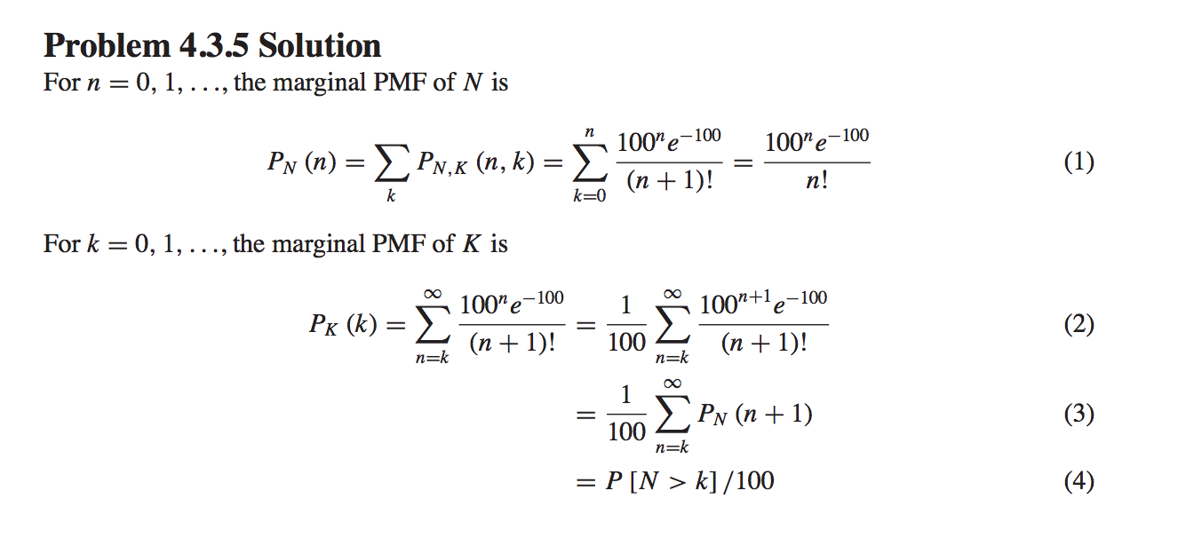

Slide 10
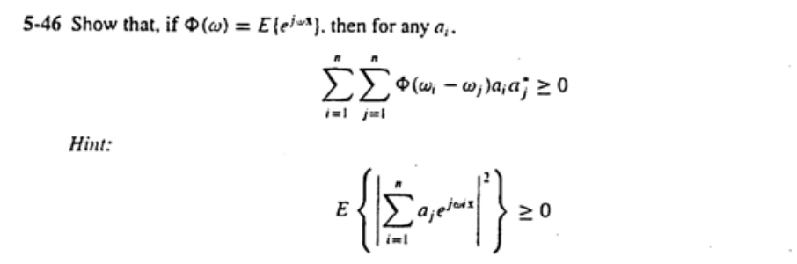
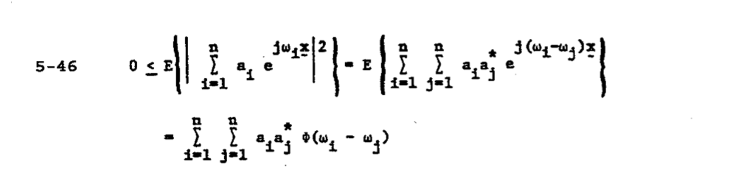
Q5

Slide 11
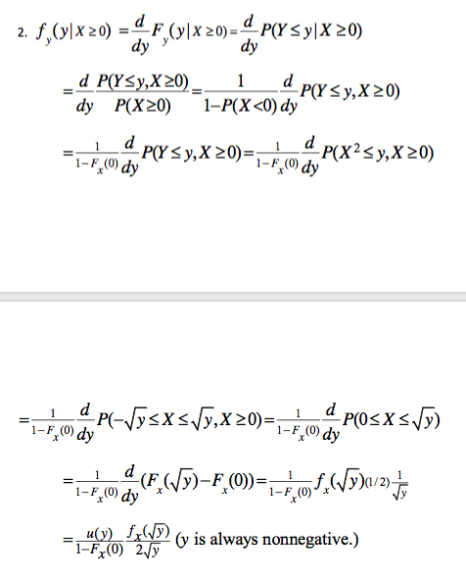

Q6

Slide 12
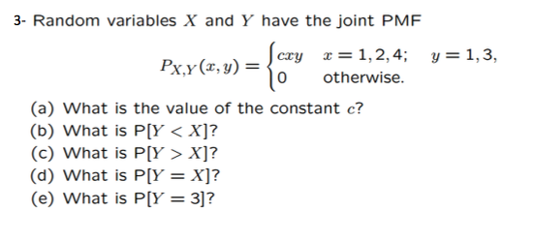
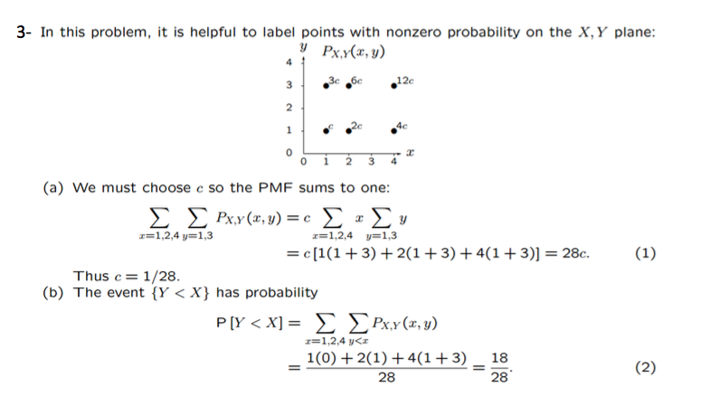
Q7
Remark: X and Y should belong to the same probability space.
Two sum of x and y can be exchanged: just like the double integral

Slide 13
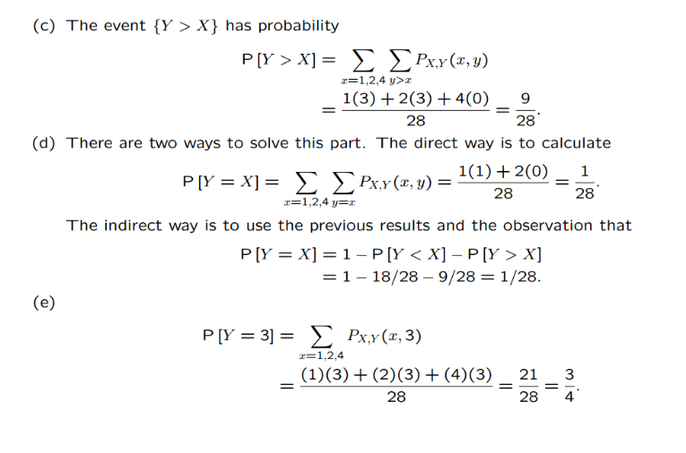

Slide 14
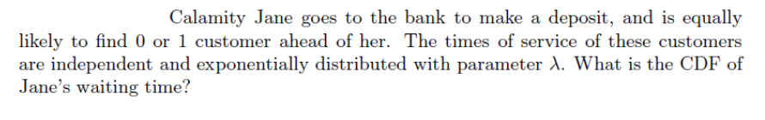
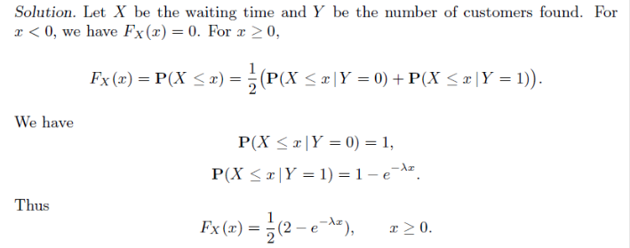
Q8
Modelling event with a random variable
A event is a binary random variable.
Event A: {Y=0}
Event B: {Y=1}

Slide 15
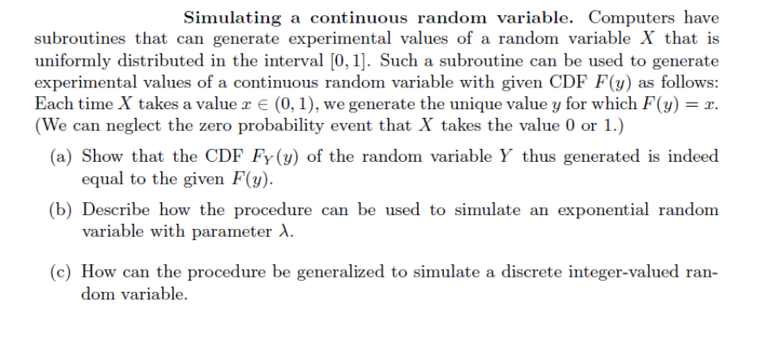
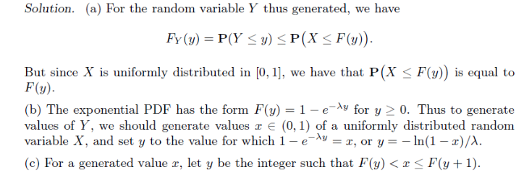
Q9

