Slide 1
Recitation 8 Linan Huang
Independence, Correlation, Orthogonality
MMSE/LMSE
Convergence of random variable: Intuition and counterexamples

Slide 2
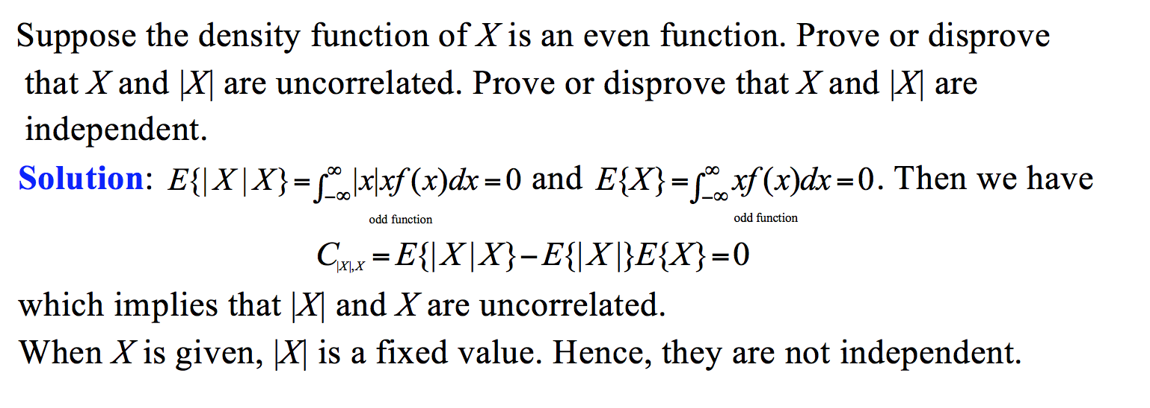

Slide 3

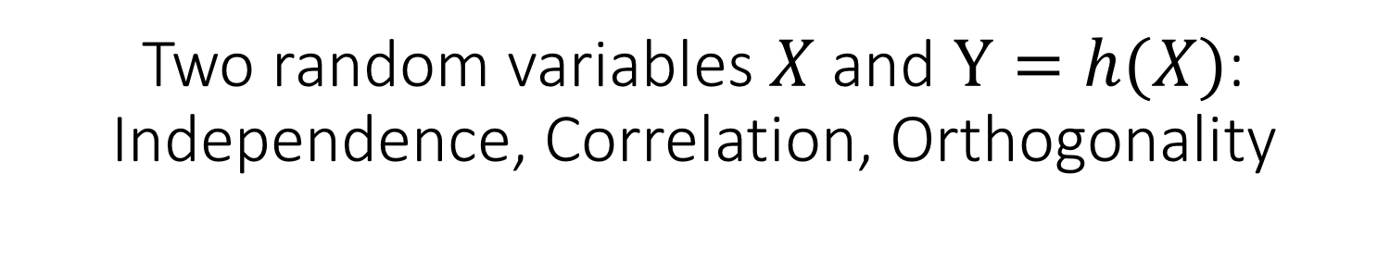
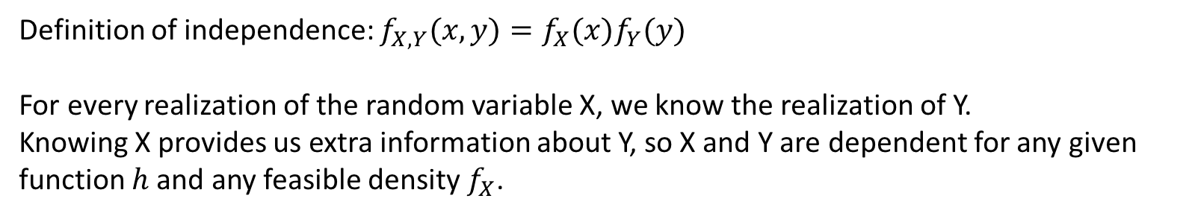
Two random variables $X$ and $Y=h(X)$: Independence, Correlation, Orthogonality
X and h(X) are not independent
Correlation (weaker) of X and h(X)
Orthogonal is not a stronger concept of uncorrelated
Correlation means the linear dependency
Definition of independence: $f_{X,Y}(x,y)=f_{X}(x)f_{Y}(y)$
For every realization of the random variable X, we know the realization of Y.
Knowing X provides us extra information about Y, so X and Y are dependent for any given function $h$ and any feasible density $f_{X}$.

Slide 4
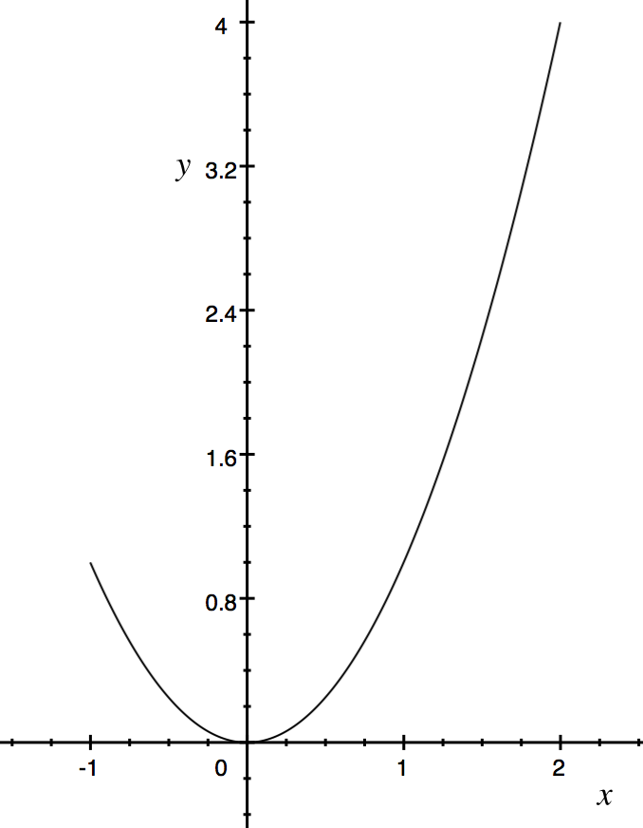
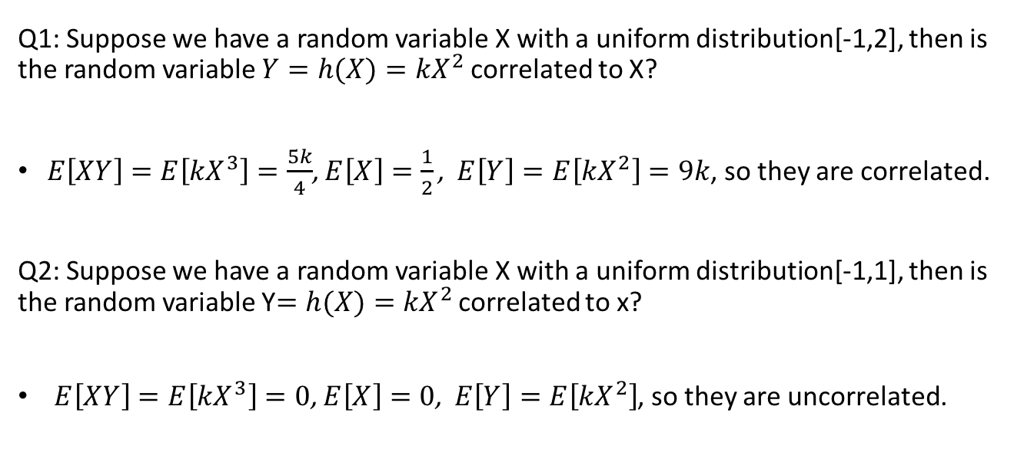
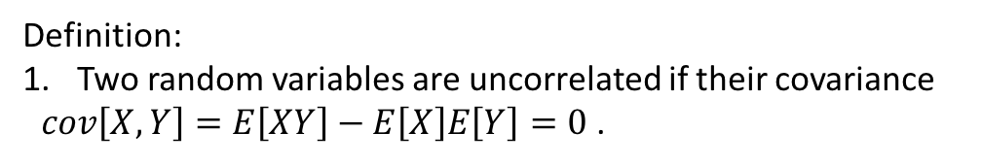
Definition:
Two random variables are uncorrelated if their covariance $cov\left[X,Y\right]=E\left[XY\right]−E\left[X\right]E\left[Y\right]=0$ .
Q1: Suppose we have a random variable X with a uniform distribution[-1,2], then is the random variable $Y=h(X)={kX}^{2}$correlated to X?
$E\left[XY\right]=E\left[{kX}^{3}\right]=\frac{5k}{4}$, $E\left[X\right]=\frac{1}{2}\text{,} E\left[Y\right]=E\left[{kX}^{2}\right]=9k$, so they are correlated.
Q2: Suppose we have a random variable X with a uniform distribution[-1,1], then is the random variable Y$=h(X)={kX}^{2}$ correlated to x?
$E\left[XY\right]=E\left[kX^{3}\right]=0$, $E\left[X\right]=0\text{,} E\left[Y\right]=E\left[{kX}^{2}\right]$, so they are uncorrelated.
"Uncorrelated" means that as one of the two variables increases, on average the other one does not increase or decrease.

Slide 5
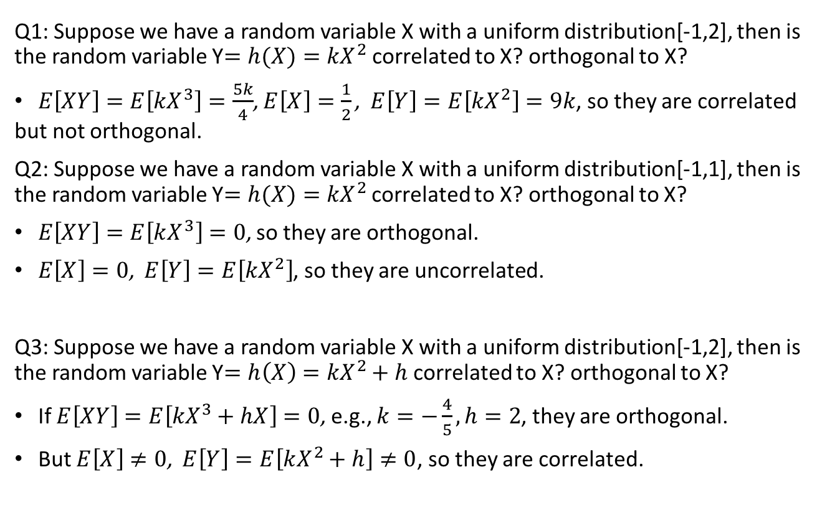
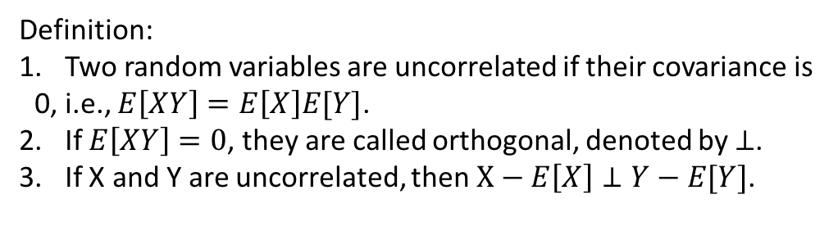
Definition:
Two random variables are uncorrelated if their covariance is 0, i.e., $E\left[XY\right]=E\left[X\right]E[Y]$.
If $E\left[XY\right]=0$, they are called orthogonal, denoted by $⊥$.
If X and Y are uncorrelated, then $X−E\left[X\right]⊥Y−E[Y]$.
Orthogonal
correlated
Non-orthogonal
uncorrelated
Orthogonal is not a stronger concept of uncorrelated
Q1: Suppose we have a random variable X with a uniform distribution[-1,2], then is the random variable Y$=h(X)={kX}^{2}$correlated to X? orthogonal to X?
$E\left[XY\right]=E\left[{kX}^{3}\right]=\frac{5k}{4}$, $E\left[X\right]=\frac{1}{2}\text{,} E\left[Y\right]=E\left[{kX}^{2}\right]=9k$, so they are correlated but not orthogonal.
Q2: Suppose we have a random variable X with a uniform distribution[-1,1], then is the random variable Y$=h(X)={kX}^{2}$ correlated to X? orthogonal to X?
$E\left[XY\right]=E\left[kX^{3}\right]=0$, so they are orthogonal.
$E\left[X\right]=0\text{,} E\left[Y\right]=E\left[{kX}^{2}\right]$, so they are uncorrelated.
Q3: Suppose we have a random variable X with a uniform distribution[-1,2], then is the random variable Y$=h\left(X\right)={kX}^{2}+h$ correlated to X? orthogonal to X?
If $E\left[XY\right]=E\left[{kX}^{3}+hX\right]=0$, e.g., $k=−\frac{4}{5},h=2$, they are orthogonal.
But $E\left[X\right]≠0\text{,} E\left[Y\right]=E\left[kX^{2}+h\right]≠0$, so they are correlated.

Slide 6
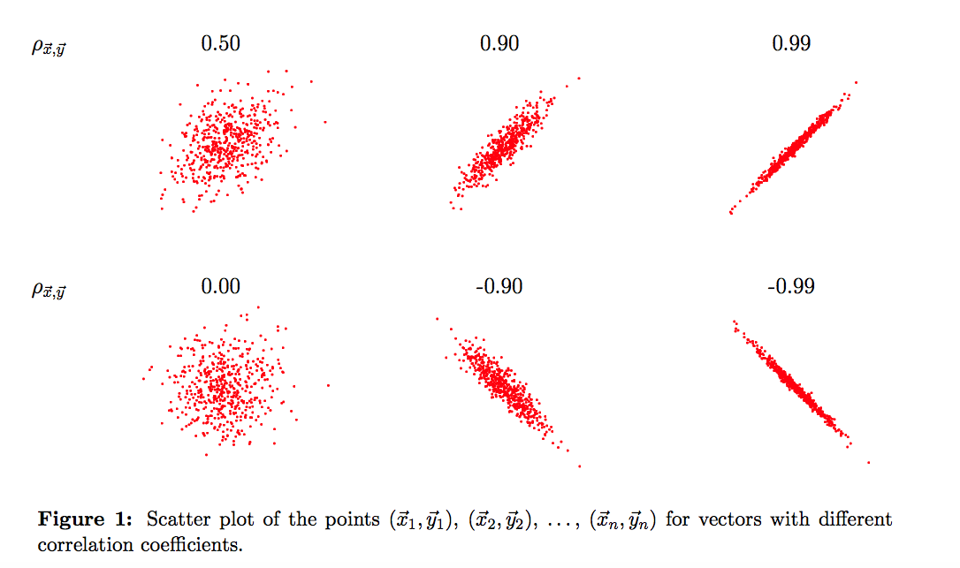
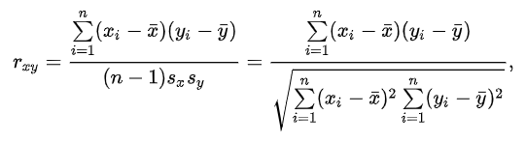
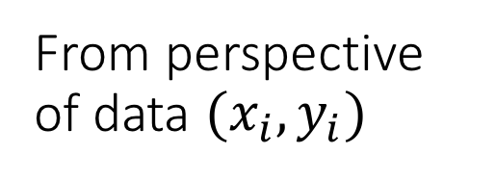
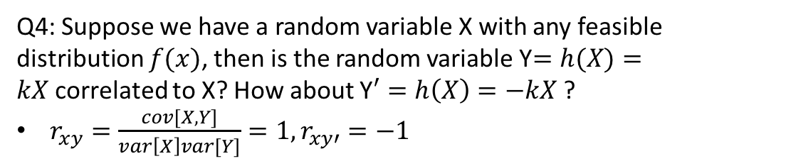
From perspective of data $(x_{i},y_{i})$
Q4: Suppose we have a random variable X with any feasible distribution $f(x)$, then is the random variable Y$=h(X)=kX$correlated to X? How about Y$′=h\left(X\right)=−kX$?
$r_{xy}=\frac{cov[X,Y]}{var\left[X\right]var[Y]}=1,r_{xy′}=−1$
Correlation coefficient is a measure of the strength and direction of the linear relationship between two variables

Slide 7



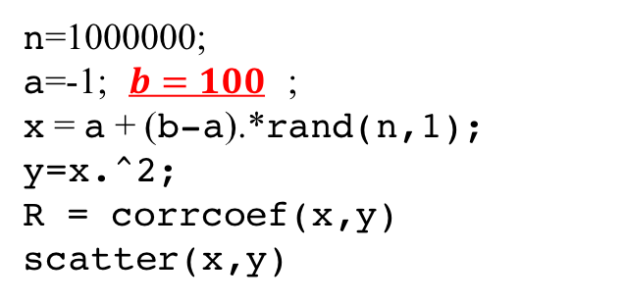
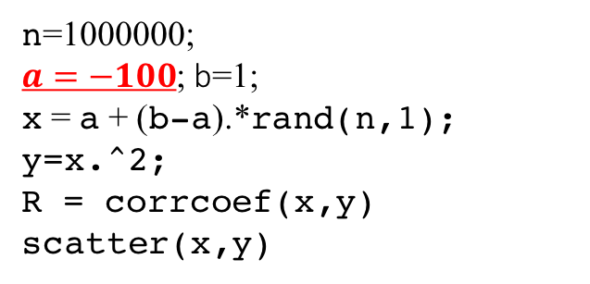
n=1000000;
a=-1;b=1;
x = a + (b-a).*rand(n,1);
y=x.^2;
R = corrcoef(x,y)
scatter(x,y)
n=1000000;
a=-1; $b=100$ ;
x = a + (b-a).*rand(n,1);
y=x.^2;
R = corrcoef(x,y)
scatter(x,y)
n=1000000;
$a=−100$; b=1;
x = a + (b-a).*rand(n,1);
y=x.^2;
R = corrcoef(x,y)
scatter(x,y)
$$r_{xy}=\text{0.0001}$$
$$r_{xy}=\text{0.9670}$$
$$r_{xy}=\text{−0.9670}$$

Slide 8
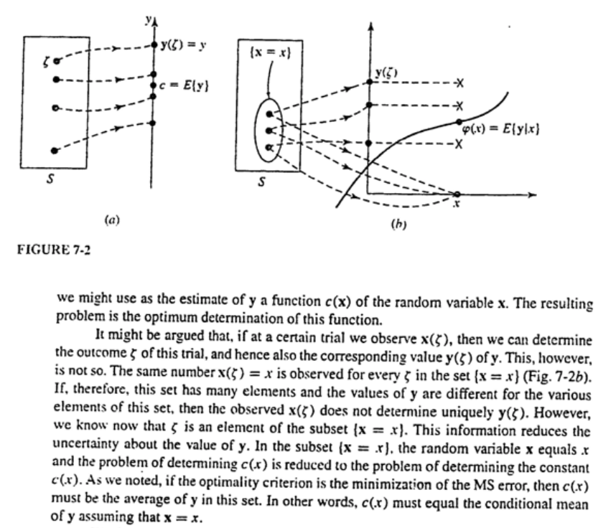
Is random variable a variable?
1. Random vector: a vector of r.v.
2. A sequence of r.v.
3. Estimation

Slide 9
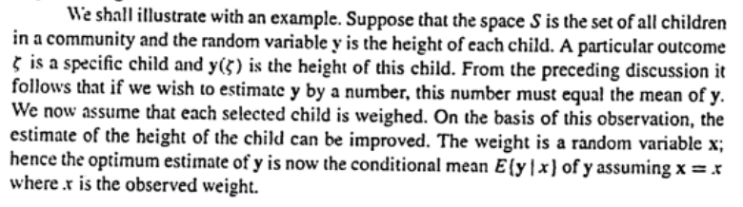

Slide 10
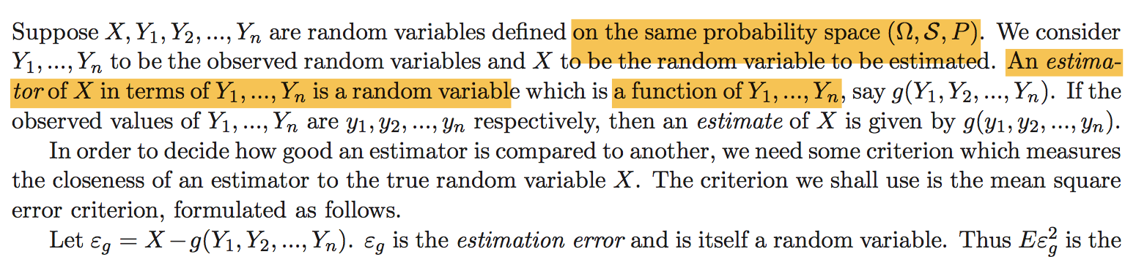

Function g is a function of random vector Y, i.e., a function of n r.v.s $Y_{i}$
$$E(X|Y)$$

Slide 11
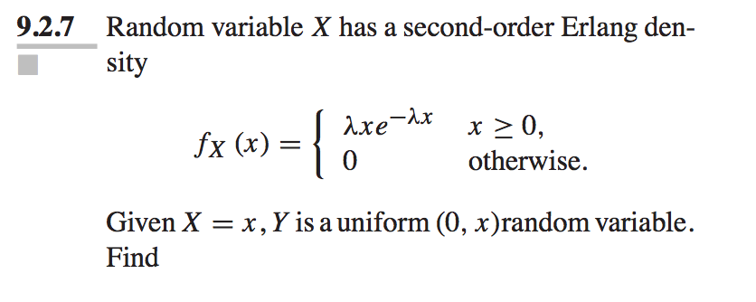
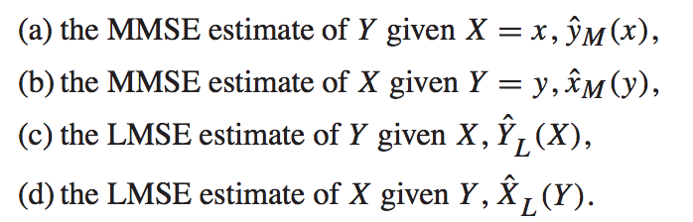
Q3

Slide 12
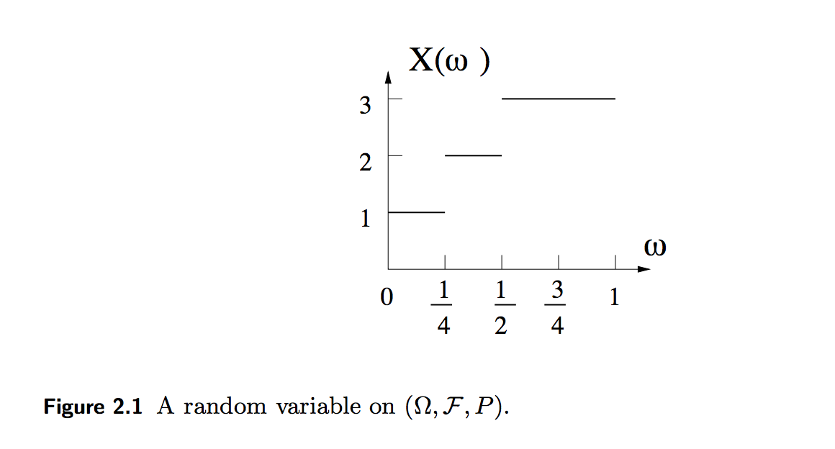
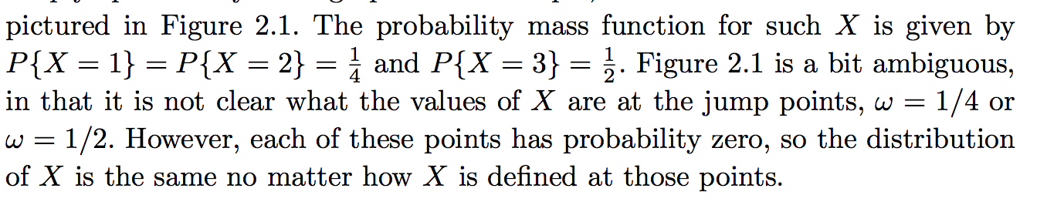

Slide 13
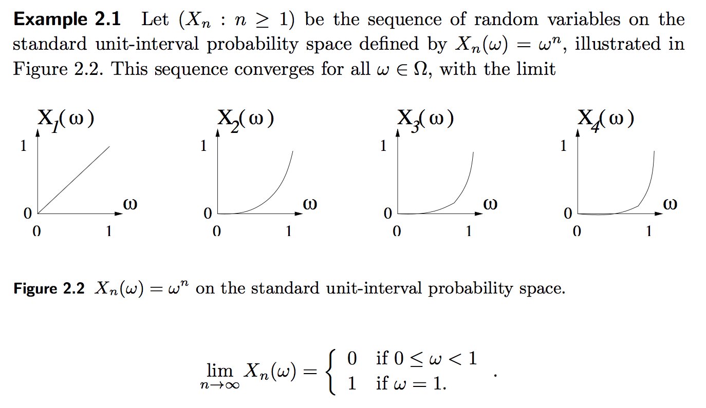
Q4

Slide 14
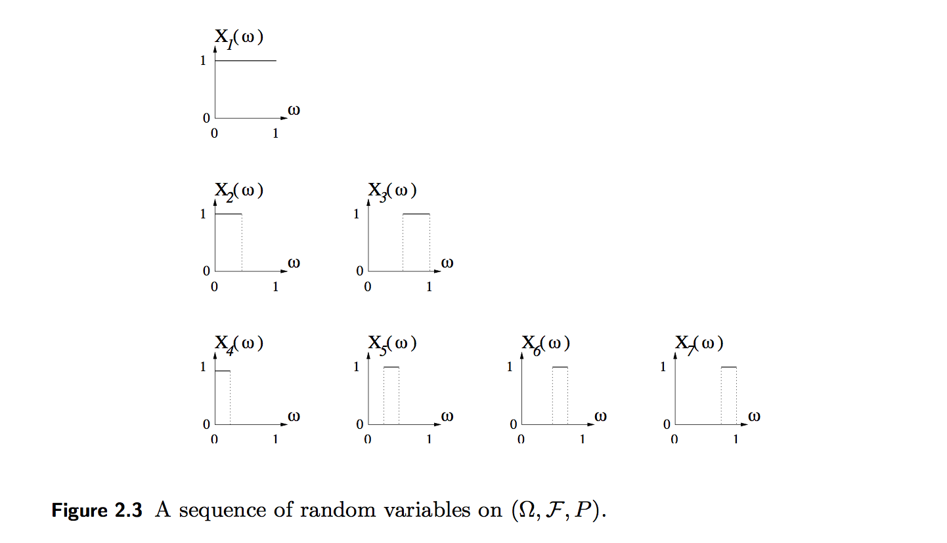
Q5
Almost sure converge?
Some weaker sense converge?

Slide 15
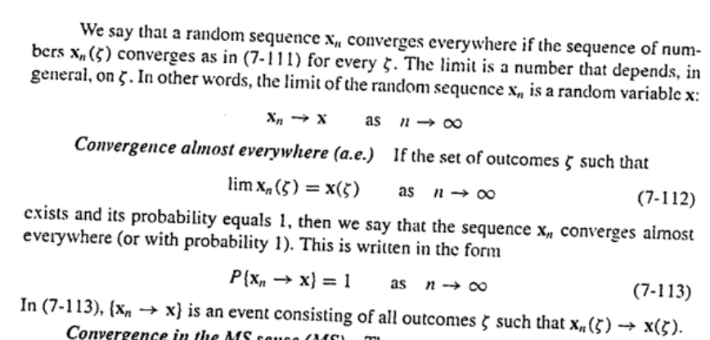
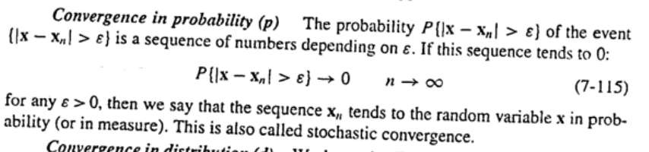

Slide 16
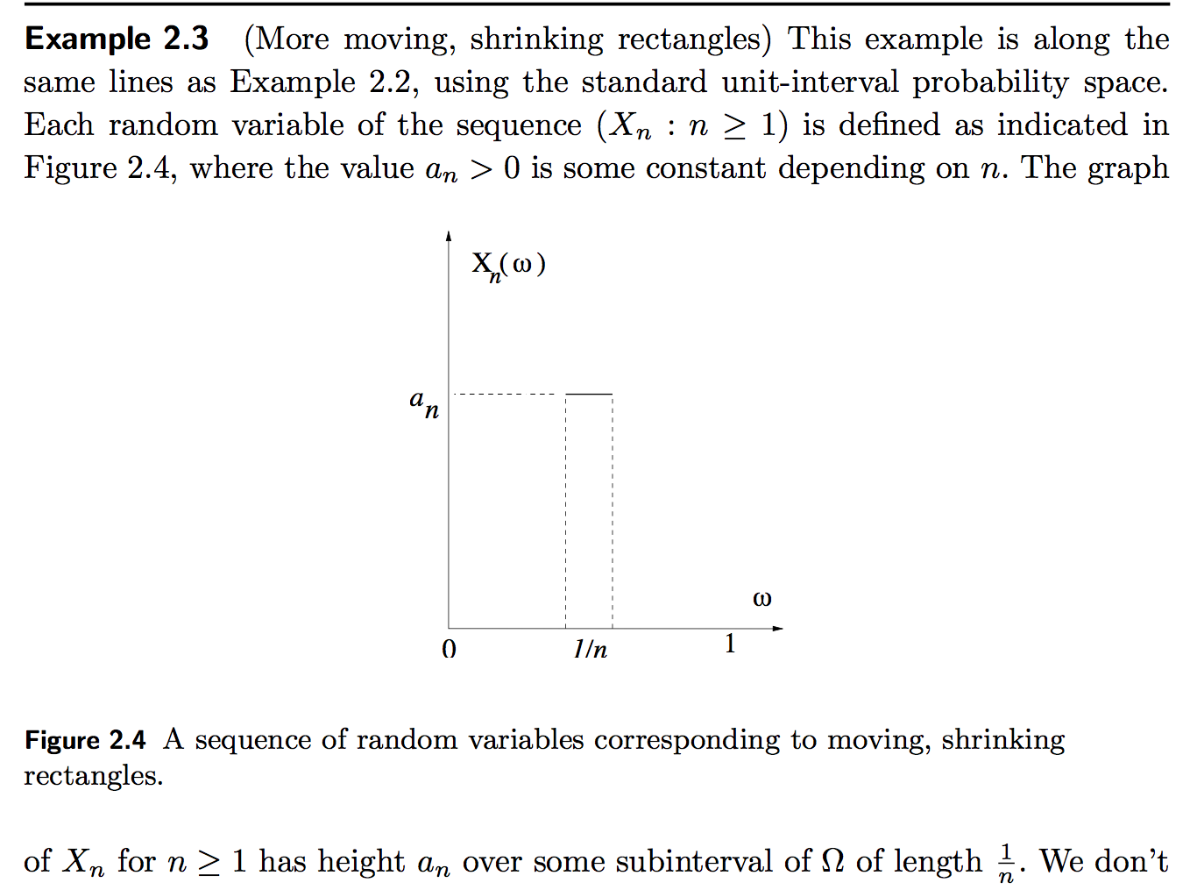
Q6
A.S?
Probability?
MS?

Slide 17
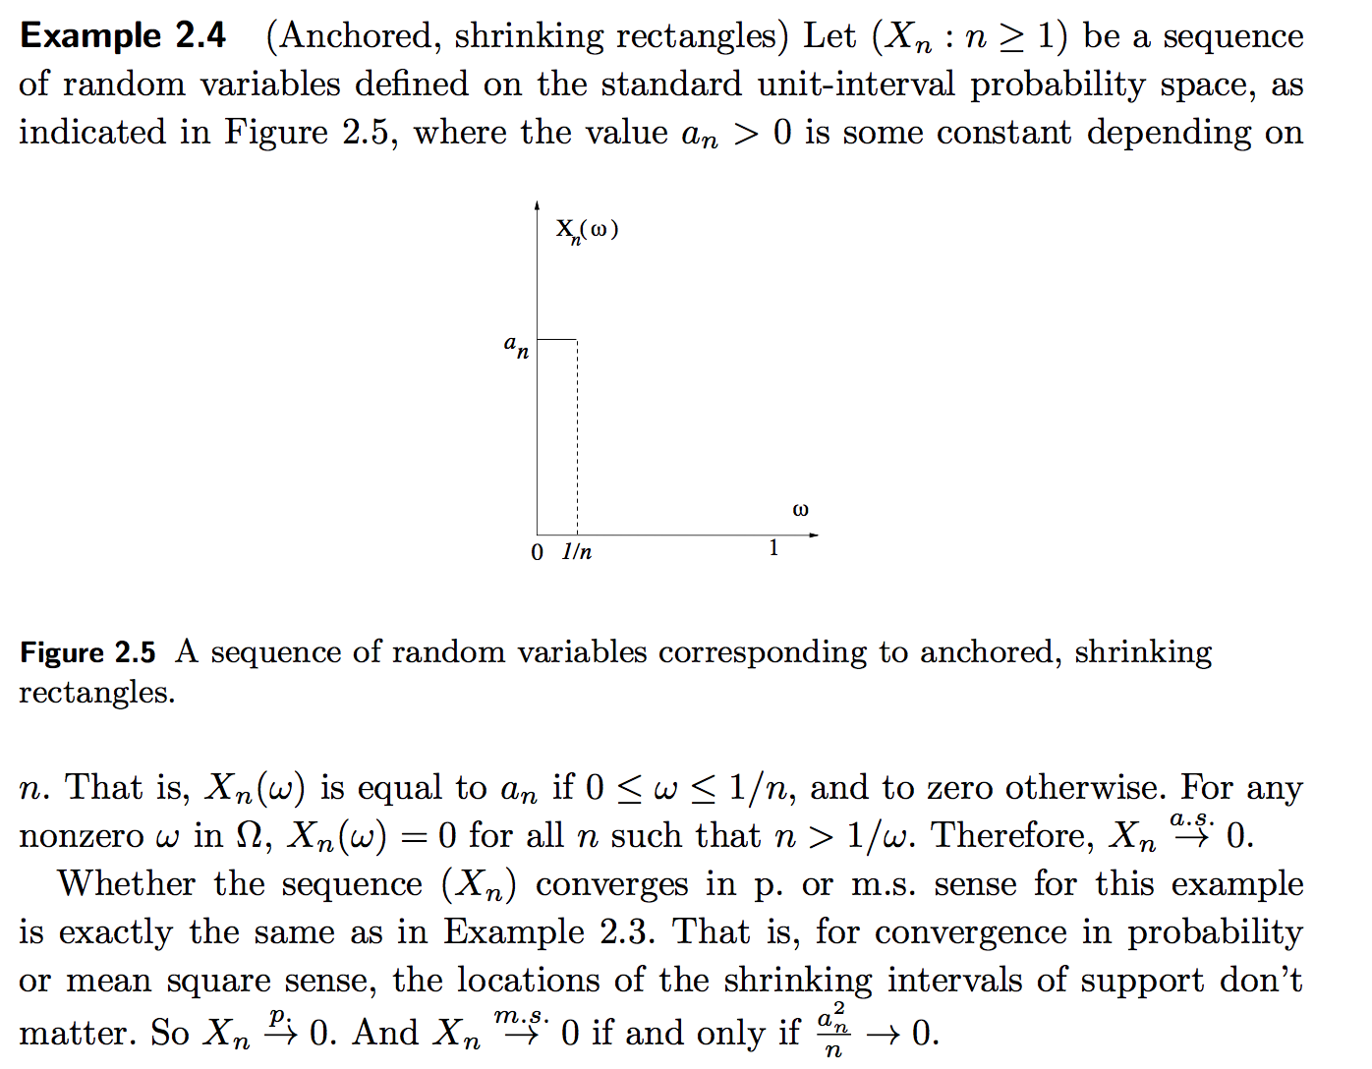

Slide 18
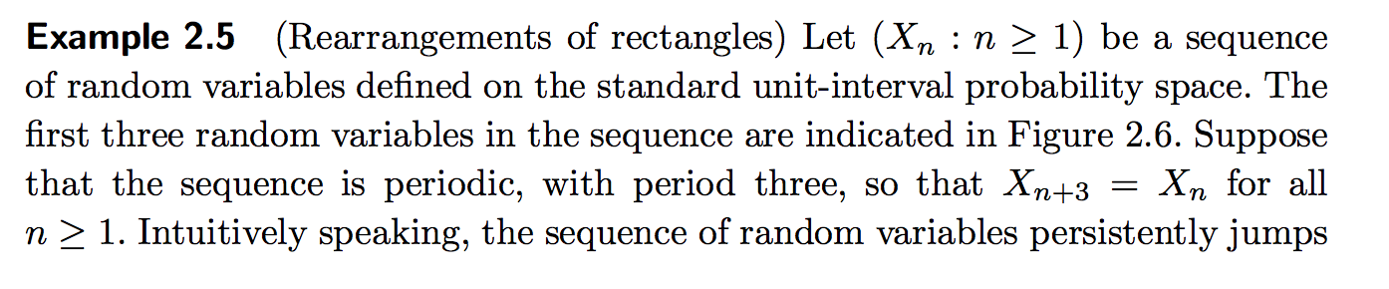
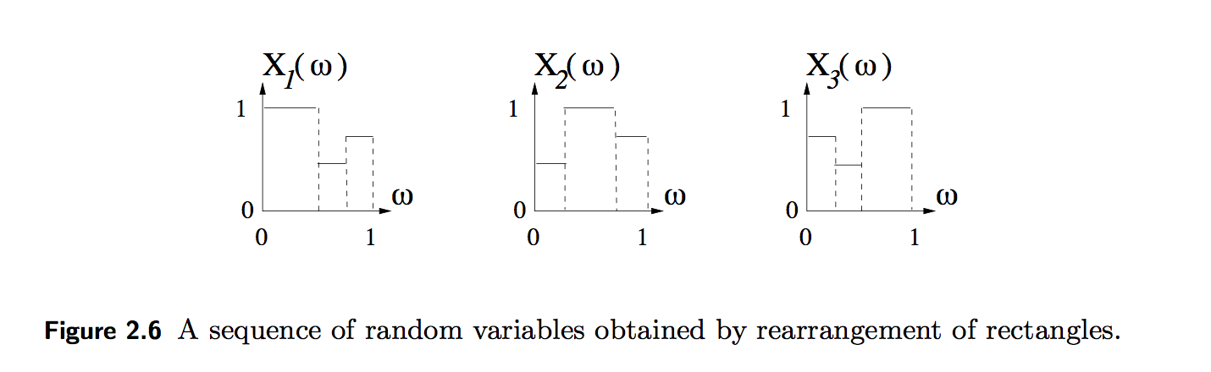
Q7
A.S?
Probability?
MS?
Distribution?

Slide 19
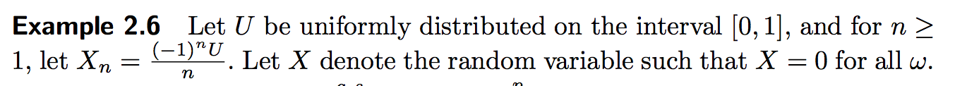
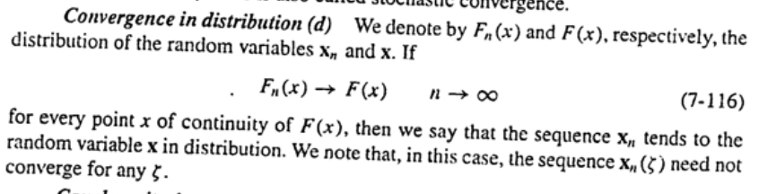
Q8

Slide 20
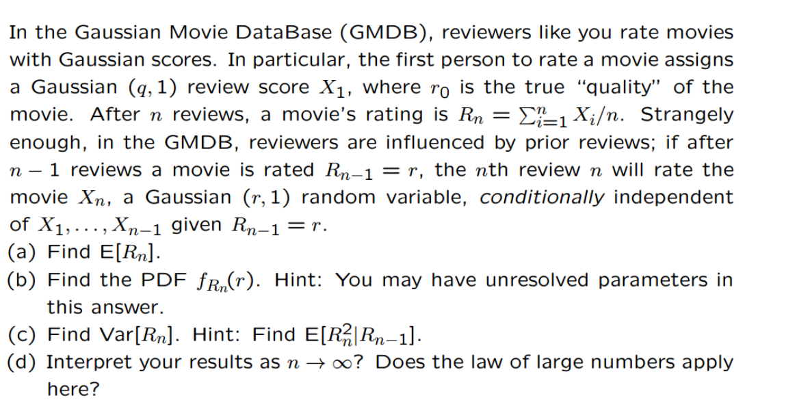
Q9

Slide 21
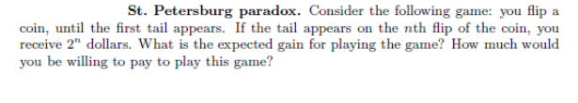
Q12
Use expectation is reasonable.
Would you agree to pay $25 to play that game?

Slide 22
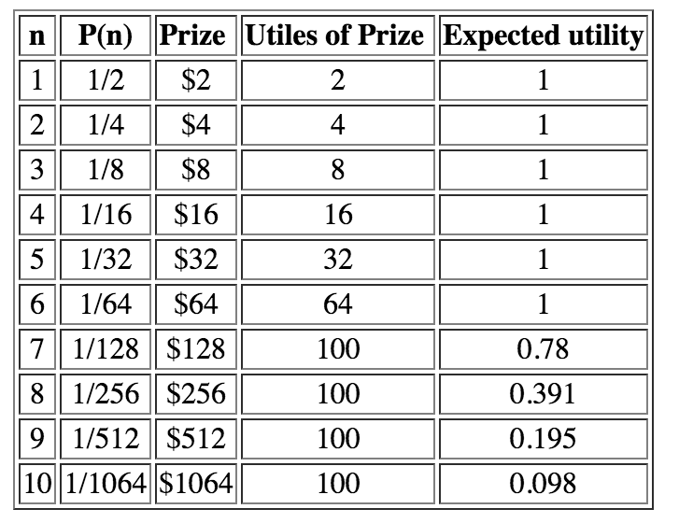
Some Remarks on why expectation may not be aligned with the human judgement
1. Decreasing Marginal Utility
2. Upper bound on utility: too much money make it a signal. Infinite value?

Slide 23
Some Remarks on why expectation may not be aligned with the human judgement
3. Risk aversion: A person is given the choice between two scenarios, one with a guaranteed payoff and one without. In the guaranteed scenario, the person receives $50. In the uncertain scenario, a coin is flipped to decide whether the person receives $100 or nothing. The expected payoff for both scenarios is $50, meaning that an individual who was insensitive to risk would not care whether they took the guaranteed payment or the gamble. However, individuals may have different risk attitudes.
How about $50000?
In real life, what you could do? Find enough people to participant and you share the uncertain benefit to achieve the expectation.
4. You have to play repeatedly for a huge times to achieve the expectation.

Slide 24


Slide 25
Martingale betting strategy
Q13
You flip a fair coin, first you bet $c. If +, you win $c; if -, you lose $c.
Propose of strategy that can guarantee a win of $c: If you lose, double the bet and flip again.
If you have infinite money, then yes (Yet you only win $c=1). If not, the expectation is 0.

Slide 26
Stay away from gambling!

