Slide 1
Iterators and Generators
Giuseppe Attardi
Dipartimento di Informatica
Università di Pisa

Slide 2
What is an iterator?
An Iterator is an object that can be used to control the iteration behavior of a loop
A generator yields values one at a time instead of returning all values
The benefits of using generators:
  Generates values on demand
  Requires less memory
  Allows the caller to start processing immediately
  Improves the performance of an application

Slide 3
Example: Tree Traversal
Tree is a very common data structure
A lot of applications:
  File system
  Video categorization
  ...
Find and process data contained in a certain of tree nodes
Find blue nodes and do something with the information stored in them
slide by Hayouan Li

Slide 4
All-In-One Solution
Code reuse problem
ReadBlue(Node n) {
if (n.color == Blue)
Read(n);
for (Node child: n.children())
ReadBlue(child);
}
WriteBlue(Node n) {
if (n.color == Blue)
Write(n, what_ever);
for (Node child: n.children())
WriteBlue(child);
}
PlayBlue(Node n) {...}
EmptyBlue(Node n) {...}
Find blue nodes and do something on each
slide by Hayouan Li

Slide 5
With Function Objects
MapBlue(Node n, func(Node n)) {
if (n.color == Blue)
func(n);
for (Node child: n.children())
MapBlue(child, func);
}
Read(Node n) {...}
Write(Node n) { what_ever; ...};
MapBlue(root, Read);
MapBlue(root, Write);
Find blue nodes and do something on each
slide by Hayouan Li

Slide 6
Visitor Pattern
Pass object that visits the nodes
Better integrated with OO paradigm
Still fairly complex

Slide 7
Tree
interface Tree { }
class Node implements Tree {
List<Tree> children;
}
class Leaf implements Tree {
int value;
}

Slide 8
Visitor on a Tree
interface Visitable {
void accept(Visitor v);
}
interface Visitor {
void visit(Visitable v);
}
class VisitableNode extends Node, implements Visitable {
void accept(Visitor v) {
v.visit(this);
for (VisitableNode c: children)
c.accept(visitor);
}
class VisitableLeaf extends Leaf, implements Visitable {
void accept(Visitor v) { v.visit(this); }

Slide 9
Visitor Usage
class Printer implements Visitor {
void visit(VisitableNode n) { }
void visit(VisitableLeaf l) { print(l.value); }
}

Slide 10
CMM Garbage Collector
Generational Mostly Copying Collector
Tricolor marking
white object are copied to NextGeneration and turned into gray by function scavenge(x)
gray objects are turned to black by invoking x.traverse()
x.traverse() in turn call scavenge(p) for all pointers p in x

Slide 11
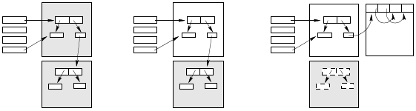
CMM Phases
Root Set
Heap
Root Set
Heap
Root Set
Heap
Before Collection
After Page Promotion
After Compaction

Slide 12
CMM Visitor Pattern
class CmmObject {
void* operator new(size_t, CmmHeap*);
virtual void traverse() = 0; // accept visiting GC
void mark();
};
class Node : public CmmObject {
void traverse() {
scavenge(left); // GC visit
scavenge(right); // GC visit
};

Slide 13
Iterators

Slide 14
C++ Template Enumeration
template<class T>
class EnumerableVector : std::vector<T> {
public:
Enumeration getEnumeration() {
return (Enumeration(this));
}
class Enumeration { … }
};

Slide 15
Enumeration (2)
class Enumeration {
private:
vector<T> const* vp;
unsigned idx;
public:
Enumeration(vector<T> const* vector) :
vp(vector), idx(0) { }
T const& next() { // uses 'T‘
if (idx == vp->size())
throw NoSuchElementException(index);
return (*vp)[idx++];
}
bool hasNext() { return idx < vp->size(); }
};

Slide 16
Enumeration (3)
EnumerableVector<int> ev;
…
EnumerableVector<int>::Enumeration en = ev.getEnumeration();
while (en.hasNext())
cout << en.next() << endl;

Slide 17
C# Iterators
interface IEnumerable<T>
interface IEnumerator<T> : IDisposable {
bool MoveNext();
T Current { get; }
void Dispose();
}

Slide 18
Java Enumeration Interface
interface Enumeration<T> {
boolean hasMoreElements();
T nextElement();
}

Slide 19
Java Iterator Interface
interface Iterator<T> {
boolean hasNext();
T next();
void remove();
}

Slide 20
Java for loop
ArrayList<String> items;
for (String item : items) { System.out.println(item);
}
Works for any object that implements the Iterable interface

Slide 21
Java Iterable Interface
interface Iterable<T> {
Iterator<T> iterator();
void forEach(Consumer<? super T> action);
default Spliterator<T> spliterator();
}

Slide 22
Java 8: forEach + lambda
Map<String, Integer> items =
new HashMap<>();
items.put("A", 10); …
items.forEach((k,v)->
System.out.println("Item: " + k + " Count: " + v));
// method reference items.forEach(System.out::println);

Slide 23
Python Iterators
Obtain an iterator. Method in iterable class:
def __iter__(self): …
Iterator interface. Single method
def __next__(self): …
Termination by raising
StopIterationException
Builtin function iter() takes an iterable object and returns an iterator

Slide 24
Generators

Slide 25
What is a generator?
A generator is an iterator (not viceversa)
A method or a function can be turned into a generator by a specific language construct like:
  yield

Slide 26
Problem: collecting all results
An accumulator is needed
Nodes FindBlue(Node n) {
Nodes buf = new Nodes();
if (n.color == Blue)
buf.append(n);
for (Node child: n.children())
buf.append(FindBlue(child));
return buf;
}
Nodes B = FindBlue(root);
for (Node b: B) {
Read(b);
Write(b);
Play(b);
Empty(b);
}
Find blue nodes and do something on each

Slide 27
With a Generator
Enumerator<Node> FindBlue(Node n) {
if (n.color == Blue)
yield return n;
for (Node child: n.children())
FindBlue(child);
}
for (Node n: FindBlue(root)) {
Read(n);
Write(n);
Play(n);
Empty(n);
Delete(n);
}
Find blue nodes and do something on each

Slide 28
Generator vs Stateful Function
Generator
  Language-level construct that keeps runtime state of a function across invocations
  Uses simple instructions with clear semantics
    yield break
    yield return
Stateful Function, i.e. closure
  Must be implemented by user
  Requires complex control structures
Visitor Pattern

Slide 29
Yield Operator
Available in:
  C#
  JavaScript
  Python
  Ruby
Special case of closure (or continuation)

Slide 30
Infinite Sequence
def fib():
first = 0
second = 1
yield first
yield second
while True:
next = first + second
yield next
first = second
second = next
for n in fib():
print n

Slide 31
Compiler turn into a closure-like
def fib():
first = [0]
second = [1]
def next():
res = first[0] + second[0]
first[0] = second[0]
second[0] = res
return res
return next

Slide 32
Tree Visit
class Node():
def __init__(self, label):
self.label = label
self.left = None
self.right = None

Slide 33
Hand coded iterator
class Node():
…
def __iter__(self):
return TreeIterator(self)
class TreeIterator():
def __init__(self, node):
self.stack = [node]
# state can be either: 'goLeft', 'visit', 'goRight'
self.state = 'goLeft'

Slide 34
Iteration method
def next(self):
while self.stack:
node = self.stack[-1] # stack top
if self.state == 'goLeft':
if node.left:
self.stack.append(node.left)
else:
self.state = 'visit'
elif self.state == 'visit':
self.state = ‘goRight’
return node.label
elif self.state == 'goRight':
self.stack.pop() # its visit is complete
if node.right:
self.state = 'goLeft'
self.stack.append(node.right)
else:
self.state = 'visit‘ # no fully visited nodes are on the stack
self.stack.pop()
raise StopIteration

Slide 35
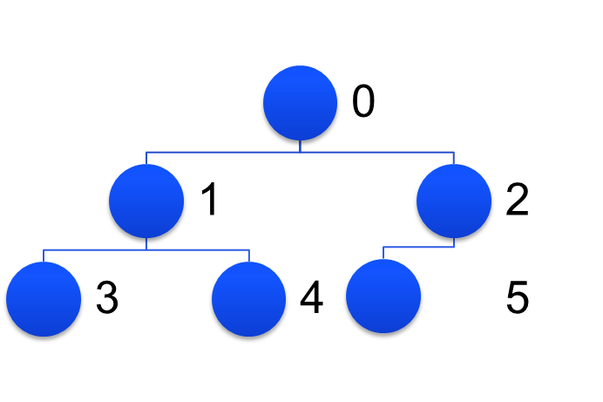
Testing the iterator
n0 = Node(0); n1 = Node(1); n2 = Node(2)
n3 = Node(3); n4 = Node(4); n5 = Node(5)
n0.left = n1
n0.right = n2
n1.left = n3
n1.right = n4
n2.left = n5
for n in n0:
print n

Slide 36
Expansion of the for loop
it = n0.__iter__()
try:
while True:
v = it.next()
print v
catch StopIteration:
continue

Slide 37
Inorder Visit
def inorder(t):
if t:
for x in inorder(t.left):
yield x
yield t.label
for x in inorder(t.right):
yield x

Slide 38
Tree insertion
class Node():
def __init__(self, label):
self.label = label
self.left = None
self.right = None
def insert(self, val):
if self.label < val:
if self.right:
self.right.insert(val)
else:
self.right = Node(val)
elif self.left:
self.left.insert(val)
else:
self.left = Node(val)

Slide 39
Test
r = Node(0)
for i in [2, 1, -2, -1, 3]:
r.insert(i)
for v in inorder(r):
print v
-2 -1 0 1 2 3

Slide 40
Example
def map(func, iterable):
result = []
for item in iterable:
result.append(func(item))
return result
def imap(func, iterable):
for item in iterable:
yield func(item)

Slide 41
'yield' and 'try'/'finally'
Python does not allow 'yield' inside a 'try' block with a 'finally' clause:
try:
yield x
yield x
finally:
print x
'yield' inside 'finally' or in 'try'/'except' is allowed

