Slide 1



A Web-Based System to improve
the Women Quality of Life and
Quality of Care
A. Starita*, K. Cerbioni*, E. Palanca*
D. Majidi°, R. Fontanelli°
*Computer Science Department, University of Pisa, Italy
°Synapsis s.r.l., Livorno, Italy
EMBEC, Vienna November 6th, 1999

Slide 2
The WOMAN Project
An European Project covering the Sector C/7 Health Care of the Telematic Application Programme.
The field of interest is a subset of the endocrine-physiologic-reproductive female sphere, i.e. Post-Menopause
EMBEC ’99

Slide 3
Consortium
C1: Dipartimento di Medicina Della Procreazione e dell’Etá Evolutiva, Università degli Studi Pisa
C2: Dip. di Informatica, Università degli Studi di Pisa
A2.1: Synapsis s.r.l., Livorno
C3: Department of Obstetricia and Gynaecology, Free University Hospital of Amsterdam
C4: Università di Napoli, “Federico II”, Istituto di Ginecologia Ostetrica e Fisiopatologia della Riproduzione Umana
C5: Autonomous University of Barcelona, Fundacio Santiago Dexeus Font
C6: Engineering Ingegneria Informatica spa
EMBEC ’99

Slide 4
WOMAN Goals
The main goal is to offer to Women continuity of care, accessibility to data, knowledge and information, regarding Menopause
Development of a Web Application to improve the co-ordination of shared data and to provide tutorial/assistant Telematic Services for Clinicians.
Integration of the already existing resources available on Menopause (knowledge, information, databases) at the Healthcare Centres involved in the project.
EMBEC ’99

Slide 5
WOMAN Steps
Networking (physical and logical) connection between the primary centres and the other functional areas (radiology, pathology, etc.) within each hospital
creation of a WOMAN HealthCare Patient Record, based on distributed database for an optimal use of shared data (personal, clinical, instrumental test records)
development of user friendly telematic applications that make easier the exchange of multimedia data such as mammograms, ecographies, etc., through agreed file formats following the recommended European Standards
EMBEC ’99

Slide 6
WOMAN Steps
creation of statistically significant databases for epidemiological studies in order to achieve new informative, tutorial, assistant and research protocols
diffusion and dissemination of information, data, results through easily accessible Telematic informative services, to support the post-menopausal women to make informed choices in self-care, and in prevention of the major serious diseases
creation of Telematic Services for Women to improve the continuity of care and the interactions with healthcare structures
EMBEC ’99

Slide 7
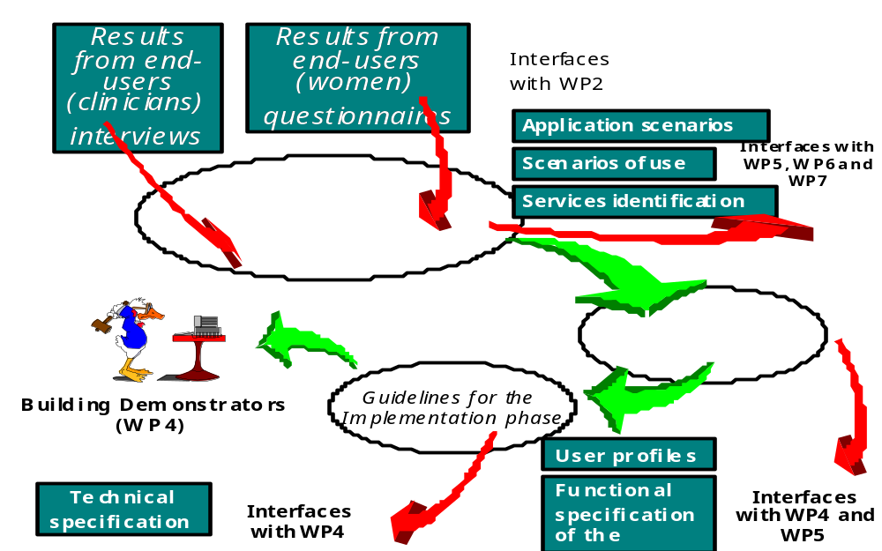
WOMAN Schema

Slide 8
WOMAN Analysis
The user needs analysis, in collaboration with the clinical partners has identified:
  Users profiles and Services profiles
  Definition of the Woman HealthCare Patient
  Record
  Woman Application Scenarios
  Woman Use Cases
  Proposed Services
EMBEC ’99

Slide 9
Object Oriented Design
Adoption of the Unified Modelling Language to
formally represent User Needs Analysis.
Using UML the following steps were performed:
definition of case diagrams to represent the domain
actors and related accessible services
design of the Woman HealthCare Patient Record in
accordance with the Security Standardisation rules
(CEN/TC 251, ISO, UNI, etc.)
design of the relational Database
design of the system able to provide the telematic
required services
EMBEC ’99

Slide 10
WOMAN User Profiles
  Women (WOMEN divided into two groups
  PATIENTS & global CITIZENS)
  Clinicians in WOMAN consortium
  (PARTNERS)
  Clinicians in out-patient departments in
  Woman consortium (OUTPAT)
  General Practitioners (GP)
  Gynaecologists (GYN)
  Other Specialists (OTHER)
  System Administrator (ADMIN)
EMBEC ’99

Slide 11
WOMAN individuated Services
Information on Menopause to women
Information on Menopause to Medical staff
Clinical File: Intranet Access to Local Data
Clinical File: Extranet Access to Remote Data
Person-to-person consulting
Multi-point (broadcast) consulting
Tele Booking
Multilingual application languages
EMBEC ’99

Slide 12
Service: Information on Menopause
Women and Medical Staff accessing the Multilanguage Informative Web Sites will easily retrieve different kind of information
Pisa
Computer Science Dept.
CENTRAL
Pisa
HealthCare Centre (C1)
LOCAL
Naples HealthCare Centre (C4)
LOCAL
Amsterdam HealthCare Centre (C3)
LOCAL
Barcelona HealthCare Centre (C5)
LOCAL
EMBEC ’99

Slide 13
Services: Intranet & Extranet
Intranet Access
  Clinical Local Data management regarding
  women patients of the HealthCare centre
  Accessing point to the Telematic Services for
  Clinicians
Extranet Access
  Interaction between different Menopausal Clinics
  for sharing information collected in different
  distributed databases
EMBEC ’99

Slide 14
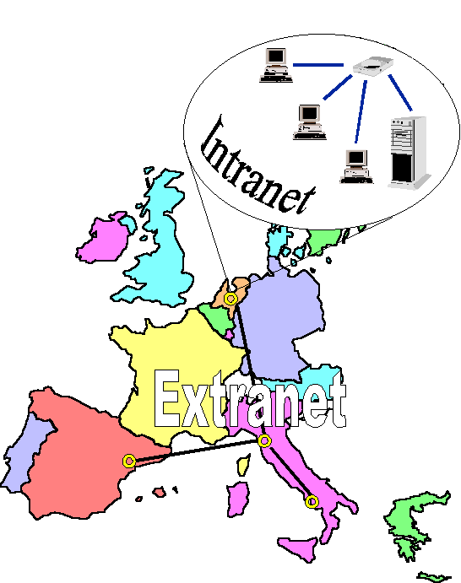
WOMAN

Slide 15
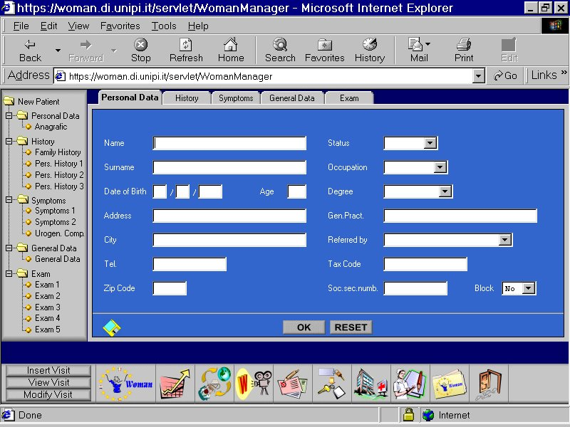

Slide 16
Services
Person-to-person consulting, tools as e-mail, videoconference, and on-line reports will be provided
Multi-point (broadcast) consulting, tools as videoconferencing and multiple lists will be provided
Tele Booking, women will have the possibility to book, via Web, services, visits and exams
Multilingual application languages, English is the language of the inter-centre connections, while at local level the national idiom for women and clinicians is provided
EMBEC ’99

Slide 17
The WOMAN Technological Framework
Distributed, Object-Oriented, Platform Independent and Multilingual service provision system using:
  Three-tier JAVA-based implementation
  approach
  eXtensible Mark-up Language (XML)
  Database and Integrated Development
  Environment, based and provided by our
  sponsor, Oracle Enterprise
EMBEC ’99

Slide 18
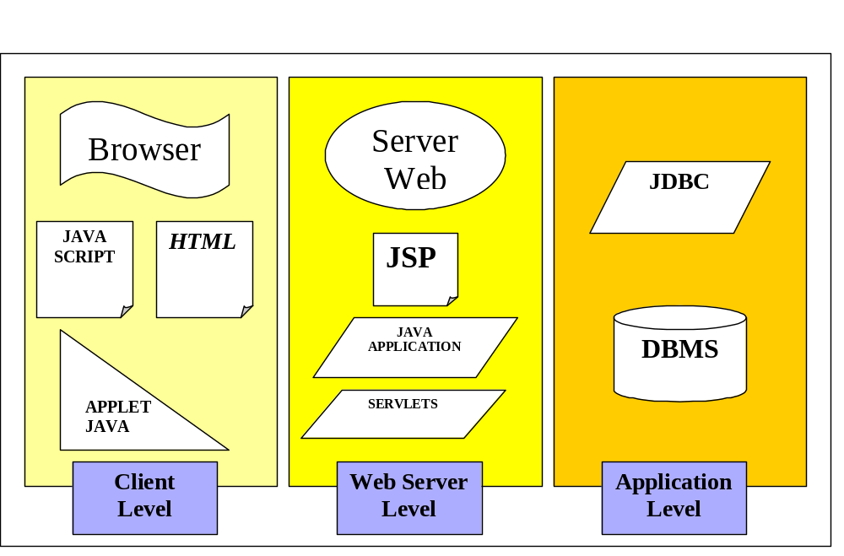
The Web Programming Model
EMBEC ’99

Slide 19
The Web Server Level
Adoption of the Model/View/Controller Paradigm
Model JavaBeans
View Java Server Pages
Controller Java Servlets
Benefits
The code is logically separeted
Usage of best tools for Java and HTML/JSP
Java developers and HTML developers can work
independently
The separation makes the application easier to test
and to maintain
EMBEC ’99

Slide 20
Conclusions
The Web environment developed will provide an added value to the existing resources, improving their own quality and their diffusion at peripheral level
The system is Multi-Platform, Multi-Language, Portable, Secure and easy to be Maintained
The system is now under validation and improvement
EMBEC ’99

