Slide 1

COMP10020 – Internet Technologies
Group D
Flutter
Aaron Hamilton (B00869530) Asim Mian (B01813743) Iram Rafique (B00858434) Paul Bennett (B01817143)

Slide 2



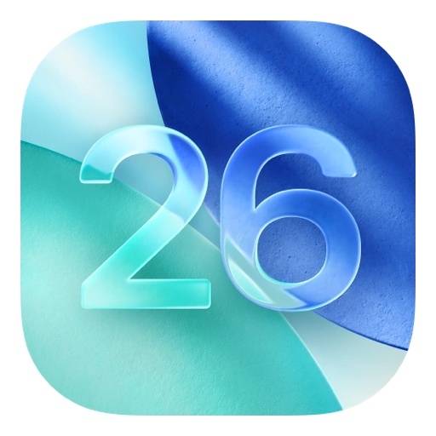



Introduction to Flutter
COMP10020 – Internet Technologies
Group D
Flutter is a cross-platform UI Framework that was created by Google, this allows developers to create one codebase and deploy on multiple platforms.
Flutter is a Declarative UI builder that uses Dart programming language.
Flutter has a rich set of pre-built widgets for creating modern, responsive user interfaces.
First stable build was released in 2018.
The platforms that Flutter support.
Android
Web
iOS
macOS
Windows
Linux

Slide 3
Introduction to Dart
COMP10020 – Internet Technologies
Group D
Dart is an Open-Source Programming Language that was also developed by Google.
It’s used in many application like; Mobile, Web, server and Internet of Things (IoT)
It was designed to replace JavaScript for Web but was redesigned.
Flutter was built around Dart and it is fast and easy to learn.

Slide 4
Relationship between Flutter & Dart
COMP10020 – Internet Technologies
Group D
Flutter is the tool/Framework used to build UI for apps
Dart is the programming language used to write the app code.
Flutter is a Declarative UI Builder
Dart controls the logic and behavior of the app.
Flutter depends on Dart to Run
Dart can be used on its own (web, server, etc.).
Together help create a Multiplatform Application
Dart makes Flutter fast and smooth.

Slide 5
How Flutter Works
COMP10020 – Internet Technologies
Group D
It composes the widgets in the UI.
Implementation of the business Logic.
Dart App
Provides the high-level APIs.
(Widgets, gestures, text input & accessibility)
Turns the Widget Tree into a visual scene.
Framework
Draws Graphics and Text.
Runs the Dart runtime.
Provides low-level Flutter API through dart:ui.
Connects to the platform using the Embedder API.
Engine
Talks to the Operating System.
Handles input, accessibility and rendering surfaces.
Manages event loops.
Provides platform-specific APIs.
Embedder
Combines everything into a runnable app.
Created automictically when you run flutter create
Runner

Slide 6
Flutter’s Widgets
COMP10020 – Internet Technologies
Group D
Flutter’s Widgets are every object that appears on the page is called a widget. It can fall from text to buttons to the structure of the application. Widgets combine into a ‘Widget Tree’.
Container
A widget which allows for styling, padding and positioning of child widgets.
Stack
A widget which allows for us to put children widgets anywhere and overlap.
Row
A widget which allows for us to put children widgets horizontally.
Tx
Text
A widget which allows for us to put string of characters together with different styling options.
Column
A widget which allows for us to put children widgets vertically.
Image
A widget which allows for us to
paint images onto the screen with different styling options.

Slide 7
Stateless & Stateful Widget
COMP10020 – Internet Technologies
Group D
Flutter’s Widgets can be either stateless, meaning they don’t interact or update.
Stateful means they can update, for example a count to increment a value.
STATELESS WIDGET
State does not change after the widget is created.
Suitable for static (Unchanging) content.
Does not have setState()
Text, Icon, Images, etc..
Simple and light weight for fixed content
STATEFUL WIDGET
State can change while the app is running.
Suitable for interactive or changing content.
Uses useState() to update the UI when needed.
Checkbox, TextField, counter
Useful when responding to user interaction

Slide 8
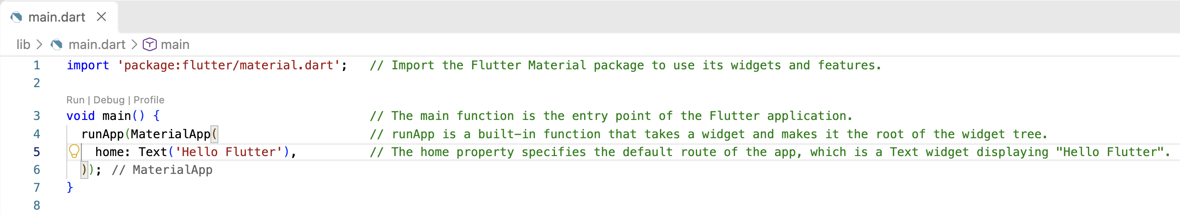
Code Example & Explanation
COMP10020 – Internet Technologies
Group D
Below is basic code to display “Hello Flutter”
Here a basic explanation on each line.

Slide 9
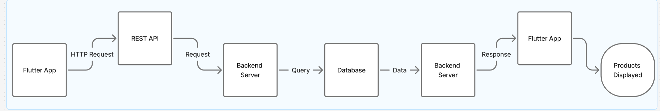

Flutter in a system
COMP10020 – Internet Technologies
Group D
Flutter App
Backend Server
> Request >
> Request >
> Data >
> Query >
Rest API
Database
< Data <
< Data <
Flutter sends a request.
The API receives the request.
The backend processes it.
The database provides the data.
The response returns to Flutter.
Flutter displays the result.
A company wants to create an app
where customers can:
Browse products
View product details
Add products to a basket
Place orders
Flutter can help with this.
Flutter creates the mobile user interface.
Customers interact with buttons, images and product lists.
Flutter communicates with a REST API to send and receive data.
The backend processes requests and works with the database.
Flutter displays the returned information to the customer.

Slide 10
Flutter in a system
COMP10020 – Internet Technologies
Group D
Flutter App
Backend Server
> Request >
> Request >
> Data >
> Query >
Rest API
Database
< Data <
< Data <
A company wants to create an app
where customers can:
Browse products
View product details
Add products to a basket
Place orders
Flutter can help with this.
Flutter creates the mobile user interface.
Customers interact with buttons, images and product lists.
Flutter communicates with a REST API to send and receive data.
The backend processes requests and works with the database.
Flutter displays the returned information to the customer.
Flutter sends a request.
The API receives the request.
The backend processes it.
The database provides the data.
The response returns to Flutter.
Flutter displays the result.

Slide 11
Advantage to Flutter
COMP10020 – Internet Technologies
Group D
Flutter is multiplatform, so you're able to deploy your application on any form of devices. This means you only need to learn one language and update only one codebase.
Faster development time is a result from the single codebase.
Testing can be completed quickly as well with Flutter’s Hot Reload that allows the program to update without having to rebuild the project every time.
Flutter is designed to build dynamic rich UI as they provide many built in widgets for creating customized interfaces
Flutter compiles directly to native machine code for production releases so performance should be great and the same through platforms
Flutter is open source and there are large developer community along side flutter. Helping Flutter become even better.

Slide 12

Disadvantage to Flutter
COMP10020 – Internet Technologies
Group D
Due to the large platform Flutter supports, some platform features may not be compatible relatively quickly.
Due to the nature of Flutter being multiplatform, it can cause apps to be larger in size compare having them natively created.
SEO optimization is sometimes poor due to its long load times and complexities, so it should stay to being a web app, like a music player, rather than blogs and pages.
While easy to learn, it may be harder for someone with no JavaScript / React experience.
Kotlin Multiplatform with Compose is blooming could be a better option for people with stronger experience with Android Development.

Slide 13
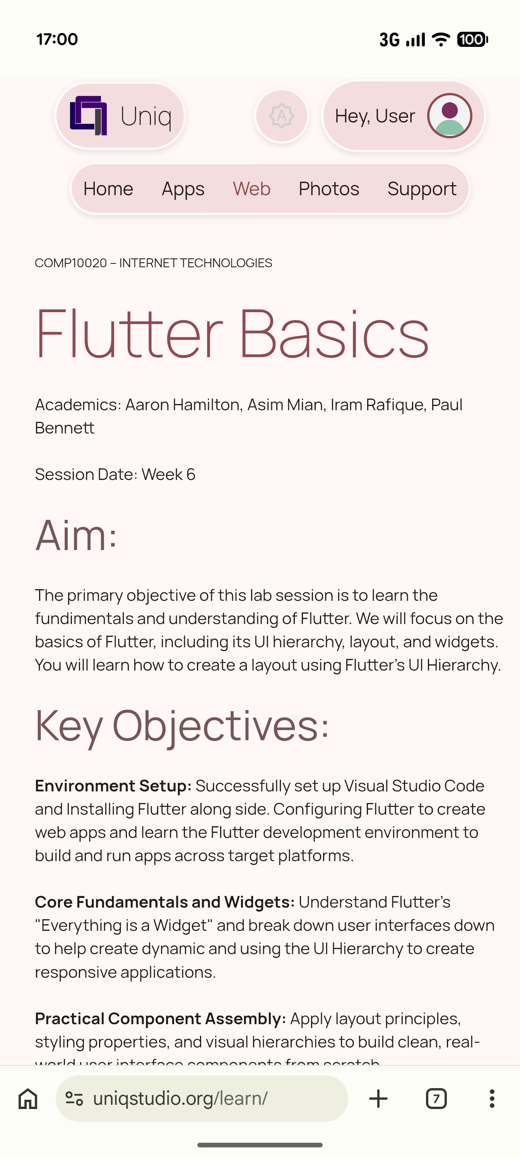
Summary
COMP10020 – Internet Technologies
Group D
Large Multiplatform Support
Dart is the programming language used to write the app code.
Declarative UI Builder
Dart controls the logic and behavior of the app.
Open source by Google, Regally updated with community help
Dart can be used on its own (web, server, etc.).
Easy to learn
Dart makes Flutter fast and smooth.

Slide 14
Now it’s your turn!
COMP10020 – Internet Technologies
Group D
Let’s make a card Widget!
www.uniqstudio.org/learn

Slide 15
References
COMP10020 – Internet Technologies
Group D
Continue with your learning!
Dart (2026) Dart documentation.
Available at: https://dart.dev/ (Accessed: 2 October 2026).
Flutter (2026) Basic widgets.
Available at: https://docs.flutter.dev/ui/widgets/basics (Accessed: 1 October 2026).
Flutter (2026) Building user interfaces with Flutter.
Available at: https://docs.flutter.dev/ui (Accessed: 1 October 2026).
Flutter (2026) Common architecture concepts.
Available at: https://docs.flutter.dev/app-architecture/concepts (Accessed: 2 October 2026).
Flutter (2026) Flutter architectural overview.
Available at: https://docs.flutter.dev/resources/architectural-overview (Accessed: 30 September 2026).
Flutter (2026) Flutter documentation.
Available at: https://docs.flutter.dev/ (Accessed: 30 September 2026).
Flutter (2026) Flutter widget index.
Available at: https://docs.flutter.dev/reference/widgets (Accessed: 2 October 2026).
Flutter (2026) How Flutter works.
Available at: https://docs.flutter.dev/learn/pathway/how-flutter-works (Accessed: 3 October 2026).

Slide 16
COMP10020 – Internet Technologies
Group D
Questions?
Aaron Hamilton (B00869530) Asim Mian (B01813743) Iram Rafique (B00858434) Paul Bennett (B01817143)

