Slide 1

Customer Shopping Behavior Analysis
Transactional insights from 3,900 purchases across product categories — uncovering spending patterns, segments, and strategic opportunities.

Slide 2

Dataset at a Glance
3,900
18
Transactions
Features
37
Missing Values
Review Rating column
Demographics · Purchase details · Shopping behavior · Subscription status

Slide 3

Data Preparation in Python
Load & Explore
Clean Data
Engineer Features
Load to PostgreSQL
Snake_case standardization, redundant column removal, and database integration completed the pipeline.

Slide 4
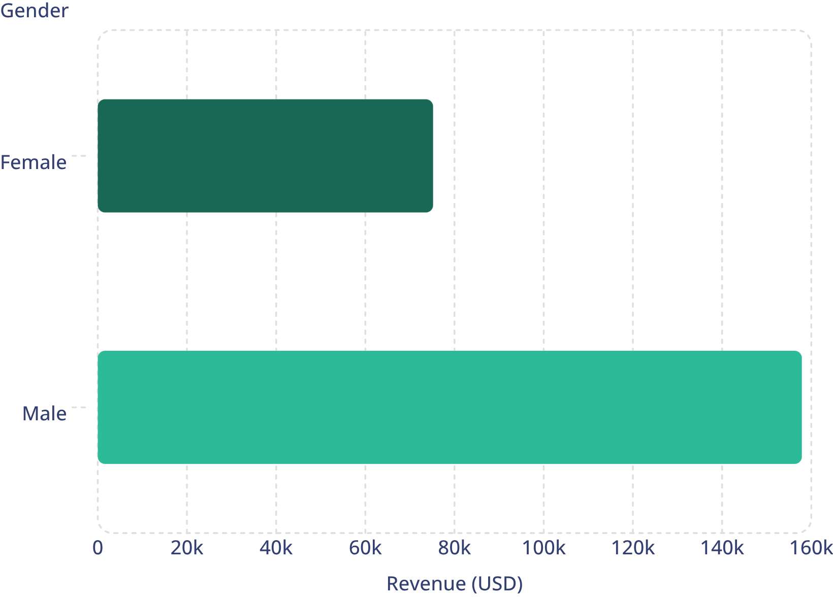

Revenue by Gender
Key Finding
Male customers generated 2.1× more revenue than female customers across 3,900 transactions.
Male: $157,890 · Female: $75,191

Slide 5
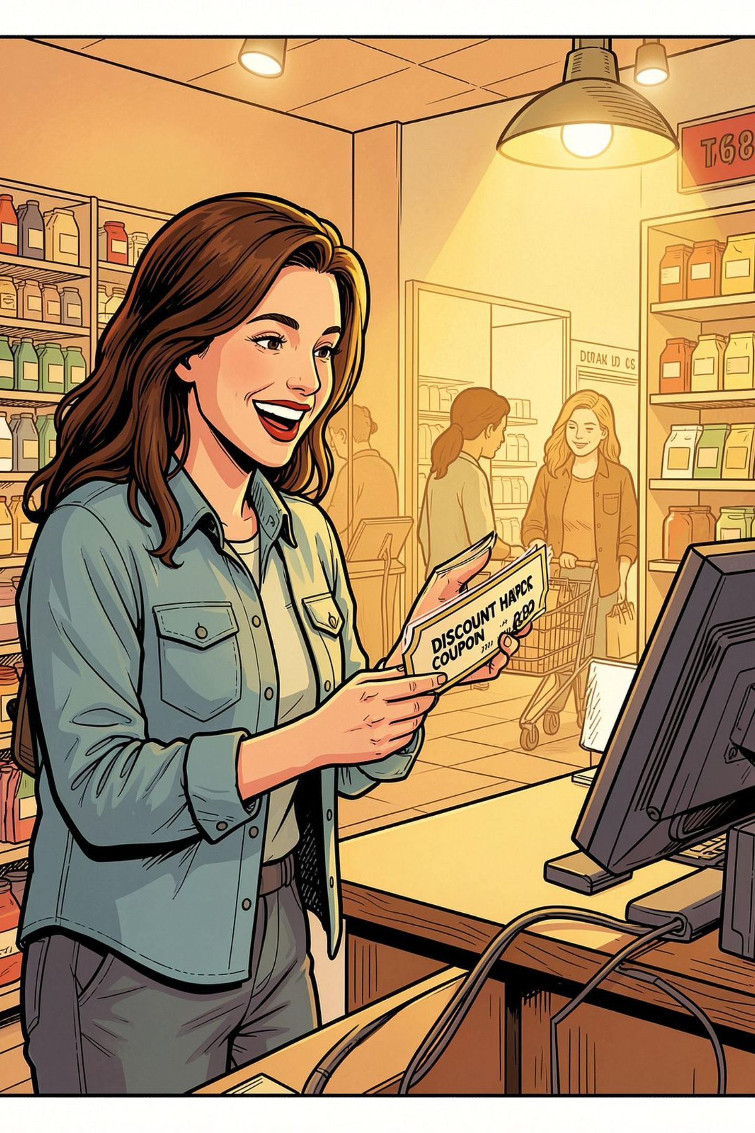
Discount & Shipping Insights
839 High-Spend Discount Users
Express vs. Standard
Used discounts but still spent above average purchase amount
Express avg: $60.48 · Standard avg: $58.46
Most Discount-Dependent
Hat (50%), Sneakers (49.7%), Coat (49.1%)

Slide 6
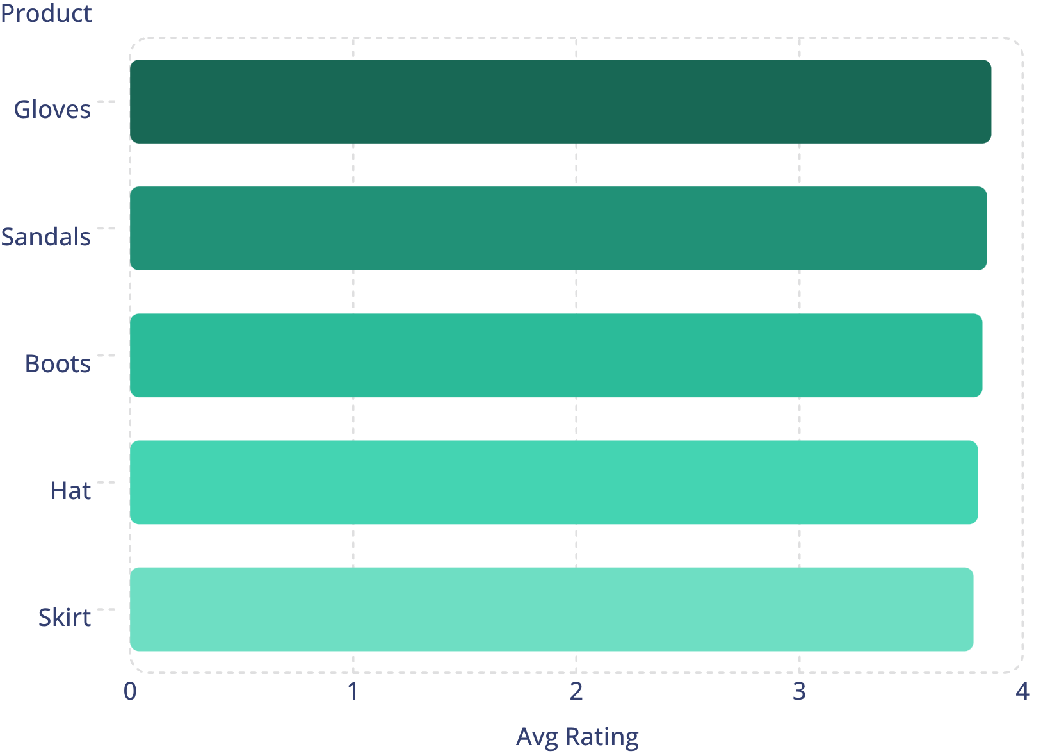
Top-Rated Products
Top 5 by Average Review
Overall average review rating: 3.75 / 5.0
Gloves lead at 3.86 — strong candidates for featured campaigns.

Slide 7
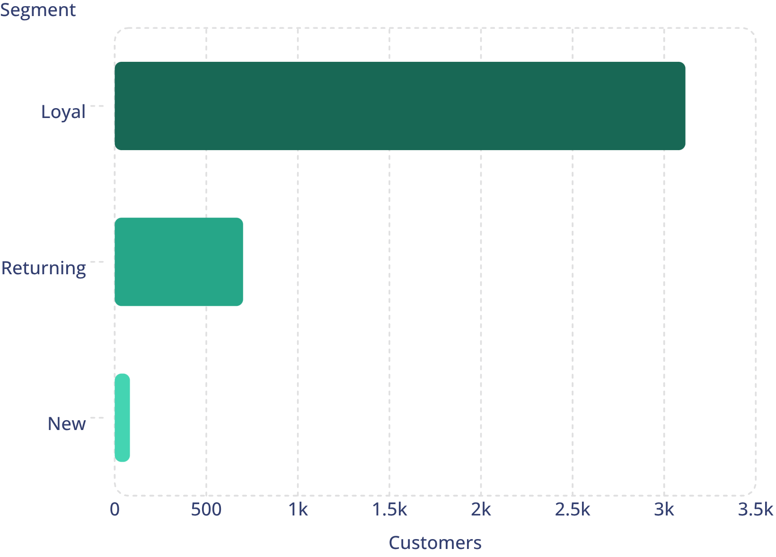
Customer Segmentation
Segment Breakdown
Loyal customers dominate at 3,116 — 80% of the base.
Only 83 new customers; opportunity to grow acquisition.
958 repeat buyers (>5 purchases) are subscribed

Slide 8


Subscribers vs. Non-Subscribers
27%
73%
Subscribed
Non-Subscribed
1,053 customers · $62,645 revenue
2,847 customers · $170,436 revenue
Avg spend nearly identical: $59.49 (subscribers) vs. $59.87 (non-subscribers). Subscription conversion is the growth lever.

Slide 9
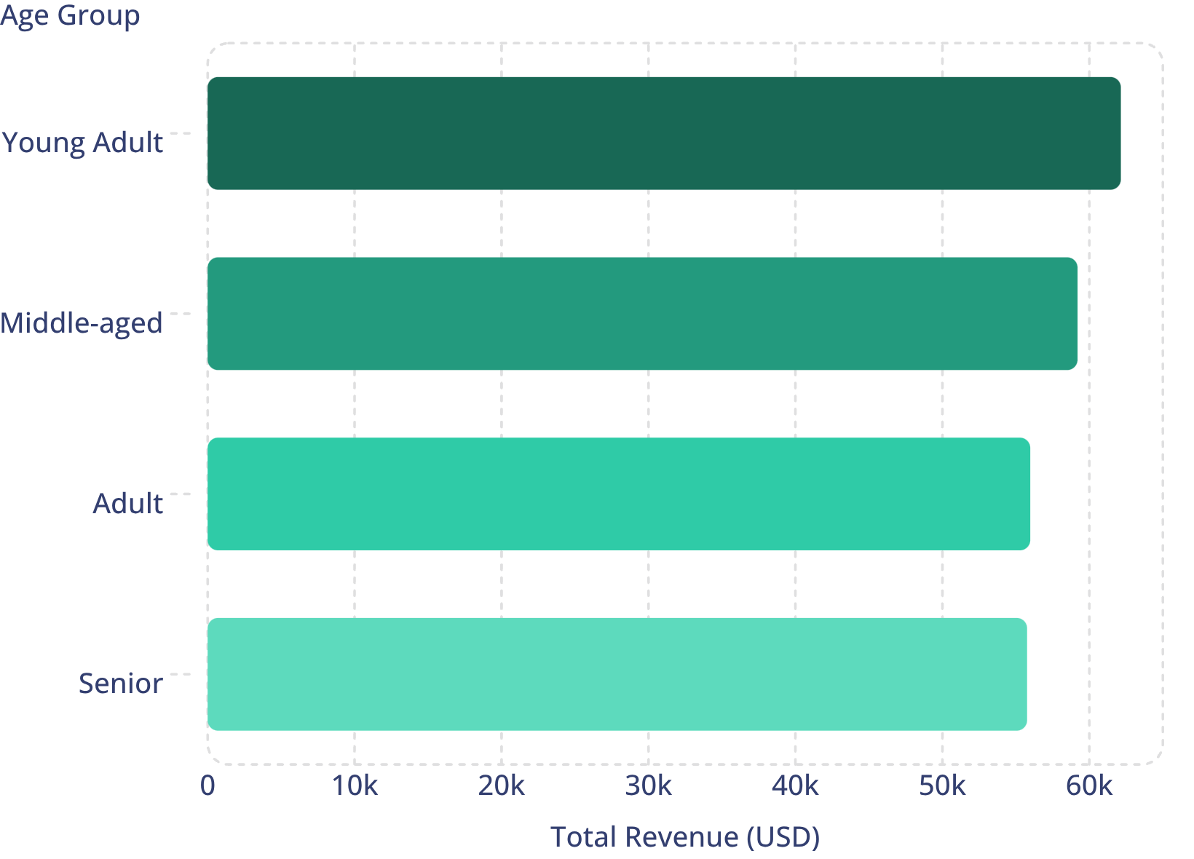
Revenue by Age Group
Age Group Performance
Young Adults lead revenue at $62,143. Revenue is relatively evenly distributed — all groups are valuable targets.

Slide 10





Business Recommendations
Boost Subscriptions
Promote exclusive subscriber benefits
Loyalty Programs
Reward repeat buyers → Loyal segment
Review Discount Policy
Balance sales lift with margin control
Targeted Marketing
Focus on high-revenue age groups & express-shipping users

