Slide 1

Airtel Udyam
A small business goes digital in one sitting
Team Shenron, IIITD
Unique · Mayank Kataria
Live prototype https://airtel-udyam-kappa.vercel.app
Code github.com/Unique0202/Team_Shenron_Airtel_Hackathon
Watch demo video

Slide 2

Only 7 in 100 interested businesses become customers
One quarter of SMB leads (5,000, Apr–Jun 2026): 17.6 days to activate, 3 status calls per customer, ₹15,053 to acquire each customer
Where the 4,632 lost leads went, and what fixes it
Why they left | Leads | Our fix
Never reached, or no one visited | 1,951 | Advisor works any time, no visit
Quote slow, complex or too pricey | 1,006 | Instant plain bill, right-sized bundle
Not interested, locked in, mobile only | 1,182 | Better targeting; start with one SIM
Paperwork, mismatched documents | 273 | Smart KYC + e-sign
Waited after KYC (install, payment) | 220 | Tracker; check feasibility upfront
Funnel stage (% of previous stage). Source: smb_leads.csv
What we found in the data
2,830 of the lost leads (61%) dropped for reasons a self-serve journey removes: no visit, slow or confusing quote, paperwork, silence after KYC.
Status chasing predicts churn: 1 call 6% churn, 5 calls 28%.
Digital leads are cheapest (₹112–274 per lead) but 26–32% are never reached.
Sales sells the target, not the need: 5G AirFiber asked 39×, sold 9×.
No GSTIN, no deal: 2.0% conversion vs 9.6%; Tamil leads via field sales 2.6%.

Slide 3
Who to win first, with what bundle, at what price
Lead with professional offices, win micro businesses digitally, keep field sales for chains. Bundles are the prototype's real output.
1 Professional offices
25% of leads · 11.1% convert · lowest CAC (₹10,695)
Example: Dental clinic, 2 sites, 12 staff
Fibre 300 ×2, cloud backup, endpoint security, managed firewall, cloud email
₹9,811 / month
2-year plan, setup halved to ₹4,000
Digital-first: owners are online and need uptime + data safety
2 Micro retail & services
54% of leads · 4.1% convert · CAC ₹20,007 vs ₹2,470 bill
Example: Kirana in Lucknow, 3 staff, no GSTIN
5G AirFiber (no fibre wait), cloud POS & billing, 2 CCTV cameras, website
₹2,825 / month
No GST paperwork needed; live in 4 days
Digital only: a field visit costs more than 8 months of revenue
3 Multi-site & manufacturers
21% of leads · 11–13% convert · ₹16–28k bills, churn 8–11%
Example: Restaurant chain, 5 outlets, 60 staff
Fibre 300 ×5, SD-WAN, 4G failover, CCTV, cloud telephony, 6 SIMs
₹33,754 / month
2-year plan (SD-WAN minimum)
Field sales, with the advisor pre-qualifying the lead
1 Chat
5 minutes, 10 languages, voice
2 Bill
instant, one monthly price
3 Verify
10 minutes, consent first
4 Track
install in 2–7 days, no calls

Slide 4
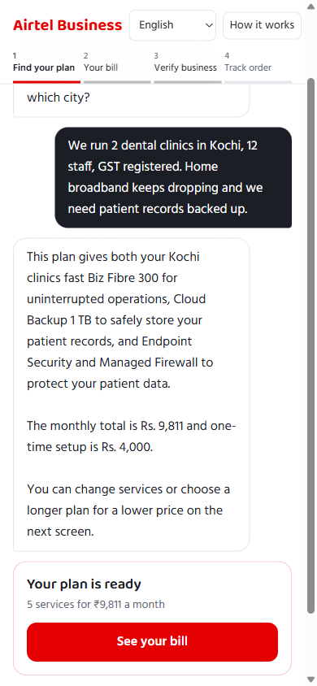
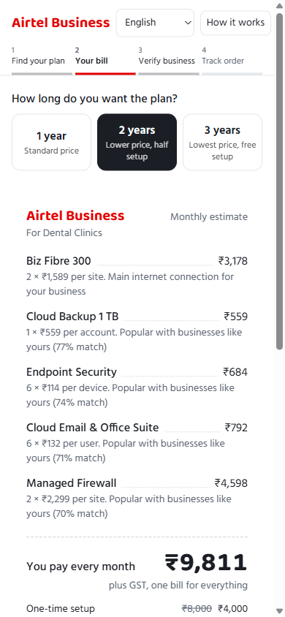
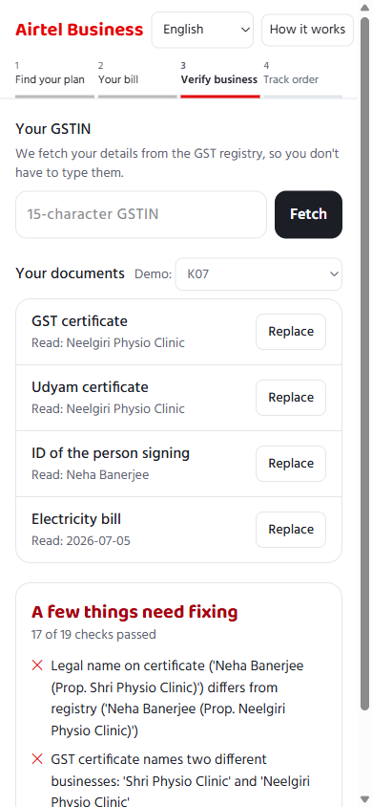
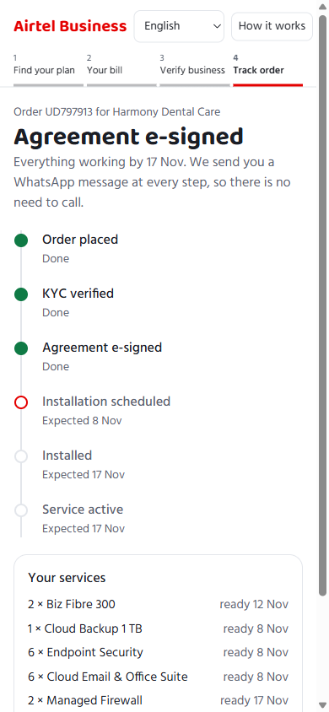
Working prototype: first message to placed order, on a phone
Try it
airtel-udyam-kappa.vercel.app
Tested
Hindi + English chats end to end; 10 languages and voice input
Rules catch all 6 planted KYC problems in the 12 sample applicants; the 6 clean ones pass
Every recommended bundle passes eligibility, dependency and budget rules (automated tests)
Also built
Under-the-hood panel: profile, ML scores, what the model saw
Partner console: dropped leads ranked by likelihood to convert
1 Advisor understands the business and explains the plan in plain words
2 One monthly bill like a shop receipt; toggle services, pick 1–3 years
3 Smart KYC caught a planted problem: two business names on one GST certificate
4 Order tracker with expected dates replaces status calls

Slide 5
Agents talk, rules decide: built for regulated customer data
Business owner
web or WhatsApp, voice, 10 languages
Privacy gateway
GSTIN, PAN, phone, Aadhaar → tokens before any model call
Orchestrator API
journey state, fallback across models
Privacy by design (DPDP Act 2023)
Consent first: purpose, what is collected, retention and withdrawal shown before KYC
Tokenization at source: identifiers never reach the external model
Masking in screens, API responses and logs (32TTNX•••••T1ZW)
Minimisation: registry lookup pre-fills details; only 4 documents asked
Retention: photos are read in memory, never stored; only the verification result is kept
Localisation: production runs the model in an India region or on Airtel's Agent Bridge
Telecom rules: business KYC is instant; each SIM user still completes their own e-KYC
Advisor agent
chat + profile extraction
KYC agent
reads document photos
Order agent
state machine, no model
Rules engine: city tier, size, GSTIN, dependencies
Blur check before any model call
Tracker with expected dates + WhatsApp updates
ML ranker: 25 product models, AUC 0.78
GST & Udyam registry lookup, checksum + misread repair
Per-SIM-user e-KYC step (DoT rule)
Pricing: contract & bundle discounts, budget cap
20 cross-document checks (names, state, 90-day bill)
Partner console: propensity model, AUC 0.75
Why judges can trust the output: the language model only converses and extracts. Which products are allowed, what they cost and whether KYC passes is decided by code, so the advisor cannot invent a price or sell an ineligible product. Busy or out-of-quota models fail over in seconds; each document photo is read only once.

Slide 6
Rivals stop at “request a callback”; we close online, on one bill
 | Bundle across products | Online checkout | Indian languages | One bill | Digital KYC | Entry price / month
Jio Business | Partly: BB + cloud + landline | Partly: buy online or callback | No (English pages) | Partly | No, at install | ₹801 (100 Mbps)
Vi Business | No: mobile only | Partly: form, 48 h callback | Not stated | No | Partly, doorstep | Not published
Tata Tele Business | Partly: office packs | No: callback, partners | Partly: voice AI | Partly | No | Quote only
Airtel Business today | No: separate silos | No: callback in 1 day | No | No | No | ₹499 (2022 list)
Local ISPs | No: broadband only | Partly: app booking | Local staff | No | Partly, app upload | ~₹699
Single-product apps | No: one tool each | Yes, minutes | Partly | No | Yes | ₹59–2,799 each
Airtel Udyam (ours) | Yes: 25 products, rules-checked | Yes | Yes: 10 + voice | Yes | Yes: registry + e-sign | ₹2,825 (kirana bundle)
Where we win
• Close simple cases online; telcos all stop at a callback
• One bundle, one bill replaces 4–6 vendors (ISP, telco, WhatsApp, email, POS, CCTV)
• Only Airtel owns network, SIMs, WhatsApp channel and partners to do it
Watch out
• Jio sets the price anchor (₹801): sell total value, not Mbps
• Tata Tele is moving to advisor + voice AI; speed matters
• SaaS apps sign up in minutes: our checkout must match
Field force & partners
• Advisor closes simple cases; complex and dropped leads go to people
• Partner console ranks leads: top 20% hold 47% of activations
• Partners earn commission on assisted digital sign-ups; installs stay human
Sources: operator websites and press, Oct 2025 – Nov 2026 (full list in analysis/competition.md).

Slide 7
Impact: 2× the customers from the same leads, at 60% lower cost
Metric | Today | Target (12 mo) | Lever
Lead → activation | 7.4% | 15% | No-visit and quote drops recovered online
Time to activate | 17.6 days | ≤ 7 days | Instant quote and KYC; install is the only wait
Acquisition cost | ₹15,053 | ≤ ₹6,000 | Micro and digital leads off field sales
Status calls / customer | 3.0 | < 0.5 | Tracker + proactive WhatsApp updates
6-month churn | 15.2% | ≤ 10% | Fewer chases, right-sized bundles (≤ 6 items)
6-month churn by status calls the customer made
Status calls per activated customer (n = 368)
Same 5,000 leads a quarter: 368 → 750 customers. At the median ₹6,900 bill that is about ₹3.2 crore more annual revenue from each quarter's leads, for ₹45 lakh of acquisition spend instead of ₹55 lakh today.
Next
Site-feasibility check before the quote (41 leads lost to “fibre not feasible”)
GST registration help for the 29% of leads without a GSTIN
A/B test the advisor against field sales in the pilot
Rollout
0–3 months: pilot in Kochi and Lucknow, professional offices + micro, 3 languages
3–9 months: 10 cities, WhatsApp front end, partner console to channel partners
9–12 months: national, 10 languages, on Airtel's Agent Bridge
Risks and mitigations
Wrong advice: rules decide, human handoff in one tap
Model outage or quota: multi-model fallback, cached reads
Channel conflict: partners paid on assisted digital deals
SIM KYC rules: per-user e-KYC built into the tracker

