Slide 1
FlakeHound++
A C++ Tool for Detecting Flaky Tests & Automating
Test Analysis
Supervisor: Md. Saeed Siddik
Shohidur Rahman (Roll: 245425)
LOC: ~3500

Slide 2
The Problem: Flaky Tests
Tests sometimes pass, sometimes fail without code changes
Wastes time , developers debug fake problems
Breaks CI/CD trust, can't rely on test results
Hard to find why tests are flaky
Reasons: timing issues, thread/concurrency bugs, random values, environment settings

Slide 3
The Solution: FlakeHound++
Dynamic Analysis
Static Analysis
• Run tests many times
• Track which tests fail
• Count how often they fail
• Find flaky patterns
• Read C++ code
• Look for risky code
• Find flakiness causes
• Tell why tests fail

Slide 4
How It Works - Step by Step
INPUT
Test Code + XML
RUNNER
Run Tests N Times
PARSER
Extract Results
ANALYZER
Find Issues
REPORTS
Show Causes
Simple Flow:
Provide test executable (+ XML for GoogleTest projects)
2. Run tests multiple times
3. Parse and collect all test results (pass/fail data)
4. Analyze code and results to identify flaky tests (static + dynamic analysis)
5. Generate easy-to-read reports with explanations

Slide 5
Before Mid
Test Runner
Runs tests N times, captures results
Aggregates pass/fail data
Flakiness Calculator
Wilson confidence interval (95%)
Categorizes: stable, mildly_flaky, highly_flaky, always_failing
Report Generator
Formats text reports with statistics
Displays Wilson scores
Demo Test Suite
2 stable + 2 flaky tests
Proves detection works

Slide 6
After Mid
XML Parser
Parse GoogleTest XML output for real project (e.g., abseil-cpp)
Extract test names, status, timing data
Static Code Analysis
Build Lexer → AST → CFG pipeline
Analyse test code
Machine Learning
Logistic regression with Stochastic Gradient Descent
Train on static features
Predict flakiness before running tests
Root Cause Explanation
Correlate dynamic failure with static patterns

Slide 7
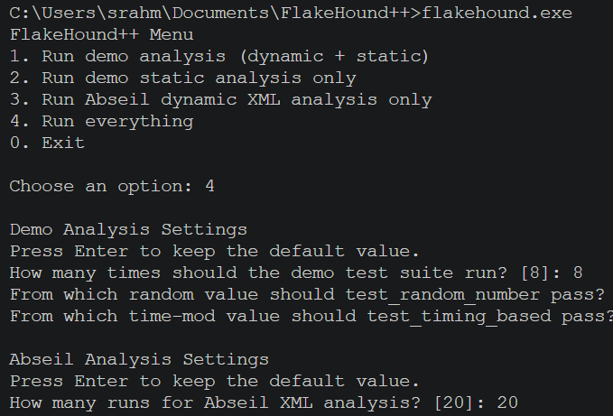
Demo
I/O

Slide 8
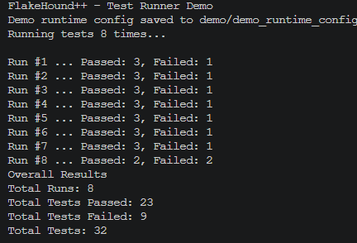
Demo
I/O

Slide 9
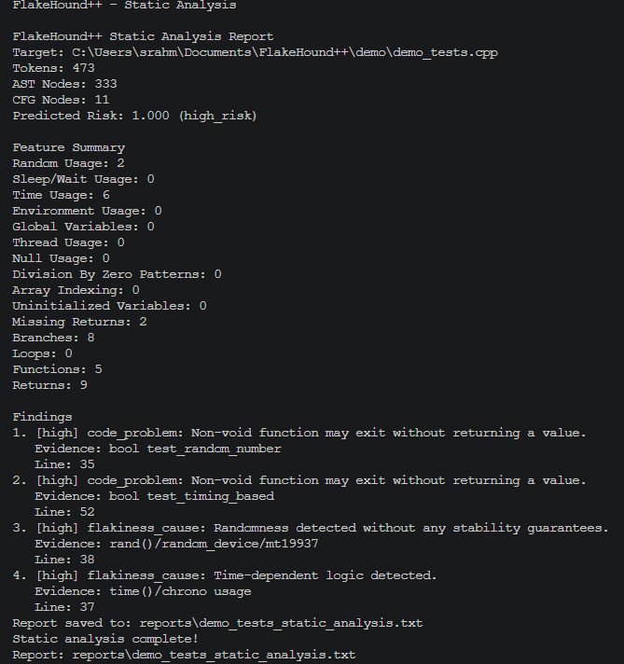
Demo
I/O

Slide 10
What The Tool Will Detect
Flakiness Causes
Code Problems
• Random numbers (no seed)
• Sleep or wait calls
• Environment variables
• Time-based code
• Shared global variables
• Thread/concurrency issues
• Array out of bounds
• Null pointer use
• Memory leaks
• Division by zero
• Uninitialized variables
• Missing return statements

Slide 11
Project Scope
What's Included
• C++ and GoogleTest
• Simple and fast
• Find flaky tests
• Explain why they fail
• Easy to use
Not Included
• Big complex libraries
• Full compiler
• Auto code fixing
• Multiple languages
• Fancy GUI

Slide 12
Thank You!
Questions & Feedback Welcome

