Slide 1
Implementation of the model
The shape of Input/output and CNN model

Slide 2

The shape of input/output
Input: x_train shape: (number of all samples for training, 4)
x_test shape: (number of all samples for testing, 4)
4 means 4 features
Output: y_train shape: (number of all samples for training, 2)
y_test shape: (number of all samples for testing, 2)
2 means 2 labels

Slide 3
CNN Model
convolution 1.st layer + BatchNormalization + Dropout, “relu”, outputshape:4x64
convolution 2nd layer + BatchNormalization + Dropout, “relu”, outputshape:4x128
Maxpooling, strides=1, outputshape:3x128
convolution 3rd layer + BatchNormalization + Dropout, “relu”, outputshape:3x256
Maxpooling, strides=1, outputshape:2x256
Flatten, outputshape:1x512
Dense 1st layer + BatchNormalization + Dropout, “relu”, outputshape:1x64
Dense 2nd layer + BatchNormalization + Dropout, “relu”, outputshape:1x32
Dense 3rd layer + BatchNormalization + Dropout, “relu”, outputshape:1x16
Dense final layer , “softmax”, outputshape:1x2

Slide 4
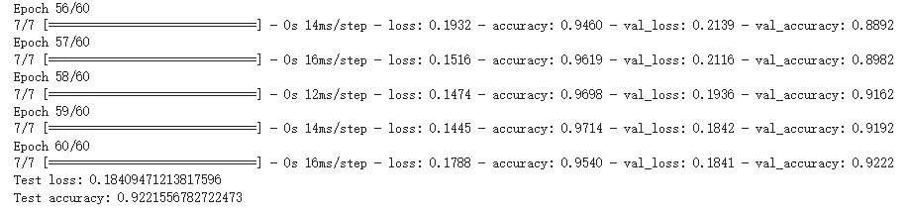
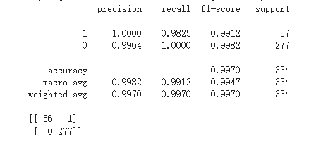
Performance Evalution

Slide 5
result from CNN model visualization

Slide 6
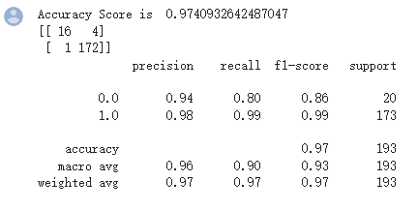
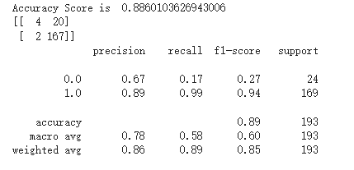
SVM Model and LogisticRegression Model
Accuracy Score of SVM Model
Accuracy Score of LogisticRegression Model

Slide 7
result from SVM model visualization and compare with CNN

Slide 8
Plan
Try different Region and visualisation of results
Improve accuracy
2.1 not in terms of time points, but in terms of time periods
2.2 find better threshold and epoch
monitor Train process to avoid overfitting
improve reality of generation data

