Slide 1
CNN Model and Input structure

Slide 2
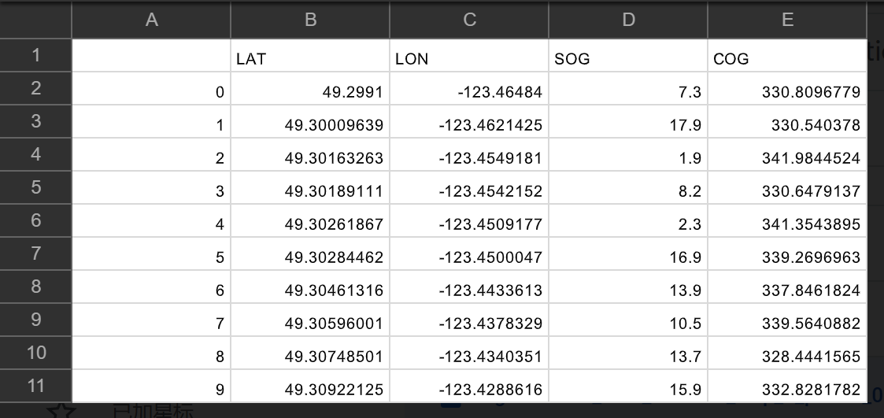
450*Segment (15 ships and 30 period for each) real Data of each Ship in 10 min
Origin_real_Data
Data_region.py
real_Data_region_1
Data_Processing.py
58*Segment (5 ships) generated Data of each Ship in 10 min
generation.py

Slide 3
450x real Segments (each Segment contains 10 timePoint and 4 feature for each timePoint, so its 10x4 2DArray)
combined and be saved in 3D Array 508x10x4
Model
58x generated Segments(each Segment is 10x4 2D Array)
label for each Segment be saved in 2D Array 508x2

Slide 4
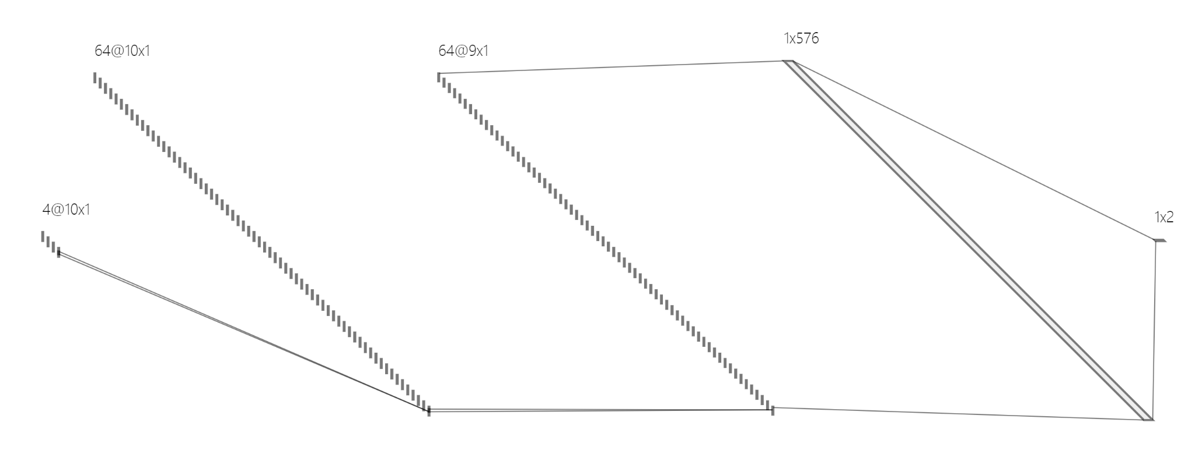

Slide 5
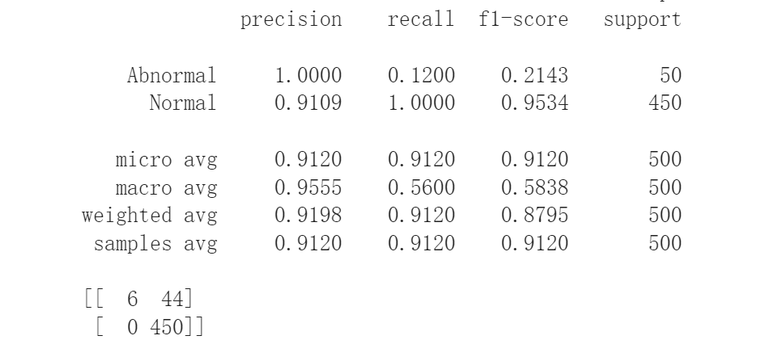

Slide 6
Distance
Distance instead of LOG LON

