Slide 1
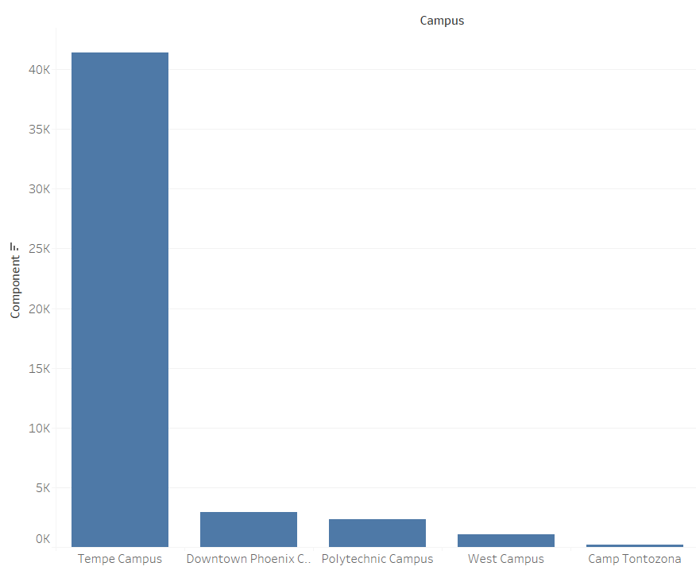
HVAC – Component analysis
Identified the issues related to HVAC system and ~43000 request was raised regarding HVAC between May 2015 to May 2017
We found around 45% of the HVAC issues are because of the components like Handler, Fan, Bearing and Filter

Slide 2
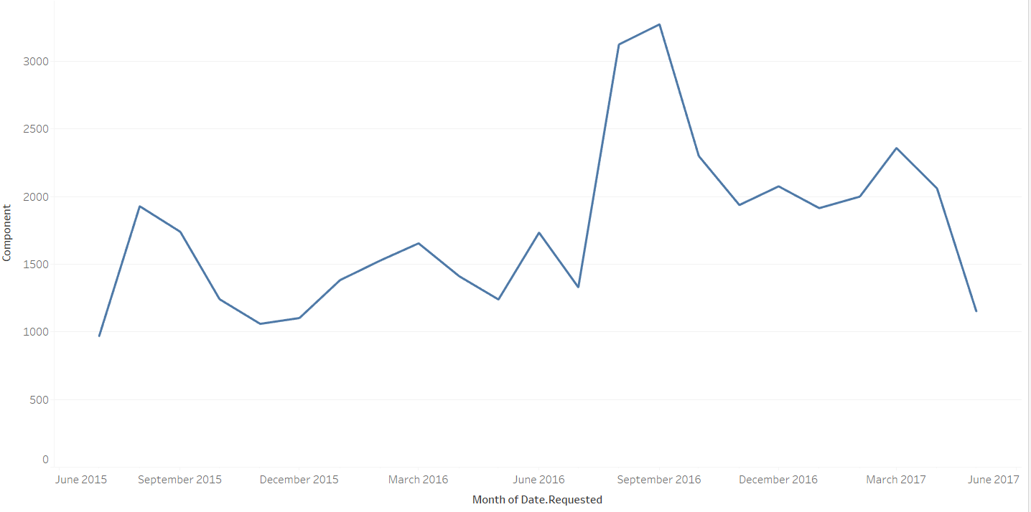
Trend analysis of component failures in Tempe campus
Seasonality and trend exist in the component failure. We were able to see peaks during the month of August, September and small peak in March

Slide 3
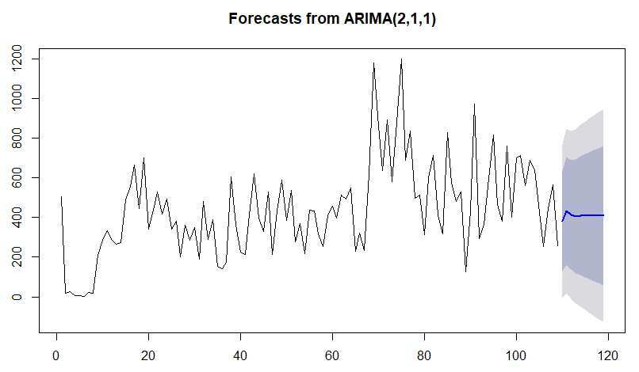
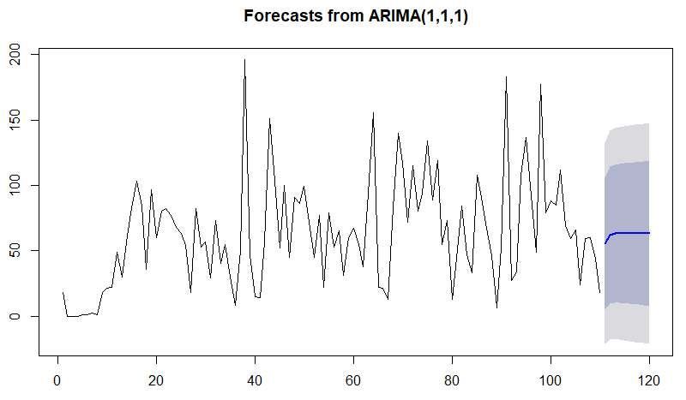
HVAC – Component analysis (Predictive analysis)
Time series
We tried to forecast the component failures using time series methodology
We tried different modeling techniques and different level of granularity (like Holts winter , ARIMA and at month level, week level
ARIMA models gave best results and we also tried to forecast individual component failure
Components Failures at week level
Fan Failures at week level
Regression Techniques
In order to increase the predictive capability. We are working on improving the model by leveraging the text data in the request
We created term frequency( Occurrence of the words in the request) for all the HVAC request and created a lag of one week
We got approximately 5600 new features and added it with old features (120)
Trying different techniques to identify the key predictors from the dataset and working on multiple regression techniques to reduce the error rate

