Slide 1
Electronics!
United Innovators

Slide 2
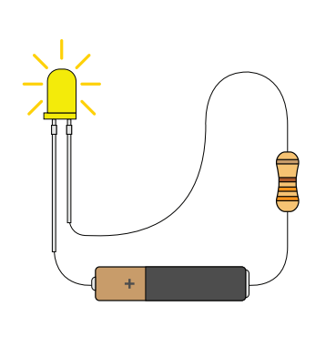

What are Circuits?
A circuit is basically an electrical loop with a starting point and an
ending point - with any number of components in between.

Slide 3
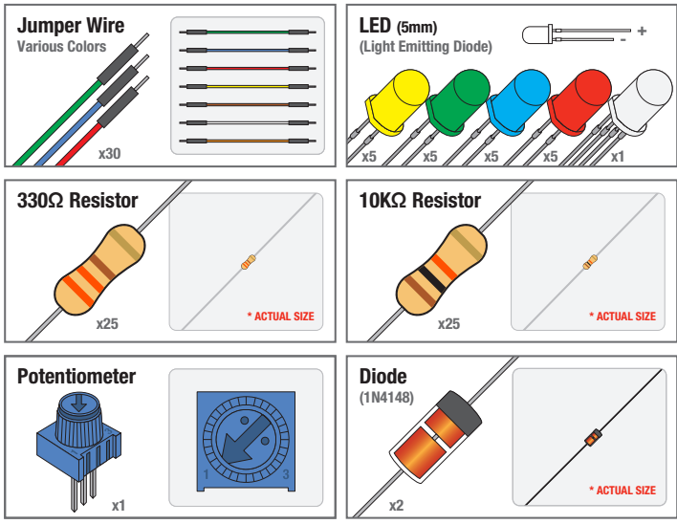
Components of Circuits
Circuits can include resistors, diodes, inductors, sensors of all sizes and shapes,
motors, and any other handful of hundreds of thousands of components.

Slide 4
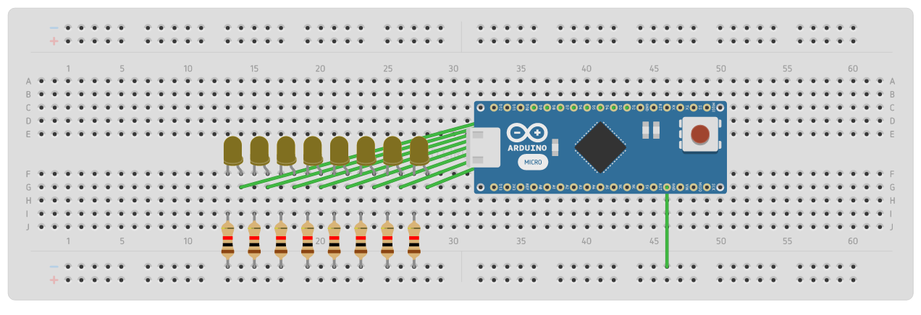
Today’s Objective
We are going to make Circuits using LED’s and different electronic components!
https://circuits.io/circuits/4131173-led-blink-alternating

Slide 5
Instructions
On Each table there are 4 different Circuits for you to explore
Choose a Circuit to begin with and place the components as shown in the diagram.
Follow the instructions for the given circuit.
Witness the awesomeness of your beautiful creation
~Feel Free to change the code and circuits if you would like to do so!
Issues? Questions? Just Ask!

