Slide 1
Bird’s Eye View

Slide 2
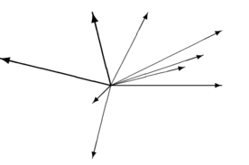
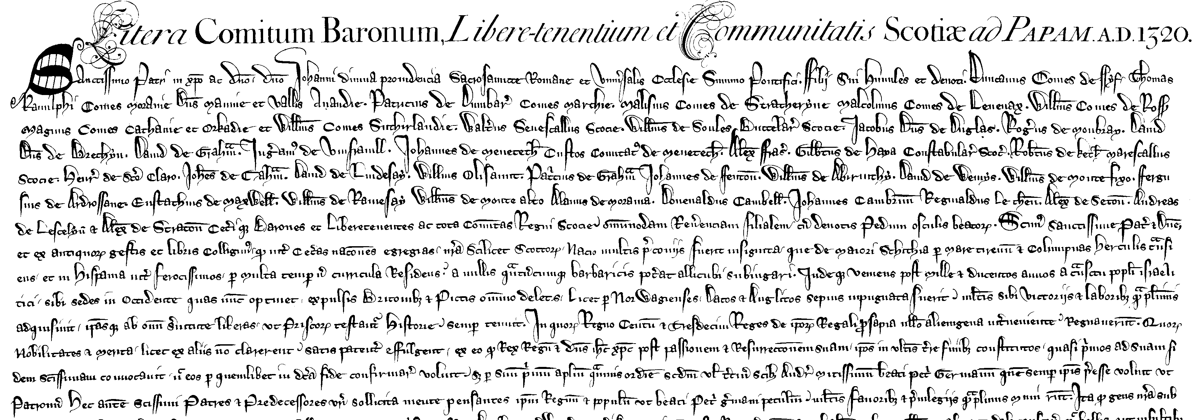

Semantic Analysis in NLP
Logical Forms
λx.p₁(a,b) ʌ p₂(c,x)
Vectors
KBs
Trees/DAGs
w₁ w₂ w₃ w₄ w₅

Slide 3
Symbolic Semantic Representation
The focus of this tutorial: symbolic, sentence-level (or few sentences max)
By “semantic” NLPers refer to many different things
Some of which:
Representation that supports inference
Representation relates to the text to some extra-linguistic semantics (grounding)
The compositional structure of a sentence/text
An invariant of “meaning-preserving” variation (translation or paraphrase)

Slide 4



Semantic Structures: Stability to Paraphrasing
“John showered”
Hebrew:
ג'ון התקלח
John showered-himself
≈
“John took a shower”
≠
Hebrew:
ג'ון לקח את
הספר שלי
“John took my book”

Slide 5
Semantic Structures: Stability to Paraphrasing
Syntactic Schemes
Semantic Schemes
founding of the school
president of the United States
United States president
founding of the school
president of the United States
United States president

Slide 6
Why not just have Syntax?
Syntactic structure is very useful, but
Syntactic schemes often under-specify, or are orthogonal to semantic distinctions
Syntax varies considerably across languages (translation divergences; e.g., Dorr, 1994)
Accessibility to non-expert annotators
Syntactic annotation requires highly proficient annotators
Can semantic structure be more accessible?
6

Slide 7
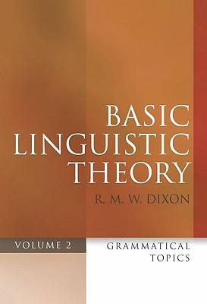
UCCA: Design Principles
Abstract away from formal variation
Cross-linguistic applicability
Accessibility to non-expert annotators
Modularity
Theoretical foundations:
Mostly, Basic Linguistic Theory, a typological descriptive framework by R.M.W. Dixon
Notes:
Influence from Dixon:
the definition of a clause, the distintion between construction and strategy (realization). So a copula cxn or an adjective is a strategy, but aspect or negation are constructions.

Slide 8
UCCA: Formalism
Terminals
Units
Relations and arguments
Categories
Layers
Participant
Arg.
Participant
Arg.
Rel.
Process
Elaborator
Arg.
Rel..
Arg.
Center
Rel..
John writes long books
Notes:
That’s not the interface.
Talk about agreement

Slide 9
UCCA’s Foundational Layer
Focus: semantic heads, predicate-argument relations and linkage between them
Maximally coarse-grained (14 categories)
Based on the semantic aspect of Basic Linguistic Theory’s definition of a clause

Slide 10
UCCA’s Foundational Layer: Scenes
“After graduation, Sorkin moved to New York City where he worked odd jobs including delivering telegrams, and driving a limousine.”
Notes:
Scenes: they have some temporal and spatial dimensions. When it is shared, it is one scene (e.g., secondary relations, coordination)

Slide 11
UCCA’s Foundational Layer: Scenes
Parallel Scene (H)
Process (P)
Participant (A)
Linker (L)
H
H
L
P
A
A
A
Process
“After graduation, Sorkin moved to New York City”
Nouns/adjectives/prepositions (etc.) can evoke scenes
Participants need not be syntactic arguments

Slide 12
UCCA’s Foundational Layer: States
Parallel Scene (H)
Process (P)
State (S)
Participant (A)
Linker (L)
H
H
L
P
A
A
A
State
“After graduation, Sorkin stayed in New York City”

Slide 13
Sensitivity to Content, not Syntactic Categories
Verbs can be adverbials:
“John began_{D} swimming“
Prepositions can be many things:
Case markers: “Yossi lives in_{R} Jerusalem”
Linkers: “After_{L} graduation, Sorkin moved to NYC”
Scene-evokers: “The tree is in_{S} the garden”
Possessives can mark
A State: “your_{S+A} car_{A}”
Part-whole relation: “your_{C} hands_{C}”
Participation: “your_{A} kick_{P}”
Legend:
Process (P)
State (S)
Participant (A)
Adverbial (D)
Elaborator (E)
Center (C)
E
S+A
A

Slide 14
Inter-Scene Linkage
“After graduation, Sorkin moved to New York City where he worked odd jobs including delivering telegrams, and driving a limousine.”
Scenes:
“graduation_{P} … Sorkin_{A}”
“Sorkin_{A} moved_{P} [to New York City]_{A}”
“he_{A} worked_{P} [odd jobs]_{A}”
“he_{A} … delivering_{P} telegrams_{A}”
“he_{A} … driving_{P} [a limousine]_{A}”
“after”
“where”
“including”
“and”

Slide 15
Coarse-grained, Refinable
Two additional layers for UCCA:
Semantic roles / Preposition supersenses (Schneider et al., 2018; Prange et al., 2019):
Possession is not scene-evoking:
- Kinship: “John’s sister”
- Part-Whole: “The car’s windshield”
Possession is scene-evoking:
- Agent: “John’s kick saved the game”
- Patient: “The boy’s murder was never reported”
- Ownership: “John’s computer”
Notes:
Annotation is carried out in passages.

Slide 16
Coarse-grained, Refinable
Two additional layers that refine the foundational layer:
Semantic roles / Preposition supersenses (Schneider et al., 2018; Prange et al., 2019a):
Coreference resolution (mentions are constrained by UCCA’s foundational layer; Prange et al., 2019b)
Possession is not scene-evoking:
- Kinship: “John’s sister”
- Part-Whole: “The car’s windshield”
Possession is scene-evoking:
- Agent: “John’s kick saved the game”
- Ownership: “John’s computer”
Notes:
Annotation is carried out in passages.

Slide 17
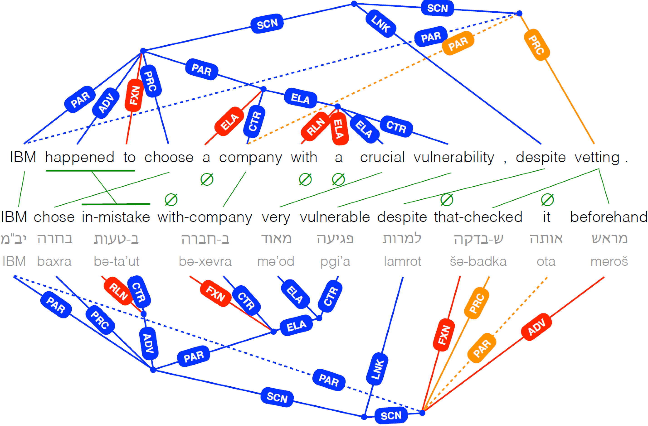
Translation Divergences / Stability
Parser_{T}
Notes:
Advantages of CCG over dependencies: passives, conjunction, negation, questions
-- add more web-oriented examples
--

Slide 18
A Corpus Study of Translation Stability
How well does UCCA preserve structure across English-French translations?
UCCA:
participant secondary process participant secondary process
“John usually comes” “John a l’habitude de venir”
Syntax: noun adverb verb noun noun verb
18

Slide 19

Cross-linguistic Stability: Results
Scene divergences:
→ 92% of the English Scenes and 95% of the French Scenes have a correspondent on the other side
Comparison to syntax: stability of the number of Scenes/paragraph vs. the number of clauses/paragraph
→ UCCA is more stable than PTB-style syntactic trees
19

Slide 20
UCCA: Cross-linguistic Stability
Nevertheless, occasional UCCA divergences are found:
Officers were probing the increasing gloom with their night glasses
Les officiers armés_{S} de leur lorgnette de nuit fouillaient
l’obscurité croissante
20

