Slide 1
UCCA E✘tensions
Jakob Prange ▫ COLING 2020 Tutorial
https://github.com/UniversalConceptualCognitiveAnnotation/tutorial

Slide 2

Building upon a solid foundation

Slide 3



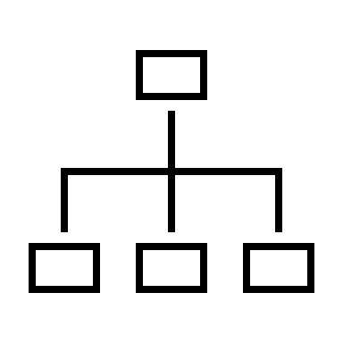
Building upon a solid foundation
UCCA is designed as a multi-layered structure, which allows for its open-ended extension
The foundational layer (FL) has relatively flat structure, makes coarse distinctions
Additional layers can capture additional semantic phenomena by...
refining existing categories
introducing new distinctions
adding deeper / more complex structure

Slide 4
Semantic Roles
FL does not distinguish Participants’ roles
E.g., Agent, Theme, Circumstance, Purpose, …
Expressed by various linguistic markers:
Word order [Mary_{A} saw John_{A}] vs [John_{A} saw Mary_{A}]
Case [Er sah [den Fuchs]] vs [Ihn sah [der Fuchs]]
Prepositions [The conquest [of Britain] [by the Romans]]
[ Antoinette_{A} drew_{P} [a sheep]_{A} [for the princess]_{A} [in the desert]_{A} ]

Slide 5
Semantic Roles
Several existing frameworks for role annotation: FrameNet, VerbNet, PropBank
We chose SNACS (Schneider et al.) for its independence of any one language or lexicon
50 hierarchical categories
Designed to disambiguate prepositions and case
Idea: UCCA and SNACS are complementary and compatible

Slide 6
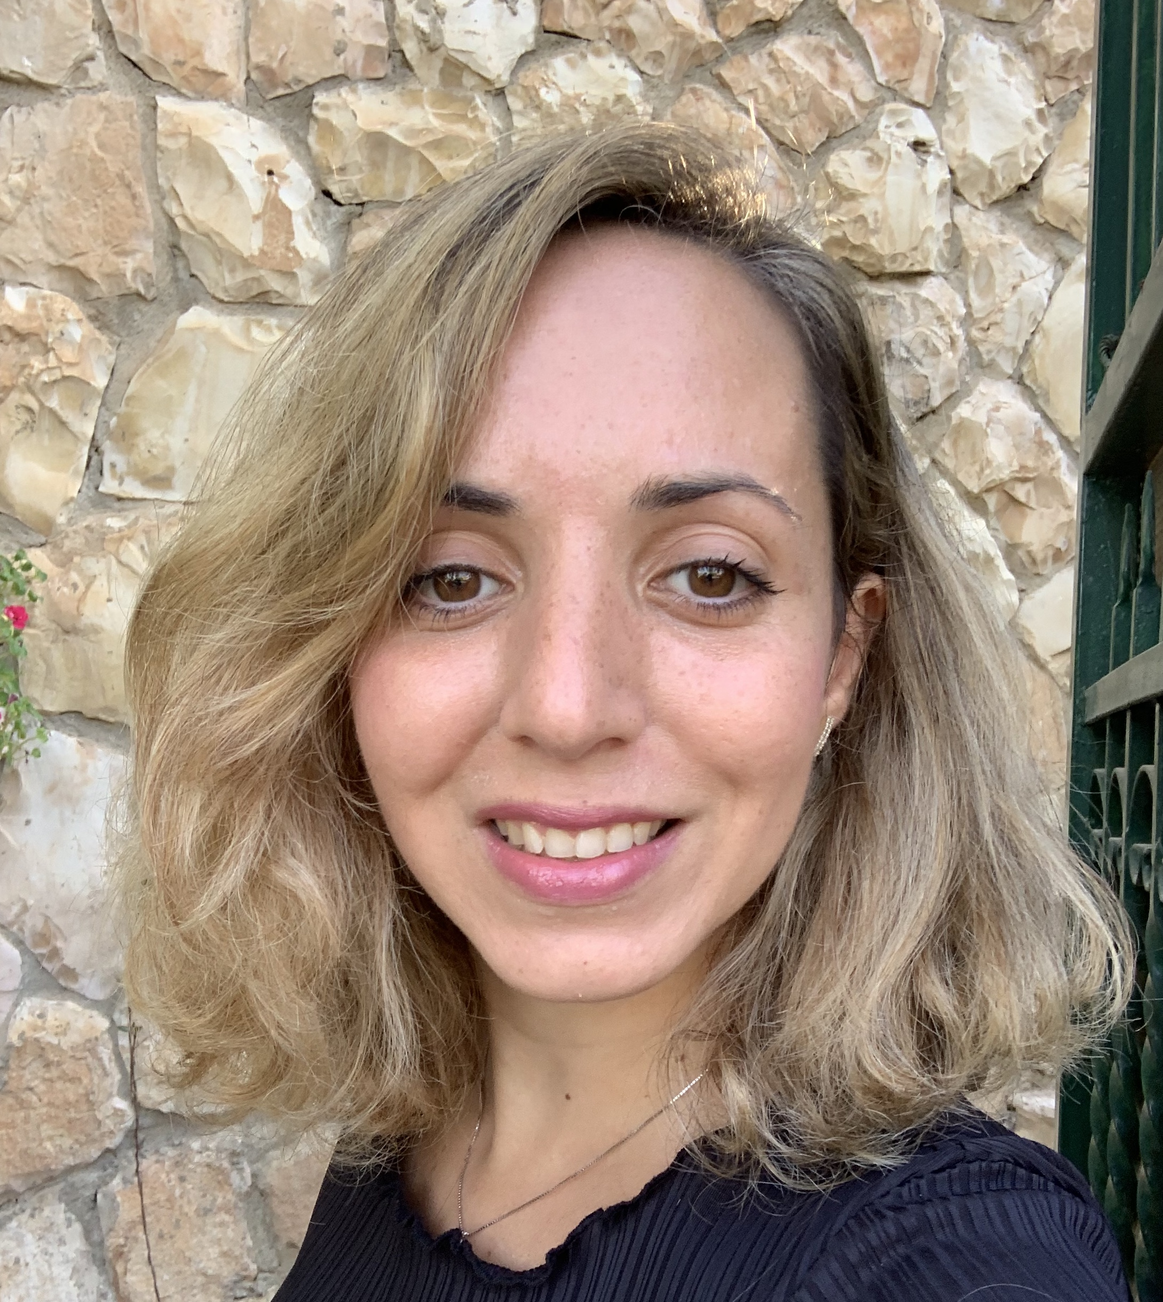
Semantic Roles, Strategy A
Adi Shalev
Shalev at al., DMR 2019: “Preparing SNACS for Subjects and Objects”
Refine all Participant units with a SNACS role
[ Antoinette_{A:Originator↝Agent} drew_{P} [a sheep]_{A:Topic↝Theme} ]
Ensures full coverage of Participants
Shows that SNACS is applicable to subjects and objects
Notes:
[INSERT Distribution and/or Example]

Slide 7
Semantic Roles, Strategy B
Prange et al., CoNLL 2019: “Made for each other”
Annotate all semantic roles explicitly marked with a lexical item (preposition, possessive, …)
[ She_{A} drew_{P} it_{A} [for the princess]_{A:Beneficiary} [in the desert]_{A:Locus} ]
SNACS-annotated corpus already existed
Automatic rule-based integration
Joint ML experiments show mutual benefit of SNACS and UCCA

Slide 8
Semantic Roles, Summary
[ Antoinette_{A:Originator↝Agent} drew_{P} [a sheep]_{A:Topic↝Theme} [for the princess]_{A:Beneficiary} [in the desert]_{A:Locus} [at night]_{T:Time} ]_{H} since_{L} [she asked her]_{H:Explanation}
Shalev et al.
covered in both
Prange et al.

Slide 9
(Co-)reference
Remember Remote Edges?
Reentrant edges indicating a unit mentioned in one place also participates elsewhere (e.g., in another scene)
[ [The man_{C} [who is happy_{S} (man)_{A}]_{E}]_{A} is tall_{S} ]
But coreference between explicit mentions is not encoded in FL!
[ [The man] is happy ] [ He is tall ]

Slide 10
(Co-)reference
Prange et al., DMR 2019: “Semantically Constrained Multilayer Annotation”
Add coreference annotation for Participants and Scenes
[ Did_{F} [anyone else]_{A} have_{F} [these fears]_{S} ? ] [ How_{D} did_{F} you_{A} get_over_{P} them_{A} ? ]

Slide 11
(Co-)reference
Prange et al., DMR 2019: “Semantically Constrained Multilayer Annotation”
Add coreference annotation for Participants and Scenes
[ Did_{F} [anyone else]_{A} have_{F} [these fears]_{S} ? ] [ How_{D} did_{F} you_{A} get_over_{P} them_{A} ? ]

Slide 12
(Co-)reference
Prange et al., DMR 2019: “Semantically Constrained Multilayer Annotation”
Add coreference annotation for Participants and Scenes
[ Did_{F} [anyone else]_{A} have_{F} [these fears]_{S} ? ] [ How_{D} did_{F} you_{A} get_over_{P} them_{A} ? ]
Also certain cases of Time, Elaborator, Relator, Quantity, and Adverbial units

Slide 13
Implicit Arguments
We don’t always say everything we mean…
Imperatives (“Please pay attention!” – Who? To what?)
Passives (“The tutorial is being presented.” – By whom?)
Relational nouns (“teacher” – What do they teach? To whom?)
Conventionalized/habitual scenes (“I already ate.” – What?)
Implicit Units (IMP) in FL, but no distinction of different types
Unclear why/when a predicate’s arguments can be IMP, how accessible they are, when they should be annotated

Slide 14

Implicit Arguments
Ruixiang Cui
Cui and Hershcovich, DMR 2020 “Refining Implicit Argument Annotation for UCCA”
Define a taxonomy of IMP categories and annotate them in a refinement layer
[ IMP_{A} Thank_{P+G} [you guys]_{A} ] (me, the speaker)
[ I_{A} do_{F} n’t_{D} recommend_{P} [IMP_{A} using_{P} [this_{E} company_{C}]_{A}] ]
[ IMP_{A} Delivery_{P} is_{F} [lightning_{E} fast_{C}]_{D} ] (deliverer)
[ I_{A} already_{D} ate_{P} IMP_{A} ]
[ Delivery_{P} IMP_{A} is_{F} [lightning_{E} fast_{C}]_{D} ] (delivered)
[ I_{A} do_{F} n’t_{D} steal_{P} IMP_{A} ]

Slide 15

Future Work
There is a lot left to refine and extend!

Slide 16

Future Work
There is a lot left to refine and extend!
Word senses
Quantifier scope
Tense/aspect, modality
Information structure (e.g. definiteness)
Discourse coherence relations, speech acts

Slide 17
✘-Framework Comparison
Jakob Prange ▫ COLING 2020 Tutorial
https://github.com/UniversalConceptualCognitiveAnnotation/tutorial

Slide 18

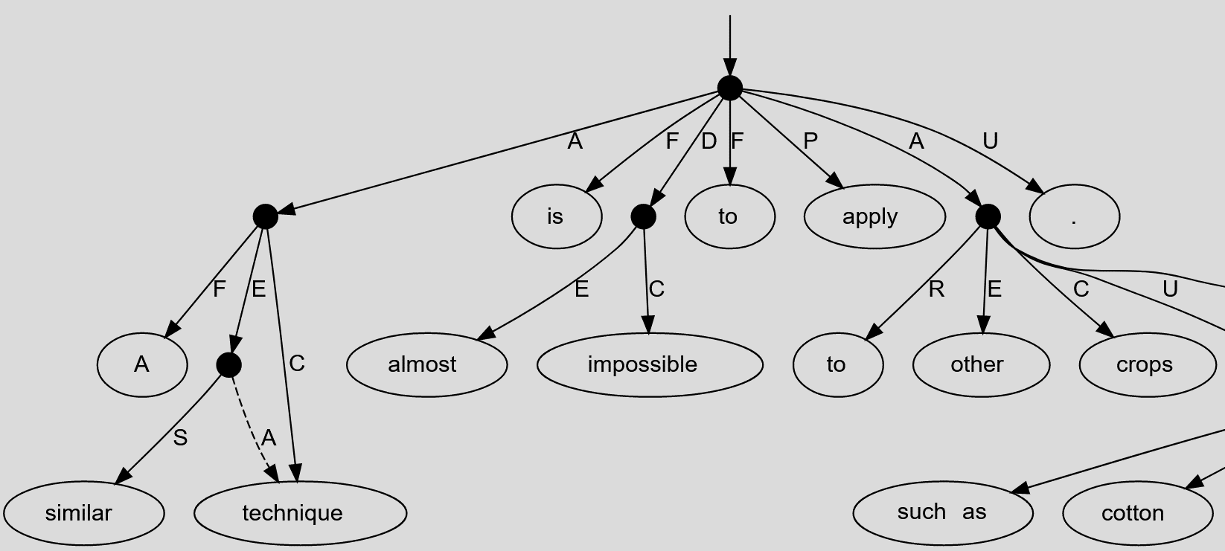
Dimensions for Comparison
A similar technique is almost impossible to apply to other crops .

Slide 19

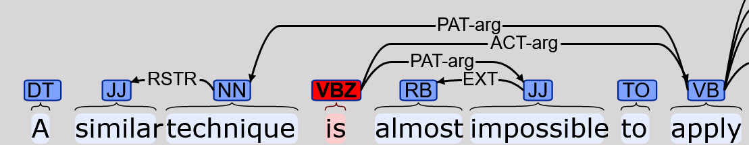
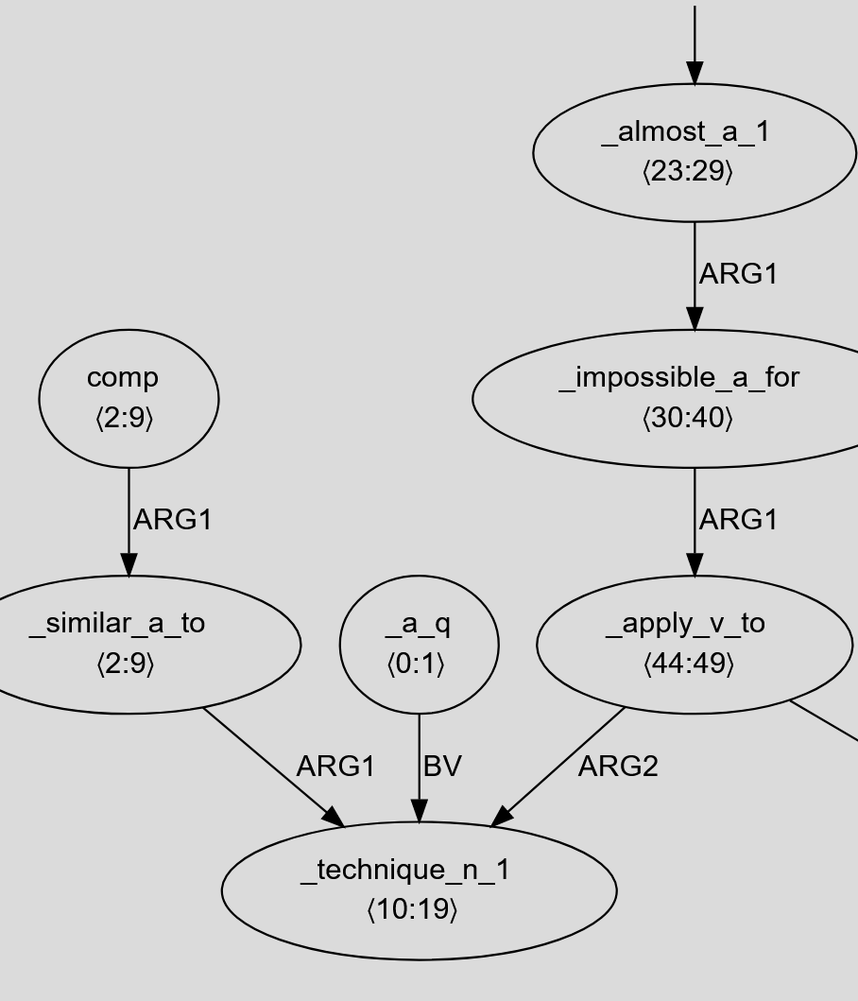
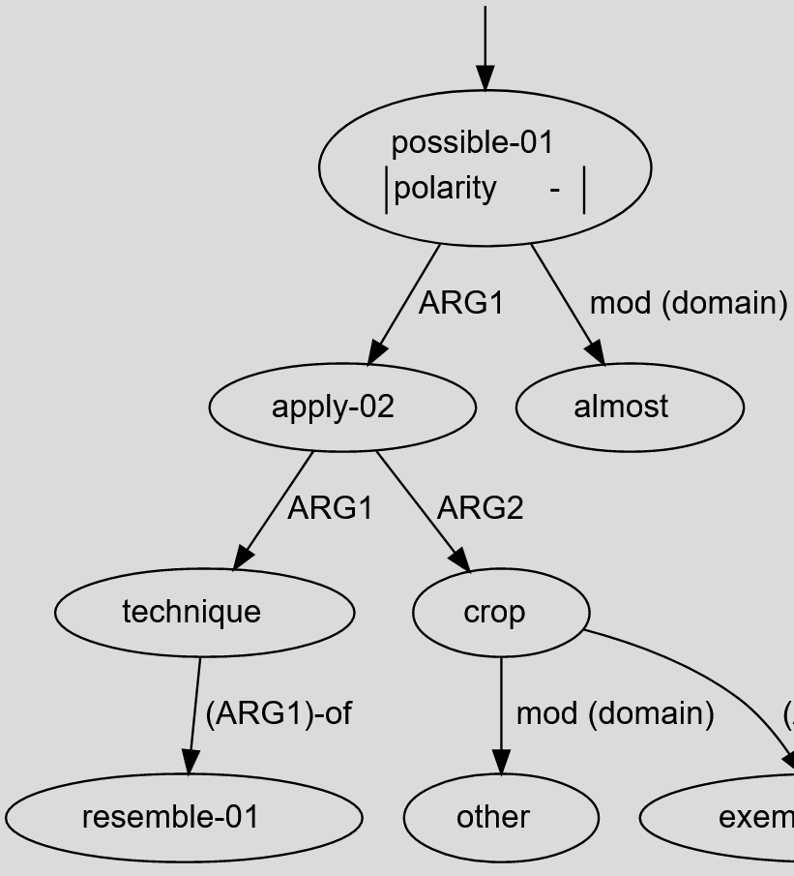
Dimensions for Comparison
Koller et al., ACL 2019 Tutorial
Type 0: Bilexical dependencies: PAS, DM, PSD, also CCG, UD (syntax)
Type 1: Anchored: EDS, PTG
Type 2: Unanchored: AMR, DRG
A similar technique is almost impossible to apply to other crops .
Anchoring
Type 0
Type 1
Type 2
Anchored
Abstract concepts
Non-terminals

Slide 20
Dimensions for Comparison
Koller et al., ACL 2019 Tutorial
Type 0: Bilexical dependencies: PAS, DM, PSD, also CCG, UD (syntax)
Type 1: Anchored: UCCA, EDS, PTG
Type 2: Unanchored: AMR, DRG
A similar technique is almost impossible to apply to other crops .
Anchoring
✘
Type 0
Type 1
Type 2
Anchored
Abstract concepts
Non-terminals

Slide 21

Dimensions for Comparison
http://mrp.nlpl.eu/2019/index.php?page=2
http://mrp.nlpl.eu/2020/index.php?page=12
More info and source of images
Koller et al., ACL 2019 Tutorial
Type 0: Bilexical dependencies: PAS, DM, PSD, also CCG, UD (syntax)
Type 1: Anchored: UCCA, EDS, PTG
Type 2: Unanchored: AMR, DRG
Prange et al., DMR 2019
Token-anchored: UCCA Foundational Layer, FrameNet
Syntax-anchored: PropBank, Prague Tectogrammar
Sentence-anchored: AMR
Semantics-anchored: Additional UCCA Layers, Multi-sentence AMR
Anchoring
A|similar|technique|is|almost|impossible|to|apply|to|other|crops|.
✘
✘
✘
✘
Single-layer
Modularity
“Massively multilayer corpora” e.g., OntoNotes, GUM

Slide 22
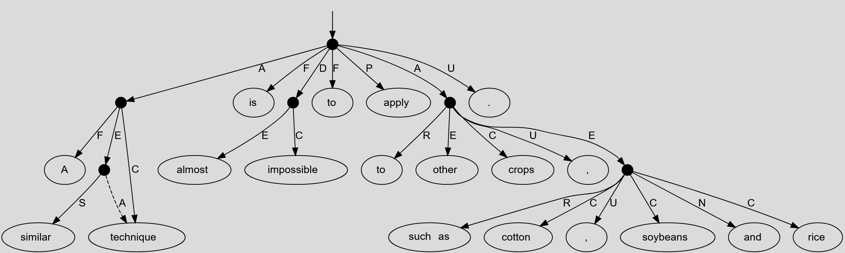
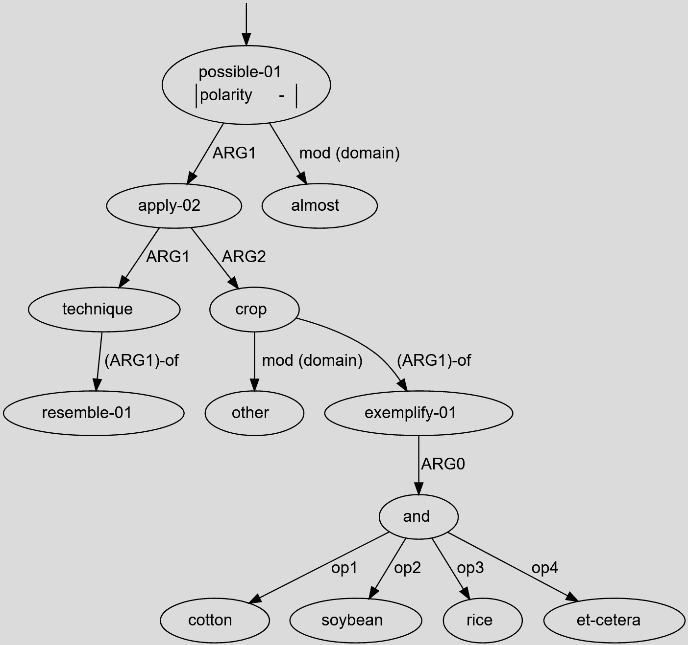

Versus other MRs: AMR (Banarescu et al.)
Both aim to capture sentence-level semantic structure
Both are DAGs (reentrancies play an important role)
Anchoring
AMR is unanchored / sentence-anchored
UCCA (FL) is anchored in tokens directly
Modularity
AMR has many fine-grained categories in a single layer
UCCA is built on a coarse foundational layer + extensions
Universality
AMR concepts are drawn from a lexicon
UCCA is lexicon-free and designed for cross-linguistic stability
AMR

Slide 23
Versus other MRs: MRP Shared Tasks
Oepen et al. CoNLL 2019, 2020
Taking stock of the many recent advances in the field of MR
Comparing state-of-the-art parsers in different frameworks
Encouraging multitask learning (MTL) approaches that tackle multiple related formulations of the semantic parsing task with a single system
Featured UCCA, along with other Type 1, 2, and 0 approaches
New theoretical insights, data, and SotA parsers

Slide 24
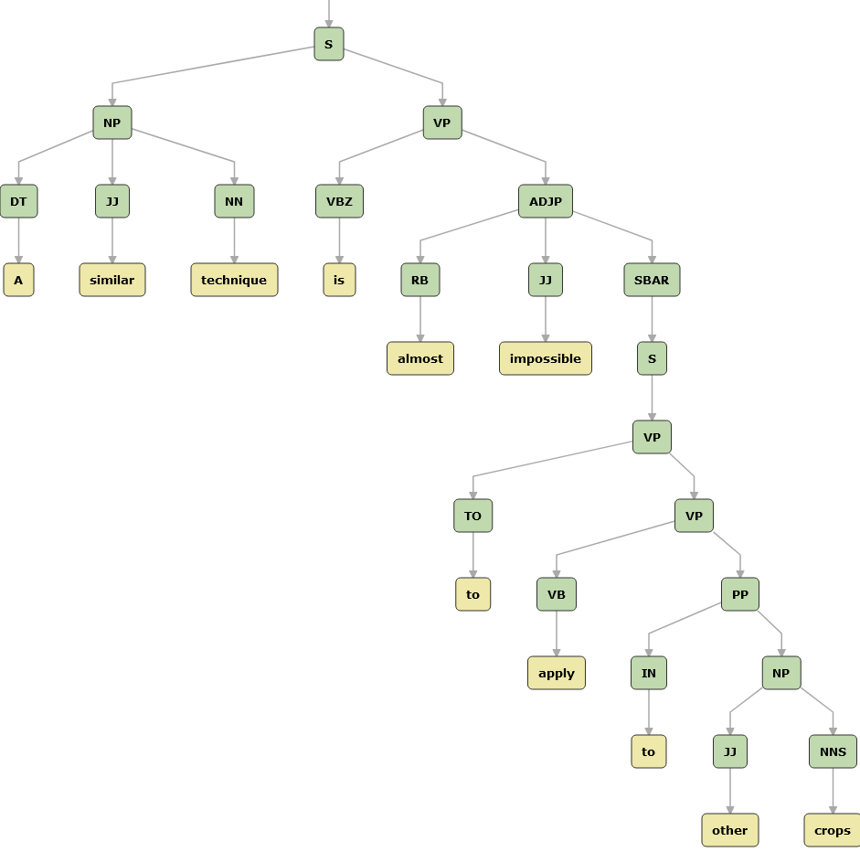
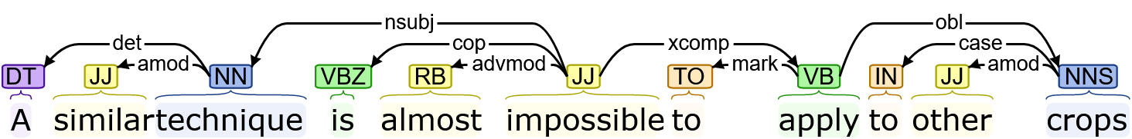
Versus Syntactic Representations
UCCA abstracts away from syntax
Stable across paraphrastic superficial variation
UCCA scenes ≠ syntactic predicates
Nouns and adjectives can be scene-evoking
Verbs can be secondary verbs or light verbs (non-scenes)
UCCA unit structures tend to be flat
Compared to, e.g., binary branching in syntactic phrase structure
Constituency Parse (PTB)
Dependency Parse (UD)

Slide 25
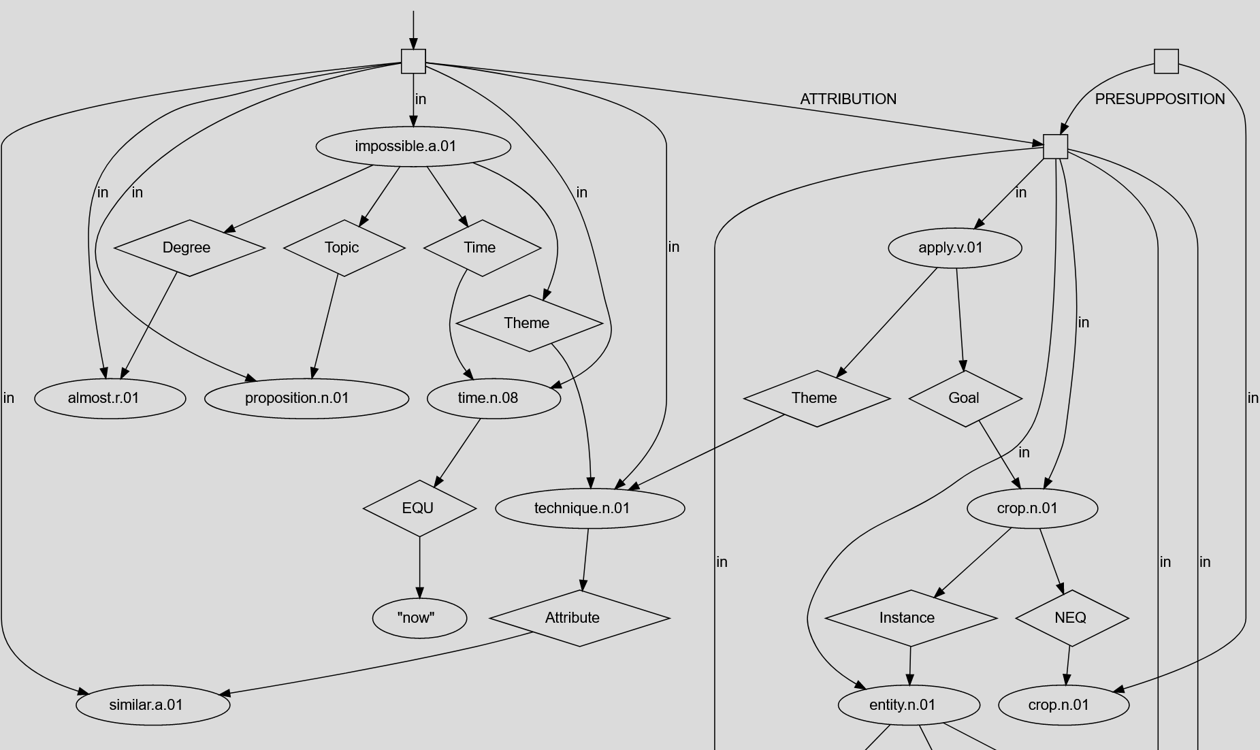
Versus Discourse Representations
Discourse structure is not (currently) a primary focus of UCCA
But some relevant features
Coreference Layer, Implicit Unit refinements
Linker + Parallel Scene structure (with SNACS relations)
Ground and Linker edges identify discourse signals, but don’t disambiguate them
By far not as elaborate as, e.g., DRG (and not aiming to be)
…yet!
DRG

Slide 26

✘
Originator↝Agent
Recipient↝Theme
IMP_{A} _{P+G} _{A}
[ _{R} _{A} _{P}]_{A}
IMP_{A} Thank_{P+G} you_{A}
[for_{R} your_{A} attention_{P}]_{A} !
Deictic
Many layers
Topic↝Beneficiary
Experiencer↝Gestalt
Jakob Prange
jakob@cs.georgetown.edu
https://jakob.georgetown.domains
Modularity
✘
Foundational
Layer
1 Layer
More info!
https://github.com/UniversalConceptualCognitiveAnnotation/tutorial
Token /
Type 0; Type 1
Syntax
Sentence;
Type 2
Semantics
Anchoring

Slide 27
UCCA Tutorial
Bird’s Eye View of UCCA ▫ Omri Abend
Annotation of English ▫ Nathan Schneider
Annotated Corpora & UCCAApp ▫ Dotan Dvir
Extension Layers & Comparison to Other Formalisms ▫ Jakob Prange
Parsing, Evaluation, & Applications ▫ Daniel Hershcovich
Crosslinguistic Studies ▫ Omri Abend
Thanks to my co-presenters and Georgetown students in the Advanced Semantic Representations course for feedback!
More info!
https://github.com/UniversalConceptualCognitiveAnnotation/tutorial

