Slide 1
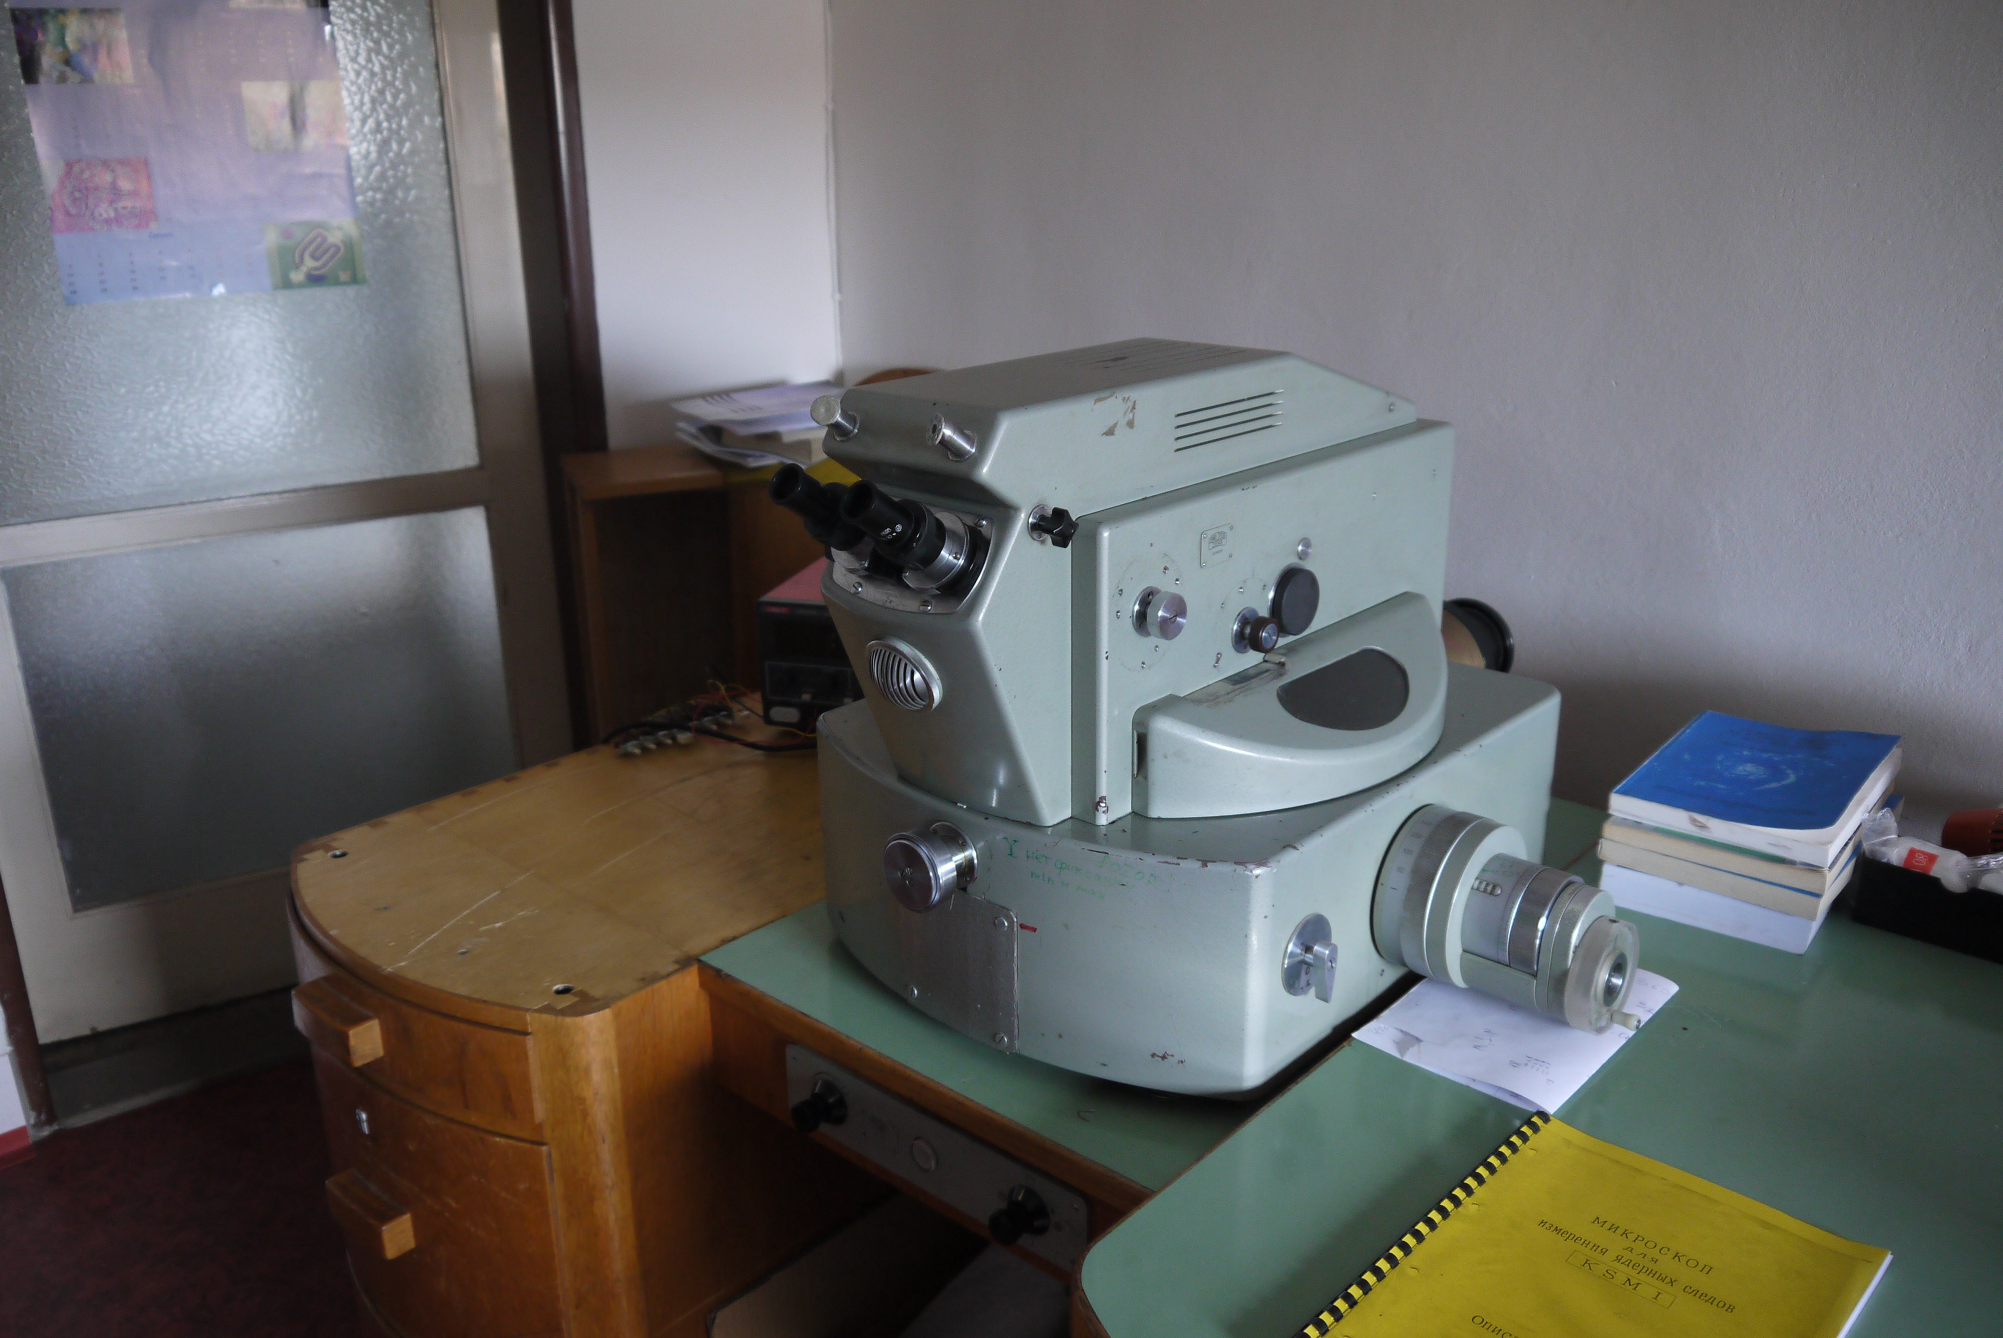
Ω axis
Z axis
X axis

Slide 2
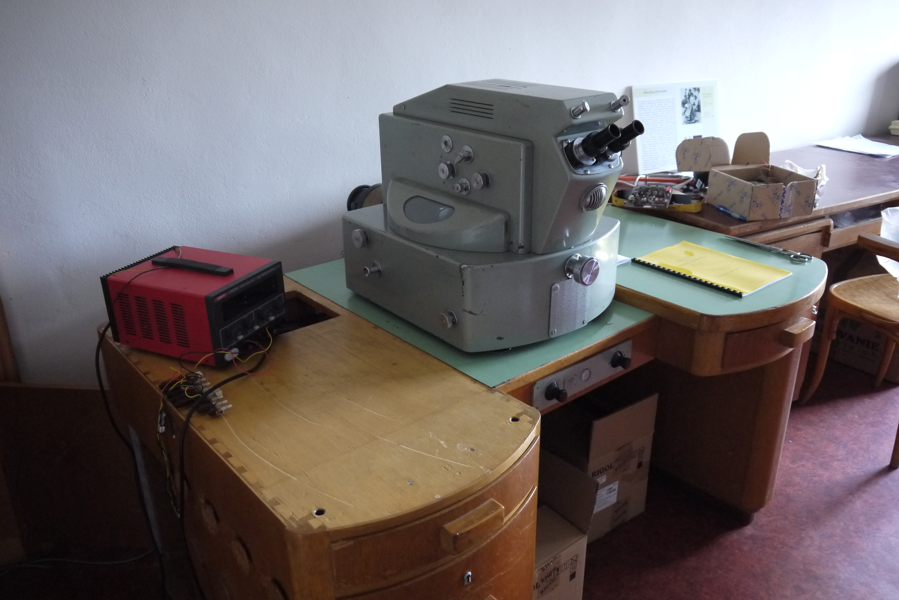
Y axis

