Slide 1

MOVIE RECOMMENDATION SYSTEM

Slide 2
Content
About Recommendation System
Types of Recommendation System
Methodology
Problem Statement
About Dataset
Objective of Project
Flow of Project Deployment
Plan of team for Project Deployment
References
Conclusion

Slide 3
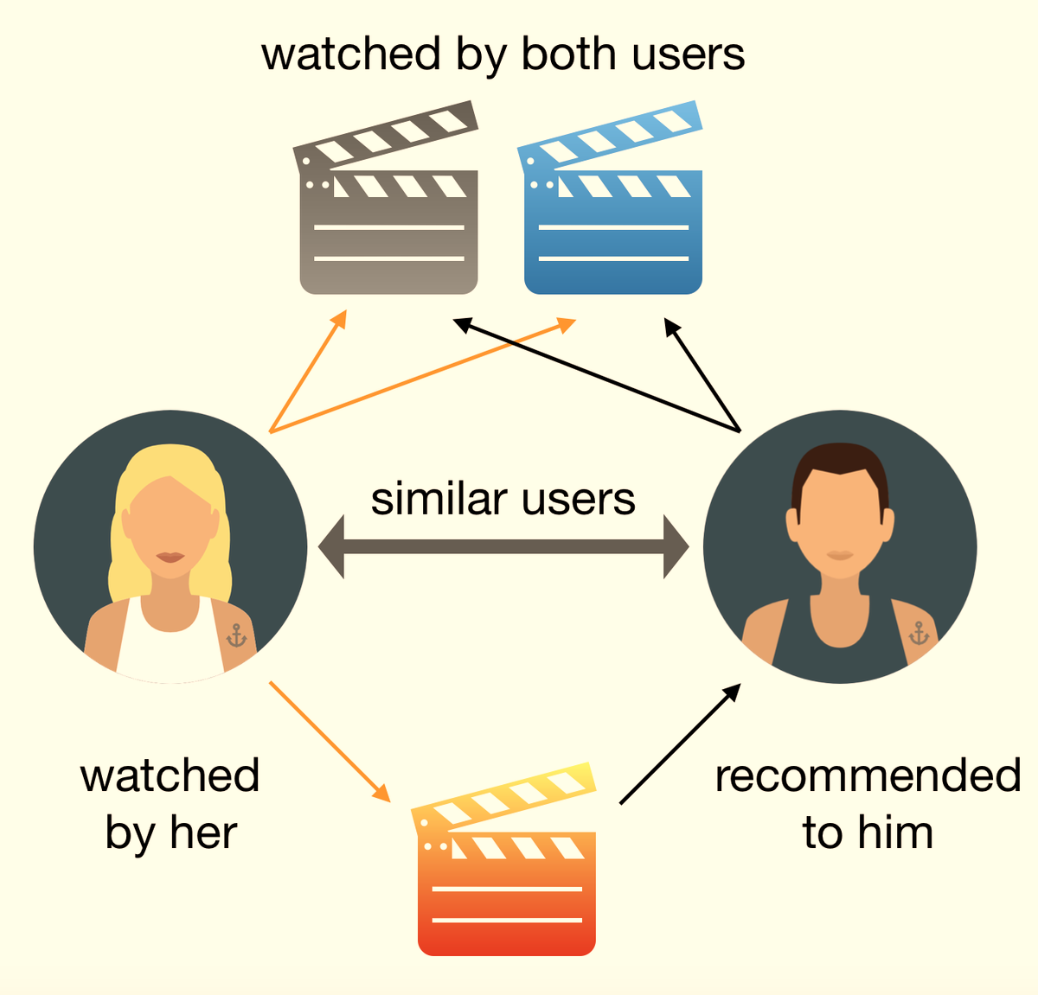
ABOUT RECOMMENDATION SYSTEM
Recommender systems are a technological proxy for a social process.
Recommender systems are a way of suggesting like or similar items and ideas to a users specific way of thinking.
Recommender systems try to automate aspects of a completely different information discovery model where people try to find other people with similar tastes and then ask them to suggest new things.

Slide 4
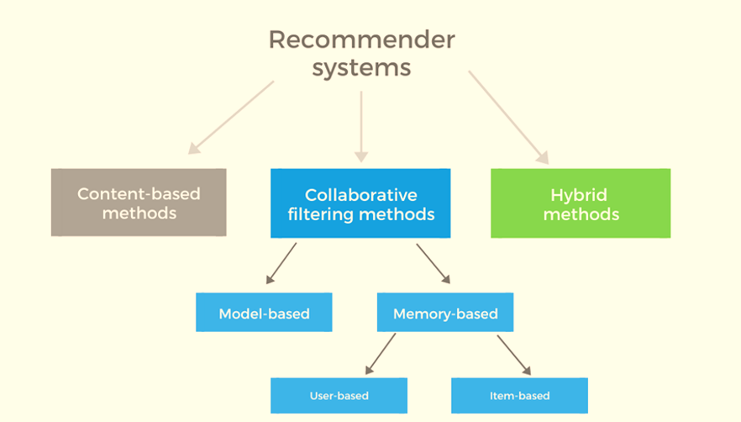
TYPES OF RECOMMENDATION SYSTEM
Popularity based method
Content based method

Slide 5
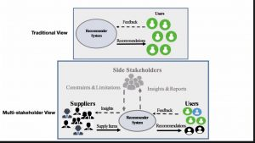
POPULARITY BASED RECOMMENDATION SYSTEM
It is trend based model which work or current trends
Its uses basically which item is in trend right now
It is non sensitive to user interest and preferences

Slide 6
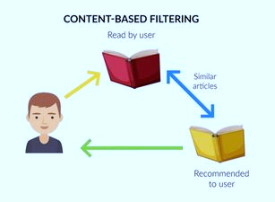
CONTENT BASED RECOMENDATION
It based on information on the content of items rather than on other users’ opinions.
Uses a machine learning algorithm to induce a profile of the users preferences from examples based on a feature description of content.

Slide 7
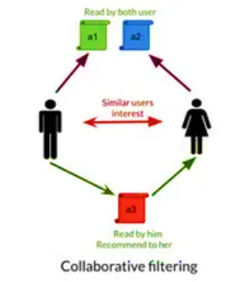
COLLABRATIVE FILTER BASED MODEL
Maintain a database of many users’ ratings of a variety of items.
For a given user, find other similar users whose ratings strongly correlate with the current user.
Recommend items rated highly by these similar users, but not rated by the current user.
Almost all existing commercial recommenders use this approach (e.g. Amazon).

Slide 8
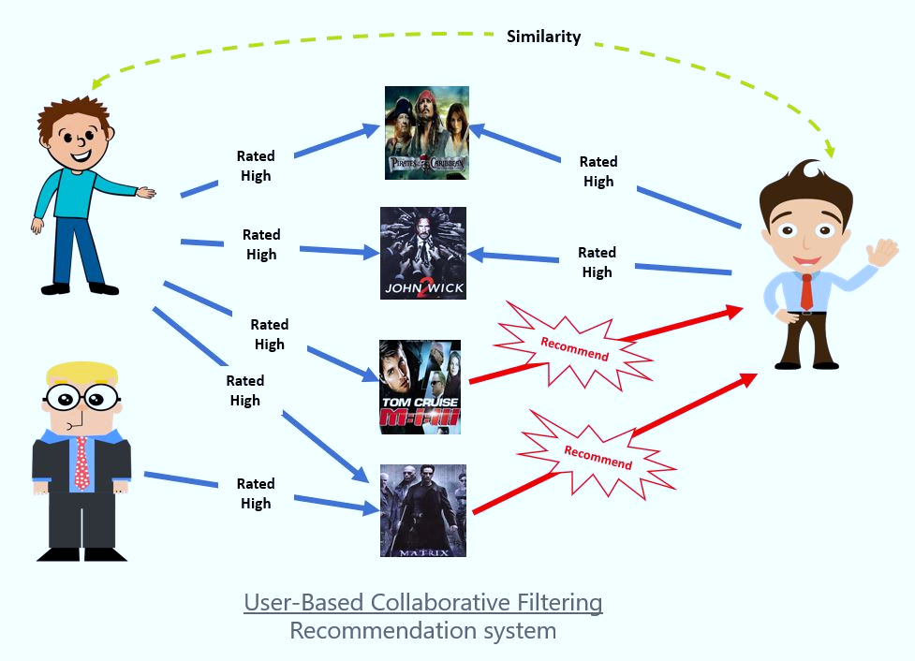
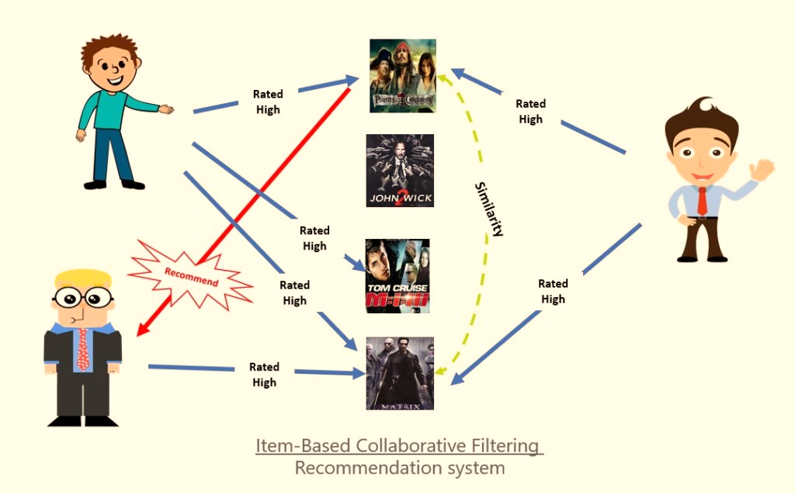
TYPES COLLABRATIVE FILTER BASED MODEL
USER BASED SYSTEM
ITEM BASED SYSTEM

Slide 9
USER BASED & ITEM BASE RECOMENDATION
User-Based Collaborative Filtering is a technique used to predict the items that a user might like on the basis of ratings given to that item by the other users who have similar taste with that of the target user.
Item-based Collaborative Filtering uses the most similar items to a user's already-rated items to generate a list of recommendations.
Item based model use rating distributions per item, not per user.

Slide 10
CHALLENGES OF COLLABORATIVE SYSTEM
Data sparsity
Scalability
Synonyms
Gray sheep( confused opinion)
Shilling attacks
Diversity and the long tail

Slide 11
Methodology
Research Paper breakdown and setting up the direction of project
Baseline model preparation , foundation for project
Final Testing, define MLOP’s Pipeline and application quality check
Tuning the model to be robust , basic application building
Final Presentation

Slide 12
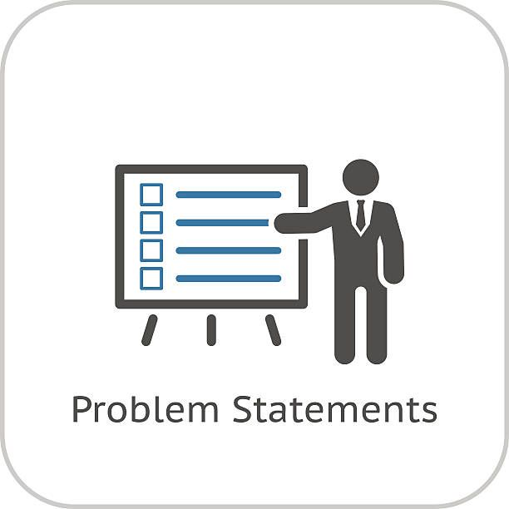
PROBLEM STATEMENT
Using different techniques of Machine Learning, we need to build a Recommender System that recommends movies based on “ Cast, Genre, Reviews, TMDB/IMDB ratings”
Using different types of recommendation techniques :
1. Popularity based recommender system
2. Content based Recommender System
3. Collaborative Recommender System

Slide 13
INFORMATION OF DATASET
Dataset consist 45000 movies.
Dataset is taken from Kaggle
In the dataset contain 6 json file like
1. movies_metadata,
2. credits,
3.ratings_small,
4.keywords,
5.link_small,
6.links.

Slide 14
OBJECTIVE
We have to build the end to end project with model deployment on recommender system
To build end to end content based movie recommender system with Web Application development and deployment
To build end to end Popularity based movie recommender system with Web Application development and deployment
To build end to end Collaborative based movie recommender system web application with Web Application development and deployment

Slide 15
Motivation
Many of the top commerce sites use recommender systems to improve sales.
Users may find new books, music, or movies that was previously unknown to them.
Also can find the opposite for e.g.: movies or music that will definitely not be enjoyed.
Most important motivation is automated suggestion for movies with different genres.

Slide 16
Data Pre-Processing
Reading CSV files using pandas
Data integrity Check for missing values, duplicates values etc.
Merging of Data frame
Creation of new features and removal of redundant features.
Recommendation system vise feature selection
Text Mining & Visualization
1.Lemmatization and stop words removals
2. Data cleaning with regular expression
3.Text vectorization using TFIDF or Word-2-Vec embedding
4.Word Cloud( e.g. genres, top 50 words etc.)
5.Plotting Visualization related corpus length parameter
6. Visualization related to numerical parameter (like rating, revenue, budget)
Project Flow
Base line Recommendation System:
Base on Popularity Index recommendation system
Content based recommender system using cosine similarity
Collaborative base recommender system
Fine tuning the model implementing MLOPs
Web application development using Stream lit
Final application and Quality Check
Deployment on Heroku
Model Building and Deployment

Slide 17
PLAN FOR END TO END PROJECT DEPLOYMENT
Task | Task Name | Assigned to
Task 1 | Outline Creation | Yashshree Baviskar
Task 2 | Model Building based on Popularity Based movie recommender system | G Srineha
Task 3 | Content based movie recommender system model building | Yashshree Baviskar
Task 4 | Collaborative Based movie recommender system model building | Nilkantha Bag
Task 5 | Mid –Level Presentation | Ravi Teja
Task 6 | Development and Deployment of Web Application | Chaitanya Dubal and Nilkantha Bag
Task 7 | Final Report Preparation | Ravi Teja, G Srineha and Yashshree

Slide 18
References
http://www.acm.org/cacm/MAR97/resnick.html
http://www.ercim.org/publication/ws-proceedings/DelNoe02/CliffordLynchAbstract.pdf
http://people.cs.vt.edu/~ramakris/papers/ppp.pdf
http://www.cs.umn.edu/Research/GroupLens/papers/pdf/ec-99.pdf
http://www.rashmisinha.com/talks/Recommenders-SIGIR.pdf
https://youtu.be/v_mONWiFv0k
https://towardsdatascience.com/recommendation-system-in-python-lightfm-61c85010ce17
https://www.analyticsvidhya.com/blog/2022/01/a-comprehensive-guide-on-recommendation-engines-in-2022/
https://en.wikipedia.org/wiki/Item-item_collaborative_filtering

Slide 19
Conclusions
Recommending and personalization are important approaches to combating information over-load.
Machine Learning is an important part of systems for these tasks.
Collaborative filtering has problems.
Content-based methods address these problems (but have problems of their own).
Integrating both is best.

Slide 20



