Slide 1
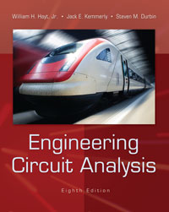
Chapter 10 Sinusoidal Steady-State Analysis
1
Copyright © 2013 The McGraw-Hill Companies, Inc. Permission required for reproduction or display.

Slide 2

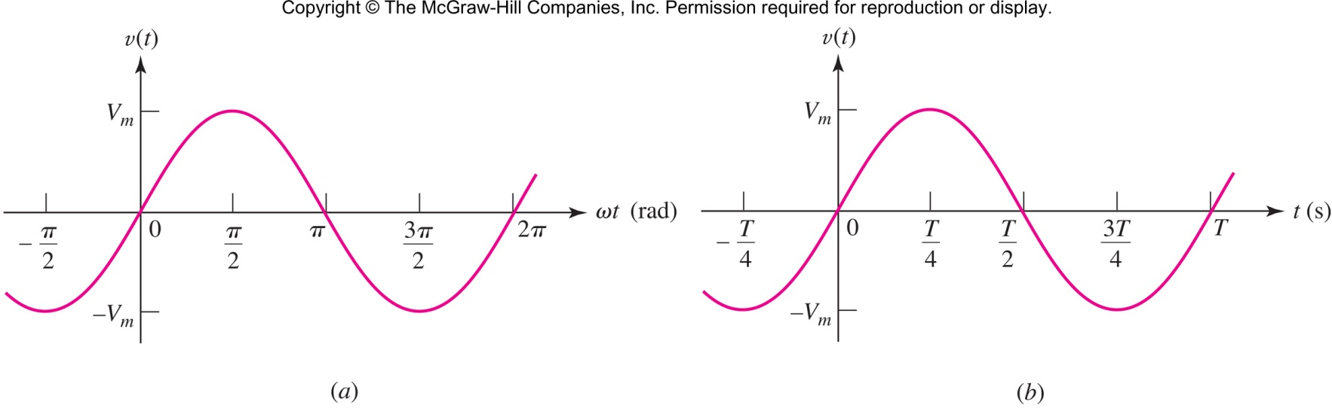
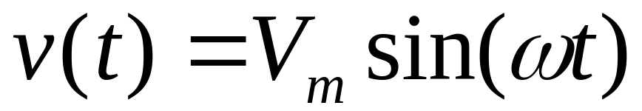
the amplitude of the wave is V_{m}
the argument is ωt
the radian or angular frequency is ω
note that sin() is periodic
Copyright © 2013 The McGraw-Hill Companies, Inc. Permission required for reproduction or display.

Slide 3

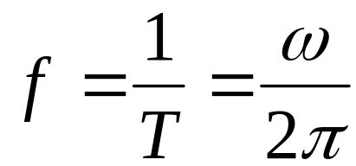
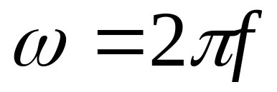
the period of the wave is T
the frequency f is 1/T: units Hertz (Hz)
Copyright © 2013 The McGraw-Hill Companies, Inc. Permission required for reproduction or display.

Slide 4

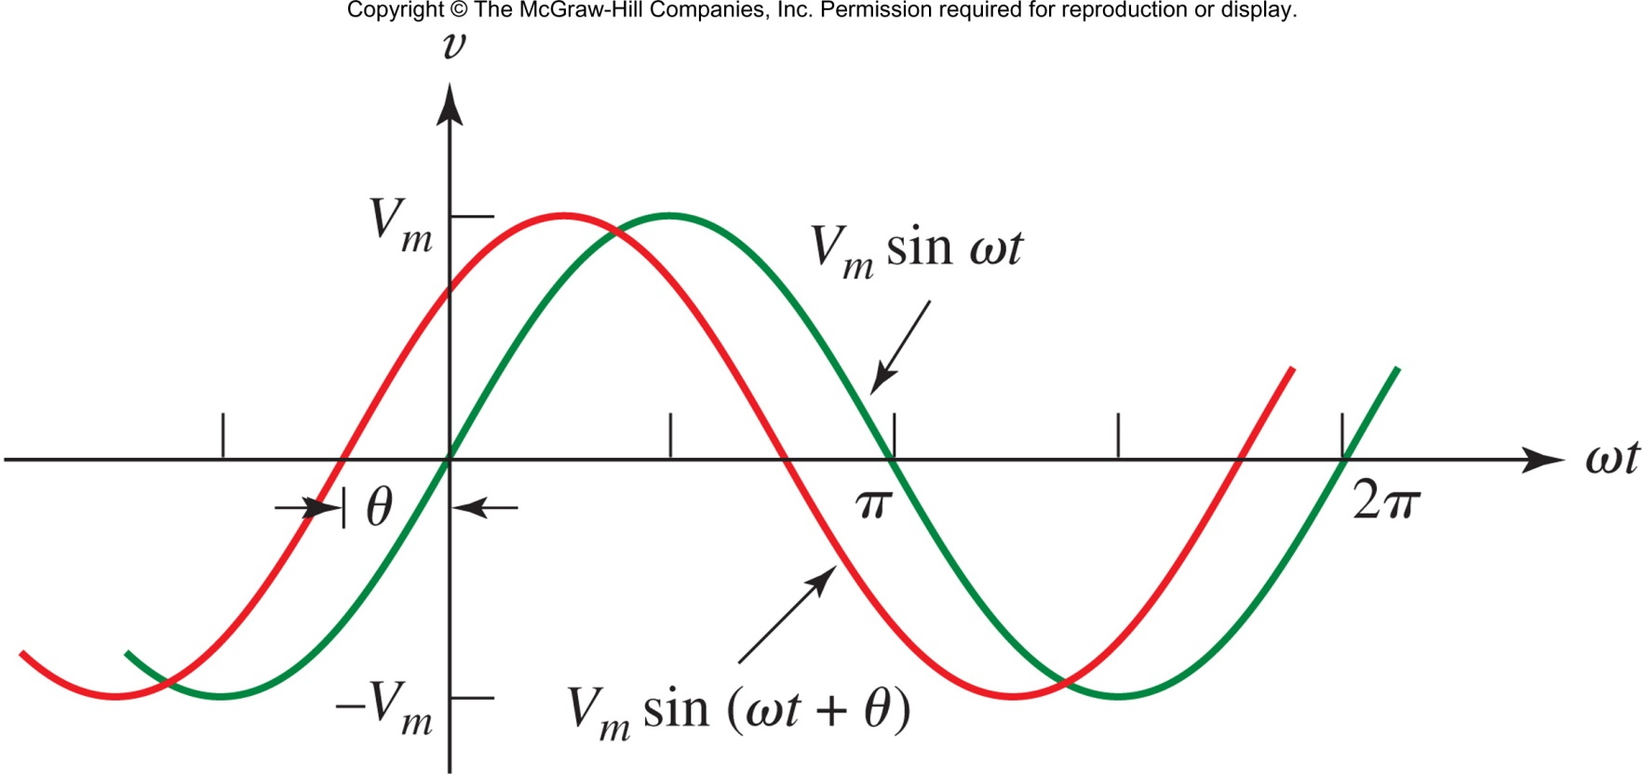
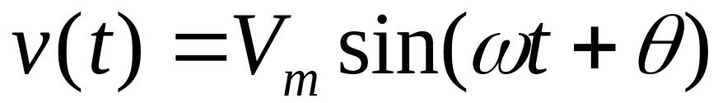
A more general form of a sine wave includes a phase θ
The new wave (in red) is said to lead the original (in green) by θ.
The original sin(ωt) is said to lag the new wave by θ.
θ can be in degrees or radians, but the argument of sin() is always radians.
Copyright © 2013 The McGraw-Hill Companies, Inc. Permission required for reproduction or display.

Slide 5

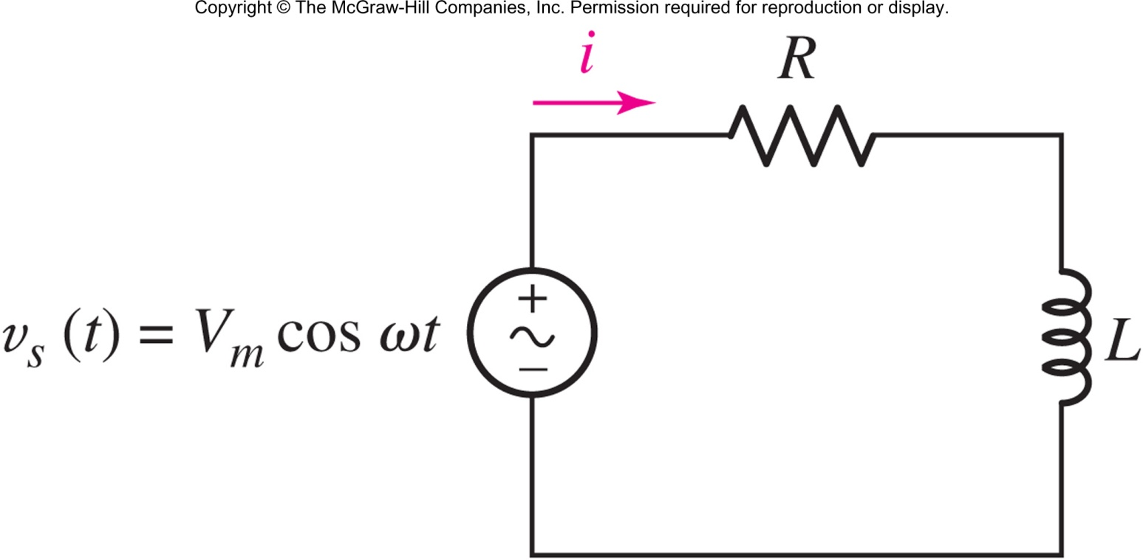
When the source is sinusoidal, we often ignore the transient/natural response and consider only the forced or “steady-state” response.
The source is assumed to exist forever: −∞<t<∞
Copyright © 2013 The McGraw-Hill Companies, Inc. Permission required for reproduction or display.

Slide 6

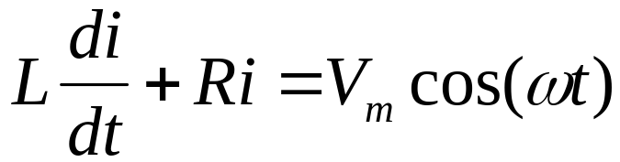

Apply KVL:
Make a good guess:
Solve for the constants:
Copyright © 2013 The McGraw-Hill Companies, Inc. Permission required for reproduction or display.

Slide 7


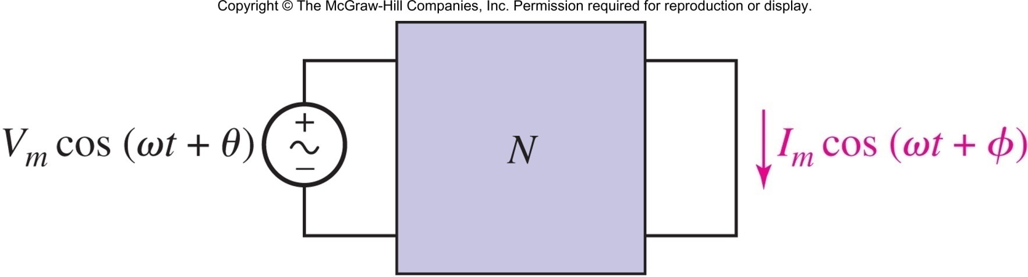
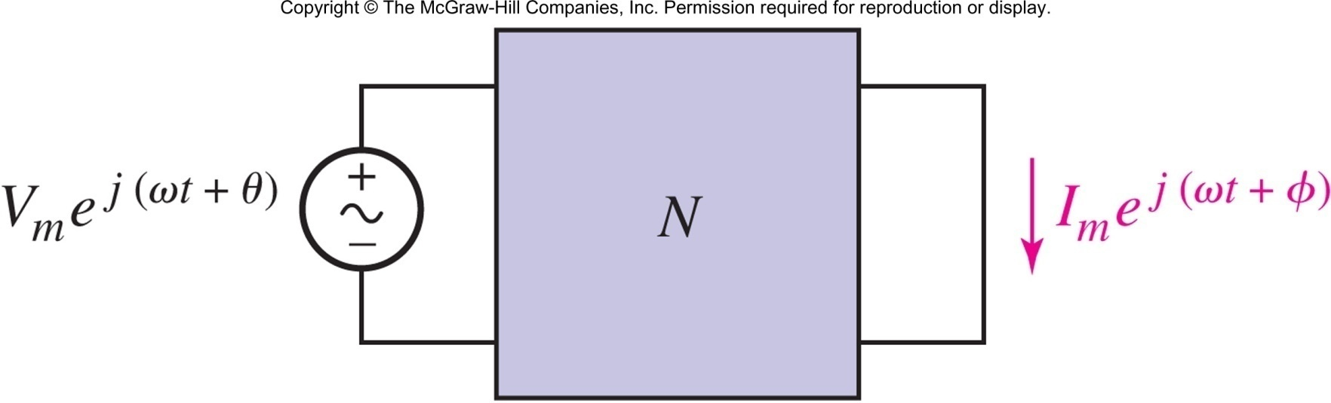
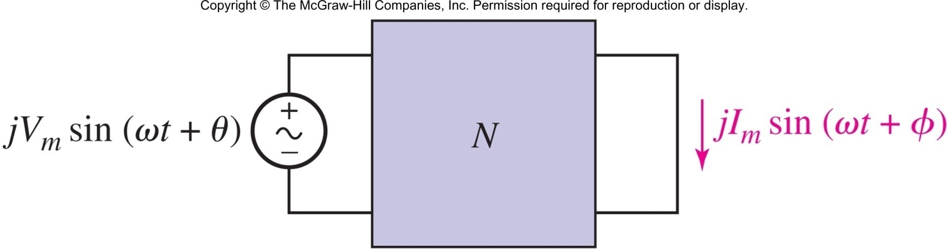
Apply superposition and use
Copyright © 2013 The McGraw-Hill Companies, Inc. Permission required for reproduction or display.

Slide 8

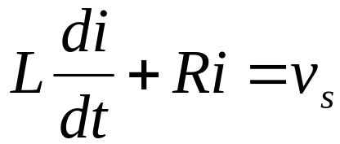
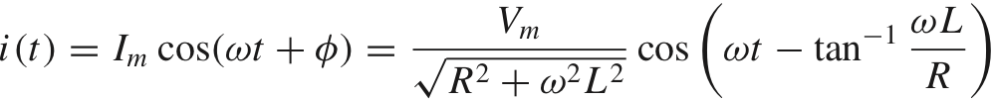
Apply KVL, assume v_{s}=V_{m}e^{jωt}.
Find the complex response
i(t) = I_{m}e^{jωt+θ}
Find I_{m} and θ, (discard the imaginary part)
Copyright © 2013 The McGraw-Hill Companies, Inc. Permission required for reproduction or display.

Slide 9

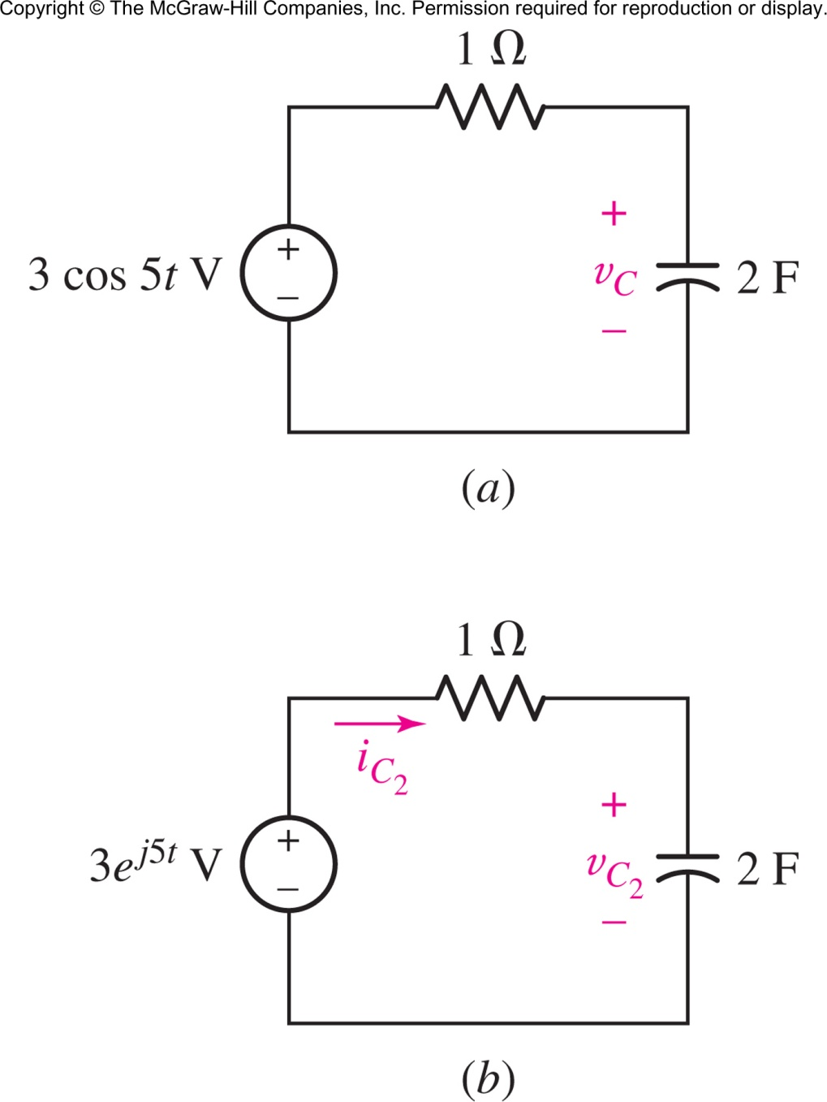
Find the voltage on the capacitor.
Answer: v_{c}(t)=298.5 cos(5t − 84.3◦) mV
Copyright © 2013 The McGraw-Hill Companies, Inc. Permission required for reproduction or display.

Slide 10

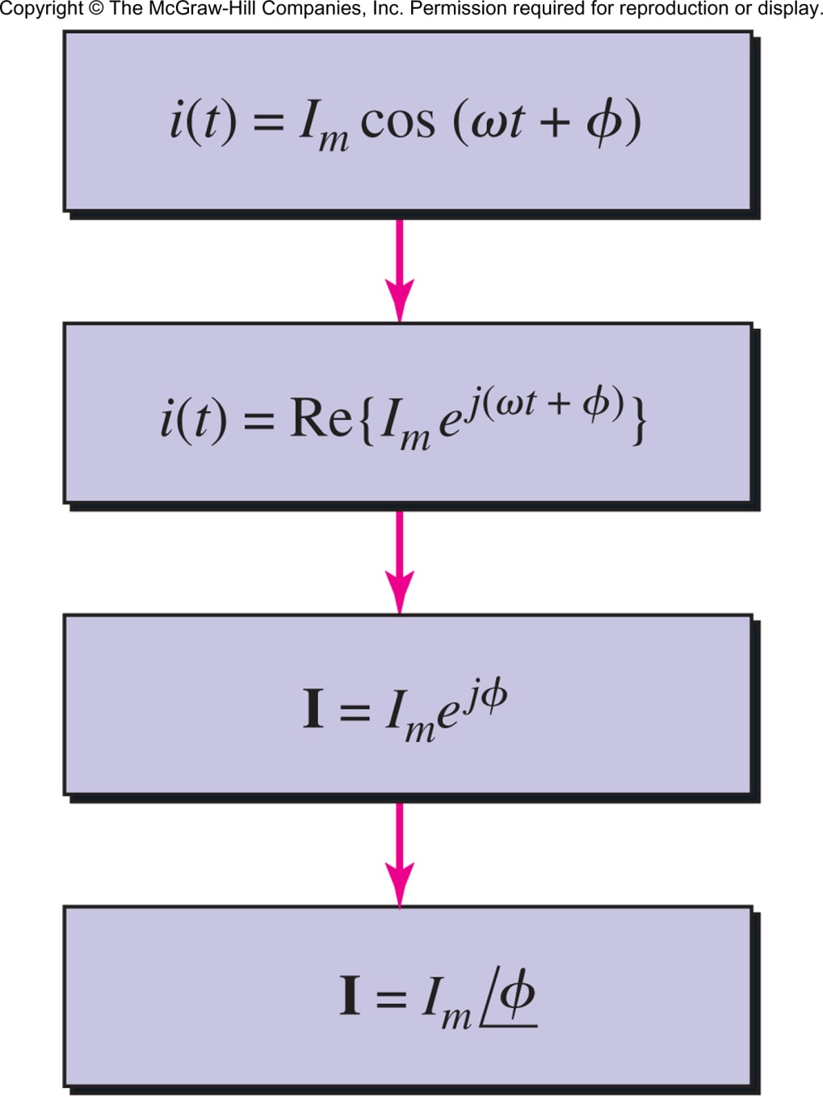
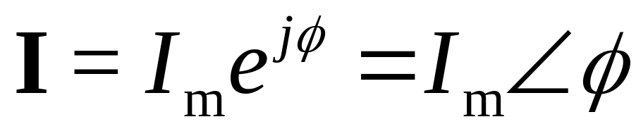
The term e^{jωt} is common to all voltages and currents and can be ignored in all intermediate steps, leading to the phasor:
The phasor representation of a current (or voltage) is in the frequency domain
Copyright © 2013 The McGraw-Hill Companies, Inc. Permission required for reproduction or display.

Slide 11

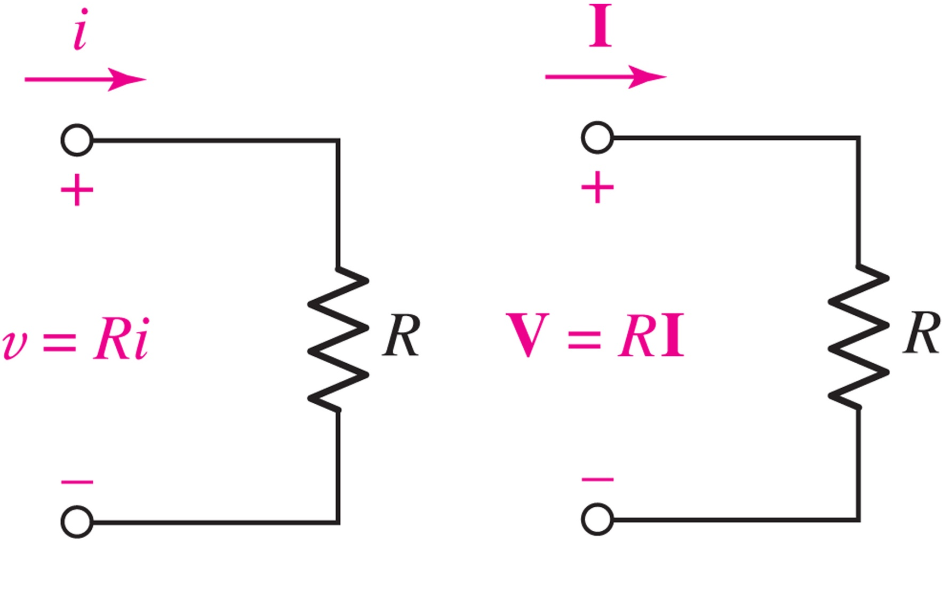
In the frequency domain, Ohm’s Law takes the same form:
Copyright © 2013 The McGraw-Hill Companies, Inc. Permission required for reproduction or display.

Slide 12

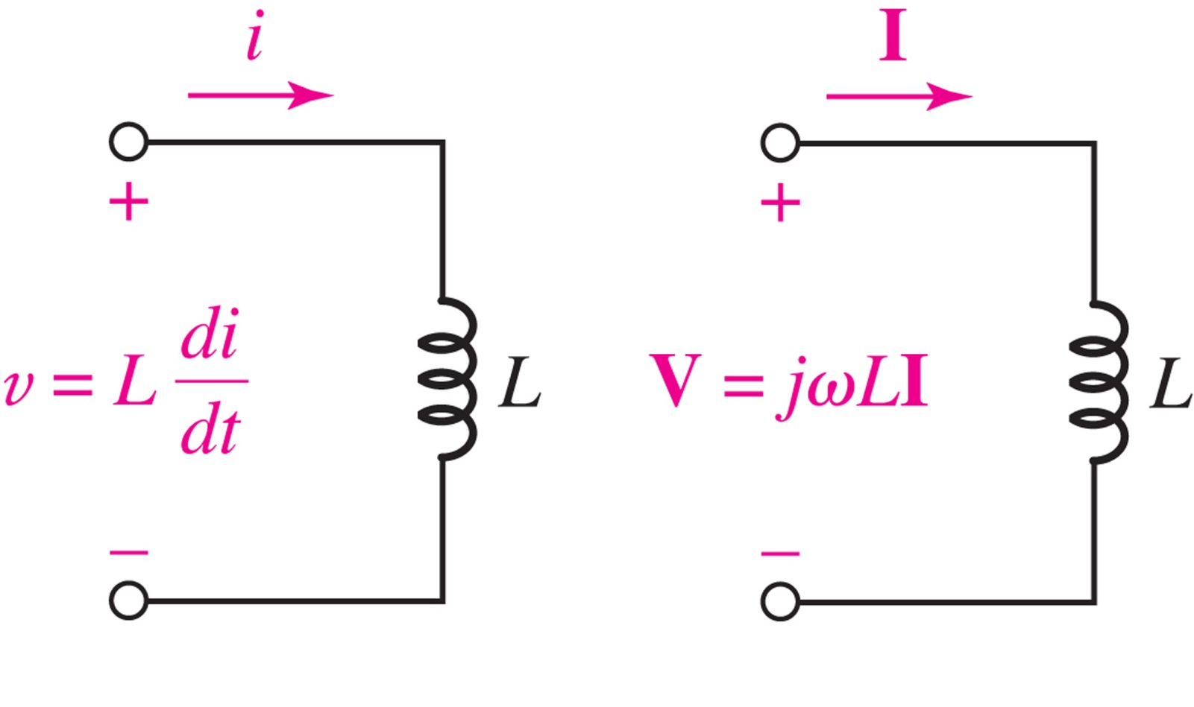
Differentiation in time becomes multiplication in phasor form: (calculus becomes algebra!)
Copyright © 2013 The McGraw-Hill Companies, Inc. Permission required for reproduction or display.

Slide 13

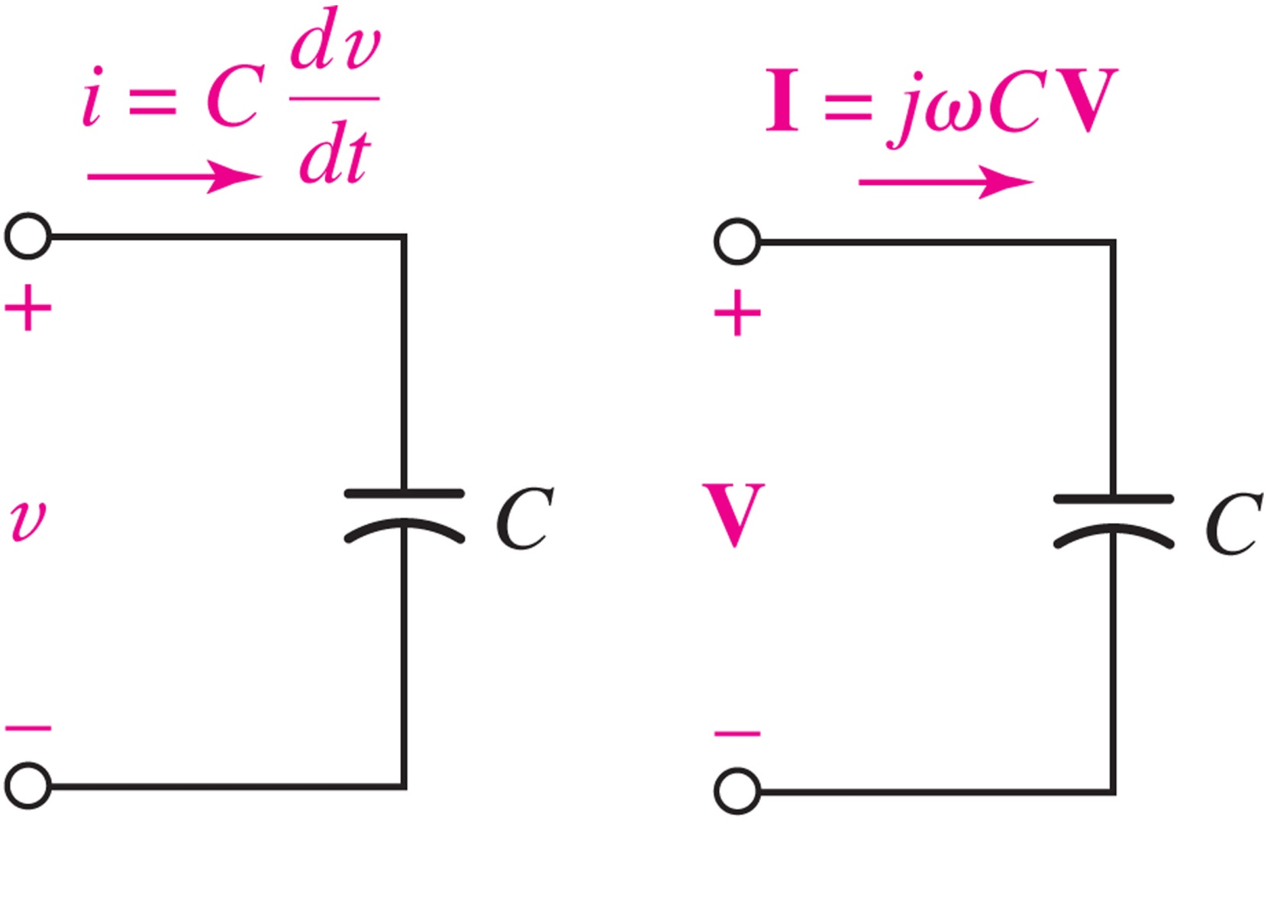
Differentiation in time becomes multiplication in phasor form: (calculus becomes algebra!)
Copyright © 2013 The McGraw-Hill Companies, Inc. Permission required for reproduction or display.

Slide 14

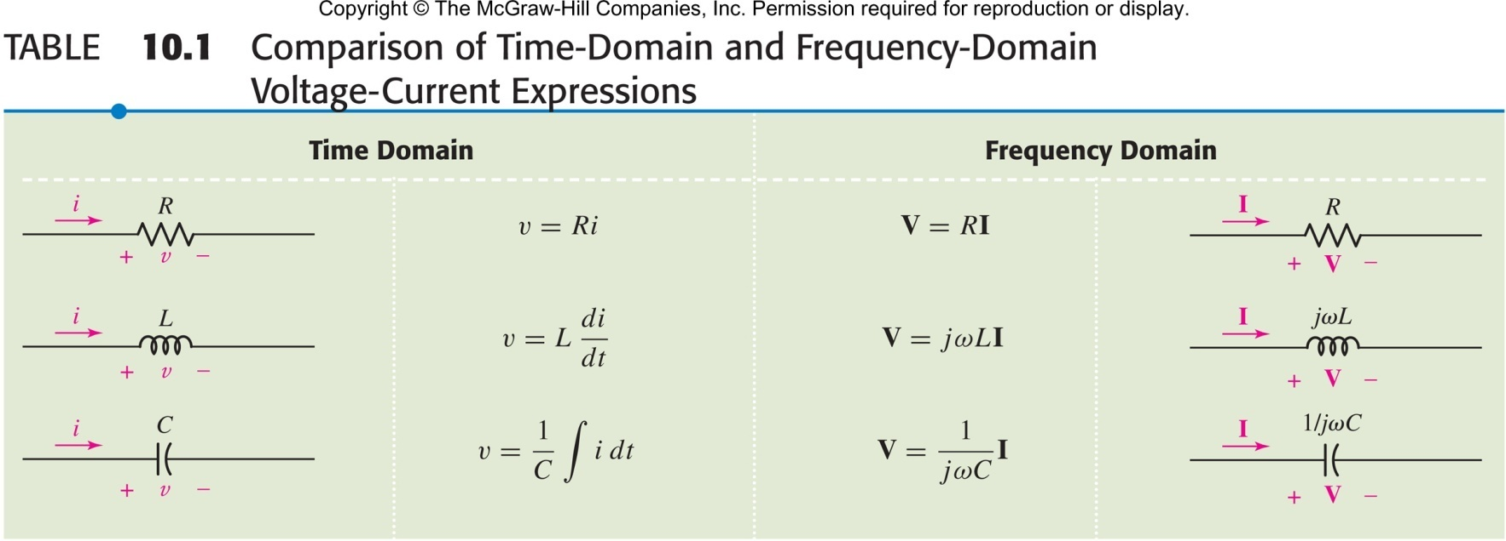
Time Domain Frequency Domain
Calculus (hard but real) Algebra (easy but complex)
Copyright © 2013 The McGraw-Hill Companies, Inc. Permission required for reproduction or display.

Slide 15

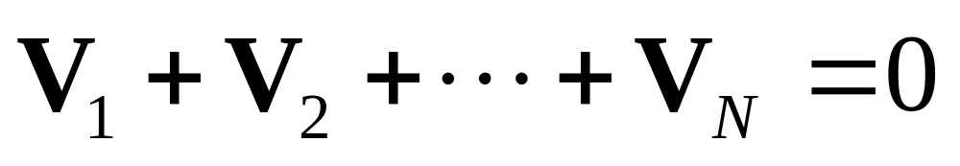
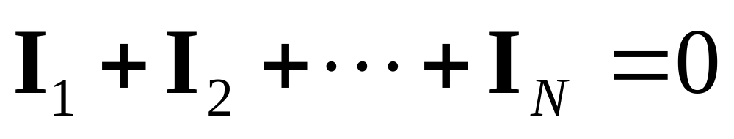
Applying KVL in time implies KVL for phasors:
Applying KCL in time implies KCL for phasors:
Copyright © 2013 The McGraw-Hill Companies, Inc. Permission required for reproduction or display.

Slide 16

Define impedance as Z=V/I, i.e. V=IZ
Z_{R}=R Z_{L}=jωL Z_{C}=1/jωC
Impedance is the equivalent of resistance in the frequency domain.
Impedance is a complex number (unit ohm).
Impedances in series or parallel can be combined using “resistor rules.”
Copyright © 2013 The McGraw-Hill Companies, Inc. Permission required for reproduction or display.

Slide 17

the admittance is Y=1/Z
Y_{R}=1/R Y_{L}=1/jωL Y_{C}=jωC
if Z=R+jX; R is the resistance, X is the reactance (unit ohm Ω)
if Y=G+jB; G is the conductance, B is the susceptance: (unit siemen S)
Copyright © 2013 The McGraw-Hill Companies, Inc. Permission required for reproduction or display.

Slide 18

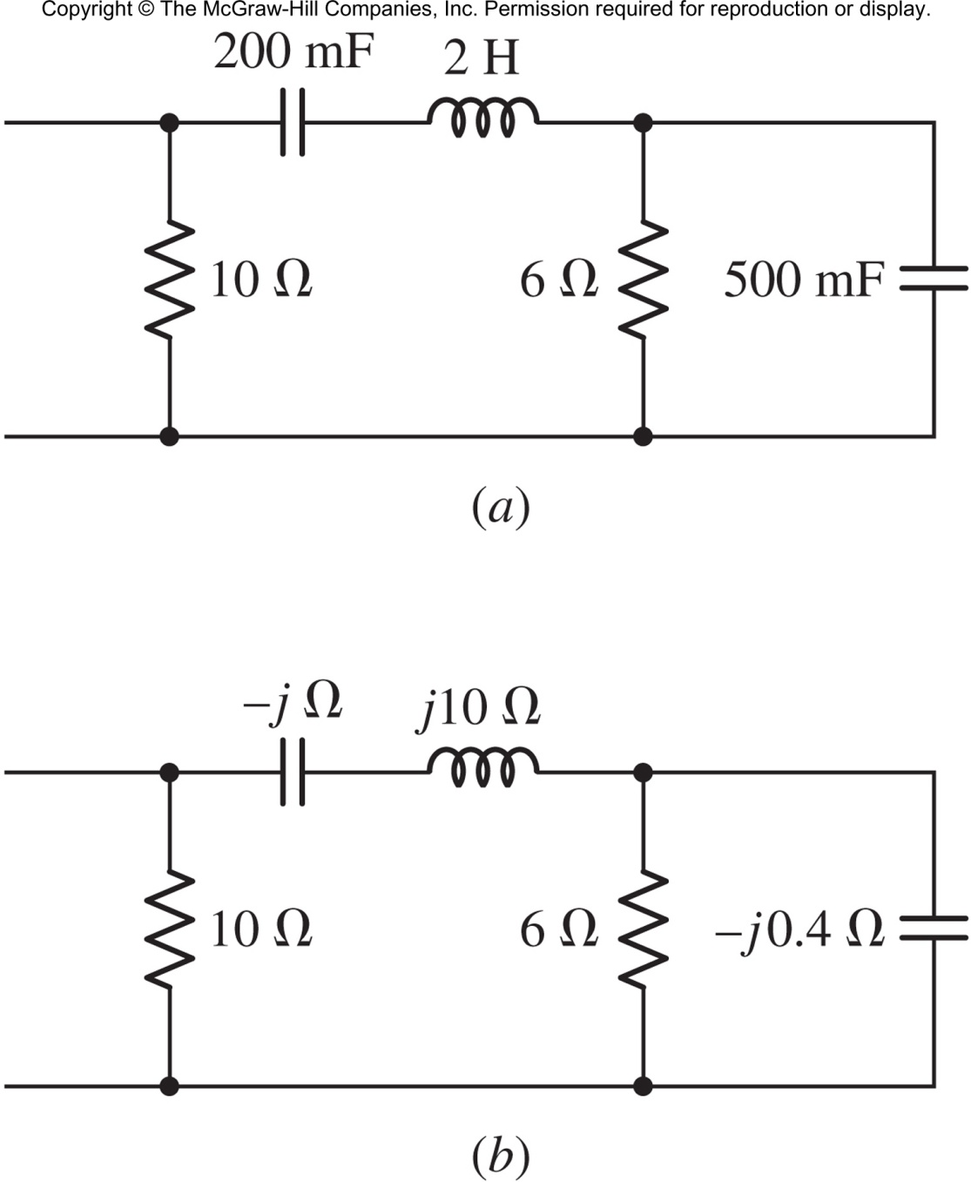
Find the impedance of the network at 5 rad/s.
Answer: 4.255 + j4.929 Ω
Copyright © 2013 The McGraw-Hill Companies, Inc. Permission required for reproduction or display.

Slide 19

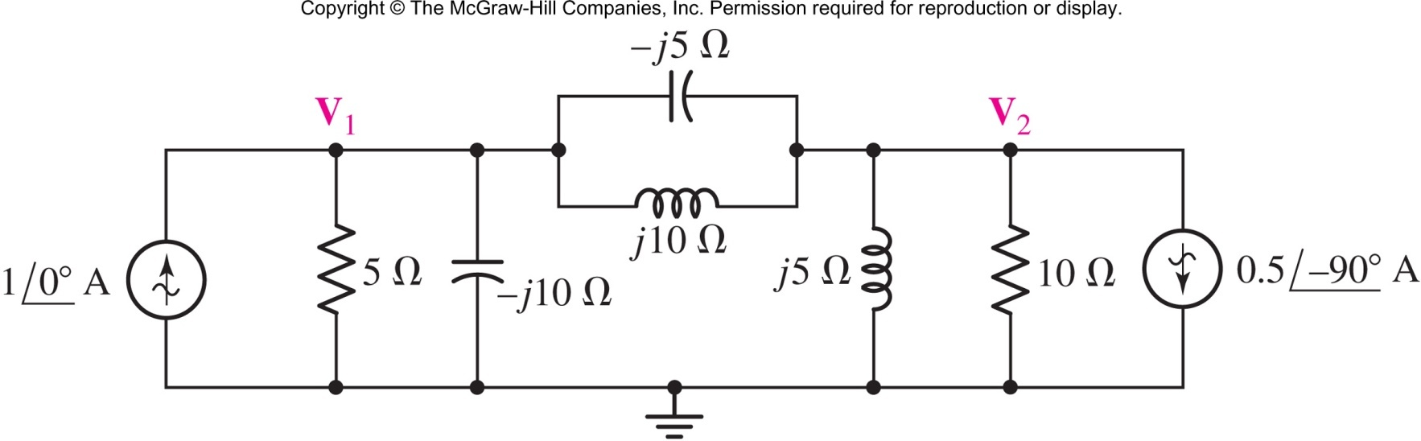
Find the phasor voltages V₁ and V₂.
Answer: V₁=1-j2 V and V₂=-2+j4 V
Copyright © 2013 The McGraw-Hill Companies, Inc. Permission required for reproduction or display.

Slide 20
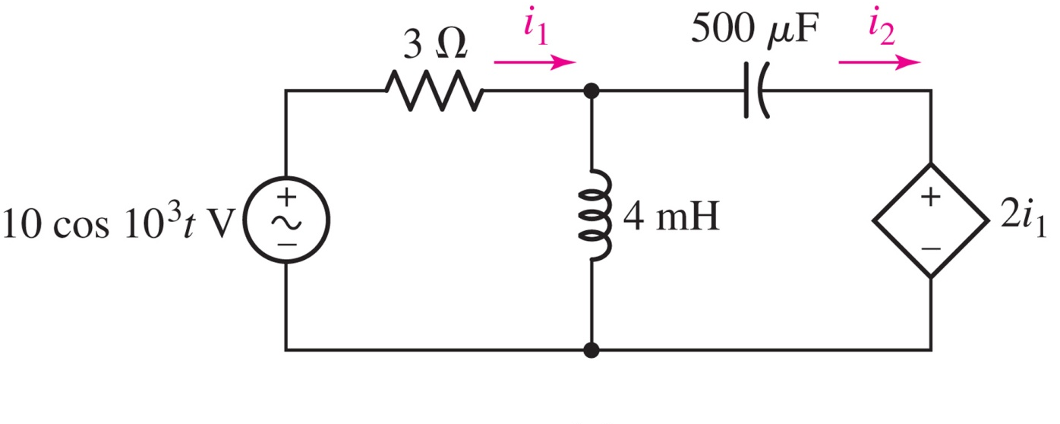
Find the currents i₁(t) and i₂(t).
Answer:
i₁(t) = 1.24 cos(10³t + 29.7◦) A
i₂(t) = 2.77 cos(10³t + 56.3◦) A
Copyright © 2013 The McGraw-Hill Companies, Inc. Permission required for reproduction or display.

Slide 21

The superposition principle applies to phasors; use it to find V₁.
Answer: V₁=V_{1L} +V_{1R} =(2-j2)+(-1) = 1-j2 V
Copyright © 2013 The McGraw-Hill Companies, Inc. Permission required for reproduction or display.

Slide 22

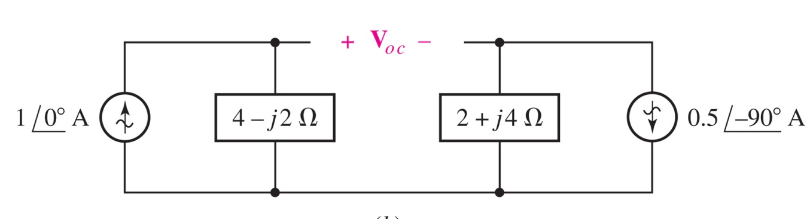
Thévenin’s theorem also applies to phasors; we can use it to find V₁.
The setup is shown below:
Copyright © 2013 The McGraw-Hill Companies, Inc. Permission required for reproduction or display.

Slide 23

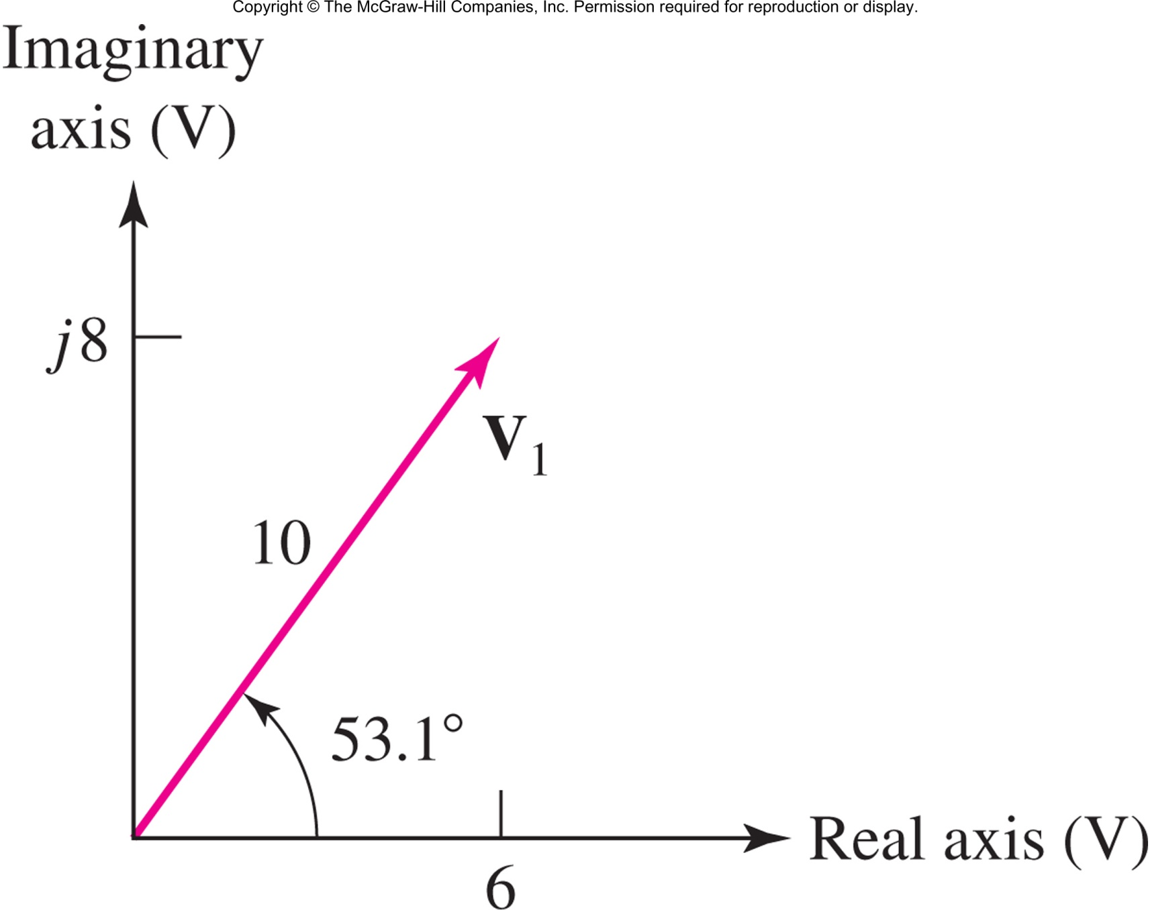
The arrow for the phasor V on the phasor diagram is a photograph, taken at ωt = 0, of a rotating arrow whose projection on the real axis is the instantaneous voltage v(t).
Copyright © 2013 The McGraw-Hill Companies, Inc. Permission required for reproduction or display.

Slide 24

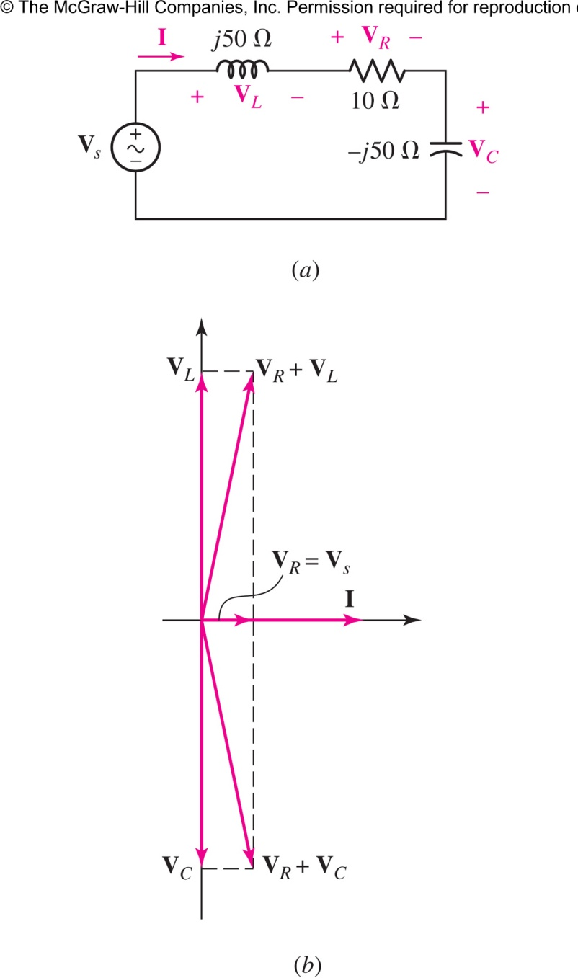
If we assume I=1 ⁄ 0° A
Copyright © 2013 The McGraw-Hill Companies, Inc. Permission required for reproduction or display.

Slide 25

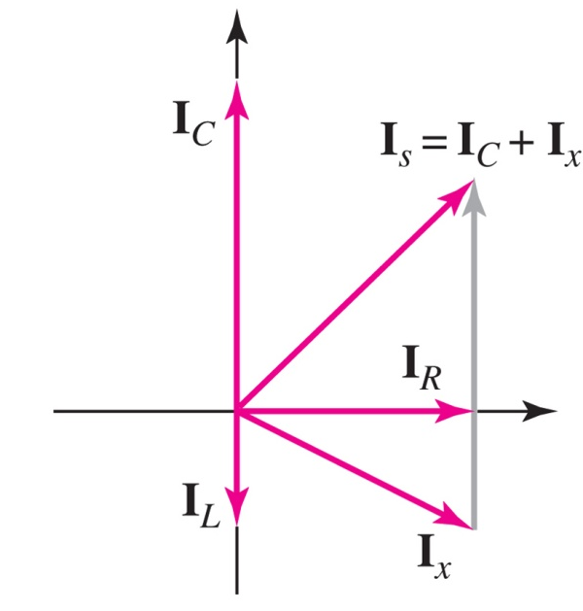
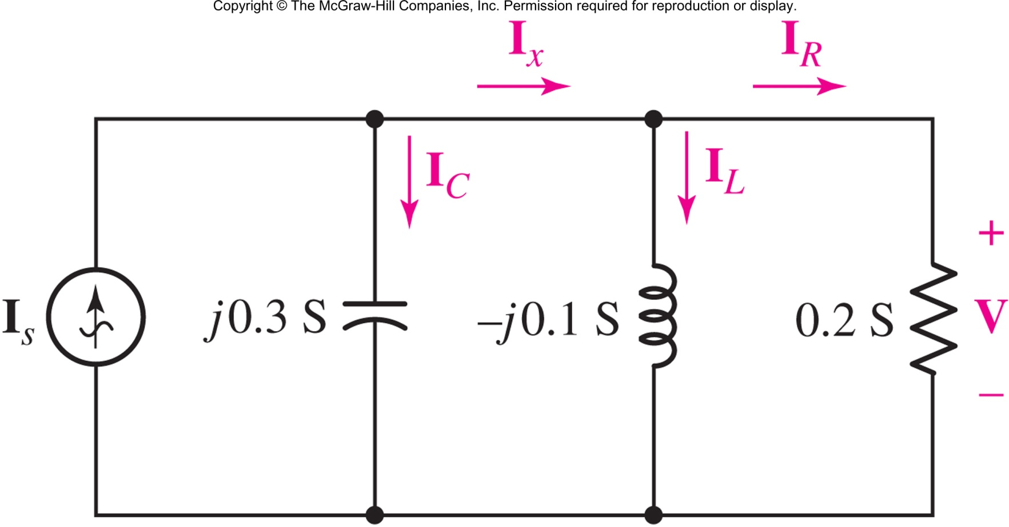
Assume V = 1 /0◦ V
Copyright © 2013 The McGraw-Hill Companies, Inc. Permission required for reproduction or display.

