Slide 1


Chapter 11 AC Circuit Power Analysis
Copyright © 2013 The McGraw-Hill Companies, Inc. Permission required for reproduction or display.

Slide 2

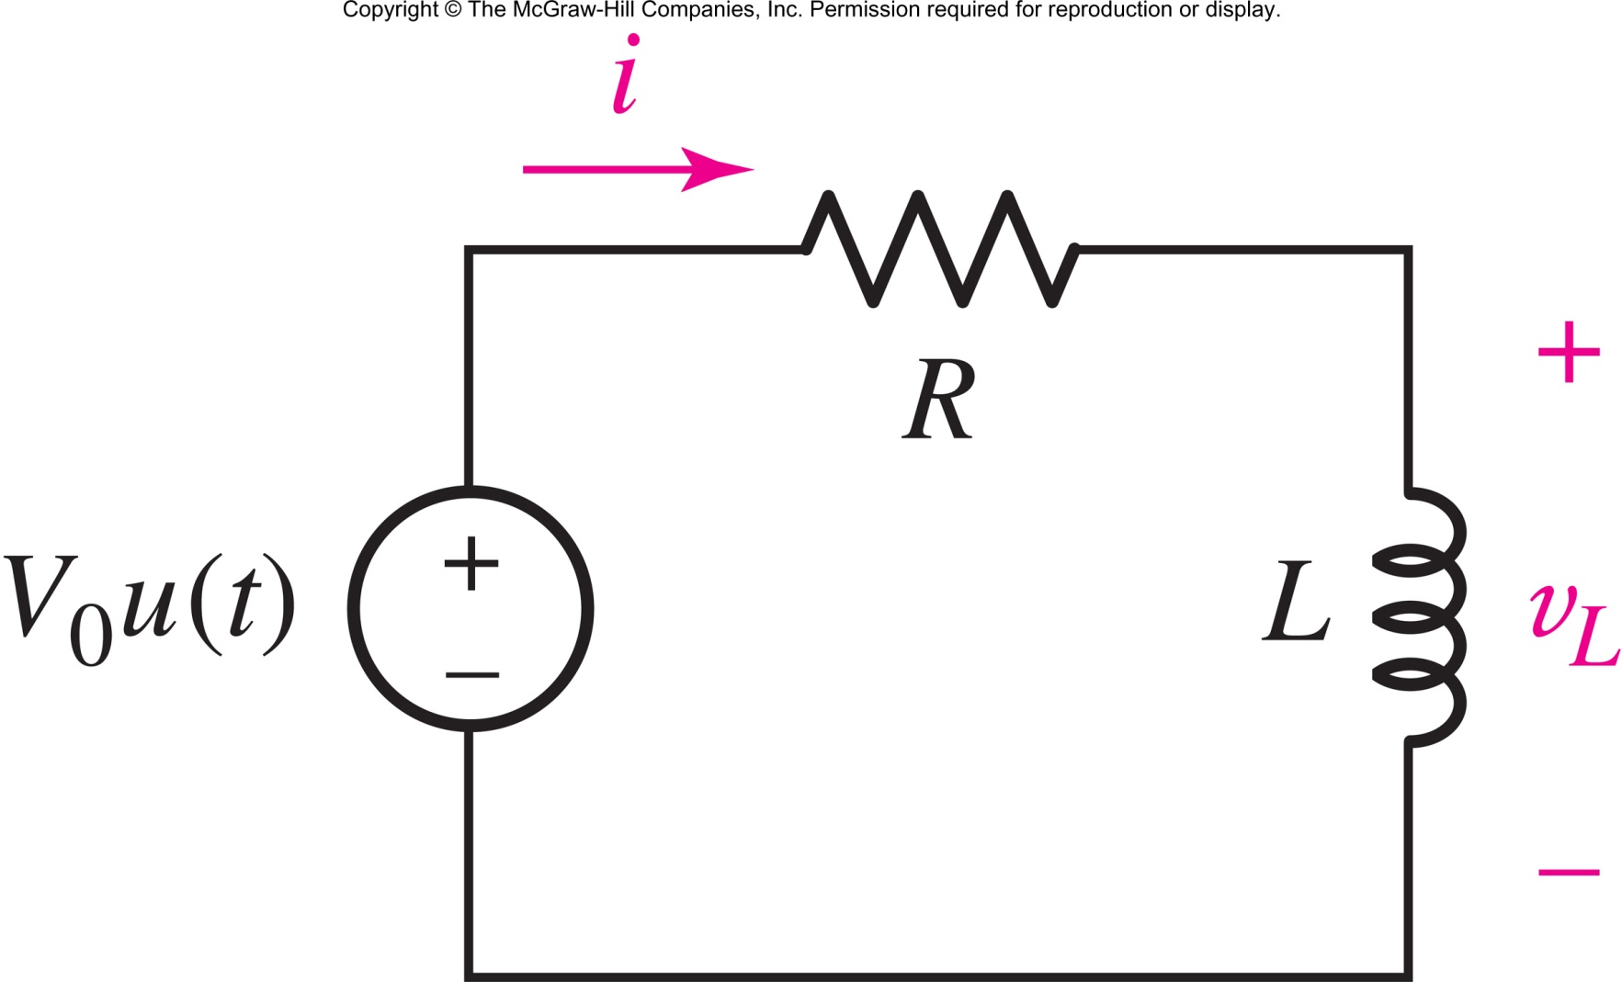
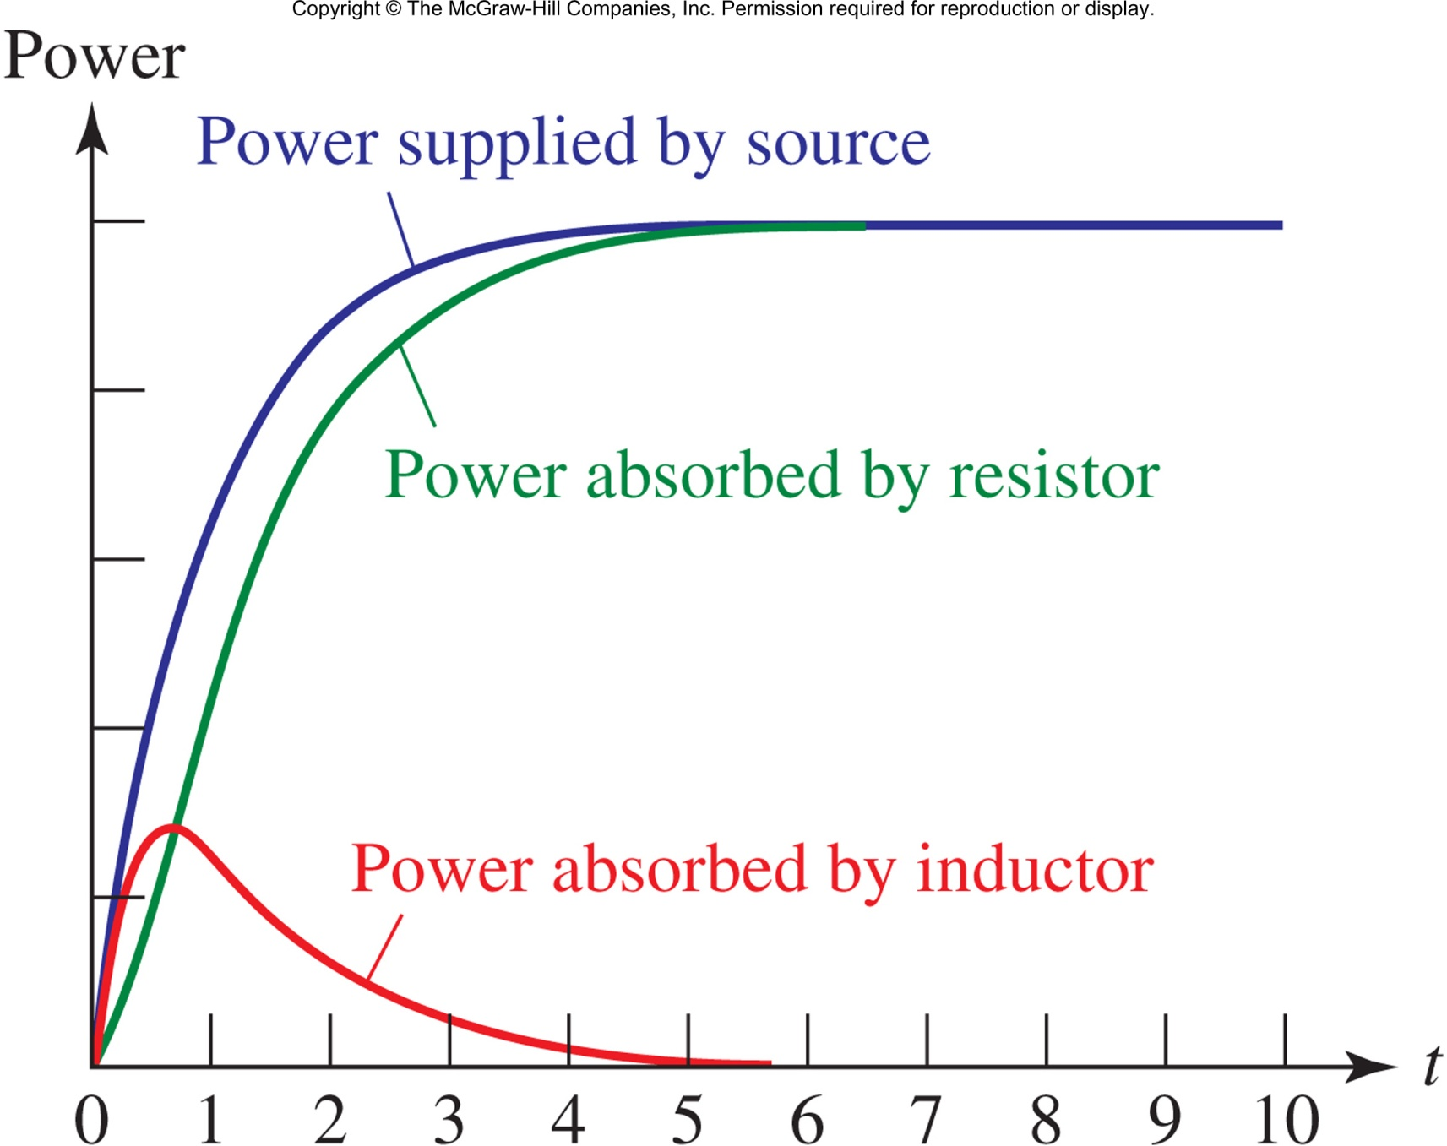
The instantaneous power is p(t)=v(t)i(t).
At all times t,
power supplied = power absorbed
Copyright © 2013 The McGraw-Hill Companies, Inc. Permission required for reproduction or display.

Slide 3



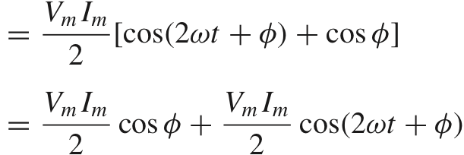
If in the same RL circuit, the source is V_{m}cos(ωt), then
and so the power will be
Double Frequency Term
Constant
Term
Copyright © 2013 The McGraw-Hill Companies, Inc. Permission required for reproduction or display.

Slide 4

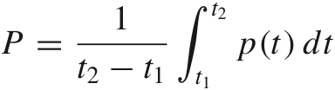
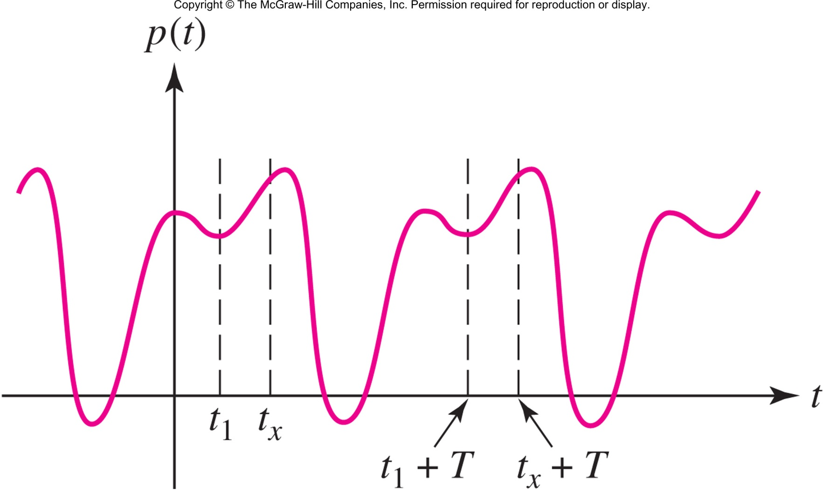
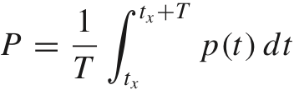
The average power over an arbitrary interval from t₁ to t₂ is
When the power is periodic with period T, the average power is calculated over any one period:
Copyright © 2013 The McGraw-Hill Companies, Inc. Permission required for reproduction or display.

Slide 5

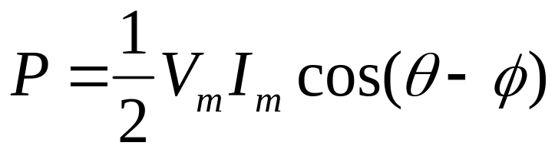
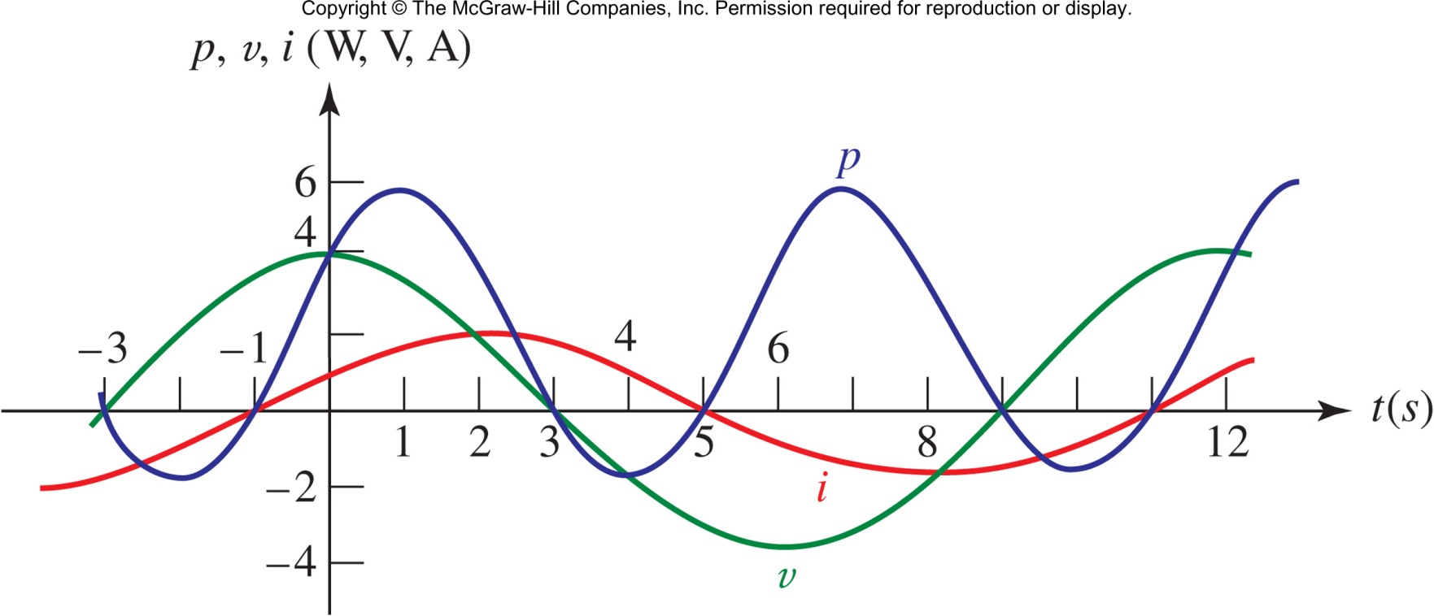
If v(t)=V_{m}cos(ωt+θ) and i(t)=I_{m}cos(ωt+ϕ), then
Copyright © 2013 The McGraw-Hill Companies, Inc. Permission required for reproduction or display.

Slide 6

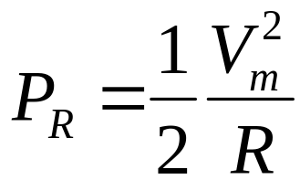
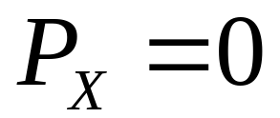
The average power absorbed by a resistor R is
The average power absorbed by a purely reactive element(s) is zero, since the current and voltage are 90 degrees out of phase:
Copyright © 2013 The McGraw-Hill Companies, Inc. Permission required for reproduction or display.

Slide 7

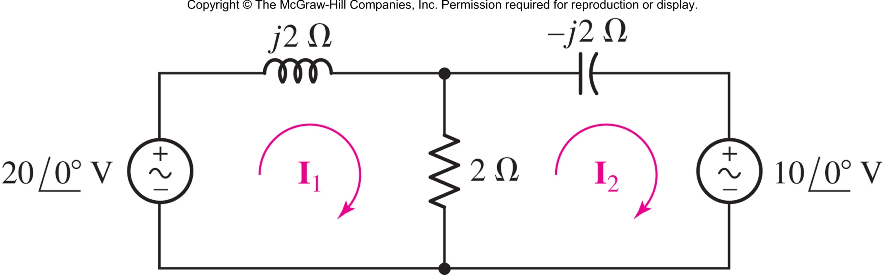
Find the average power absorbed by each element.
Answer: P_{L}=0 W P_{C}=0 W, P_{R}=25 W
P_{left}=-50 W P_{right}=25 W
Copyright © 2013 The McGraw-Hill Companies, Inc. Permission required for reproduction or display.

Slide 8

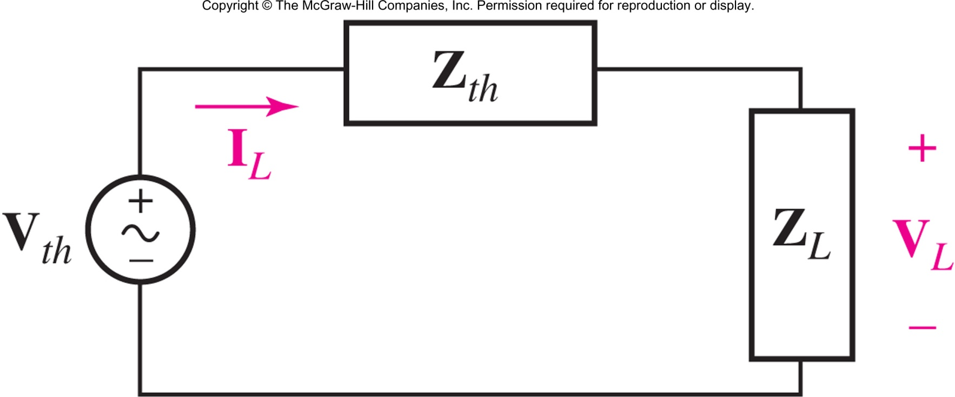
An independent voltage source in series with an impedance Z_{th} delivers a maximum average power to that load impedance Z_{L} which is the conjugate of Z_{th}:
Z_{L} = Z_{th}*
Copyright © 2013 The McGraw-Hill Companies, Inc. Permission required for reproduction or display.

Slide 9

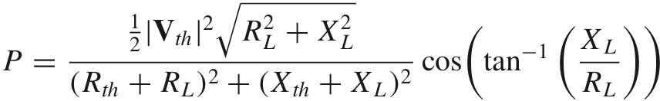
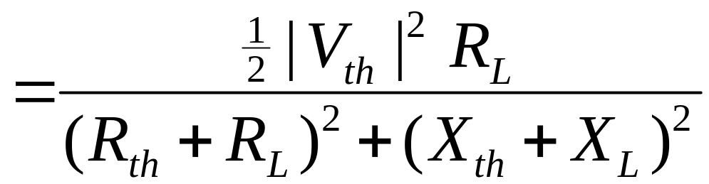
First, solve for the load power:
Clearly, P is largest when X_{L}+X_{th}=0
Solving dP/dR_{L}=0 will show that R_{L}=R_{th}
Copyright © 2013 The McGraw-Hill Companies, Inc. Permission required for reproduction or display.

Slide 10

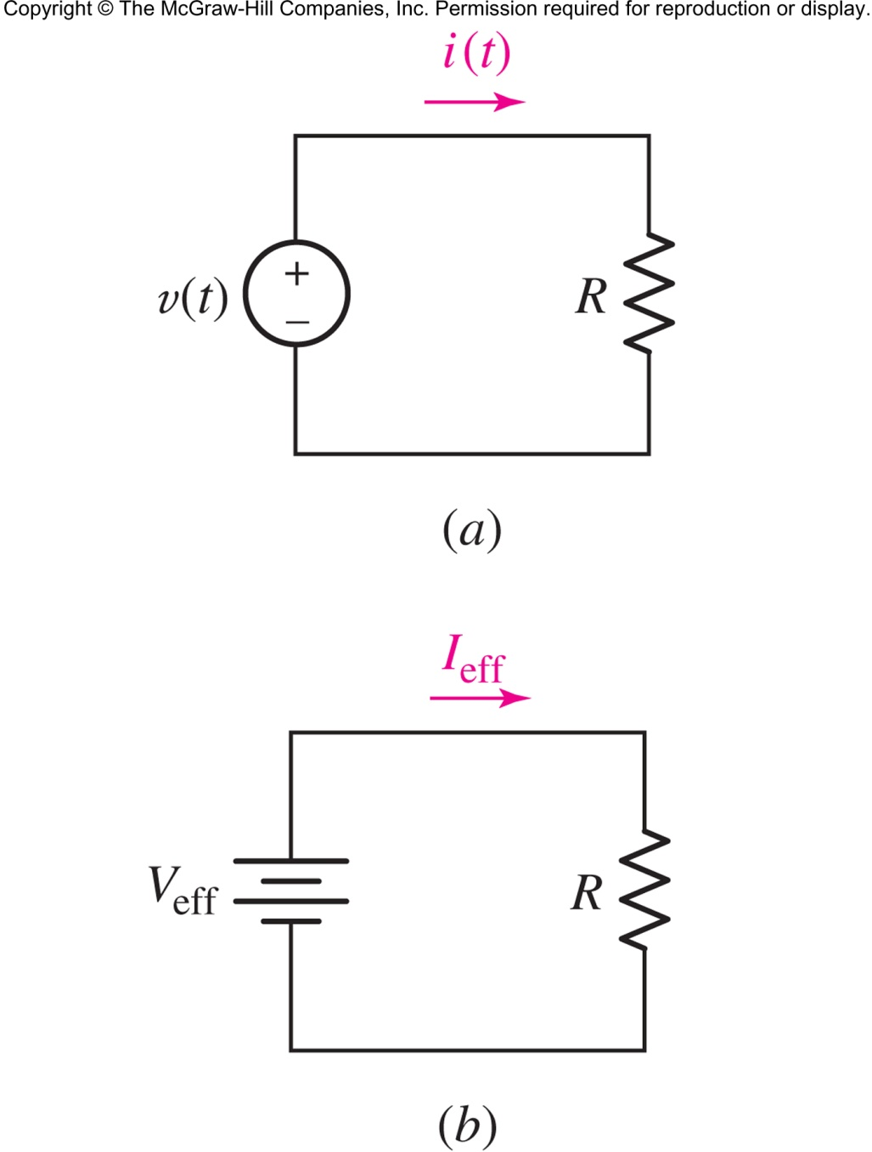
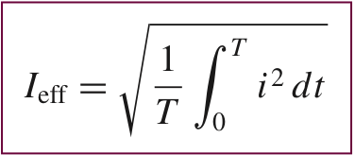
The same power is delivered to the resistor in the circuits shown.
periodic, period T
Copyright © 2013 The McGraw-Hill Companies, Inc. Permission required for reproduction or display.

Slide 11

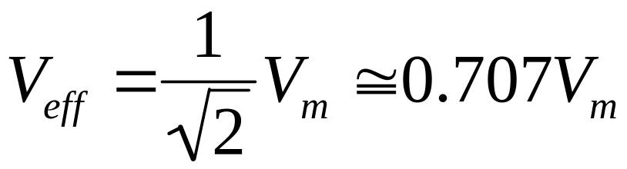
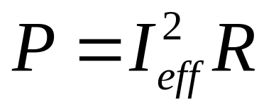
The effective value is often referred to as the root-mean-square or RMS value.
For sine waves:
Power is now
Copyright © 2013 The McGraw-Hill Companies, Inc. Permission required for reproduction or display.

Slide 12

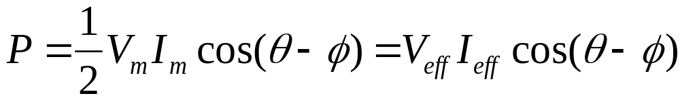
If v(t)=V_{m}cos(ωt+θ) and i(t)=I_{m}cos(ωt+ϕ), then
the apparent power is defined as V_{eff}I_{eff} and is given the units volt-ampere V•A
Copyright © 2013 The McGraw-Hill Companies, Inc. Permission required for reproduction or display.

Slide 13
Find the average power being delivered to an impedance Z_{L}= 8 − j11 Ω by a current I= 5e^{j20°} A.
Only the 8-Ω resistance enters the average-power calculation, since the j11-Ω component will not absorb any average power.
Thus,
P = (1/2)(5²)8 = 100 W
Copyright © 2013 The McGraw-Hill Companies, Inc. Permission required for reproduction or display.

Slide 14
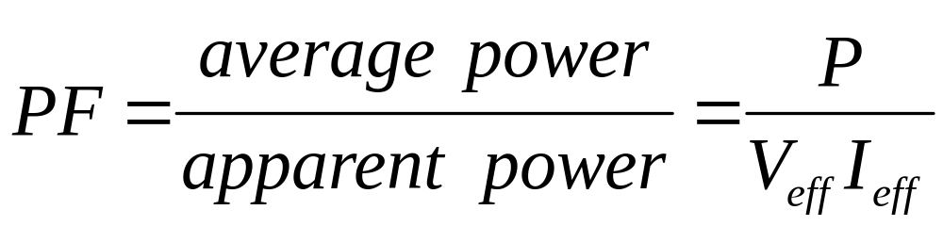
Power factor is defined as
for a resistive load, PF=1
for a purely reactive load, PF=0
generally, 0 ≤ PF ≤ 1
Copyright © 2013 The McGraw-Hill Companies, Inc. Permission required for reproduction or display.

Slide 15


Since the power factor for sine waves is
the information as to whether current leads or lags voltage is lost, so we add the adjective to the power factor term.
An inductive load has a lagging PF.
A capacitive load has a leading PF.
Copyright © 2013 The McGraw-Hill Companies, Inc. Permission required for reproduction or display.

Slide 16

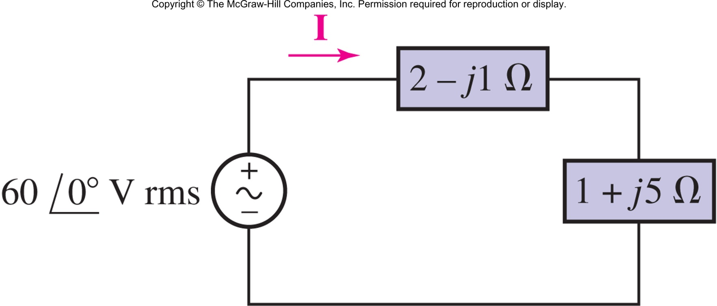
Find the average power delivered to each of the two loads, the apparent power supplied by the source, and the power factor of the combined loads.
Answer: 288 W, 144 W, 720 VA, PF=0.6 (lagging)
Copyright © 2013 The McGraw-Hill Companies, Inc. Permission required for reproduction or display.

Slide 17

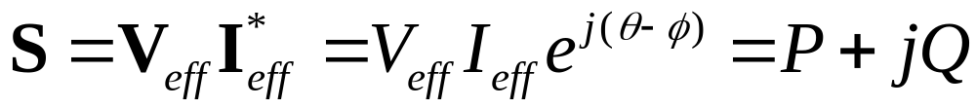
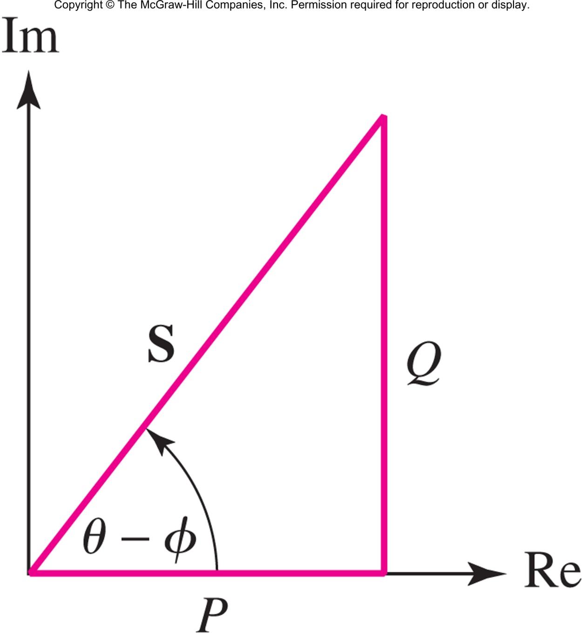
Define the complex power S as
the real part of S is P, the average power
the imaginary part of S is Q, the reactive power, which represents the flow of energy back and forth from the source (utility company) to the inductors and capacitors of the load (customer)
Copyright © 2013 The McGraw-Hill Companies, Inc. Permission required for reproduction or display.

Slide 18
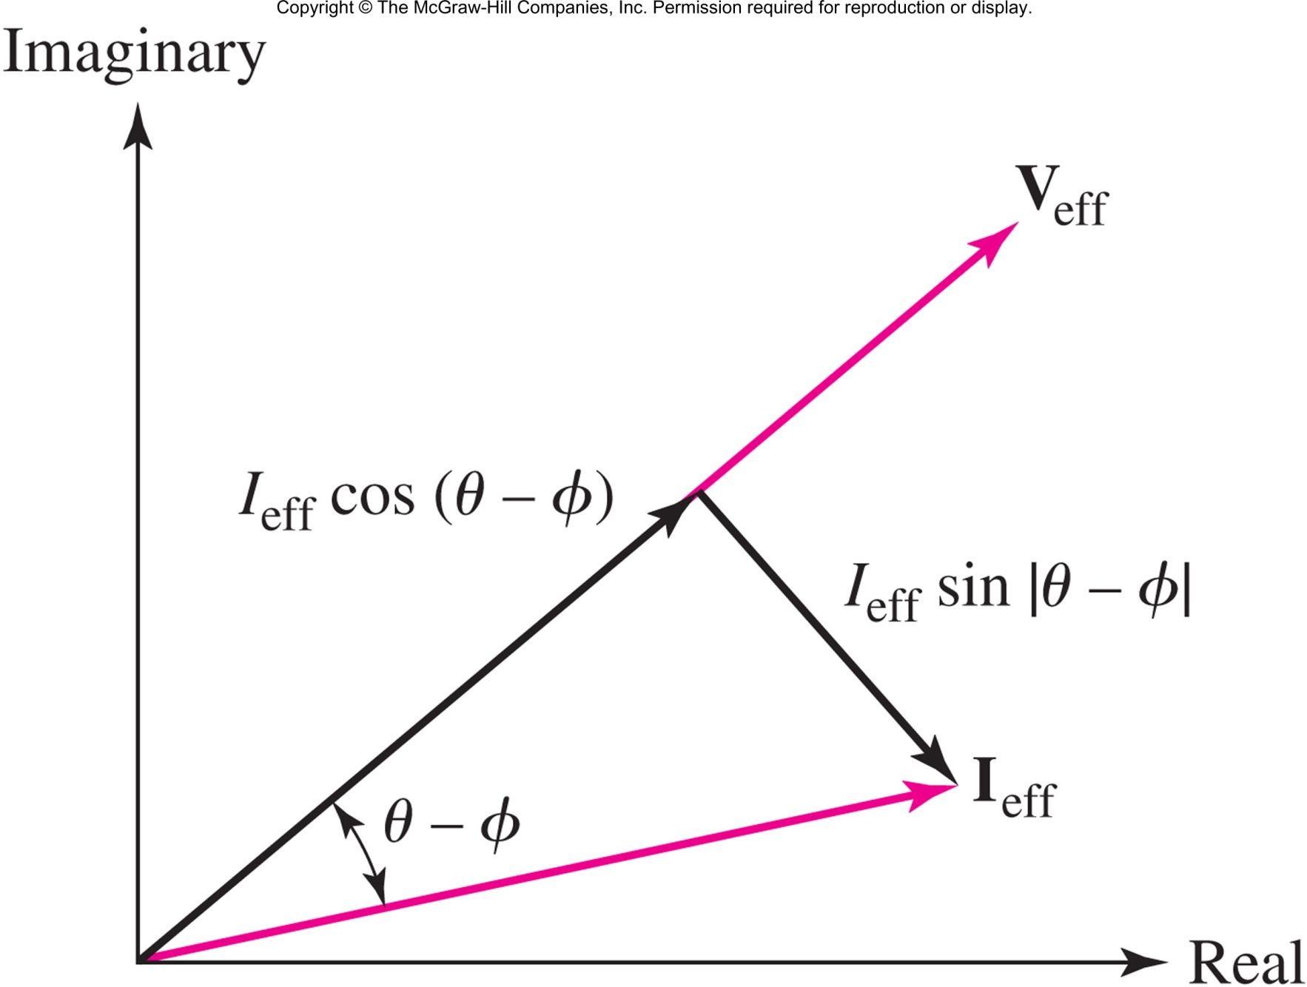
Splitting the current phasor I_{eff} into in-phase and out-of-phase components is another way of visualizing the complex power.
Copyright © 2013 The McGraw-Hill Companies, Inc. Permission required for reproduction or display.

Slide 19
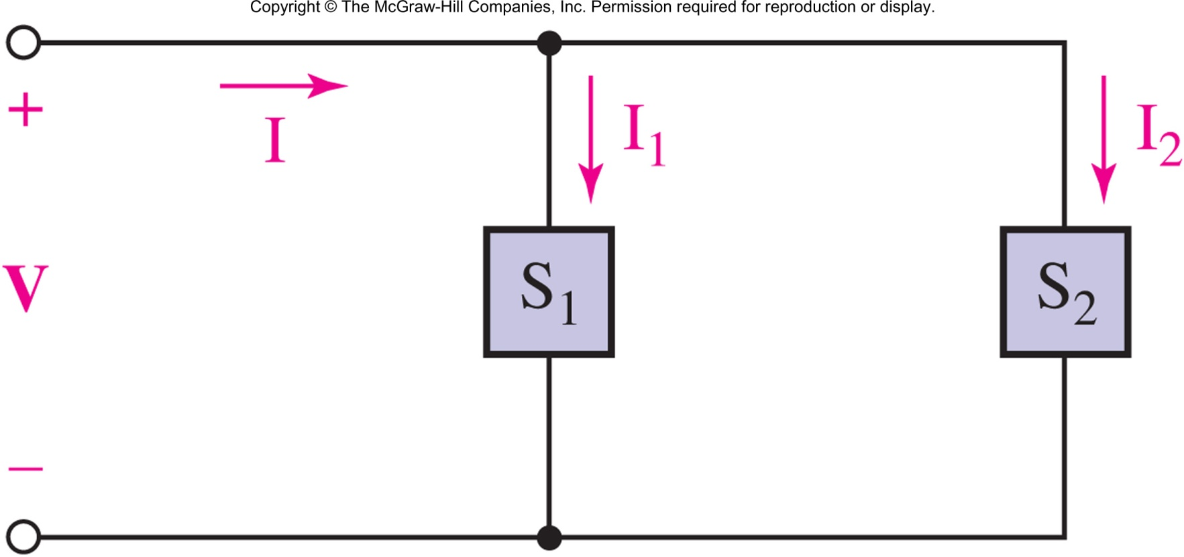
Complex powers to loads add:
Copyright © 2013 The McGraw-Hill Companies, Inc. Permission required for reproduction or display.

Slide 20

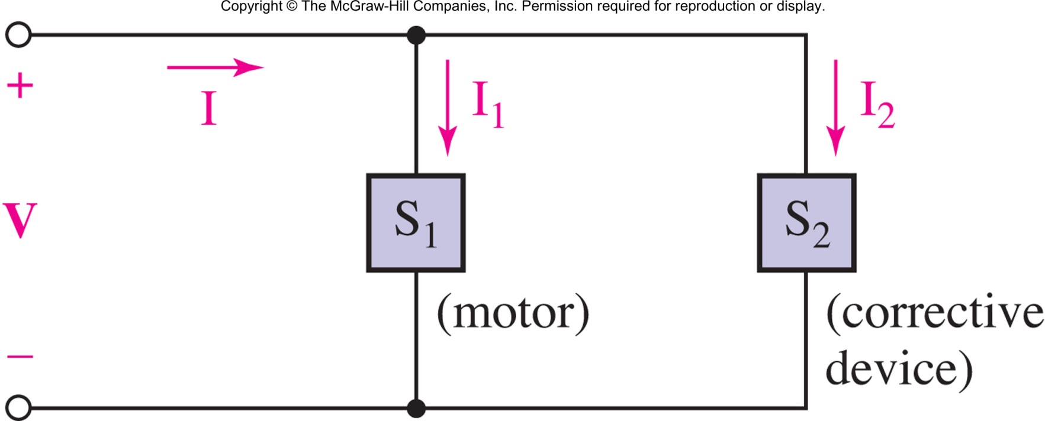
An industrial consumer is operating a 50 kW induction motor at a lagging PF of 0.8. The source voltage is 230 V rms. In order to obtain lower electrical rates, the customer wishes to raise the PF to 0.95 lagging.
Specify a suitable solution.
Answer: deploy a capacitor in parallel with the motor, as shown above.
At 60 Hz, C=1.056 mF
Copyright © 2013 The McGraw-Hill Companies, Inc. Permission required for reproduction or display.

