Slide 1

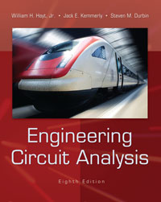
Chapter 14
Complex Frequency and the Laplace Transform
Copyright © 2013 The McGraw-Hill Companies, Inc. Permission required for reproduction or display.

Slide 2

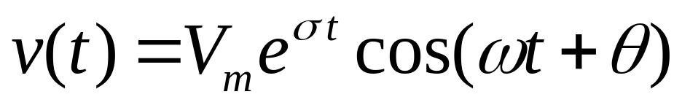

An exponentially damped sinusoidal function, such as the voltage
includes as “special cases”
dc, when σ=ω=0: v(t)=V_{m}cos(θ)=V₀
sinusoidal, when σ=0:
exponential, when ω=0: v(t)=V_{m}e^{σt}
Copyright © 2013 The McGraw-Hill Companies, Inc. Permission required for reproduction or display.

Slide 3

Any function that may be written in the form
f (t) = Ke^{st}
where K and s are complex constants (independent of time) is characterized by the complex frequency s.
Copyright © 2013 The McGraw-Hill Companies, Inc. Permission required for reproduction or display.

Slide 4

A constant voltage
v(t) = V₀
may be written in the form
v(t) = V₀e^{(0)t}
So: the complex frequency of a dc voltage or current is zero (i.e., s = 0).
Copyright © 2013 The McGraw-Hill Companies, Inc. Permission required for reproduction or display.

Slide 5

The exponential function
v(t) = V₀e^{σt}
is already in the required form.
The complex frequency of this voltage
is therefore σ or
s = σ + j0
Copyright © 2013 The McGraw-Hill Companies, Inc. Permission required for reproduction or display.

Slide 6

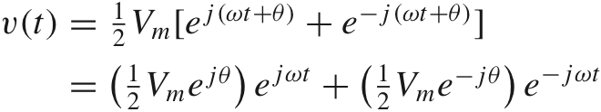

For a sinusoidal voltage
we apply Euler’s identity:
to show that
Copyright © 2013 The McGraw-Hill Companies, Inc. Permission required for reproduction or display.

Slide 7

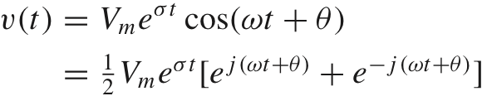
The damped sine has two complex frequencies
s₁=σ+jω and s₂=σ−jω
which are complex conjugates of each other.
Copyright © 2013 The McGraw-Hill Companies, Inc. Permission required for reproduction or display.

Slide 8

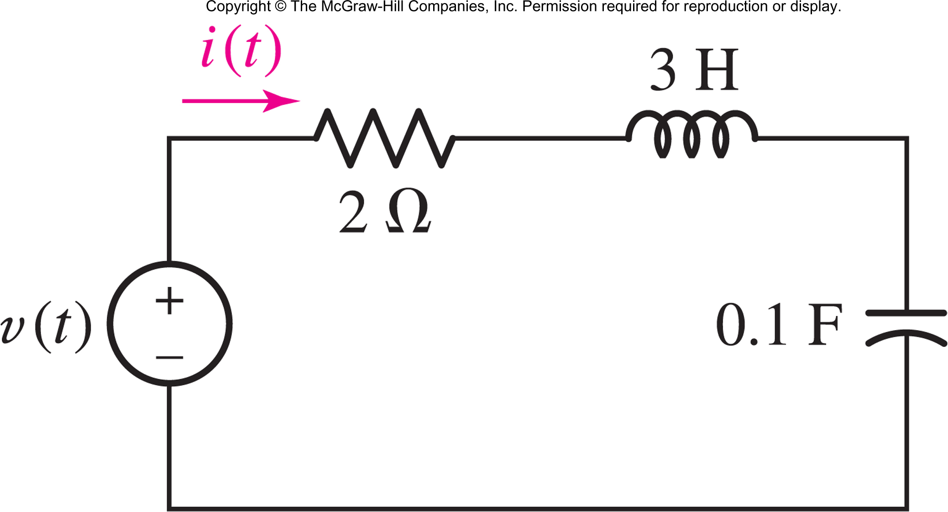
If v(t) =60e^{−2t} cos(4t + 10°) V, solve for i(t).
Method: write v(t) = Re{Ve^{st}} with s = −2 + j4
Answer: 5.37e^{−2t} cos(4t − 106.6◦) A
Copyright © 2013 The McGraw-Hill Companies, Inc. Permission required for reproduction or display.

Slide 9


The two-sided Laplace transform of a function f(t) is defined as
F(s) is the frequency-domain representation of the time-domain waveform f(t).
Copyright © 2013 The McGraw-Hill Companies, Inc. Permission required for reproduction or display.

Slide 10
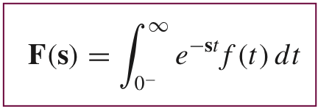
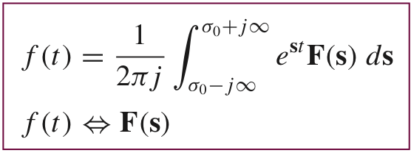
For time functions that do not exist for t < 0, or for those time functions whose behavior for t < 0 is of no interest, the time-domain description can be thought of as v(t)u(t).
This leads to the one-sided Laplace Transform, which from now on will be called simply
the Laplace Transform.
Copyright © 2013 The McGraw-Hill Companies, Inc. Permission required for reproduction or display.

Slide 11

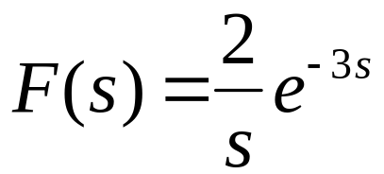
Compute the Laplace transform of the function f(t) = 2u(t − 3).
Apply:
to show that
Copyright © 2013 The McGraw-Hill Companies, Inc. Permission required for reproduction or display.

Slide 12

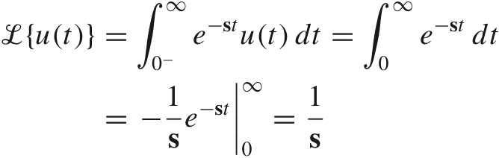

This is valid for
Re(s)>0
Copyright © 2013 The McGraw-Hill Companies, Inc. Permission required for reproduction or display.

Slide 13

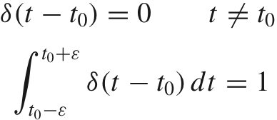
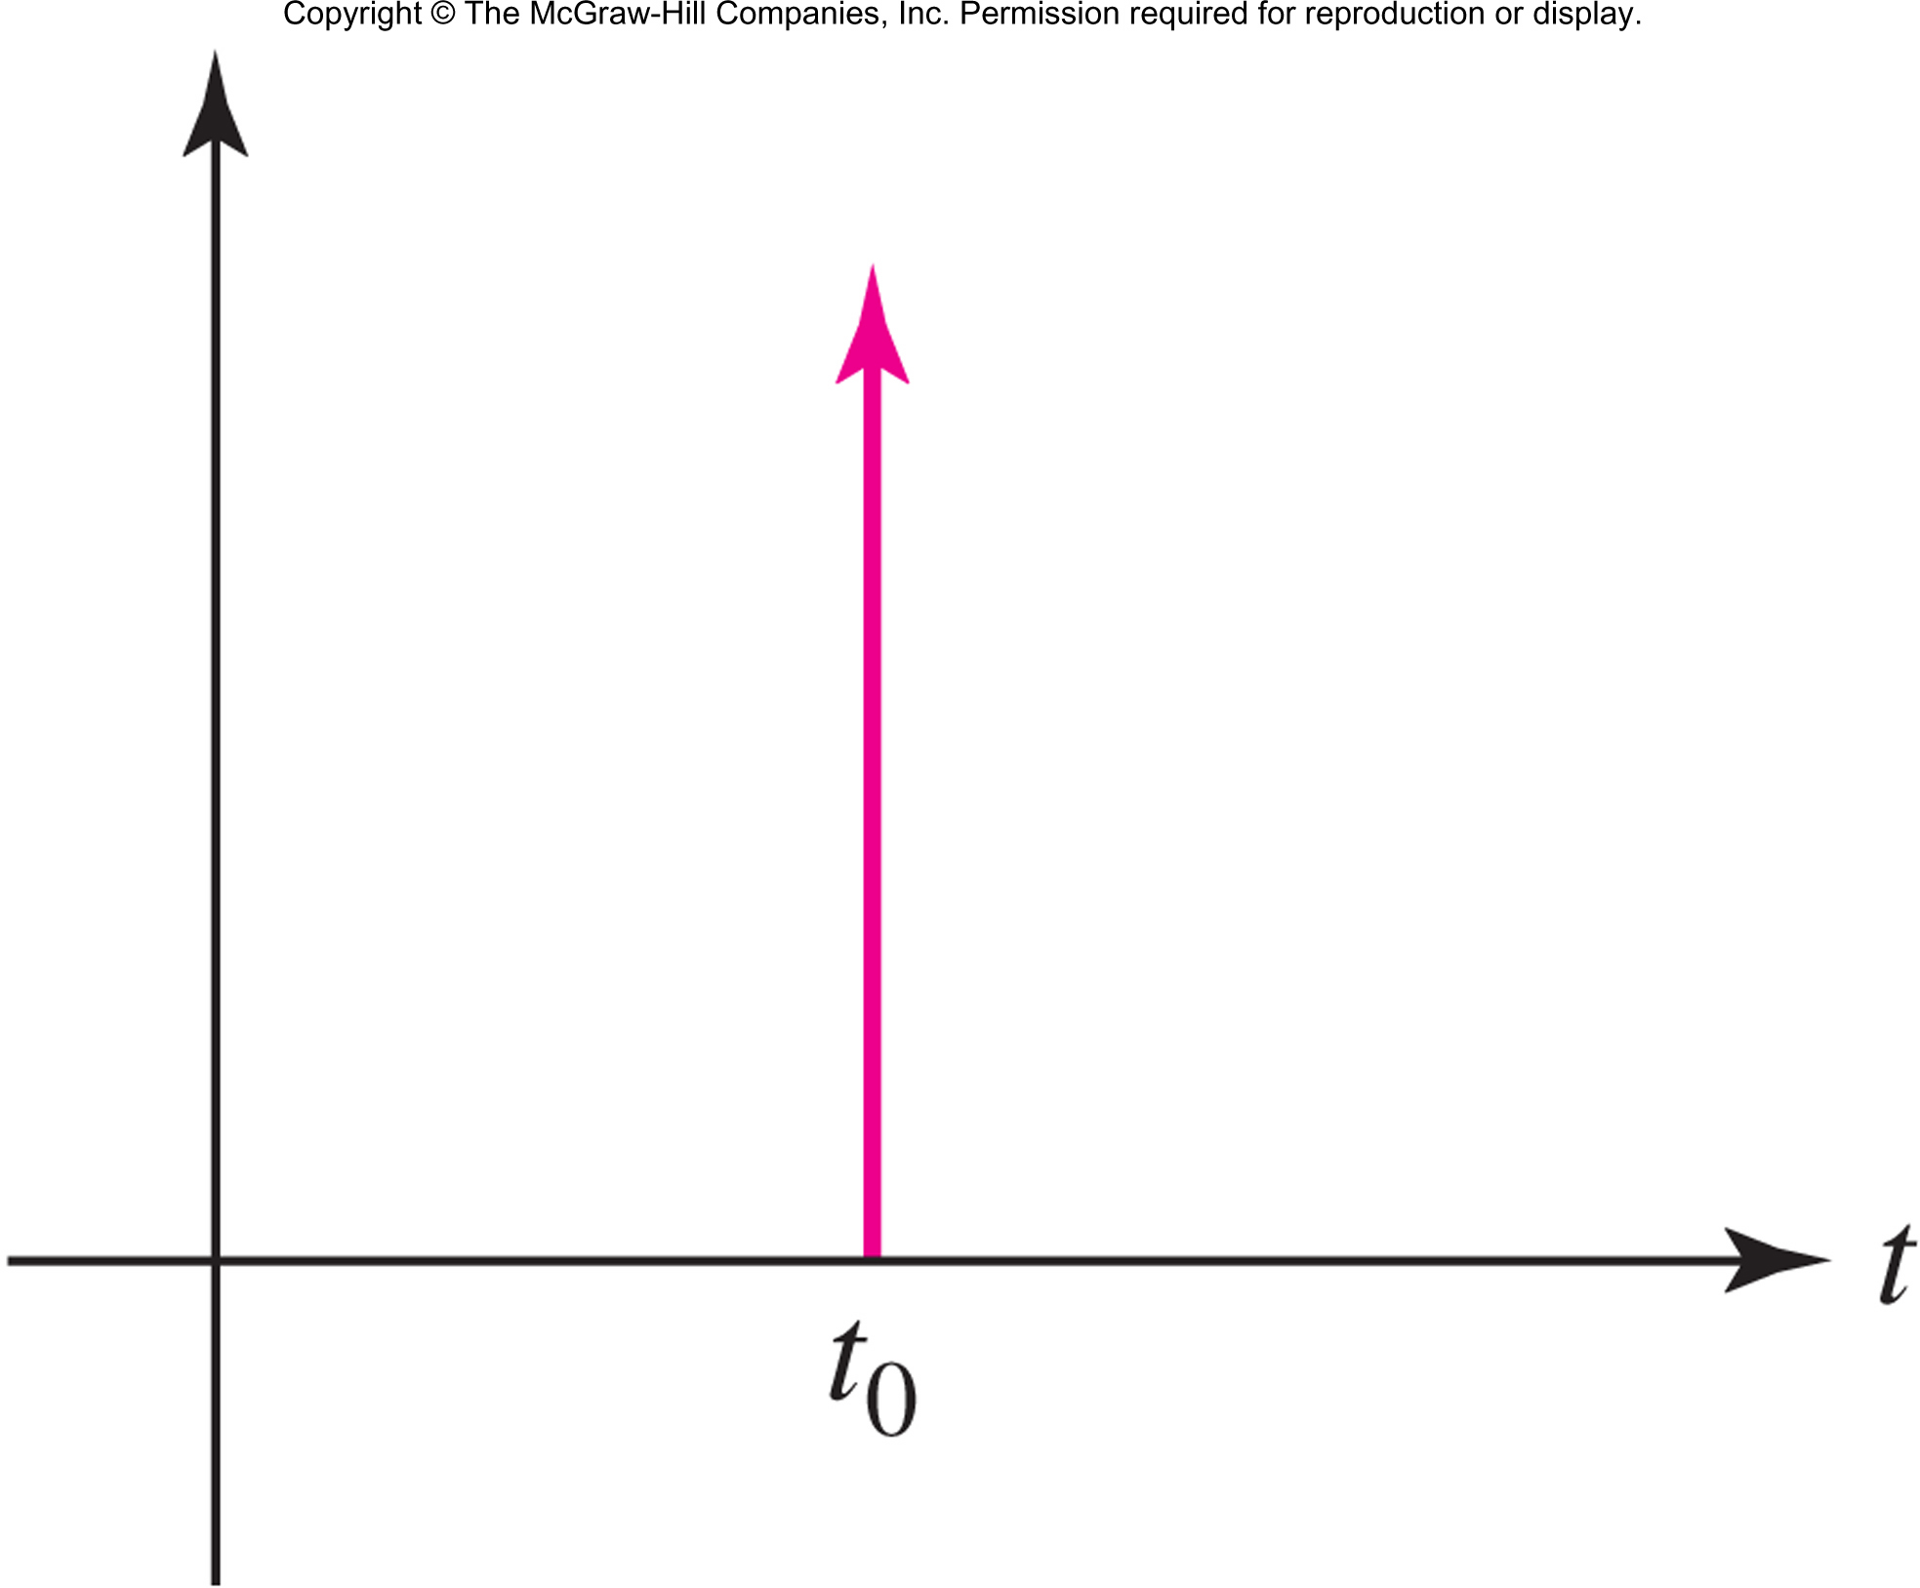
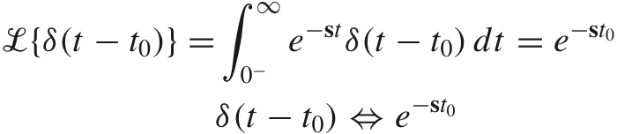
The unit impulse is defined as δ(t)=du(t)/dt
Copyright © 2013 The McGraw-Hill Companies, Inc. Permission required for reproduction or display.

Slide 14


The value of is f(t₀)
This is the sifting property of the unit impulse.
The Laplace Transform pair is simple:
Copyright © 2013 The McGraw-Hill Companies, Inc. Permission required for reproduction or display.

Slide 15


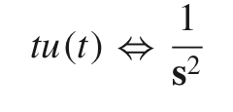

The decaying exponential:
The ramp:
The “ramp/exponential”:
Copyright © 2013 The McGraw-Hill Companies, Inc. Permission required for reproduction or display.

Slide 16

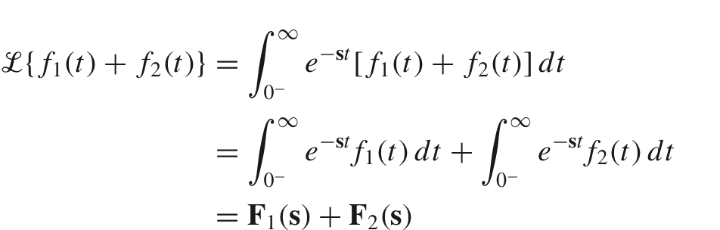
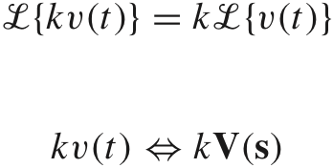
Copyright © 2013 The McGraw-Hill Companies, Inc. Permission required for reproduction or display.

Slide 17
Calculate the inverse transform of
F(s) =2(s + 2)/s.
Method: Use linearity properties and transform pairs.
Answer: f(t) =2δ(t) + 4u(t)
Copyright © 2013 The McGraw-Hill Companies, Inc. Permission required for reproduction or display.

Slide 18

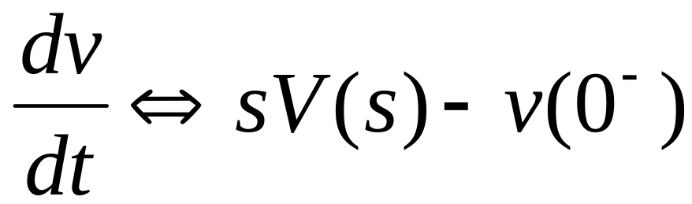
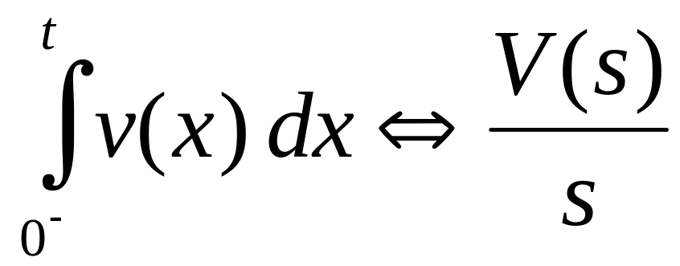
Time Differentiation:
Time Integration:
Copyright © 2013 The McGraw-Hill Companies, Inc. Permission required for reproduction or display.

Slide 19

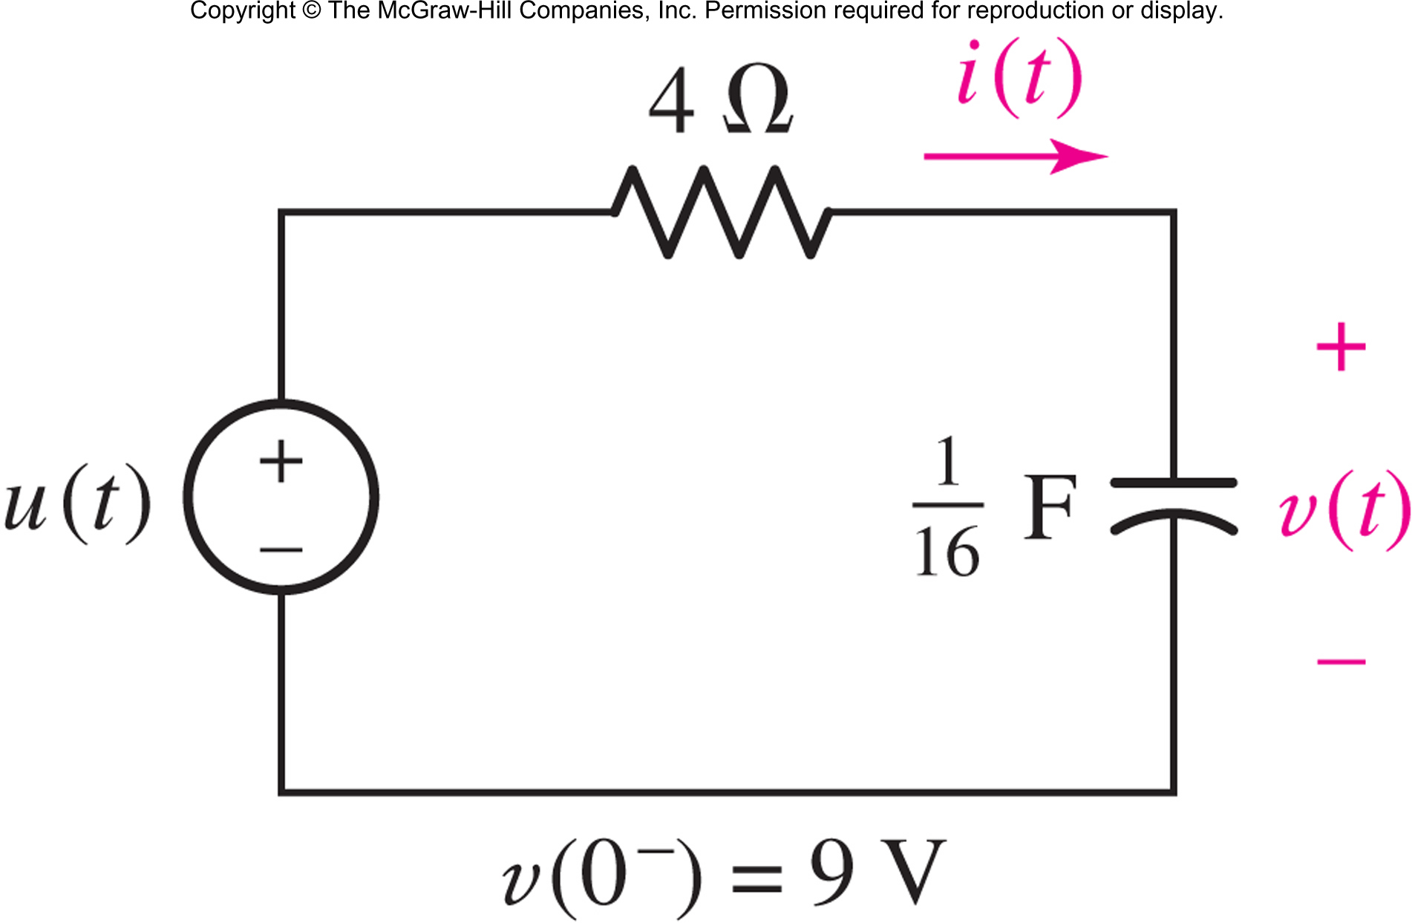
Determine i(t) and v(t) for t > 0 in the series RC circuit shown:
Answer: i(t) = −2e^{−4t}u(t) A, v(t) = (1 + 8e^{−4t} )u(t) V
Copyright © 2013 The McGraw-Hill Companies, Inc. Permission required for reproduction or display.

Slide 20

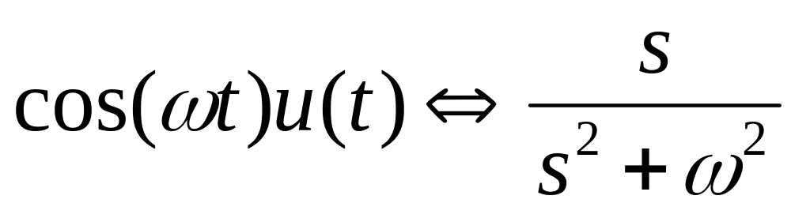
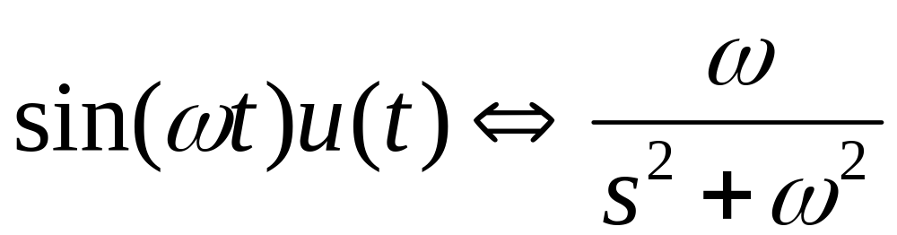
Copyright © 2013 The McGraw-Hill Companies, Inc. Permission required for reproduction or display.

Slide 21


Initial Value Theorem:
Final Value Theorem:
Copyright © 2013 The McGraw-Hill Companies, Inc. Permission required for reproduction or display.

Slide 22
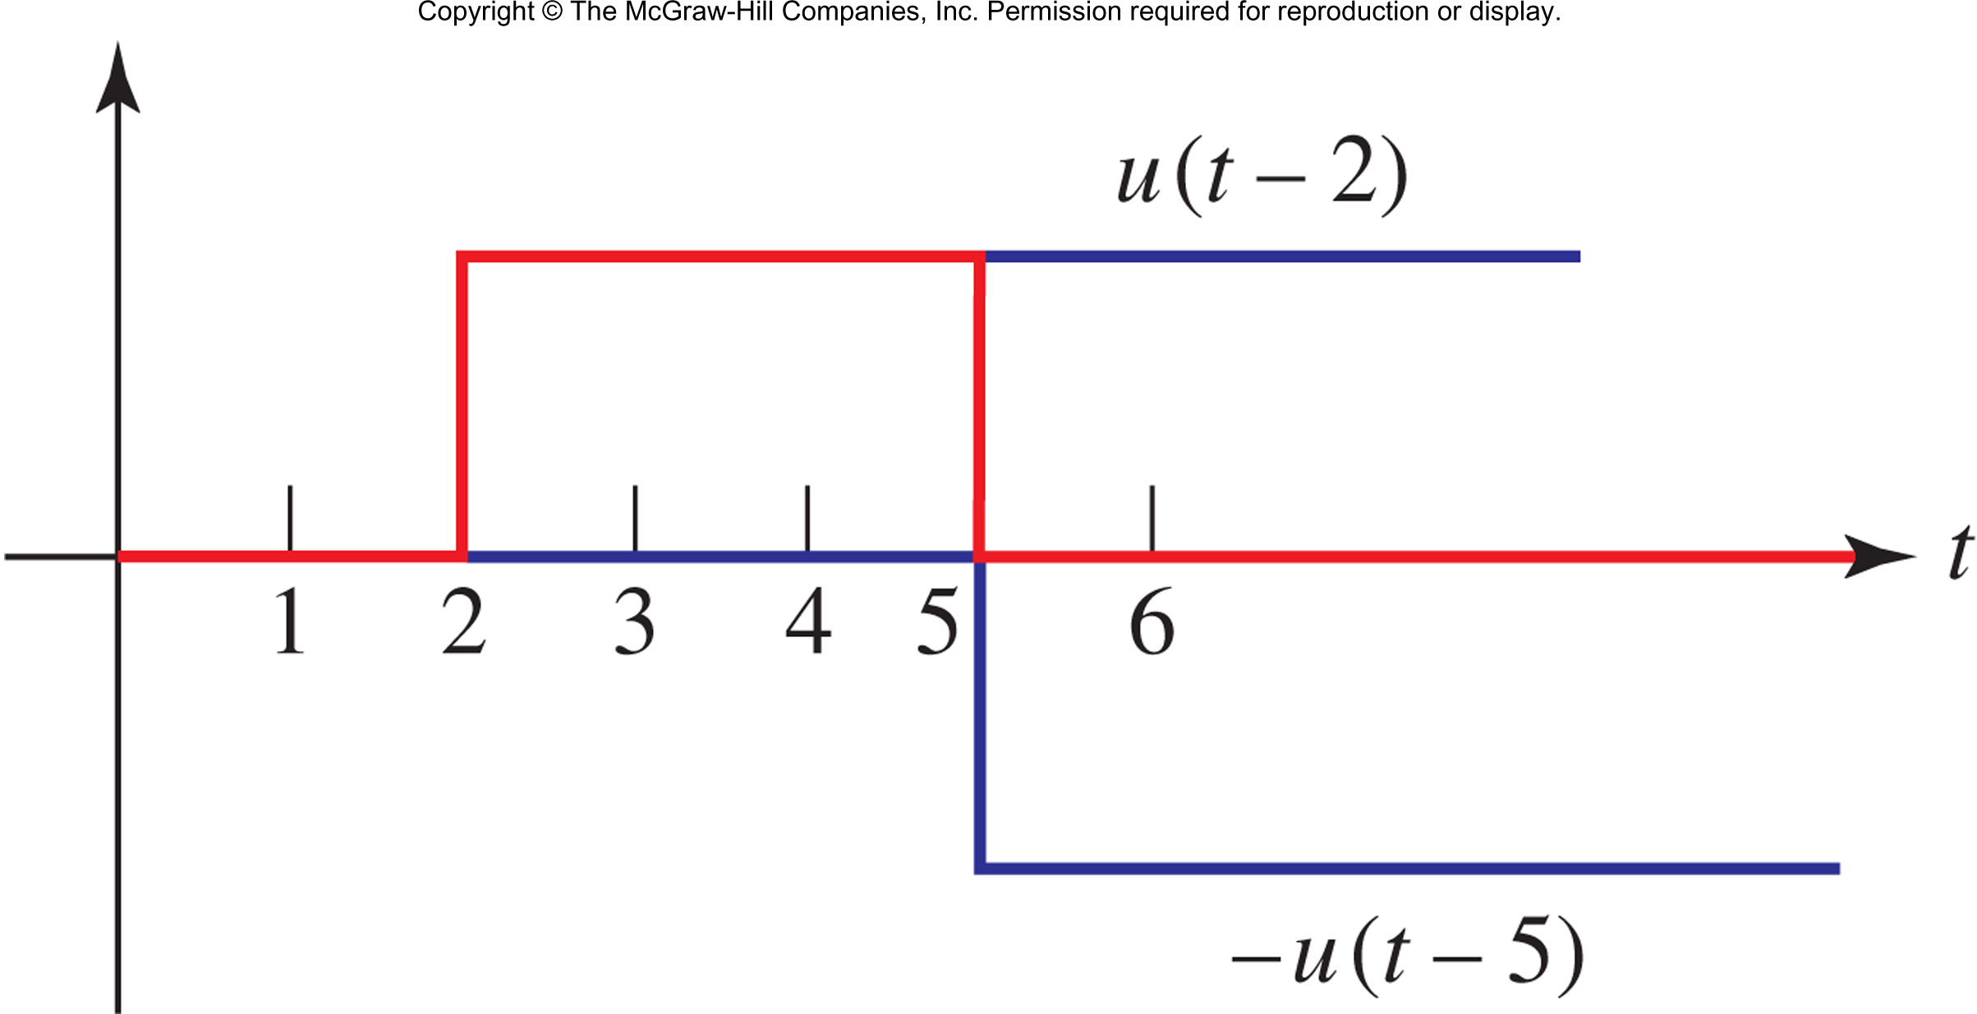
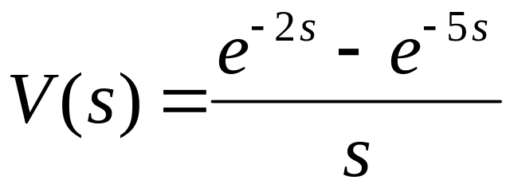
Determine the transform of the rectangular pulse
v(t) = u(t − 2) −u(t − 5)
Answer:
Copyright © 2013 The McGraw-Hill Companies, Inc. Permission required for reproduction or display.

