Slide 1


Chapter 17
Two-Port Networks
Copyright © 2013 The McGraw-Hill Companies, Inc. Permission required for reproduction or display.

Slide 2

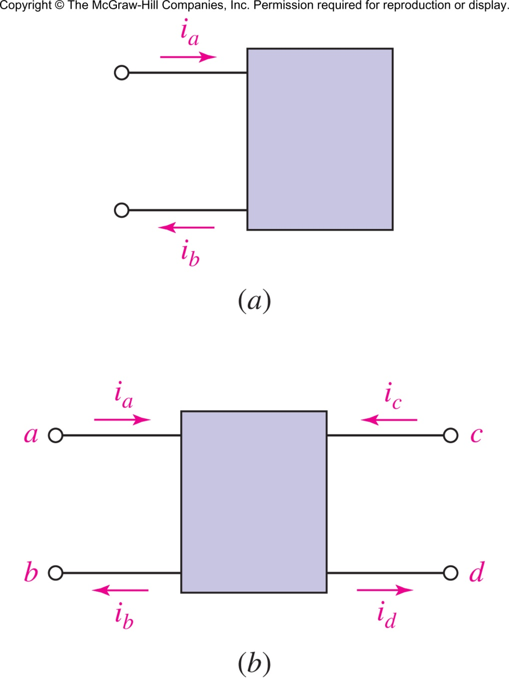
In a one-port network, i_{a}=i_{b}
In a two-port network, i_{a}=i_{b} and i_{c}=i_{d} but only if the connections are made port-to-port.
Copyright © 2013 The McGraw-Hill Companies, Inc. Permission required for reproduction or display.

Slide 3

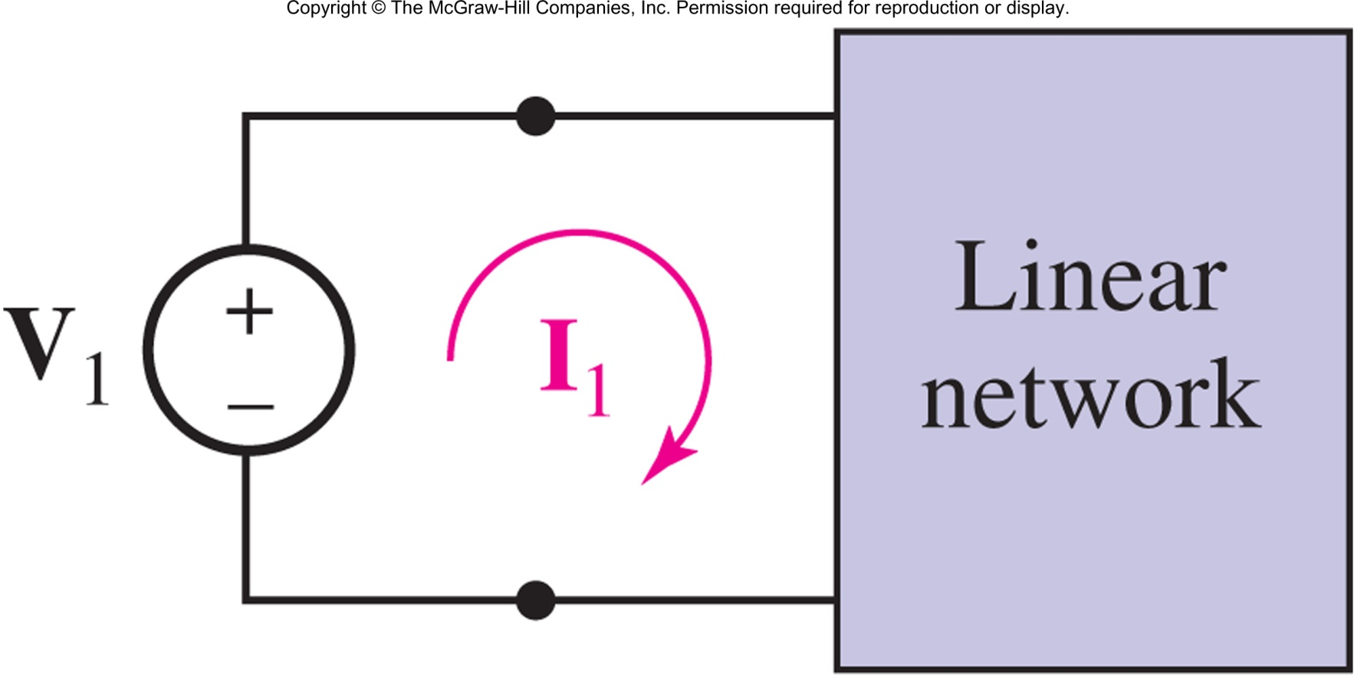
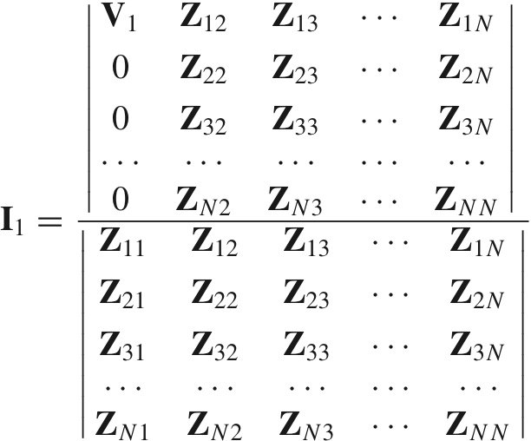
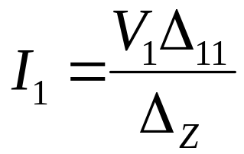
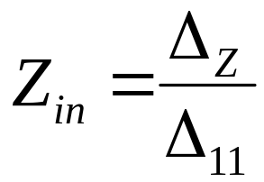
An N mesh passive network
Copyright © 2013 The McGraw-Hill Companies, Inc. Permission required for reproduction or display.

Slide 4

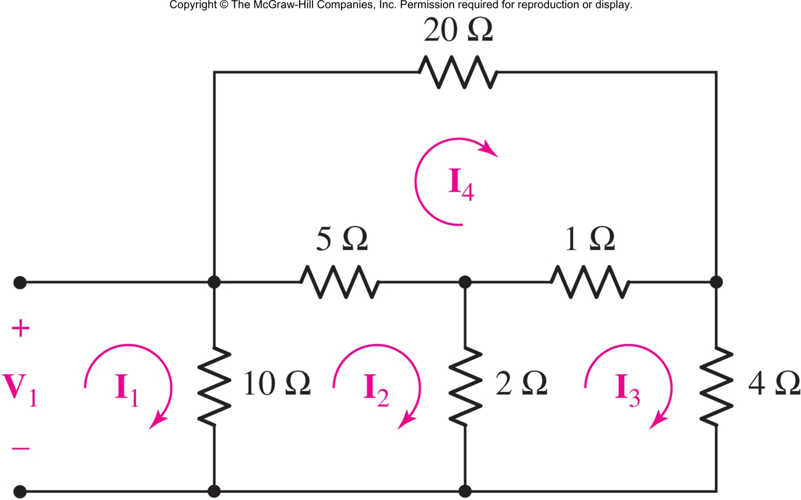
Show that the input impedance is 3.485 Ω.
Copyright © 2013 The McGraw-Hill Companies, Inc. Permission required for reproduction or display.

Slide 5

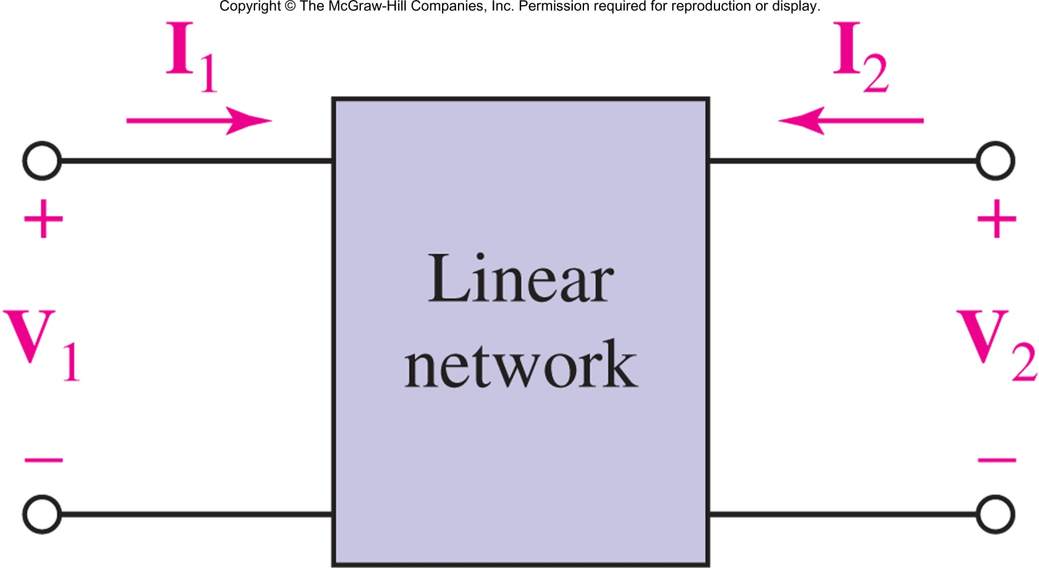
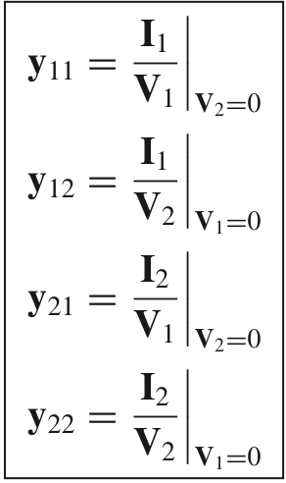
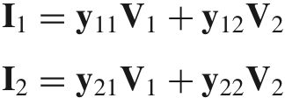
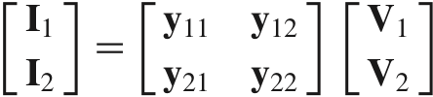
Copyright © 2013 The McGraw-Hill Companies, Inc. Permission required for reproduction or display.

Slide 6

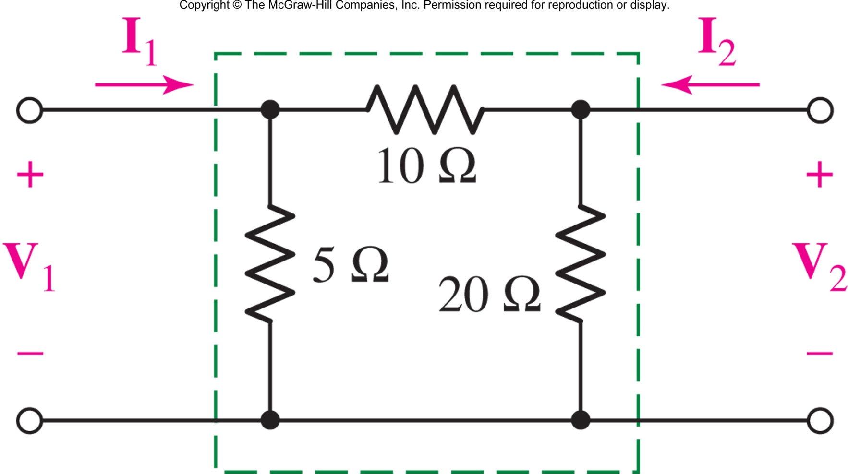
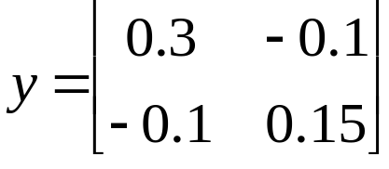
Find the admittance parameters.
Answer:
Copyright © 2013 The McGraw-Hill Companies, Inc. Permission required for reproduction or display.

Slide 7

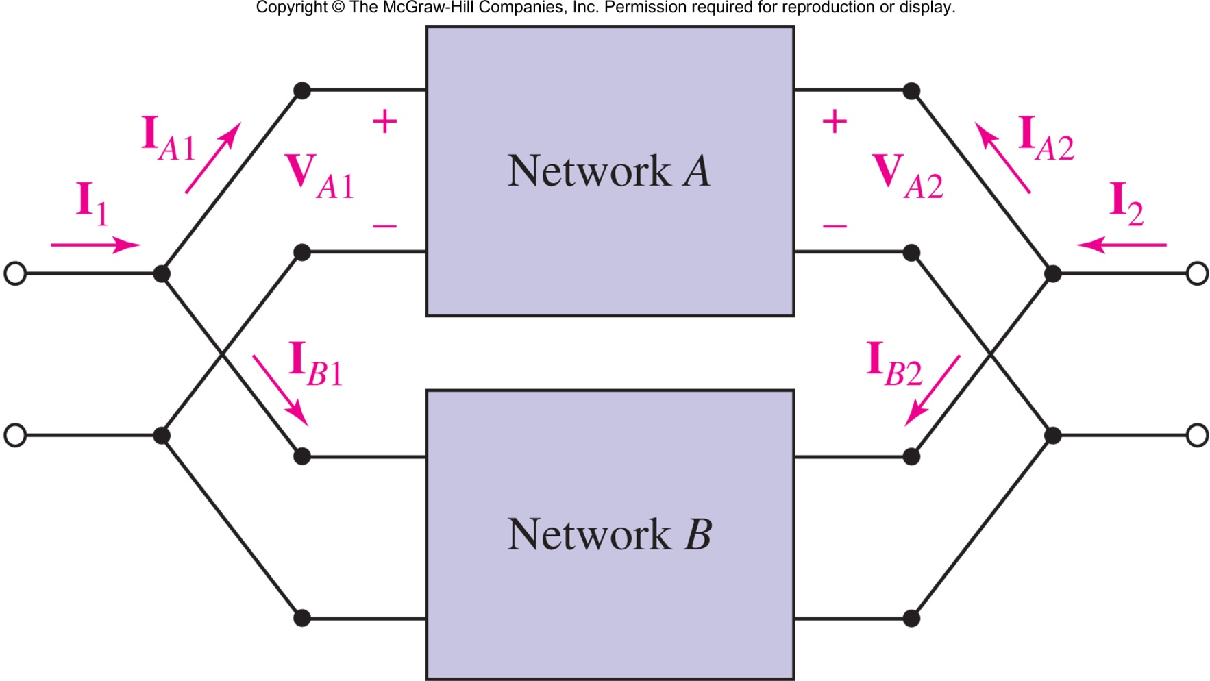
y = y_{A} + y_{B}
Copyright © 2013 The McGraw-Hill Companies, Inc. Permission required for reproduction or display.

Slide 8

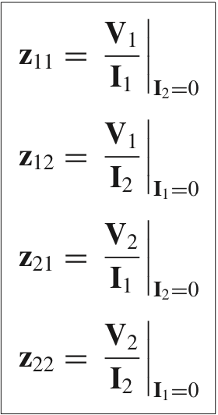
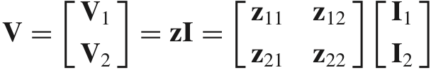
Copyright © 2013 The McGraw-Hill Companies, Inc. Permission required for reproduction or display.

Slide 9

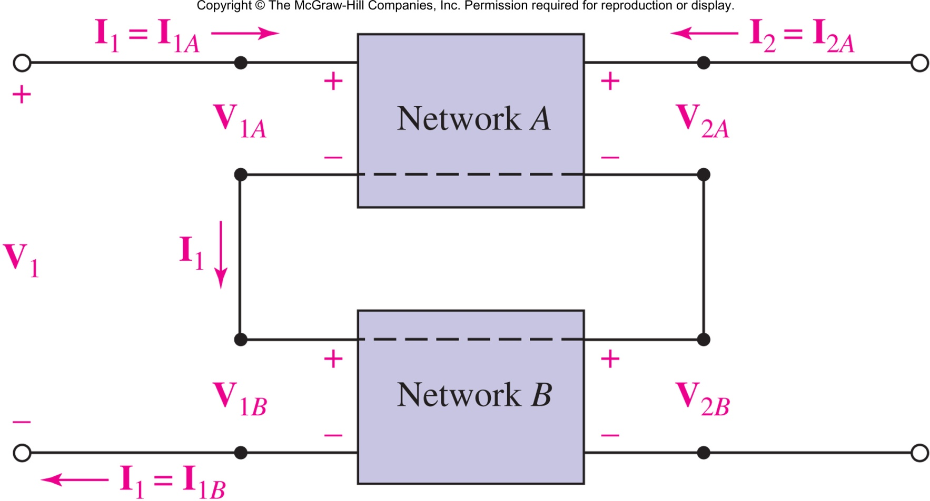
z = z_{A} + z_{B}
Copyright © 2013 The McGraw-Hill Companies, Inc. Permission required for reproduction or display.

Slide 10

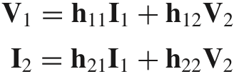
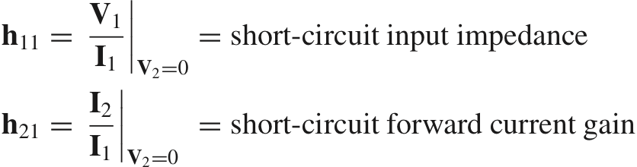
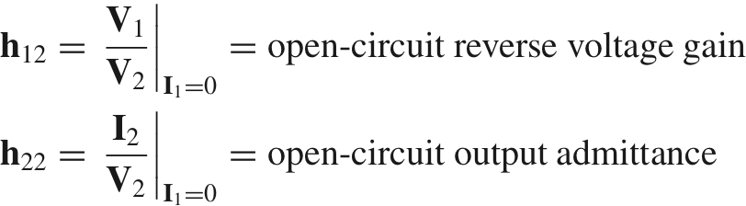
Copyright © 2013 The McGraw-Hill Companies, Inc. Permission required for reproduction or display.

Slide 11

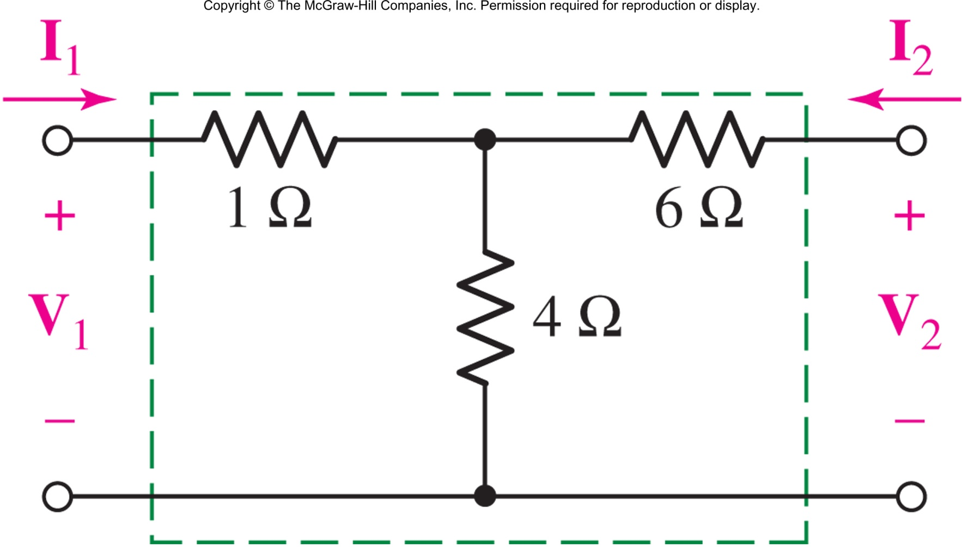
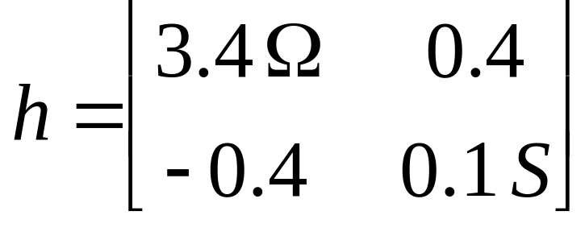
Copyright © 2013 The McGraw-Hill Companies, Inc. Permission required for reproduction or display.

Slide 12

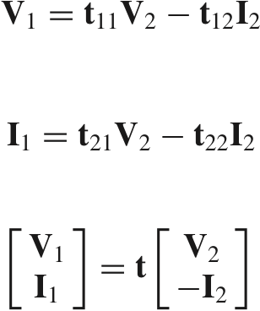
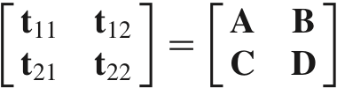
Copyright © 2013 The McGraw-Hill Companies, Inc. Permission required for reproduction or display.

Slide 13

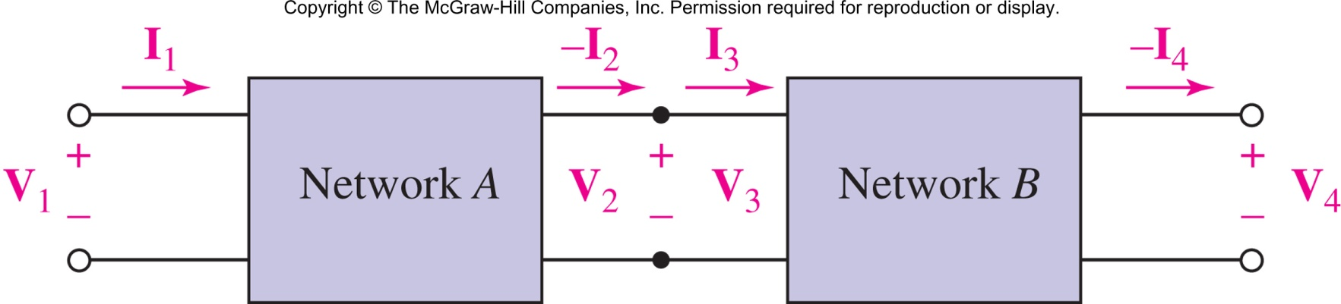
t = t_{A} t_{B}
Copyright © 2013 The McGraw-Hill Companies, Inc. Permission required for reproduction or display.

Slide 14

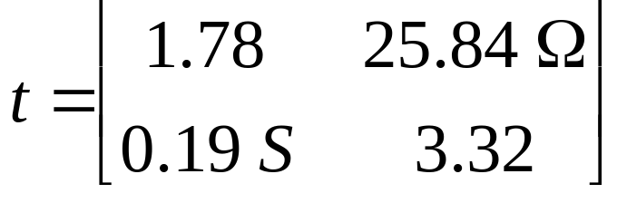
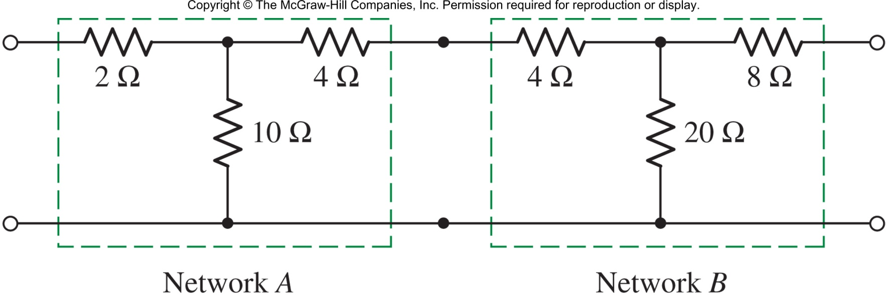
Show that the ABCD parameters for the cascade of network A and network B are:
Copyright © 2013 The McGraw-Hill Companies, Inc. Permission required for reproduction or display.

