Slide 1

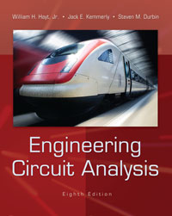
Chapter 18 Fourier Circuit Analysis
Copyright © 2013 The McGraw-Hill Companies, Inc. Permission required for reproduction or display.

Slide 2

A general periodic function of period T=2π/ω₀ can be represented by an infinite sum of harmonic sines and cosines.
The harmonics of
v₁(t) = cos(ω₀t)
have frequencies nω₀, where ω₀ is the fundamental frequency and n = 1, 2, 3, . . . .
Copyright © 2013 The McGraw-Hill Companies, Inc. Permission required for reproduction or display.

Slide 3

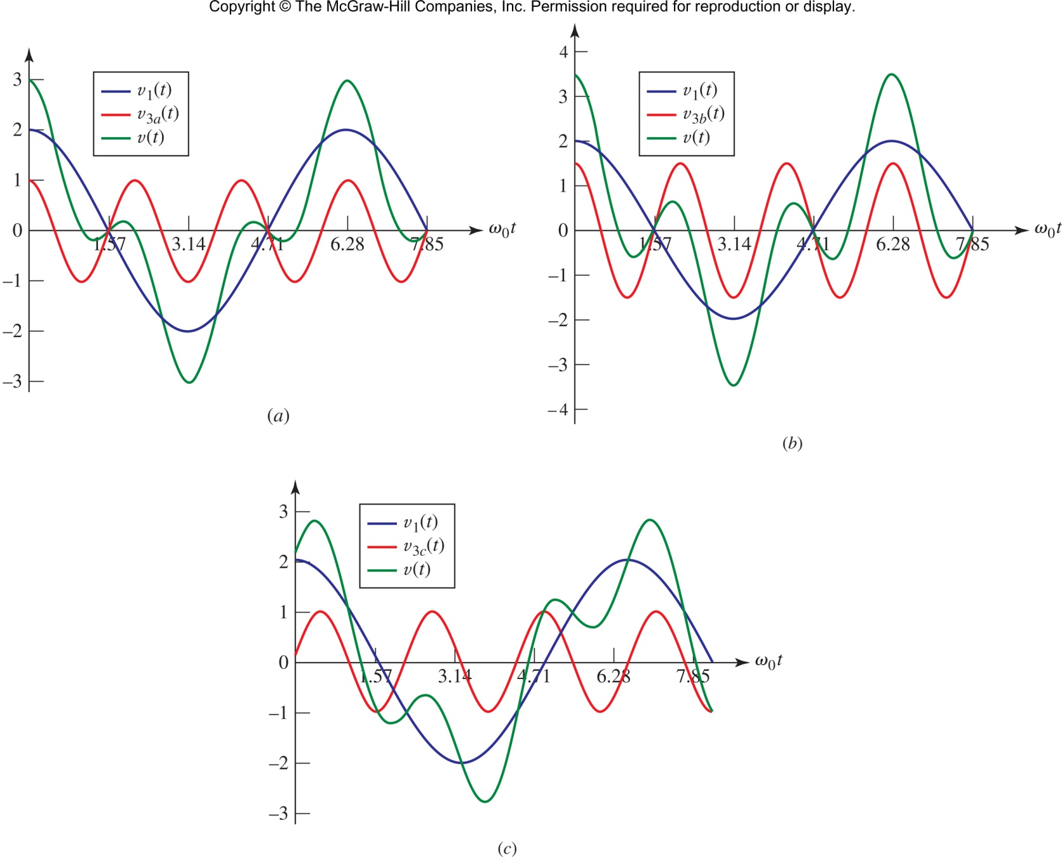
The sum (green) of a fundamental (blue) and a third harmonic (red) can look very different, depending on the amplitude and phase of the harmonic.
Copyright © 2013 The McGraw-Hill Companies, Inc. Permission required for reproduction or display.

Slide 4

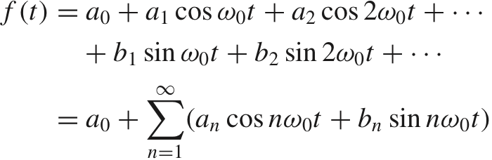
Any “normal” periodic function f(t) can be expressed as a Fourier series:
The period T and fundamental frequency ω₀ satisfy T=2π/ω₀
Copyright © 2013 The McGraw-Hill Companies, Inc. Permission required for reproduction or display.

Slide 5

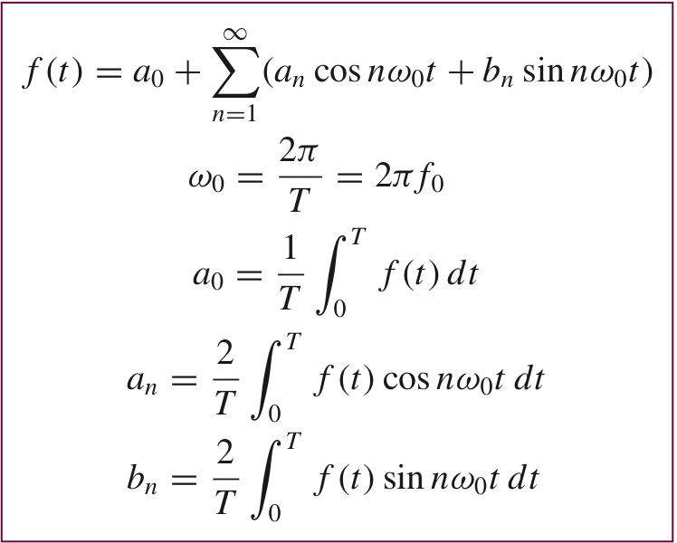
Copyright © 2013 The McGraw-Hill Companies, Inc. Permission required for reproduction or display.

Slide 6

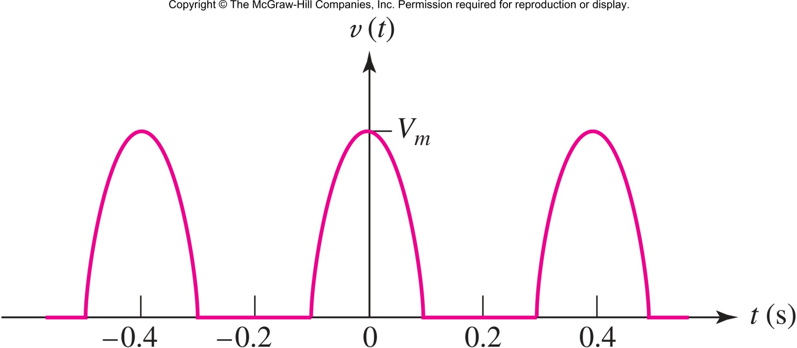
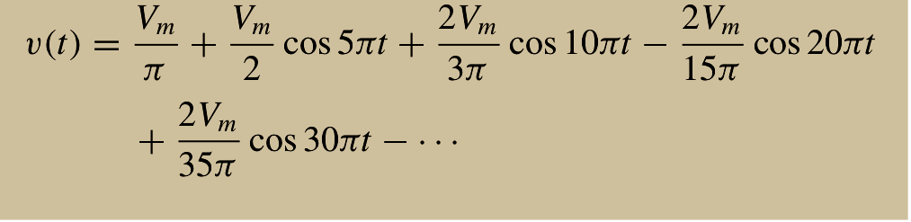
Find the Fourier Series of the half-wave rectified sine wave shown.
Copyright © 2013 The McGraw-Hill Companies, Inc. Permission required for reproduction or display.

Slide 7

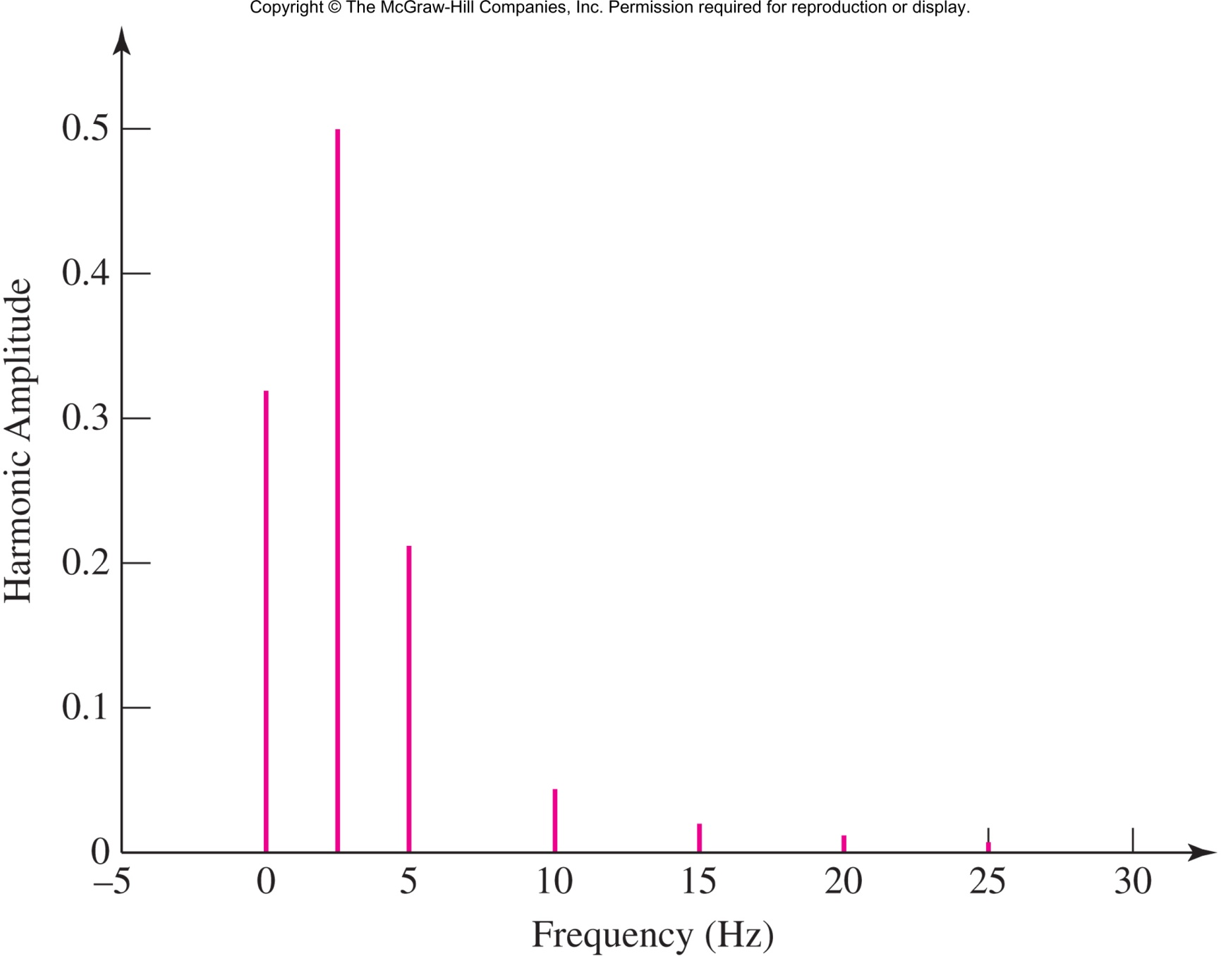
The discrete-line spectrum with V_{m}=1
Copyright © 2013 The McGraw-Hill Companies, Inc. Permission required for reproduction or display.

Slide 8

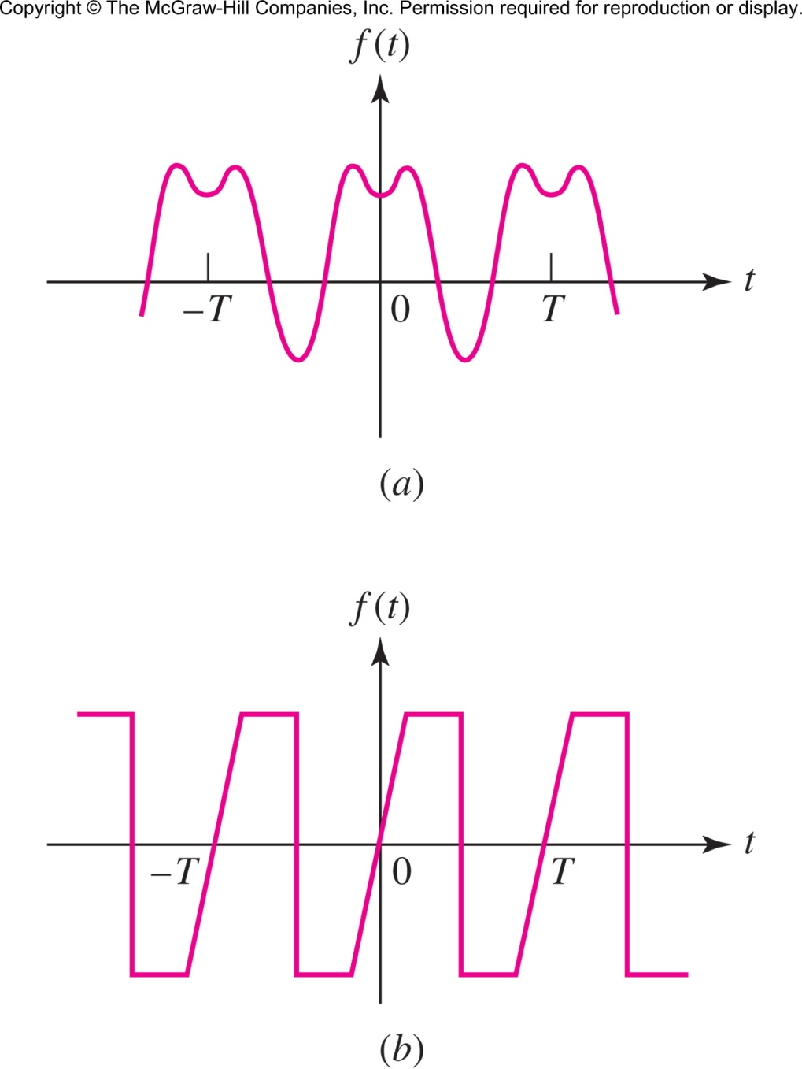
Even: f(t)=f(-t)
FS: b_{n}=0
Odd:
f(t)=-f(-t)
FS: a_{n}=0
Copyright © 2013 The McGraw-Hill Companies, Inc. Permission required for reproduction or display.

Slide 9

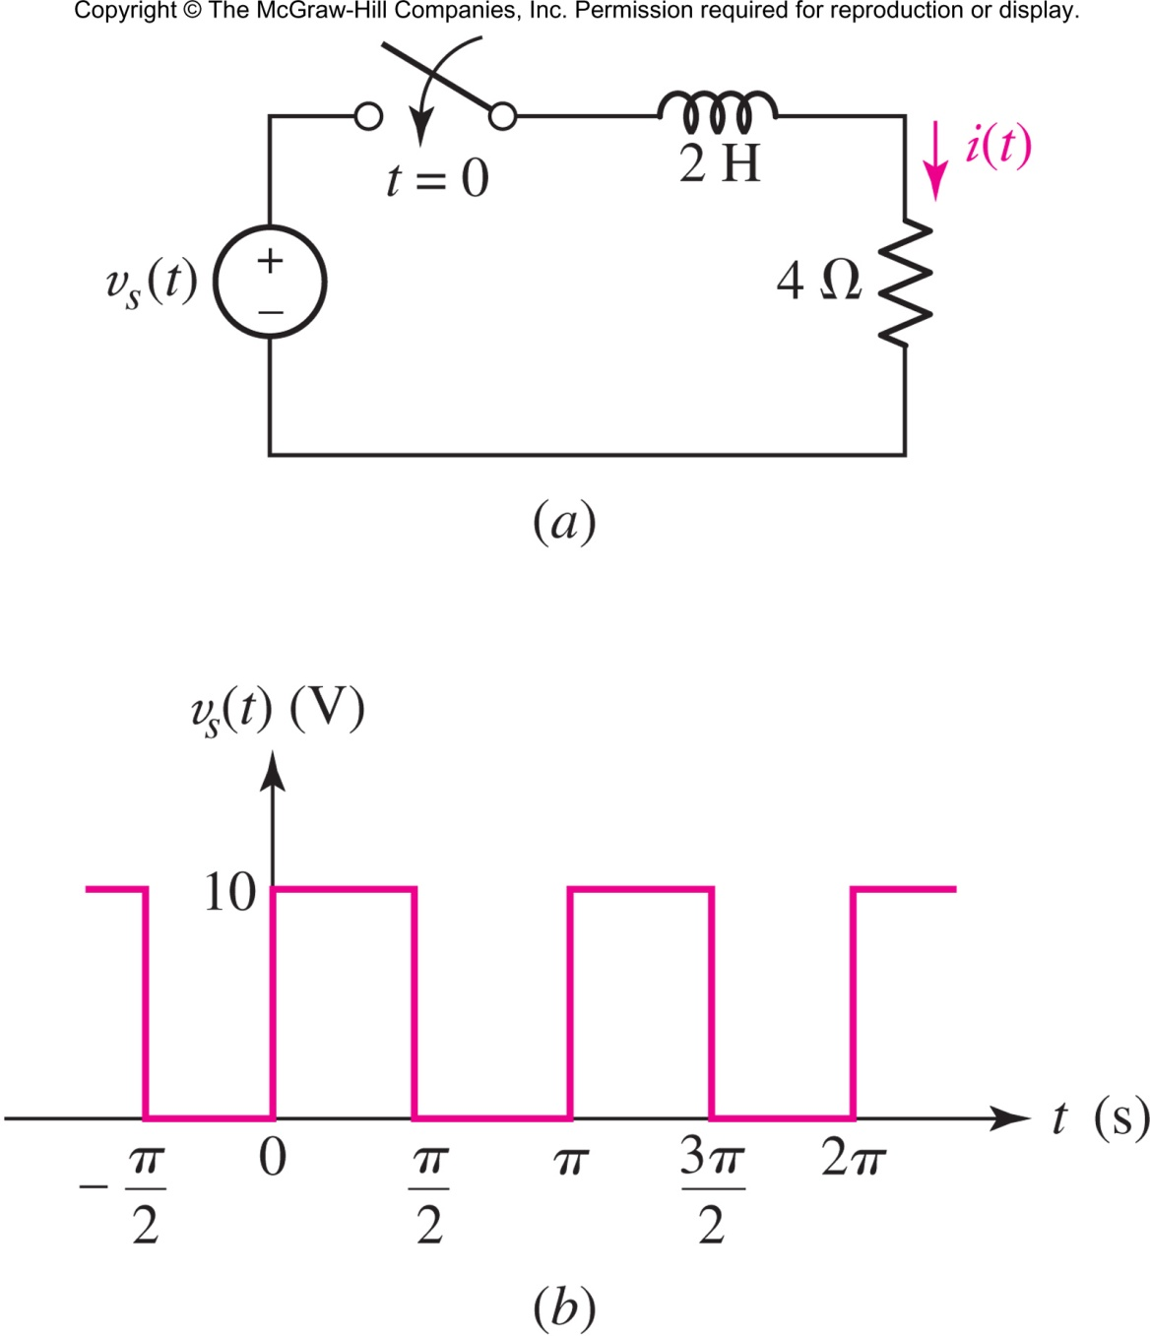
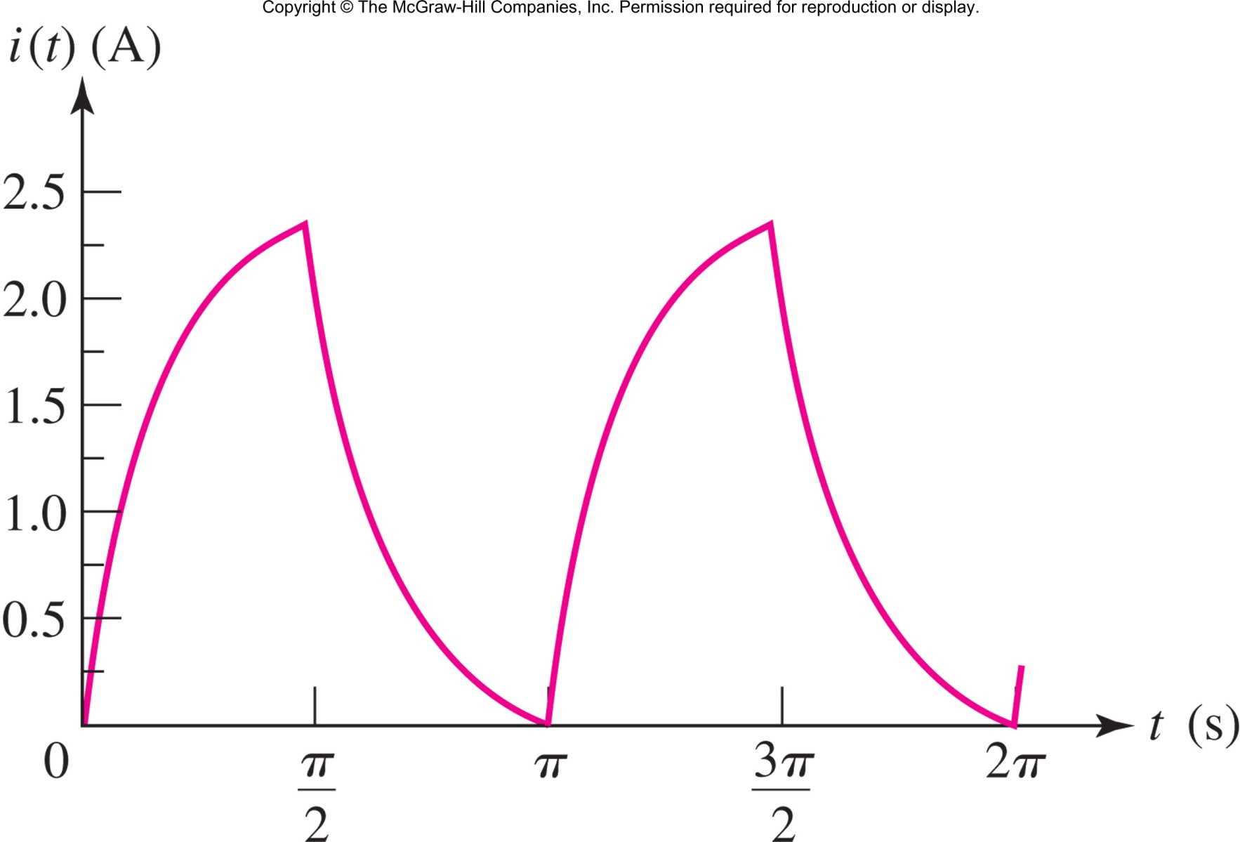
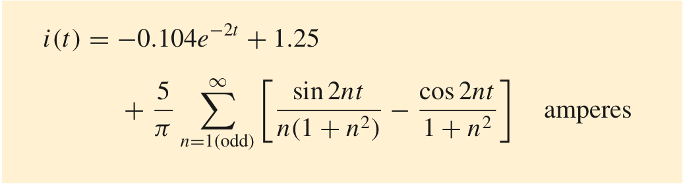
Find i(t).
Copyright © 2013 The McGraw-Hill Companies, Inc. Permission required for reproduction or display.

Slide 10

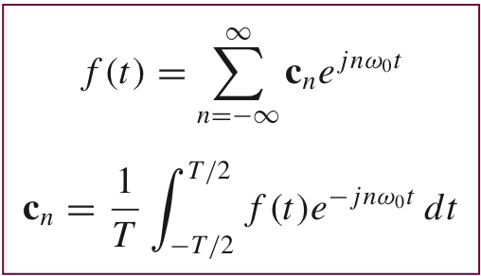
A more compact and simpler method of expressing the Fourier series is to use complex exponentials instead of sine and cosine:
Copyright © 2013 The McGraw-Hill Companies, Inc. Permission required for reproduction or display.

Slide 11

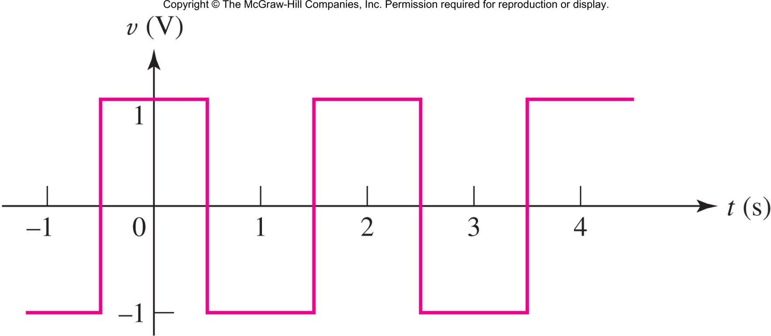
Determine the c_{n} values for v(t).
Answer: 2/(nπ) sin(nπ/2) for n odd, 0 otherwise
Copyright © 2013 The McGraw-Hill Companies, Inc. Permission required for reproduction or display.

Slide 12

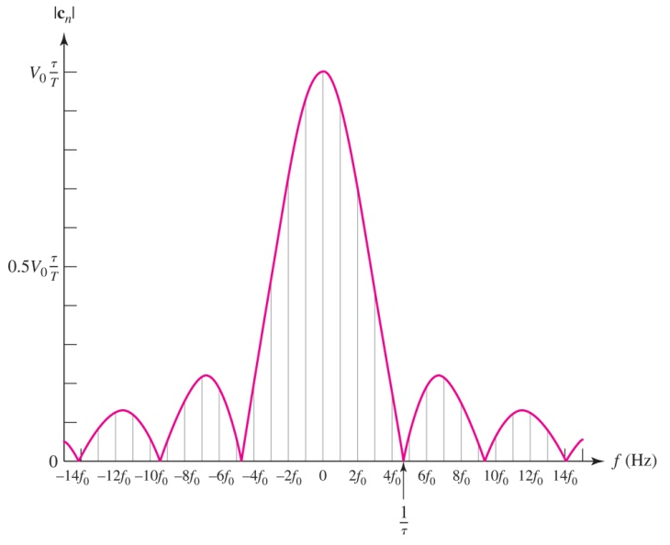
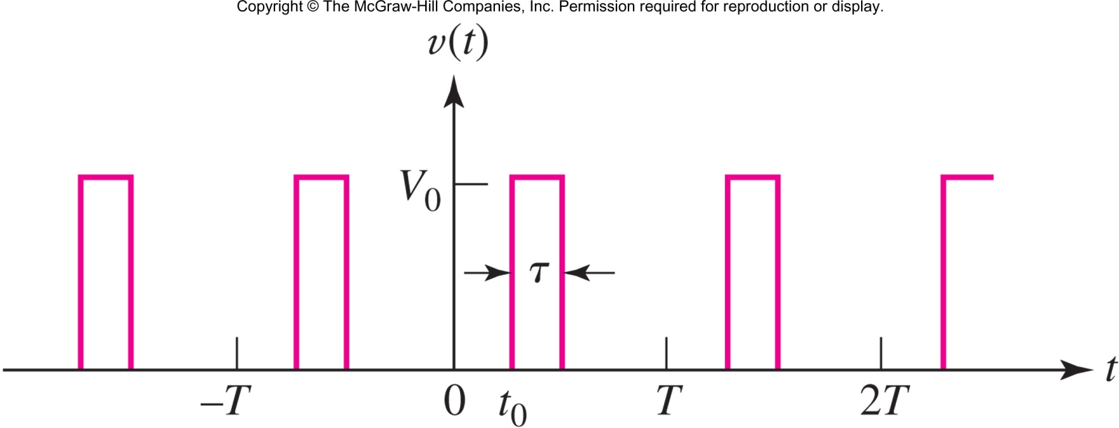
Copyright © 2013 The McGraw-Hill Companies, Inc. Permission required for reproduction or display.

Slide 13

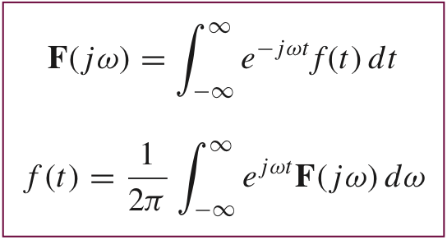
The Fourier Series concept can be extended to include non-periodic waveforms using the Fourier Transform:
Copyright © 2013 The McGraw-Hill Companies, Inc. Permission required for reproduction or display.

Slide 14

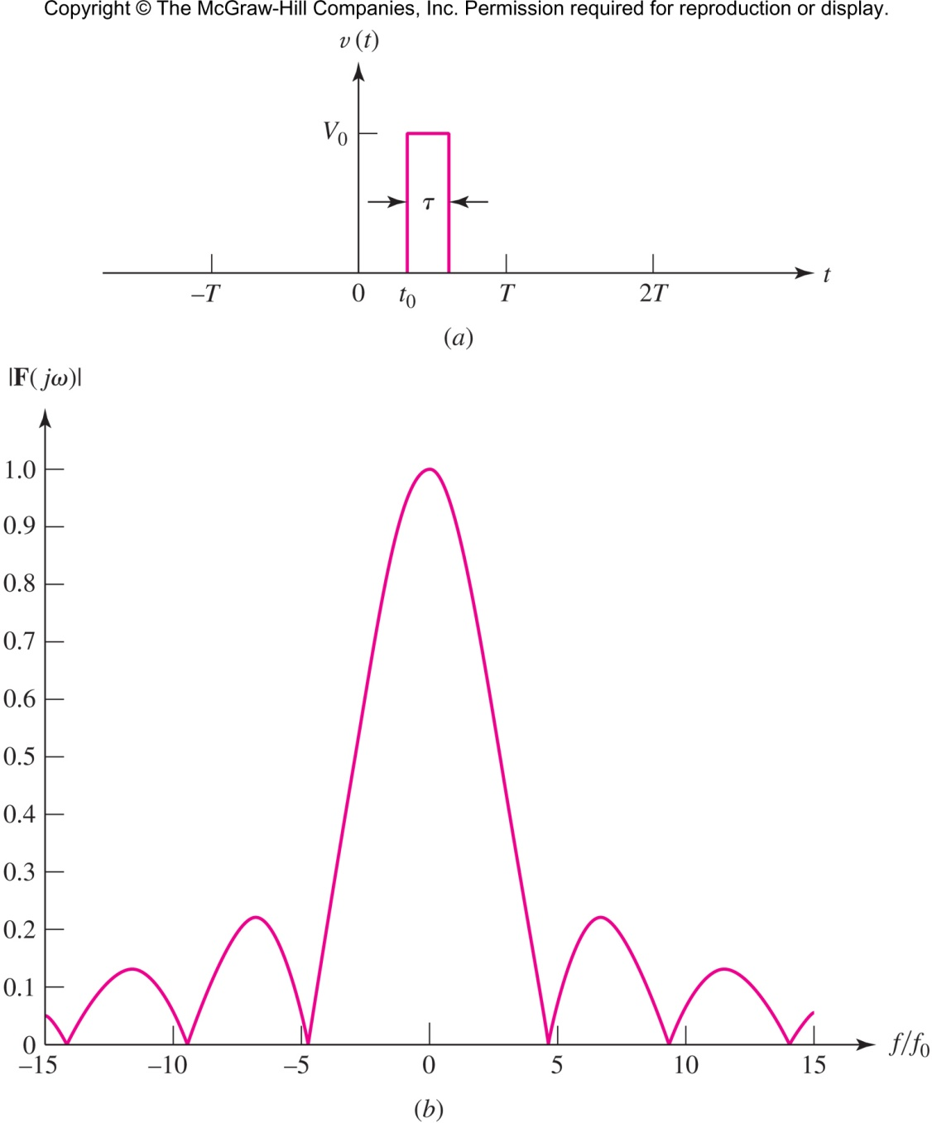
Copyright © 2013 The McGraw-Hill Companies, Inc. Permission required for reproduction or display.

Slide 15


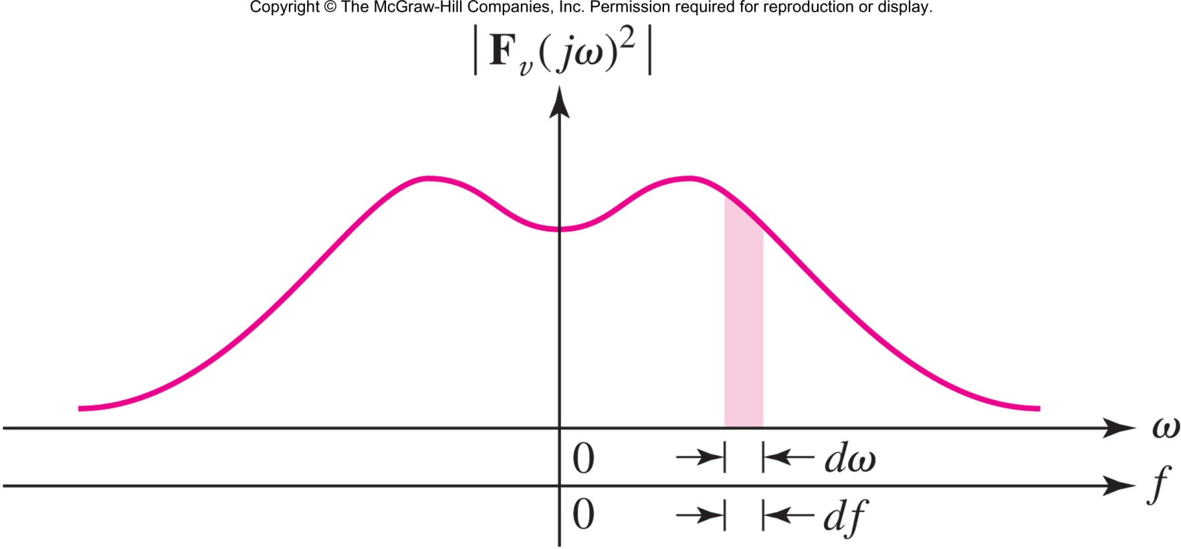
Parseval’s Theorem
allows us to think of |F(jω)|² as the energy density of f(t) at ω.
Copyright © 2013 The McGraw-Hill Companies, Inc. Permission required for reproduction or display.

Slide 16

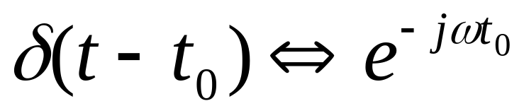
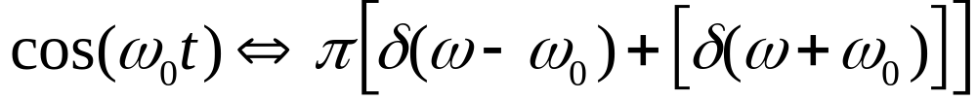
The Unit-Impulse:
Cosine:
Other transform pairs are derived in Section 18.7 and summarized in Table 18.2
Copyright © 2013 The McGraw-Hill Companies, Inc. Permission required for reproduction or display.

Slide 17

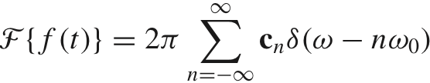
The Fourier Transform also exists for periodic functions, although we must resort to using the impulse function to represent it:
With this knowledge, Fourier Series can be ignored in favor of the Fourier Transform.
Copyright © 2013 The McGraw-Hill Companies, Inc. Permission required for reproduction or display.

Slide 18

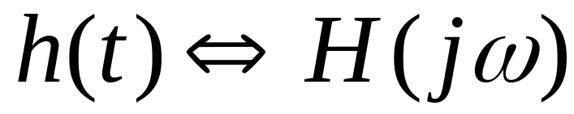
The system function H(jω), defined as the Fourier transform of the impulse response
allows the calculation of the output of a system given the Fourier Transform of its input:
Copyright © 2013 The McGraw-Hill Companies, Inc. Permission required for reproduction or display.

Slide 19

the system function and the transfer function are identical: H( jω) = G(ω)
[The fact that one argument is ω while the other is indicated by jω is immaterial and arbitrary; the j merely makes possible a more direct comparison between the Fourier and Laplace transforms.]
Our previous work on steady-state sinusoidal analysis using phasors was but a special case of the more general techniques of Fourier transform analysis.
Copyright © 2013 The McGraw-Hill Companies, Inc. Permission required for reproduction or display.

Slide 20

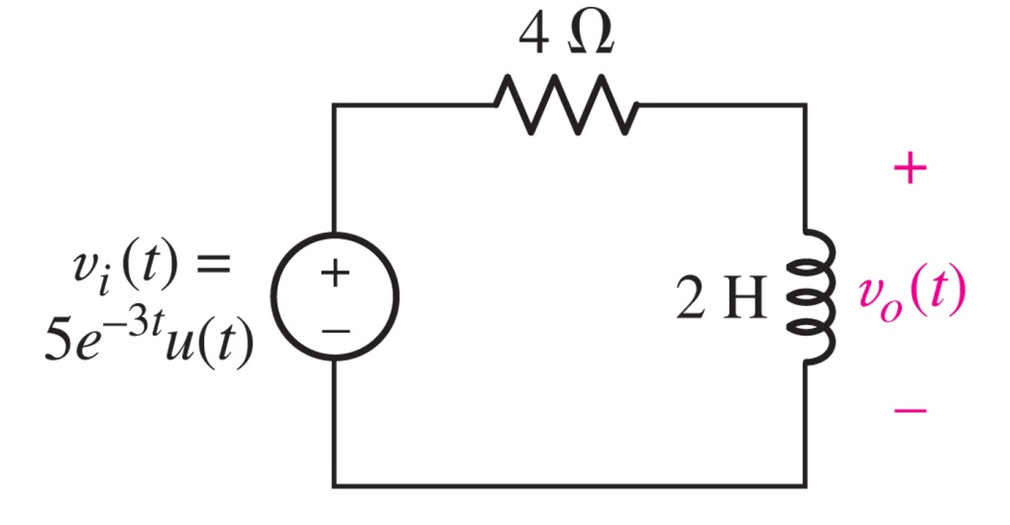
Find v₀(t) using Fourier techniques.
Method: find
H(jω) by assuming
V_{o} and V_{i} are
sinusoids.
So: H(jω)=j2ω/(4 + j2ω)
and using FT tables and partial fractions:
v_{o}(t)=5(3e^{−3t} − 2e^{−2t} )u(t)
Copyright © 2013 The McGraw-Hill Companies, Inc. Permission required for reproduction or display.

