Slide 1


Chapter 1
Introduction
Copyright © 2013 The McGraw-Hill Companies, Inc. Permission required for reproduction or display.

Slide 2

All engineers share a considerable amount of common ground, particularly when it comes to problem solving.
Circuit analysis has long been a traditional introduction to the art of problem solving from an engineering perspective.
Copyright © 2013 The McGraw-Hill Companies, Inc. Permission required for reproduction or display.

Slide 3

Linear problems are inherently more easily solved than their nonlinear counterparts.
For this reason, we often seek reasonably accurate linear approximations (or models) to physical situations.
The linear models are more easily manipulated and understood—making design a more straightforward process.
Copyright © 2013 The McGraw-Hill Companies, Inc. Permission required for reproduction or display.

Slide 4

Analysis is the process through which we determine the scope of a problem, obtain the information required to understand it, and compute the parameters of interest.
Design is the process by which we synthesize something new as part of the solution to a problem.
A crucial part of design is analysis of potential solutions!
Copyright © 2013 The McGraw-Hill Companies, Inc. Permission required for reproduction or display.

Slide 5

In addition to preparing for further study in electrical engineering, we also will develop:
a methodical approach to problem solving
the ability to determine the goal or goals of a particular problem
skill at collecting the information needed to effect a solution, and
opportunities for practice at verifying solution accuracy.
Copyright © 2013 The McGraw-Hill Companies, Inc. Permission required for reproduction or display.

Slide 6

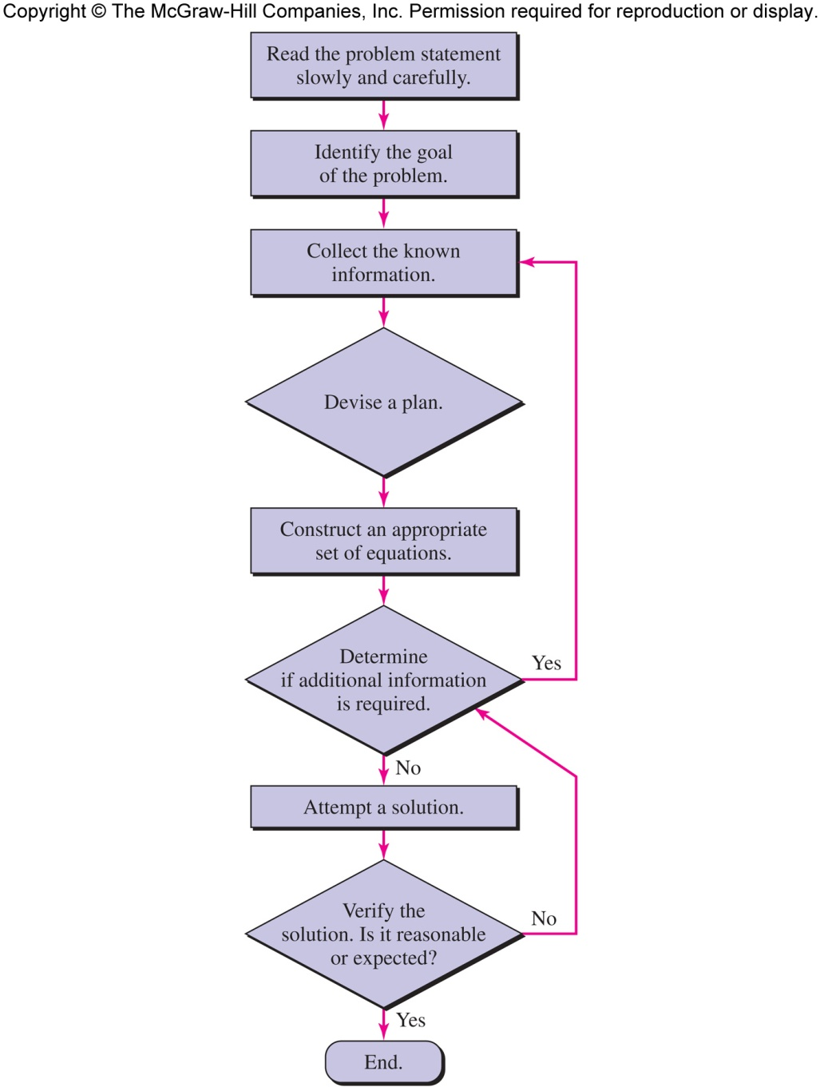
Copyright © 2013 The McGraw-Hill Companies, Inc. Permission required for reproduction or display.

