Slide 1

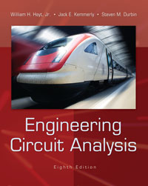
Chapter 2
Basic Components and Electric Circuits
Copyright © 2013 The McGraw-Hill Companies, Inc. Permission required for reproduction or display.

Slide 2

Base units:
  meter (m), kilogram (kg), second (s), ampere (A)
  also: kelvin, mole, and candela
Derived units:
  work or energy: joule (J)
  power (rate of doing work): watt (W)
  1 W = 1 J/s
Copyright © 2013 The McGraw-Hill Companies, Inc. Permission required for reproduction or display.

Slide 3

Any measurement can be expressed in terms
of a unit, or a unit with a “prefix” modifier.
Example: 12.3 mW = 0.0123 W =1.23 x 10⁻² W
FACTOR | NAME | SYMBOL
10⁻⁹ | nano | n
10⁻⁶ | micro | μ
10⁻³ | milli | m
10³ | kilo | k
10⁶ | mega | M
Copyright © 2013 The McGraw-Hill Companies, Inc. Permission required for reproduction or display.

Slide 4

charge is conserved: it is neither created nor destroyed
symbol: Q or q; units are coulomb (C)
the smallest charge, the electronic charge, is carried by an electron (−1.602×10⁻¹⁹ C) or a proton (+1.602×10⁻¹⁹ C)
in most circuits, the charges in motion are electrons
Copyright © 2013 The McGraw-Hill Companies, Inc. Permission required for reproduction or display.

Slide 5

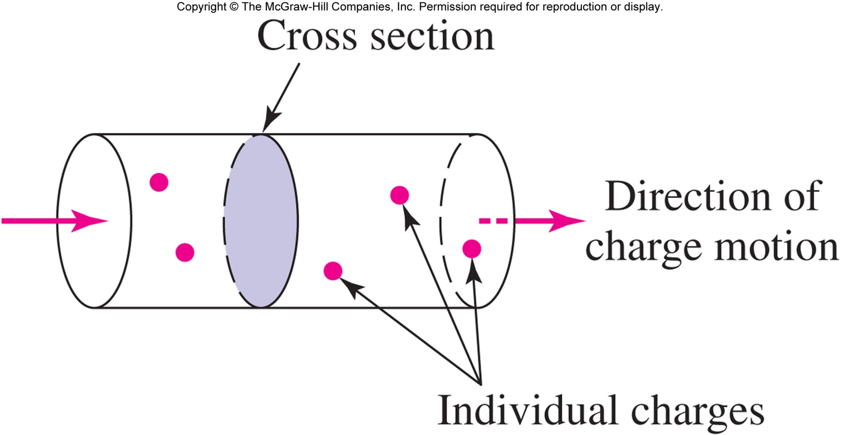
Current is the rate of charge flow:
1 ampere = 1 coulomb/second (or 1 A = 1 C/s)
Copyright © 2013 The McGraw-Hill Companies, Inc. Permission required for reproduction or display.

Slide 6
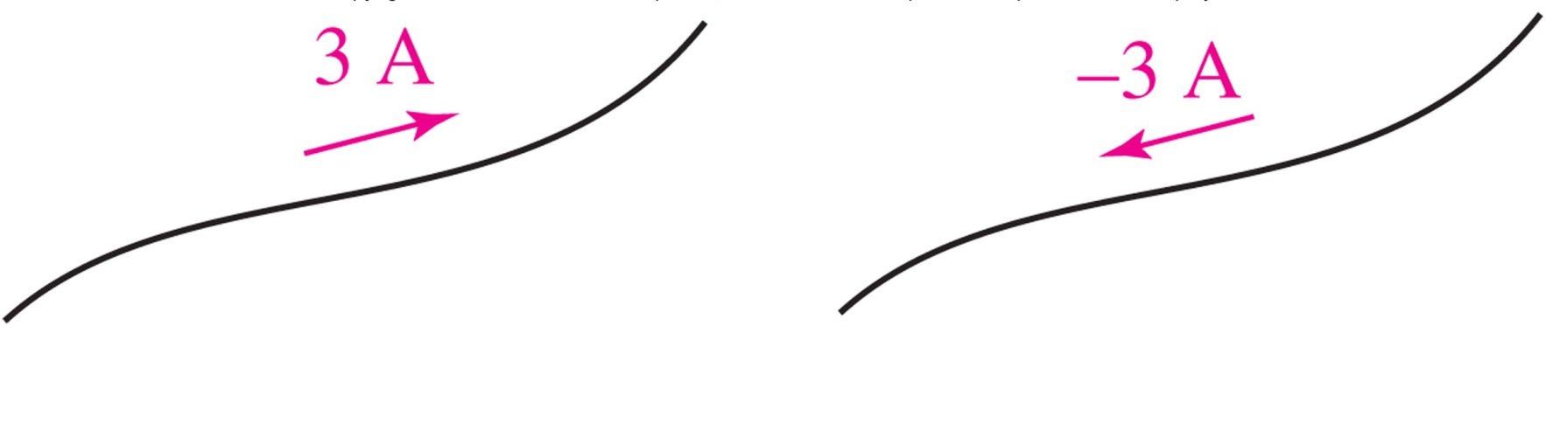
Current (designated by I or i) is the rate of flow of charge
Current must be designated with both a direction and a magnitude
These two currents are the same:
Copyright © 2013 The McGraw-Hill Companies, Inc. Permission required for reproduction or display.

Slide 7

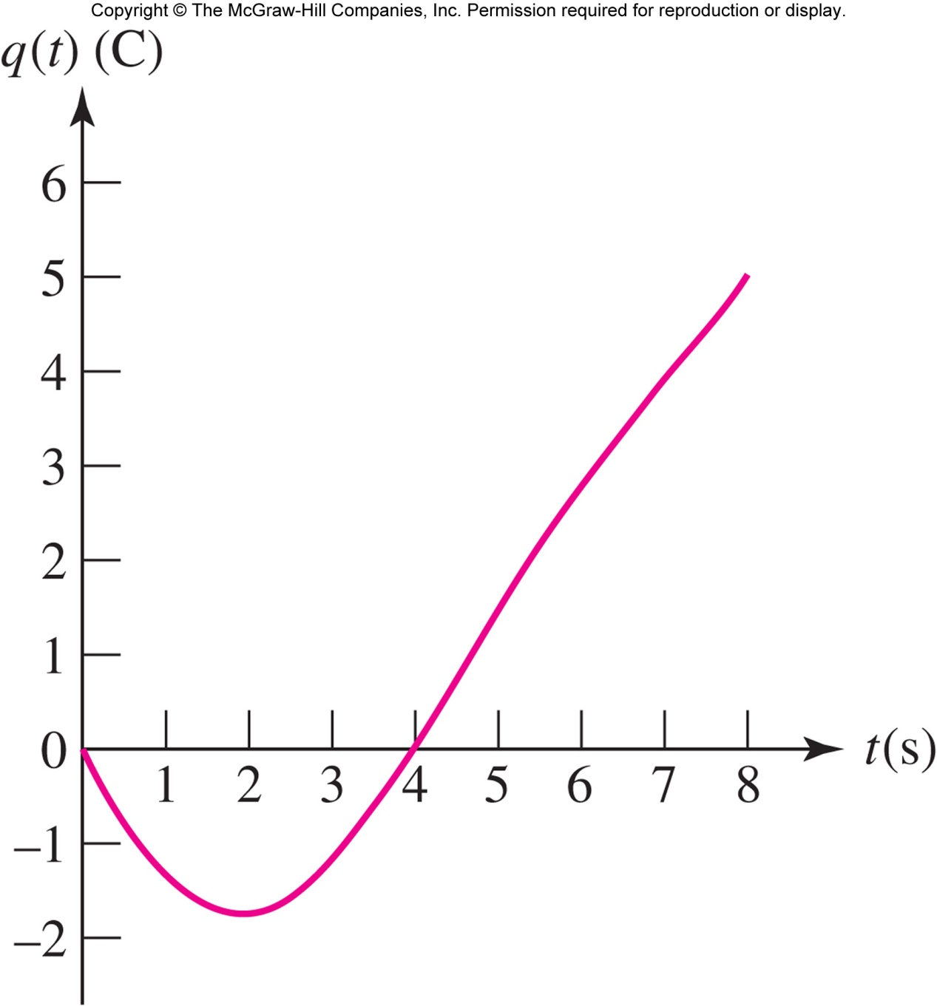
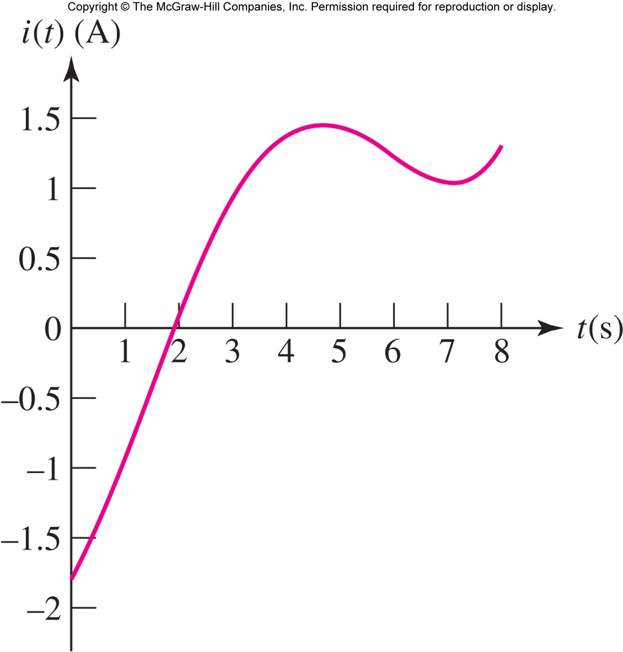
Copyright © 2013 The McGraw-Hill Companies, Inc. Permission required for reproduction or display.

Slide 8

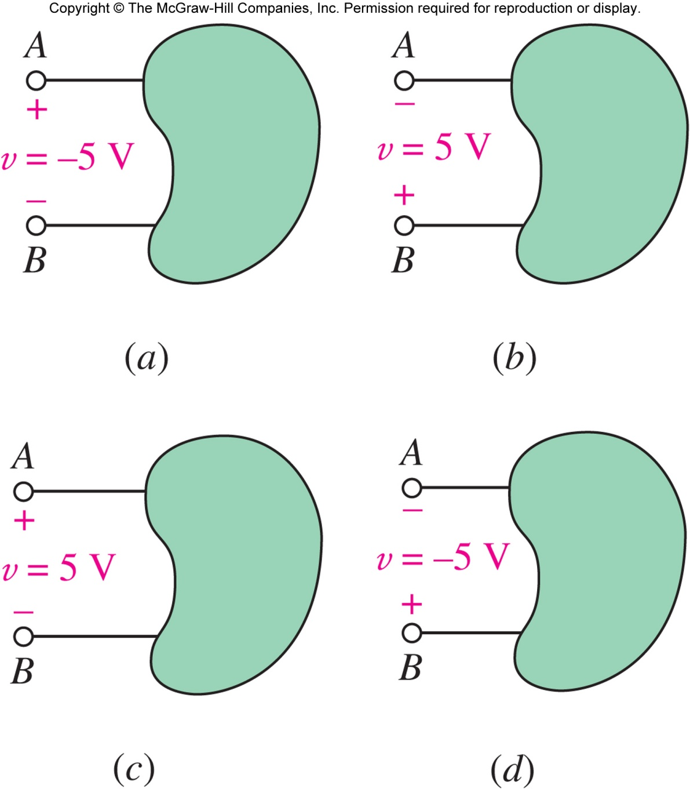
When 1 J of work is required to move 1 C of charge from A to B, there is a voltage of 1 volt between A and B.
Voltage (V or v) across an element requires both a magnitude and a polarity.
Example: (a)=(b), (c)=(d)
Copyright © 2013 The McGraw-Hill Companies, Inc. Permission required for reproduction or display.

Slide 9

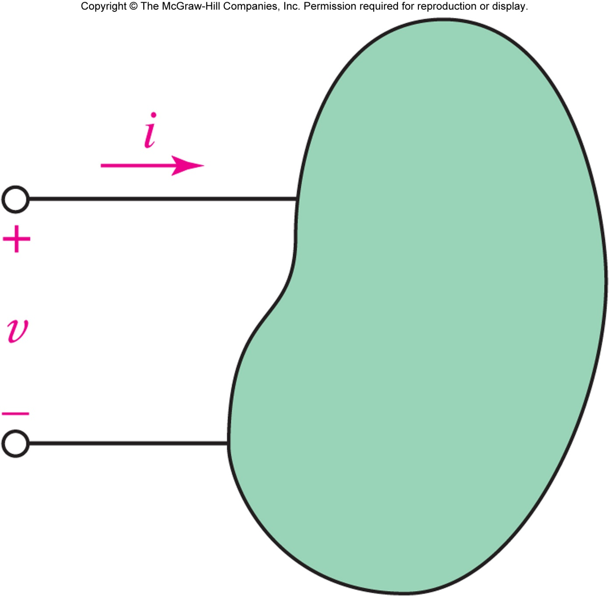
The power required to push a current i (C/s) into a voltage v (J/C) is p = vi ( J/s = W).
When power is positive, the element is absorbing energy.
When power is negative, the element is supplying energy.
Copyright © 2013 The McGraw-Hill Companies, Inc. Permission required for reproduction or display.

Slide 10

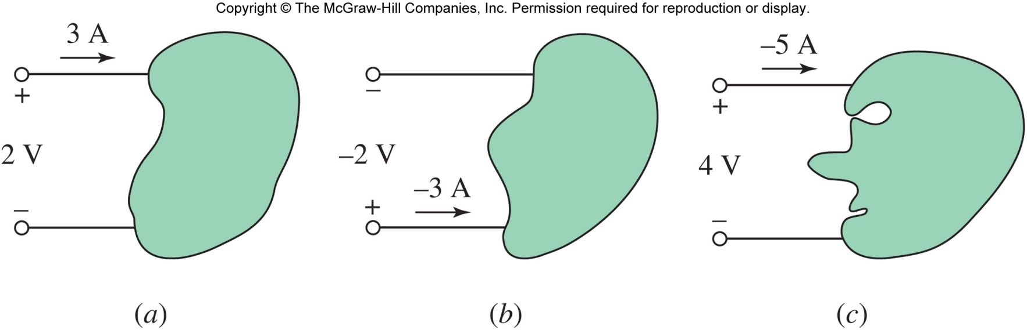
How much power is absorbed by the three elements above?
P_{a} = + 6 W, P_{b} = +6 W, P_{c} = -20 W.
(Note: (c) is actually supplying power)
Copyright © 2013 The McGraw-Hill Companies, Inc. Permission required for reproduction or display.

Slide 11

A circuit element usually has two terminals (sometimes three or more).
The relationship between the voltage v across the terminals and the current i through the device defines the circuit element model.
Copyright © 2013 The McGraw-Hill Companies, Inc. Permission required for reproduction or display.

Slide 12

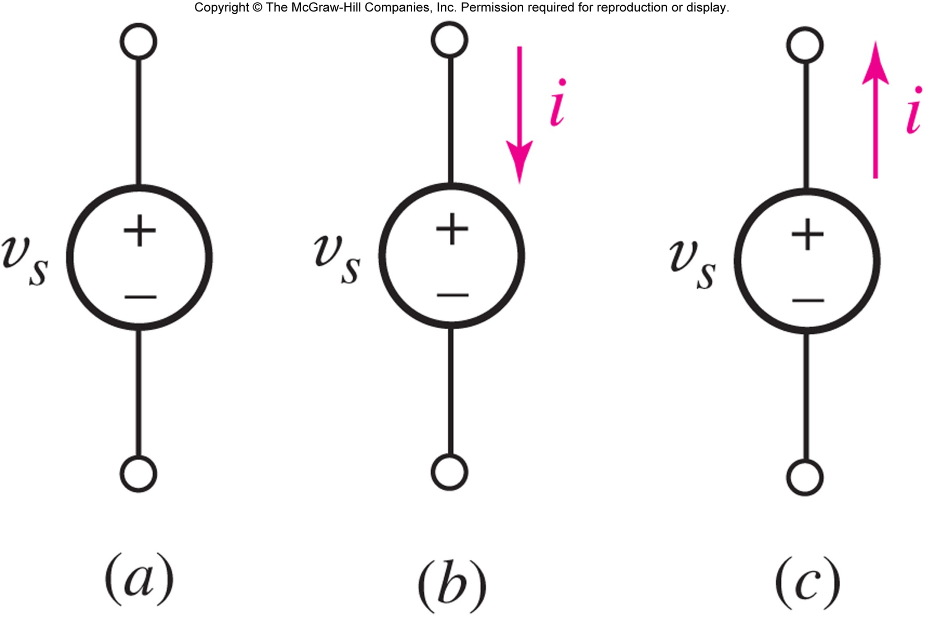
An ideal voltage source is a circuit element that will maintain the specified voltage v_{s} across its terminals.
The current will be determined by other circuit elements.
Copyright © 2013 The McGraw-Hill Companies, Inc. Permission required for reproduction or display.

Slide 13

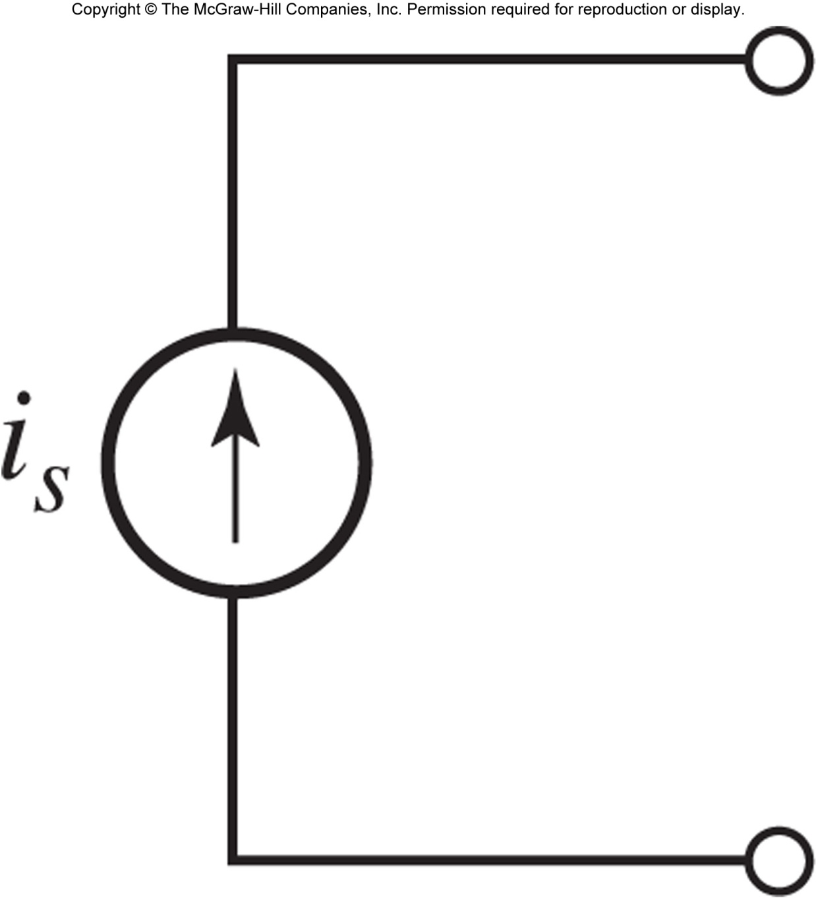
An ideal current source is a circuit element that maintains the specified current flow i_{s} through its terminals.
The voltage is determined by other circuit elements.
Copyright © 2013 The McGraw-Hill Companies, Inc. Permission required for reproduction or display.

Slide 14

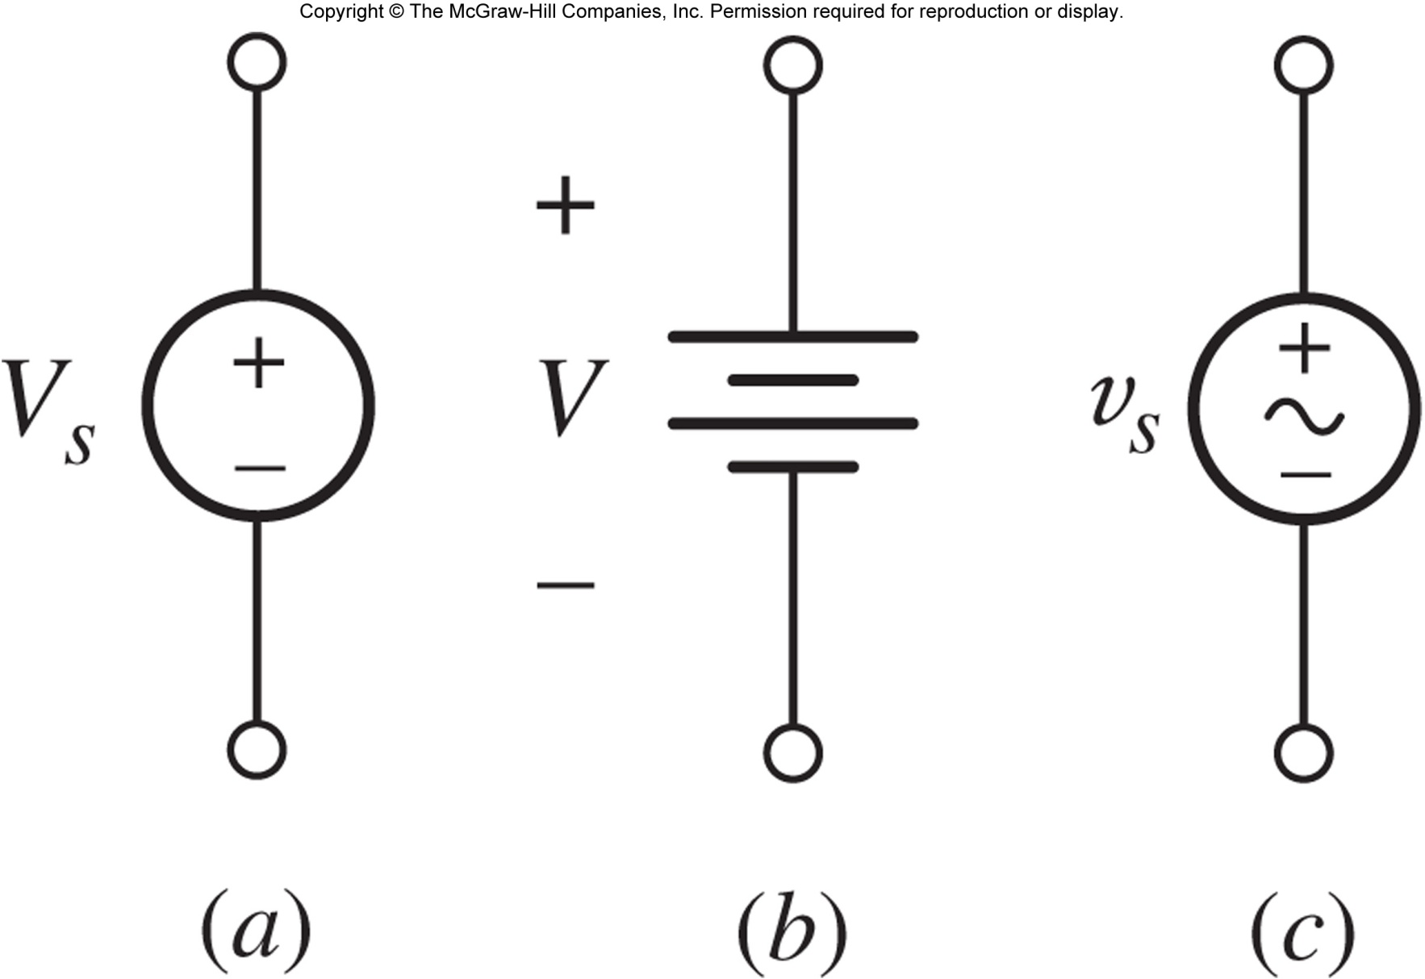
A voltage source is an idealization (no limit on current) and generalization (voltage can be time-varying) of a battery.
A battery supplies a constant “dc” voltage V but in practice a battery has a maximum power.
Copyright © 2013 The McGraw-Hill Companies, Inc. Permission required for reproduction or display.

Slide 15

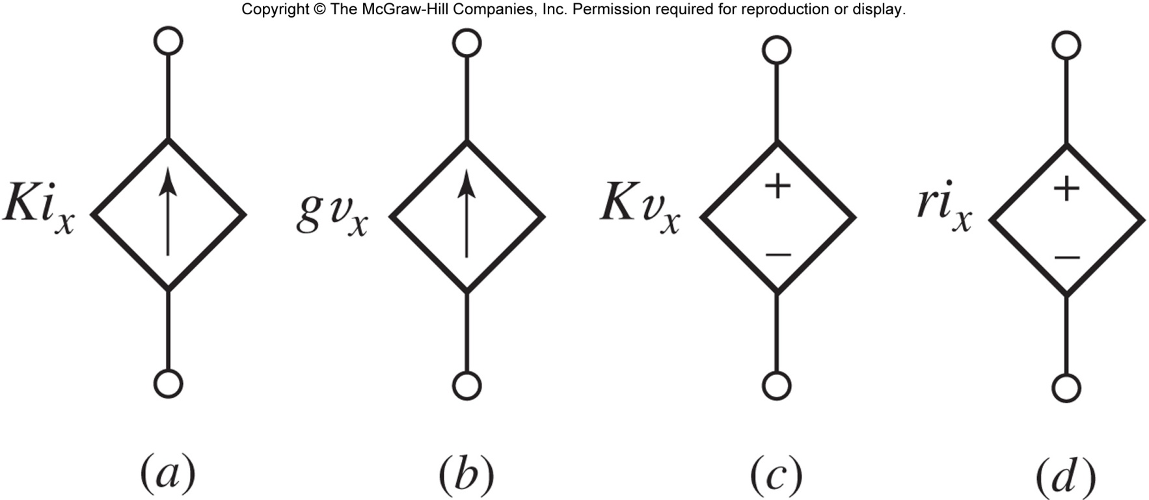
Dependent current sources (a) and (b) maintain a current specified by another circuit variable.
Dependent voltage sources (c) and (d) maintain a voltage specified by another circuit variable.
Copyright © 2013 The McGraw-Hill Companies, Inc. Permission required for reproduction or display.

Slide 16

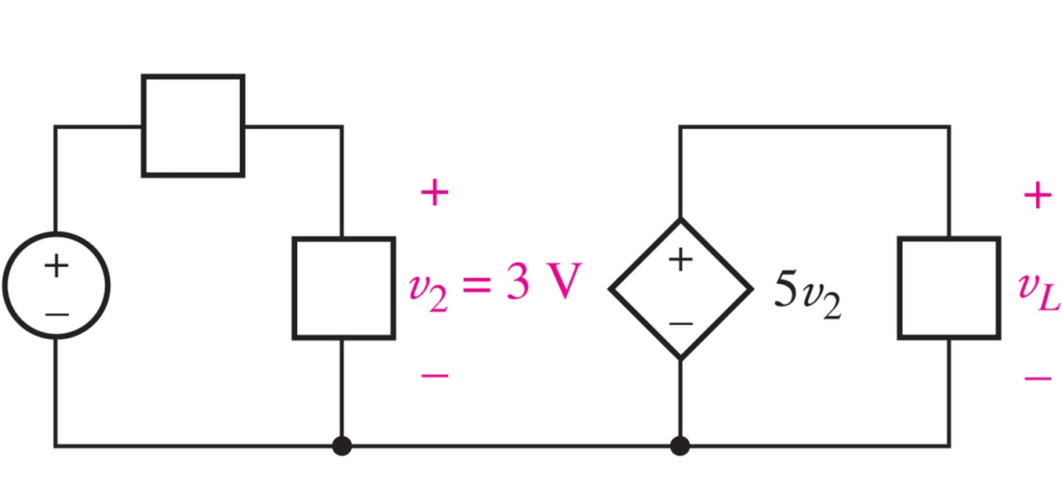
Find the voltage v_{L} in the circuit below.
Copyright © 2013 The McGraw-Hill Companies, Inc. Permission required for reproduction or display.

Slide 17

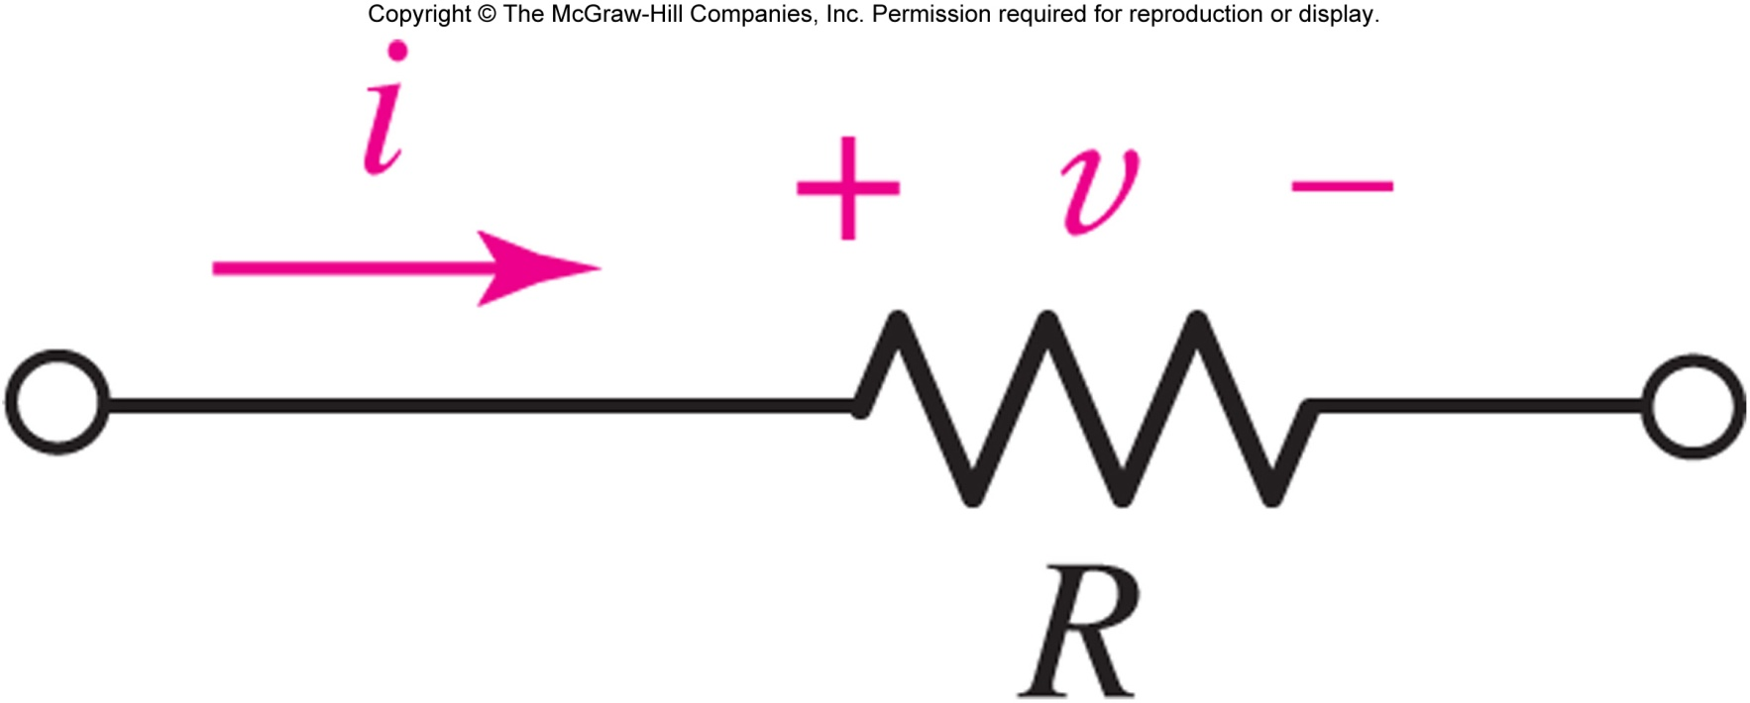
A (linear) resistor is an element for which
v=iR
where the constant R is a resistance.
The equation is known as “Ohm’s Law.”
The unit of resistance is ohm (Ω).
Copyright © 2013 The McGraw-Hill Companies, Inc. Permission required for reproduction or display.

Slide 18

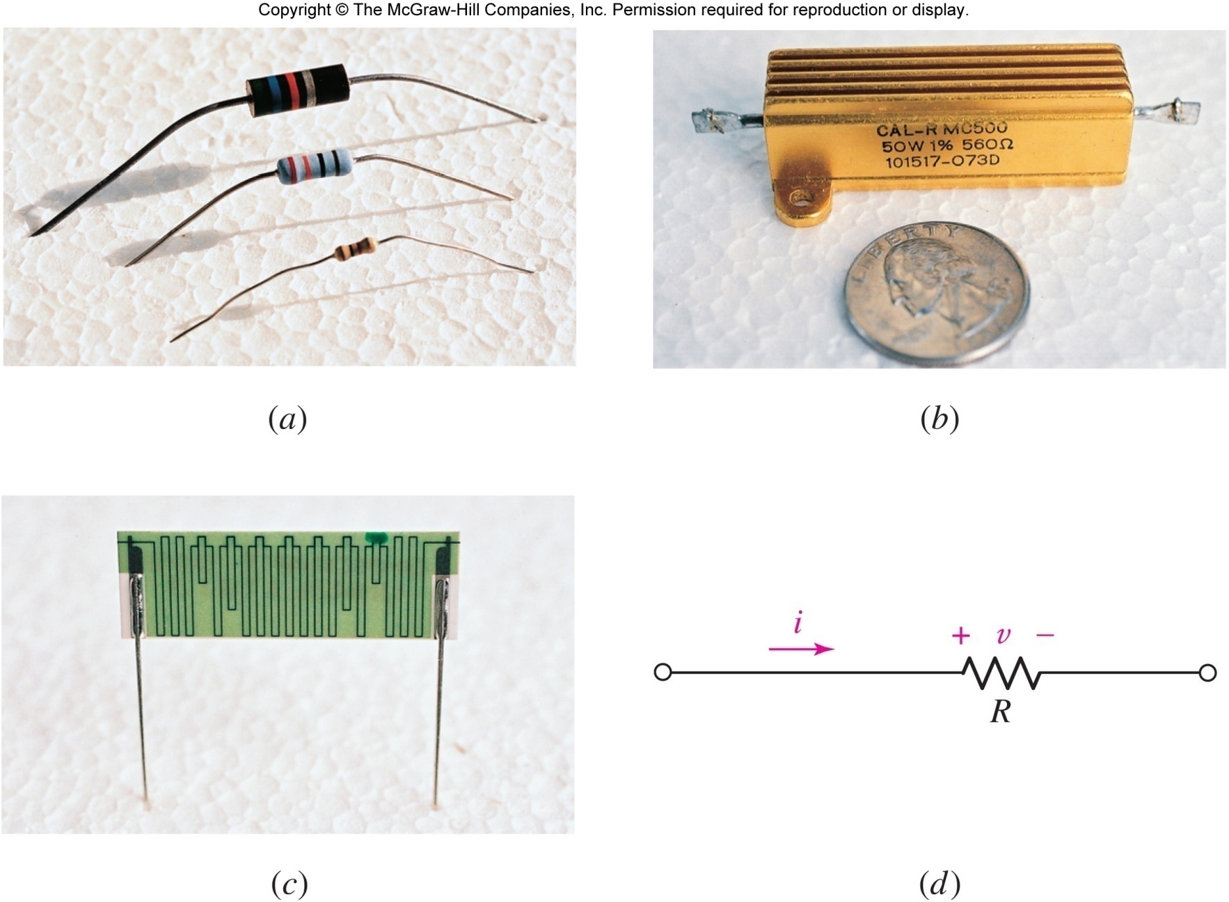
typical resistors (b) power resistor
(c) a 10 TΩ resistor (d) circuit symbol
Copyright © 2013 The McGraw-Hill Companies, Inc. Permission required for reproduction or display.

Slide 19

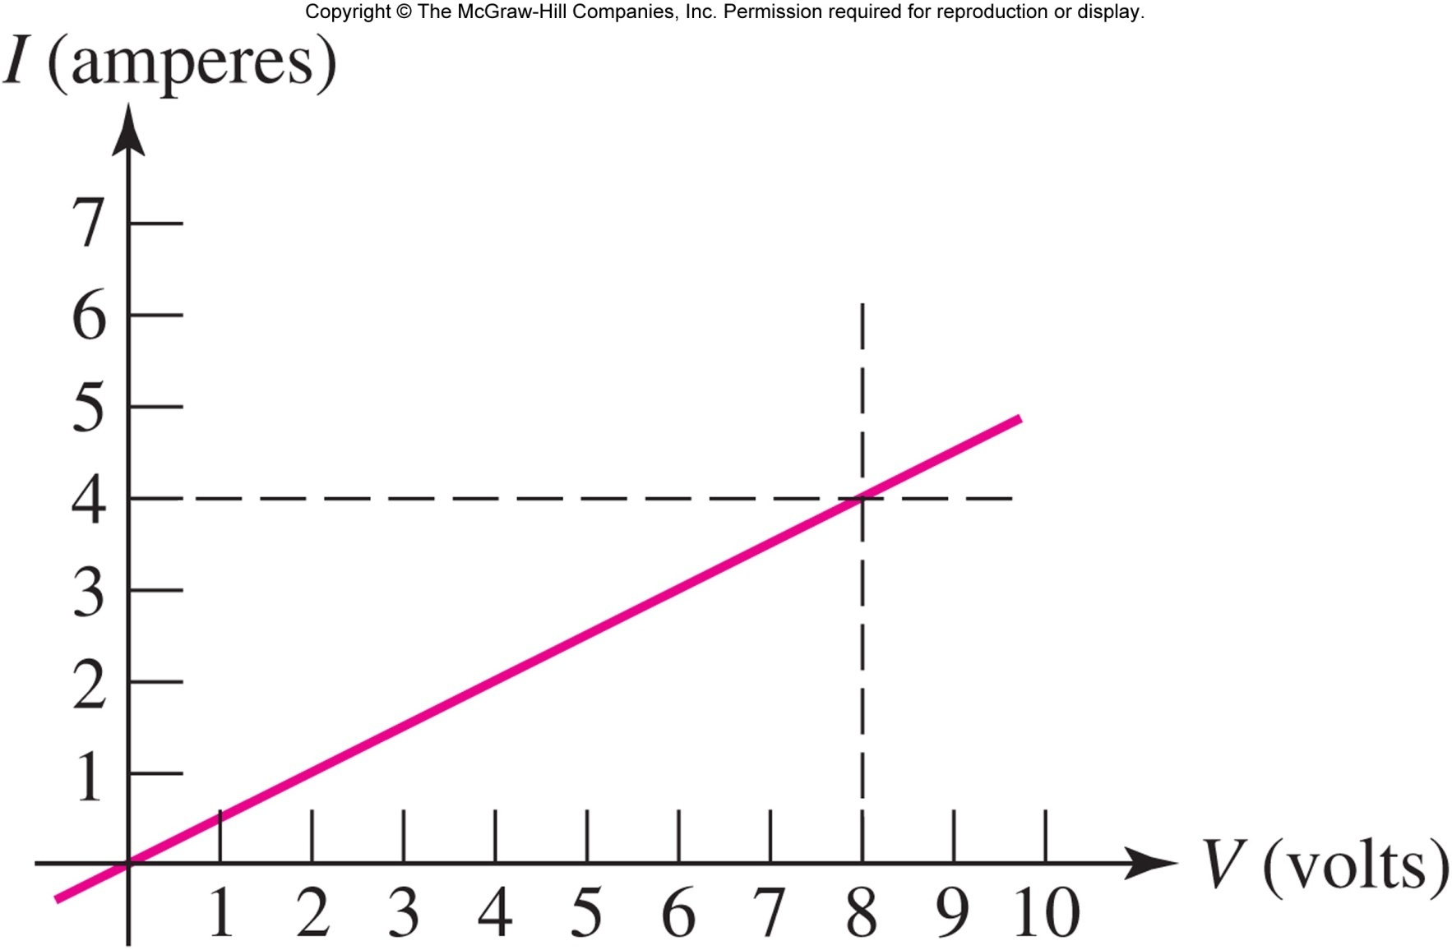
For a resistor, the plot of current versus voltage is a straight line:
In this example, the slope is 4 A / 8 V or 0.5 Ω^{-1.}
This is the graph for a 2 ohm resistor.
Copyright © 2013 The McGraw-Hill Companies, Inc. Permission required for reproduction or display.

Slide 20

Resistors absorb power: since v=iR
p=vi = v²/R = i²R
Positive power means the device is absorbing energy.
Power is always positive for a resistor!
Copyright © 2013 The McGraw-Hill Companies, Inc. Permission required for reproduction or display.

Slide 21

A 560 Ω resistor is connected to a circuit which causes a current of 42.4 mA to flow through it.
Calculate the voltage across the resistor and the power it is dissipating.
v = iR = (0.0424)(560) = 23.7 V
p = i ²R = (0.0424)²(560) = 1.007 W
Copyright © 2013 The McGraw-Hill Companies, Inc. Permission required for reproduction or display.

Slide 22

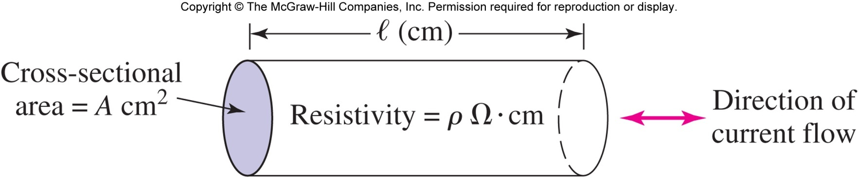
The resistance of a wire is determined by the resistivity of the conductor as well as the geometry:
R = ρ l / A
[In most cases, the resistance of wires can be assumed to be 0 ohms.]
Copyright © 2013 The McGraw-Hill Companies, Inc. Permission required for reproduction or display.

Slide 23

We sometimes prefer to work with the reciprocal of resistance (1/R), which is called conductance (symbol G, unit siemens (S)).
A resistor R has conductance G=1/R.
The i-v equation (i.e. Ohm’s law) can be written as
i=Gv
Copyright © 2013 The McGraw-Hill Companies, Inc. Permission required for reproduction or display.

Slide 24

An open circuit between A and B means i=0.
Voltage across an open circuit: any value.
An open circuit is equivalent to R = ∞ Ω.
A short circuit between A and B means v=0.
Current through a short circuit: any value.
A short circuit is equivalent to R = 0 Ω.
Copyright © 2013 The McGraw-Hill Companies, Inc. Permission required for reproduction or display.

