Slide 1

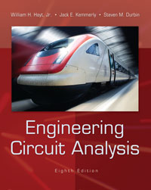
Chapter 4
Basic Nodal and Mesh Analysis
Copyright © 2013 The McGraw-Hill Companies, Inc. Permission required for reproduction or display.

Slide 2

as circuits get more complicated, we need an organized method of applying KVL, KCL, and Ohm’s
nodal analysis assigns voltages to each node, and then we apply KCL
mesh analysis assigns currents to each mesh, and then we apply KVL
Copyright © 2013 The McGraw-Hill Companies, Inc. Permission required for reproduction or display.

Slide 3

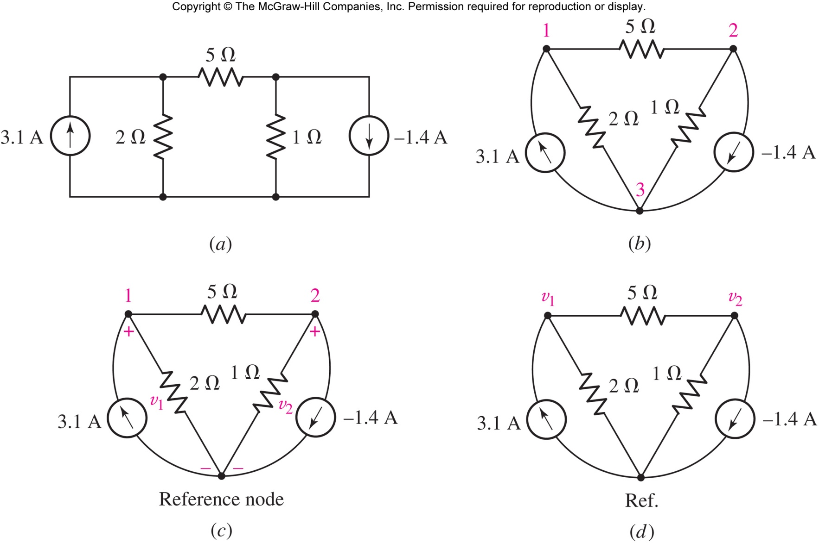
assign voltages to every node relative to a reference node
in this example, there are three nodes
Copyright © 2013 The McGraw-Hill Companies, Inc. Permission required for reproduction or display.

Slide 4

as the bottom node, or
as the ground connection, if there is one, or
a node with many connections
assign voltages relative to reference
Answer: i₃(t) = 1.333 sin t V
Copyright © 2013 The McGraw-Hill Companies, Inc. Permission required for reproduction or display.

Slide 5

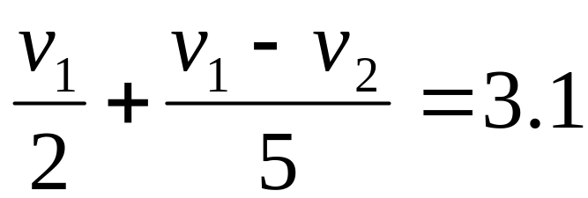
Apply KCL to node 1 ( Σ out = Σ in) and Ohm’s law to each resistor:
Note: the current flowing out of node 1 through the 5 Ω resistor is
v₁-v₂= i5
Copyright © 2013 The McGraw-Hill Companies, Inc. Permission required for reproduction or display.

Slide 6
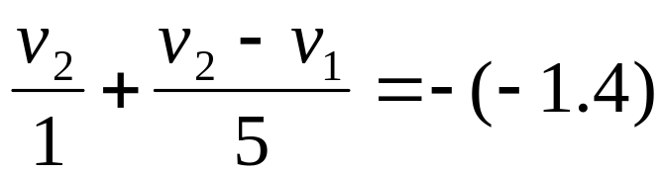
Apply KCL to node 2 ( Σ out = Σ in) and Ohm’s law to each resistor:
We now have two equations for the two unknowns v₁ and v₂ and can solve.
[ v₁ = 5 V and v₂= 2V]
Copyright © 2013 The McGraw-Hill Companies, Inc. Permission required for reproduction or display.

Slide 7

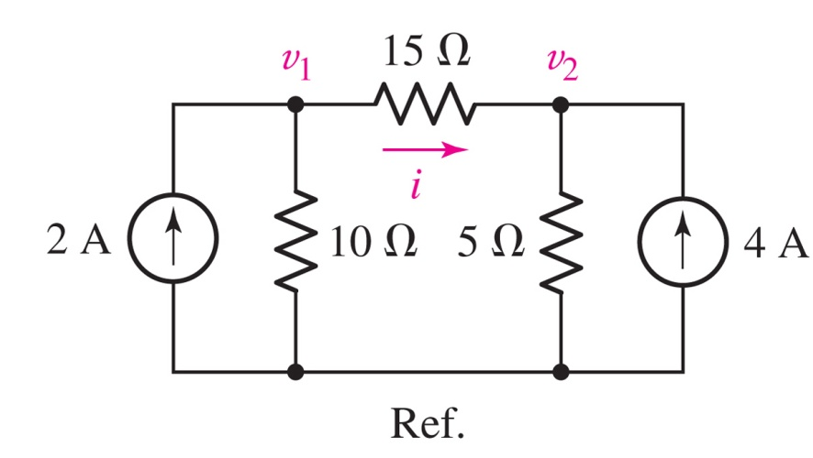
Find the current i in the circuit.
Answer: i = 0 (since v₁=v₂=20 V)
Copyright © 2013 The McGraw-Hill Companies, Inc. Permission required for reproduction or display.

Slide 8

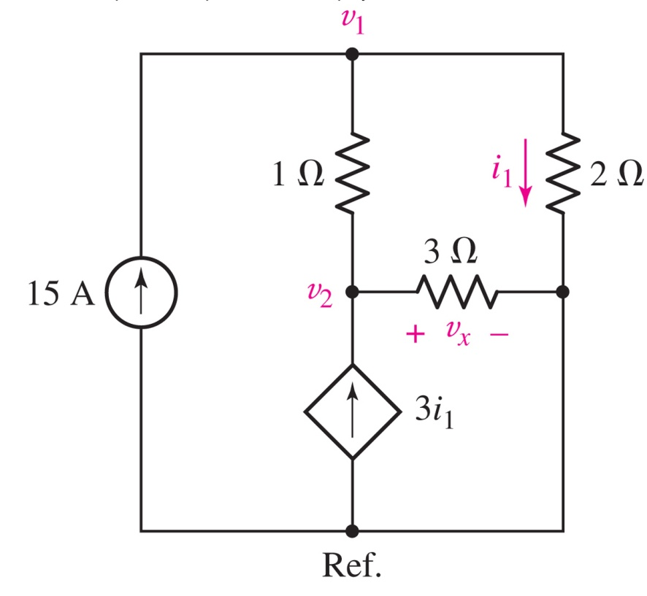
Determine the power supplied by the dependent source.
Key step: eliminate i₁ from the equations using v₁=2i₁
Answer: 4.5 kW
Copyright © 2013 The McGraw-Hill Companies, Inc. Permission required for reproduction or display.

Slide 9

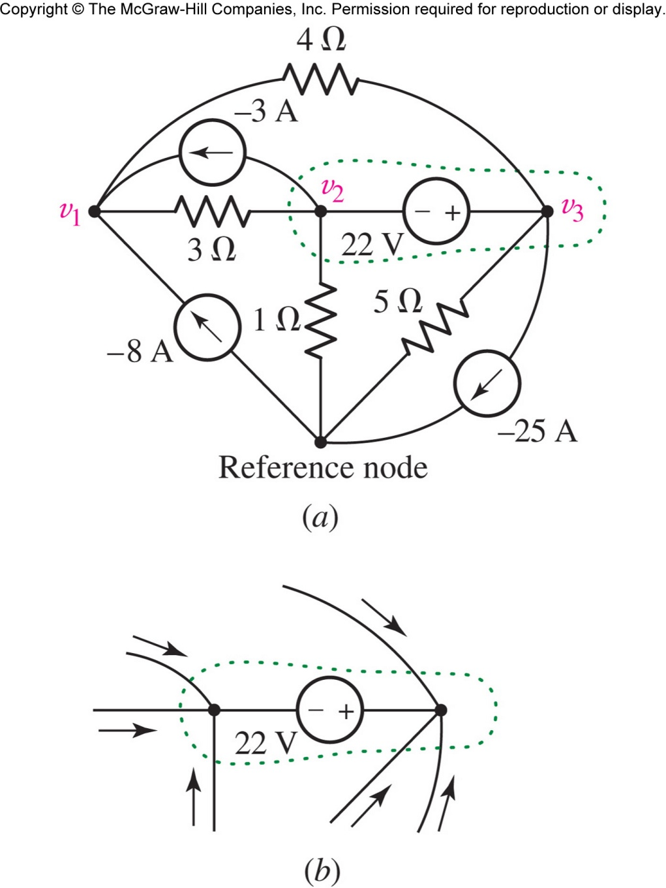
What is the current through a voltage source connected between nodes?
We can eliminate the need for introducing a current variable by applying KCL to the supernode.
Copyright © 2013 The McGraw-Hill Companies, Inc. Permission required for reproduction or display.

Slide 10

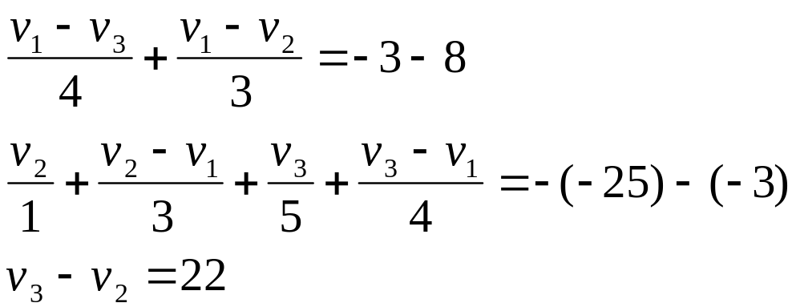
Apply KCL at Node 1.
Apply KCL at the supernode.
Add the equation for the voltage source inside the supernode.
Copyright © 2013 The McGraw-Hill Companies, Inc. Permission required for reproduction or display.

Slide 11

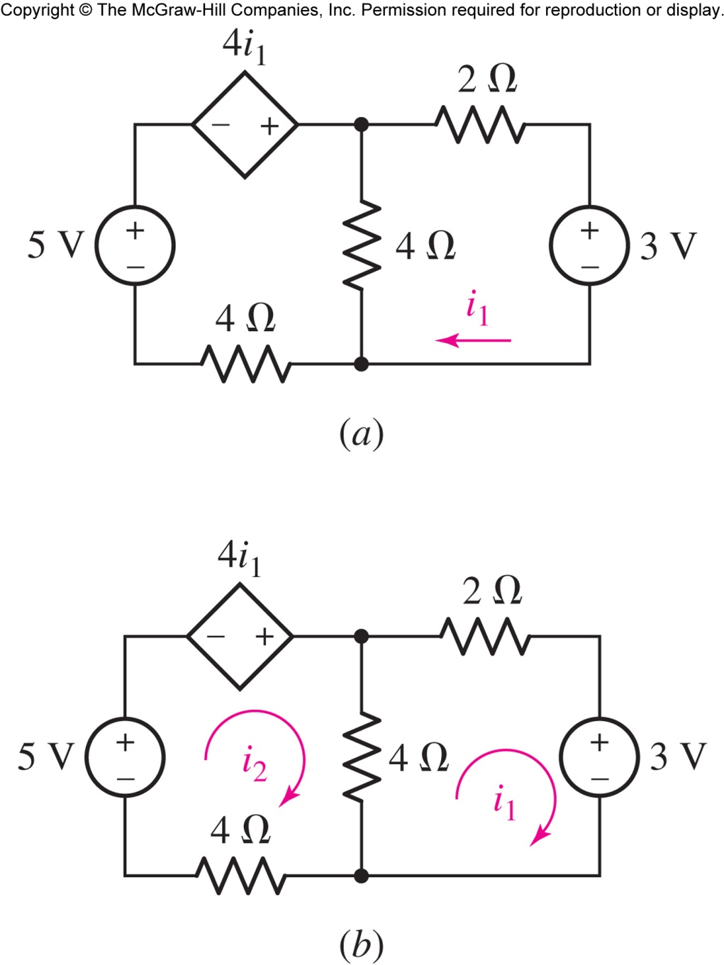
Find i₁
Answer: i₁ = - 250 mA.
Copyright © 2013 The McGraw-Hill Companies, Inc. Permission required for reproduction or display.

Slide 12

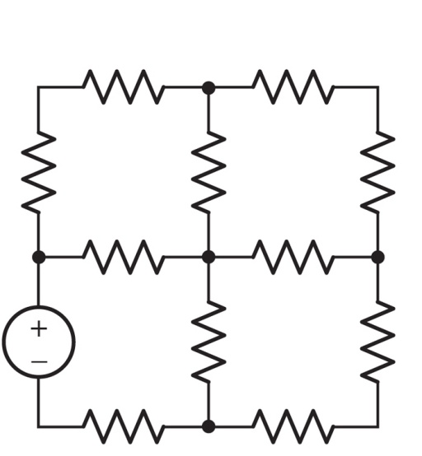
a mesh is a loop which does not contain any other loops within it
in mesh analysis, we assign currents and solve using KVL
assigning mesh currents automatically ensures KCL is followed
this circuit has four meshes:
Copyright © 2013 The McGraw-Hill Companies, Inc. Permission required for reproduction or display.

Slide 13

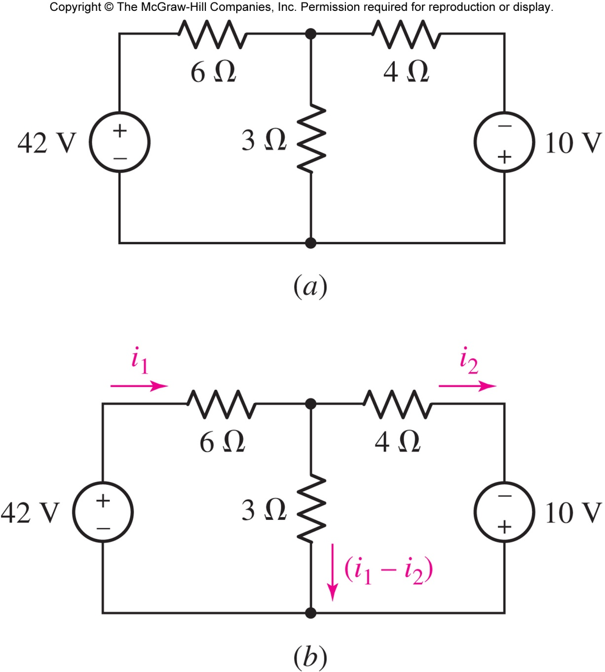
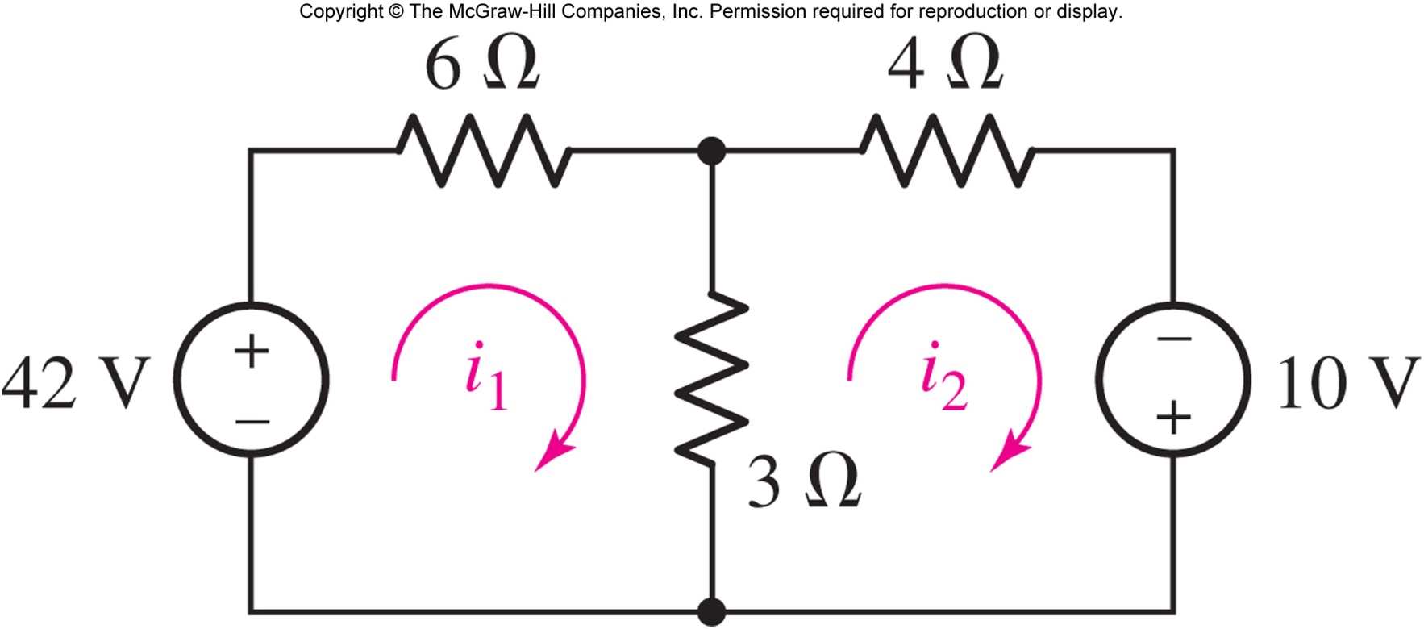
Mesh currents
Branch currents
Copyright © 2013 The McGraw-Hill Companies, Inc. Permission required for reproduction or display.

Slide 14

Apply KVL to mesh 1 ( Σ drops=0 ):
-42 + 6i₁ +3(i₁-i₂) = 0
Apply KVL to mesh 2 ( Σ drops=0 ):
3(i₂-i₁) + 4i₂ -10 = 0
Copyright © 2013 The McGraw-Hill Companies, Inc. Permission required for reproduction or display.

Slide 15

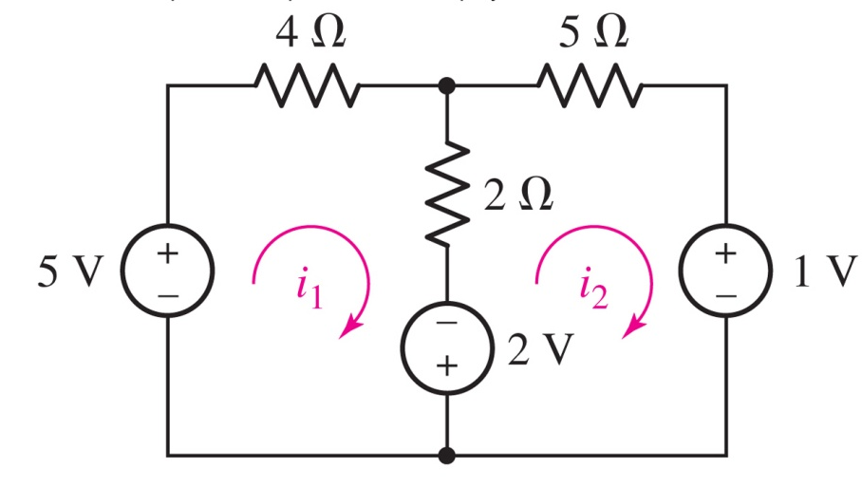
Determine the power supplied by the 2 V source.
Answer: 2.474 W
Applying KVL to the meshes:
−5 + 4i₁ + 2(i₁ − i₂) − 2 = 0
+2 + 2(i₂ − i₁) + 5i₂ + 1 = 0
Solve: i₁=1.132 A, i₂ = −0.1053 A.
Copyright © 2013 The McGraw-Hill Companies, Inc. Permission required for reproduction or display.

Slide 16

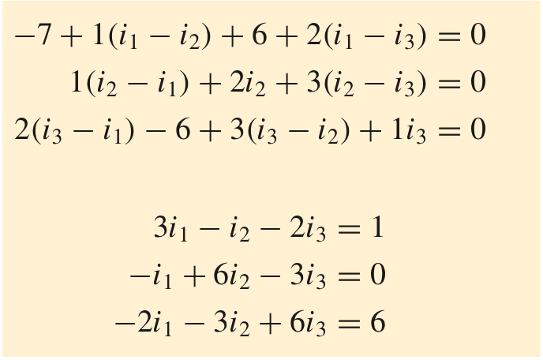
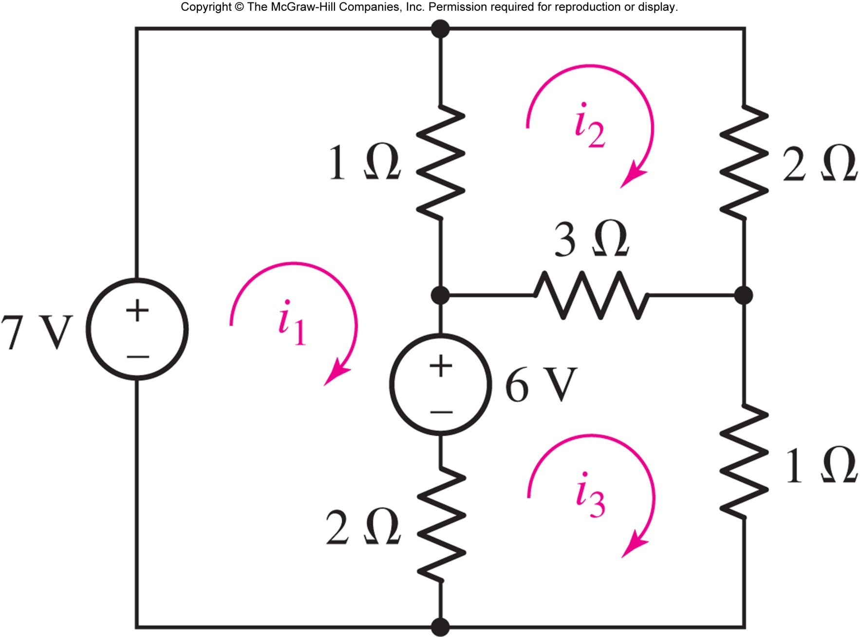
Follow each mesh clockwise
Simplify
Solve the equations:
i₁ = 3 A, i₂ = 2 A, and i₃ = 3 A.
Copyright © 2013 The McGraw-Hill Companies, Inc. Permission required for reproduction or display.

Slide 17

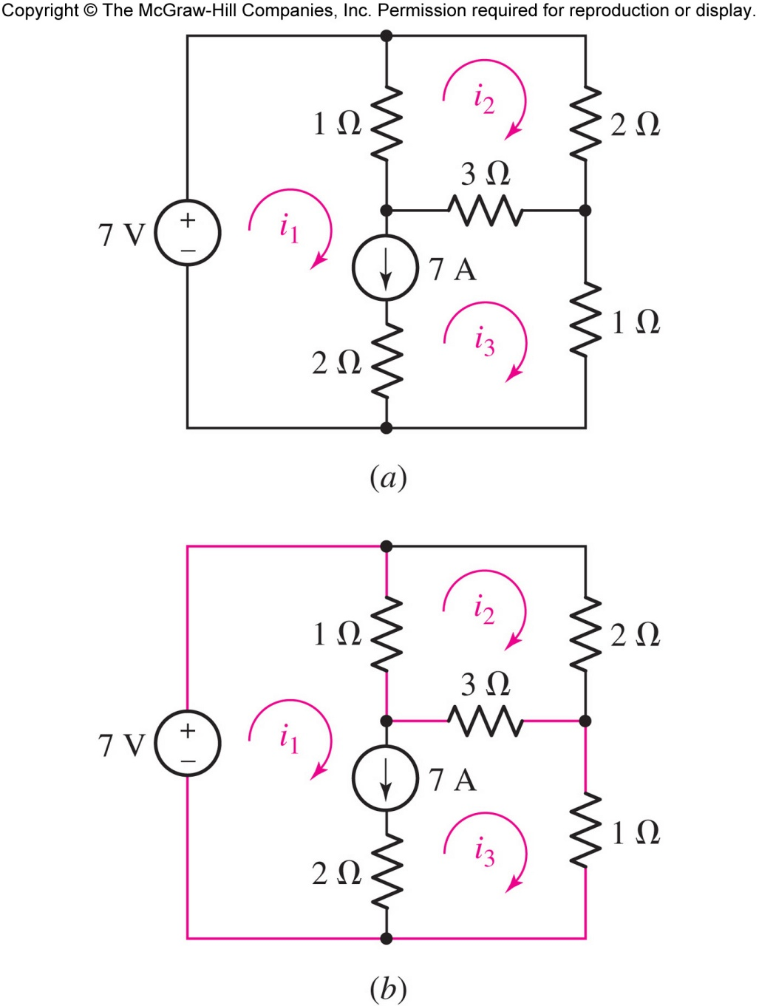
What is the voltage across a current source in between two meshes?
We can eliminate the need for introducing a voltage variable by applying KVL to the supermesh formed by joining mesh 1 and mesh 3.
Copyright © 2013 The McGraw-Hill Companies, Inc. Permission required for reproduction or display.

Slide 18

Apply KVL to mesh 2:
1(i₂ − i₁) + 2i₂ + 3(i₂ − i₃) = 0
Apply KVL supermesh 1/3:
-7 +1(i₁ − i₂) + 3(i₃ − i₂) +1i₃ = 0
Add the current source:
7 =i₁ − i₃
Copyright © 2013 The McGraw-Hill Companies, Inc. Permission required for reproduction or display.

Slide 19
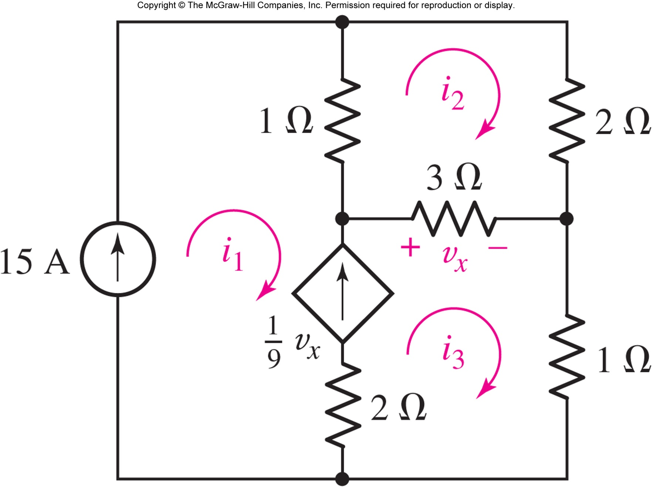
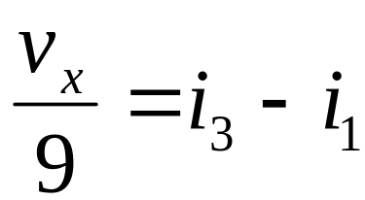
Find the currents.
Key step:
Answer: i₁ = 15 A , i₂ = 11 A, and i₃ = 17 A
Copyright © 2013 The McGraw-Hill Companies, Inc. Permission required for reproduction or display.

Slide 20

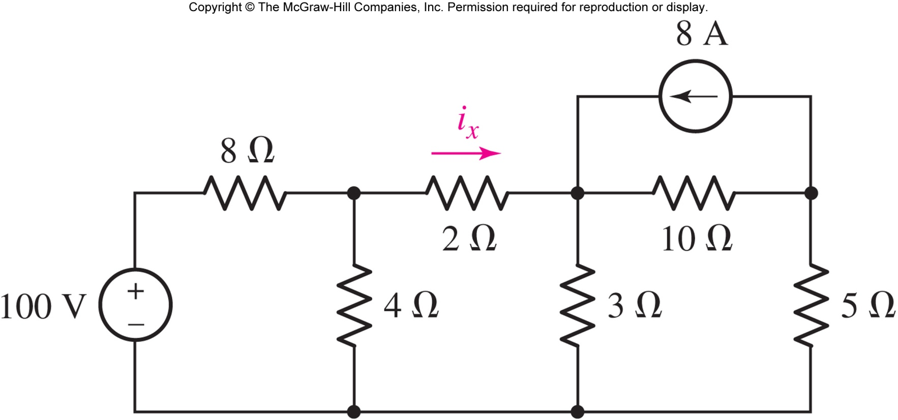
use the one with fewer equations, or
use the method you like best, or
use both (as a check), or
use circuit simplifying methods from the next chapter
Copyright © 2013 The McGraw-Hill Companies, Inc. Permission required for reproduction or display.

