Slide 1
Hardware Description Languages
HDLs

Slide 2
Hardware Description Languages
An HDL:
  Describes circuits and systems in textual format like a software program
  It is NOT sequential like software programs
  Can be processed by computers
  Examples: VHDL, Verilog, AHDL, MODAL
Applications:
  Simulation
  Synthesis

Slide 3
Simulation and Synthesis
Simulation
  Input waveform and circuit description --> Output waveform
  Predicts circuit behavior before fabrication (debug before physical implementation)
برنامه نويسي
کامپايل
اجرا
ويرايش

Slide 4
Simulation and Synthesis
Synthesis
  Automated circuit generation
  Software program takes design description and tries to find the equivalent circuit
ورود طرح
کامپايل
شبيه سازي
سنتز
شبيه سازي
ويرايش
ويرايش

Slide 5
Verilog HDL
  Verilog or VHDL?
    Similar concepts and capabilities
    Different syntax
  Verilog:
    Similar to C/C++ syntax
    Case sensitive
    Comments: //
    ; at the end of each statement

Slide 6
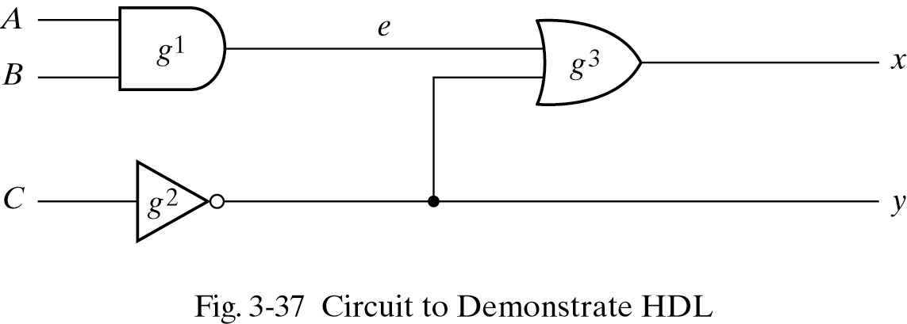
Example
module:
  A hardware component
ports:
  A component’s input(s) and output(s)
    must specify input or output or inout
wires:
  Intermediate signals
//HDL Example 3-1
//--------------------------
module smpl_circuit(A,B,C,x,y);
input A,B,C;
output x,y;
wire e;
and g1(e,A,B);
not g2(y, C);
or g3(x,e,y);
endmodule
Concurrent Execution
  Order not important

Slide 7
Delays
Timescale:
  ‘timescale (time unit)/(precision)
  Example: ‘timescale 1ns/100ps
    1ns: time unit
    100ps: precision (unit used for rounding)
    Default: 1ns/100ps (0.1 ns)
Gate Delays:
  Used by simulator to generate correct waveforms

Slide 8
Delays
//HDL Example 3-2
//---------------------------------
//Description of circuit with delay
module circuit_with_delay (A,B,C,x,y);
input A,B,C;
output x,y;
wire e;
and #(30) g1(e,A,B);
or #(20) g3(x,e,y);
not #(10) g2(y,C);
endmodule

Slide 9
Testbench
Testbench:
  Program written to test the circuit
  Applies the input values at the right times
  Instantiates (calls) the module(s)
  Reports the outputs for evaluation

Slide 10
Testbench Example
//HDL Example 3-3
//----------------------
//Stimulus for simple circuit
module stimcrct;
reg A,B,C;
wire x,y;
circuit_with_delay cwd(A,B,C,x,y);
initial
begin
A = 1'b0; B = 1'b0; C = 1'b0;
#100
A = 1'b1; B = 1'b1; C = 1'b1;
#100 $finish;
end
endmodule
//Description of circuit with delay
module circuit_with_delay (A,B,C,x,y);
input A,B,C;
output x,y;
wire e;
and #(30) g1(e,A,B);
or #(20) g3(x,e,y);
not #(10) g2(y,C);
endmodule
Testbench:
  Doesn’t have ports
  Instantiates the module
  Assigns values: <size>’<base><value>
    Base: b, o, d, h.
  ABC = “000” → “111”
  100ns delay
  Finishes at 200ns

Slide 11
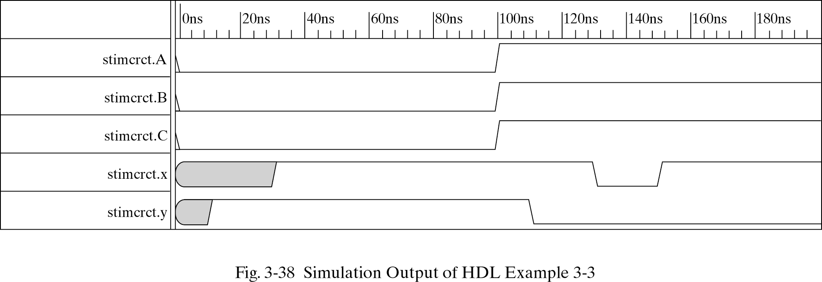
Testbench Example

Slide 12
Boolean Expressions
  & AND
  | OR
  ~ NOT
    assign x = (A & B) | ~C;
  Another example:
//HDL Example 3-4
//------------------------------
//Circuit specified with Boolean equations
module circuit_bln (x,y,A,B,C,D);
input A,B,C,D;
output x,y;
assign x = A | (B & C) | (~B & C);
assign y = (~B & C) | (B & ~C & ~D);
endmodule

Slide 13
Primitives
Built-in Primitives:
  and, or, not, nand, nor, xor, xnor, buf
User-Defined Primitives (UDP):
  User can define by truth table
  Use primitive keyword (instead of module)
  Only one output but many inputs
    first output, then inputs
  Inputs’ order must correspond with the truth table
  Truth table between table and end table

Slide 14
UDP
//HDL Example 3-5
//-----------------------------------
//User defined primitive(UDP)
primitive crctp (x,A,B,C);
output x;
input A,B,C;
//Truth table for x(A,B,C) = Minterms (0,2,4,6,7)
table
// A B C : x (Note that this is only a comment)
0 0 0 : 1;
0 0 1 : 0;
0 1 0 : 1;
0 1 1 : 0;
1 0 0 : 1;
1 0 1 : 0;
1 1 0 : 1;
1 1 1 : 1;
endtable
endprimitive

Slide 15
UDP Usage
  Usage: much the same way as system-defined primitives:
crctp #(20) myInstance(w, x, y, z);

Slide 16
Simulation
ModelSim:
  An industrial and widely-used simulator
  Around $25K

