Slide 1
Why Do We Test Software?
Introduction to Software Testing (2nd edition) Chapter 1 http://www.cs.gmu.edu/~offutt/softwaretest/
Updated August 2018

Slide 2
Testing in the 21st Century
Software defines behavior
network routers, finance, switching networks, other infrastructure
Today’s software market:
is much bigger
is more competitive
has more users
Embedded Control Applications
airplanes, air traffic control
spaceships
watches
ovens
remote controllers
Agile processes put increased pressure on testers
Programmers must unit test – with no training or education!
Tests are key to functional requirements – but who builds those tests ?
Industry is going through a revolution in what testing means to the success of software products
PDAs
memory seats
DVD players
garage door openers
cell phones

Slide 3
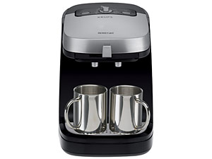
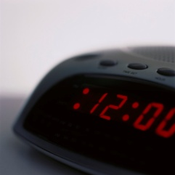
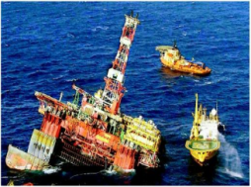
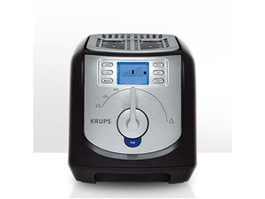

Software is a Skin that Surrounds Our Civilization
Quote due to Dr. Mark Harman

Slide 4
Software Faults, Errors & Failures
Software Fault: A static defect in the software
Software Failure: External, incorrect behavior with respect to the requirements or other description of the expected behavior
Software Error: An incorrect internal state that is the manifestation of some fault
Faults in software are equivalent to design mistakes in hardware.
Software does not degrade.

Slide 5
Fault and Failure Example
A patient gives a doctor a list of symptoms
Failures
The doctor tries to diagnose the root cause, the ailment
Fault
The doctor may look for anomalous internal conditions (high blood pressure, irregular heartbeat, bacteria in the blood stream)
Errors
Most medical problems result from external attacks (bacteria, viruses) or physical degradation as we age.
Software faults were there at the beginning and do not “appear” when a part wears out.

Slide 6
A Concrete Example
Fault: Should start searching at 0, not 1
public static int numZero (int [ ] arr)
{ // Effects: If arr is null throw NullPointerException
// else return the number of occurrences of 0 in arr
int count = 0;
for (int i = 1; i < arr.length; i++)
{
if (arr [ i ] == 0)
{
count++;
}
}
return count;
}
Test 1
[ 2, 7, 0 ]
Expected: 1
Actual: 1
Error: i is 1, not 0, on the first iteration
Failure: none
Test 2
[ 0, 2, 7 ]
Expected: 1
Actual: 0
Error: i is 1, not 0
Error propagates to the variable count
Failure: count is 0 at the return statement

Slide 7


The Term Bug
Bug is used informally
Sometimes speakers mean fault, sometimes error, sometimes failure … often the speaker doesn’t know what it means!
This class will try to use words that have precise, defined, and unambiguous meanings
“an analyzing process must equally have been performed in order to furnish the Analytical Engine with the necessary operative data; and that herein may also lie a possible source of error. Granted that the actual mechanism is unerring in its processes, the cards may give it wrong orders. ” – Ada, Countess Lovelace (notes on Babbage’s Analytical Engine)
BUG
“It has been just so in all of my inventions. The first step is an intuition, and comes with a burst, then difficulties arise—this thing gives out and [it is] then that 'Bugs'—as such little faults and difficulties are called—show themselves and months of intense watching, study and labor are requisite. . .” – Thomas Edison

Slide 8
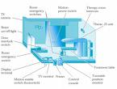
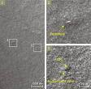


Spectacular Software Failures
NASA’s Mars lander: September 1999, crashed due to a units integration fault
THERAC-25 design
Mars Polar Lander crash site?
THERAC-25 radiation machine: Poor testing of safety-critical software can cost lives: 3 patients were killed
Ariane 5: exception-handling bug : forced self destruct on maiden flight (64-bit to 16-bit conversion: about 370 million $ lost)
Ariane 5 explosion: Millions of $$
Intel’s Pentium FDIV fault: Public relations nightmare
We need our software to be dependable
Testing is one way to assess dependability

Slide 9

Northeast Blackout of 2003
508 generating units and 256 power plants shut down
Affected 10 million people in Ontario, Canada
Affected 40 million people in 8 US states
Financial losses of
$6 Billion USD
The alarm system in the energy management system failed due to a software error and operators were not informed of the power overload in the system

Slide 10
Costly Software Failures
NIST report, “The Economic Impacts of Inadequate Infrastructure for Software Testing” (2002)
Inadequate software testing costs the US alone between $22 and $59 billion annually
Better approaches could cut this amount in half
Huge losses due to web application failures
Financial services: $6.5 million per hour (just in USA!)
Credit card sales applications: $2.4 million per hour (in USA)
In Dec 2006, amazon.com’s BOGO offer turned into a double discount
2007: Symantec says that most security vulnerabilities are due to faulty software
World-wide monetary loss due to poor software is staggering

Slide 11
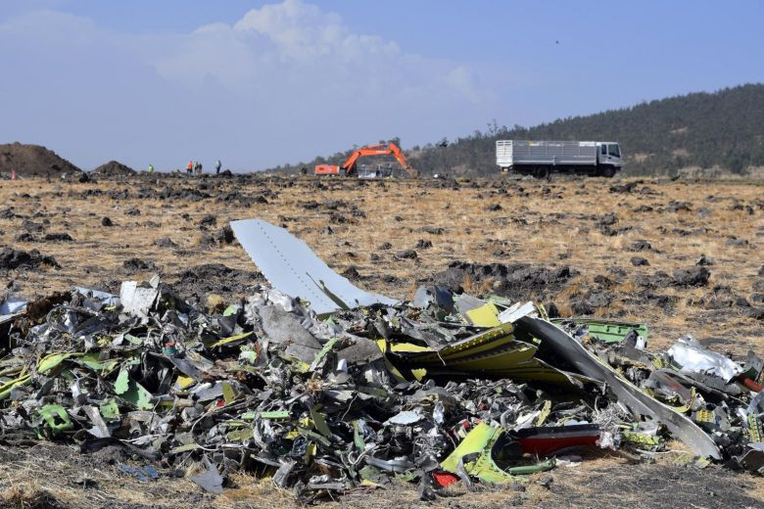

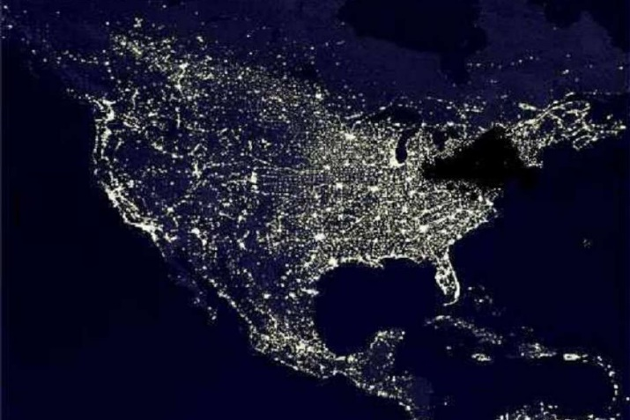
Spectacular software Failures
Boeing A220: Engines failed after software update allowed excessive vibrations
Boeing 737 Max : Crashed due to overly aggressive software flight overrides (MCAS)
Toyota brakes: Dozens dead, thousands of crashes
Healthcare website: Crashed repeatedly on launch—never load tested
Northeast blackout: 50 million people, $6 billion USD lost … alarm system failed
Software testers try to find faults before the faults find users

Slide 12
Testing in the 21st Century
More safety critical, real-time software
Embedded software is ubiquitous … check your pockets
Enterprise applications means bigger programs, more users
Paradoxically, free software increases our expectations!
Security is now all about software faults
Secure software is reliable software
The web offers a new deployment platform
Very competitive and very available to more users
Web apps are distributed
Web apps must be highly reliable
Industry desperately needs our inventions !

Slide 13
The True Cost of Software Failure
Fail watch analyzed news articles for 2016
606 reported software failures
Impacted half the world’s population
Cost a combined $1.7 trillion US dollars
Poor software is a significant drag on the world’s economy
Not to mention frustrating

Slide 14
What Does This Mean?
Software testing is getting more important
What are we trying to do when we test?
What are our goals?

Slide 15
Validation & Verification (IEEE)
Validation: The process of evaluating software at the end of software development to ensure compliance with intended usage
Verification: The process of determining whether the products of a given phase of the software development process fulfill the requirements established during the previous phase
IV&V stands for “independent verification and validation”

Slide 16
Testing Goals Based on Test Process Maturity
Level 0: There’s no difference between testing and debugging
Level 1: The purpose of testing is to show correctness
Level 2: The purpose of testing is to show that the software doesn’t work
Level 3: The purpose of testing is not to prove anything specific, but to reduce the risk of using the software
Level 4: Testing is a mental discipline that helps all IT professionals develop higher quality software

Slide 17
Level 0 Thinking
Testing is the same as debugging
Does not distinguish between incorrect behavior and mistakes in the program
Does not help develop software that is reliable or safe
This is what we teach undergraduate CS majors

Slide 18
Level 1 Thinking
Purpose is to show correctness
Correctness is impossible to achieve
What do we know if no failures?
Good software or bad tests?
Test engineers have no:
Strict goal
Real stopping rule
Formal test technique
Test managers are powerless
This is what hardware engineers often expect

Slide 19
Level 2 Thinking
Purpose is to show failures
Looking for failures is a negative activity
Puts testers and developers into an adversarial relationship
What if there are no failures?
This describes most software companies.
How can we move to a team approach ??

Slide 20
Level 3 Thinking
Testing can only show the presence of failures
Whenever we use software, we incur some risk
Risk may be small and consequences unimportant
Risk may be great and consequences catastrophic
Testers and developers cooperate to reduce risk
This describes a few “enlightened” software companies

Slide 21
Level 4 Thinking
A mental discipline that increases quality
Testing is only one way to increase quality
Test engineers can become technical leaders of the project
Primary responsibility to measure and improve software quality
Their expertise should help the developers
This is the way “traditional” engineering works

Slide 22
Where Are You?
Are you at level 0, 1, or 2?
Is your organization at work at level 0, 1, or 2?
Or 3?
We hope to teach you to become “change agents” in your workplace …
Advocates for level 4 thinking

Slide 23
Tactical Goals : Why Each Test ?
If you don’t know why you’re conducting each test, it won’t be very helpful
Written test objectives and requirements must be documented
What are your planned coverage levels?
How much testing is enough?
Common objective – spend the budget … test until the ship-date …
Sometimes called the “date criterion”

Slide 24

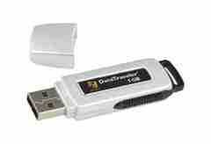
Here! Test This!
Offutt’s first “professional” job
Big software program
MicroSteff – big
software system
for the mac
V.1.5.1 Jan/2007
Jan/2011
Verdatim
DataLife
MF2-HD
1.44 MB
A stack of computer printouts—and no documentation

Slide 25
Why Each Test ?
If you don’t start planning for each test when the functional requirements are formed, you’ll never know why you’re conducting the test
1980: “The software shall be easily maintainable”
Threshold reliability requirements?
What fact does each test try to verify?
Requirements definition teams need testers!

Slide 26
Cost of Not Testing
Poor Program Managers might say: “Testing is too expensive.”
Testing is the most time consuming and expensive part of software development
Not testing is even more expensive
If we have too little testing effort early, the cost of testing increases
Planning for testing after development is prohibitively expensive

Slide 27
Cost of Late Testing
60
Assume $1000 unit cost, per fault, 100 faults
$250K
50
40
$360K
30
Fault origin (%)
Fault detection (%)
Unit cost (X)
20
$20K
$100K
$13K
10
$6K
0
Requirements
Design
Prog / Unit Test
Integration Test
System Test
Post-Deployment
Software Engineering Institute; Carnegie Mellon University; Handbook CMU/SEI-96-HB-002
Notes:
28-Oct-2010, at GTAC, added the animation to demonstrate increasing the number of faults found early, thereby decreasing the number of faults found late, and finally saving money. Lots of it! This animation is fairly complicated … must practice first!!

Slide 28
Why Do We Test Software ?
A tester’s goal is to eliminate faults as early as possible
Improve quality
Reduce cost
Preserve customer satisfaction

