Slide 1
Network simulation
Zeinab Movahedi

Slide 2
Network Simulation
Motivation:
learn fundamentals of evaluating network performance via simulation
Overview:
fundamentals of discrete event simulation
analyzing simulation outputs
ns-2 simulation
Notes:
- The goal for us is to understand how networks work by simulating them.
- we’ll be looking at the following in particulat
- fundamentals of event simulation – what are events? How are they tracke?
- details of a particular popular network simulator other
- other examples are opnet, qualnet etc

Slide 3
The evaluation spectrum
simulation
prototype
numerical
models
emulation
operational
system

Slide 4
Introduction (1 of 3)
The best advice to those about to embark on a very large simulation is
often the same as Punch’s famous advice to those about to marry: ‘Don’t!’
– Bratley, Fox and Schrage (1986)
System to be characterized may not be available
During design or procurement stage
Still want to predict performance
Or, may have system but want to evaluate wide-range of workloads
→ Simulation
However, simulations may fail
Need good programming, statistical analysis and perf eval knowledge

Slide 5
What is simulation?
system boundary
exogenous inputs
to system
(the environment)
system under study
(has deterministic rules
governing its behavior)
“real” life
observer
program boundary
pseudo random inputs
to system
(models environment)
computer program
simulates deterministic
rules governing behavior
“simulated” life
observer
Notes:
We want to study the behaviour of system under a given set of external factors
- For Internet, our system is the way we have placed nodes, routers, our protocols running on them (HTTP, TCP) etc.
- Our “exogenous” behaviour” can be, for exampe – how users are using the system – for example growth of online streaming video with youtube.
- We want to model the system so that we can engineer better systems
- Its clear that simulation becomes harder as we have large systems and varied inputs. We should be able to distiguish between the important and the non-imp. Properties, so that we can observe the relevant ones

Slide 6
Why Simulation?
goal: study system performance, operation
real-system not available, is complex/costly or dangerous (eg: space simulations, flight simulations)
quickly evaluate design alternatives (eg: different system configurations)
evaluate complex functions for which closed form formulas or numerical techniques not available
Notes:
We should go ahead and observe tha actual system if possible, but we can’t do so for a variety of reasons.
More importantly, Simulation can let you abstract out some of the complexity.
Simulation is repeatable – When studying flash crowds, its hard to create flash crowds again and again, but its possible to simulate them as many times as needed

Slide 7
Simulation: advantages/drawbacks*
advantages:
sometimes cheaper
find bugs (in design) in advance
generality: over analytic/numerical techniques
detail: can simulate system details at arbitrary level
drawbacks:
caution: does model reflect reality
large scale systems: lots of resources to simulate (especially accurately simulate)
may be slow (computationally expensive – 1 min real time could be hours of simulated time)
statistical uncertainty in results
Notes:
Simulation lets you separate the design bugs from the implementation bugs (for example – a server farm - have not got enough provisioning) – estimate etc

Slide 8
Programming a simulation
What ‘s in a simulation program?
simulated time: internal (to simulation program) variable that keeps track of simulated time
system “state”: variables maintained by simulation program define system “state”
e.g., may track number (possibly order) of packets in queue, current value of retransmission timer
events: points in time when system changes state
each event has associated event time
e.g., arrival of packet to queue, departure from queue
precisely at these points in time that simulation must take action (change state and may cause new future events)
model for time between events (probabilistic) caused by external environment

Slide 9
Discrete Event Simulation
simulation program maintains and updates list of future events: event list
simulator structure:
initialize event list
get next (nearest future)
event from event list
Need:
well defined set of events
for each event: simulated system action, updating of event list
time = event time
process event
(change state values, add/delete
future events from event list
update statistics
n
done?
y

Slide 10
Simulation: example
packets arrive (avg. interrarrival time: 1/ λ) to router (avg. execution time 1/μ) with two outgoing links
arriving packet joins link i with probability φ_{i}
λ
μ₁
μ₂
state of system: size of each queue
system events:
job arrivals
service time completions
define performance measure to be gathered

Slide 11
Simulation: example
μ₁
λ
μ₂
Simulator actions on arrival event
choose a link
if link idle {place pkt in service, determine service time (random number drawn from service time distribution) add future event onto event list for pkt transfer completion, set number of pkts in queue to 1}
if buffer full {increment # dropped packets, ignore arrival}
else increment number in queue where queued
create event for next arrival (generate interarrival time) stick event on event list

Slide 12
Simulation: example
μ₁
λ
μ₂
Simulator actions on departure event
remove event, update simulation time, update performance statistics
decrement counter of number of pkts in queue
If (number of jobs in queue > 0) put next pkt into service – schedule completion event (generate service time for put)

Slide 13
Gathering Performance Statistics
avg delay at queue i: record D_{ij} : delay of customer j at queue i. Let N_{i} be # customers passing through queue i
throughput at queue i, γ_{i} =
total simulated time
average queue length at i:
Little’s Law

Slide 14
Analyzing Output Results
Each time we run a simulation, (using different random number streams), we will get different output results!
distribution of random numbers
to be used during simulation
(interarrival, service times)
input
simulation
output
random number sequence 1
output results 1
input
simulation
output
random number sequence 2
output results 2
… …
… …
… …
input
simulation
output
random number sequence M
output results M

Slide 15
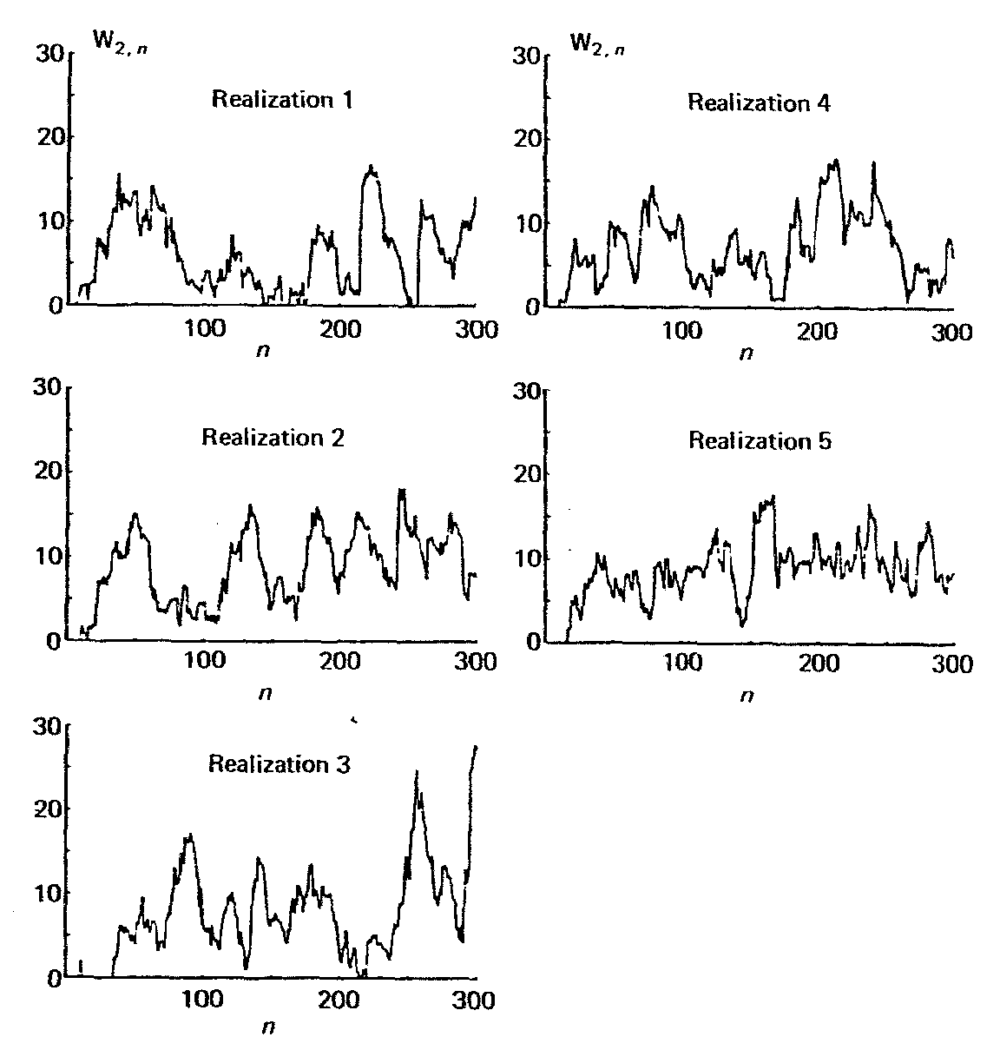
Analyzing Output Results
λ
μ₁
μ₂
W_{2,n}: delay of nth departing customer from queue 2

Slide 16
Analyzing Output Results
λ
μ₁
μ₂
each run shows variation in customer delay
one run different from next
statistical characterization of delay must be made
expected delay of n-th customer
behavior as n approaches infinity
average of n customers

Slide 17
Transient Behavior
simulation outputs that depend on initial condition (i.e., output value changes when initial conditions change) are called transient characteristics
“early” part of simulation
later part of simulation less dependent on initial conditions
λ
μ₁
μ₂

Slide 18
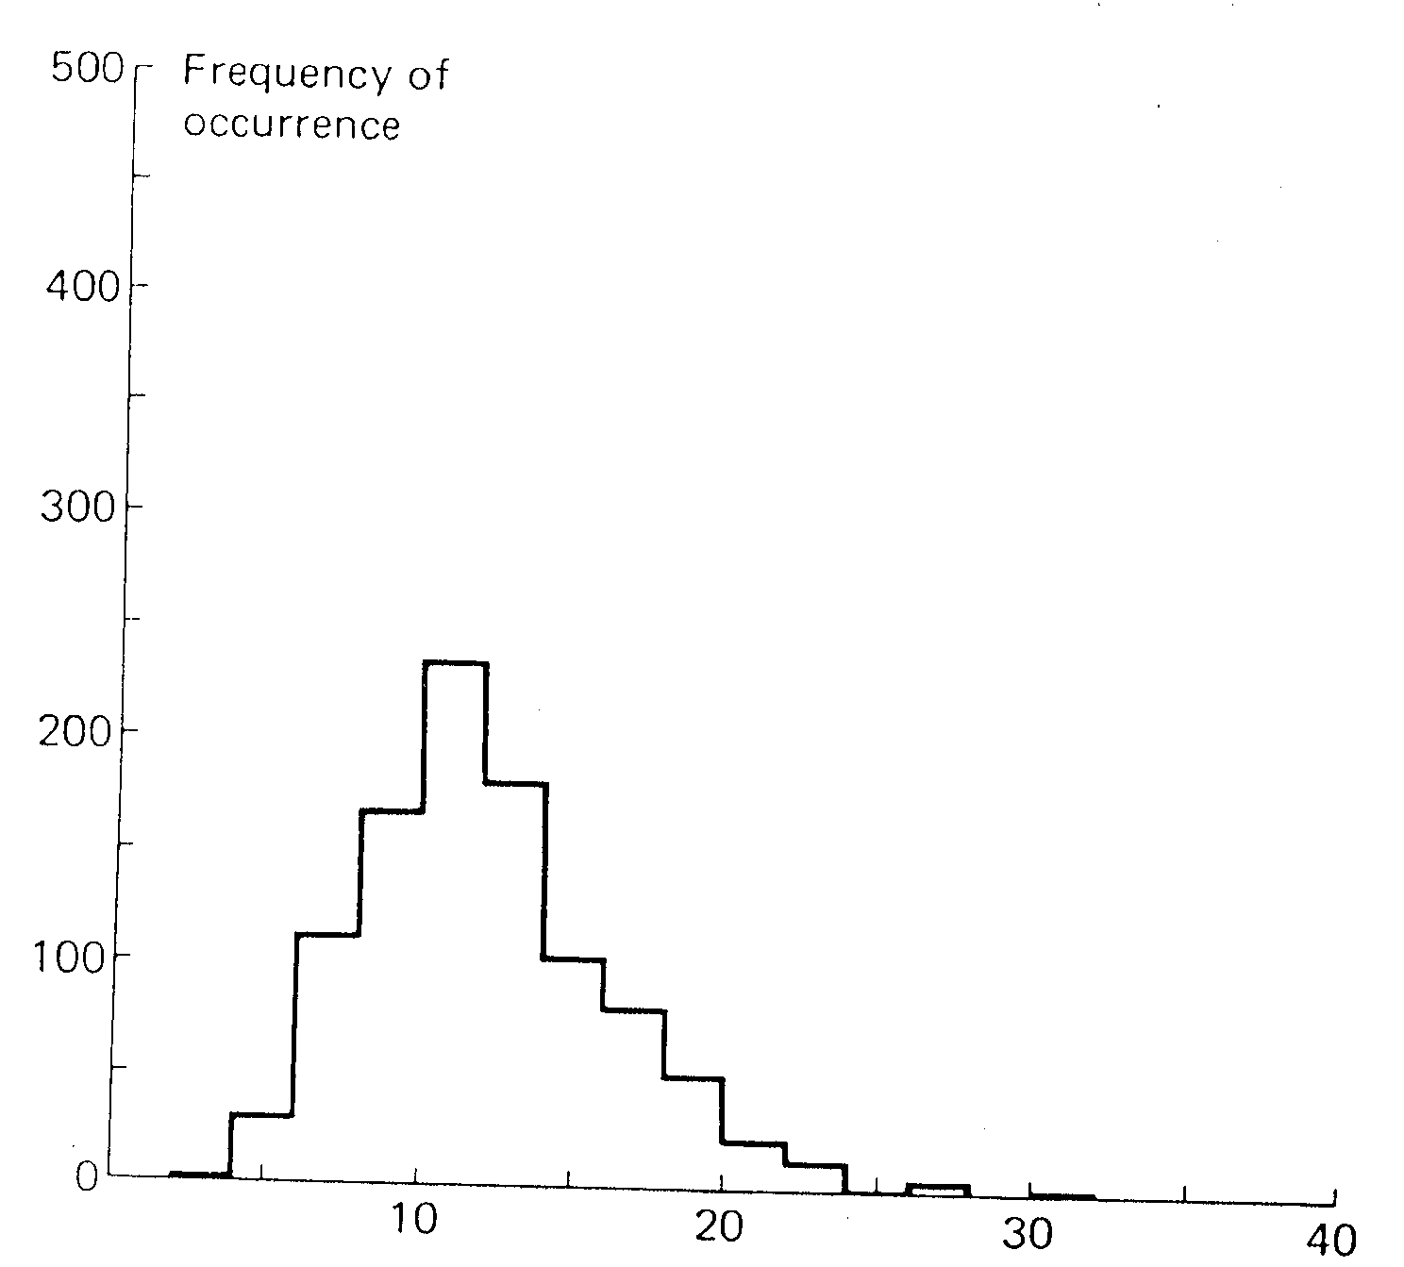
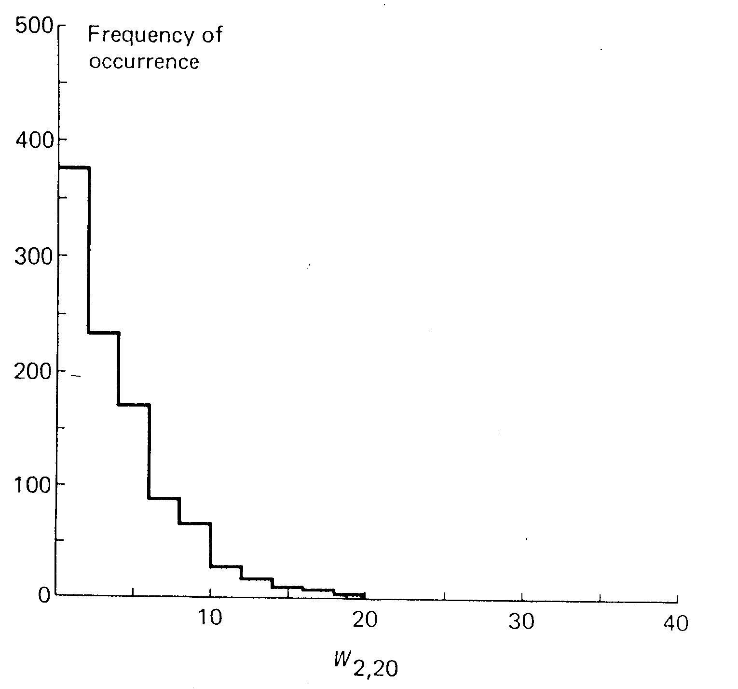
Effect of initial conditions
histogram of delay of 20th customer, given initially empty (1000 runs)
histogram of delay of 20th customer, given non-empty conditions (1000 runs)

Slide 19
Simulation: example
packets arrive (avg. interrarrival time: 1/ λ) to router (avg. execution time 1/μ) with two outgoing links
arriving packet joins link i with probability φ_{i}
λ
μ₁
μ₂

Slide 20
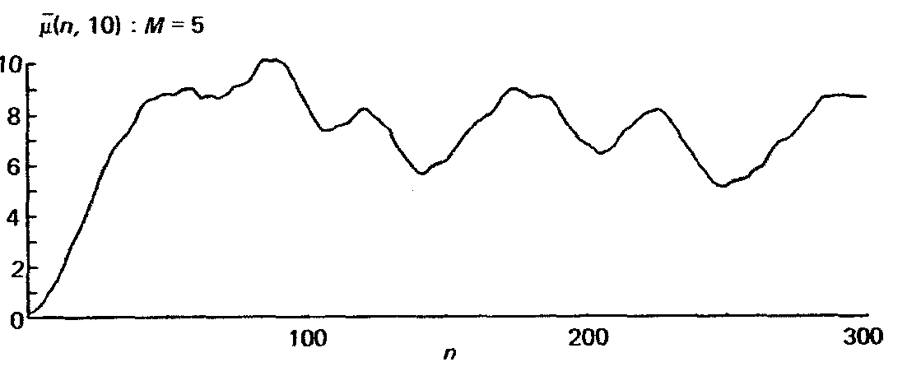
Steady state behavior
output results may converge to limiting “steady state” value if simulation run “long enough”
avg delay
of packets
[n, n+10]
avg of 5 simulations
discard statistics gathered during transient phase, e.g., ignore first n₀ measurements of delay at queue 2
pick n₀ so statistic is “approximately the same” for different random number streams and remains same as n increases

Slide 21
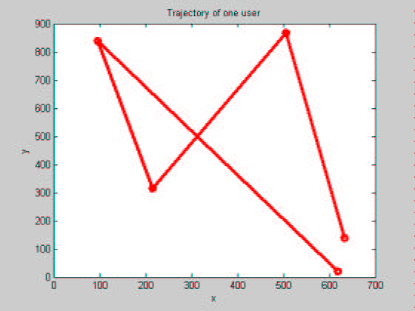
Example: Random Waypoint Model
Simplest random waypoint model:
mobile picks next waypoint M_{n} uniformly in area, independent of past and present
mobile picks next speed V_{n} uniformly in [v_{min}; v_{max}] independent of past and present
mobile moves towards M_{n} at constant speed V_{n}
M_{n+1}
M_{n}

Slide 22
Issue with RWP Model: Decay
Distributions of node speed, position, distances, etc change with time
100 users average
Speed (m/s)
1 user
Time (s)

Slide 23
Confidence Intervals
run simulation: get estimate X₁ as estimate of performance metrics of interest
repeat simulation M times (each with new set of random numbers), get X₂, … X_{M} – all different!
which of X₁, … X_{M} is “right”?
intuitively, average of M samples should be “better” than choosing any one of M samples
How “confident”
are we in X?

Slide 24
Confidence Intervals
cannot get perfect estimate of true mean, μ, with finite # samples
look for bounds: find c1 and c2 such that:
Probability(c1 < μ < c2) = 1 – α
[c1,c2]: confidence interval
100(1-α): confidence level

Slide 25
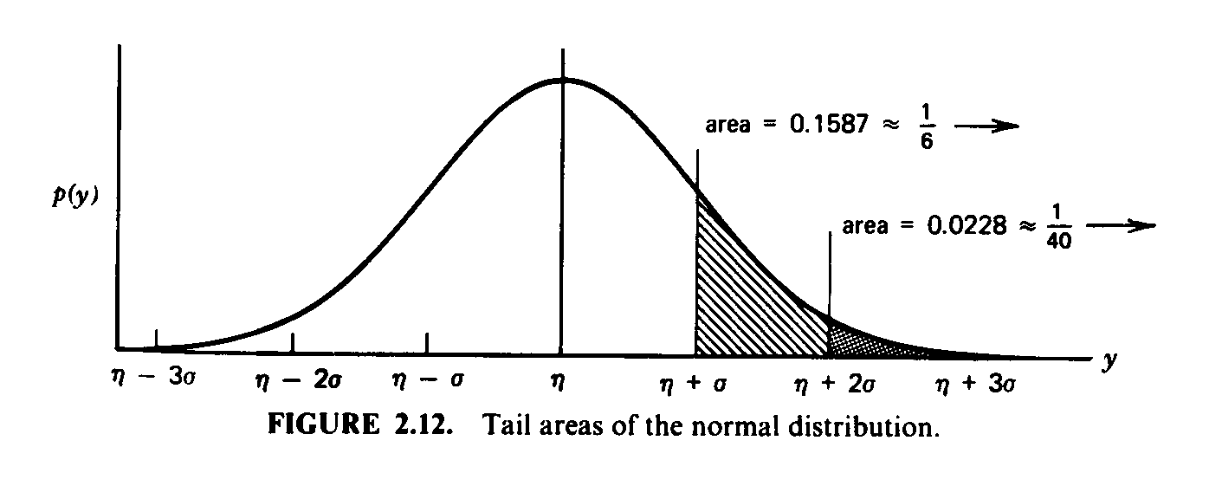
Confidence Intervals: Central Limit Thm
Central Limit Theorem: If samples X₁, … X_{M} independent and from same population with population mean μ and standard deviation σ, then
sample mean:
is approximately normally distributed with mean u and standard deviation

Slide 26
Confidence Intervals .. more
don’t know population standard deviation; estimate it using sample (observed) standard deviation:
given we find upper and lower tails of normal distributions containing α100% of mass

Slide 27
Confidence Intervals .. the recipe
Given samples X₁, …, X_{M,} (e.g., having repeated simulation M times), compute
95% confidence interval:

Slide 28
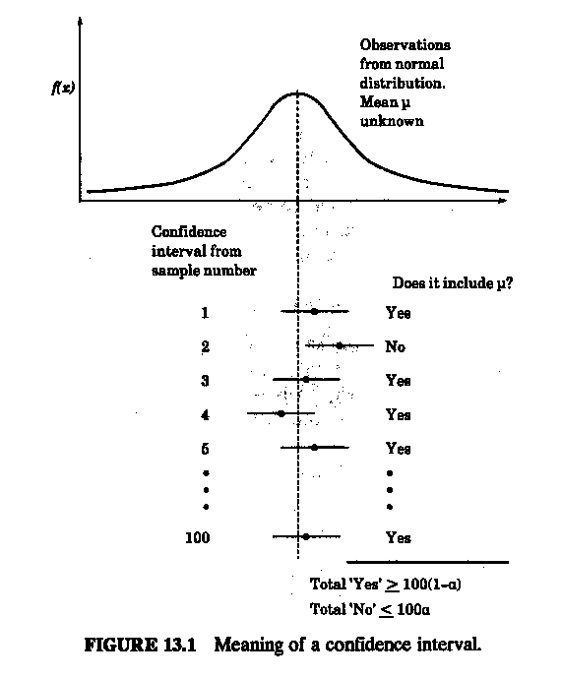
Interpretation of Confidence Interval
If we calculate confidence intervals as in recipe, 95% of confidence intervals thus computed will contain true (unknown) population mean.

Slide 29
Generating confidence intervals for steady state measures
Independent replications
generate n independent replications with m samples, remove first l₀ samples from each to obtain
2. calculate sample mean and variance from
3. use t-distribution to compute confidence intervals
4. can combine with sequential stopping rule to obtain confidence interval of specified width.

Slide 30
Generating confidence intervals for steady state measures
batch means: take single run, delete first l₀ observations, divide remainder into n groups and obtain X_{i} for i-th, i = 1,…,n
follow procedure for independent replications
complication due to nonindependence of X_{i}s
potential efficiency due to deletion of only l₀ observation

Slide 31
ns-2, the network simulator
discrete event simulator
modeling network protocols
wired, wireless, satellite
TCP, UDP, multicast, unicast
web, telnet, ftp
ad hoc, sensor nets
infrastructure: stats, tracing, error models, etc.
prepackaged protocols and modules, or create your own
Our goal:
flavor of ns: simple example, modification, execution and trace analysis

Slide 32
What is NS2?
Network Simulator
A package of tools that simulates behavior of networks
Create Network Topologies
Log events that happen under any load
Analyze events to understand the network behavior
Notes:
Read

Slide 33
Creating Topologies
5Mbps,
10ms
300Kbps,
100ms
n1
n5
n3
500Kbps,
50ms
n4
n2
n6
2Mbps,
20ms
300Kbps,
100ms
Notes:
NS2 lets us create topologies with different nodes, different types of links in betweeb them

Slide 34
Creating Topologies
Nodes
Set properties like queue length, location
Protocols, routing algorithms
Links
Set types of link – Simplex, duplex, wireless, satellite
Set bandwidth, latency etc.
Done through tcl Scripts

Slide 35
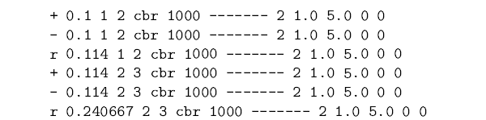
Observing Network Behavior
Observe behavior by tracing “events”
Eg. packet received, packet drop etc.
Src Dst IP Address, Port
time
Notes:
The picture shows an example trace file:
- + shows that a packet entered the queue
- shows that a packet left the queue
- r shows the packet was received
time, type of packet etc

Slide 36
Observing Network Behavior
NAM:
Network Animator
A visual aid showing how packets flow along the network
Notes:
Apart from having a trace file, it comes with a Network animator tool that allows visualization of nodes (much like the diagrams that we see in text books)

Slide 37
Basics of using NS2
Define Network topology, load, output files in Tcl Script
To run,
$ ns simple_network.tcl
Internally, NS2 instantiates C++ classes based on the tcl scripts
Output is in form of trace files
Notes:
Read

Slide 38
A simple Example – Creating the topology
Bandwidth:1Mbps
Latency: 10ms
n1
n2
Notes:
So lets start by creating a topology is NS2, we’re just defining stuff, no packets are going through yet

Slide 39
Creating the topology
#create a new simulator object
set ns [new Simulator]
#open the nam trace file
set nf [open out.nam w]
$ns namtrace-all $nf
#define a 'finish' procedure
proc finish {} {
global ns nf
$ns flush-trace
#close the trace file
close $nf
#execute nam on the trace file
exec nam out.nam &
exit 0
}
Notes:
set ns [new Simulator]: generates an NS simulator object instance, and assigns it to variable ns (italics is used for variables and values in this section). What this line does is the following:
Create a scheduler (default is calendar scheduler)
The "Simulator" object has member functions that do the following:
Create compound objects such as nodes and links (described later)
Connect network component objects created (ex. attach-agent)
Set network component parameters (mostly for compound objects)
Create connections between agents (ex. make connection between a "tcp" and "sink")

Slide 40
Creating the topology (Contd)
#create two nodes
set n0 [$ns node]
set n1 [$ns node]
#create a duplex link between the nodes
$ns duplex-link $n0 $n1 1Mb 10ms DropTail
Notes:
set n0 [$ns node]: The member function node creates a node. A node in NS is compound object made of address and port classifiers (described in a later section). Users can create a node by separately creating an address and a port classifier objects and connecting them together. However, this member function of Simulator object makes the job easier.
$ns duplex-link node1 node2 bandwidth delay queue-type: creates two simplex links of specified bandwidth and delay, and connects the two specified nodes. In NS, the output queue of a node is implemented as a part of a link, therefore users should specify the queue-type when creating links. In the above simulation script, DropTail queue is used. If the reader wants to use a RED queue, simply replace the word DropTail with RED.

Slide 41
Adding traffic
n1
1Mbps,10ms
n2
udp
null
cbr
node
agent
Packet Size: 500 bytes
rate: 800Kbps
source
link
cbr traffic
0.5
4.5
5.0
time
0.0
Notes:
We are going to extend the example now: we are going to attach a udp agent to n1 and a sink at n2. (agents are abstractions – of “sockets” that are present in unix)
We are going to use udp to send constant bit-rate traffic – what this means is – that the rate is constant and packet size is constant (we will set these parameters)

Slide 42
Putting it together..
#create a udp agent and attach it to node n0
set udp0 [new Agent/UDP]
$ns attach-agent $n0 $udp0
#Create a CBR traffic source and attach it to udp0
set cbr0 [new Application/Traffic/CBR]
$cbr0 set packetSize_ 500
$cbr0 set interval_ 0.005
$cbr0 attach-agent $udp0
#create a Null agent(a traffic sink) and attach it to node n1
set null0 [new Agent/Null]
$ns attach-agent $n1 $null0
#Connect the traffic source to the sink
$ns connect $udp0 $null0
#Schedule events for CBR traffic
$ns at 0.5 "$cbr0 start"
$ns at 4.5 "$cbr0 stop"
#call the finish procedure after 5 secs of simulated time
$ns at 5.0 "finish"
#run the simulation
$ns run
Notes:
$ns attach-agent node agent: The attach-agent member function attaches an agent object created to a node object. Actually, what this function does is call the attach member function of specified node, which attaches the given agent to itself. Therefore, a user can do the same thing by, for example, $n0 attach $tcp. Similarly, each agent object has a member function attach-agent that attaches a traffic source object to itself.
$ns connect agent1 agent2: After two agents that will communicate with each other are created, the next thing is to establish a logical network connection between them. This line establishes a network connection by setting the destination address to each others' network and port address pair.

Slide 43
A second Scenario * (from NS by Example)
Taken from NS by Example by Jae Chung and Mark Claypool

Slide 44
A second Example (From NS by Example)
#Create a simulator object
set ns [new Simulator]
#Define different colors for data flows (for NAM)
$ns color 1 Blue
$ns color 2 Red
#Open the NAM trace file
set nf [open out.nam w]
$ns namtrace-all $nf
#Define a 'finish' procedure
proc finish {} {
global ns nf
$ns flush-trace
#Close the NAM trace file
close $nf
#Execute NAM on the trace file
exec nam out.nam &
exit 0
}

Slide 45
A Second Scenario (Contd.)
#Create four nodes
set n0 [$ns node]
set n1 [$ns node]
set n2 [$ns node]
set n3 [$ns node]
#Create links between the nodes
$ns duplex-link $n0 $n2 2Mb 10ms DropTail
$ns duplex-link $n1 $n2 2Mb 10ms DropTail
$ns duplex-link $n2 $n3 1.7Mb 20ms DropTail
#Set Queue Size of link (n2-n3) to 10
$ns queue-limit $n2 $n3 10

Slide 46
A Second Scenario (Contd.)
#Give node position (for NAM)
$ns duplex-link-op $n0 $n2 orient right-down
$ns duplex-link-op $n1 $n2 orient right-up
$ns duplex-link-op $n2 $n3 orient right
#Monitor the queue for link (n2-n3). (for NAM)
$ns duplex-link-op $n2 $n3 queuePos 0.5
Notes:
$ns duplex-link-op node1 node2 ...: The next couple of lines are used for the NAM display. To see the effects of these lines, users can comment these lines out and try the simulation.

Slide 47
A Second Scenario (Contd.)
#Setup a TCP connection
set tcp [new Agent/TCP]
$tcp set class_ 2
$ns attach-agent $n0 $tcp
set sink [new Agent/TCPSink]
$ns attach-agent $n3 $sink
$ns connect $tcp $sink
$tcp set fid_ 1
#Setup a FTP over TCP connection
set ftp [new Application/FTP]
$ftp attach-agent $tcp
$ftp set type_ FTP
To create agents or traffic sources, we need to know the class names these objects (Agent/TCP, Agent/TCPSink, Application/FTP and so on).
This information can be found in the NS documentation.
But one shortcut is to look at the "ns-2/tcl/libs/ns-default.tcl" file.
Notes:
et tcp [new Agent/TCP]: This line shows how to create a TCP agent. But in general, users can create any agent or traffic sources in this way. Agents and traffic sources are in fact basic objects (not compound objects), mostly implemented in C++ and linked to OTcl. Therefore, there are no specific Simulator object member functions that create these object instances. To create agents or traffic sources, a user should know the class names these objects (Agent/TCP, Agnet/TCPSink, Application/FTP and so on). This information can be found in the NS documentation or partly in this documentation. But one shortcut is to look at the "ns-2/tcl/libs/ns-default.tcl" file. This file contains the default configurable parameter value settings for available network objects. Therefore, it works as a good indicator of what kind of network objects are available in NS and what are the configurable parameters.
$ns attach-agent node agent: The attach-agent member function attaches an agent object created to a node object. Actually, what this function does is call the attach member function of specified node, which attaches the given agent to itself. Therefore, a user can do the same thing by, for example, $n0 attach $tcp. Similarly, each agent object has a member function attach-agent that attaches a traffic source object to itself.
$ns connect agent1 agent2: After two agents that will communicate with each other are created, the next thing is to establish a logical network connection between them. This line establishes a network connection by setting the destination address to each others' network and port address pair.

Slide 48
A Second Scenario (Contd.)
#Setup a UDP connection
set udp [new Agent/UDP]
$ns attach-agent $n1 $udp
set null [new Agent/Null]
$ns attach-agent $n3 $null
$ns connect $udp $null
$udp set fid_ 2
#Setup a CBR over UDP connection
set cbr [new Application/Traffic/CBR]
$cbr attach-agent $udp
$cbr set type_ CBR
$cbr set packet_size_ 1000
$cbr set rate_ 1mb
$cbr set random_ false

Slide 49
A Second Scenario (Contd.)
#Schedule events for the CBR and FTP agents
$ns at 0.1 "$cbr start"
$ns at 1.0 "$ftp start"
$ns at 4.0 "$ftp stop"
$ns at 4.5 "$cbr stop"
#Detach tcp and sink agents (not really necessary)
$ns at 4.5 "$ns detach-agent $n0 $tcp ; $ns detach-agent $n3 $sink"
#Call the finish procedure after 5 seconds of simulation time
$ns at 5.0 "finish"
#Print CBR packet size and interval
puts "CBR packet size = [$cbr set packet_size_]"
puts "CBR interval = [$cbr set interval_]"
#Run the simulation
$ns run

Slide 50
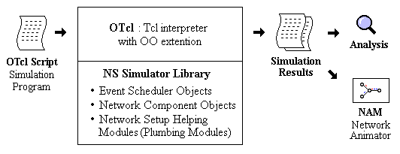
What is ns?
Object-oriented, discrete event-driven network simulator
Written in C++ and OTcl
By VINT: Virtual InterNet Testbed

Slide 51
Hello World – Interactive mode
bash-shell$ ns
% set ns [new Simulator]
_o3
% $ns at 1 “puts \“Hello World!\””
1
% $ns at 1.5 “exit”
2
% $ns run
Hello World!
bash-shell$

Slide 52
Hello World – Batch mode
simple.tcl
set ns [new Simulator]
$ns at 1 “puts \“Hello World!\””
$ns at 1.5 “exit”
$ns run
bash-shell$ ns simple.tcl
Hello World!
bash-shell$

Slide 53
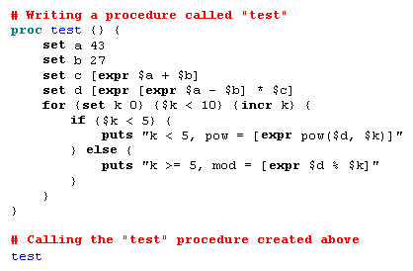
Basic Tcl: ex-tcl.tcl

Slide 54
How can I add to NS2?
Adding Protocols to NS2 is possible
Need to create the C++ class
Need to create the OTcl Linkage
More info at:
http://www.isi.edu/nsnam/ns/tutorial/index.html
Tutorial about how to add a simple protocol to NS2

Slide 55
Documentation – NS2 documentation
NS2 Tutorial by Marc Greis
http://www.isi.edu/nsnam/ns/tutorial/index.html
Good starting point for understanding the overall structure of NS2
Examples:
What is the relation between c++ classes and Otcl classes?
basic info on instantiating NS2 instance, tcl scripting
NS2 by exemples
http://nile.wpi.edu/NS/

Slide 56
Documentation – NS2 Documentation
NS2 for beginners
http://www-sop.inria.fr/maestro/personnel/Eitan.Altman/COURS-NS/n3.pdf
More detailed than Marc Greis’ Tutorial
More info on getting it up and running – rather than internals
Examples:
What does each line of a tcl script do?
Most common examples of trace formats that are useful

Slide 57
Documentation – Tcl Documentation
Tcl Tutorial
http://www.tcl.tk/man/tcl8.5/tutorial/tcltutorial.html
Tcl Manual
All commands and their explanation
http://www.tcl.tk/man/tcl8.6/TclCmd/contents.htm

Slide 58
Bug-Fixing – When things go wrong..
Googling for the problem! ☺
Extensive NS2 mailing lists
Chances are that other people have had the same problem are very high
Responsive forums

Slide 59
Bug-Fixing – When things go wrong..
NS2 in-built examples
Extensive inbuilt examples
“diffing” with the examples helps a lot
Sometimes a good idea to start from a script that does something similar

Slide 60
Bug-Fixing – When things go wrong..
Taking a look at the code
Everyone adds to NS2 ☺
May not always confirm to the norms
IP TTL set to 32 instead of 256 ☺

Slide 61
Bug-Fixing Questions
What is the expected behaviour of the network?
Have I connected the network right?
Am I logging trace information at the right level? Can I change it to narrow down on the problem?
Has anyone else out there had the same problem?
Is there something similar in examples that I can look at, and build upon?
Does the code really do what the protocol says? Are all the default parameters correct?
Is Tcl being picky here? ☺

Slide 62
NS Simulations for Beginners

Slide 63
Simulation elements
Mobility file*
Simulation trace
Simulation Tcl file
Network simulator
Trace analysis
Traffic file**

Slide 64
Set the communication range
Set the receiving threshold in the network interface
Phy/WirelessPhy set RXThresh_ <value>
Outil defined in: ~ns/indep-utils/propagation/threshold.cc
threshold -m <propagation-model> [other-options] distance
where <propagation-model> is either FreeSpace, TwoRayGround or Shadowing, and the distance is the communication range in meter.

Slide 65
Transmission range
For a transmission range of 200m
Antenna/OmniAntenna set X_ 0
Antenna/OmniAntenna set Y_ 0
Antenna/OmniAntenna set Z_ 1.5
Antenna/OmniAntenna set Gt_ 1.0
Antenna/OmniAntenna set Gr_ 1.0
Phy/WirelessPhy set CPThresh_ 10.0
Phy/WirelessPhy set CSThresh_ 1.559e-11
Phy/WirelessPhy set RXThresh_ 3.652e-10
Phy/WirelessPhy set Rb_ 2*1e6
Phy/WirelessPhy set Pt_ 0.2818
Phy/WirelessPhy set freq_ 914e+6
Phy/WirelessPhy set L_ 1.0

Slide 66

Traffic and topology creation
Traffic generation
Topology generation

Slide 67
How to run simulation with arguments
ns <name of simulation TCL file> arg1 arg2 … argn
# of arguments
List of arguments
proc getopt {argc argv} { ;#procedure getopt with 2 arguments
global opt
for {set i 0} {$i < $argc} {incr i} {
set arg [lindex $argv $i]
if {[string range $arg 0 0] != "-"} continue
set name [string range $arg 1 end]
set opt($name) [lindex $argv [expr $i+1]]
}
}
getopt $argc $argv ;#call the procedure
lindex list indexList
Treats its first argument as a Tcl list, returning the index’est element from it.
Returns a range of consecutive characters from string, starting with the character whose index is first and ending with the character whose index is last.
Global variable

Slide 68
Script to lunch a simulation
Lunch a simulation for various parameters
For example, for different # of nodes
To see the impact of that parameter on network performance
Solution 1:
Solution 2: Use a script language and execute the program in a loop
ns simulation.tcl –stop 10
ns simulation.tcl –stop 30
ns simulation.tcl –stop 50
ns simulation.tcl –stop 70
ns simulation.tcl –stop 100
ns simulation.tcl –stop 130
ns simulation.tcl –stop 200
exec_sim.py
#!/usr/bin/env python
import os
for nn in 10 30 50 70 100 130 200:
os.system("ns wrls-dsr.tcl -nn "+str(nn))
os.system("tail -n 1 simple.tr")
./exec_sim.py

Slide 69
Script to lunch simulation
For interdependent ns parameters (Ex. Number of nodes which is parameter of both cbrgen, setdest files and some other functions within the .tcl file)
Must product connection and topology files according to the value of ns argument and not its default value
Call the cbrgen and setdest in the python script with these arguments before the execution of simulation tcl file by ns
Give the produced connection and topology file as arguments of ns
#!/usr/bin/env python
import os
import subprocess as sub
for nn in 10, 20, 30:
os.system("ns ../indep-utils/cmu-scen-gen/cbrgen.tcl -type cbr -nn "+str(nn)+" -seed 0.1 -mc 10 -rate 4.0 > traf")
os.system("~/ns/ns-allinone-2.30/ns-2.30/indep-utils/cmu-scen-gen/setdest/./setdest -v 1 -n "+str(nn)+" 20 -p 10 -M 2 -t 1 -x 400 -y 500 > scen")
os.system("ns wrls-dsr.tcl -nn "+str(nn))

Slide 70
Format of wireless trace
To enable the revised trace support
Should be called before the universal trace command
$ns use-newtrace
$ns trace-all <trace-fd>
s -t 0.267662078 -Hs 0 -Hd -1 -Ni 0 -Nx 5.00 -Ny 2.00 -Nz 0.00 -Ne -1.000000 -Nl RTR -Nw --- -Ma 0 -Md 0 -Ms 0 -Mt 0 -Is 0.255 -Id -1.255 –It message -Il 32 -If 0 -Ii 0 -Iv 32
s -t 1.511681090 -Hs 1 -Hd -1 -Ni 1 -Nx 390.00 -Ny 385.00 -Nz 0.00 –Ne -1.000000 -Nl RTR -Nw --- -Ma 0 -Md 0 -Ms 0 -Mt 0 -Is 1.255 -Id -1.255 –It message -Il 32 -If 0 -Ii 1 -Iv 32
s -t 10.000000000 -Hs 0 -Hd -2 -Ni 0 -Nx 5.00 -Ny 2.00 -Nz 0.00 –Ne -1.000000 -Nl AGT -Nw --- -Ma 0 -Md 0 -Ms 0 -Mt 0 -Is 0.0 -Id 1.0 -It tcp -Il 1000 –If 2 -Ii 2 -Iv 32 -Pn tcp -Ps 0 -Pa 0 -Pf 0 -Po 0
r -t 10.000000000 -Hs 0 -Hd -2 -Ni 0 -Nx 5.00 -Ny 2.00 -Nz 0.00 –Ne -1.000000 -Nl RTR -Nw --- -Ma 0 -Md 0 -Ms 0 -Mt 0 -Is 0.0 -Id 1.0 -It tcp -Il 1000 –If 2 -Ii 2 -Iv 32 -Pn tcp -Ps 0 -Pa 0 -Pf 0 -Po 0

Slide 71
s -t 0.267662078 -Hs 0 -Hd -1 -Ni 0 -Nx 5.00 -Ny 2.00 -Nz 0.00 -Ne -1.000000 -Nl RTR -Nw --- -Ma 0 -Md 0 -Ms 0 -Mt 0 -Is 0.255 -Id -1.255 –It message -Il 32 -If 0 -Ii 0 -Iv 32
Event type the first field describes the type of event taking place at the node
s send
r receive
d drop
f forward
General tag The second field starting with "-t" may stand for time or global setting
-t time
-t * (global setting)
Next hop info This field provides next hop info and the tag starts with a leading "-H".
-Hs: id for this node
-Hd: id for next hop towards the destination.

Slide 72
s -t 0.267662078 -Hs 0 -Hd -1 -Ni 0 -Nx 5.00 -Ny 2.00 -Nz 0.00 -Ne -1.000000 -Nl RTR -Nw --- -Ma 0 -Md 0 -Ms 0 -Mt 0 -Is 0.255 -Id -1.255 –It message -Il 32 -If 0 -Ii 0 -Iv 32
Node property tags This field denotes the node properties like node-id, the level at which tracing is being done like agent,
router or MAC. The tags start with a leading "-N" and are listed as below:
-Ni: node id
-Nx: node’s x-coordinate
-Ny: node’s y-coordinate
-Nz: node’s z-coordinate
-Ne: node energy level
-Nl: trace level, such as AGT, RTR, MAC
-Nw: reason for the event. The different reasons for dropping a packet include:
"END" DROP_END_OF_SIMULATION
"COL" DROP_MAC_COLLISION
"RET" DROP_MAC_RETRY_COUNT_EXCEEDED
"NRTE" DROP_RTR_NO_ROUTE i.e no route is available.
"LOOP" DROP_RTR_ROUTE_LOOP i.e there is a routing loop
"TTL" DROP_RTR_TTL i.e TTL has reached zero.
"TOUT" DROP_RTR_QTIMEOUT i.e packet has expired.
"CBK" DROP_RTR_MAC_CALLBACK
"IFQ" DROP_IFQ_QFULL i.e no buffer space in IFQ.
"ARP" DROP_IFQ_ARP_FULL i.e dropped by ARP

Slide 73
s -t 0.267662078 -Hs 0 -Hd -1 -Ni 0 -Nx 5.00 -Ny 2.00 -Nz 0.00 -Ne -1.000000 -Nl RTR -Nw --- -Ma 0 -Md 0 -Ms 0 -Mt 0 -Is 0.255 -Id -1.255 –It message -Il 32 -If 0 -Ii 0 -Iv 32
Packet information at IP level The tags for this field start with a leading "-I" and are listed along with their explanations as following:
-Is: source address.source port number
-Id: dest address.dest port number
-It: packet type
-Il: packet size
-If: flow id
-Ii: unique id
-Iv: ttl value

Slide 74
s -t 0.267662078 -Hs 0 -Hd -1 -Ni 0 -Nx 5.00 -Ny 2.00 -Nz 0.00 -Ne -1.000000 -Nl RTR -Nw --- -Ma 0 -Md 0 -Ms 0 -Mt 0 -Is 0.255 -Id -1.255 –It message -Il 32 -If 0 -Ii 0 -Iv 32
Packet info at "Application level" The packet information at application level consists of the type of application like ARP, TCP, the type of adhoc routing protocol like PUMA, DSR, AODV etc being traced.
This field consists of a leading "-P“ and list of tags for different application is listed as below:
-P arp Address Resolution Protocol. Details for ARP is given by the following tags:
-Po: ARP Request/Reply
-Pm: src mac address
-Ps: src address
-Pa: dst mac address
-Pd: dst address

Slide 75
s -t 0.267662078 -Hs 0 -Hd -1 -Ni 0 -Nx 5.00 -Ny 2.00 -Nz 0.00 -Ne -1.000000 -Nl RTR -Nw --- -Ma 0 -Md 0 -Ms 0 -Mt 0 -Is 0.255 -Id -1.255 –It message -Il 32 -If 0 -Ii 0 -Iv 32
-P dsr
The Tags for the dsr protocol:
-Ph: how many nodes traversed
-Pq: routing request flag
-Ps: route request sequence number
-Pp: routing reply flag
-Pl: reply length
-Pe: src of srcrouting->dst of the source routing
-Pw: error report flag ?
-Pm: number of errors
-Pc: report to whom
-Pb: link error from linka->linkb

Slide 76
-P cbr Constant bit rate.
The following tags are defined for cbr:
-Pi: sequence number
-Pf: how many times this pkt was forwarded
-Po: optimal number of forwards
-P tcp
-Ps: seq number
-Pa: ack number
-Pf: how many times this pkt was forwarded
-Po: optimal number of forwards

Slide 77
Analyzing results
PDR: Packet Delivery Ratio
Ratio of packets received at destination
Average End-to-End Delay (AE2ED)
The average time taken by data packets to reach the destination
Overhead
The extra bytes sent to allow the data transmission
A: grep -r "^s" simple.tr | grep "cbr" | grep "AGT" |wc –l
B: grep -r "^r" simple.tr | grep "cbr" | grep "AGT" |wc -l
PDR = A/B
A: grep -r "^s" simple.tr | grep “RTR" | grep "AGT" |wc –l
B: grep -r "^s" simple.tr | grep "cbr" | grep "AGT" |wc -l
PDR = A/(B+A)

Slide 78
Automatic analyzing of results
Instead of analyzing the results after each simulation manually, automating this task:
For more complex calculation, a python file can be called which computes performance parameter separately.
#!/usr/bin/env python
import os
import subprocess as sub
for stop in 150, 200, 300:
os.system("ns wrls-dsr.tcl -stop "+str(stop))
a=(os.popen("grep -r "'^r'" simple.tr | grep "‘cbr" | grep "'AGT'" |wc -l").readline())
b=(os.popen("grep -r "'^s'" simple.tr | grep "‘cbr'" | grep "'AGT'" |wc -l").readline())
print float(a), "\t", int(b), float(a)/float(b)

Slide 79
Automatic analyzing of results
PDR.py
#!/usr/bin/env python
import sys, string
from Numeric import *
from stats import *
statfile = open(sys.argv[1], 'r')
sent=0.0
rcvd=0.0
for line in statfile:
word = string.split(line)
if (len(word) < 34):
continue
if (word[18] == "AGT"):
if (word[0] == 's'):
if (word[34] == "tcp"):
sent+=1
if (word[18] == "AGT"):
if (word[0] == 'r'):
if (word[34] == "tcp"):
rcvd+=1
print rcvd/sent
#!/usr/bin/env python
import os
import subprocess as sub
for stop in 150, 200, 300:
os.system("ns wrls-dsr.tcl -stop "+str(stop))
os.system("./PDR.py simple.tr")

Slide 80
Redirect result to a file
#!/usr/bin/env python
import sys, string
from Numeric import *
from stats import *
statfile = open(sys.argv[1], 'r')
resultfile = open("results", 'w')
#or resultfile = open("results", ‘a')
sent=0.0
rcvd=0.0
for line in statfile:
word = string.split(line)
if (len(word) < 34):
continue
if (word[18] == "AGT"):
if (word[0] == 's'):
if (word[34] == "tcp"):
sent+=1
if (word[18] == "AGT"):
if (word[0] == 'r'):
if (word[34] == "tcp"):
rcvd+=1
resultfile.write(str(rcvd/sent))
#!/usr/bin/env python
import os
for stop in 150, 200, 300:
os.system("ns wrls-dsr.tcl -stop "+str(stop))
os.system("./PDR.py simple.tr")
#os.system("./PDR.py simple.tr > results")

Slide 81
Simulation runs | confidence interval
Exercise 1: how to proceed to run the simulation 30 times for each scenario?
Exercise 2: how to calculate the confidence interval for each scenario?
For x in range(10):
print x
List=[]
List.append(‘a’)
Print List
List.append(‘b’)
Print List
List[1]
0 1 2 3 4 5 6 7 8 9
[‘a’]
[‘b’]
[‘a’, ‘b’]
‘b’

Slide 82
Simulation runs | confidence interval
#!/usr/bin/env python
# This file is to compute the confidence interval of "n" random variables (here: random variables are the PDR
# taken each from a simulation run)
import os, sys, string
from math import *
statfile = open(sys.argv[1], 'r') # open the file passed in argument of python program (obviously this file should
# contain the value of random variables
PDR=[] # to memorize the value of random variables required for variance calcul
sum_PDR = 0.0 # to calculate the sum (optional)
count = 0 # to count the number of random variables
for line in statfile:
word = string.split(line)
PDR.append(float(word[0]))
sum_PDR += float(word[0])
count +=1
avg_PDR = sum_PDR / count # or avg_PDR = mean(PDR)
var_PDR = 0.0
for x in range(count):
var_PDR += (PDR[x] - avg_PDR)**2
Sn_PDR = var_PDR / (count-1)
beta_PDR = 1.96 * Sn_PDR / sqrt(count)
print sys.argv[2], avg_PDR, beta_PDR

Slide 83
Prepare data for plotting
#!/usr/bin/env python
import os
import subprocess as sub
for nn in 10, 20, 30:
for run in range(3):
os.system("ns ~/ns/ns-allinone-2.30/ns-2.30/indep-utils/cmu-scen-gen/cbrgen.tcl -type cbr -nn "+str(nn)+" -seed 0."+str(nn)+" -mc 10 -rate 4.0 > traf")
os.system("~/ns/ns-allinone-2.30/ns-2.30/indep-utils/cmu-scen-gen/setdest/./setdest -v 1 -n "+str(nn)+" 20 -p 10 -M 2 -t 500 -x 400 -y 500 > scen")
os.system("ns wrls-dsr_file.tcl -nn "+str(nn))
os.system("./PDR.py simple.tr")
os.system("./confInt.py results "+str(nn)+" >> stats2plot")

Slide 84
Creating graphic
#!/bin/bash
echo "# Pour gnuplot
# Command is : gnuplot courbe.gp
# set key left bottom
set title 'nn vs. PDR'
set xlabel 'nn'
set ylabel 'PDR'
set yrange [0:1]
set term postscript eps enhanced color '"Times-Roman"' 22
set output 'nn_PDR.eps'
plot '"stats2plot"' using 1:2:3 t '"ms=2"' with yerrorlines" > courbe.gp
gnuplot courbe.gp

Slide 85
Exercice II
How to launch simulations varying both number pf nodes (nn) and maximum speed (ms)?

Slide 86
Overlapping multiple graphics
Plot a graphic with several curves, each curve ploting the value of PDR with different number of nodes for a given maximum speed of nodes
#!/bin/bash
echo "# Pour gnuplot
# Command is : gnuplot courbe.gp
# set key left bottom
set title 'nn vs. PDR'
set xlabel 'nn'
set ylabel 'PDR'
set yrange [0:1]
set term postscript eps enhanced color '"Times-Roman"' 22
set output 'nn_PDR.eps'
plot '"stats2plot_ms2"' using 1:2:3 t '"ms=2"' with yerrorlines, '"stats2plot_ms3"' using 1:2:3 t '"ms=3"' with yerrorlines" > courbe.gp
gnuplot courbe.gp

