Slide 1
Python Bootcamp
Image Analysis

Slide 2
Image Analysis in Python
- Exploration:
Load, build and navigate N-dimensional images
- Image Comparison:
Registration, resampling, and image comparison.
- Masks and Filters:
Intensity patterns to select sub-regions
Convolutional filters to detect interesting features

Slide 3
Jupyter Notebooks
- Python executable web based documents
- Python kernel
- Anaconda Navigator App or Terminal
- files in a directory with a .ipynb suffix

Slide 4
P
Uptate | Uptate | Uptate | Uptate
Gitium estrum | Gitium estrum | Gitium estrum | Gitium estrum
te voloritas | te voloritas | te voloritas | te voloritas
quidellupta dolesto raepele ssuntia | quidellupta dolesto raepele ssuntia | quidellupta dolesto raepele ssuntia | quidellupta dolesto raepele ssuntia
videl mo | videl mo | videl mo | videl mo

Slide 6
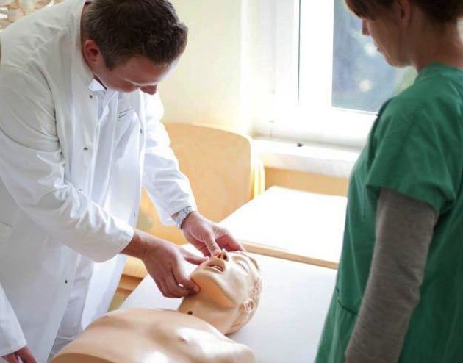
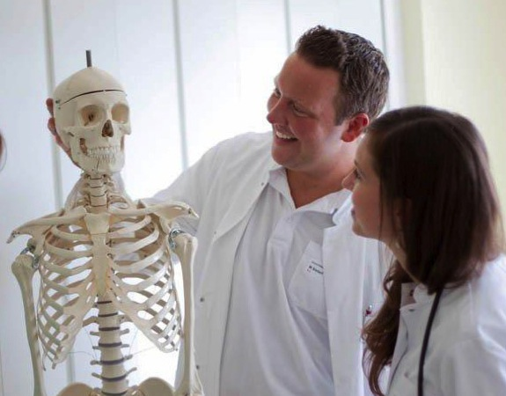
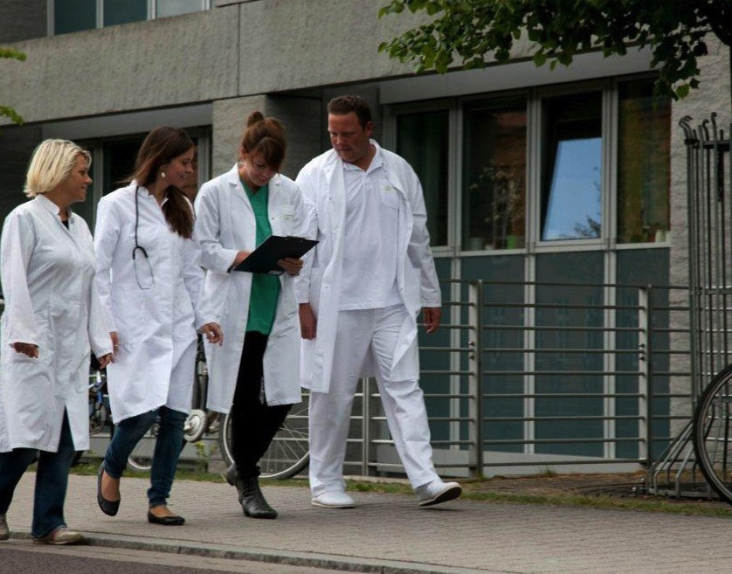

Slide 7
Python
Py
Pyt

