Slide 1
Python Bootcamp
Deep Learning

Slide 2
Python
- General purpose: build anything
- Open source! Free!
- Python packages, also for data science
- Many applications and fields

Slide 3
Conclusion
- This model does significantly better than random guessing!

Slide 4
DICOM images in Python
- Eamples of medical signals:
- Electroencephalogram (EEG)
- Electrocardiogram (ECG or EKG)
- Electromyography (EMG)

Slide 5
DICOM in Python
- Medical images can be saved in different formats:
  Images from the MRI scanner:
  initially collected in the DICOM format
  can be converted to other formats for easier analysis
Format Name | File Extension | Origin
DICOM | .dcm | ACR/NEMA Consortium
NIfTI | .nii | Neuroimaging Informatics Technology Initiative
Analyze | .img/.hdr | Header( Analyze Software, Mayo Clinic )
MINC | .mnc | Montreal Neurological Institute
META | .mhd/.mha

Slide 6
DICOM in Python
- Medical signals can be saved in different formats:
Signal Type | File Extension | Origin
EEG | .fif | Fractal Image Format
 | .edf | European data Format
 | .bdf | BioSemi data Format
 | .gdf | General data Format
 | .set | EEGlab
ECG | .dat/.hea | Header( Analyze Software, Mayo Clinic )
 | .apn | European data Format
ECG | .txt | Text Format
 | .mat/.hea | Header( Analyze Software, Mayo Clinic )

Slide 7
Image Analysis in Python
- PyDicom :
is the best package to deal with DICOM files. It’s kinda obvious because it’s specifically designed for DICOM. It provides more flexible options, especially when you want to deal with DICOM metadata and not just pixel data. On the other side, if you want only the pixel data, the better solution is ImageIO as it provides only the basic metadata that you need to deal with pixel data.
- Registration, resampling and image comparison

Slide 8
Image Analysis in Python
- Image Comparison:
- Registration, resampling and image comparison

Slide 9
Image Analysis in Python
- Masks and Filters:
- Application of:
Intensity patterns to select sub-regions
Convolutional filters to detect interesting features

Slide 10
Image Analysis in Python
- Measurement:
- Image segmentation
- Object labeling
- Morphological measurement

Slide 11
P
Uptate | Uptate | Uptate | Uptate
Gitium estrum | Gitium estrum | Gitium estrum | Gitium estrum
te voloritas | te voloritas | te voloritas | te voloritas
quidellupta dolesto raepele ssuntia | quidellupta dolesto raepele ssuntia | quidellupta dolesto raepele ssuntia | quidellupta dolesto raepele ssuntia
videl mo | videl mo | videl mo | videl mo

Slide 13
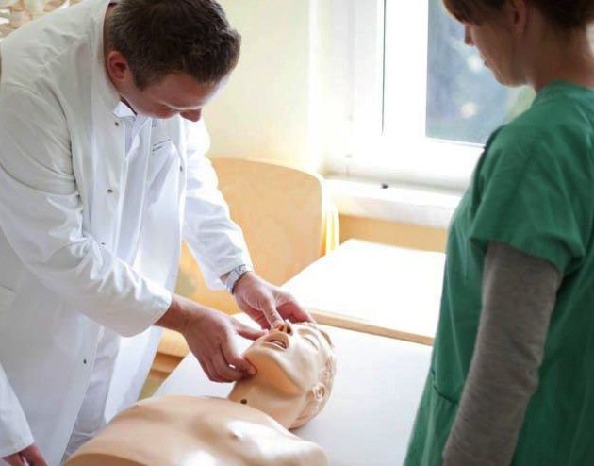
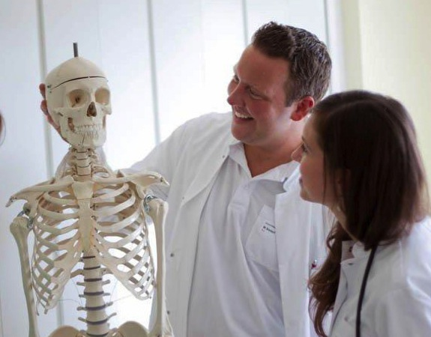
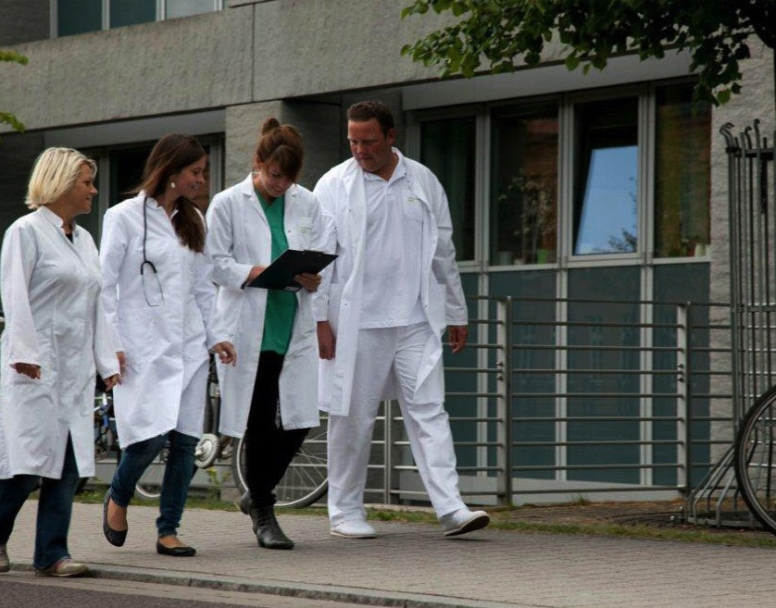

Slide 14
Python
Py
Pyt

