Slide 1
Bottom-up Syntax Analysis – ELR(k) PART 1
Prof. A. Morzenti

Slide 2


Informal/intuitive example of bottom-up syntax analysis
example grammar for: sequence of lists (at)⁺ separated by s
We add the sets of followers of nonterminals follow(S) and follow(I) useful for the analysis
{s, $⊣$}
{$⊣$}
sets of followers (also called lookahead) allow the parser to decide when
to continue the analysis following a machine transition (shift move), or
to recognize a nonterminal and to build a subtree (reduce move)

Slide 3
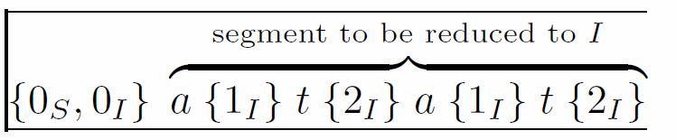

Trace of the analysis for string $x=atatsat⊣$
Analysis of S starts with that of I: a sort of ε-move (called closure)
It pushes on the stack the macro-state (m-state) {0_{S}, 0_{I}} including the initial states of M_{S} and M_{I}
read a, transition $0_{I}\underset{→}{a}1_{I}$, macrostate {1_{I}} is pushed
after shift of t first choice: reduce or shift? it shifts because current char cc=a∉follow(I)
remind that follow(A) often called lookahead set
next (below) second choice between reduce and shift: it reduces because cc=s∈follow(I)
which is the reduction handle? Go back in the stack until initial state of M_{I}: O_{I}
but watch out: there are cases in which things are more complex …
the reduction builds the first fragment of the syntax tree

Slide 4
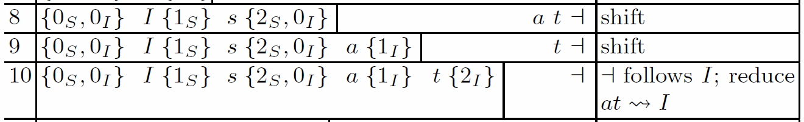
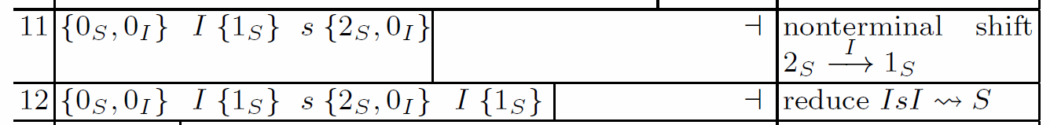
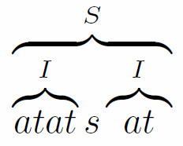
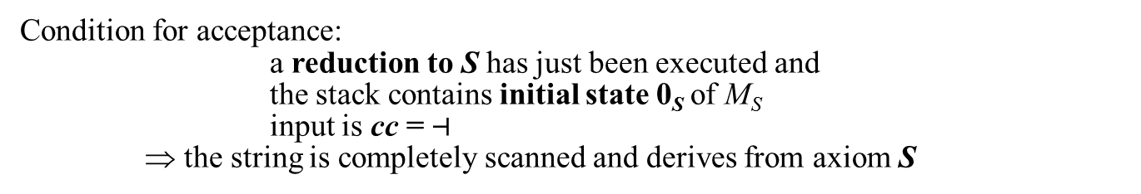
the reduction atat→I is registered in the stack by means of a NONterminal shift
then another choice between reduce and shift: it executes a shift because cc=s∉follow(S)
then a reduction at→I because cc=$⊣$∈follow(I)
syntax tree fragment
nonterminal shift
then a reduction IsI→S because cc=$⊣$ ∈follow(S)
syntax tree fragment
Condition for acceptance:
a reduction to S has just been executed and
the stack contains initial state 0_{S} of M_{S}
input is cc = $⊣$
⇒ the string is completely scanned and derives from axiom S
Complete syntax tree

Slide 5

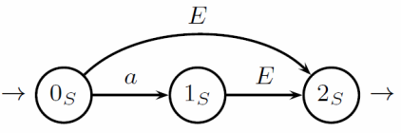











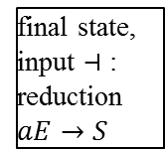
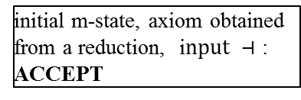







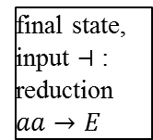

















it is not always so easy to choose the correct reduction: it may be necessary to advance further in the string...
Example: another grammar G₂
$$\{⊣\}$$
$$\{⊣\}$$
even-length strings (aa)⁺=L(0_{E}) and odd-length a(aa)⁺=a⋅L(1_{S}) derived very differently
derivation becomes clear only after complete scan, when the terminator $⊣$ is encountered
Example: analysis of string aaa$⊣$
computation that generates it: $0_{S}\underset{→}{a} 1_{S} \underset{→}{ε}0_{E} \underset{→}{a} 1_{E} \underset{→}{a}2_{E}$ NB: state $2_{E}$ is final
But there is another computation, which generates aaaa$⊣$ : $0_{S}\underset{→}{ε } 0_{E} \underset{→}{a}1_{E} \underset{→}{a} 2_{E}\underset{→}{a}1_{E} \underset{→}{a}2_{E}$
the parser, while scanning the string, «doesn’t know», and investigates both hypotheses
$$0_{S}$$
$$a$$
$$1_{S}$$
$$1_{E}$$
$$a$$
$$2_{E}$$
final state, input $⊣$ : reduction $aa→E$
$$a_{ }$$
NB: on the stack there are pointers, but they have a limited value, hence the stack alphabet is finite, we are still using the PDA model
$$ε_{ }$$
$$ε_{ }$$
NB: final states are circled
$$0_{E}$$
$$a$$
$$1_{E}$$
$$a$$
$$2_{E}$$
$$a$$
$$1_{E}$$
$$0_{E}$$
final state but input $≠⊣$ : no reduction
stack element
$$0_{S}$$
$$a$$
$$1_{S}$$
$$E$$
$$2_{S}$$
final state, input $⊣$ : reduction $aE→S$
$$0_{S}$$
$$S$$
$$ε_{ }$$
$$ε_{ }$$
$$ε_{ }$$
initial m-state, axiom obtained from a reduction, i$nput ⊣$ : ACCEPT
$$0_{E}$$
$$a$$
$$1_{E}$$
$$0_{E}$$
$$0_{E}$$

Slide 6

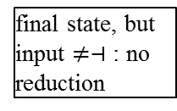







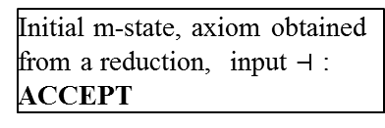


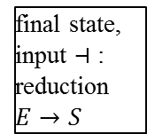

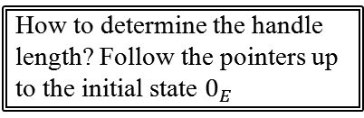






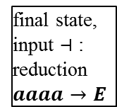









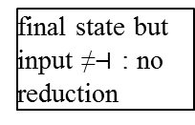


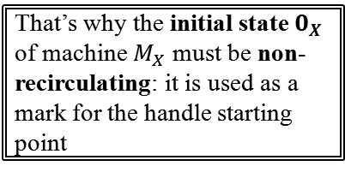

another example: analysis of string aaaa$⊣$
$$\{⊣\}$$
$$\{⊣\}$$
Computation that generates it: $0_{S}\underset{→}{ε} 0_{E}\underset{→}{a} 1_{E} \underset{→}{a}2_{E}$ $\underset{→}{a} 1_{E} \underset{→}{a}2_{E}$
$$0_{S}$$
$$a$$
$$1_{S}$$
$$1_{E}$$
$$a$$
$$2_{E}$$
$$a$$
$$1_{E}$$
final state but input ≠$⊣$ : no reduction
$$a_{ }$$
How to determine the handle length? Follow the pointers up to the initial state $0_{E}$
$$ε_{ }$$
$$ε_{ }$$
$$0_{E}$$
$$a$$
$$1_{E}$$
$$a$$
$$2_{E}$$
$$a$$
$$1_{E}$$
$$a$$
$$2_{E}$$
final state, input $⊣$ : reduction $aaaa→E$
$$0_{E}$$
final state, but input $≠⊣$ : no reduction
That’s why the initial state $0_{X}$ of machine $M_{X}$ must be non-recirculating: it is used as a mark for the handle starting point
$$0_{S}$$
$$E$$
$$2_{S}$$
final state, input $⊣$ : reduction $E→S$
$$0_{S}$$
$$S$$
$$ε_{ }$$
$$ε_{ }$$
Initial m-state, axiom obtained from a reduction, input $⊣$ : ACCEPT
$$0_{E}$$
$$0_{E}$$

Slide 7











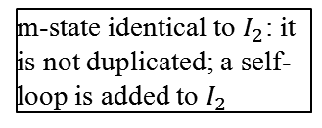









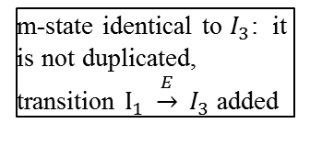
construction of the pilot automaton, which
Guides the analysis of the stack automaton
Incorporates in its states (macro-states, m-states) info on all possible computations, which, scanning a sentential form, reach that m-state
if necessary, the m-states contain many (machine)states corresponding to various conjectures on the derivation (analysis threads) investigated in parallel
in the stack of the parser the states of the analysis threads are linked using pointers
the pilot automaton is built once forall and used to guide all possible analyses
$$I_{0}$$
$$I_{1}$$
$$0_{S}$$
$$a$$
$$1_{S}$$
$$ε_{ }$$
$$a_{ }$$
$$ε_{ }$$
$$I_{2}$$
$$a_{ }$$
$$0_{E}$$
$$a$$
$$1_{E}$$
$$a$$
$$2_{E}$$
$$a$$
$$1_{E}$$
$$a_{ }$$
$$0_{E}$$
$$a$$
$$1_{E}$$
$$a$$
$$2_{E}$$
BASE part of m-state that includes the non-initial states
$$E$$
$$E$$
$$E$$
$$E$$
CLOSURE part of an m-state that includes initial states
m-state identical to $I_{2}$: it is not duplicated; a self-loop is added to $I_{2}$
$$2_{S}$$
$$2_{S}$$
m-state identical to $I_{3}$: it is not duplicated, transition $I_{1} \underset{→}{E} I_{3}$ added
$$I_{3}$$

Slide 8
























paths incorporated into the pilot automaton
$$I_{0}$$
$$I_{1}$$
$$0_{S}$$
$$1_{S}$$
$$a_{ }$$
$$I_{2}$$
$$a_{ }$$
$$0_{E}$$
$$a$$
$$1_{E}$$
$$2_{E}$$
$$a_{ }$$
$$0_{E}$$
$$1_{E}$$
$$E$$
$$E$$
$$2_{S}$$
$$I_{3}$$
$$a$$
$$0_{E}$$
$$a$$
$$1_{E}$$
$$a$$
$$2_{E}$$
$$a$$
$$1_{E}$$
strings $aa{\left(aa\right)}^{∗}$
$$0_{S}$$
$$E$$
$$2_{S}$$
$$a$$
$$E$$
$$0_{S}$$
$$1_{S}$$
$$2_{S}$$

Slide 9
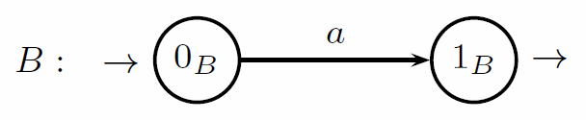









LOOKAHEAD: the parser looks ahead to choose the next action:
Very often one char is enough : analysis ELR(1) (in gen.: ELR(k) looks at next k chars)
Example: language where lookahead is needed (NB a finite language (G not recursive): L={a, aa, ba, baa})
Consider analysis of strings $baa⊣$ and $ba⊣$
$$0_{S}$$
$$b$$
$$4_{S}$$
Both states 1_{A} and 1_{B} are final: a reduction is in order; a →A or a→B ?
$$ε_{ }$$
$$ε_{ }$$
It depends on what comes next in the input
$$0_{A}$$
$$0_{A}$$
$$a$$
$$1_{A}$$
$$ε_{ }$$
$$ε_{ }$$
if there is an a then the derivation is $S  bAa  baa$ hence reduction is $aA$
$$0_{B}$$
$$0_{B}$$
$$a$$
$$1_{B}$$
if there is a $⊣$ then the derivation is $S  bB  ba$ hence reduction is $aB$

Slide 10

























Let us build the relevant part of the pilot automaton
$$I_{0}$$
$$0_{S}$$
$$ε_{ }$$
$$0_{A}$$
We use the pilot automaton for analyzing string $ba…$
$$ε_{ }$$
$$0_{B}$$
$$b_{ }$$
$$I_{0}$$
$$I_{5}$$
$$I_{4}$$
$$I_{5}$$
$$0_{S}$$
$$b$$
$$4_{S}$$
$$4_{S}$$
$$a$$
$$1_{A}$$
$$I_{4}$$
$$ε_{ }$$
$$0_{A}$$
$$0_{A}$$
$$1_{A}$$
$$0_{A}$$
$$0_{B}$$
$$0_{B}$$
$$a$$
$$1_{B}$$
$$a_{ }$$
$$ε_{ }$$
$$1_{B}$$
$$0_{B}$$
the pilot’s m-state I₄ does not help in choosing between the two possible reductions (a→A and a→B)
This situation is called reduction-reduction conflict

Slide 11




Solution: we incorporate the lookahead in the pilot automaton m-state
as a consequence the number of m-states increases: the automaton executes a “subtler” analysis
lookahead = set of chars that can follow the string derived from the current nonterminal
a char in the lookahead will be the input when the final state of the current machine will be reached
its presence in the input indicates that the reduction is in order
Now every pilot m-state contains a set of items (also called candidates in the textbook)
item = pair: $↑state, lookahead$
Example: derivation $SBaaa$
string a derived from B is followed by a
Example: derivation $SAa$
string a derived from A is followed by $⊣$
{$⊣$}

Slide 12




























Construction of the pilot automaton
{$⊣$}
$$A_{ }$$
$$I_{2}$$
$$I_{0}$$
$$I_{1}$$
$$B_{ }$$
$$2_{S} ⊣$$
$$a_{ }$$
$$1_{S} ⊣$$
$$0_{S} ⊣$$
$$0_{A} ⊣$$
$$A_{ }$$
$$I_{1}$$
The lookahead is the same because in M_{S} nothing follows the nonterm. A
$0_{B} a$
$$1_{S} ⊣$$
$$B_{ }$$
$$I_{1}$$
$$a_{ }$$
$$I_{4}$$
$$a_{ }$$
$$I_{8}$$
$$b_{ }$$
$$I_{5}$$
$$B_{ }$$
$$1_{S} ⊣$$
$$I_{6}$$
$$a_{ }$$
$$1_{A} ⊣$$
$$1_{A} a$$
$$4_{S} ⊣$$
The set of (machine) states inside an m-state is called kernel
$$a_{ }$$
$$A_{ }$$
$$5_{S} ⊣$$
$$0_{A} a$$
$$1_{B} a$$
$$1_{B} ⊣$$
$0_{B}⊣$
The lookahead is the same because in M_{S} nothing follows the nonterm. B
NB: the lookahead changes (i.e., it may change) only when a closure part is computed
because the closure indicates the start of the analysis of a string derived from a new nonterminal
and one must determine what can be expected (in the parsed string) after the string derived from the nonterminal whose initial state is placed in the closure
instead, the lookahead does not change when a shift is considered
(the next state is reached inside the same machine)

Slide 13




































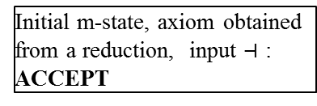



$$A_{ }$$
$$I_{2}$$
$$I_{0}$$
$$I_{1}$$
$$B_{ }$$
$$2_{S} ⊣$$
$$a_{ }$$
$$1_{S} ⊣$$
$$0_{S} ⊣$$
$$0_{A} ⊣$$
$0_{B} a$
$$B_{ }$$
$$a_{ }$$
$$I_{4}$$
$$a_{ }$$
$$I_{8}$$
$$b_{ }$$
$$I_{5}$$
$$B_{ }$$
$$1_{A} ⊣$$
$$4_{S} ⊣$$
$$I_{6}$$
$$1_{A} a$$
$$a_{ }$$
$$A_{ }$$
$$0_{A} a$$
$$5_{S} ⊣$$
$$1_{B} a$$
$$1_{B} ⊣$$
$0_{B}⊣$
Analysis of string $baa⊣$
lookahead = input: reduce $aA$
$$I_{0}$$
$$b_{ }$$
$$I_{5}$$
$$a_{ }$$
$$I_{8}$$
lookahead = input: reduce b$AaS$
$$0_{S} ⊣$$
$$4_{S} ⊣$$
$$1_{A} a$$
$$0_{A} ⊣$$
$$0_{A} a$$
NB: nonterminal shift of $A$
$0_{B} a$
$0_{B}⊣$
$$1_{B} ⊣$$
$$I_{0}$$
$$b_{ }$$
$$I_{5}$$
$$A_{ }$$
$$I_{6}$$
$$a_{ }$$
$$I_{1}$$
$$I_{0}$$
$$S_{ }$$
$$0_{S} ⊣$$
$$4_{S} ⊣$$
$$5_{S} ⊣$$
$$1_{S} ⊣$$
$$0_{S} ⊣$$
Initial m-state, axiom obtained from a reduction, input $⊣$ : ACCEPT
$$0_{A} ⊣$$
$$0_{A} a$$
$$0_{A} ⊣$$
$0_{B} a$
$0_{B}⊣$
$0_{B} a$

Slide 14



$$A_{ }$$
$$I_{2}$$
$$I_{0}$$
$$I_{1}$$
$$B_{ }$$
$$2_{S} ⊣$$
$$a_{ }$$
$$1_{S} ⊣$$
$$0_{S} ⊣$$
$$0_{A} ⊣$$
$0_{B} a$
$$B_{ }$$
$$a_{ }$$
$$I_{4}$$
$$a_{ }$$
$$I_{8}$$
$$b_{ }$$
$$I_{5}$$
$$B_{ }$$
$$1_{A} ⊣$$
$$4_{S} ⊣$$
$$I_{6}$$
$$1_{A} a$$
$$a_{ }$$
$$A_{ }$$
$$0_{A} a$$
$$5_{S} ⊣$$
$$1_{B} a$$
$$1_{B} ⊣$$
$0_{B}⊣$
Analysis of string $ba⊣$
lookahead = input: reduce $aB$
$$I_{0}$$
$$b_{ }$$
$$I_{5}$$
$$a_{ }$$
$$I_{8}$$
lookahead = input: reduce b$BS$
$$0_{S} ⊣$$
$$4_{S} ⊣$$
$$1_{A} a$$
$$0_{A} ⊣$$
$$0_{A} a$$
Exercise: simulate tha analysis of strings a$⊣$ and $aa⊣$
$0_{B} a$
$0_{B}⊣$
$$1_{B} ⊣$$
$$I_{0}$$
$$b_{ }$$
$$I_{5}$$
$$B$$
$$I_{1}$$
$$I_{0}$$
$$S_{ }$$
$$0_{S} ⊣$$
$$4_{S} ⊣$$
$$1_{S} ⊣$$
$$0_{S} ⊣$$
Initial m-state, axiom obtained from a reduction, input $⊣$ : ACCEPT
$$0_{A} ⊣$$
$$0_{A} a$$
$$0_{A} ⊣$$
$0_{B} a$
$0_{B}⊣$
$0_{B} a$

Slide 15
























Example (more interesting but still simple) with an infinite language
$L=\left\{a^{n} b^{m} \right| n ≥ m ≥ 0\}$
pilot has m-states with several items in the base
NB: because $L\left(2_{S}\right)=\{ε\}$
$$I_{0}$$
$$I_{1}$$
$$I_{2}$$
$$0_{S} ⊣$$
$$a_{ }$$
$$1_{S} ⊣$$
$$a_{ }$$
$$1_{S} ⊣$$
$$0_{N} ⊣$$
$$1_{N} ⊣$$
$$1_{N} b⊣$$
$$a_{ }$$
$$N_{ }$$
$$0_{N} b⊣$$
$$0_{N} b⊣$$
$$I_{3}$$
$$2_{S} ⊣$$
$$0_{N} b$$
$$N_{ }$$
$$N_{ }$$
NB: items with the same state are grouped merging the lookahead
$$0_{N} ⊣$$
$$I_{4}$$
$$2_{S} ⊣$$
$$I_{5}$$
$$2_{S} ⊣$$
$$2_{N}⊣$$
$$2_{N} b⊣$$
$$b_{ }$$
$$b_{ }$$
$$I_{6}$$
$$3_{N} ⊣$$
$$I_{7}$$
$$3_{N} b⊣$$
NB: often the pilot automaton has various groups of m-states with the same kernel (set of states in the base and closure) but with distinct lookahead sets
multiple candidates in the base of an m-state ⇒ PDA must perform several analysis attempts in parallel

Slide 16




















$$I_{0}$$
$$I_{1}$$
$$I_{2}$$
$$0_{S} ⊣$$
$$a_{ }$$
$$1_{S} ⊣$$
$$a_{ }$$
$$1_{S} ⊣$$
$$N$$
$$0_{N} ⊣$$
$$1_{N} ⊣$$
$$1_{N} b⊣$$
$$a_{ }$$
$$N_{ }$$
$$0_{N} b⊣$$
$$0_{N} b⊣$$
$$a_{ }$$
$$a_{ }$$
$$N$$
$$I_{3}$$
$$2_{S} ⊣$$
$$N_{ }$$
$$N_{ }$$
$$a_{ }$$
$$N$$
$$b$$
$$I_{4}$$
$$2_{S} ⊣$$
$$I_{5}$$
$$2_{S} ⊣$$
$$_{ }$$
$$2_{N}⊣$$
$$2_{N} b⊣$$
$$b_{ }$$
$$b_{ }$$
$$I_{6}$$
$$3_{N} ⊣$$
$$I_{7}$$
$$3_{N} b⊣$$
NB: length of the reduction handle ($ε$) is 0: nothing is popped from the stack
lookahead = input: reduce $aNbN$
Example: analysis of string $aaab⊣$
lookahead = input: reduce $εN$
$$I_{0}$$
$$a_{ }$$
$$I_{1}$$
$$a_{ }$$
$$I_{2}$$
$$a_{ }$$
$$I_{2}$$
$$N$$
$$I_{5}$$
$$b_{ }$$
$$I_{7}$$
NB: length of the reduction handle ($aaN$) is not known in advance: it is determined runtime by inspecting the stack
$$0_{S} ⊣$$
$$1_{S} ⊣$$
$$1_{S} ⊣$$
$$1_{S} ⊣$$
$$2_{S} ⊣$$
$$3_{N} b⊣$$
$$0_{N} ⊣$$
$$1_{N} ⊣$$
$$1_{N} b⊣$$
$$1_{N} b⊣$$
$$2_{N} b⊣$$
$$0_{N} b⊣$$
$$0_{N} b⊣$$
$$0_{N} b⊣$$
lookahead = input: reduce $aaNS$
$$I_{0}$$
$$a_{ }$$
$$I_{1}$$
$$a_{ }$$
$$I_{2}$$
$$N$$
$$I_{5}$$
$$0_{S} ⊣$$
$$1_{S} ⊣$$
$$1_{S} ⊣$$
$$2_{S} ⊣$$
$$I_{0}$$
$$S_{ }$$
$$0_{N} ⊣$$
$$1_{N} ⊣$$
$$1_{N} b⊣$$
$$2_{N} b⊣$$
$$0_{S} ⊣$$
ACCEPT
$$0_{N} b⊣$$
$$0_{N} b⊣$$
$$0_{N} ⊣$$
Exercise: simulate the analysis of some strings, e.g. ε, aa, aab, ab, abb

