Slide 1
Bottom-up Syntax Analysis– ELR(k) PART 2
Prof. A. Morzenti

Slide 2















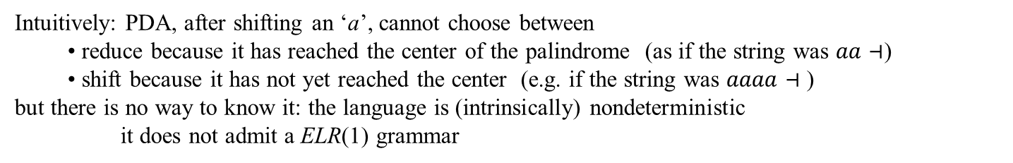


What can go wrong in the ELR(1) analysis: (1) shift-reduction conflict
the grammar is nondeterministic:
the center of the string cannot be identified
let us build only one part of the pilot (the one for the a’s; the other part for the b’s is symmetric)
shift-reduction conflict in $I_{1}$
$$I_{0}$$
$$I_{1}$$
$$I_{2}$$
$$0_{S} ⊣$$
$$a_{ }$$
$$1_{S} ⊣$$
$$1_{S} a$$
analysis of string $aa…⊣$ (ex. input $aa⊣$ or $aaaa⊣$)
$$a_{ }$$
$$0_{S} a$$
$$0_{S} a$$
lookahead = input: reduce $εS$ ?
$$I_{0}$$
$$a_{ }$$
$$I_{1}$$
$$a_{ }$$
$$I_{2}$$
input = label on pilot arc: shift?
$$0_{S} ⊣$$
$$1_{S} ⊣$$
$$1_{S} a$$
derivation: $SaSaaεa=aa$
$$0_{S} a$$
$$0_{S} a$$
derivation: $SaSaaaSaaaaaa$
Intuitively: PDA, after shifting an ‘a’, cannot choose between
reduce because it has reached the center of the palindrome (as if the string was $aa⊣$)
shift because it has not yet reached the center (e.g. if the string was $aaaa⊣$ )
but there is no way to know it: the language is (intrinsically) nondeterministic
it does not admit a ELR(1) grammar

Slide 3

















































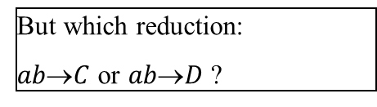


What can go wrong in the ELR(1) analysis: (2) reduce-reduce conflict
$$S{\left(Ccd | Dce\right)}^{∗}$$
$C→{\left(ab\right)}^{+}$
$D→{\left(ab\right)}^{+}$
$$1_{S}$$
$$c_{ }$$
$$3_{S}$$
$$d$$
$$0_{C}$$
$$a_{ }$$
$$1_{C}$$
$$b_{ }$$
$$2_{C}$$
$$C$$
$$C$$
$$0_{S}$$
$$5_{S}$$
$$a_{ }$$
$$D$$
$$D$$
$$2_{S}$$
$$4_{S}$$
$$e$$
$$a_{ }$$
$$1_{D}$$
$$b_{ }$$
$$c_{ }$$
$$0_{D}$$
$$2_{D}$$
let us build only the pilot portion that shows the conflict
$$a_{ }$$
$$I_{0}$$
$$I_{1}$$
$$I_{2}$$
$$0_{S} ⊣$$
$$a_{ }$$
$$1_{C} c$$
$$b_{ }$$
$$2_{C} c$$
reduce-reduce conflict
final states of distinct machines, same lookahead
$$0_{C} c$$
$$1_{D} c$$
$$2_{D} c$$
$$0_{D} c$$
Analysis of string $abce⊣$
input = lookahead: reduce
NB: LR(1): of the remaining input, the analyzer knows only c
$$I_{0}$$
$$a_{ }$$
$$I_{1}$$
$$b_{ }$$
$$I_{2}$$
$$1_{C} c$$
But which reduction:
$abC$ or $abD$ ?
$$0_{S} ⊣$$
$$2_{C} c$$
$$0_{C} c$$
$$1_{D} c$$
$$2_{D} c$$
$$0_{D} c$$
NB: the string $abce⊣$ is not ambiguous
$$S$$
$$D c e$$
Derivation: $SDceabce$, syntax tree
$$a b$$

Slide 4
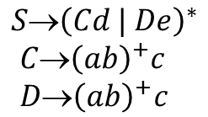
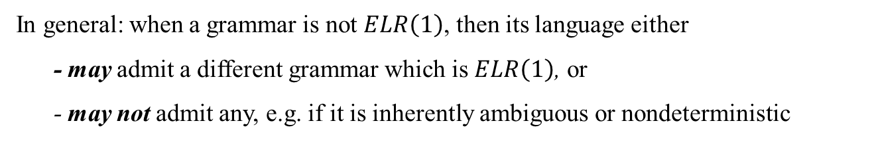
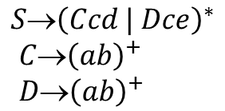


One can remedy (in this case, but not always) by modifying the grammar
The c part, common to the two alternatives, can be incorporated into the two rules of C and D
Analyzer can distinguish the two alternatives, lookahead now is d (for C) and e (for D)
$$S{\left(Ccd | Dce\right)}^{∗}$$
$C→{\left(ab\right)}^{+}$
$D→{\left(ab\right)}^{+}$
$$S{\left(Cd | De\right)}^{∗}$$
$C→{\left(ab\right)}^{+}c$
$D→{\left(ab\right)}^{+}c$
BTW: In fact, by substituting C and D into S one can notice that the language is regular
$$S→{\left({\left(ab\right)}^{+}cd |{\left(ab\right)}^{+}ce\right)}^{∗}$$
$$S{\left({\left(ab\right)}^{+}c \left(d | e\right)\right)}^{∗}$$
This one is a $ELR\left(1\right)$ grammar. Exercise: build the pilot:
One can see that it is isomorphic to the machine of S
In general: when a grammar is not $ELR\left(1\right)$, then its language either
- may admit a different grammar which is $ELR\left(1\right)$, or
- may not admit any, e.g. if it is inherently ambiguous or nondeterministic

Slide 5

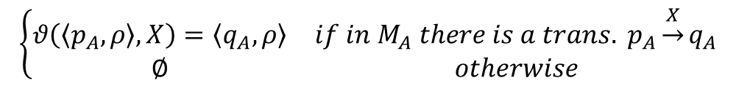
Let us provide a formalization/encoding of the pilot automaton construction
(see the textbook for further details)
DEF: an item is a pair ⟨q, a⟩ ∈ Q × (Σ ∪ {$⊣$})
for ease of writing, items with the same state are grouped
⟨q, {a₁, a₂, … a_{k}}⟩ ⇔ {⟨q, a₁,⟩, ⟨q, a₂,⟩, … ⟨q, a_{k}⟩}
NB: with the shift operation the lookahead does not change: it changes only when the closure operation is performed
DEF: shift operation
CAN BE SKIPPED WITHOUT DAMAGE
$$\left\{\begin{matrix}θ\left(\left\langle p_{A}, ρ\right\rangle ,X\right)=\left\langle q_{A}, ρ\right\rangle & if in M_{A} there is a trans. p_{A}\underset{→}{X}q_{A} \\ ∅ & otherwise\end{matrix}\right.$$
The shift operation is defined also for m-states (seen as sets I of items) in the obvious way
$$θ\left(I,X\right)=\left\{θ\left(c, X\right) \right| c∈I\}$$
We assume the function closure(C) is defined
it computes the closure of a set C of items with lookahead
(we do not report yet the detailed definition of closure)

Slide 6
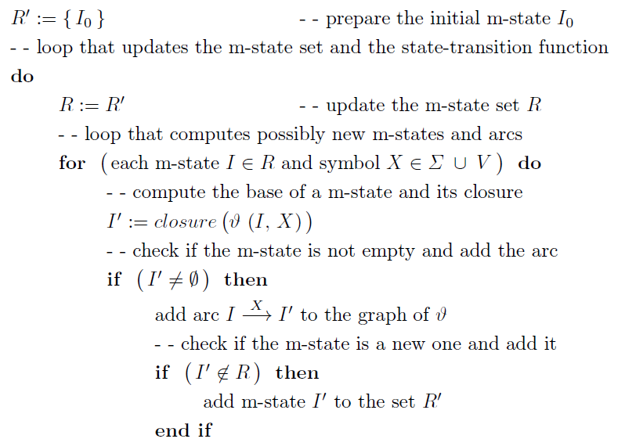
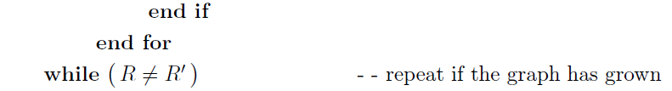

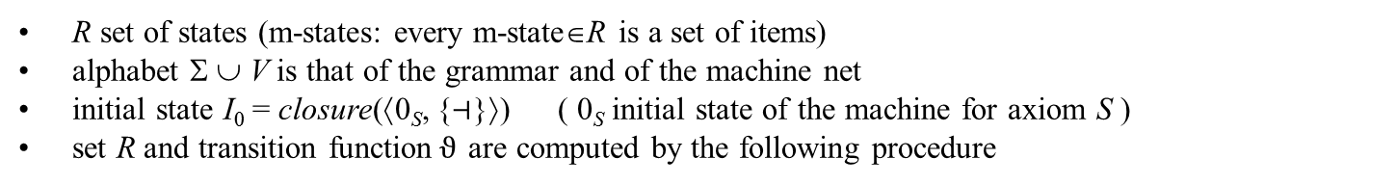
CONSTRUCTION OF THE PILOT AUTOMATON $𝓟$
$𝒫=\left\langle R, Σ ∪ V, θ, I_{0}\right\rangle$ where
R set of states (m-states: every m-state∈R is a set of items)
alphabet Σ ∪ V is that of the grammar and of the machine net
initial state I₀ = closure(⟨0_{S}, {$⊣$}⟩) ( 0_{S} initial state of the machine for axiom S )
set R and transition function$ϑ$ are computed by the following procedure
CAN BE SKIPPED WITHOUT DAMAGE
a typical incremental construction: it terminates when nothing new is found
no state is final; the pilot is used to drive the PDA, not to accept strings

Slide 7
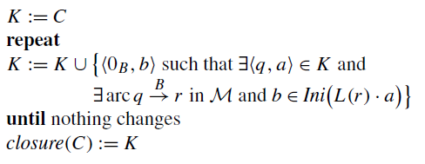
We now provide a formalization/encoding of the closure function
(for details see the textbook, 2ndEd §4.5.2, or 3rdEd §4.5.3)
closure(C) is the closure of a set C of items with lookahead
A typical fixpoint computation
b
<q a>
...
B
...
r
<0_{B} b>
...
q
<0_{B} b a>
...
computes the set of the machines reached from q through one or more invocations, with no state transition
for machine M_{B} (represented by the initial state 0_{B}) lookahead includes character b
that can occur when M_{B} terminates
Effect of term Ini(L(r)·a) when ε ∈ L(r) (e.g., when state r is final): char a is included in the lookahead and the item in the closure above is <0_{B} b a >

Slide 8
IMPORTANT REMARK
So far in the analysis examples we push in the stack the pilot m-states
with the items including the lookahead
The information on the lookahead seems to be redundant (it is already in the pilot)
In the coming grammar examples (with multiple transitions and convergent arcs) the lookahead is needed
and during the analysis one must separate in the stack the items with same state and different lookahead
Grammar with convergent arcs are rare
usually, in visualizations of analysis, one can omit the lookahead
if one knows that the grammar does not have any convergent arc

Slide 9
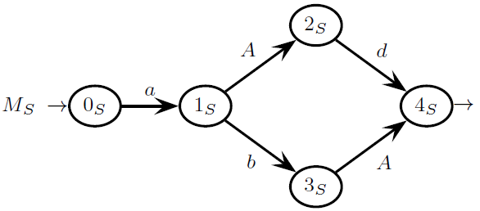
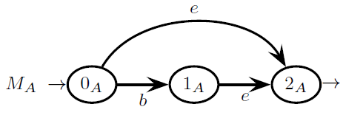



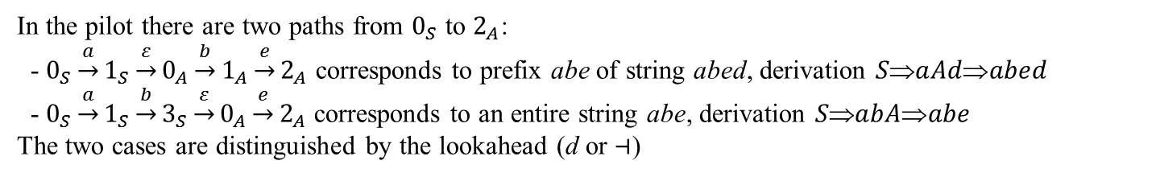


















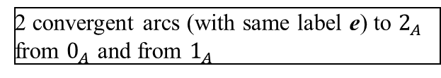

What can go wrong with ELR(1) analysis: (3) multiple trans. + conflictual convergent arcs
(NB: these are contrived cases: rarely met in practice)
Let us first consider a case with no conflicts
$$S  a\left(Ad | bA\right)$$
$A  e | (be)$
construction of the pilot:
$$I_{0}$$
$$I_{1}$$
$$I_{2}$$
NB: $L\left(4_{S}\right)=ε$
$$a_{ }$$
$$1_{S} ⊣$$
$$3_{S}⊣$$
$$I_{3}$$
$$0_{S} ⊣$$
$$b_{ }$$
$$e_{ }$$
$$2_{A} d⊣$$
2 convergent arcs (with same label e) to $2_{A}$ from $0_{A}$ and from $1_{A}$
$$0_{A} d$$
$$1_{A} d$$
$$0_{A} ⊣$$
$$A_{ }$$
$$A_{ }$$
$$2_{S} ⊣$$
$$d_{ }$$
$$4_{S} ⊣$$
$$I_{5}$$
$$I_{4}$$
In the pilot there are two paths from $0_{S}$ to $2_{A}$:
- $0_{S}\underset{→}{a}1_{S}\underset{→}{ε}0_{A}\underset{→}{b}1_{A}\underset{→}{e}2_{A}$ corresponds to prefix abe of string abed, derivation $SaAdabed$
- $0_{S}\underset{→}{a}1_{S}\underset{→}{b}3_{S}\underset{→}{ε}0_{A}\underset{→}{e}2_{A}$ corresponds to an entire string abe, derivation $SabAabe$
The two cases are distinguished by the lookahead (d or $⊣$)

Slide 10


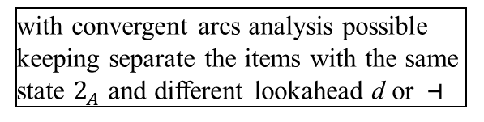
















Multiple transitions + convergent arcs analysis of the two strings abe$⊣$ e abed$⊣$
$$I_{0}$$
$$I_{1}$$
$$I_{2}$$
$$a_{ }$$
$$1_{S} ⊣$$
$$3_{S}⊣$$
$$I_{3}$$
$$0_{S} ⊣$$
$$b_{ }$$
$$e_{ }$$
$$1_{A} d$$
$$2_{A} d⊣$$
$$0_{A} d$$
$$0_{A} ⊣$$
$$A_{ }$$
$$A_{ }$$
$$I_{4}$$
$$2_{S} ⊣$$
$$d_{ }$$
$$4_{S} ⊣$$
$$I_{5}$$
Analysis of abe$⊣$
$$I_{0}$$
$$a_{ }$$
$$I_{1}$$
$$b_{ }$$
$$I_{2}$$
$$e_{ }$$
$$I_{3}$$
input = lookahead: reduce $eA$
$$0_{S} ⊣$$
$$1_{S} ⊣$$
$$3_{S}⊣$$
$$2_{A} d$$
with convergent arcs analysis possible keeping separate the items with the same state $2_{A}$ and different lookahead d or $⊣$
$$0_{A} d$$
$$1_{A} d$$
$$2_{A} ⊣$$
$$0_{A} ⊣$$
$$I_{0}$$
$$a_{ }$$
$$I_{1}$$
$$b_{ }$$
$$I_{2}$$
$$A_{ }$$
$$I_{5}$$
input = lookahead: reduce $abAS$
$$0_{S} ⊣$$
$$1_{S} ⊣$$
$$3_{S}⊣$$
$$4_{S} ⊣$$
$$0_{A} d$$
$$1_{A} d$$
S
$$0_{A} ⊣$$
a b
A
$$I_{0}$$
$$S$$
ACCEPT
$$0_{S} ⊣$$
e

Slide 11






Multiple transitions + convergent arcs analysis of string abed$⊣$
$$I_{0}$$
$$I_{1}$$
$$I_{2}$$
$$a_{ }$$
$$1_{S} ⊣$$
$$3_{S}⊣$$
$$I_{3}$$
$$0_{S} ⊣$$
$$b_{ }$$
$$e_{ }$$
$$1_{A} d$$
$$2_{A} d⊣$$
$$0_{A} d$$
$$0_{A} ⊣$$
$$A_{ }$$
$$A_{ }$$
$$I_{4}$$
$$2_{S} ⊣$$
$$d_{ }$$
$$4_{S} ⊣$$
$$I_{5}$$
Analysis of abed$⊣$
$$I_{0}$$
$$a_{ }$$
$$I_{1}$$
$$b_{ }$$
$$I_{2}$$
$$e_{ }$$
$$I_{3}$$
input = lookahead: reduce b$eA$
$$0_{S} ⊣$$
$$1_{S} ⊣$$
$$3_{S}⊣$$
$$2_{A} d$$
$$0_{A} d$$
$$1_{A} d$$
$$2_{A} ⊣$$
$$0_{A} ⊣$$
$$I_{0}$$
$$a_{ }$$
$$I_{1}$$
$$A_{ }$$
$$I_{4}$$
$$d$$
$$I_{5}$$
input = lookahead: reduce $aAdS$
$$0_{S} ⊣$$
$$1_{S} ⊣$$
$$2_{S} ⊣$$
$$4_{S} ⊣$$
$$0_{A} d$$
S
a
A
$$d$$
$$I_{0}$$
$$S$$
ACCEPT
$$0_{S} ⊣$$
b e

Slide 12


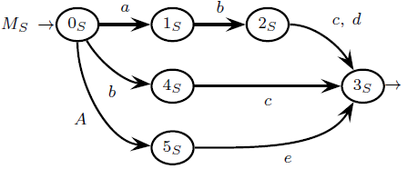









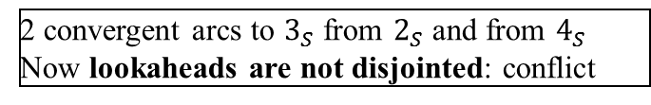











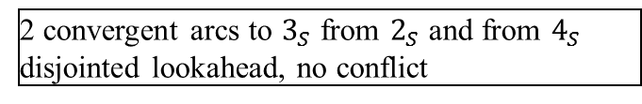
























An unfortunate case: multiple transitions + convergent arcs with conflict
Example:
pilot:
$$S_{ }$$
$$I_{0}$$
$$I_{1}$$
$$I_{4}$$
$$a_{ }$$
$$I_{7}$$
$$0_{S} ⊣$$
$$a_{ }$$
$$1_{S} ⊣$$
$$a_{ }$$
$$1_{S} e$$
$$1_{A} e$$
$$1_{A} e$$
$$S_{ }$$
$$2_{A} e$$
$$0_{A} e$$
$$0_{S} e$$
$$0_{S} e$$
$$b_{ }$$
$$0_{A} e$$
$$0_{A} e$$
$$I_{2}$$
$$4_{S} ⊣$$
$$b_{ }$$
$$b_{ }$$
2 convergent arcs to $3_{S}$ from $2_{S}$ and from $4_{S}$
Now lookaheads are not disjointed: conflict
$$d$$
$$c_{ }$$
$$2_{S} ⊣$$
$$2_{S} e$$
$$A_{ }$$
$$I_{5}$$
$$4_{S} e$$
$$A_{ }$$
$$4_{S} e$$
$$I_{8}$$
$$I_{9}$$
$$3_{S} ⊣$$
2 convergent arcs to $3_{S}$ from $2_{S}$ and from $4_{S}$
disjointed lookahead, no conflict
$$c_{ }$$
$$d$$
$$c_{ }$$
$$A_{ }$$
$$e_{ }$$
$$I_{10}$$
$$3_{S} e⊣$$
$$3_{S} e$$
$$I_{11}$$
$$e_{ }$$
$$I_{3}$$
$$5_{S} ⊣$$
$$I_{6}$$
$$5_{S} e$$

Slide 13
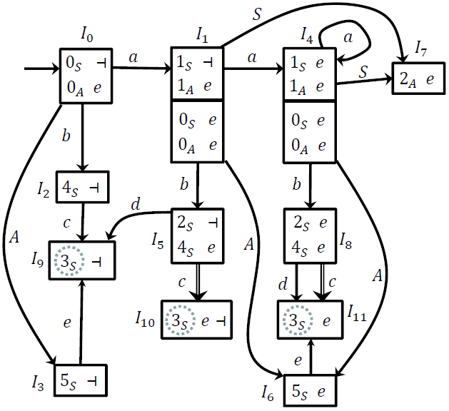






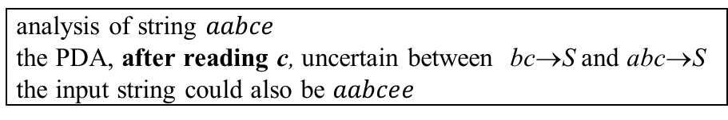








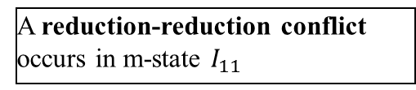
analysis of string $aabce$
the PDA, after reading c, uncertain between bc→S and abc→S
the input string could also be $aabcee$
S
S
A
A
S
S
A
S
a a b c e
a a b c e e
two computations of the machine net generate string aabc
and lead, on the pilot, to the same m-state, same state and same lookahead
0_{S} $\underset{→}{ε}$ 0_{A}
$\underset{→}{a}$ 1_{A}
$\underset{→}{ε}$ 0_{S}
$\underset{→}{a}$ 1_{S}
$\underset{→}{b}$ 2_{S}
$\underset{→}{c}$ 3_{S}
A reduction-reduction conflict
occurs in m-state $I_{11}$
0_{S} $\underset{→}{ε}$ 0_{A}
$\underset{→}{a}$ 1_{A}
$\underset{→}{ε}$ 0_{S}
$\underset{→}{ε}$ 0_{A}
$\underset{→}{a}$ 1_{A}
$\underset{→}{ε}$ 0_{S}
$\underset{→}{b}$ 4_{S}
$\underset{→}{c}$ 3_{S}

Slide 14















visual representation of a convengence conflict
X
$$I′$$
$$p$$
$$I$$
$$s$$
p π
X
X
$$s    $$
r ρ
$$r$$
NB: $  $ ≠ ∅
NB: non to be confused with the the presence of multiple transitions (which is harmless)!
$$I′$$
$$I$$
X
X
$$s  $$
$$p$$
$$s$$
p π
$$t   $$
r ρ
X
$$t$$
$$r$$

Slide 15
In conclusion, to check applicability of bottom-up parsing method (LR)
called ELR(1) condition (Left scan Rightmost derivation with lookahead 1 for Extended grammars)
Build the pilot automaton
Check the following conditions
Absence of shift - reduce conflicts
Absence of reduce – reduce conflicts
Absence of convergence conflicts

Slide 16
COMPLEXITY OF PARSING
when analyzing string x, with length n = |x|, number of elements in the stack is O(n)
to determine the number of moves of the PDA, we add up
n_{T} = # terminal shift, n_{N} = # nonterminal shift, n_{R} = # reductions,
clearly, n_{T} = n and n_{N} = n_{R} (∀ reduction also a nonterminal shift is executed)
⇒ total number of moves is
n_{T} + n_{R} + n_{N} = n + 2 ⋅ n_{R}
furthermore
number of reductions involving a terminal (e.g. A → a, A → a B, A → B a C) is ≤ n
number of reductions not involving terminals, i.e., of type A→ε or A→B (copy rules) or A → B C etc…, is linearly limited by n (≤ k ⋅ n + c for some k, c∈N) because the grammar has no circular derivations
Therefore the complexity of the parsing algorithm is O(n)

Slide 17
PARSER IMPLEMENTATION USING A VECTOR-STACK
in practice, by coding with common programing languages, one can access the stack elements below the top
⇒ the pointer component of the tuples in the stack can be an integer (with no value restriction)
that points directly to the position in the stack where the current thread of analysis starts
from a theoretical viewpoint, the parser model is not a PDA anymore (the stack alphabet is infinite)
in practice, this implementation is possible and easy in all common programming platforms
In the tuples corresponding to items of the m-state base, instead of a pointer to the previous element
one can copy the same value included in the previous stack element
at reduction time the stack is popped until the position denoted by the index (excluded)
This method of using integer indexes is exploited in the Earley Algorithm
that can be applied to a much wider class of grammars than the ELR method seen so far

Slide 18





































RECONSIDER AN EXAMPLE already treated
$$I_{0}$$
$$I_{1}$$
$$I_{2}$$
$$0_{S} ⊣$$
$$a_{ }$$
$$1_{S} ⊣$$
$$a_{ }$$
$$1_{S} ⊣$$
$$0_{N} ⊣$$
$$1_{N} ⊣$$
$$1_{N} b⊣$$
$$a_{ }$$
$$N_{ }$$
$$0_{N} b⊣$$
$$0_{N} b⊣$$
$$I_{3}$$
$$2_{S} ⊣$$
$$N_{ }$$
$$N_{ }$$
$$I_{4}$$
$$2_{S} ⊣$$
$$I_{5}$$
$$2_{S} ⊣$$
$$2_{N}⊣$$
$$2_{N} b⊣$$
$$b_{ }$$
$$b_{ }$$
$$I_{6}$$
$$3_{N} ⊣$$
$$I_{7}$$
$$3_{N} b⊣$$
pointer has the same value as in previous macrostate
input = lookahead: reduce $aNbN$
Example analysis of string $aaab⊣$
Input = lookahead: reduce $εN$
$$I_{0}$$
$$a_{ }$$
$$I_{1}$$
$$a_{ }$$
$$I_{2}$$
$$a_{ }$$
$$I_{2}$$
$$N$$
$$I_{5}$$
$$b_{ }$$
$$I_{7}$$
$$0_{S} ⊣$$
$$1_{S} ⊣$$
$$1_{S} ⊣$$
$$1_{S} ⊣$$
$$2_{S} ⊣$$
$$3_{N} b⊣$$
$$0_{N} ⊣$$
$$1_{N} ⊣$$
$$1_{N} b⊣$$
$$1_{N} b⊣$$
$$2_{N} b⊣$$
$$0_{N} b⊣$$
$$0_{N} b⊣$$
$$0_{N} b⊣$$
input = lookahead: reduce $aaNS$
$$I_{0}$$
$$a_{ }$$
$$I_{1}$$
$$a_{ }$$
$$I_{2}$$
$$N$$
$$I_{5}$$
$$0_{S} ⊣$$
$$1_{S} ⊣$$
$$1_{S} ⊣$$
$$2_{S} ⊣$$
$$I_{0}$$
$$S_{ }$$
ACCEPT
$$0_{N} ⊣$$
$$1_{N} ⊣$$
$$1_{N} b⊣$$
$$2_{N} b⊣$$
$$0_{S} ⊣$$
$$0_{N} b⊣$$
$$0_{N} b⊣$$
$$0_{N} ⊣$$

Slide 19
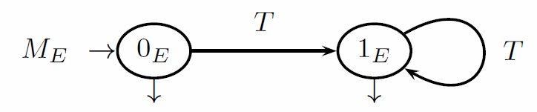
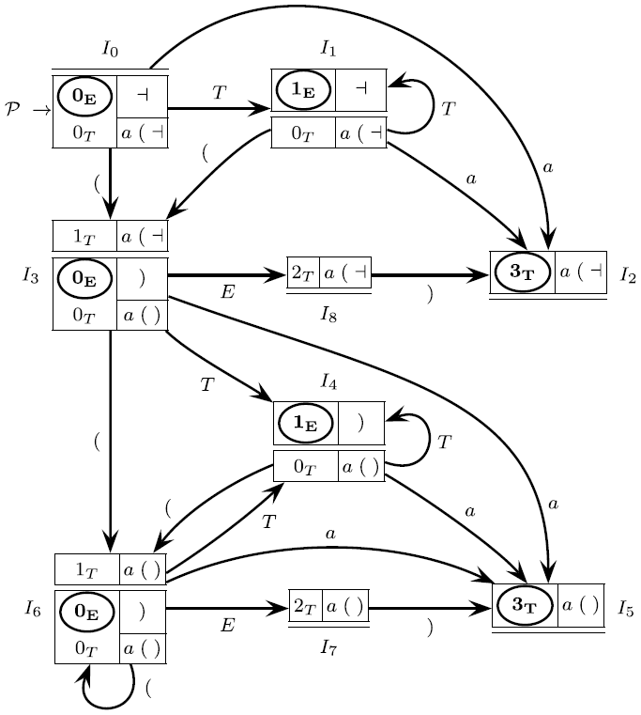
Final Example of an ELR(1) grammar
Exercise: build the pilot automaton
The grammar (axiom E)
can be analyzied using the top-down method (simpler)

