Slide 1
Top-Down Syntax Analysis – ELL(k)
Prof. A. Morzenti

Slide 2
Example – top-down analysis of sentence: a a b b b a a a a
Framed numbers = order in rule application
subscripts of nonterminals in the tree = applied rule
Leftmost: always expanded 1st nonterm. from left
S ⇒ aSAB
⇒ aaSABAB
⇒ aabABAB
⇒ aabbABAB
⇒ aabbbABAB
⇒ aabbbaBAB ⇒
⇒ aabbbaaAB
⇒ aabbbaaaB
⇒ aabbbaaaa
S₁
1
a
S₁
2
A₄
8
B₆
9
a
S₂
3
A₃
4
B₆
a
a
7
b
b
A₃
5
a
b
A₄
6
a

Slide 3


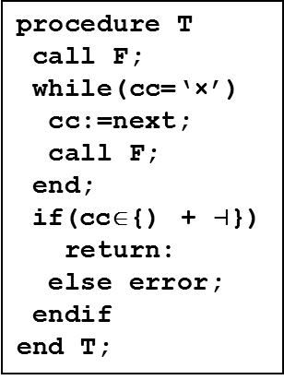
TOP DOWN ANALYSIS
Top down parsing procedures are guided directly by the transition diagrams of the machines
they determine the rules from which a string is derived
very soon, when the first character is read
In the textbook top-down parsing is derived from bottom-up by imposing further restrictions
the pilot automaton is eventually transformed into the grammar machine net
annotated with information to allow for a unique choice in presence of forks
guide set added to each arc: it tells which chars are encountered following the arc
in case of forks the guide sets on all transitions must be disjointed
procedure T
call F;
while(cc=‘×’)
cc:=next;
call F;
end;
if(cc∈{) + $⊣$})
return:
else error;
endif
end T;
E → T (+ T )*
T → F ( × F )*
F → a | ‘(’ E ‘)’
T
+
×
M_{E}:
M_{T}:
F
2_{T}
0_{E}
1_{E}
3_{E}
0_{T}
1_{T}
T
F

Slide 4
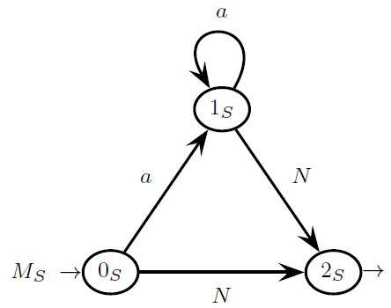
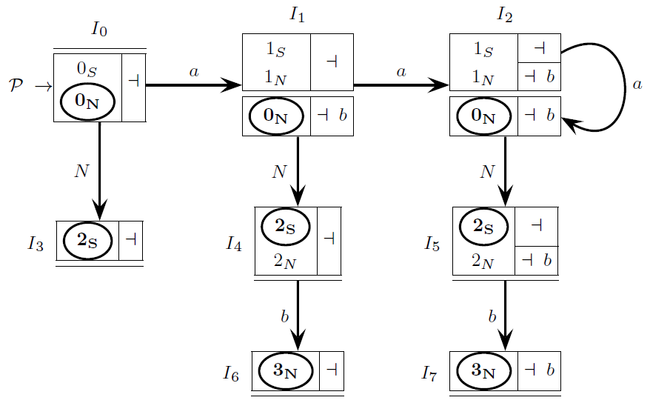

WHAT CAN PREVENT TOP-DOWN PARSING - 1 - MULTIPLE TRANSITIONS
An m-state I has multiple transitions if <p, π>,<r,ρ>∈I and both δ(p, X) and δ(r, X) are defined
Example: grammar S → a* N N → aNb | ε : multiple transitions between I₀ and I₁, I₁ and I₂
multiple transitions originate several analysis threads, typical of bottom up (ELR) analysis
several hypotheses are simultaneously investigated
this prevents top-down parsing, where only one analysis hypothesis is considered
Absence of multiple transitions is called Single Transition Property (STP)
(NB: obviously STP ensures absence of convergent arcs in the pilot
there are no pairs of distinct paths that might possibly rejoin)

Slide 5
WHAT CAN PREVENT TOP-DOWN PARSING - 2 - LEFT RECURSIVE DERIVATIONS
A derivation A $\underset{⇒}{+}$ Av, with v ≠ ε , is called left recursive
It derives from rules with left recursion, either direct or indirect
possibly in presence of nullable nonterminals
Example: E → X E + a | a X → ε | b
Presence of left recursive derivations prevents top-down deterministic analysis
1_{A}
Example:
A {a, b, …}
A:
a
0_{A}
2_{A}
{a}
B {b, …}
3_{A}

Slide 6
ELL(1) CONDITION FOR A GRAMMAR
A grammar G, represented as a machine net, is ELL(1) iff:
1. The pilot automaton satisfies the ELR(1) condition
2. There are no left recursive derivations
3. The pilot automaton has no multiple transitions (STP satisfied)
NB: therefore the family of ELL(1) languages is a subset of the ELR(1) languages
ELR(1) is a more general/powerful method than ELL(1)

Slide 7
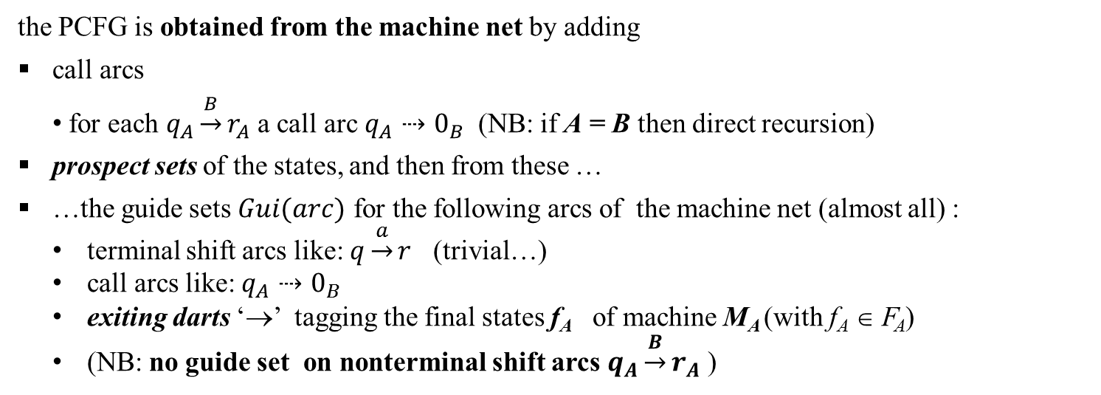
IF THE ELL(1) CONDITION IS SATISFIED THEN
ONE CAN BUILD THE PARSER CONTROL FLOW GRAPH (PCFG)
It constitutes the control flow graph of the code of the ELL(1) parser
From the PCFG one can easily derive (also manually) the parser program code
it consists of a set of recursive procedures, one for each nonterminal
the PCFG is obtained from the machine net by adding
call arcs
for each $q_{A}\underset{→}{B}r_{A}$ a call arc $q_{A}⇢0_{B}$ (NB: if A = B then direct recursion)
prospect sets of the states, and then from these …
…the guide sets $Gui(arc)$ for the following arcs of the machine net (almost all) :
terminal shift arcs like: $q\underset{→}{a}r$ (trivial…)
call arcs like: $q_{A}⇢0_{B}$
exiting darts ‘→’ tagging the final states f_{A} of machine M_{A} (with f_{A} ∈ F_{A})
(NB: no guide set on nonterminal shift arcs $q_{A}\underset{→}{B}r_{A}$ )

Slide 8
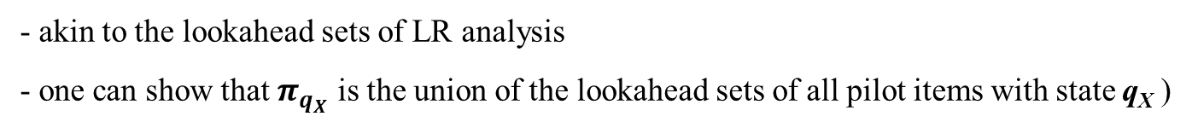
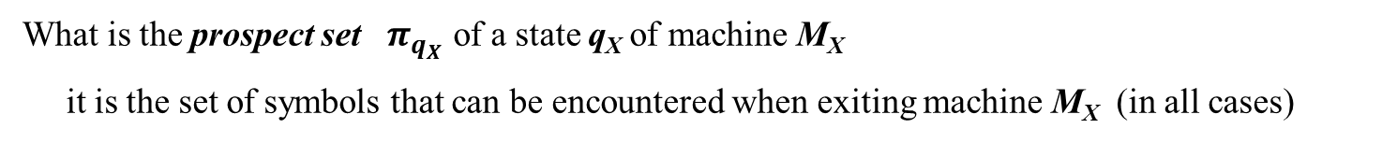
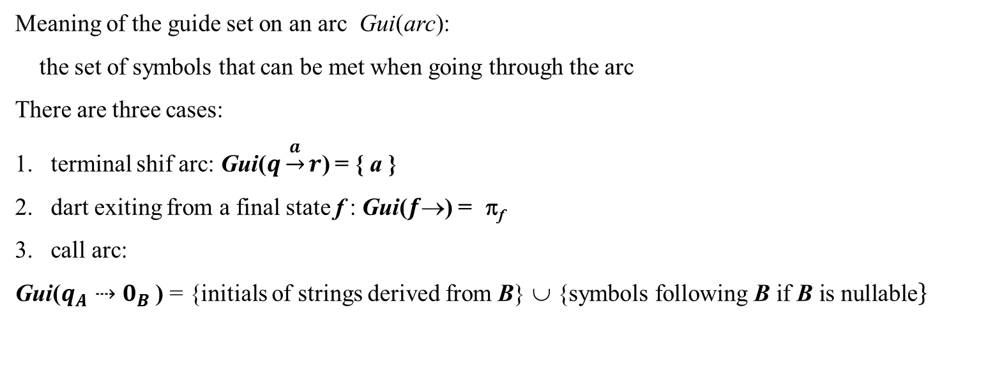
What is the prospect set $π_{q_{X}}$ of a state q_{X} of machine M_{X}
it is the set of symbols that can be encountered when exiting machine M_{X} (in all cases)
- akin to the lookahead sets of LR analysis
- one can show that $π_{q_{X}}$ is the union of the lookahead sets of all pilot items with state q_{X} )
Meaning of the guide set on an arc Gui(arc):
the set of symbols that can be met when going through the arc
There are three cases:
terminal shif arc: Gui($q\underset{→}{a}r$) = { a }
dart exiting from a final state f : Gui($f$) = π_{f}
call arc:
Gui($q_{A}⇢0_{B}$ ) = {initials of strings derived from B} ∪ {$\left.\text{symbol}\text{s} \text{following} \text{B} \text{if} \text{B} \text{is} \text{nullable}\right\}$
Guide sets can be computed (also) manually by simply “inspecting” the machine net
NB: in the slides sometimes prospect sets placed inside the circle denoting the final state

Slide 9
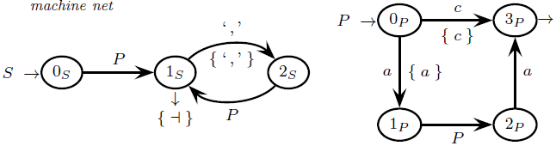
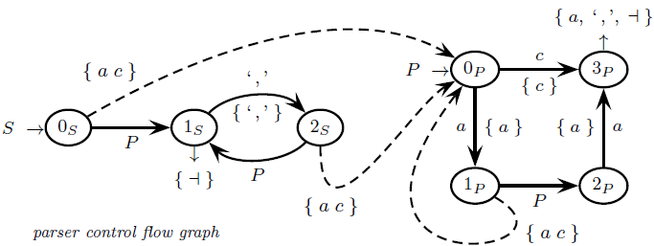
Guide sets for the grammar / machine net
very simple because P is not nullable
call arcs
S axiom

Slide 10
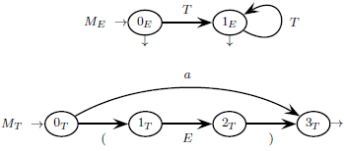
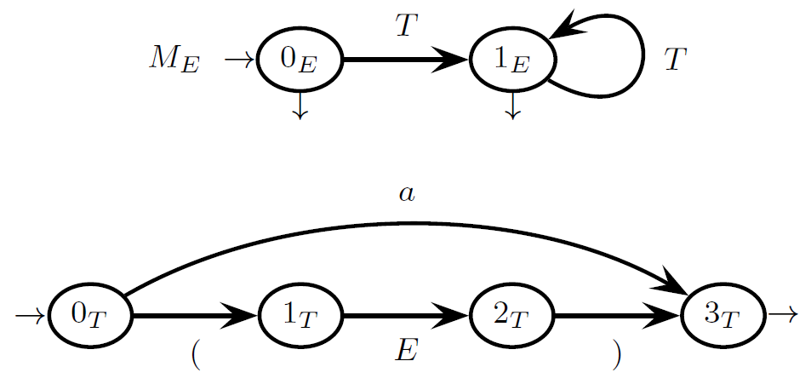



Prospect sets for a grammar / machine net
(we only show those on the final states because they coincide with the guide sets on exit darts )
after T there can be another T: Ini(L(T))={ a ( }
$$π_{0_{E}}=π_{1_{E}}=\{ ⊣ ) \}$$
E is the axiom
$$π_{3_{T}}=\left\{ \right) ( a ⊣ \}$$
exiting T one can also exit E, therefore ‘)’∈$π_{3_{T}}$

Slide 11
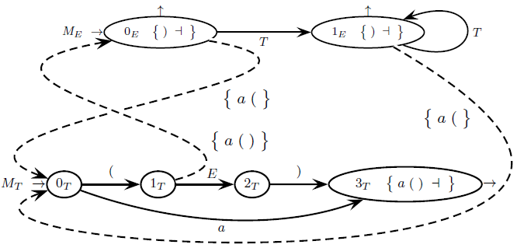
Guide sets for a grammar / machine net
call arcs
=Ini(L(T))
Idem
Gui($1_{T}⇢0_{E}$) = { a ( ) } because { ( a } = Ini(E) and E is nullable and { ‘)’ } = Ini(L(2_{T}))

Slide 12
In the PCFG almost all arcs (except for the NONterminal shift) are interpreted as conditional instructions
terminal shift arcs p $\underset{→}{a}$ q are gone through if current char cc = a
call arcs q_{A} $⇢$0_{B} are gone through if current char cc∈Gui(q_{A} $⇢$ 0_{B})
exit arcs f_{A}→ from a node with prospect set $π_{f_{A}}$ are gone through if current char cc∈ $π_{f_{A}}$
instead NONterminal shif arcs p $\underset{→}{A}$ q are (inconditional) «return from machine call»
It can be proved that
disjointed guide sets on alternative arcs ⇔ ELL(1) condition satisfied
Therefore
ELL(1) condition can be checked through the guide sets, without building the pilot automaton :-)
if guide sets are disjointed then top-down syntax analysis is possible

Slide 13
PARSER IMPLEMENTATION BY MEANS OF RECURSIVE PROCEDURES
the PCFG is translated into a set of parameterless recursive procedures
(⇒ one procedure for each nonterminal)
call arc ⇒ procedure call
terminal shift arc ⇒ call of next procedure (interface to the scanner/lexical analyzer)
final state dart ⇒ procedure return
guide sets are used to choose the next move
the analysis starts by invoking the procedure for the axiom
the technique is called recursive descent

Slide 14
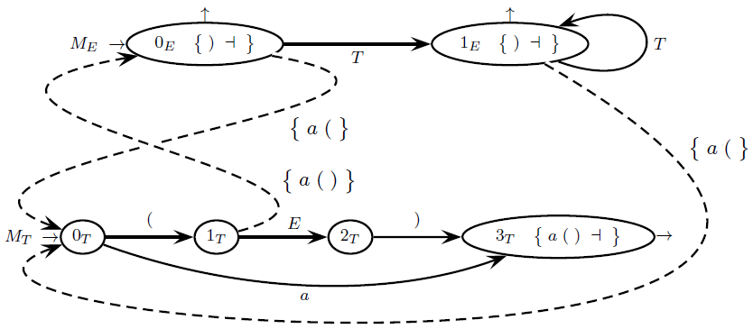
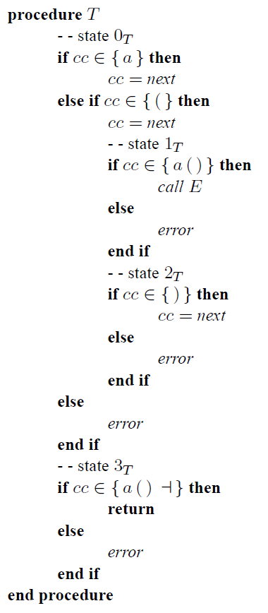
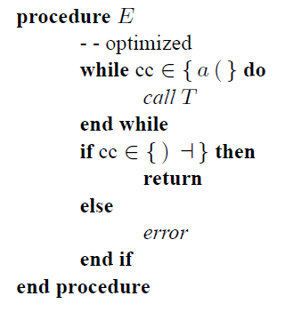
running example

Slide 15
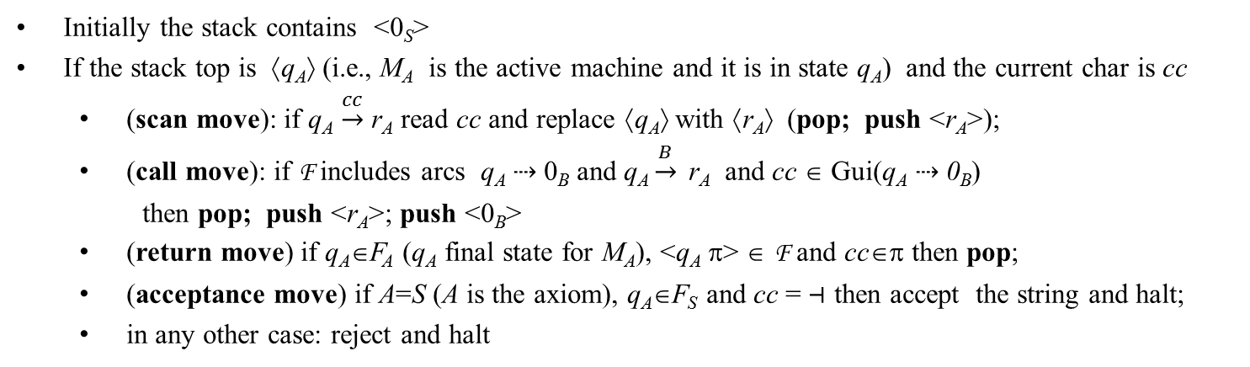
TOP-DOWN PREDICTIVE ANALYZER:
ALGORITHM WITH EXPLICIT STACK (NO RECURSIVE PROCEDURES)
Based on the PCFG F
Initially the stack contains <0_{S}>
If the stack top is ⟨q_{A}⟩ (i.e., M_{A} is the active machine and it is in state q_{A}) and the current char is cc
(scan move): if q_{A} $\underset{→}{cc}$ r_{A} read cc and replace ⟨q_{A}⟩ with ⟨r_{A}⟩ (pop; push <r_{A}>);
(call move): if F includes arcs q_{A} $⇢$ 0_{B} and q_{A} $\underset{→}{B}$ r_{A} and cc ∈ Gui(q_{A} $⇢$ 0_{B})
then pop; push <r_{A}>; push <0_{B}>
(return move) if q_{A}∈F_{A} (q_{A} final state for M_{A}), <q_{A} π> ∈ F and cc∈π then pop;
(acceptance move) if A=S (A is the axiom), q_{A}∈F_{S} and cc = $⊣$ then accept the string and halt;
in any other case: reject and halt
r_{A} is the return point

Slide 16
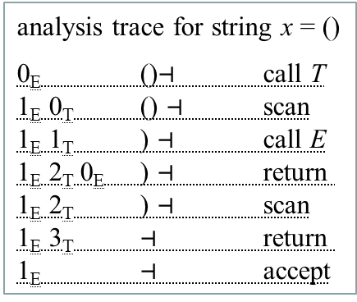
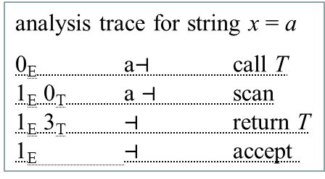
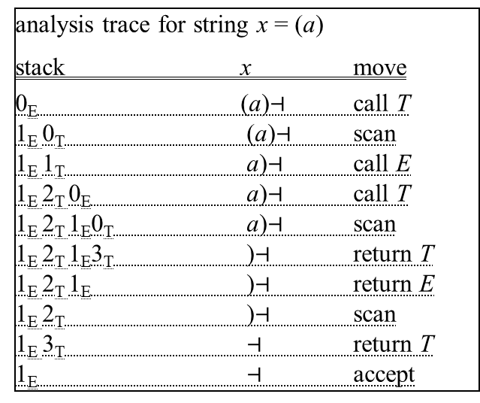
predictive analysis: example with explicit stack
analysis trace for string x = (a)
stack x move
0_{E} (a)$⊣$ call T
1_{E} 0_{T} (a)$⊣$ scan
1_{E} 1_{T} a)$⊣$ call E
1_{E} 2_{T} 0_{E} a)$⊣$ call T
1_{E} 2_{T} 1_{E}0_{T} a)$⊣$ scan
1_{E} 2_{T} 1_{E}3_{T} )$⊣$ return T
1_{E} 2_{T} 1_{E} )$⊣$ return E
1_{E} 2_{T} )$⊣$ scan
1_{E} 3_{T} $⊣$ return T
1_{E} $⊣$ accept
analysis trace for string x = ()
0_{E} ()$⊣$ call T
1_{E} 0_{T} () $⊣$ scan
1_{E} 1_{T} ) $⊣$ call E
1_{E} 2_{T} 0_{E} ) $⊣$ return
1_{E} 2_{T} ) $⊣$ scan
1_{E} 3_{T} $⊣$ return
1_{E} $⊣$ accept
analysis trace for string x = a
0_{E} a$⊣$ call T
1_{E} 0_{T} a $⊣$ scan
1_{E} 3_{T} $⊣$ return T
1_{E} $⊣$ accept

Slide 17
INCREASING THE LOOKAHEAD FOR NON-ELL(1) GRAMMARS
If a grammar is not ELL(1) it sometimes may be possible to transform it to make it ELL(1)
this transformation can be complex and make the grammar less terse
Possible alternative: increase the lookahead
the parser chooses the next move based on a number k>1 of input chars
if one obtains disjointed guide sets of length k then the ELL(k) analysis is feasible
we do not provide systematic rules to compute the guide sets of with lookahead k ≥ 2
we just inspect the machines to determine them, based on intuition

Slide 18
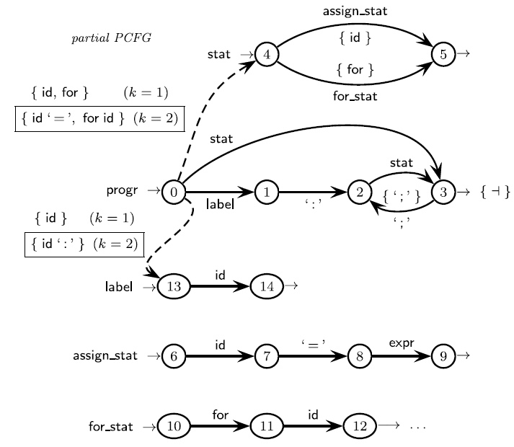
Example: conflict between identifiers of instruction labels and variable names
id is both a label for any instruction
and a variable name in the left side of assignments
To discern one must look beyond the next token
if “id :” ⇒ label
if “id =” ⇒ assignment
NB: guide sets of length k=2 are framed

