Slide 1
Syntax Analysis for Nondeterministic Grammars: the Earley Method
Prof. A. Morzenti

Slide 2
EARLEY: A MORE GENERAL SYNTAX ANALYSIS METHOD
It covers any free grammar (even ambiguous ones), but …
… we apply it completely only to nondeterministic grammars
It reconstructs in parallel all possible derivations of the analyzed string
The Earley method is similar to ELR, but it does not use a stack
it uses a vector of sets, which represents efficiently various stacks with common parts
there is a close relation with the ELR implementation through a vector-stack
It simulates a nondeterministic pushdown automaton, but without incurring in exponential complexity
NB: the ELR method simulates in parallel many computations, but only up to a reduction
The algorithm exists in different versions with or without lookahead
for simplicity we will use NO LOOKAHEAD

Slide 3
Example – a non-ELR(k) grammar
S:
A:
a
A
b
0_{S}
A, B
1_{S}
0_{A}
1_{A}
2_{A}
3_{A}
b
a
a
B
b
B:
0_{B}
1_{B}
2_{B}
3_{B}
4_{B}
b

Slide 4
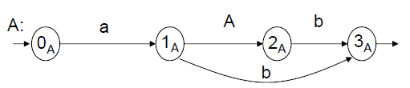


Analysis of string : aabb
S
A
a A b
a b
starting point of the (sub)string
E[0]
a E[1]
a E[2]
b E[3]
b E[4]
⟨0_{S},0⟩
⟨0_{A},0⟩
⟨0_{B},0⟩
a
⟨1_{A},0⟩
⟨1_{B},0⟩
⟨0_{A},1⟩
a
⟨2_{B},0⟩
⟨1_{A},1⟩
⟨0_{B},2⟩
⟨0_{A},2⟩
b
⟨4_{B}, 0⟩
⟨3_{A}, 1⟩
⟨1_{S},0⟩
⟨2_{A},0⟩
⟨3_{A},0⟩
⟨1_{S},0⟩
b
b
because E[0]
includes ⟨0_{S}, 0⟩
a
a
A
B
because E[1]
includes ⟨1_{A}, 0⟩
because E[0]
includes ⟨0_{S}, 0⟩
A
a
= term. & nonterm. shift
= closure
= nonterm. shift from a final state
string aabb is accepted because ⟨1_{S}, 0⟩ ∈ E[4], and 1_{S} is a final state for M_{S}
the string aab would also be accepted because ⟨1_{S}, 0⟩ ∈ E[3], and 1_{S} is a final state for M_{S}
The Earley algorithm, besides deciding whether x∈L, does so also for all prefixes of x

Slide 5
ALGORITHM – Earley recognizer
The algorithm builds a vector E[0..n], n=|x|, x = x₁ x₂ … x_{n}
each E[i] stores sets of pairs ⟨s, j⟩, j≤i, just like in the ELR stack, but with no lookahead
vector E contains all analysis threads in compact form (common parts shared)
meaning of pair ⟨q_{A}, j⟩ ∈ E[i]:
substring x_{j+1 .. i} is derived from A through computation 0_{A} → q_{A} in M_{A}
We define the fundamental kinds of moves in the Earley algorithm
terminal shift scans input: at most n shifts executed, one for each symbol in x
closure similar to ELR closure
NONterminal shift similar to ELR nonterminal shift
completion = iterated (closure + nonterminal shift)

Slide 6
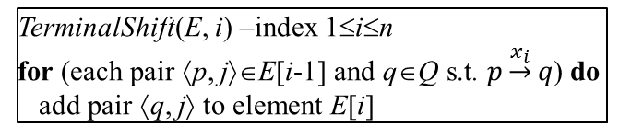
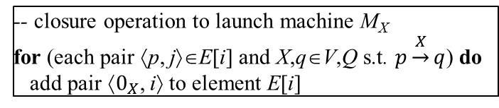
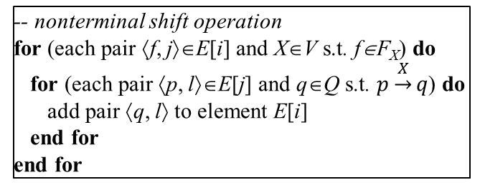
TerminalShift(E, i) –index 1≤i≤n
for (each pair ⟨p, j⟩∈E[i-1] and q∈Q s.t. $p\underset{→}{x_{i}}q$) do
add pair ⟨q, j⟩ to element E[i]
-- closure operation to launch machine M_{X}
for (each pair ⟨p, j⟩∈E[i] and X,q∈V,Q s.t. $p\underset{→}{X}q$) do
add pair ⟨$0_{X}$, i⟩ to element E[i]
-- nonterminal shift operation
for (each pair ⟨f, j⟩∈E[i] and X∈V s.t. f∈F_{X}) do
for (each pair ⟨p, l⟩∈E[j] and q∈Q s.t. $p\underset{→}{X}q$) do
add pair ⟨q, l⟩ to element E[i]
end for
end for
p
X
q
M_{X} :
…
f
E [j]
E [i]
.....
⟨ p, l ⟩
.....
⟨ f, j ⟩
.....
⟨ q, l ⟩
.....
X

Slide 7
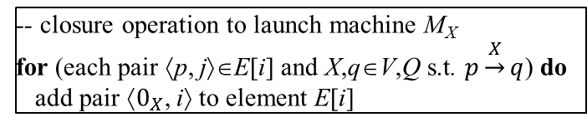
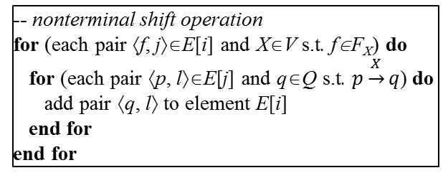
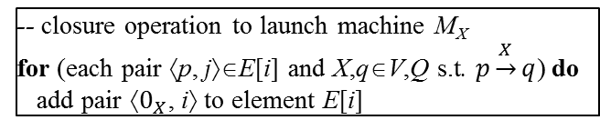
TerminalShift(E, i) –index 1≤i≤n
for (each pair ⟨p, j⟩∈E[i-1] and q∈Q s.t. $p\underset{→}{x_{i}}q$) do
add pair ⟨q, j⟩ to element E[i]
-- closure operation to launch machine M_{X}
for (each pair ⟨p, j⟩∈E[i] and X,q∈V,Q s.t. $p\underset{→}{X}q$) do
add pair ⟨$0_{X}$, i⟩ to element E[i]
-- nonterminal shift operation
for (each pair ⟨f, j⟩∈E[i] and X∈V s.t. f∈F_{X}) do
for (each pair ⟨p, l⟩∈E[j] and q∈Q s.t. $p\underset{→}{X}q$) do
add pair ⟨q, l⟩ to element E[i]
end for
end for
Completion(E, i) –index 0≤i≤n
do
while (some pair has been added)
-- closure operation to launch machine M_{X}
for (each pair ⟨p, j⟩∈E[i] and X,q∈V,Q s.t. $p\underset{→}{X}q$) do
add pair ⟨$0_{X}$, i⟩ to element E[i]
Algorithm Earley syntactic analysis
E[0] := {⟨ 0_{S}, 0⟩}
for i :=1 to n do E[i] := ∅ end for
Completion(E, 0)
i := 1
-- while vector is not completed
-- and previous element is not empty
while (i≤n ∧ E[i-1]≠∅) do
TerminalShift(E, i)
Completion(E, i)
i++
end while
-- nonterminal shift operation
for (each pair ⟨f, j⟩∈E[i] and X∈V s.t. f∈F_{X}) do
for (each pair ⟨p, l⟩∈E[j] and q∈Q s.t. $p\underset{→}{X}q$) do
add pair ⟨q, l⟩ to element E[i]
end for
end for
string x accepted if and only if ⟨f_{S}, 0⟩∈ E[n] (NB: f_{S}∈F_{S} is a final state of machine M_{S} of axiom S )
NB: every symbol x_{i} of the string is read only once;
the scanning head never moves left; there is no backtrack

Slide 8
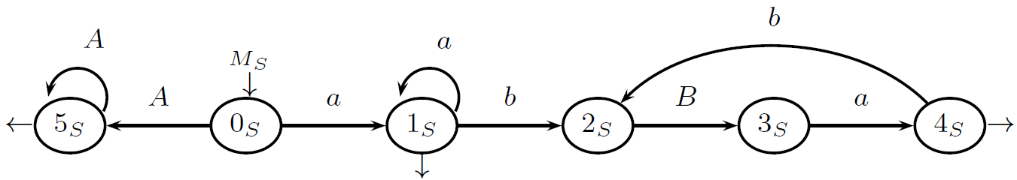

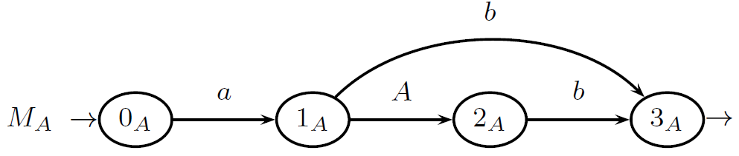

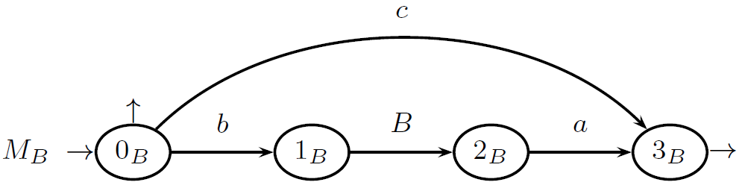

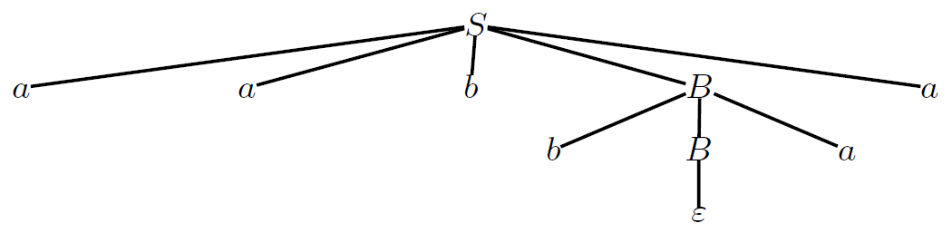
A MORE COMPLEX CASE WITH A NONDETERMINISTIC GRAMMAR
NONDETERMINISM: if - all groups of a’s and b’s have the same length, and
- there is no c
then the string structure can be determined only at the end of the scan
(based on whether it ends with a’s or b’s)
Syntax tree for string aabbaa

Slide 9
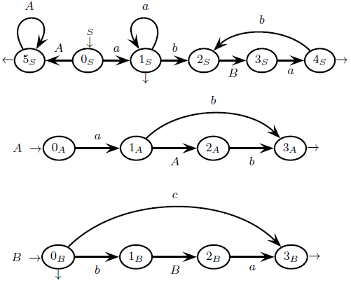
ANALYSIS OF STRING aabbaa
E[0]
a E[1]
a E[2]
b E[3]
b E[4]
a E[5]
a E[6]
a
a
b
accept
0_{S} 0
1_{S} 0
1_{S} 0
2_{S} 0
B
1_{B} 3
3_{B} 3
4_{S} 0
b
b
a
a
1_{A} 1
3_{A} 1
3_{A} 0
a
1_{A} 4
1_{A} 5
0_{A} 0
1_{A} 0
a
a
a
b
0_{A} 1
0_{A} 2
0_{B} 3
0_{B} 4
3_{S} 0
0_{A} 6
B
2_{A} 0
B
5_{S} 0
0_{A} 5
A
3_{S} 0
2_{B} 3
A
= closure
0_{A} 4
= term.&nonterm.shift
= nonterm.shift from a final state

Slide 10
in the textbook the interested students can find:
(§ 4.10.2) Analysis of the computational complexity (O(n³), i.e., cubic in |x|)
(§ 4.10.2) Proof of correctness and completeness
(§ 4.10.3) Algorithm for syntax tree construction
only one tree: the grammar assumed non-ambiguous (though possibly nondeterministic)

